Slide 1
Maximum-Shift String Matching Algorithms
Hakem Adil Kadhim, NurAini AbdulRashid
2014 International Conference on Computer and Information Sciences (Kuala Lumpur, Malaysia) (ICCOINS) (pp. 1-6). IEEE
Presenter: Shih-Hong Li
Date: May 7, 2024
Notes:
清華大學 盧錦隆

Slide 2
Abstract(1/2)
The string matching algorithms have broad applications in many areas of computer sciences. These areas include operating systems, information retrieval, editors, Internet searching engines, security applications and biological applications. Two important factors used to evaluate the performance of the sequential string matching algorithms are number of attempts and total number of character comparisons during the matching process. This research proposes to integrate the good properties of three single string matching algorithms, Quick-Search, Zuh-Takaoka and Horspool , to produce hybrid string matching algorithm called Maximum-Shift algorithm. Three datasets are used to test the proposed algorithm, which are, DNA, Protein sequence and English text.

Slide 3
Abstract(2/2)
The hybrid algorithm, Maximum-Shift, shows efficient results compared to four string matching algorithms, Quick-Search, Horspool, Smith and Berry Ravindran, in terms of the number of attempts and the total number of character comparisons.

Slide 4
String matching
S = hello world
Pattern = world

Slide 5
Horspool algorithm
preprocessing phase
Search phase

Slide 6
Preprocessing phase
The pattern string = RAJKUMAR
Length of pattern = 8
Shift table:
A | J | K | M | R | U
1 | 5 | 4 | 2 | 7 | 3 | 8

Slide 7
Search phase
A | J | K | M | R | U
1 | 5 | 4 | 2 | 7 | 3 | 8
K | A | N | N | A | D | A |  | F | I | L | M |  | I | N | D | U | S | T | R | Y |  | I | C | O | N |  | I | S |  | D | R |  | R | A | J | K | U | M | A | R
R | A | J | K | U | M | A | R

Slide 8
Search phase
A | J | K | M | R | U
1 | 5 | 4 | 2 | 7 | 3 | 8
K | A | N | N | A | D | A |  | F | I | L | M |  | I | N | D | U | S | T | R | Y |  | I | C | O | N |  | I | S |  | D | R |  | R | A | J | K | U | M | A | R
R | A | J | K | U | M | A | R

Slide 9
Search phase
A | J | K | M | R | U
1 | 5 | 4 | 2 | 7 | 3 | 8
K | A | N | N | A | D | A |  | F | I | L | M |  | I | N | D | U | S | T | R | Y |  | I | C | O | N |  | I | S |  | D | R |  | R | A | J | K | U | M | A | R
R | A | J | K | U | M | A | R

Slide 10
Search phase
A | J | K | M | R | U
1 | 5 | 4 | 2 | 7 | 3 | 8
K | A | N | N | A | D | A |  | F | I | L | M |  | I | N | D | U | S | T | R | Y |  | I | C | O | N |  | I | S |  | D | R |  | R | A | J | K | U | M | A | R
R | A | J | K | U | M | A | R

Slide 11
Search phase
A | J | K | M | R | U
1 | 5 | 4 | 2 | 7 | 3 | 8
K | A | N | N | A | D | A |  | F | I | L | M |  | I | N | D | U | S | T | R | Y |  | I | C | O | N |  | I | S |  | D | R |  | R | A | J | K | U | M | A | R
R | A | J | K | U | M | A | R

Slide 12
Search phase
A | J | K | M | R | U
1 | 5 | 4 | 2 | 7 | 3 | 8
K | A | N | N | A | D | A |  | F | I | L | M |  | I | N | D | U | S | T | R | Y |  | I | C | O | N |  | I | S |  | D | R |  | R | A | J | K | U | M | A | R
R | A | J | K | U | M | A | R

Slide 13
Maximum-shift algotithm
Preprocessing Stage
Quick-search algorithm
Zuh Takaoka algorithm
Max-shift stage
Search phase
Given a genesequence y=ATCTAACATCATAACCCTAATTGGCAGAGAGAGAATCAATCGAATCA
And a pattern p = GCAGAGAG

Slide 14
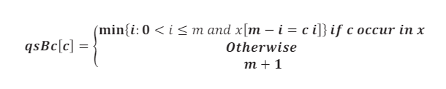
Preprocessing Stage (Quick-Search)
Shift table
The pattern string = GCAGAGAG
Length of pattern = 8
Shift table:
A | C | G | T
2 | 7 | 1 | 9

Slide 15
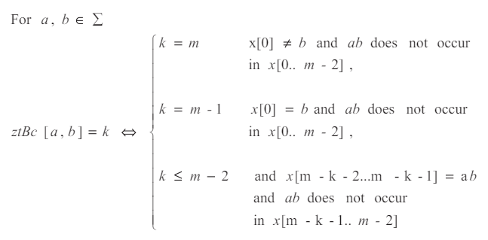
Preprocessing Stage (Zuh Takaoka algorithm)
Shift table

Slide 16
Preprocessing Stage (Zuh Takaoka algorithm)
The pattern string = GCAGAGAG
Length of pattern = 8
Shift table:
Initial
 | A | C | G | T
A | 8 | 8 | 8 | 8
C | 8 | 8 | 8 | 8
G | 8 | 8 | 8 | 8
T | 8 | 8 | 8 | 8

Slide 17
Preprocessing Stage (Zuh Takaoka algorithm)
The pattern string = GCAGAGAG
Length of pattern = 8
Shift table: ztBc[i][‘G’] = m - 1;
 | A | C | G | T
A | 8 | 8 | 7 | 8
C | 8 | 8 | 7 | 8
G | 8 | 8 | 7 | 8
T | 8 | 8 | 7 | 8

Slide 18
Preprocessing Stage (Zuh Takaoka algorithm)
The pattern string = GCAGAGAG
Length of pattern = 8
Shift table: ztBc[x[i - 1]][x[i]] = m - 1 - i;
ztBc[‘G’]][‘C’] = 8-1-1 = 6
 | A | C | G | T
A | 8 | 8 | 4 | 8
C | 5 | 8 | 7 | 8
G | 3 | 6 | 7 | 8
T | 8 | 8 | 7 | 8

Slide 19
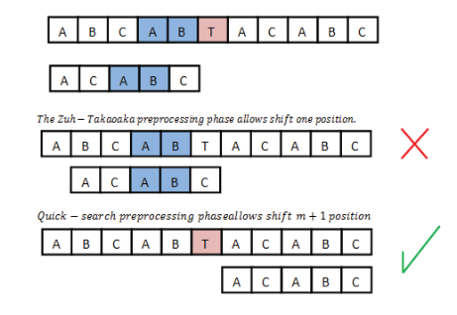
Max-shift stage
如果視窗後一個元素跟 沒有再 pattern 裡面 或者出現在後兩元素的前面 且 視窗最後兩個元素出現在 pattern 裡面 ->shift m+1

Slide 20
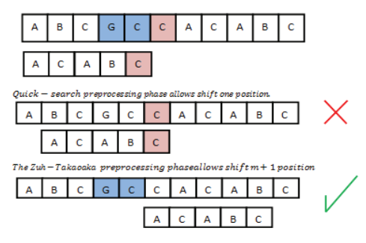
Max-shift stage
如果視窗後一個元素沒有再 pattern 裡面或者出現在後兩元素的前面 且 視窗最後兩個元素沒有出現在 pattern 裡面 -> shift m

Slide 21
Search phase (1/7)(case 1 )
1 | 2 | 3 | 4 | 5 | 6 | 7 | 8 | 9 | 10 | 11 | 12 | 13 | 14 | 15 | 16 | 17 | 18 | 19 | 20 | 21 | 22 | 23 | 24 | 25 | 26 | 27 | 28 | 29 | 30 | 31 | 32 | 33 | 34 | 35 | 36 | 37 | 38 | 39 | 40 | 41 | 42 | 43 | 44 | 45 | 46 | 47
A | T | C | T | A | A | C | A | T | C | A | T | A | A | C | C | C | T | A | A | T | T | G | G | C | A | G | A | G | A | G | A | G | A | A | T | C | A | A | T | C | G | A | A | T | C | A
G | C | A | G | A | G | A | G
Quick-search
Zuh Takaoka
A | C | G | T
2 | 7 | 1 | 9
 | A | C | G | T
A | 8 | 8 | 4 | 8
C | 5 | 8 | 7 | 8
G | 3 | 6 | 7 | 8
T | 8 | 8 | 7 | 8

Slide 22
Search phase (2/7)
1 | 2 | 3 | 4 | 5 | 6 | 7 | 8 | 9 | 10 | 11 | 12 | 13 | 14 | 15 | 16 | 17 | 18 | 19 | 20 | 21 | 22 | 23 | 24 | 25 | 26 | 27 | 28 | 29 | 30 | 31 | 32 | 33 | 34 | 35 | 36 | 37 | 38 | 39 | 40 | 41 | 42 | 43 | 44 | 45 | 46 | 47
A | T | C | T | A | A | C | A | T | C | A | T | A | A | C | C | C | T | A | A | T | T | G | G | C | A | G | A | G | A | G | A | G | A | A | T | C | A | A | T | C | G | A | A | T | C | A
 |  |  |  |  |  |  |  |  | G | C | A | G | A | G | A | G
Quick-search
Zuh Takaoka
A | C | G | T
2 | 7 | 1 | 9
 | A | C | G | T
A | 8 | 8 | 4 | 8
C | 5 | 8 | 7 | 8
G | 3 | 6 | 7 | 8
T | 8 | 8 | 7 | 8

Slide 23
Search phase (3/7)
1 | 2 | 3 | 4 | 5 | 6 | 7 | 8 | 9 | 10 | 11 | 12 | 13 | 14 | 15 | 16 | 17 | 18 | 19 | 20 | 21 | 22 | 23 | 24 | 25 | 26 | 27 | 28 | 29 | 30 | 31 | 32 | 33 | 34 | 35 | 36 | 37 | 38 | 39 | 40 | 41 | 42 | 43 | 44 | 45 | 46 | 47
A | T | C | T | A | A | C | A | T | C | A | T | A | A | C | C | C | T | A | A | T | T | G | G | C | A | G | A | G | A | G | A | G | A | A | T | C | A | A | T | C | G | A | A | T | C | A
 |  |  |  |  |  |  |  |  |  |  |  |  |  |  |  |  | G | C | A | G | A | G | A | G
Quick-search
Zuh Takaoka
A | C | G | T
2 | 7 | 1 | 9
 | A | C | G | T
A | 8 | 8 | 4 | 8
C | 5 | 8 | 7 | 8
G | 3 | 6 | 7 | 8
T | 8 | 8 | 7 | 8

Slide 24
Search phase (4/7)
1 | 2 | 3 | 4 | 5 | 6 | 7 | 8 | 9 | 10 | 11 | 12 | 13 | 14 | 15 | 16 | 17 | 18 | 19 | 20 | 21 | 22 | 23 | 24 | 25 | 26 | 27 | 28 | 29 | 30 | 31 | 32 | 33 | 34 | 35 | 36 | 37 | 38 | 39 | 40 | 41 | 42 | 43 | 44 | 45 | 46 | 47
A | T | C | T | A | A | C | A | T | C | A | T | A | A | C | C | C | T | A | A | T | T | G | G | C | A | G | A | G | A | G | A | G | A | A | T | C | A | A | T | C | G | A | A | T | C | A
 |  |  |  |  |  |  |  |  |  |  |  |  |  |  |  |  |  |  |  |  |  |  | G | C | A | G | A | G | A | G
Quick-search
Zuh Takaoka
A | C | G | T
2 | 7 | 1 | 9
 | A | C | G | T
A | 8 | 8 | 4 | 8
C | 5 | 8 | 7 | 8
G | 3 | 6 | 7 | 8
T | 8 | 8 | 7 | 8

Slide 25
Search phase (4/7)
1 | 2 | 3 | 4 | 5 | 6 | 7 | 8 | 9 | 10 | 11 | 12 | 13 | 14 | 15 | 16 | 17 | 18 | 19 | 20 | 21 | 22 | 23 | 24 | 25 | 26 | 27 | 28 | 29 | 30 | 31 | 32 | 33 | 34 | 35 | 36 | 37 | 38 | 39 | 40 | 41 | 42 | 43 | 44 | 45 | 46 | 47
A | T | C | T | A | A | C | A | T | C | A | T | A | A | C | C | C | T | A | A | T | T | G | G | C | A | G | A | G | A | G | A | G | A | A | T | C | A | A | T | C | G | A | A | T | C | A
 |  |  |  |  |  |  |  |  |  |  |  |  |  |  |  |  |  |  |  |  |  |  | G | C | A | G | A | G | A | G
Quick-search
Zuh Takaoka
A | C | G | T
2 | 7 | 1 | 9
 | A | C | G | T
A | 8 | 8 | 4 | 8
C | 5 | 8 | 7 | 8
G | 3 | 6 | 7 | 8
T | 8 | 8 | 7 | 8

Slide 26
Search phase (5/7)
1 | 2 | 3 | 4 | 5 | 6 | 7 | 8 | 9 | 10 | 11 | 12 | 13 | 14 | 15 | 16 | 17 | 18 | 19 | 20 | 21 | 22 | 23 | 24 | 25 | 26 | 27 | 28 | 29 | 30 | 31 | 32 | 33 | 34 | 35 | 36 | 37 | 38 | 39 | 40 | 41 | 42 | 43 | 44 | 45 | 46 | 47
A | T | C | T | A | A | C | A | T | C | A | T | A | A | C | C | C | T | A | A | T | T | G | G | C | A | G | A | G | A | G | A | G | A | A | T | C | A | A | T | C | G | A | A | T | C | A
 |  |  |  |  |  |  |  |  |  |  |  |  |  |  |  |  |  |  |  |  |  |  |  |  |  |  | G | C | A | G | A | G | A | G
Quick-search
Zuh Takaoka
A | C | G | T
2 | 7 | 1 | 9
 | A | C | G | T
A | 8 | 8 | 4 | 8
C | 5 | 8 | 7 | 8
G | 3 | 6 | 7 | 8
T | 8 | 8 | 7 | 8

Slide 27
Search phase (6/7)
1 | 2 | 3 | 4 | 5 | 6 | 7 | 8 | 9 | 10 | 11 | 12 | 13 | 14 | 15 | 16 | 17 | 18 | 19 | 20 | 21 | 22 | 23 | 24 | 25 | 26 | 27 | 28 | 29 | 30 | 31 | 32 | 33 | 34 | 35 | 36 | 37 | 38 | 39 | 40 | 41 | 42 | 43 | 44 | 45 | 46 | 47
A | T | C | T | A | A | C | A | T | C | A | T | A | A | C | C | C | T | A | A | T | T | G | G | C | A | G | A | G | A | G | A | G | A | A | T | C | A | A | T | C | G | A | A | T | C | A
 |  |  |  |  |  |  |  |  |  |  |  |  |  |  |  |  |  |  |  |  |  |  |  |  |  |  |  |  |  |  |  |  |  |  |  | G | C | A | G | A | G | A | G
Quick-search
Zuh Takaoka
A | C | G | T
2 | 7 | 1 | 9
 | A | C | G | T
A | 8 | 8 | 4 | 8
C | 5 | 8 | 7 | 8
G | 3 | 6 | 7 | 8
T | 8 | 8 | 7 | 8

Slide 28
Search phase (7/7)
End
7 phase and 17 comparison

Slide 29

Time complexity
Preprocessing phase : O(m + $σ2$) ($σ$ represents the alphabet size )
Search phase :
Worst case: O (nm) (n represents the sequence and m represents the pattern)
Best case: O (n / (m+1))

Slide 30
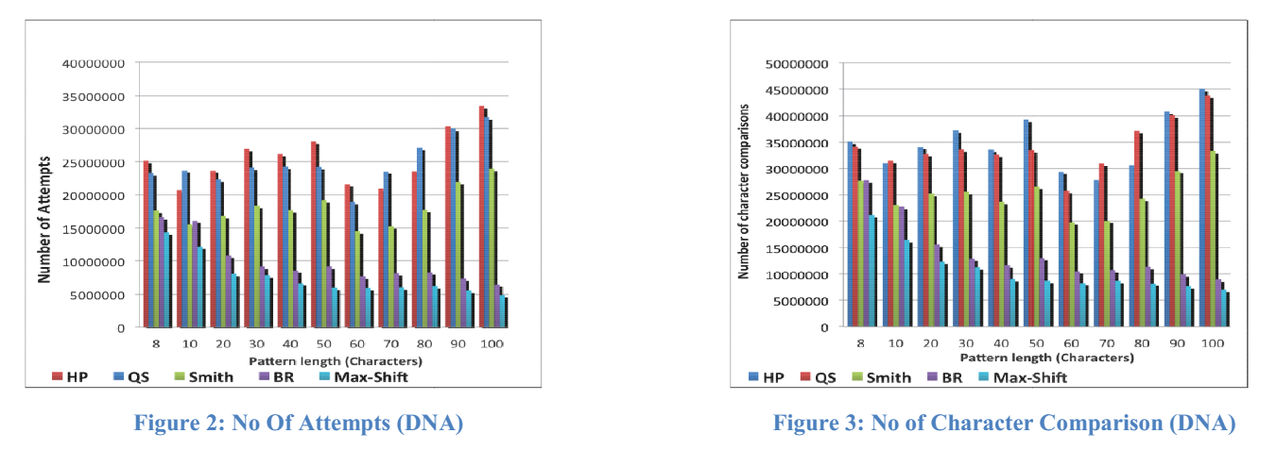
Reusult

Slide 31
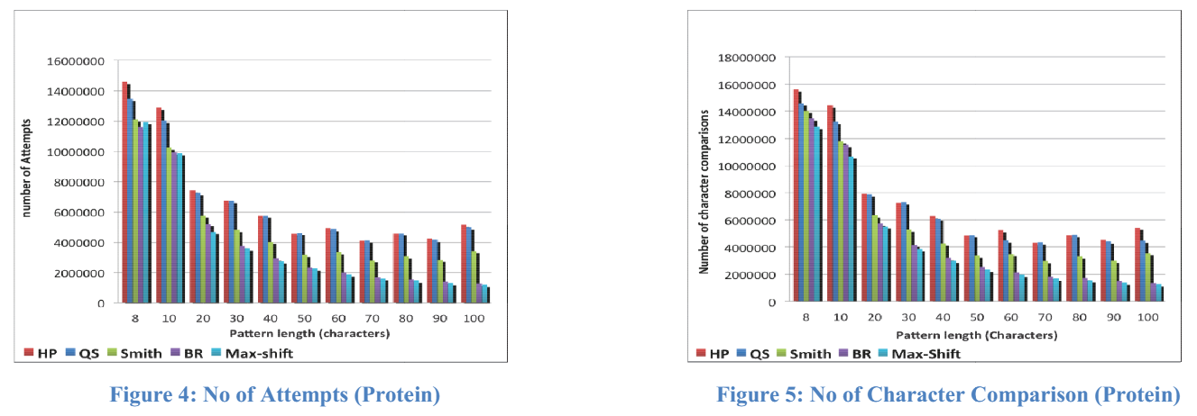
Reusult

Slide 32
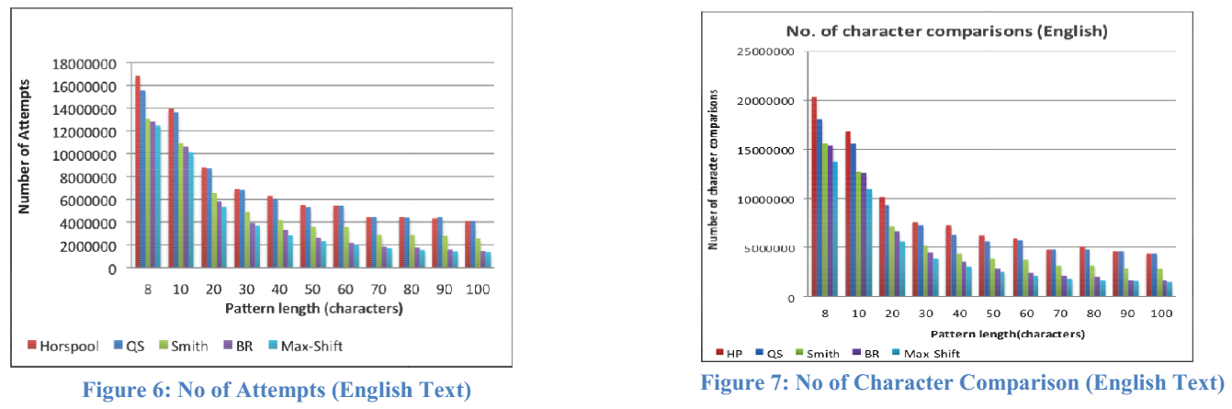
Reusult

Slide 33
Thanks

