Slide 1
Maximal common subsequence algorithms
Yoshifumi Sakai
Theoretical Computer Science 793 (2019) 132–139
Presenter: Wen-Yu Chang
Date: June 18, 2024

Slide 2
Abstract
A common subsequence of two strings is maximal if inserting any character into it no longer yields a common subsequence. The present article proposes a (sub)linearithmic-time, linear-space algorithm for finding a maximal common subsequence of two strings and a linear-time algorithm for determining if a common subsequence of two strings is maximal.

Slide 3

Maximal Common Subsequence
$X=abcde$
$Y=bcade$
LCS$=bcde$
MCS$=ade, bcde$

Slide 4









Finding an MCS
1
$$X$$
e | f | f | a | f | f | c | e | b | a | b | c | d
$$Z=ε$$
$$Y$$
f | a | f | e | e | a | f | f | b | d | d | c | f | a
2
$$X$$
e | f | f | a | f | f | c | e | b | a | b | c | d
$$Z=ε$$
$$Y$$
f | a | f | e | e | a | f | f | b | d | d | c | f | a
3
$$X$$
e | f | f | a | f | f | c | e | b | a | b | c | d
$$Z=ε$$
$$Y$$
f | a | f | e | e | a | f | f | b | d | d | c | f | a

Slide 5


Finding an MCS
4
$$X$$
e | f | f | a | f | f | c | e | b | a | b | c | d
$$Z=ε$$
$$Y$$
f | a | f | e | e | a | f | f | b | d | d | c | f | a
$$X$$
e | f | f | a | f | f | c | e | b | a | b | c | d
$$Z=a$$
$$Y$$
f | a | f | e | e | a | f | f | b | d | d | c | f | a
5
$$X$$
e | f | f | a | f | f | c | e | b
$$Z=a$$
$$Y$$
f | a | f | e | e | a | f | f | b | d | d | c | f

Slide 6





Finding an MCS
$$X$$
e | f | f | a | f | f | c | e | b
$$Z=fa$$
$$Y$$
f | a | f | e | e | a | f | f | b | d | d | c | f
$$X$$
e | f | f | a | f
$$Z=ffa$$
$$Y$$
f | a | f | e | e | a | f | f | b | d | d | c
$$X$$
e | f | f | a
$$Z=fffa$$
$$Y$$
f | a | f | e | e | a | f

Slide 7

Finding an MCS
$$X$$
e | f
$$Z=efffa$$
$$Y$$
f | a | f | e | e | a

Slide 8

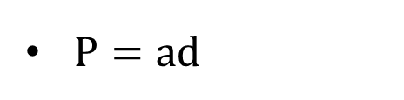





Finding a constrained MCS
$P=ad$
1
$$X$$
e | e | e | a | e | e | c | e | b | e | b | d | b
$$Z=d$$
$$Y$$
f | a | f | f | f | a | f | f | b | d | d | c | f | a
2
4
6
8
10
$$X$$
e | e | e | a | e | e | c | e | b | e | b
$$Z=d$$
$$Y$$
f | a | f | f | f | a | f | f | b | d
3
5
7
9

Slide 9


Finding a constrained MCS
$P=ad$
11
$$X$$
e | e | e | a | e | e | c | e | b | e | b
$$Z=bd$$
$$Y$$
f | a | f | f | f | a | f | f | b | d
12
13
$$X$$
e | e | e | a | e | e | c | e | b | e
$$Z=abd$$
$$Y$$
f | a | f | f | f | a | f | f

Slide 10
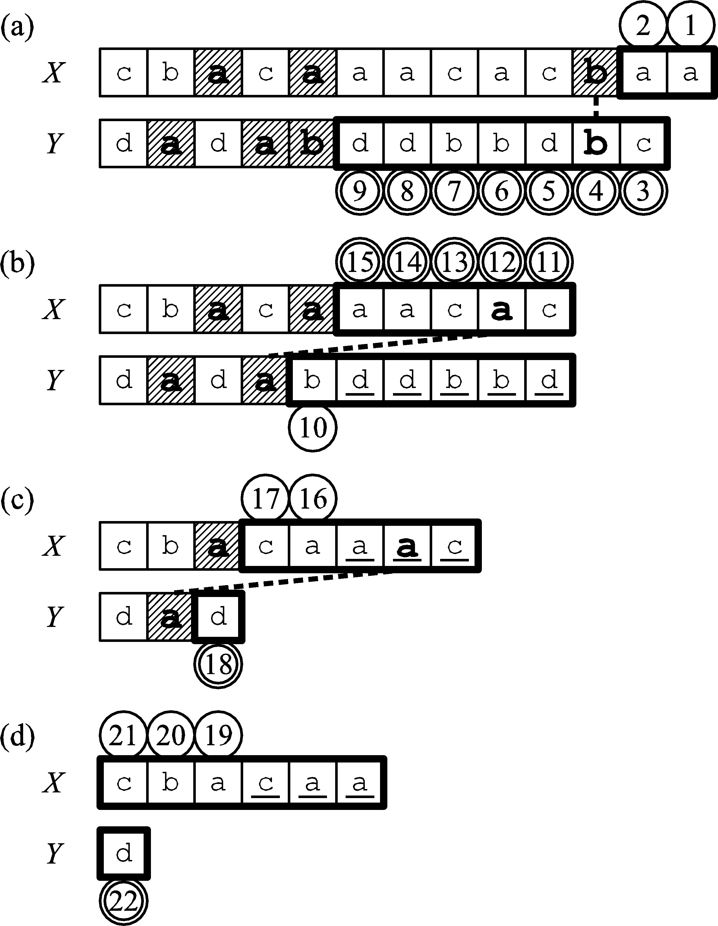

Determining MCS
$W=aab$

Slide 11
Determining MCS
$W=aab$

Slide 12

Time Complexity
Finding MCS & CMCS: O$(n\sqrt{\log{n}/\log{\log{n}}})$ (integer sorting)
Determining MCS: O$(n)$
$n=|X|+|Y|$

