Slide 1
Chord: A Scalable Peer-to-Peer Lookup Protocol for Internet Applications
Stoica, I., Morris, R., Liben-Nowell, D., Karger, D. R., Kaashoek, M. F., Dabek, F., & Balakrishnan, H. (2003).
IEEE/ACM Transactions on networking, 11(1), 17-32.
Presenter : Jing-Xiang Yang
Date : June 18, 2024

Slide 2
ABSTRACT
A fundamental problem that confronts peer-to-peer applications is the efficient location of the node that stores a desired data item. This paper presents Chord, a distributed lookup protocol that addresses this problem. Chord provides support for just one operation: given a key, it maps the key onto a node. Data location can be easily implemented on top of Chord by associating a key with each data item, and storing the key/data pair at the node to which the key maps. Chord adapts efficiently as nodes join and leave the system, and can answer queries even if the system is continuously changing. Results from theoretical analysis and simulations show that Chord is scalable: Communication cost and the state maintained by each node scale logarithmically with the number of Chord nodes.

Slide 3
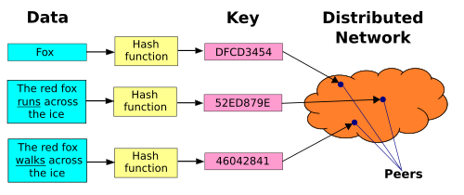
Distributed Hash Table(DHT)
Lookup service similar to a hash table
Key–value pairs are stored in a DHT
Participating node can efficiently retrieve the value associated with a given key.
Nodes can be added or removed with minimum work around re-distributing keys

Slide 4
Distributed Hash Table(DHT)
Balance : Distribute data evenly across different nodes.
Monotonicity : When nodes join or leave the DHT network, only a portion of the data needs to be redistributed, not all data.

Slide 5
Consisting Hash
Consistent hashing distributes N objects evenly across M nodes, minimizing redistribution when nodes are added or removed
Monotonicity

Slide 6
Distributing M data items across N nodes.
Traditional Hash
Consisting Hash
Data1 mod N = 1 (assign to node1)
Data2 mod N = 2 (assign to node2)
…
Define a Hash space
Assign each node and data by hash
Data
Remove a node
Identifier circle
(modulo 2^{m})
Node
Data1 mod (N-1) = 0 (assign to node0)
Data2 mod (N-2) = 1 (assign to node1)
…
(All data should be redistributed)
Remove a node

Slide 7
Chord Protocol
Find the locations of keys
How new nodes join the system

Slide 8
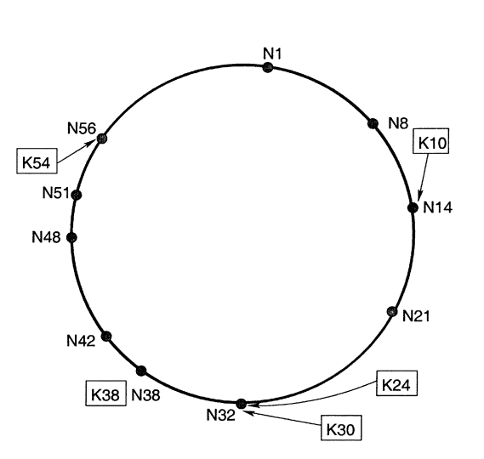
Find the locations of keys
10 nodes
keys (8 data)
Basic algorithm :
Queries for a given key pass through successor pointers until they find two nodes straddling the key.
predecessor
successor

Slide 9
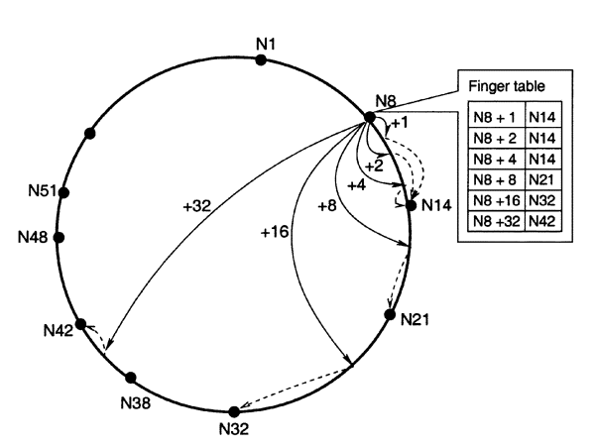
Find the locations of keys
Assume identifier circle build by modulo 2^{m}
Node maintains a finger table with up to m entries
stores information about only a small number of other nodes

Slide 10
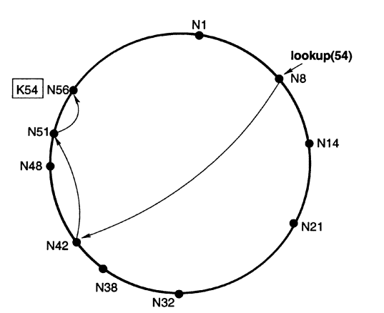
Find the locations of keys
N42 finger table
N51 finger table
N42 + 1 N48
N42 + 2 N48
N42 + 4 N48
N42 + 8 N51
N42 + 16 N1
N42 + 32 N14
N51 + 1 N56
N51 + 2 N56
N51 + 4 N56
.
.
.

Slide 11
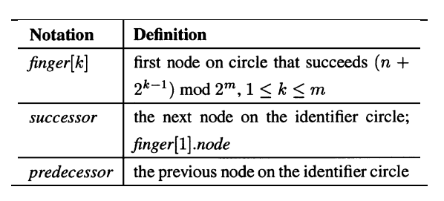
Node Information

Slide 12
How new nodes join the system
Build Finger Table
Assume new node location is j
Random pick a node n
Use node n to find j+2⁰, j+2¹ … j+2^{m-1} and their corresponding nodes
Use above information to build new node Finger Table

Slide 13
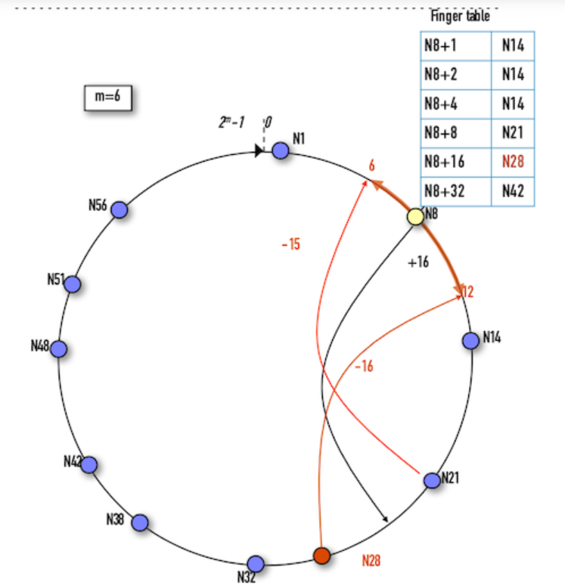
How new nodes join the system
Update old Finger Tables
m = 6
j = 28，predecessor of j : node21
Affected region : 21~28
21 < x + 2^{i} < 28
21-2^{i} < x < 28-2^{i}
if i = 4 (5th entry)
5 < x < 12
node8 update finger table with 5th entry
Notes:
筆記參考 : https://ithelp.ithome.com.tw/articles/10226984

Slide 14
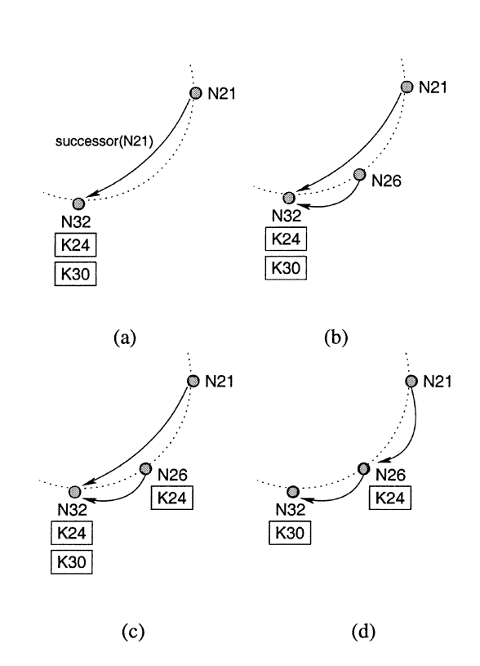
How new nodes join the system
Stabilize

Slide 15
Load Balance
node identifiers do not uniformly cover the entire identifier space
NodeA
Store too much data than NodeB
NodeB

Slide 16
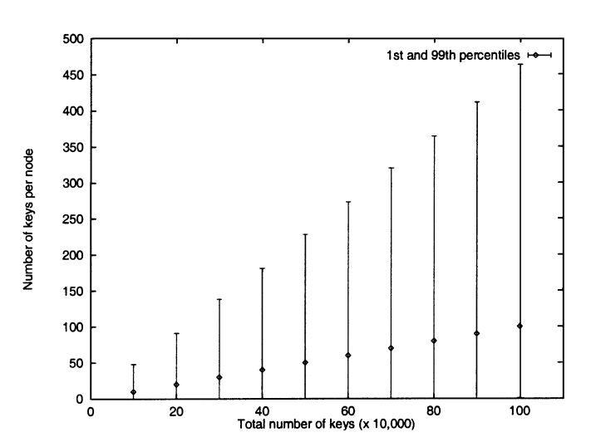

Slide 17
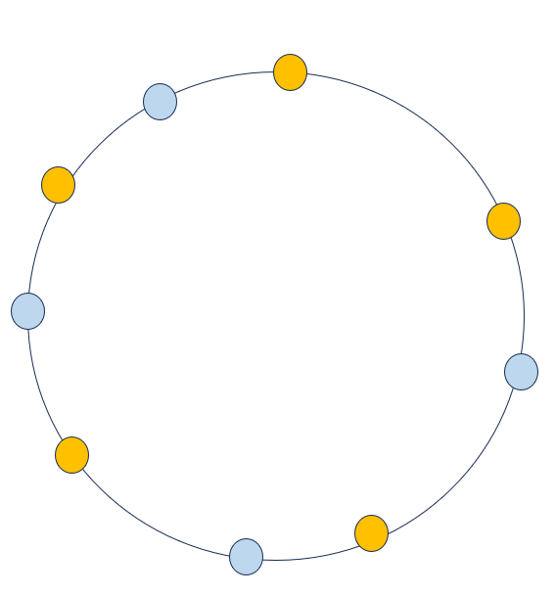
Virtual Nodes
NodeA => NodeA#1, NodeA#2 ….
NodeB => NodeB#1, NodeB#2 ….
(multiple virtual nodes mapping to real node)
With virtual nodes, more uniform coverage of the identifier space

Slide 18
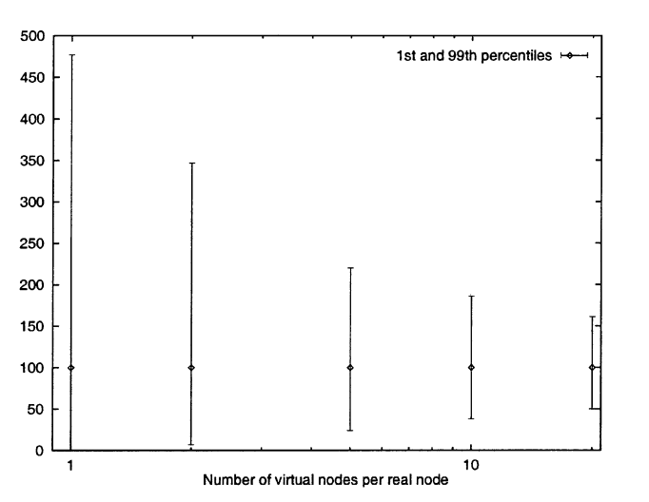
virtual nodes can improve load balance
tradeoff is that each real node needs much space to store the finger tables for its virtual nodes.

Slide 19
Thanks

