Slide 1
Order-preserving pattern matching with scaling
Youngho Kim, Munseong Kang, Joong Chae Na, Jeong Seop Sim
Information Processing Letters 180 (2023) 106333
Presenter: Wen-Yu Chang
Date: Aug. 21, 2024

Slide 2
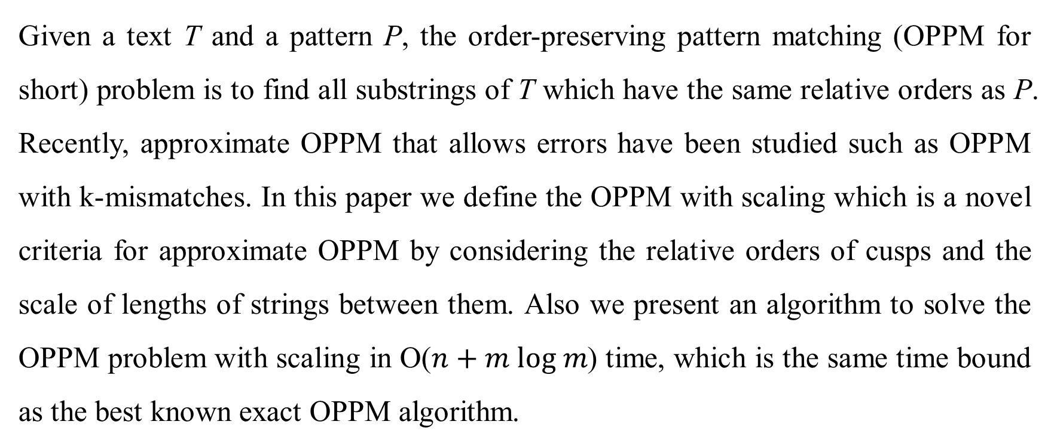
Abstract
Given a text T and a pattern P, the order-preserving pattern matching (OPPM for short) problem is to find all substrings of T which have the same relative orders as P. Recently, approximate OPPM that allows errors have been studied such as OPPM with k-mismatches. In this paper we define the OPPM with scaling which is a novel criteria for approximate OPPM by considering the relative orders of cusps and the scale of lengths of strings between them. Also we present an algorithm to solve the OPPM problem with scaling in O($n+m log m$) time, which is the same time bound as the best known exact OPPM algorithm.
Notes:
!: factorial

Slide 3
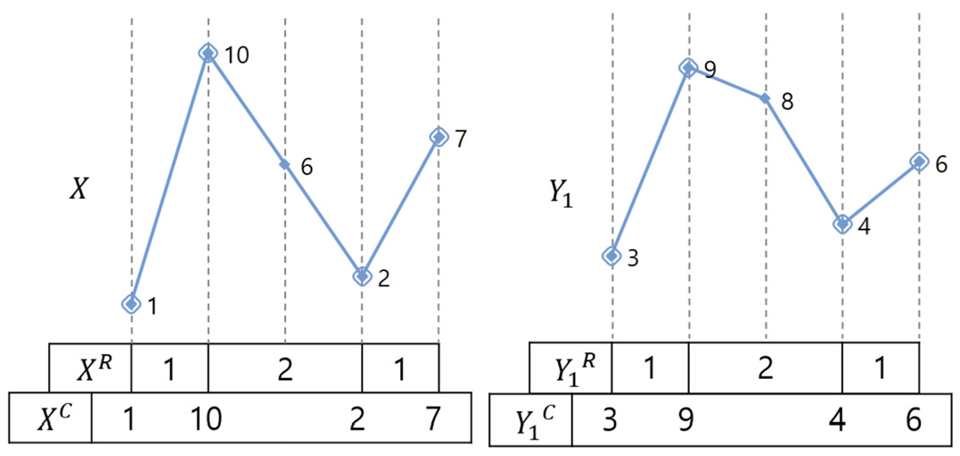

Scaled order-isomorphism (1/4)
Condition 1: $\left|X^{R}\right|=\left|Y^{R}\right|$ and $k×X^{R}\left[i\right]=Y^{R}[i]$
Condition 2: $X^{C}≈Y^{C}$
$X=\left(1, 10, 6, 2, 7\right)$
$Y_{1}=(3, 9, 8, 4, 6)$

Slide 4
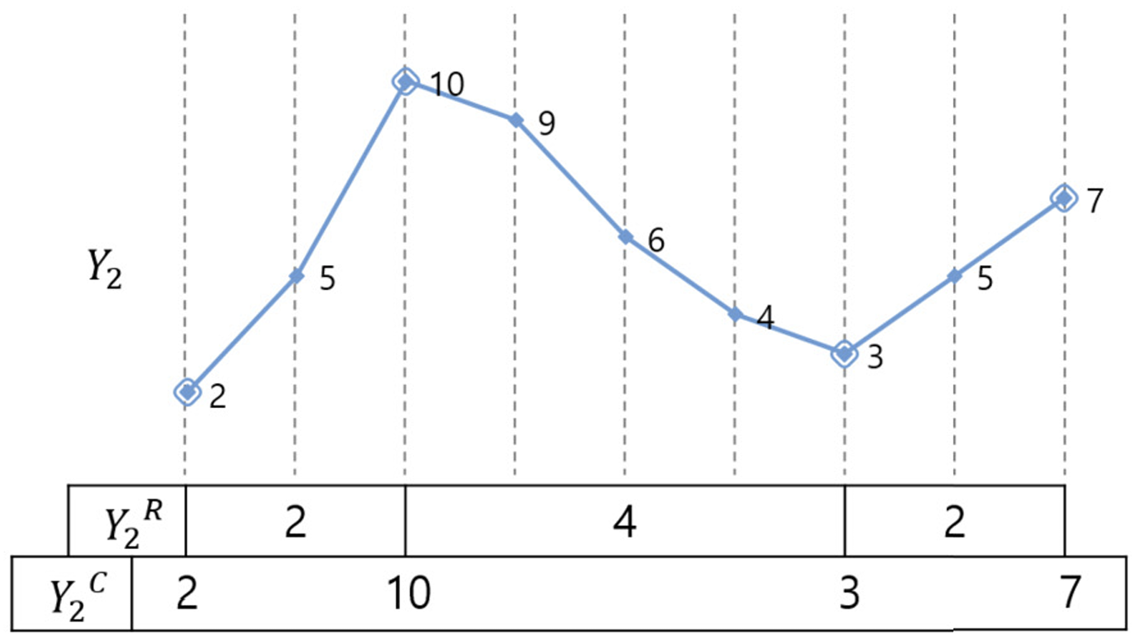
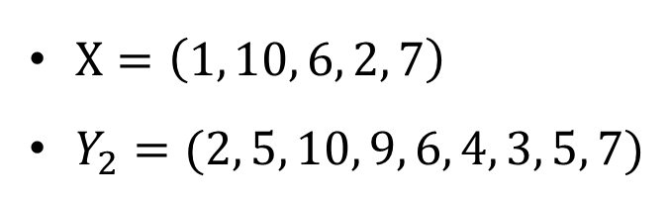
Scaled order-isomorphism (2/4)
$X=\left(1, 10, 6, 2, 7\right)$
$Y_{2}=(2, 5, 10, 9, 6, 4, 3, 5, 7)$

Slide 5
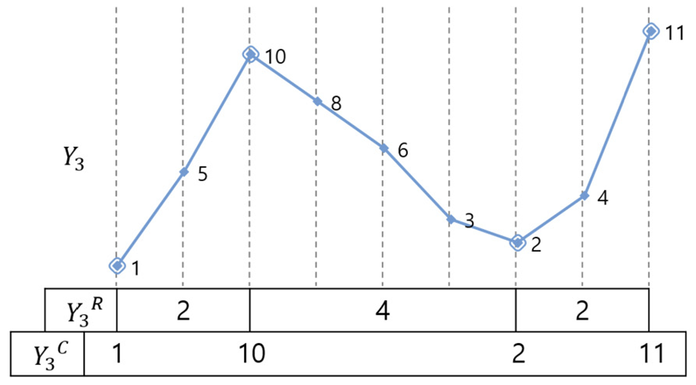
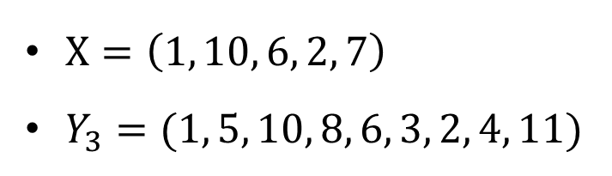
Scaled order-isomorphism (3/4)
$X=\left(1, 10, 6, 2, 7\right)$
$Y_{3}=(1, 5, 10, 8, 6, 3, 2, 4, 11)$

Slide 6
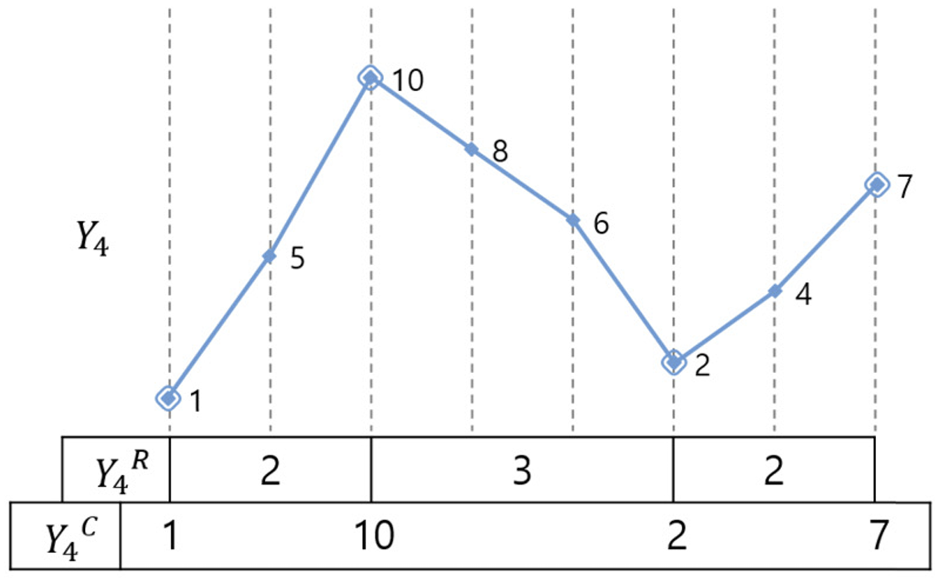
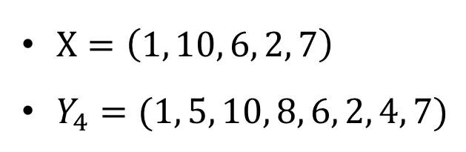
Scaled order-isomorphism (4/4)
$X=\left(1, 10, 6, 2, 7\right)$
$Y_{4}=(1, 5, 10, 8, 6, 2, 4, 7)$

Slide 7
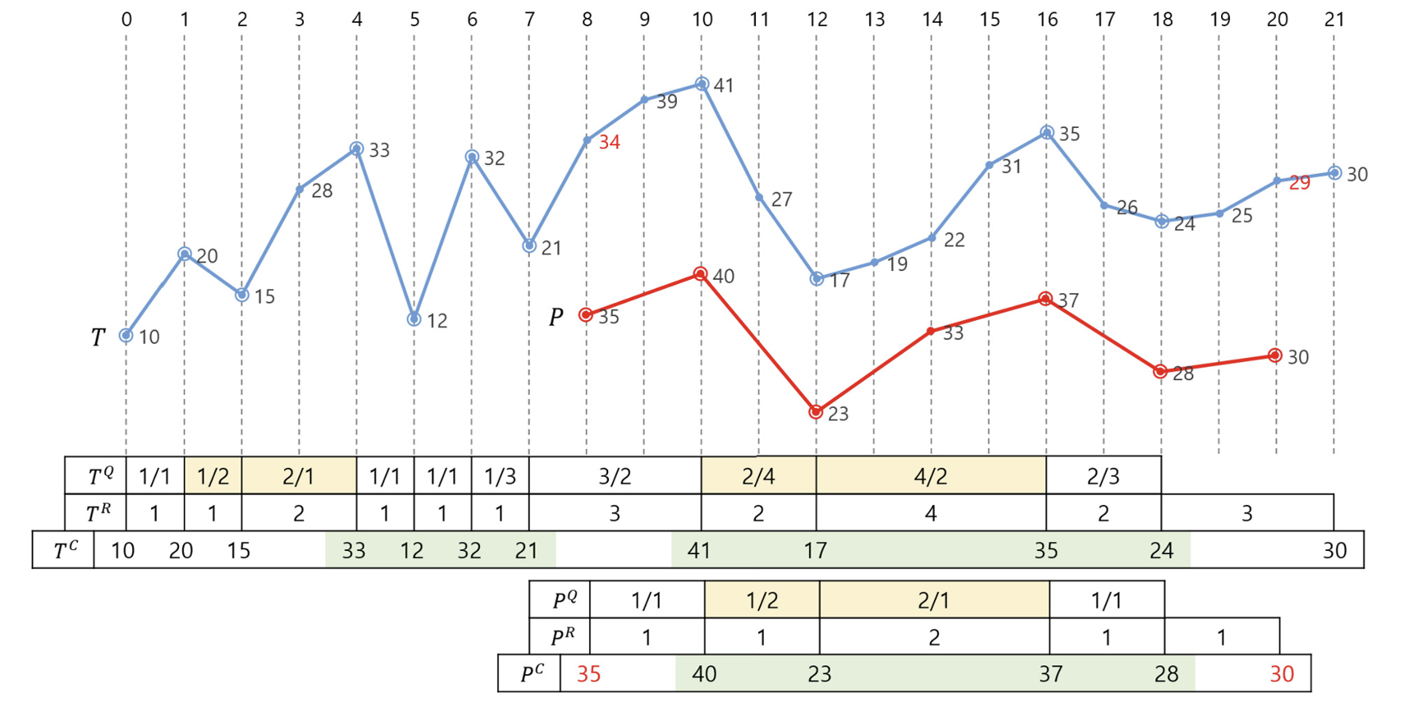
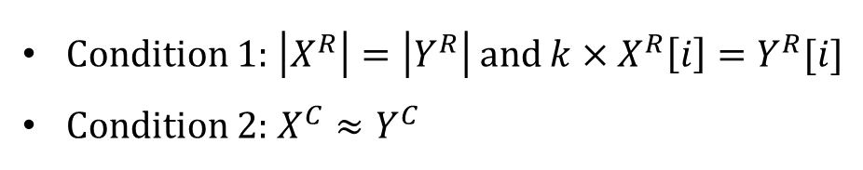
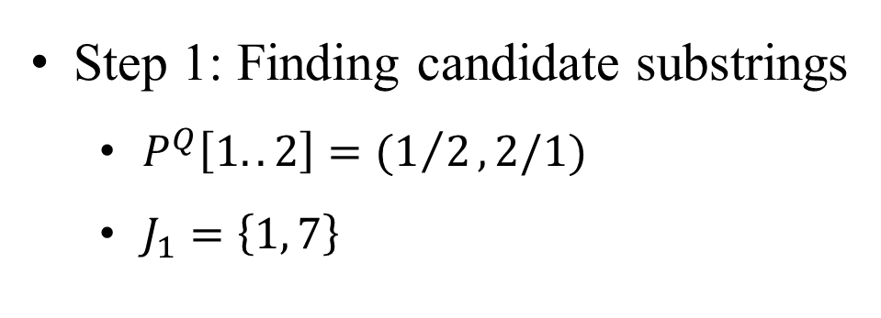
OPPM with scaling (1/4)
Condition 1: $\left|X^{R}\right|=\left|Y^{R}\right|$ and $k×X^{R}\left[i\right]=Y^{R}[i]$
Condition 2: $X^{C}≈Y^{C}$
Step 1: Finding candidate substrings
$P^{Q}\left[1..2\right]=(1/2,2/1)$
$J_{1}=\left\{1, 7\right\}$

Slide 8
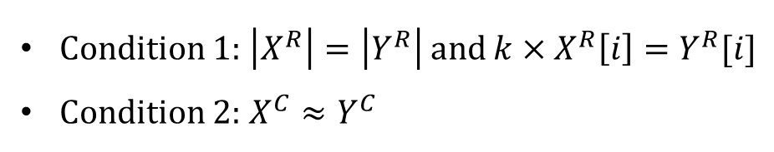

OPPM with scaling (2/4)
Condition 1: $\left|X^{R}\right|=\left|Y^{R}\right|$ and $k×X^{R}\left[i\right]=Y^{R}[i]$
Condition 2: $X^{C}≈Y^{C}$
Step 1: Finding candidate substrings
$P^{C}\left[1..4\right]=(40, 23, 37, 28)$
The order $=(4, 1, 3, 2)$
$J_{2}=\left\{3, 7\right\}$
Candidate: $T[8..20]$
Notes:
透過run length得到10和18
因為是2倍，所以前後再多2

Slide 9
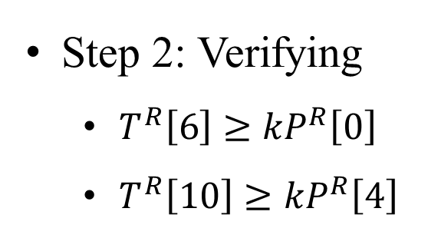
OPPM with scaling (3/4)
Condition 1: $\left|X^{R}\right|=\left|Y^{R}\right|$ and $k×X^{R}\left[i\right]=Y^{R}[i]$
Condition 2: $X^{C}≈Y^{C}$
Step 2: Verifying
$T^{R}\left[6\right]≥{kP}^{R}\left[0\right]$
$T^{R}\left[10\right]≥{kP}^{R}\left[4\right]$

Slide 10
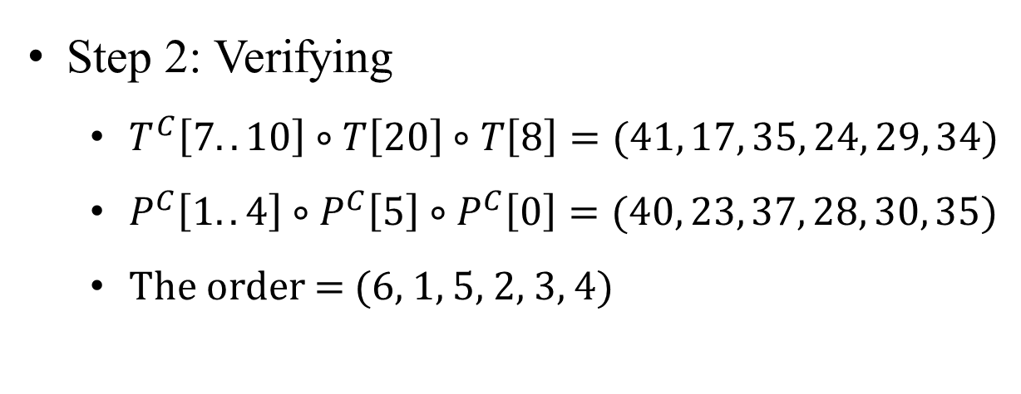
OPPM with scaling (4/4)
Condition 1: $\left|X^{R}\right|=\left|Y^{R}\right|$ and $k×X^{R}\left[i\right]=Y^{R}[i]$
Condition 2: $X^{C}≈Y^{C}$
Step 2: Verifying
$T^{C}\left[7..10\right]∘T\left[20\right]∘T\left[8\right]=(41, 17, 35, 24, 29, 34)$
$P^{C}\left[1..4\right]∘P^{C}\left[5\right]∘P^{C}\left[0\right]=(40, 23, 37, 28, 30, 35)$
The order = (6, 1, 5, 2, 3, 4)

Slide 11
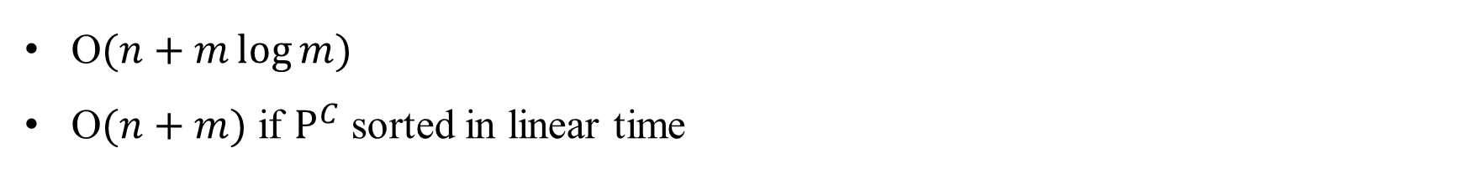
Time Complexity
O$(n+m\log{m})$
O$(n+m)$ if $P^{C}$ sorted in linear time

