Slide 1
The Longest Wave Subsequence Problem: Generalizations of the Longest Increasing Subsequence Problem
Guan-Zhi Chen, Chang-Biau Yang, Yu-Cheng Chang.
International Journal of Foundations of Computer Science (2024)
Presenter: Wan-Ni Ou
Date: Aug. 20, 2024

Slide 2
Abstract
The longest increasing subsequence (LIS) problem aims to find the subsequence exhibiting an increasing trend in a numeric sequence with the maximum length. In this paper, we generalize the LIS problem to the longest wave subsequence (LWS) problem, which encompasses two versions: LWSt and LWSr.
Given a numeric sequence A of distinct values and a target trend sequence T, the LWSt problem aims to identify the longest subsequence of A that preserves the trend of the prefix of T. And, the LWSr problem aims to find the longest subsequence of A within r segments, alternating increasing and decreasing subsequences. We propose two efficient algorithms for solving the two versions of the LWS problem.
For the LWSt problem, the time complexity of our algorithm is O(n log n), where n represents the length of the given numeric sequence A. Additionally, we propose an O(rn log n)-time algorithm for solving the LWSr problem. In both algorithms, we utilize the priority queues for the insertion, deletion, and successor operations.

Slide 3
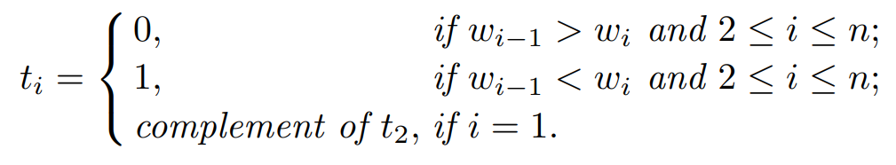
LWS
W = ⟨1, 2, 4, 9, 7, 3, 5, 6, 8⟩
T = ⟨0, 1, 1, 1, 0, 0, 1, 1, 1⟩
trend
increasing/decreasing segment
turning point: t _{i} ≠ t _{i+1}

Slide 4
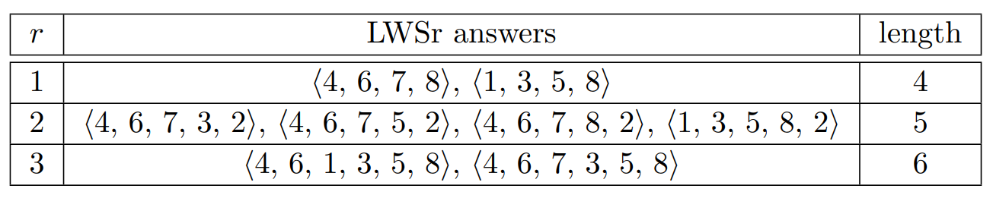
LWSt and LWSr
LWSt
A = ⟨4, 6, 1, 7, 3, 5, 8, 2⟩
A^{T}= ⟨0, 1, 0, 1, 0, 1, 1, 0⟩
T = ⟨0, 1, 1, 0, 1, 1, 1, 1⟩
LWSr

Slide 5
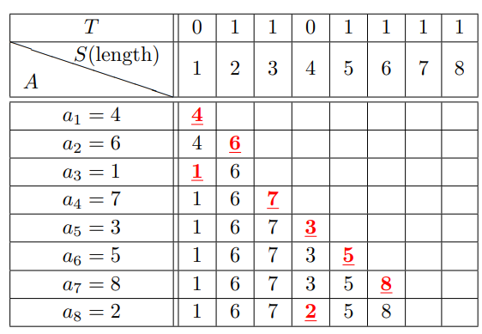
LWSt
A = ⟨4, 6, 1, 7, 3, 5, 8, 2⟩
T = ⟨0, 1, 1, 0, 1, 1, 1, 1⟩
turning point = ⟨1, 3, 4⟩

Slide 6
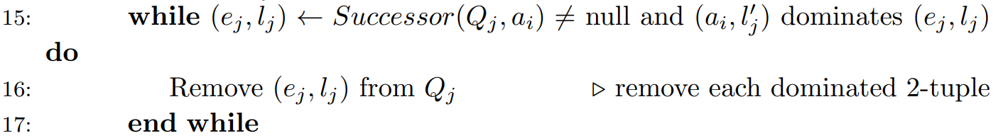
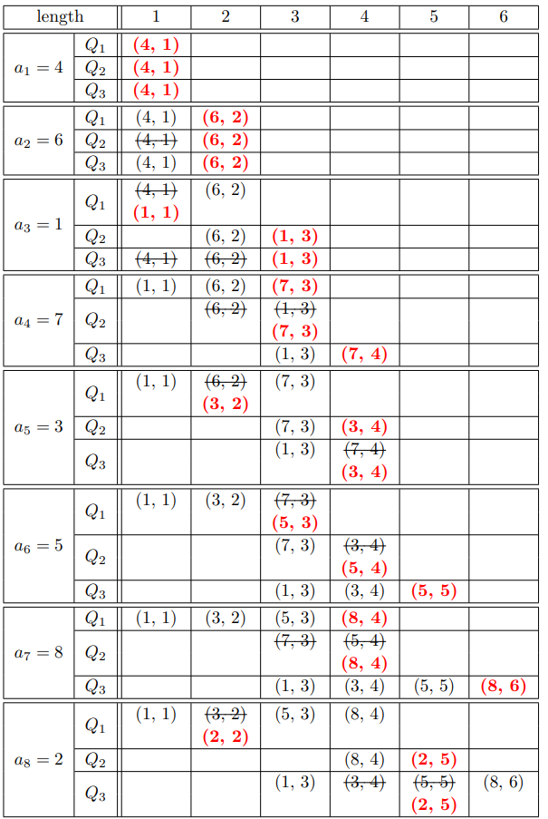


LWSr
A = ⟨4, 6, 1, 7, 3, 5, 8, 2⟩
r = 3
ANS = ⟨4, 6, 7, 3, 5, 8 ⟩

Slide 7
Conclusion
Proposed two algorithms to solve LWS problem. (assumed that all elements of the input sequence are all distinct)
LWSt
Time Complexity: O(n logn)
Space Complexity: O(n)
LWSr
Time Complexity: O(rn logn)
Space Complexity: O(rn)

Slide 8
Thanks

