Slide 1
Faster STR-IC-LCS Computation via RLE
Keita Kuboi, Yuta Fujishige, Shunsuke Inenaga, Hideo Bannai and Masayuki Takeda
Annual Symposium on Combinatorial Pattern Matching (2017). No. 20, pp. 20:1–20:12
Presenter: Hsin-Chang Yu
Date: Aug. 21, 2024

Slide 2
Abstract
The constrained LCS problem asks one to find a longest common subsequence of two input strings A and B with some constraints. The STR-IC-LCS problem is a variant of the constrained LCS problem, where the solution must include a given constraint string C as a substring. Given two strings A and B of respective lengths M and N, and a constraint string C of length at most min{M,N}, the best known algorithm for the STR-IC-LCS problem, proposed by Deorowicz (Inf. Process. Lett., 11:423–426, 2012), runs in O(MN) time.

Slide 3
Abstract
In this work, we present an O(mN+nM) time solution to the
STR-IC-LCS problem, where m and n denote the sizes of the
run-length encodings of A and B, respectively. Since m≤M and n≤N always hold, our algorithm is always as fast as Deorowicz's algorithm, and is faster when input strings are compressible via RLE.

Slide 4
STR-IC-LCS
Substring (STR)
Includes (IC)
Longest common subsequence (LCS)

Slide 5
STR-IC-LCS
A = abacab
B = babcaba
C = bb
LCSs of A, B = abcab, bacab
STR-IC-LCS of A, B, C = abb

Slide 6
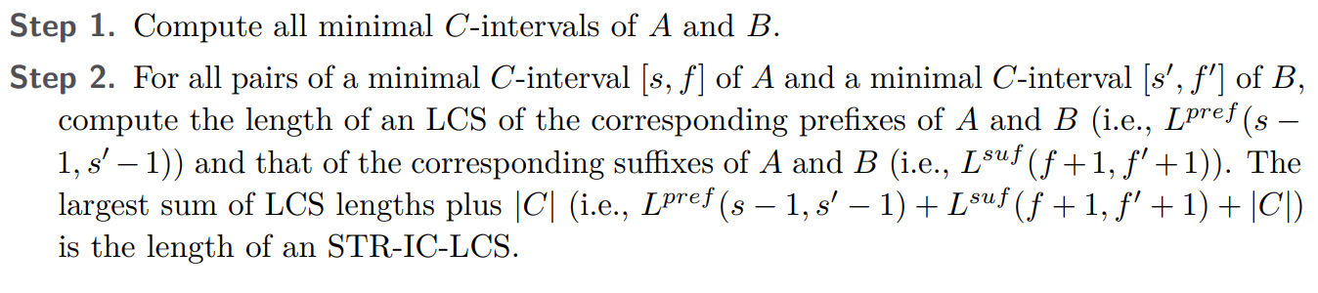
Deorowicz’s Algorithm
O(MN)

Slide 7
Minimal C-interval
A = abacab
B = babcaba
C = bca
Minimal C-interval of A = baca
Minimal C-interval of B = bca

Slide 8
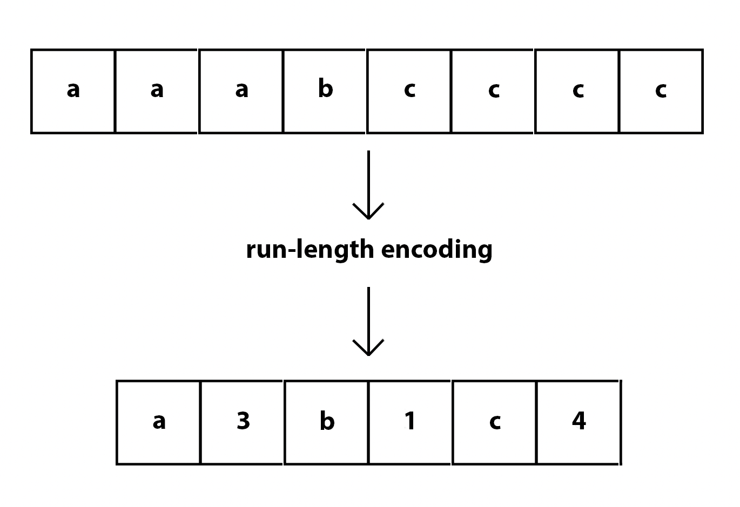
RLE

Slide 9
Algorithm via RLE
Case |RLE(C)| > 1 e.g. abac
Case |RLE(C)| = 1 e.g. aaaa

Slide 10
Case |RLE(C)| > 1
C = aabb
a | a | a | b | a | b | b | a | b | a | a | b | b | a
 | s₁ |  |  |  | f₁ |  |  |  | s₂ |  |  | f₂

Slide 11
Case |RLE(C)| > 1
C = aabb
a | a | a | b | a | b | b | a | b | a | a | b | b | a
 | s₁ |  |  |  | f₁ |  |  |  | s₂ |  |  | f₂

Slide 12
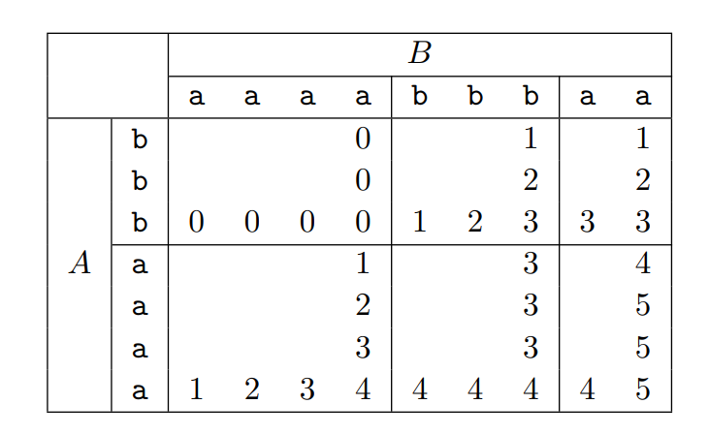
Case |RLE(C)| > 1
L^{pref}
L^{suf}
O(mN + nM) space

Slide 13
Case |RLE(C)| > 1
L^{pref}
L^{suf}
C = baa
Minimal C-interval of A = [3,5]
Minimal C-interval of B = [7,9]

Slide 14
Case |RLE(C)| = 1
Θ(MN)

Slide 15
Case |RLE(C)| = 1
RLE(A) = a⁵b³a⁴b²a¹ RLE(C) = a⁵
RLE(B) = a¹b³a⁷b³
G(1) = {[1, 5]}, G(2) = {[2, 9], [3, 10], [4, 11], [5, 12]}, G(3) = {[9, 15]}
a | a | a | a | a | b | b | b | a | a | a | a | b | b | a
s₁ |  |  |  | f₁

Slide 16
Case |RLE(C)| = 1
RLE(A) = a⁵b³a⁴b²a¹ RLE(C) = a⁵
RLE(B) = a¹b³a⁷b³
G′(1) = {[1, 8]}, G′(2) = {[5, 9], [6, 10], [7, 11]}
a | b | b | b | a | a | a | a | a | a | a | b | b | b
s₁ |  |  |  |  |  |  |  | f₁

Slide 17
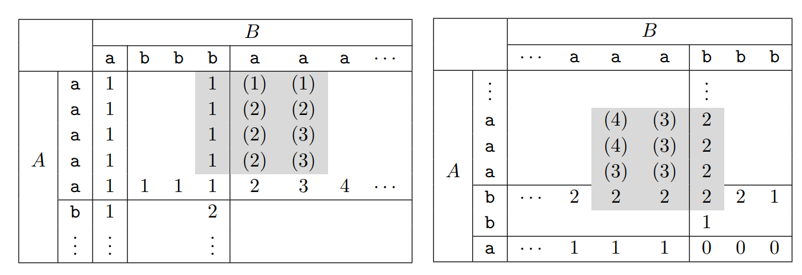
Case |RLE(C)| = 1
G(1) = {[1, 5]}, G(2) = {[2, 9], [3, 10], [4, 11], [5, 12]}, G(3) = {[9, 15]}
G′(1) = {[1, 8]}, G′(2) = {[5, 9], [6, 10], [7, 11]}

Slide 18
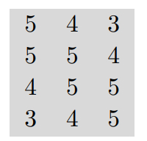
Case |RLE(C)| = 1
G(1) = {[1, 5]}, G(2) = {[2, 9], [3, 10], [4, 11], [5, 12]}, G(3) = {[9, 15]}
G′(1) = {[1, 8]}, G′(2) = {[5, 9], [6, 10], [7, 11]}

Slide 19
Case |RLE(C)| = 1
G(h) → G_{min}(h)

Slide 20
Case |RLE(C)| = 1
G(h) → G_{min}(h)
G(1) = {[1, 5]}, G(2) = {[2, 9], [3, 10], [4, 11], [5, 12]}, G(3) = {[9, 15]} →
G_{min}(1) = [1, 5], G_{min}(2) = [2, 9], G_{min}(3) = [9, 15]
G′(1) = {[1, 8]}, G′(2) = {[5, 9], [6, 10], [7, 11]} →
G_{min}(1) = [1, 8], G_{min}(2) = [5, 9]
O(mN + nM)

Slide 21
Time Complexity
RLE(A), RLE(B), RLE(C) in O(M + N + K) time
Step1 of Case 1 in O(M + N +mK +nK) time
Step2 of Case 1 in O(mn) time
Step1 of Case 1 in O(M + N) time
Step2 of Case 1 in O(mN + nM) time

Slide 22
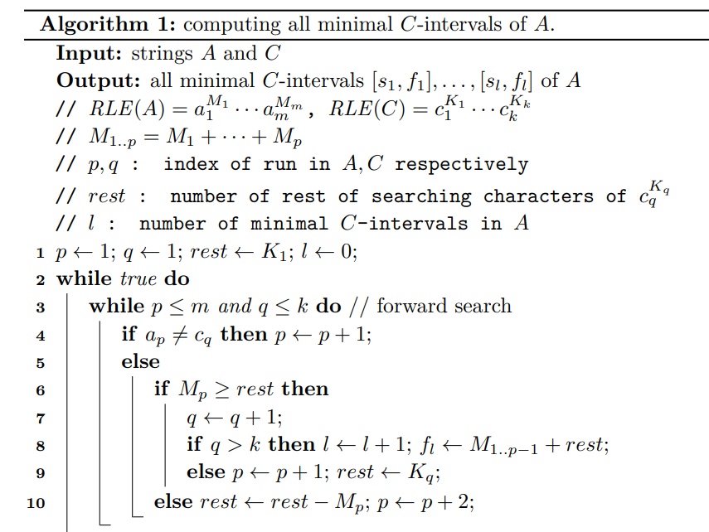
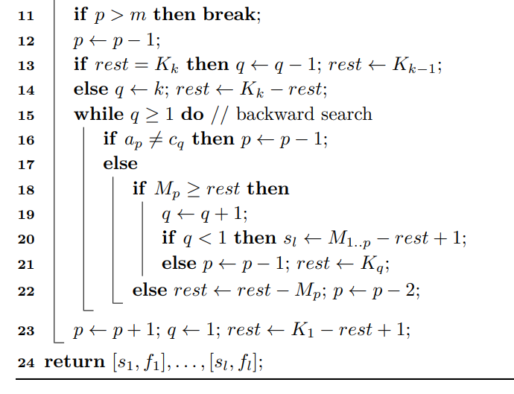
My Opinion

Slide 23
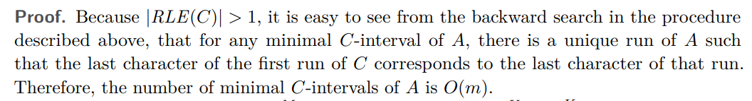
My Opinion

Slide 24
Thanks
Notes:
Given a string S of length n, an integer p ∈ [1..n] is a period of S if S[i] = S[i + p] for all i ∈ [1..n − p].
S[|S| − p + 1] = c

