Slide 1
Multiple Comparisons of Means: A Practical Guide
Gary M. Ingersoll
United Arab Emirates University
International Journal for Research in Education (IJRE), NO. 28, 2010
2012-05-23
Chiou-yi, Hor

Slide 2
Abstract
Analysis of variance (ANOVA) is a powerful set of statistical procedures that allows a researcher to compare relative differences among treatment conditions or types of individuals. In this review a limited set of post-ANOVA multiple comparison techniques are described and a set of general guidelines are provided that will accommodate most situations.

Slide 3
The multiple comparison problem
Suppose that we perform 5 t-tests, each with alpha = 0.05.
What is the probability that we will get at least one false positive result?
P(at least one false positive result)
= 1 - P(zero false positive results)
The probability of getting a false positive result for a single test is alpha = 0.05.
So the probability of not getting a false positive result for a single test is
1 – alpha = 1 - 0.05 = 0.95.
If we do k = 5 t-tests, the probability of getting no false positives on any test is 0.95^k = 0.95^5
P(at least one false positive result)
= 1 - P(zero false positive results)
= 1 – (1 - .05) ^ k
= 1 – (1 - .05) ^ 5
= 1 – (.95) ^ 5
= 0.226
Glantz, Primer of Biostatistics, Chapter 4, page 98 ff

Slide 4
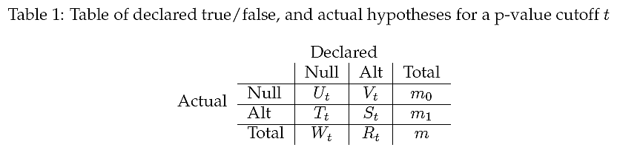
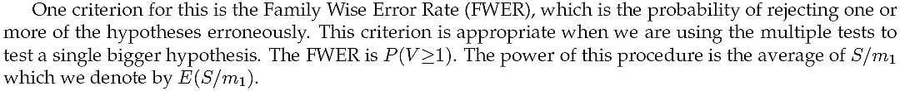
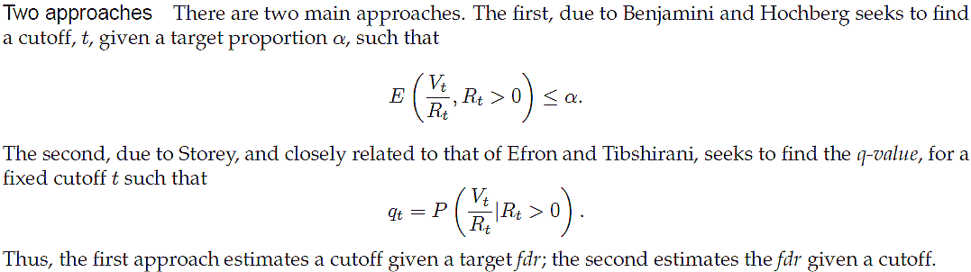
Vt: Type I / false positive error
Tt: Type II / false negative error
Family Wise Error Rate (FWER)
False Discovery Rate (FDR)
SAUNAK SEN, MULTIPLE COMPARISONS AND THE FALSE DISCOVERY RATE

Slide 5
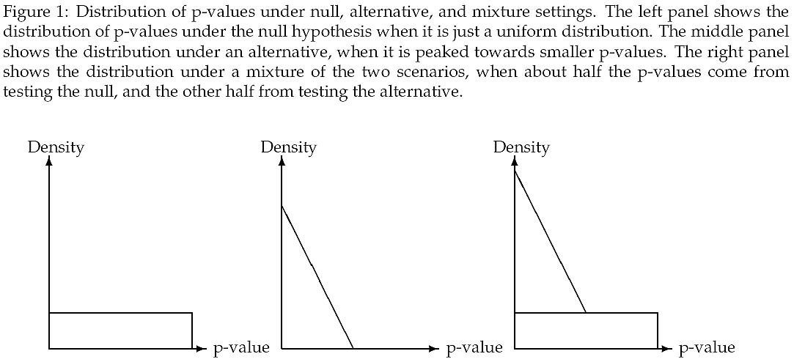
False discovery rate
SAUNAK SEN, MULTIPLE COMPARISONS AND THE FALSE DISCOVERY RATE

Slide 6
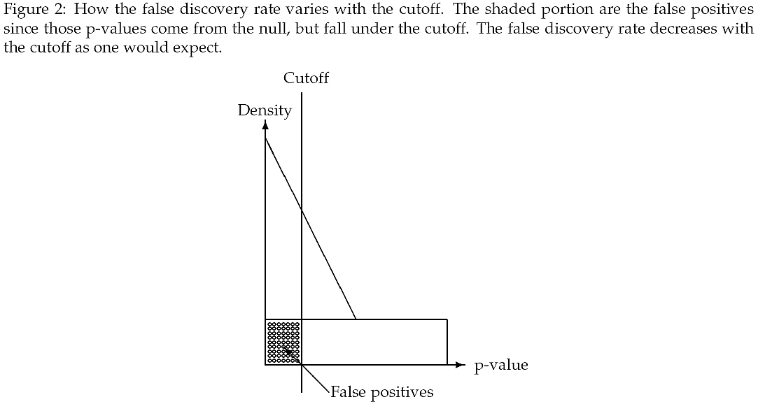
False discovery rate
SAUNAK SEN, MULTIPLE COMPARISONS AND THE FALSE DISCOVERY RATE

Slide 7
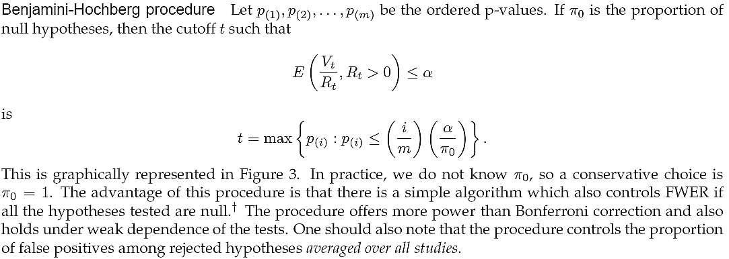
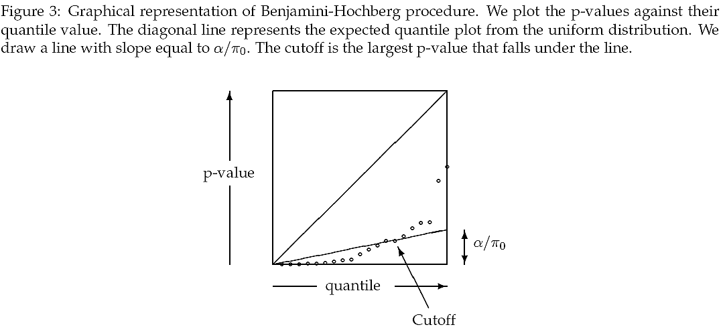
False discovery rate
SAUNAK SEN, MULTIPLE COMPARISONS AND THE FALSE DISCOVERY RATE

Slide 8
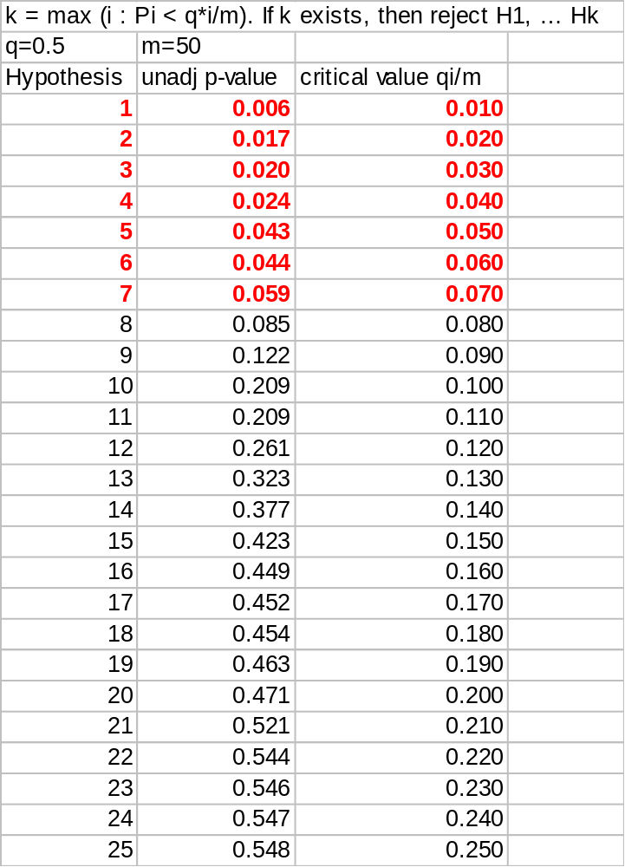
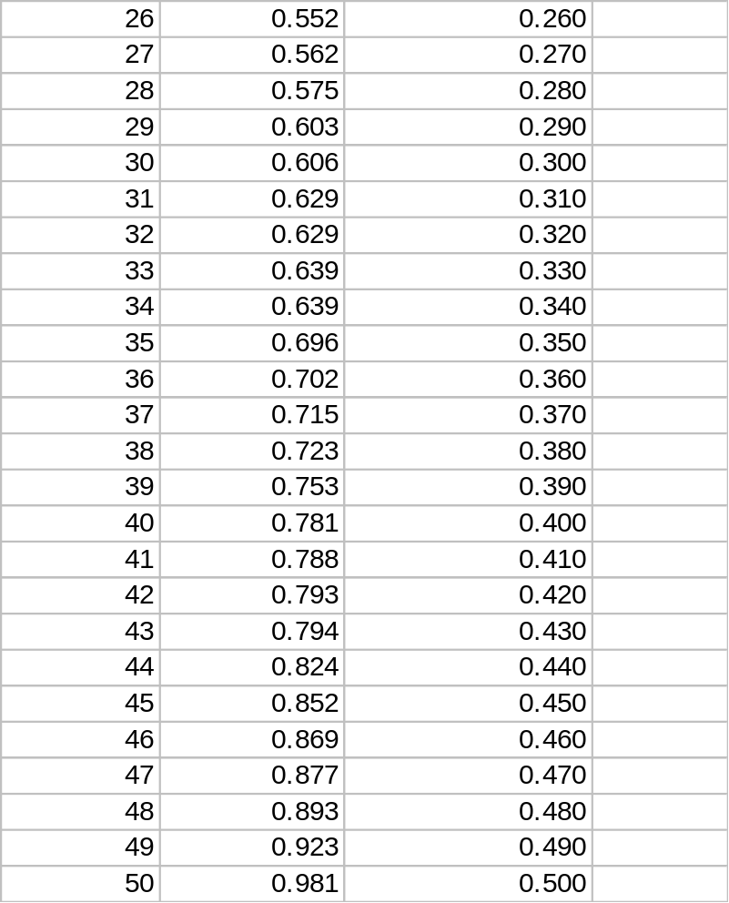
For q = 0.5, we reject the first 7 hypotheses
Glantz, Primer of Biostatistics, Chapter 4, page 98 ff

Slide 9
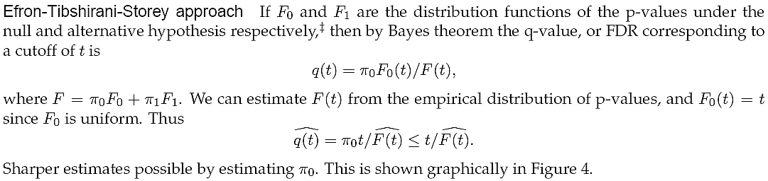
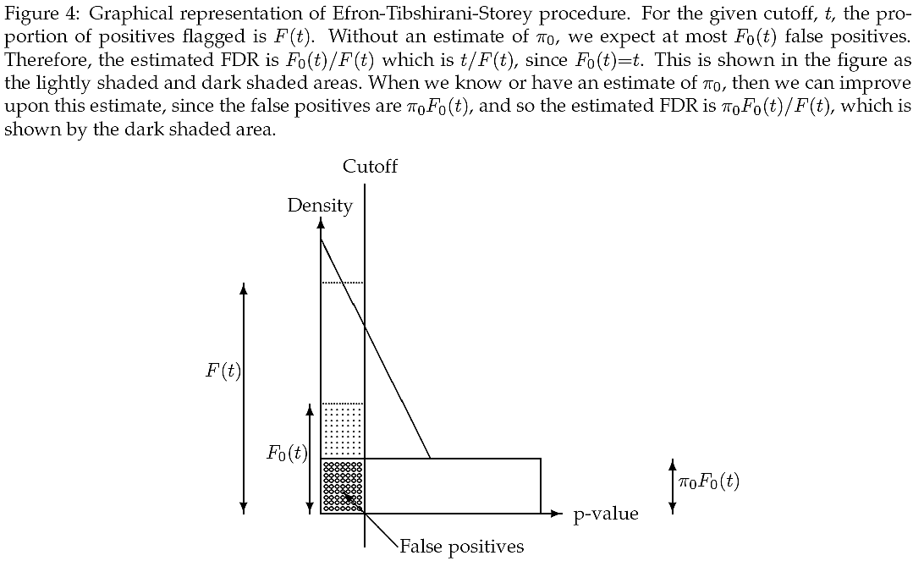
False discovery rate
SAUNAK SEN, MULTIPLE COMPARISONS AND THE FALSE DISCOVERY RATE

Slide 10
The False Discovery Rate (FDR) is the expected proportion of false positives (erroneously rejected null hypotheses) among the rejected null hypotheses.
Define the FDR as follows.
m = the number of simultaneously tested null hypotheses.
m0 = the number of null hypotheses that are true null
For each hypothesis Hi, calculate the corresponding p-value Pi from the test statistic (e.g., t-test).
R = the number of hypotheses rejected
V = the number of true null hypotheses rejected
S = the number of false null hypotheses rejected
R = V + S
Q = V/R when R > 0
Q = 0 otherwise
FDR = E(Q)
Glantz, Primer of Biostatistics, Chapter 4, page 98 ff

Slide 11
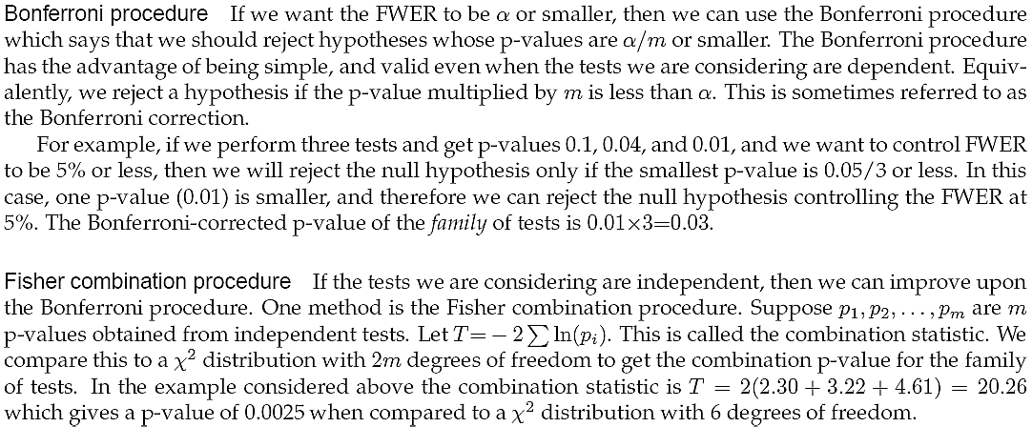
Family wise error rate
SAUNAK SEN, MULTIPLE COMPARISONS AND THE FALSE DISCOVERY RATE

Slide 12
Family-wise error rate
The probability that we will get at least one false positive result, P(at least one false positive result), is called the Family-wise error rate (FWER).
Protecting against false positive results
Many statistical methods have been developed to protect against making a false positive conclusion. We’ll examine the Bonferroni correction and Holm’s test.
Example of Bonferroni correction.
Suppose we have k = 3 t-tests.
Assume target alpha(T)= 0.05.
Bonferroni corrected p-value is alpha(T)/k = 0.05/3 = 0.0167
Unadjusted p-values are
p1 = 0.001
p2 = 0.013
p3 = 0.074
p1 = 0.001 < 0.0167, so reject null
p2 = 0.013 < 0.0167, so reject null
p3 = 0.074 > 0.0167, so do not reject null
Glantz, Primer of Biostatistics, Chapter 4, page 98 ff

Slide 13
The sources of variation for statistical tests
Random variation in the selection of the test data & the training data
  The learning algorithms should be executed multiple times over different training and test sets
Internal randomness in the estimation of model parameters
  Each unstable algorithm should be executed several times
Joaquin Pizarro et al. Multiple comparison procedures applied to model selection

Slide 14
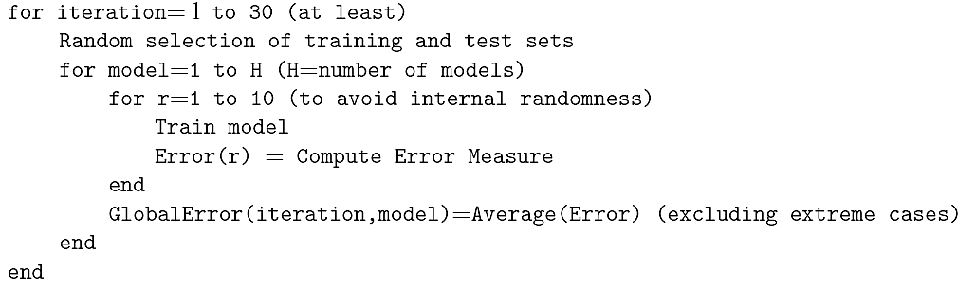
The sources of variation for statistical tests
Common procedure to get different data sets for training and testing
  K-fold cross-validation
  Random sub-sampling (without replacement)
  Bootstrapping (sampling with replacement)
Joaquin Pizarro et al. Multiple comparison procedures applied to model selection

Slide 15
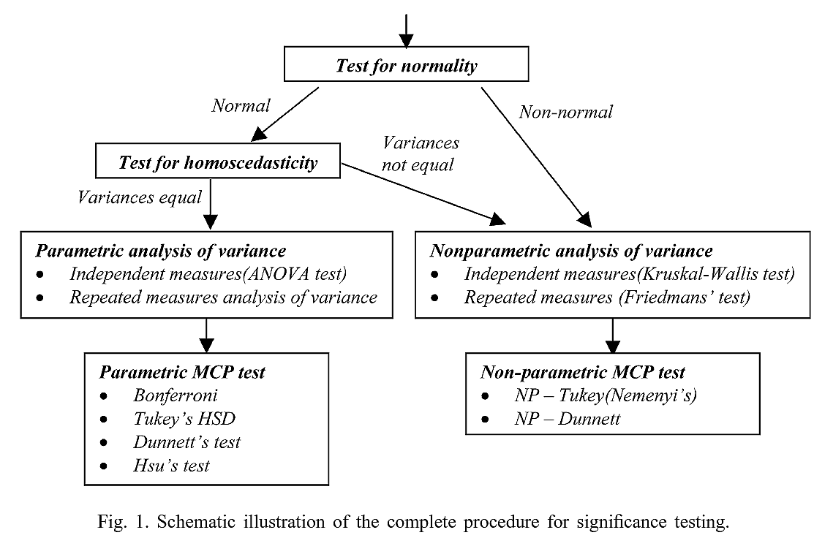
(Kolmogorov–Smirno test)
Joaquin Pizarro et al. Multiple comparison procedures applied to model selection

Slide 16
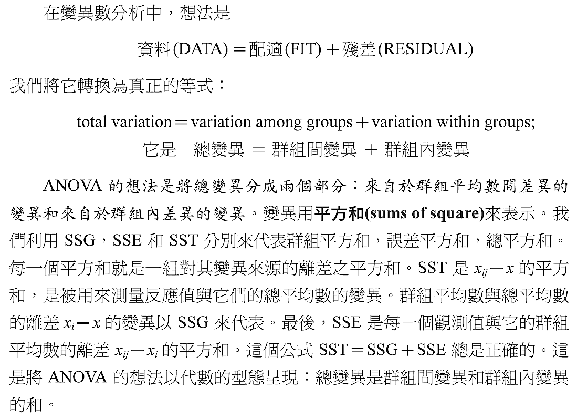
ANOVA (analysis of variance)
楊明宗, "應用統計學"

Slide 17

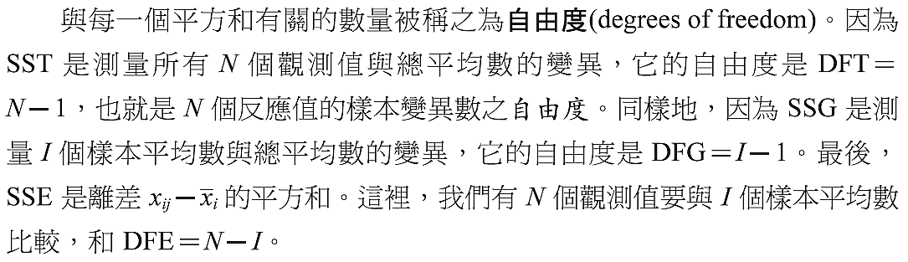
ANOVA (analysis of variance)
楊明宗, "應用統計學"

Slide 18
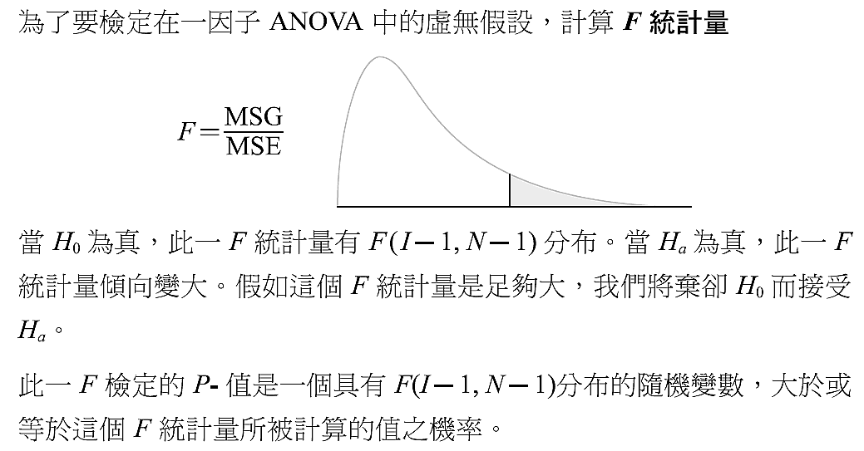
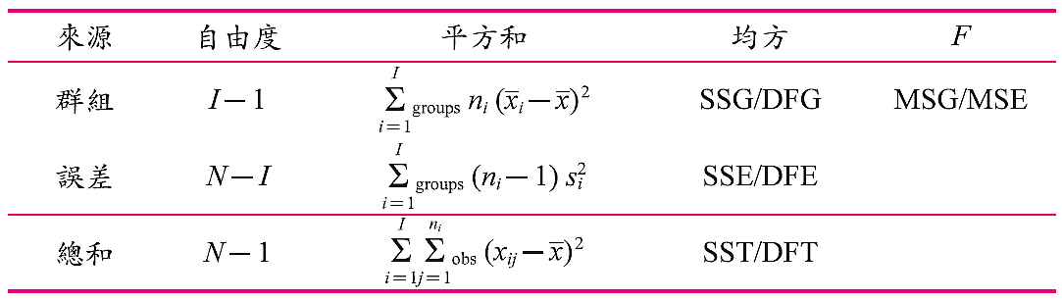
ANOVA (analysis of variance)
楊明宗, "應用統計學"

Slide 19

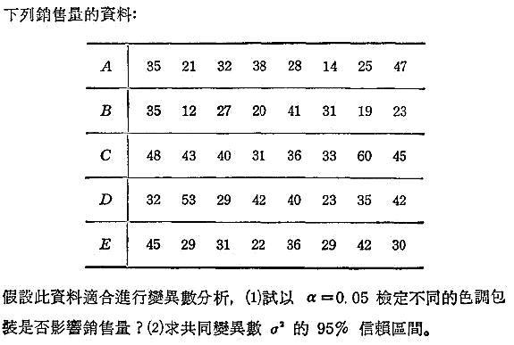
ANOVA (analysis of variance)
顏月珠, "商用統計學"

Slide 20
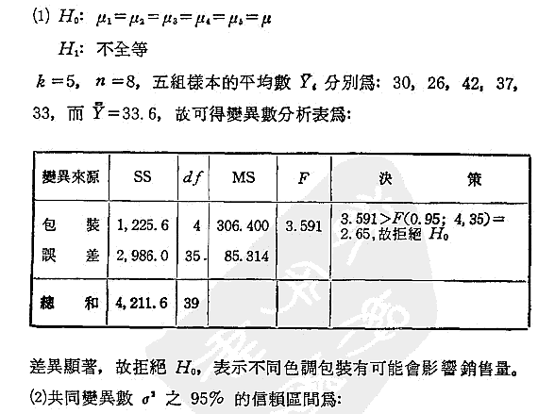

ANOVA (analysis of variance)
% X
0.025 20.569
0.050 22.465
0.075 23.763
0.100 24.797
0.125 25.678
0.150 26.460
0.175 27.174
0.200 27.836
0.225 28.460
0.250 29.054
0.275 29.625
0.300 30.178
0.325 30.717
0.350 31.246
0.375 31.767
0.400 32.282
0.425 32.795
0.450 33.306
0.475 33.819
0.500 34.336
0.525 34.857
0.550 35.386
0.575 35.924
0.600 36.475
0.625 37.040
0.650 37.623
0.675 38.228
0.700 38.859
0.725 39.522
0.750 40.223
0.775 40.971
0.800 41.778
0.825 42.660
0.850 43.640
0.875 44.753
0.900 46.059
0.925 47.663
0.950 49.802
0.975 53.203
顏月珠, "商用統計學"

Slide 21
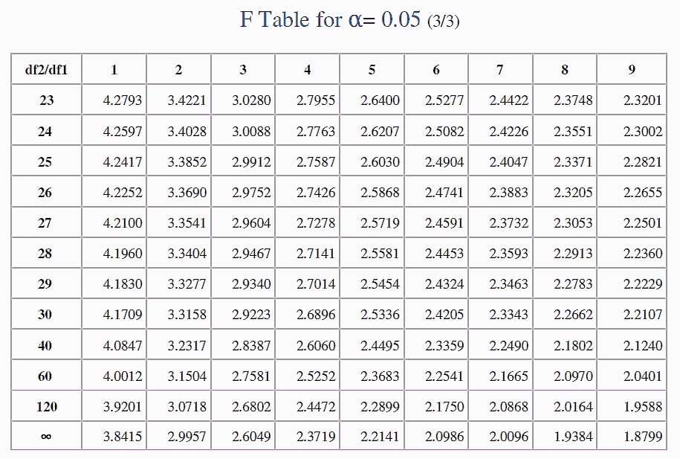
2.69
2.61
http://mat.iitm.ac.in/home/vetri/public_html/statistics/f-table.pdf

Slide 22
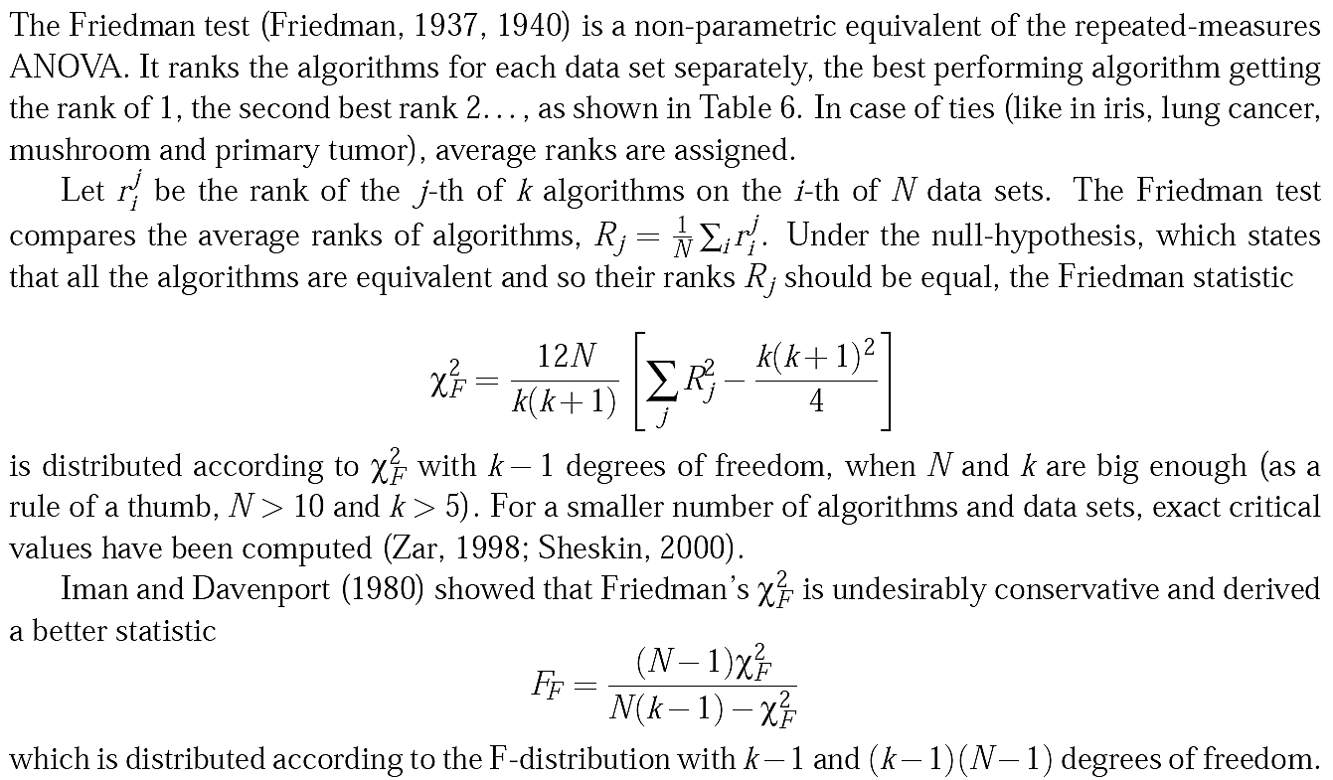
Friedman檢定

Slide 23
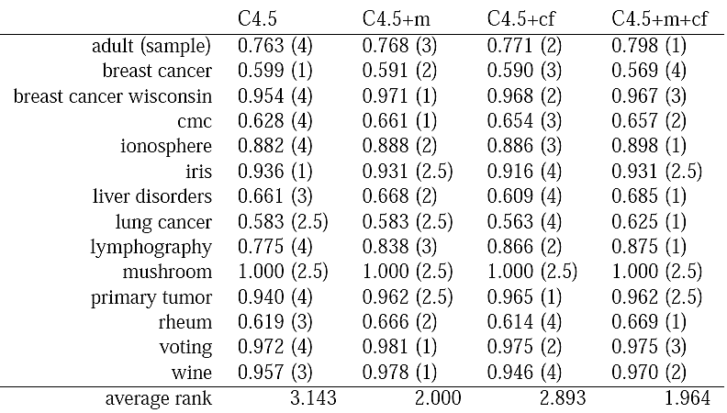


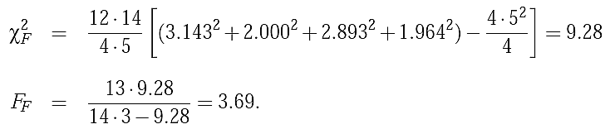
Friedman檢定

Slide 24
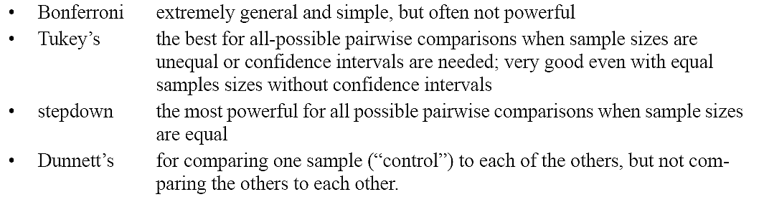
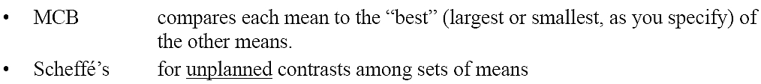
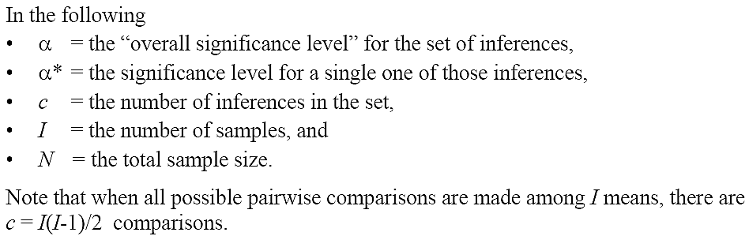
Overview of methods
http://www2.hawaii.edu/~taylor/z631/multcomp.pdf

Slide 25
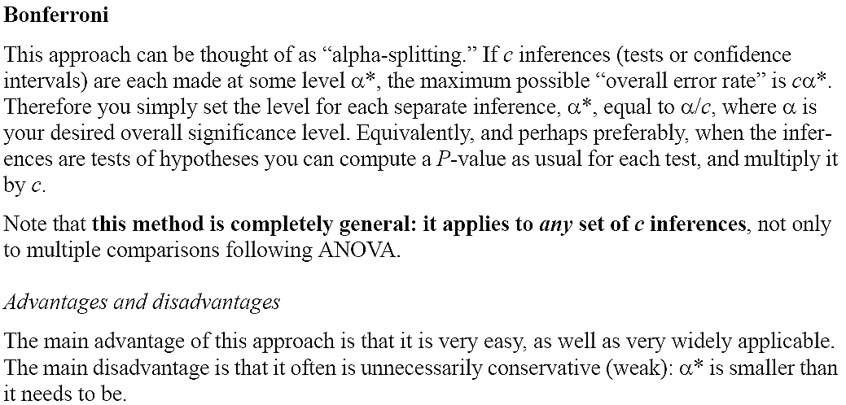
http://www2.hawaii.edu/~taylor/z631/multcomp.pdf

Slide 26
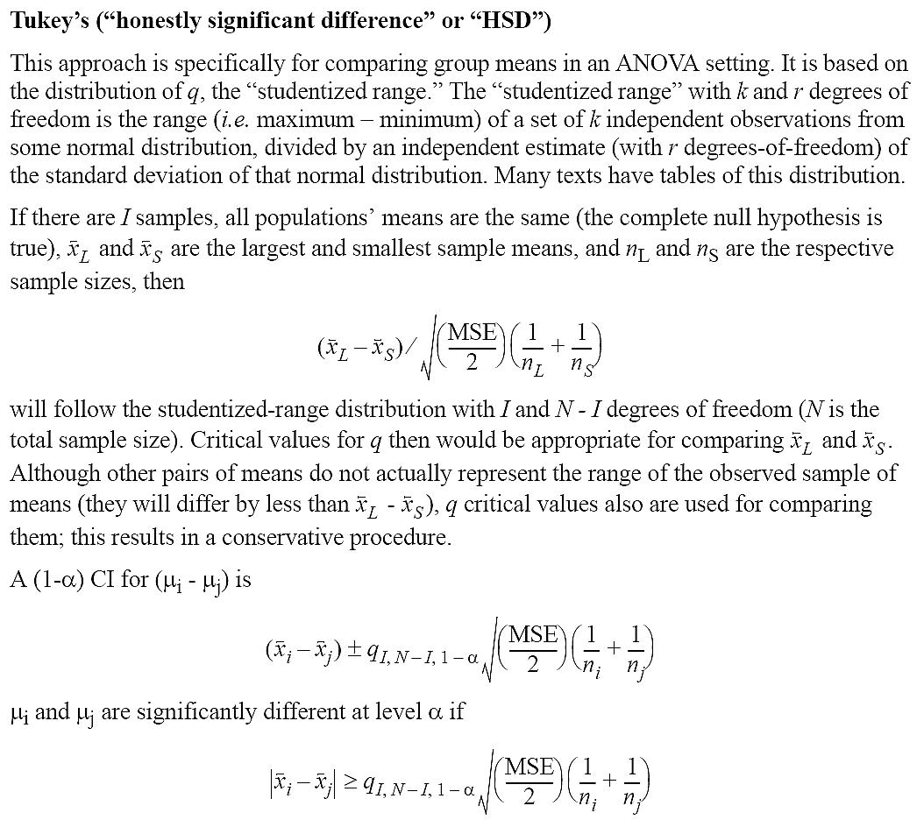
http://www2.hawaii.edu/~taylor/z631/multcomp.pdf

Slide 27
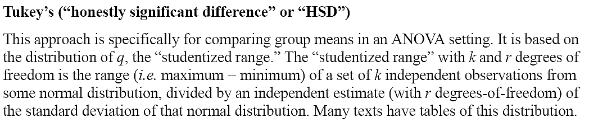
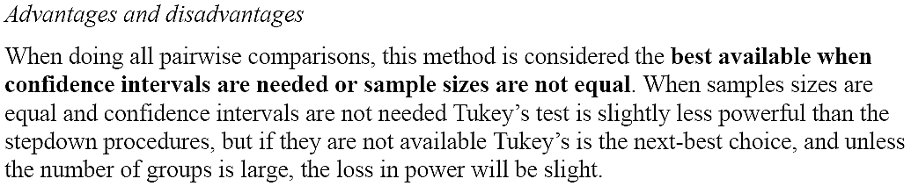
http://www2.hawaii.edu/~taylor/z631/multcomp.pdf

Slide 28
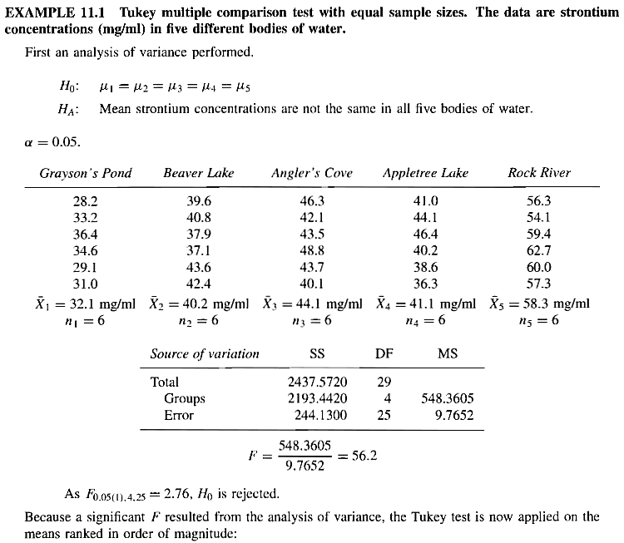
Zar, “Biostatistical analysis"

Slide 29

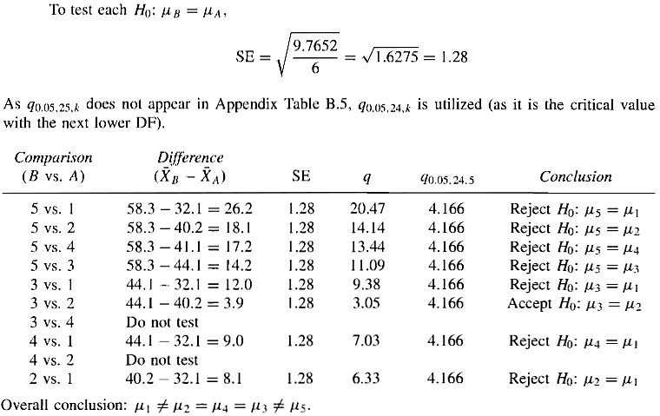

Zar, “Biostatistical analysis"

Slide 30
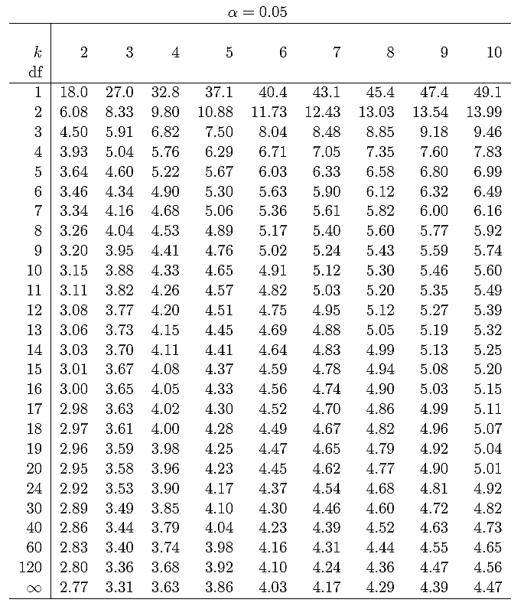

Slide 31
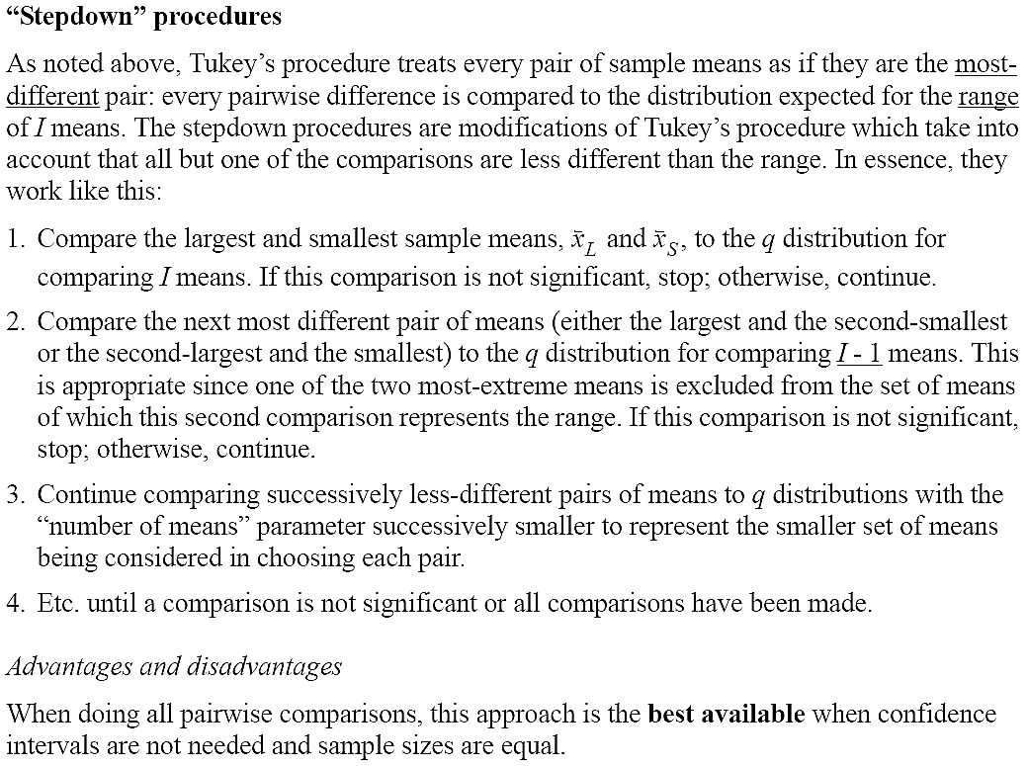
http://www2.hawaii.edu/~taylor/z631/multcomp.pdf

Slide 32
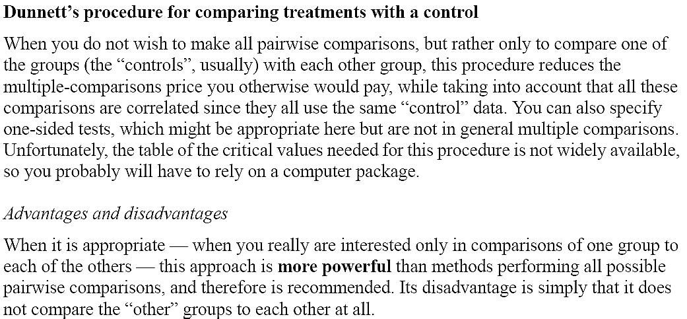
http://www2.hawaii.edu/~taylor/z631/multcomp.pdf

Slide 33
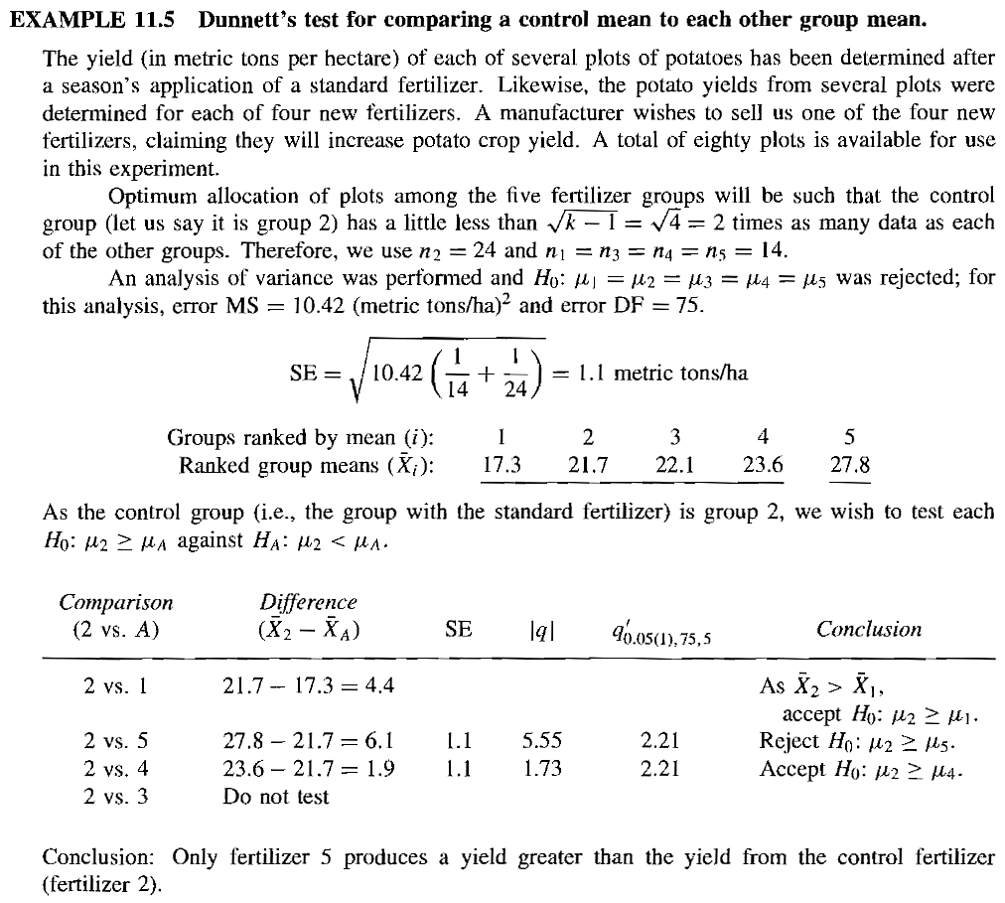
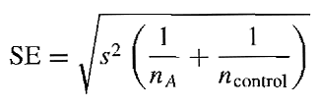

Zar, “Biostatistical analysis"

Slide 34
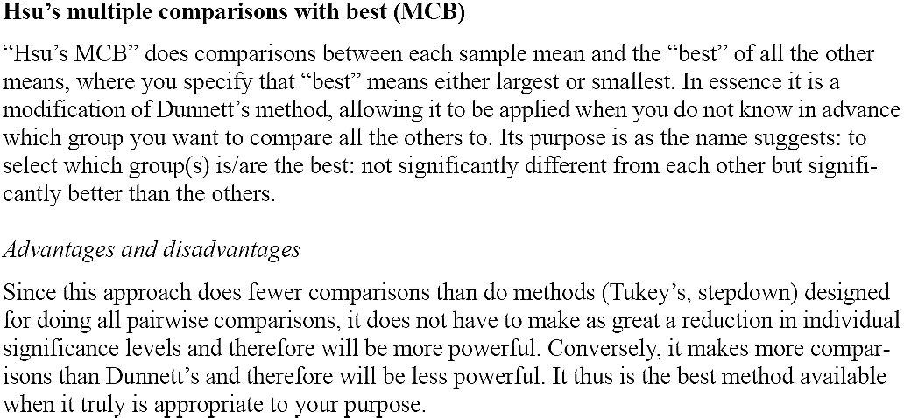
http://www2.hawaii.edu/~taylor/z631/multcomp.pdf

Slide 35
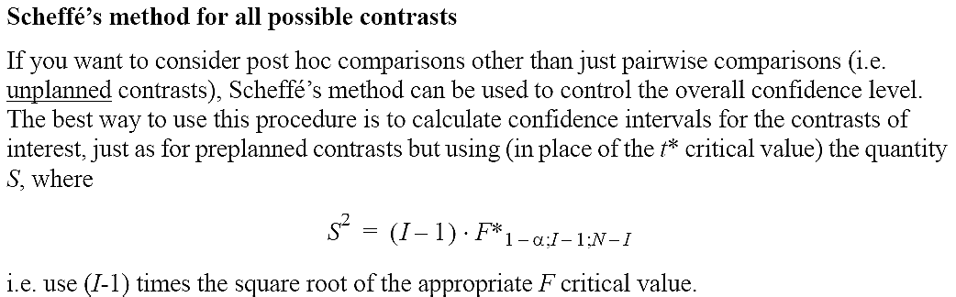
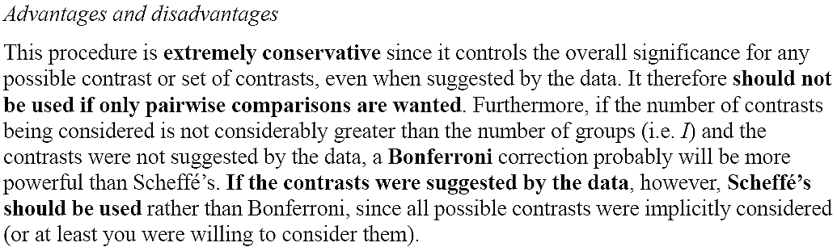
http://www2.hawaii.edu/~taylor/z631/multcomp.pdf

Slide 36
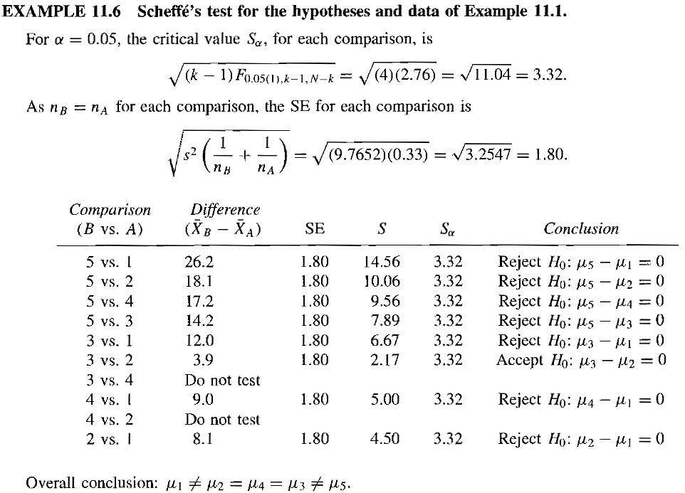



Zar, “Biostatistical analysis"

Slide 37
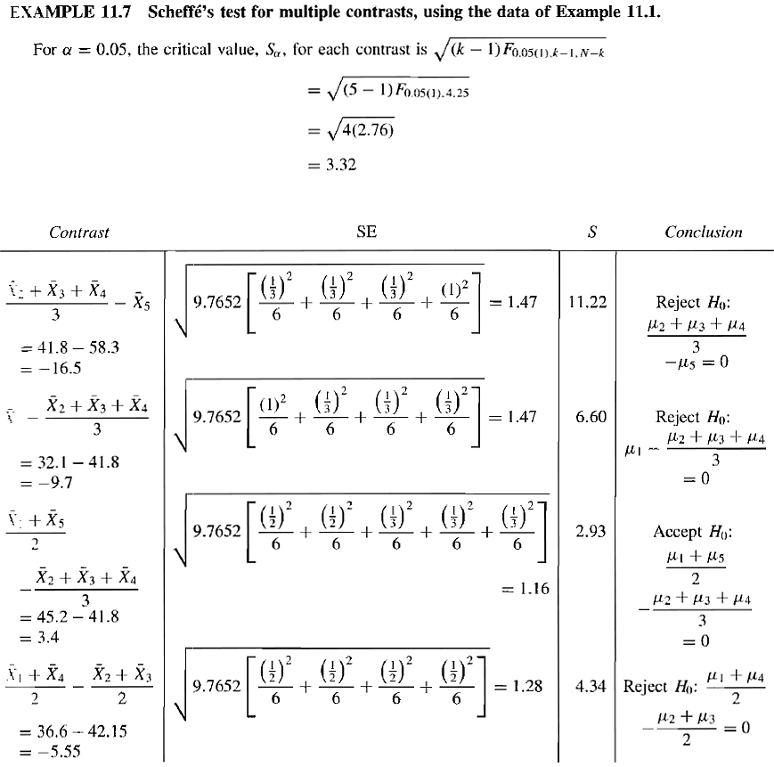
Zar, “Biostatistical analysis"

Slide 38
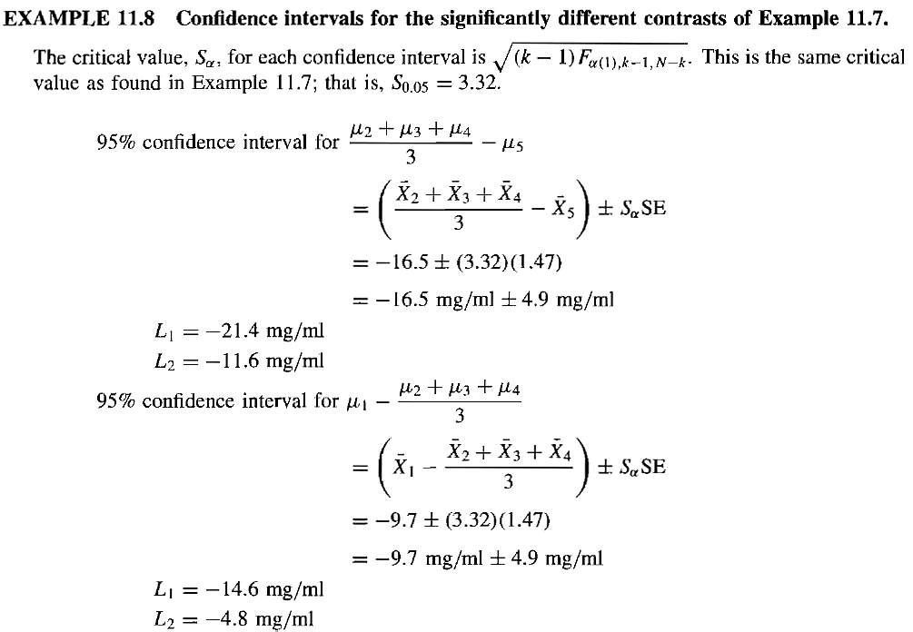

Zar, “Biostatistical analysis"

Slide 39
Case study in this paper
Data from that study were subjected to a factorial ANOVA focusing on two independent variables.
  adolescent girl/boys.
  conceptual level (cog): Low/Med/High
dependent variable
  metabolic control

Slide 40
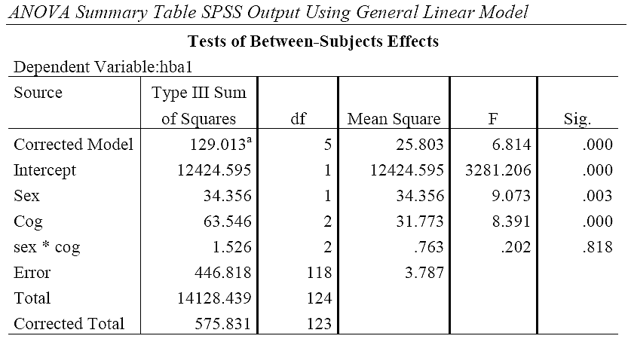
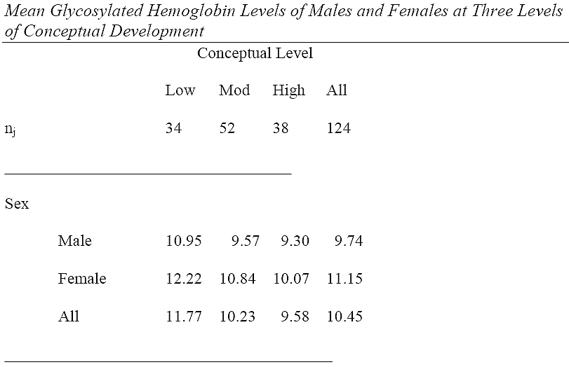

Slide 41
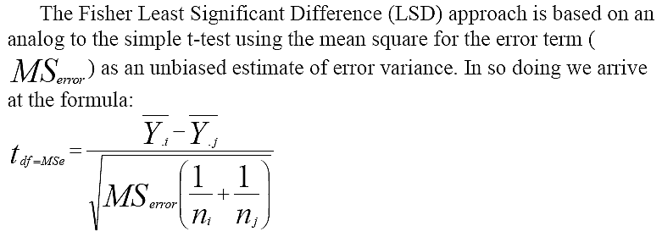
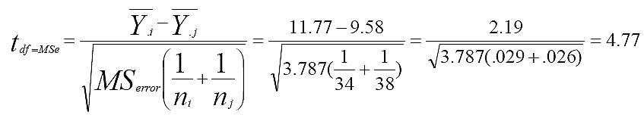
Fisher LSD
Being greater than the two-tail critical value (1.98) for a t-test with 118 degrees of freedom.

Slide 42

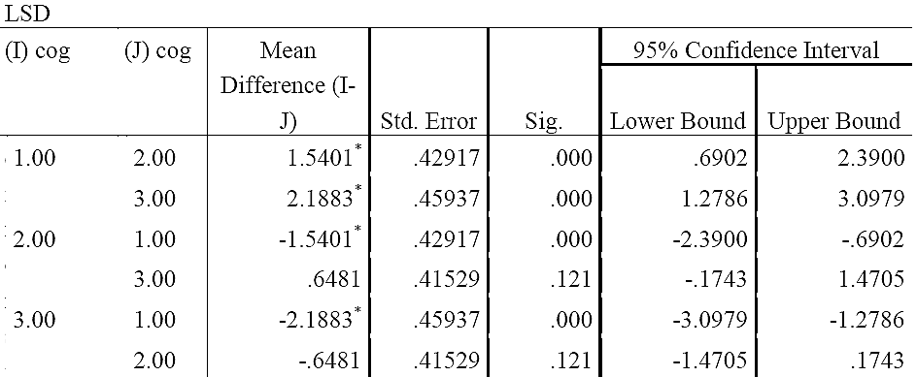
Fisher LSD for pairwise comparison
t_{1-α/2}=1.98

Slide 43
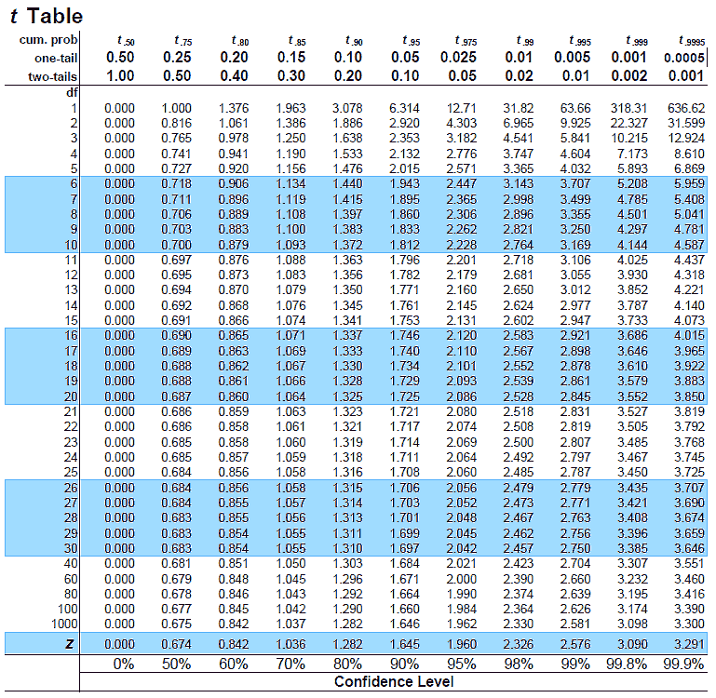
http://www.sjsu.edu/faculty/gerstman/StatPrimer/t-table.pdf

Slide 44

Tukey Honestly Significant Difference (HSD)

Slide 45




Tukey Honestly Significant Difference (HSD)
The critical values of 1-αQk,dfe are _{.05}Q_{3,120} = 3.36

Slide 46


Weighted Linear Contrasts
In more complex theoretical models, rather than rely on all pairwise comparisons, we prefer to use a finite set of “weighted” comparisons that are linked to an existing empirical context.

Slide 47

Weighted Linear Contrasts Example

Slide 48




Slide 49

Dunn confidence interval
the critical value for
Dunn α=.05 is 2.43

Slide 50


Scheffe test
The critical value for F_{2,118} is 3.087.
http://mat.iitm.ac.in/home/vetri/public_html/statistics/f-table.pdf

Slide 51

Discussion

Slide 52

子杰的必要蛋白質實驗
Essential proteins affect the cell life or functionality.
The protein-protein
interaction (PPI)
is associated with
the protein functions.

Slide 53
子杰的必要蛋白質實驗
輸入：4815 proteins
輸出： essential或nonessential
  須進行10次10-fold交叉驗證
#1 #2 #3 #4 #5 #6 #7 #8 #9 #10
CV1 1 2 1 1 2 2 2 1 2 1
CV2 1 1 1 1 2 2 2 1 2 2
CV3 2 2 1 2 1 2 1 1 2 1
CV4 1 2 1 2 2 2 1 1 1 2
CV5 2 1 2 2 1 1 2 2 1 1
CV6 2 2 1 1 1 2 2 1 1 2
CV7 1 1 2 1 2 2 1 2 1 2
CV8 2 1 2 2 2 1 1 1 2 1
CV9 1 2 1 2 2 1 1 2 1 2
CV10 1 2 1 2 2 1 1 1 2 2
10 proteins
10 2 fold CV
Notes:
id=1:10
kk=NULL
s0=rep(1,length(id))
for(i in 1:10){s=s0;s[sample(id,length(id)/2,replace=F)]=2;kk=rbind(kk,s)}
rownames(kk)=paste('CV',1:length(id),sep='')
colnames(kk)=paste('#',1:length(id),sep='')

Slide 54
特徵
Topological Properties
Protein Properties
Sequence Properties
Other Properties
Sequence Properties
Amino acid occurrence | 20
Average cysteine position | 1
Average cysteine distance | 1
Protein length | 1
Cysteine count | 1
Cysteine odd-even index | 1
Average hydrophobic | 1
Average hydrophobic around cysteine | 4
Cysteine location | 5
Average amino acid PSSM | 20
Topological Properties
Degree | 6
Bottleneck | 1
Edge percolated component | 1
Maximum neighborhood component | 1
Density of maximum neighborhood component | 1
Neighbors’ intra-degree | 1
Betweenness centrality | 4
Closeness centrality | 1
Clustering coefficient | 1
Clique level | 1
Double screening scheme | 1
Other Properties
Essential index | 1
Common function degree | 1
Open reading frames length | 1
Phyletic retention | 1
Identicalness | 1
Protein Properties
Cellular component | 5
Biological process | 6
115/11/07

Slide 55

效能指標
Predicted T
Predicted F
Actual T
TP
FN
Actual F
FP
TN

Slide 56
Bootstrap CV (BCV)
10 proteins
10 2 fold CV
10 proteins
10 2 fold bootstrap CV
#1 #2 #3 #4 #5 #6 #7 #8 #9 #10
CV1 1 2 1 1 2 2 2 1 2 1
CV2 1 1 1 1 2 2 2 1 2 2
CV3 2 2 1 2 1 2 1 1 2 1
CV4 1 2 1 2 2 2 1 1 1 2
CV5 2 1 2 2 1 1 2 2 1 1
CV6 2 2 1 1 1 2 2 1 1 2
CV7 1 1 2 1 2 2 1 2 1 2
CV8 2 1 2 2 2 1 1 1 2 1
CV9 1 2 1 2 2 1 1 2 1 2
CV10 1 2 1 2 2 1 1 1 2 2
Fold1 Fold1 Fold1 Fold1 Fold1 Fold2 Fold2 Fold2 Fold2 Fold2
CV1 #6 #2 #10 #2 #7 #1 #8 #8 #7 #5
CV2 #5 #5 #9 #4 #2 #6 #4 #2 #3 #6
CV3 #4 #6 #4 #7 #10 #10 #6 #2 #1 #1
CV4 #5 #3 #5 #2 #7 #1 #4 #1 #2 #2
CV5 #1 #6 #7 #1 #7 #7 #4 #10 #1 #5
CV6 #3 #8 #4 #6 #3 #9 #5 #5 #7 #2
CV7 #8 #2 #9 #1 #5 #6 #1 #6 #6 #10
CV8 #6 #2 #9 #6 #4 #8 #7 #7 #6 #2
CV9 #3 #7 #5 #6 #7 #2 #1 #6 #9 #7
CV10 #1 #10 #3 #5 #3 #7 #5 #9 #8 #3
Notes:
id=1:10
kk=NULL
s0=paste('#',id,sep='')
for(i in 1:10){s=c(sample(s0,length(id)/2,replace=T),sample(s0,length(id)/2,replace=T));kk=rbind(kk,s)}
rownames(kk)=paste('CV',1:length(id),sep='')
colnames(kk)=paste('Fold',rep(1:2,each=5),sep='')
Fold1 Fold1 Fold1 Fold1 Fold1 Fold2 Fold2 Fold2 Fold2 Fold2
CV1 "#6" "#2" "#10" "#2" "#7" "#1" "#8" "#8" "#7" "#5"
CV2 "#5" "#5" "#9" "#4" "#2" "#6" "#4" "#2" "#3" "#6"
CV3 "#4" "#6" "#4" "#7" "#10" "#10" "#6" "#2" "#1" "#1"
CV4 "#5" "#3" "#5" "#2" "#7" "#1" "#4" "#1" "#2" "#2"
CV5 "#1" "#6" "#7" "#1" "#7" "#7" "#4" "#10" "#1" "#5"
CV6 "#3" "#8" "#4" "#6" "#3" "#9" "#5" "#5" "#7" "#2"
CV7 "#8" "#2" "#9" "#1" "#5" "#6" "#1" "#6" "#6" "#10"
CV8 "#6" "#2" "#9" "#6" "#4" "#8" "#7" "#7" "#6" "#2"
CV9 "#3" "#7" "#5" "#6" "#7" "#2" "#1" "#6" "#9" "#7"
CV10 "#1" "#10" "#3" "#5" "#3" "#7" "#5" "#9" "#8" "#3" Fold1 Fold1 Fold1 Fold1 Fold1 Fold2 Fold2 Fold2 Fold2 Fold2
CV1 "#6" "#2" "#10" "#2" "#7" "#1" "#8" "#8" "#7" "#5"
CV2 "#5" "#5" "#9" "#4" "#2" "#6" "#4" "#2" "#3" "#6"
CV3 "#4" "#6" "#4" "#7" "#10" "#10" "#6" "#2" "#1" "#1"
CV4 "#5" "#3" "#5" "#2" "#7" "#1" "#4" "#1" "#2" "#2"
CV5 "#1" "#6" "#7" "#1" "#7" "#7" "#4" "#10" "#1" "#5"
CV6 "#3" "#8" "#4" "#6" "#3" "#9" "#5" "#5" "#7" "#2"
CV7 "#8" "#2" "#9" "#1" "#5" "#6" "#1" "#6" "#6" "#10"
CV8 "#6" "#2" "#9" "#6" "#4" "#8" "#7" "#7" "#6" "#2"
CV9 "#3" "#7" "#5" "#6" "#7" "#2" "#1" "#6" "#9" "#7"
CV10 "#1" "#10" "#3" "#5" "#3" "#7" "#5" "#9" "#8" "#3"

Slide 57


Sequential backward feature selection (SBFS)
Score: Accuracy

Slide 58

Score for SBFS
S: selected feature subset
P/R/F/M: precision/recall/F1/MCC
w_{P/R/F/M} : weights for precision/recall/F1/MCC
t: target feature #
u(k): unit step function, u(k)=1 if k>0, otherwise u(k)=0
e: punished score

Slide 59
Score for SBFS
S: selected feature subset = 15
P/R/F/M: precision/recall/F1/MCC = 0.5
w_{P/R/F/M} : weights for precision/recall/F1/MCC = 1
e: punished score = 0.1
if t=20 then C(S)=0.5*4-(20-15)*0=2
if t=10 then C(S)=0.5*4-(20-15)*0.1=1.5

Slide 60
Feature selection procedure
50% data
2 fold CV +
SBFS
5 fold CV
50% data
2 fold CV +
SBFS
5 fold CV
find best
5 fold CV
.
.
.
50% data
2 fold CV +
SBFS
5 fold CV

Slide 61


Slide 62
顯著性測試
Bootstrap
sampling
常態測試
Kolmogorov-Smirno test
for precision/recall/F1/MCC/AUC
200 BCV
變異數測試
Fold1 Fold1 Fold1 Fold1 Fold1 Fold2 Fold2 Fold2 Fold2 Fold2 ...
CV1 #6 #2 #10 #2 #7 #1 #8 #8 #7 #5
CV2 #5 #5 #9 #4 #2 #6 #4 #2 #3 #6
CV3 #4 #6 #4 #7 #10 #10 #6 #2 #1 #1
CV4 #5 #3 #5 #2 #7 #1 #4 #1 #2 #2
CV5 #1 #6 #7 #1 #7 #7 #4 #10 #1 #5
CV6 #3 #8 #4 #6 #3 #9 #5 #5 #7 #2
CV7 #8 #2 #9 #1 #5 #6 #1 #6 #6 #10
CV8 #6 #2 #9 #6 #4 #8 #7 #7 #6 #2
CV9 #3 #7 #5 #6 #7 #2 #1 #6 #9 #7
CV10 #1 #10 #3 #5 #3 #7 #5 #9 #8 #3
...
CV200
省略
變異數分析
ANOVA(組間差距是否明顯)
t檢定
以Hwang的結果為比較基礎

Slide 63

Kolmogorov-Smirno test

Slide 64


常態測試

Slide 65

10次10-fold交叉驗證
200次10-fold BCV
以Hwang的結果為比較基礎進行t檢定，較正統方法應該用Dunnett's test

Slide 66

以Hwang的結果為比較基礎進行t檢定，較正統方法應該用Dunnett's test

Slide 67


Slide 68

以Hwang的結果為比較基礎，+-僅代表是否勝出

Slide 69


Slide 70

Majority vote
Ludmila I. Kuncheva, "Combining Pattern Classifiers"

Slide 71

Majority vote
Ludmila I. Kuncheva, "Combining Pattern Classifiers"

Slide 72
Ensemble classifiers
Assume we have three independent but weak (better than randomly guessing) classifiers, each achieves a classification rate of 60%. The final output is obtained by a majority voting scheme.
The probability to make mistakes is:
  0.6*0.4*0.4 = 9.6%
  0.4*0.6*0.4 = 9.6%
  0.4*0.4*0.6 = 9.6%
  0.4*0.4*0.4 = 6.4%
The overall classification rate is: 1-3*9.6%-6.4% = 64.8%.
The analysis about majority vote can be obtained from
Ofer Matan, On Voting Ensembles of Classifiers, In Proceedings of AAAI-96 workshop on Integrating Multiple Learned Models

Slide 73

以Hwang的結果為比較基礎進行t檢定，較正統方法應該用Dunnett's test

Slide 74

以Hwang的結果為比較基礎進行t檢定，較正統方法應該用Dunnett's test

