Slide 1
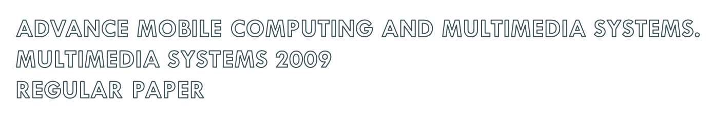
Voronoi-based reverse nearest neighbor query processing on spatial networks
Maytham Safar . Dariush Ibrahimi . David Taniar
Presenter: Bamfa Ceesay
VD-RNN
Notes:
VD-RNN

Slide 2

Abstract
Introduction
  Euclidean and Network distances.
  Incremental Network Expansion (INE)
  Voronoi Diagram (VD)
  Voronoi based network NN (VNN )
Network Voronoi Diagram
Network Voronoi Diagram Nearest Neighbor queries
Progressive Incremental Network Expansion
Voronoi Diagram Reverse Nearest Neighbor queries
Conclusion
VD-RNN

Slide 3

The use of Voronoi diagram has traditionally been applied to the computational geometry and multimedia problems. In this paper, we will show how Voronoi diagram can be applied to spatial query processing, and how in particular to Reverse Nearest neighbor (RNN) queries. Spatial and geographical query processing, in general, and RNN in particular, are becoming more important. We use the concept of Voronoi diagram and classify the RNN into four types depending on whether the query point and the interest objects are the generator point of the Voronoi polygon or not. We manipulated the properties of Network Voronoi Diagram and applied progressive incremental network expansion to find inner network distances of polygons required to solve RNN.
VD-RNN

Slide 4
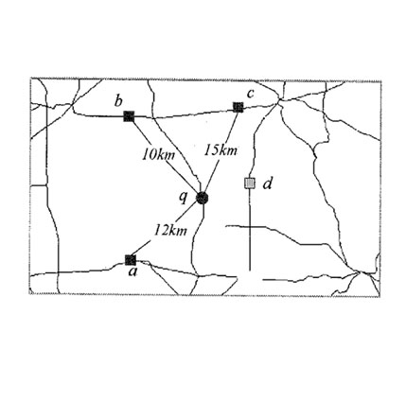
Euclidean Distance and Network distance
Definition (Spatial network databases)
In a spatial network database objects can move only on pre-defined trajectories as specified by the underlying network (representing e.g., roads,
railways, rivers, etc.)
The distance between two objects is the shortest trajectory between the two rather than the Euclidean distance
Example
  Query “Find the hotels within a 15km range” returns {a, b, c}
  Query “Find the closest hotel” returns {b}
    Euclidean nearest neighbor is d (which
is the farest in the network)
VD-RNN
Notes:
VD-RNN

Slide 5

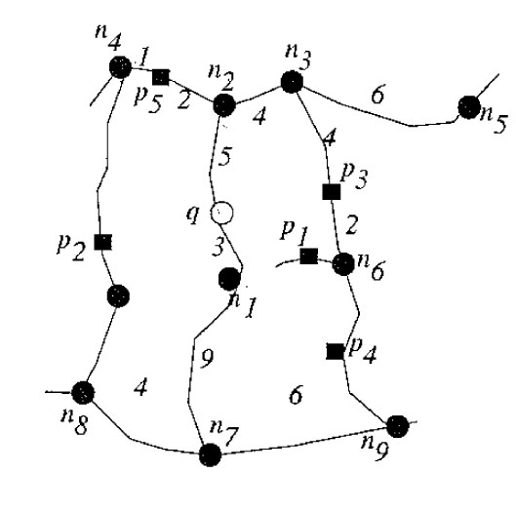
Performs network expansion starting from query point q and examines entities in the order they arrive. Nodes not yet explored are stored in a queue (Q), which is sorted according to the network distance from q.
VD-RNN

Slide 6

Example
Find the first interest object from q.
Locate the edges to (n₁, n₂) that covers q and add n₁ and n₂ to the queue; Q = {(n₁, 3), (n₂, 5)}.
Q = { (n₁, 3), (n₂, 5)}
VD-RNN
Notes:
VD-RNN

Slide 7
Example
Find the first interest object from q.
No entity is on (n1, n2), and the closest node n1; is expanded; Q = {(n₂, 5), (n₇, 12)}
No entity is on (n₁, n₇) and n₂ is expanded;
Q = {(n4, 7), (n3, 9) , (n7, 12). p₅ is discovered on (n2, n4) and d_{N}(q, p5) = 7 provides a bound to restrict the search space.
Q = { (n₁, 3), (n₂, 5)}
Q = {(n₂, 5), (n₇, 12)}
  Q = {(n₄, 8), (n₃, 9), (n₇,12)}
d_{N}(q, p5) = 7
VD-RNN
Notes:
VD-RNN

Slide 8
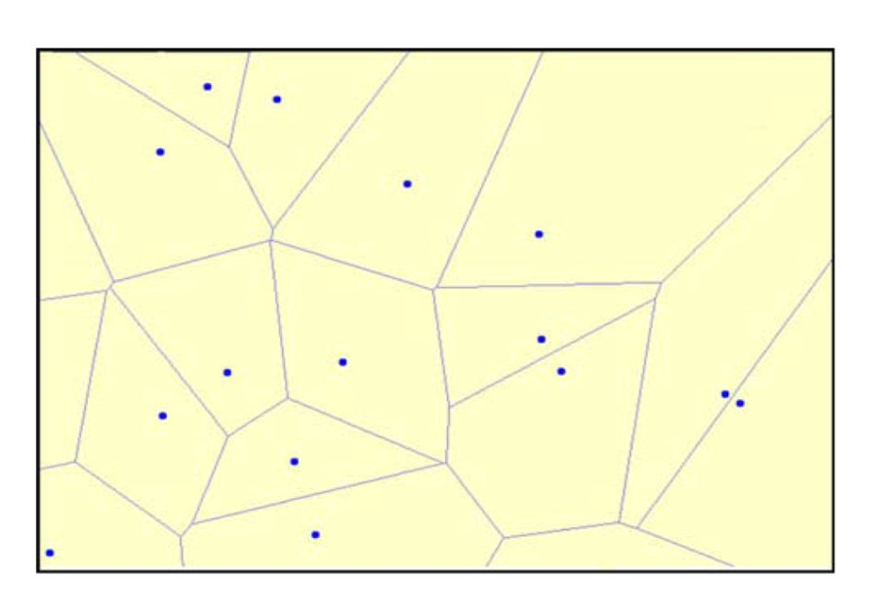
Voronoi diagram
  Voronoi Diagram (VD) of a point set P, VD(P), is a unique diagram that consist of a
set of collectively exhaustive and mutually exclusive Voronoi polygons VPs.
  Voronoi diagram has been use to solve spatial analysis problems.
Other Definitions:
  Generator point: a point in P that is the center of a Voronoi polygon.
  Voronoi edges : boundaries of Voronoi polygons. VE can be assigned to more
than one generator point.
  Adjacent polygons: VPs the share the same boundary.
Voronoi Diagram (VD))
VD-RNN
Notes:
VD-RNN

Slide 9
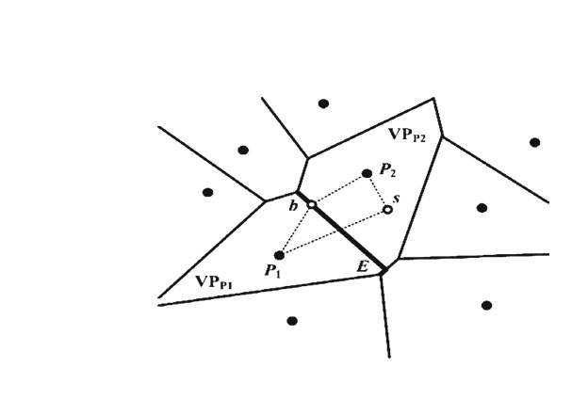
Definition :
  Given a set of discrete objects ℘ = (P1, P2, ..., Pn), n ∈ Integer I_{n}, in Cartesian space, the Voronoi polygon of Pi, VP(Pi), is a universal of points that satisfy: {∀p|d_{e}(p, P_{i}) ≤ d_{e}(p, P_{j})}, (i, j ∈ I_{n}, i _x0005_= j, P_{i}, P_{j} ∈ ℘)
The Voronoi diagram for ℘ is:
VD(℘) =⋃ VP(P_{i})
n
i=1
The function d_{e}(p, P_{i}) denotes the distance from point p to P_{i}, which can be
calculated by:
d_{e}(p, P_{i}) = ((x_{2p}− x_{2Pi} ) + (y_{2p}− y_{2Pi} ))
1/2
VD-RNN
Notes:
VD-RNN

Slide 10
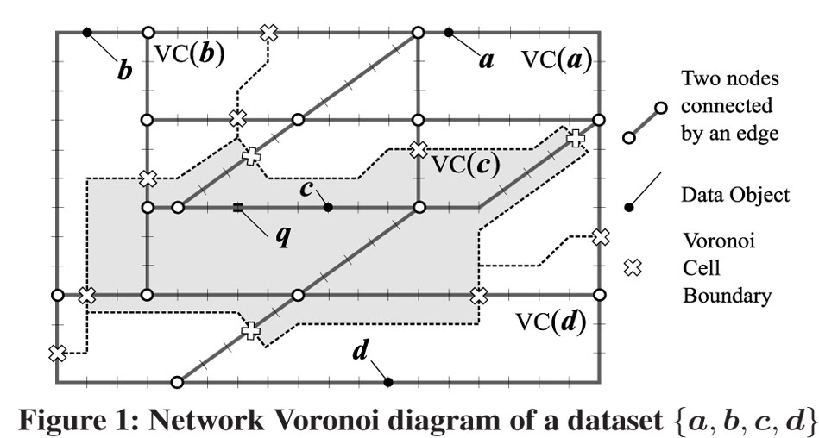
Network Voronoi Diagram
NVD is a special Voronoi diagram
Constructed on road networks involving a set of node and links rather than Euclidean plane
Essential in monitoring the nearest neighbor in respect to moving query point.
Objects: {a , b , c}
Voronoi Cell: { VC(a), VC(b), VC(c), VC(d) }
Query point: {q}
VD-RNN

Slide 11
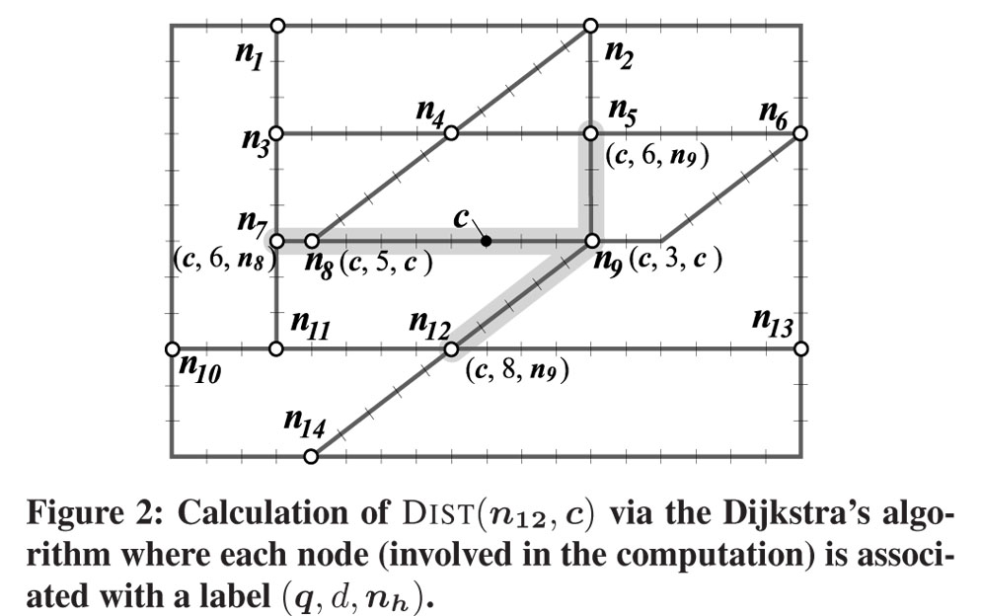
Preliminaries:
The Shortest path tree using INE in NVD.
  Example:
    Find the path (n₁₂ , c).
Notation:
(q , d ,n) where
  q= reference (query) point
  d=the shortest distance
  n=the node, d distance from q
VD-RNN

Slide 12
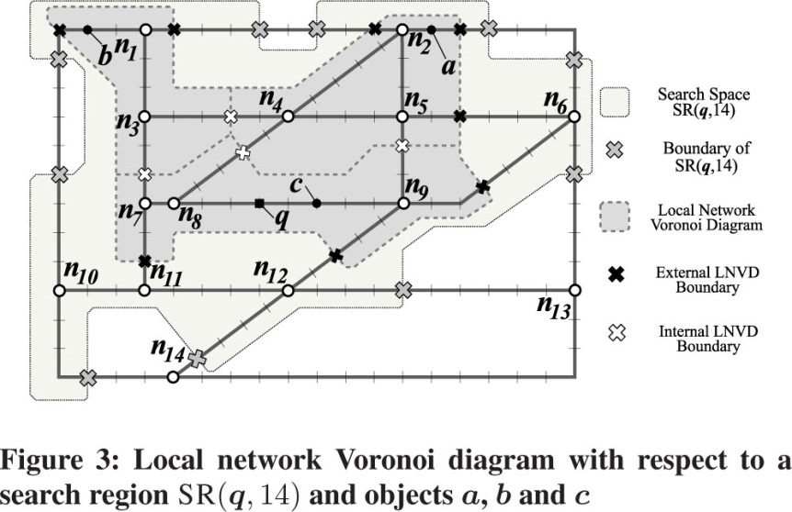
Network Voronoi Diagram Nearest Neighbor Queries
Example:
The search region within 14 units from query point q; SR(q,14).
VD-RNN

Slide 13

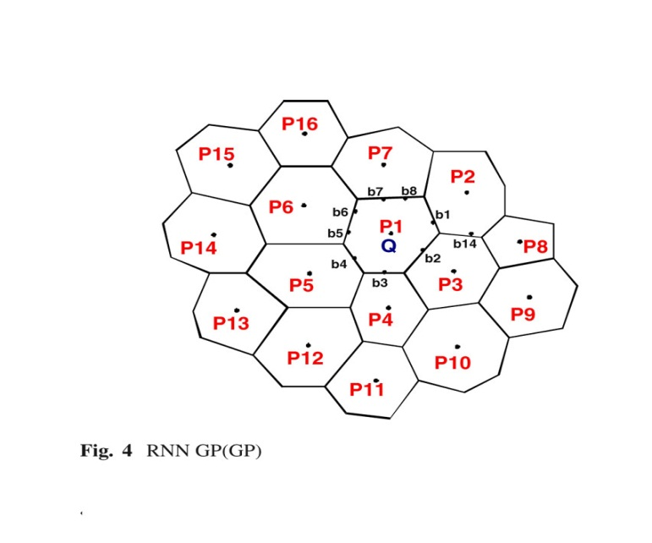
Given a query object q, find k nearest neighbor of q.
  Find the first NN of q in VC(q)
  From q, expand the network simultaneously on two different scales to:
    (i) compute q’s first NN (VC(q)’s center point) and the border points of . of VC(q).
      An INE starting from q is performed within VC(q).
    (ii) expand to objects at the center of adjacent Voronoi cells
      Unlike INE, we use pre-computed inter-cell
      distance from q to objects in the adjacent
      VCs of VC(q).
VD-RNN

Slide 14
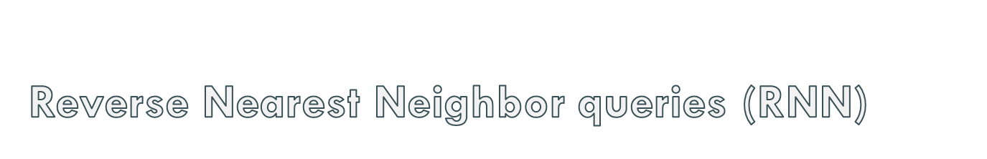
Definition1:
RNN is a query to retrieve the interest object that consider the query point as its nearest neighbor
Definition 2:
  generator point (GP), is the center point of VC
  query Object(qObj), is the point where the query is invoked.
  interest Object (iObj), is the candidate object for the query point
  reverse Object(rObj), is an interest object that is the same as query object
Notation:
  Example:
  RNN_{qObj(iObj)} , an RNN query for iObj from qObj.
VD-RNN

Slide 15
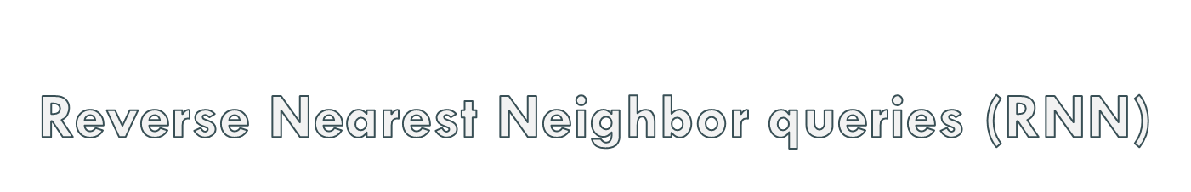
Notations:
  RNN_{x}(y)
    x=query point
    (y)=interest object or the query point.
Types of RNN
  RNN_{GP}(GP)
  RNN_{GP}(~GP)
  RNN_{~GP}(~GP)
  RNN_{~GP}(GP)
VD-RNN

Slide 16
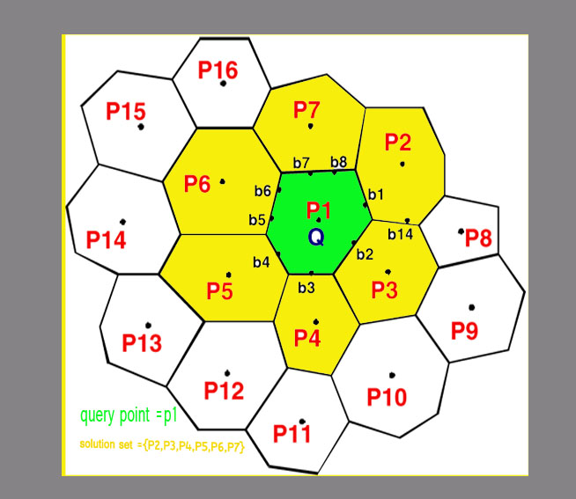
  RNN_{GP}(GP)
  Example:
    query point P1
    1NN query set {P2,P3,P4,P5,P6,P7}
  Assumption:
  for all bx :
  {dist(P1, b3)+(b3,P3)}<{dist(P1, bx)+dist(bx, Px)}
  Where Px is the adjacent VP of P1 with border point bx .
  Hence 1NN of Q=P3. let the distance be dist(Q, P3:10)
  Calculate the distance between adjacent polygons:
  Assumed that dist(P2, P7:18), dist(P2, P3:14), dist(P3, P4:8),
  And so on.
  If dist(Pi, Pj) < 1NN, then delete polygon Pi and Pj as
  candidate polygons. Delete(P3, P4).
  New candidate: {P2, P5, P6, P7}.
VD-RNN

Slide 17
  RNN_{GP}(~GP)
    If the interest objects are in the query polygon, then these interest objects are considered as the answer to the RNN query.
    If there exist no interest object in the query polygons, then there is no result for the query (an empty set solution).
VD-RNN

Slide 18
  RNN_{~GP}(~GP)
  Lemma:
    Let Q be a query point, n be node of a graph, and p a data point satisfying dist(q, n) >dist(p, n). For any point p’ ≠ p whose shortest path to Q passes through n, it holds that dist(Q , p’)>dist(p , p’).
    If dist(Q , p)<dist(p, n), stop expansion.
    Else if dist(Q , p)>dist(p, n), expansion
    from P stop and n is considered as 1NN
    of p and it can’t be the RNN of the query.
n
p
VD-RNN

Slide 19
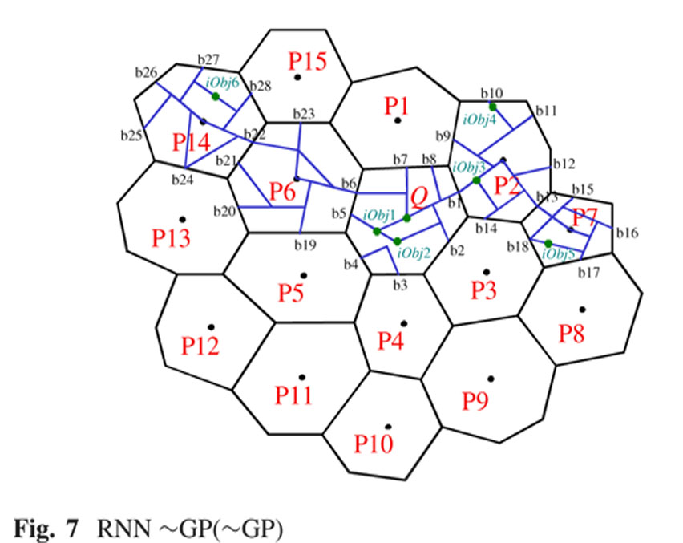
  RNN_{~GP}(~GP)
Objects reach from the query point:
  {iObj1, iObj2, b8, b7, b6, b2, b1}
Polygons with no interest points:
  {P1, P3, P4, P5,P6}
Let the locating stage and the distances of interest point from query be:
  {dist(Q, iObj1:12), dist(Q, iObj3:20), dist(Q, iObj6:35)}
VD-RNN

Slide 20

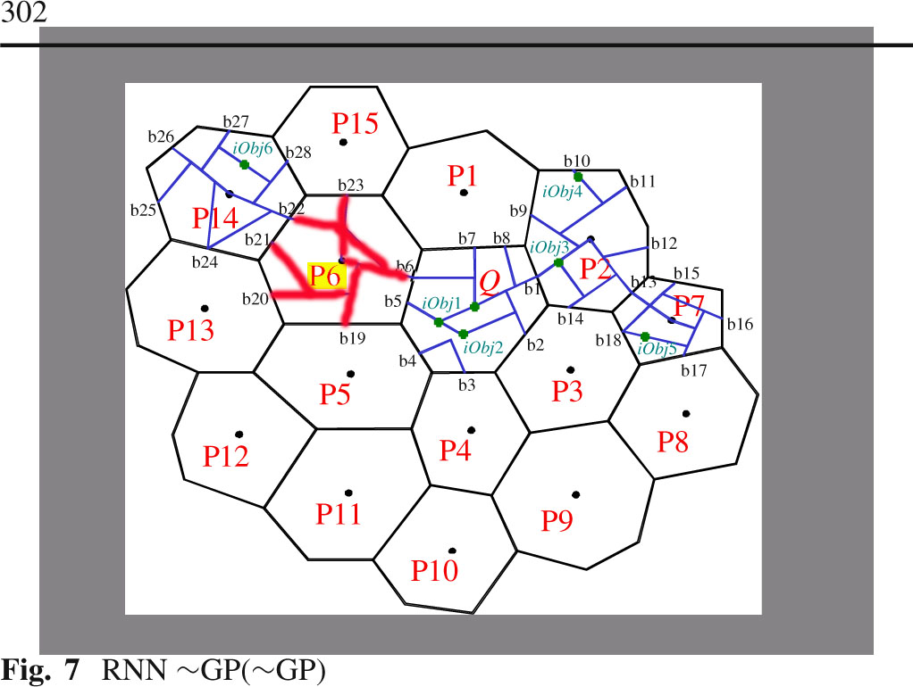
  RNN_{~GP}(~GP)
iObj1 find iObj2 and the expansion
stop. The query point is not 1NN.
Expansion to iObj5 and iObj4 goes
a longer distance before finding
any interest point. iObj3 is the 1NN
iObj6 expand to find the distance to
the polygon border points. Assuming
that the search to any direction yield
a distance greater the initial heap
value dist(Q, iObj6). This will result to
no 1NN.
The final result for our 1NN query will be
iObj3.
VD-RNN

Slide 21

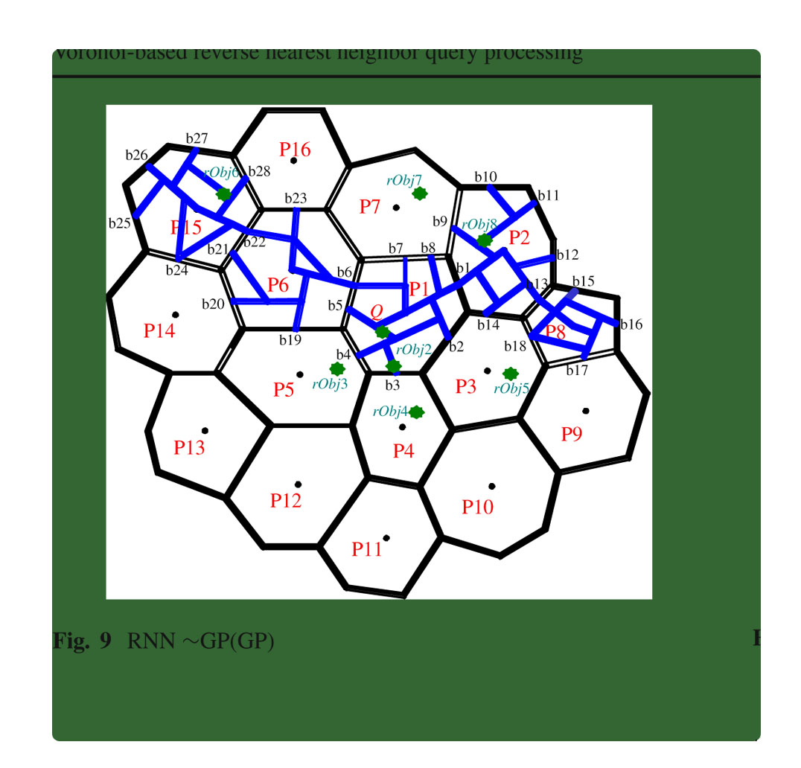
  RNN_{~GP}(GP)
    Form Q, initiate a search
    for border points.
    End query after P1 is
    discovered, in the direction
    to P1.
    Expand to {b1, b2, b4,
    b5, b6, b7, and b8}
    Check the adjacent VPs
    for rival object, if rival
    Object is found, end Query
    along that path.
    P6 has no rObj, hence is
    a candidate. Expand the
    search from P6 to find rObjs,
    {P5 and P15}.
VD-RNN

Slide 22
  RNN_{~GP}(GP)
    P6 has no rObj, hence is
    a candidate. Expand the
    search from P6 to find rObjs,
    {P5 and P15}.
    Start new expansion from
    b19 and b22 to rObj3 and
    rObj6 respectively.
    If dist(P6,rObj3) and
    dist(P6, rObj6) >dist(Q, P6)
    End the search,
    Return P6 as the NN
VD-RNN

Slide 23

We have demonstrated an emerging application of Voronoi network in spatial query processing, particularly in RNN query processing. The approach presented in this paper is applied to road network using real distances, where as most existing work focused on euclidean distance. The paper represented four different types of RNN query and algorithms to process the queries such as INE, and PINE together with NVD.
VD-RNN

