Slide 1
A fuzzy guided genetic algorithm for operon prediction
E. Jacob, R. Sasikumar and K. N. R. Nair
Bioinformatics Vol. 21 no. 8 2005, pages 1403–1407
Presenter: Yi-Pu Guo (M003040025)

Slide 2
Introduction
Operon (操縱組): 於原核生物
調節基因
起動子
操作子
構造基因
DNA
RNA 聚合酶
mRNA
蛋白質

Slide 3
Introduction
Operon (操縱組):
調節基因
起動子
操作子
構造基因
DNA
RNA 聚合酶
mRNA
蛋白質

Slide 4
Introduction
Operon prediction. Genetic algorithm + Fuzzy scoring functions

Slide 5
Scoring criteria
Intergenic distance
Participation in the same metabolic(代謝) pathway
Conservation(保留) across multiple genomes(基因組)
Similarity of protein functions

Slide 6
Genetic algorithm (GA)
Representation of potential solutions
Creation of an initial population
A fitness function to score the putative operons
Application of the genetic operators—selection, crossover and mutation to evolve the population

Slide 7
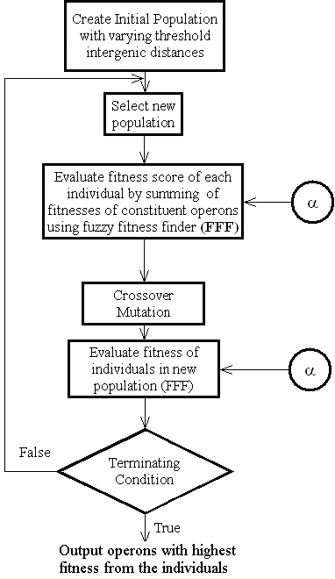
Block diagram of the genetic algorithm

Slide 8
Representation and initial population
Population
Individuals
Operon map
gene | b001 | b002 | b003 | b004 | b005 | b006 | b007 | b008
operon | 1 | 1 | 1 | 1 | 2 | 2 | 2 | 2 | …

Slide 9
The Fuzzy Fitness Finder (FFF)
The numerical values for the scores based on each criterion are then converted into fuzzy scores.
The fuzzy membership functions for the criteria have been fixed using nine triangular sets (V1, ... ,V9) where V1, V2, ... have linguistic interpretations like extremely low, very low, etc.
V1 V2 V3 V4 V5 V6 V7 V8 V9
numerical value

Slide 10
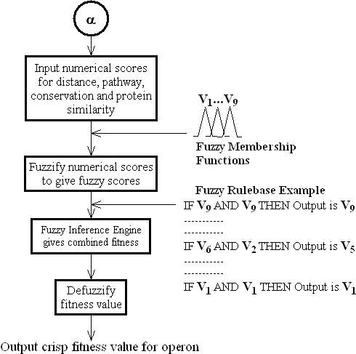
Block diagram of the FFF

Slide 11
The Fuzzy Fitness Finder (FFF)
The fuzzy scores for the different criteria are then combined to give a single score using a fuzzy inference engine.
The inference engine combines the scores two at a time. (for scalability)

Slide 12
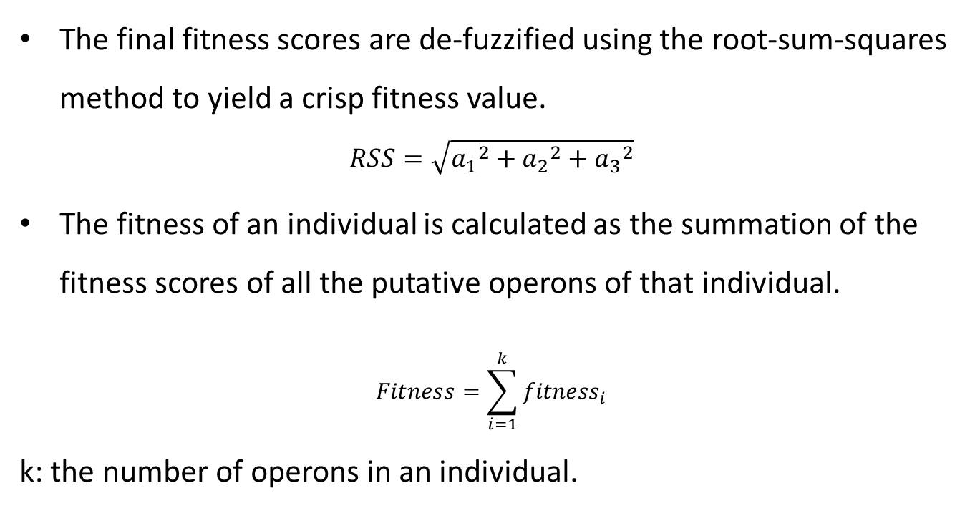
The Fuzzy Fitness Finder (FFF)
The final fitness scores are de-fuzzified using the root-sum-squares method to yield a crisp fitness value.
$$RSS=\sqrt{{a_{1}}^{2}+{a_{2}}^{2}+{a_{3}}^{2}}$$
The fitness of an individual is calculated as the summation of the fitness scores of all the putative operons of that individual.
$$Fitness=\sum_{i=1}^{k}{{fitness}_{i}}$$
k: the number of operons in an individual.

Slide 13
Results
True Positive | False Positive
False Negative | True Negative
True Positive Rate = TP/(TP+FN)
False Positive Rate = FP/FP+TN)
ROC Space (曲線下面積越大越準確)
RegulonDB (http://www.cifn.unam.mx/Computational_Genomics/regulondb)

Slide 14
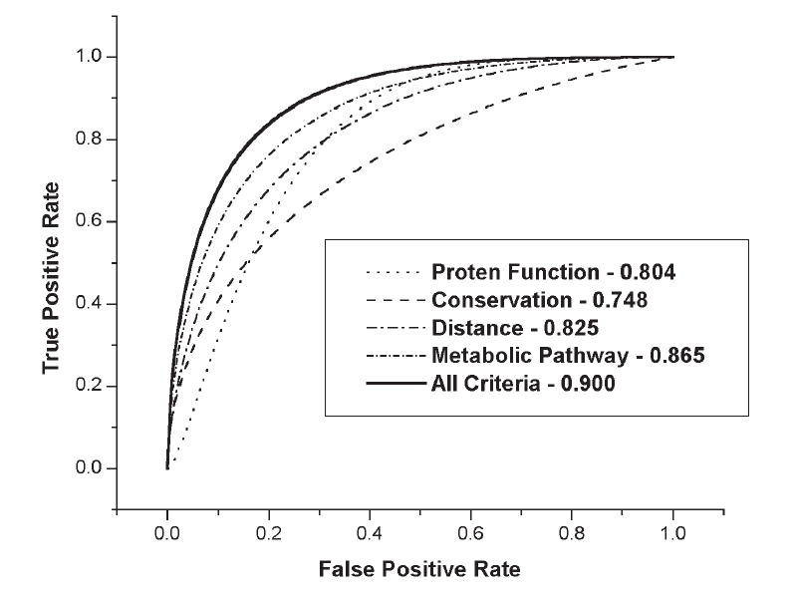
Results

Slide 15
Thanks for listening.

