Slide 1
Application of Lempel–Ziv factorization to the approximation of grammar-based compression
Wojciech Rytter
Theoretical Computer Science 302 (2003) 211 – 222
Presenter: Yi-Pu Guo
2012-08-07

Slide 2
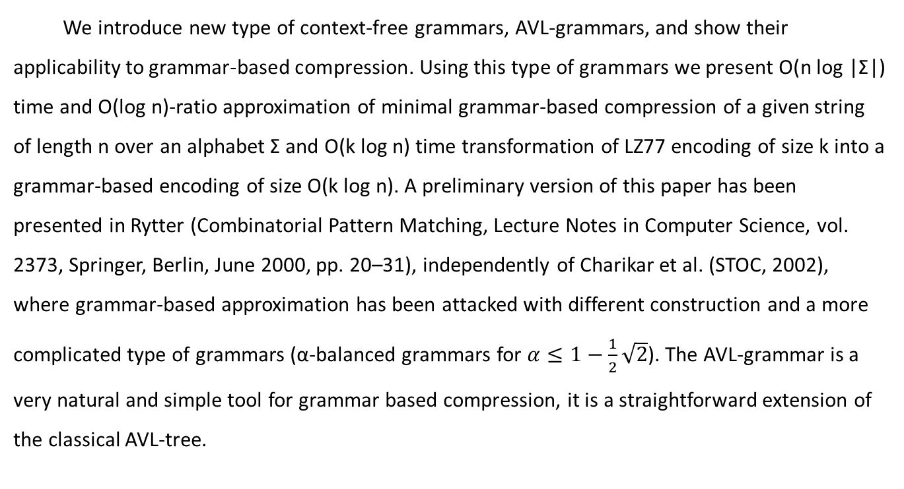
Abstract
We introduce new type of context-free grammars, AVL-grammars, and show their applicability to grammar-based compression. Using this type of grammars we present O(n log |Σ|) time and O(log n)-ratio approximation of minimal grammar-based compression of a given string of length n over an alphabet Σ and O(k log n) time transformation of LZ77 encoding of size k into a grammar-based encoding of size O(k log n). A preliminary version of this paper has been presented in Rytter (Combinatorial Pattern Matching, Lecture Notes in Computer Science, vol. 2373, Springer, Berlin, June 2000, pp. 20–31), independently of Charikar et al. (STOC, 2002), where grammar-based approximation has been attacked with different construction and a more complicated type of grammars (α-balanced grammars for $α≤1−\frac{1}{2}\sqrt{2}$). The AVL-grammar is a very natural and simple tool for grammar based compression, it is a straightforward extension of the classical AVL-tree.

Slide 3
LZ-factorizations
Consider a similar version of the LZ77 compression algorithm (called LZ1).
The subwords are called factors. “·” means concatenation (串接).
w = f₁·f₂·…·f_{k} f₁ = w[1], f_{i} is the longest prefix of f_{i}...f_{k} which occurs in f₁...f_{i-1}.
Ex: Fib₇ = abaababaabaab (n = 13) f₁·f₂·f₃·f₄·f₅·f₆ = a b a aba baaba ab

Slide 4
Grammar-based factorizations
A grammar (straight-line program) is a sequence of assignment statements.
Ex: Fib₇ = abaababaabaab (n = 13)
X₇ = X₆ · X₅; X₆ = X₅ · X₄; X₅ = X₄ · X₃; X₄ = X₃ · X₂;
X₃ = X₂ · X₁; X₂ = a; X₁ = b;
X_{i} can be a single (terminal) symbol, or X_{j} ·X_{k} (for some j,k < i).
The problem of finding the smallest size grammar generating a given text is NP-complete.

Slide 5
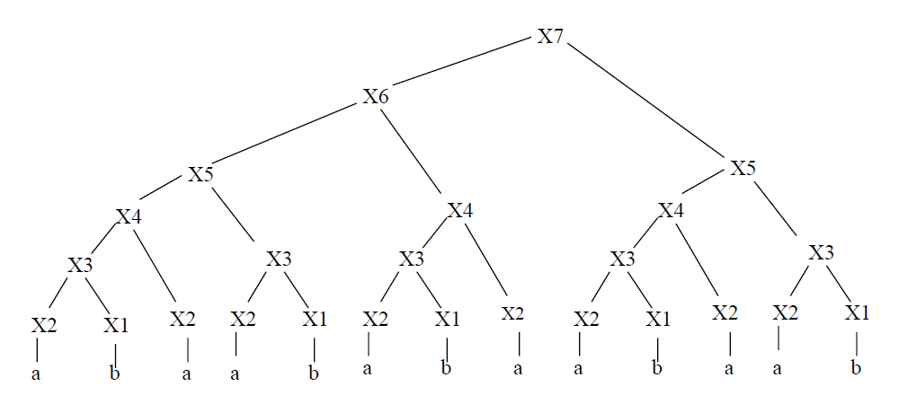

Slide 6
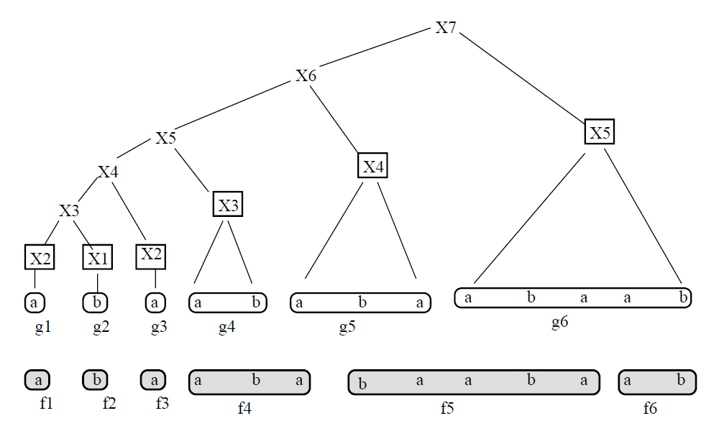

Slide 7
In this paper
O(n log |Σ|) time and O(log n)-ratio approximation of minimal grammar-based compression of a given string of length n over an alphabet Σ.
O(k log n) time transformation of LZ77 encoding of size k into a grammar-based encoding of size O(k log n).

Slide 8
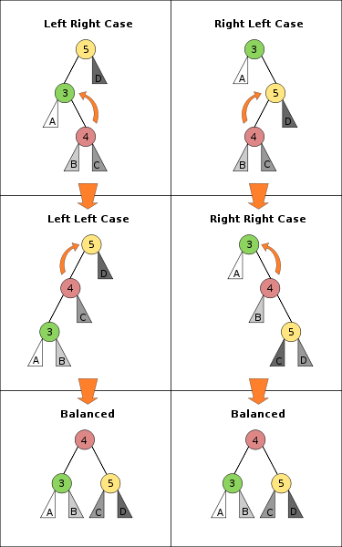
AVL Tree
-2
3
5

Slide 9
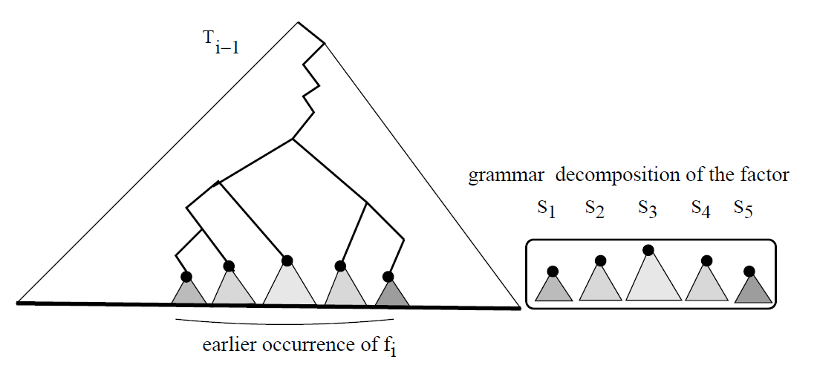
AVL-grammar
We have an LZ-factorization f₁f₂...f_{k} of w.
If f_{i} is a terminal symbol generated by a nonterminal A, G = Cancat(G,A).
Otherwise, we can find a logarithmic number of nonterminals S₁, S₂, ..., S_{t(i)} of G such that f_{i} =val(S₁)·val(S₂)·...·val(S_{t(i)}).

Slide 10
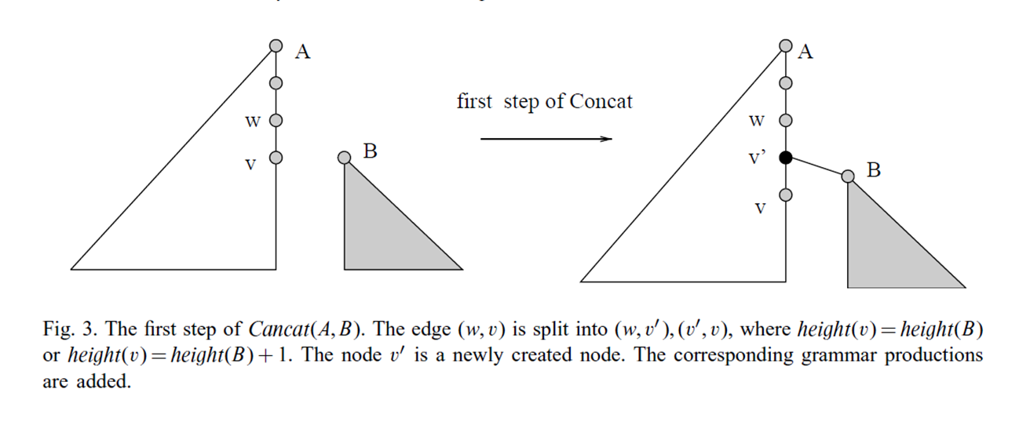
AVL Grammar
Lemma 2. Assume A, B are two nonterminals of AVL-balanced grammars. Then we can construct in O(|height(A) − height(B)|) time a AVL-balanced grammar G = Cancat(A, B), where val(G)=val(A)·val(B), by adding only O(|height(A)−height(B)|) nonterminals.

Slide 11
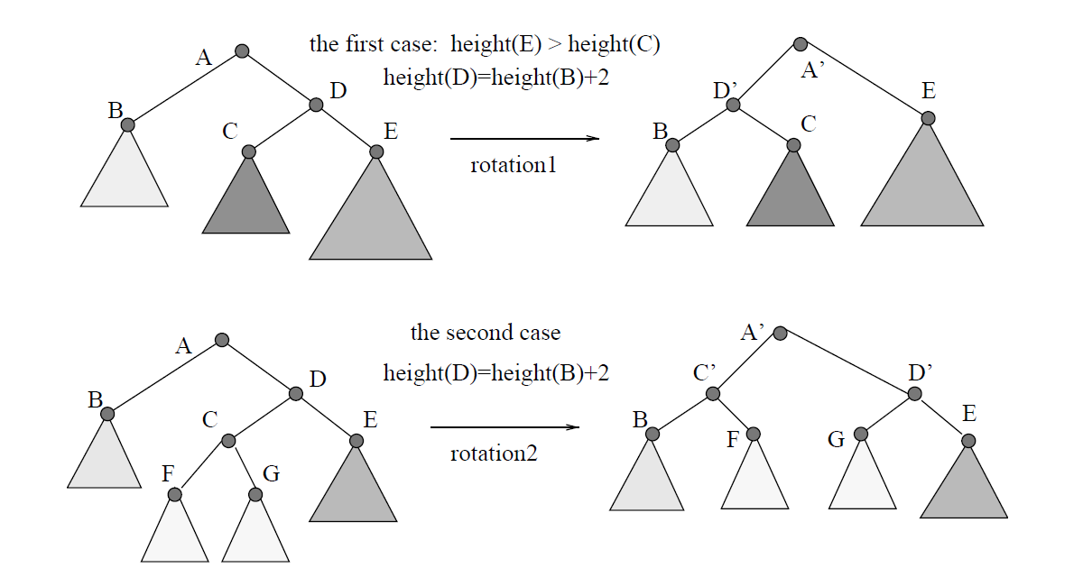

Slide 12
Remark
The grammars are easier to deal then LZ-encodings, particularly in compressed pattern-matching.
Another useful feature of our grammars is their logarithmic height (an alternative algorithm for balancing grammars).

