Slide 1
Identification of hot regions in protein-protein interactions by sequential pattern mining
Chen-Ming Hsu(許振銘), Chien-Yu Chen(陳倩瑜), Baw-Jhiune Liu(劉寶鈞), Chih-Chang Huang, Min-Hung Laio(廖敏宏), Chien-Chieh Lin(林千捷), and Tzung-Lin Wu
BMC Bioinformatics. 2007
Presenter: Che-Jui Hsu(許哲睿)
Date: 2012/08/15

Slide 2
Abstract (1)
Background: Identification of protein interacting sites is an important task in computational molecular biology. As more and more protein sequences are deposited without available structural information, it is strongly desirable to predict protein binding regions by their sequences alone. This paper presents a pattern mining approach to tackle this problem. It is observed that a functional region of protein structures usually consists of several peptide segments linked with large wildcard regions. Thus, the proposed mining technology considers large irregular gaps when growing patterns, in order to find the residues that are simultaneously conserved but largely separated on the sequences. A derived pattern is called a cluster-like pattern since the discovered conserved residues are always grouped into several blocks, which each corresponds to a local conserved region on the protein sequence.

Slide 3
Abstract (2)
Results: The experiments conducted in this work demonstrate that the derived long patterns automatically discover the important residues that form one or several hot regions of protein-protein interactions. The methodology is evaluated by conducting experiments on the web server MAGIIC-PRO based on a well known benchmark containing 220 protein chains from 72 distinct complexes. Among the tested 218 proteins, there are 900 sequential blocks discovered, 4.25 blocks per protein chain on average. About 92% of the derived blocks are observed to be clustered in space with at least one of the other blocks, and about 66% of the blocks are found to be near the interface of protein-protein interactions. It is summarized that for about 83% of the tested proteins, at least two interacting blocks can be discovered by this approach.

Slide 4
Abstract (3)
Conclusion: This work aims to demonstrate that the important residues associated with the interface of protein-protein interactions may be automatically discovered by sequential pattern mining. The detected regions possess high conservation and thus are considered as the computational hot regions. This information would be useful to characterizing protein sequences, predicting protein function, finding potential partners, and facilitating protein docking for drug discovery.

Slide 5
Hot regions
Hot regions: The assemblies of the hot spots and its neighboring moderately conserved residues.
Hot spots: Using the alanine scanning mutagenesis, which estimates the energetic contribution of individual side-chains, it suggests that a small set of interface residues can contribute the most to the binding free energy.

Slide 6
MAGIIC 簡介
利用WildSpan演算法提高效能
WildSpan演算法：找出cluster-like patterns
實際執行由web server MAGIIC-PRO執行

Slide 7
intra-block gaps & inter-block gaps
Intra-block gaps: the gaps within a block.
Inter-block gaps: the gaps in between two sequential blocks.
Example: "I-x-H-N-x(52,68)-E-x(2)-L-x-K-L" contains two conserved blocks "I-x-H-N" and "E-x(2)-L-x-K".

Slide 8
cluster-like patterns
The maximum length of an intra-block gap: the length of intra-gap is rigid and cannot exceed the specified value.
The minimum number of residues in a block: a sequential block must contain at least a certain number of residues to eliminate noises.
The flexibility of an inter-block gap: a sequence can match a pattern as long as the inter-block gap does not violate the flexibility with respect to the query protein.
The minimum number of blocks in a pattern: a binding site is usually consisted of more than one protein segment. This constraint is set as 2 by default.
The minimum support of a pattern: the minimum percentage of sequences in the training data that match the derived pattern.

Slide 9
WildSpan algorithm
Generate the complete set of closed pattern blocks satisfying the block constraint and the intra-block gap constraint. (1, 2, 4)
Discover the complete set of closed long patterns satisfying the inter-block gap constraint by connecting frequent blocks found in the first phase with large irregular gaps. (3)

Slide 10
Mining procedures (1)
Obtaining homologues of a query protein
Executing pattern mining
  The minimum support is initially set as 100% and decreased repeatedly until at least one pattern with five blocks is discovered.
  A sequential block must contain as least three conserved residues, and the maximum length of an intra-block gap is 3.
  The mining process is terminated once the mining period exceeds four minutes in a single run.
  If no patterns with five blocks can be reported with the previous settings, MAGIIC-PRO is invoked iteratively with the constraint on minimum number of blocks relaxed by one at a time.

Slide 11
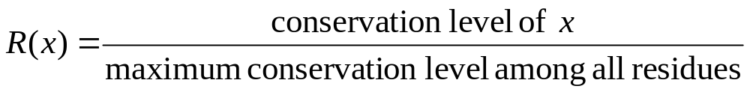
Mining procedures (2)
Emerging information from all the patterns with two or more blocks into one conservation plot
  The derived patterns are collected together to create a conservation plot.
  The conservation scores are represented in different colors. The color level of a residue x is defined as: L(x) = ceil(9 × R(x)).
  Conservation level: determined by the percentage of total number of supporting proteins merged from different patterns.

Slide 12
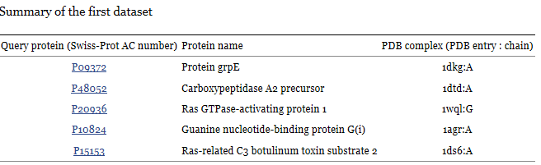
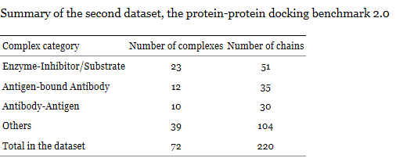
Experiments
First experiment: observed in every case that the hot regions can be revealed directly by the maximum-size pattern(the pattern with the most components).
Second experiment: investigate how the maximum-size pattern of each query protein performs in identifying protein interacting regions automatically.

Slide 13
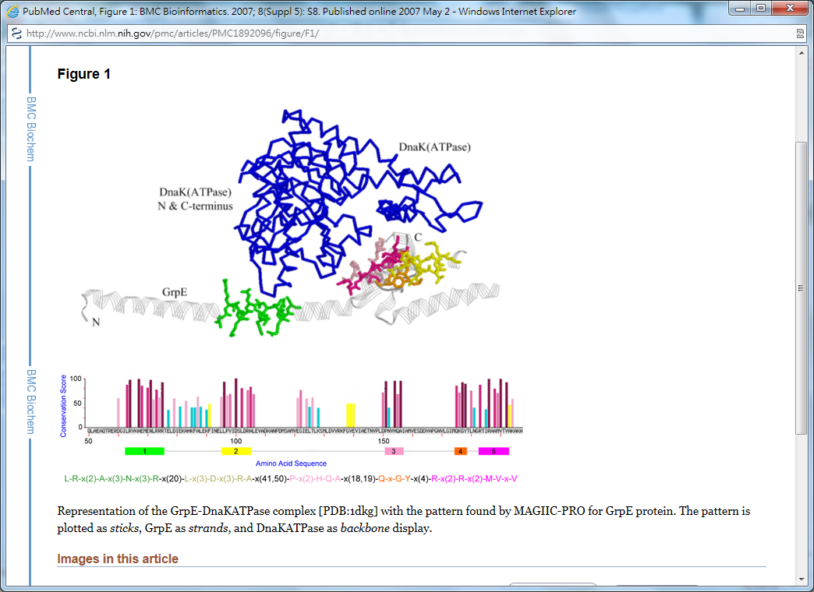
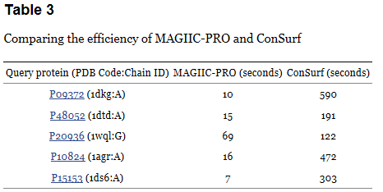
First experiment (1)

Slide 14
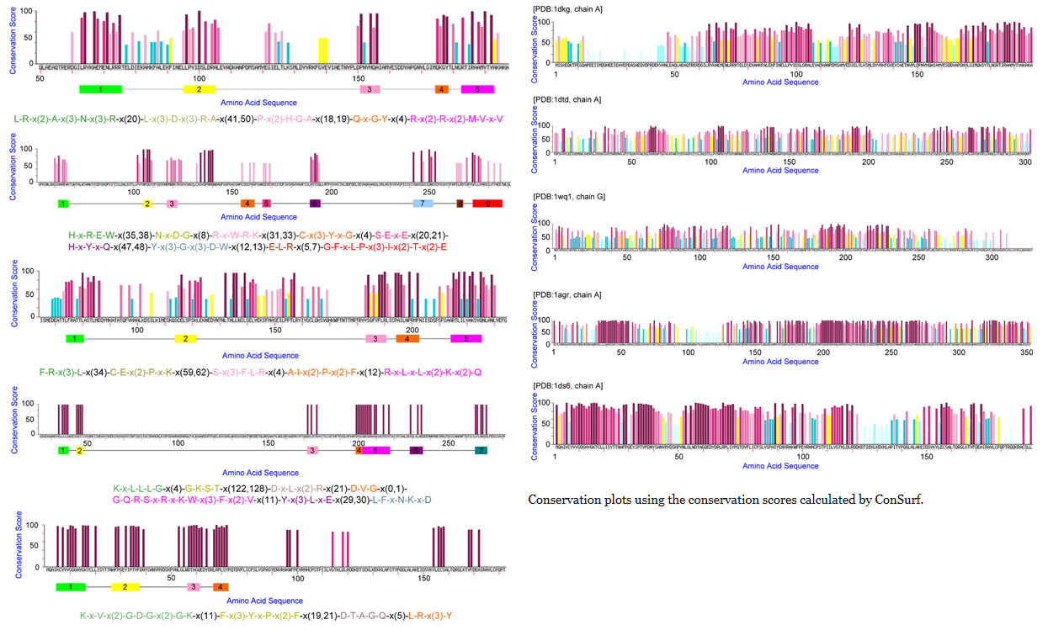
First experiment (2)

Slide 15
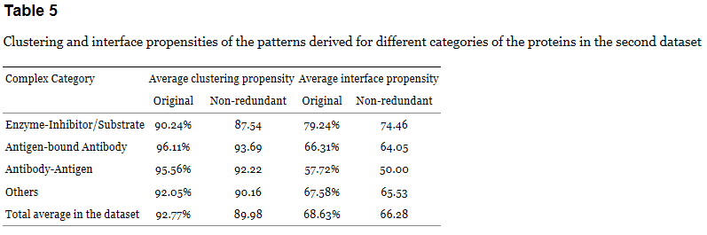
Second experiment (1)
Clustering propensity: the percentage of sequential blocks in a pattern P that interacts with at least one of the other blocks in P. The interaction between a pair of blocks is defined by the following criterion: there exists an atom from one block that is within 5 Å to an atom of the other block.
Interface propensity: the percentage of sequential blocks in a pattern P that contacts another protein chain in the complex. The definition of contact is that any of the atoms from the block is within 7 Å to any atom of another protein chain in the complex.

Slide 16
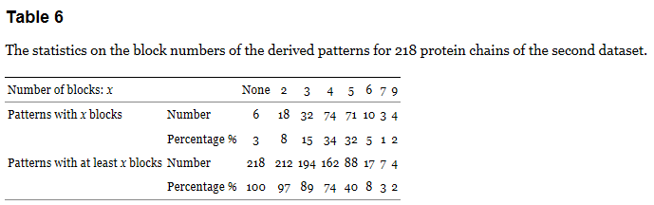
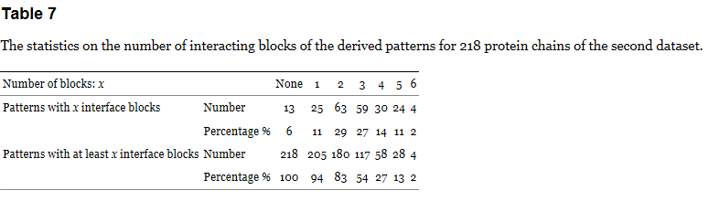
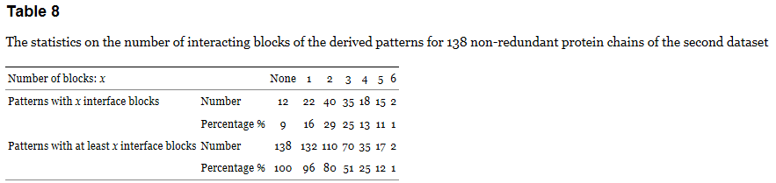
Second experiment (2)

