Slide 1
A Fast and Elitist Multiobjective Genetic Algorithm: NSGA-II
IEEE TRANSACTIONS ON EVOLUTIONARY COMPUTATION, VOL. 6, NO. 2, APRIL 2002
Kalyanmoy Deb, Associate Member, IEEE, Amrit Pratap, Sameer Agarwal, and T. Meyarivan
Presenter: Cheng Han Lee
Date:2012/08/15

Slide 2
Abstract
Multi-objective evolutionary algorithms (EAs) that use non-dominated sorting and sharing have been criticized mainly for their: 1) O(MN³) computational complexity 2) non-elitism approach; and 3) the need for specifying a sharing parameter. In this paper, we suggest a non-dominated sorting-based multi-objective EA (MOEA), called non-dominated sorting genetic algorithm II (NSGA-II), which alleviates all the above three difficulties. Specifically, a fast non-dominated sorting approach with O(MN²) computational complexity is presented.

Slide 3
Also, a selection operator is presented that creates a mating pool by combining the parent and offspring populations and selecting the best (with respect to fitness and spread) solutions. Simulation results on difficult test problems show that the proposed NSGA-II, in most problems, is able to find much better spread of solutions and better convergence near the true Pareto-optimal front compared to Pareto-archived evolution strategy and strength-Pareto EA—two other elitist MOEAs that pay special attention to creating a diverse Pareto-optimal front.

Slide 4
Moreover, we modify the definition of dominance in order to solve constrained multi-objective problems efficiently. Simulation results of the constrained NSGA-II on a number of test problems, including a five-objective seven-constraint nonlinear problem, are compared with another constrained multi-objective optimizer and much better performance of NSGA-II is observed.

Slide 5
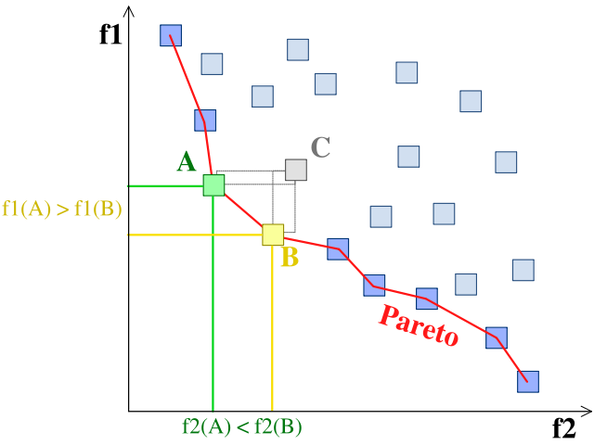
Pareto Front

Slide 6
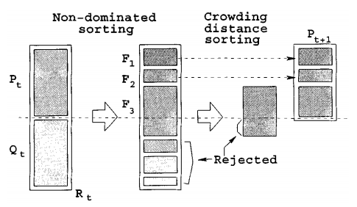
Main Loop
Sizeof(P_{t}) = Sizeof(Q_{t}) = population size
P_{t} is used for selection, crossover, and mutation to create a new population Q_{t}

Slide 7
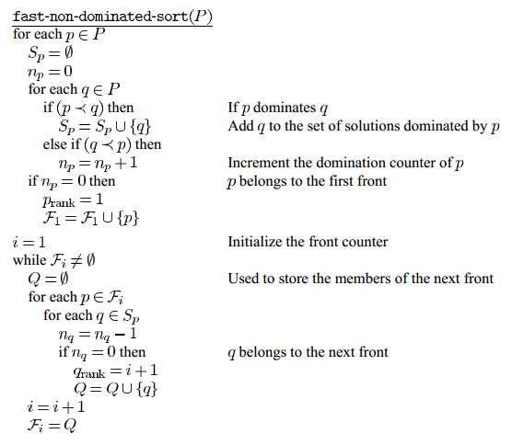
non-dominated sorting

Slide 8
Rank = 1

Slide 9
Rank = 2

Slide 10
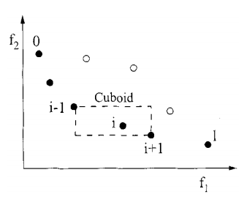
crowding-distance sorting
d_{i} = distance between p_{i-1} and p_{i+1}
The bigger the better

Slide 11
Simulation Results
Compare the performance of NSGA-II with PAES and SPEA.
Performance Measures
Distance
Diversity

Slide 12
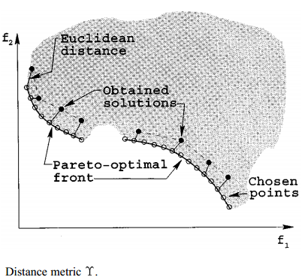

Slide 13
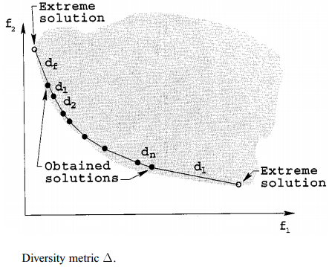


Slide 14
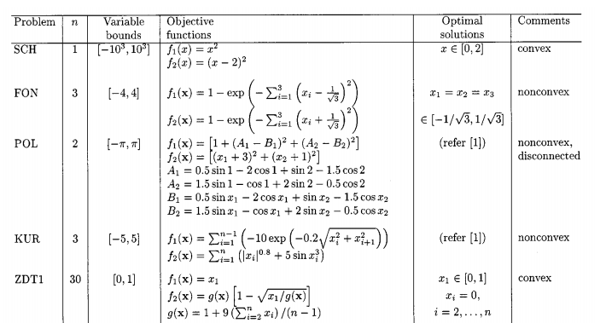
Test Problems

Slide 15
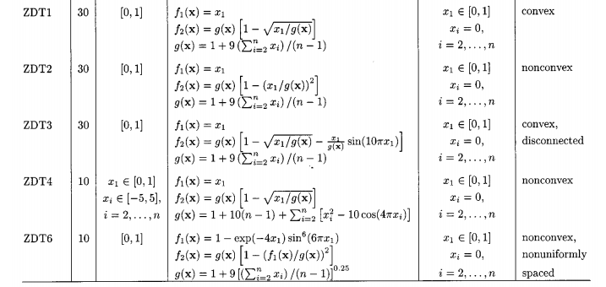

Slide 16
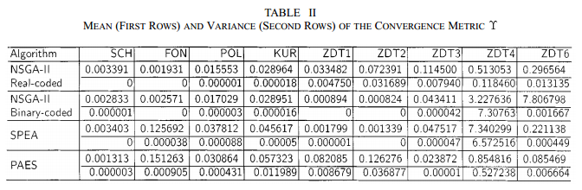

Slide 17
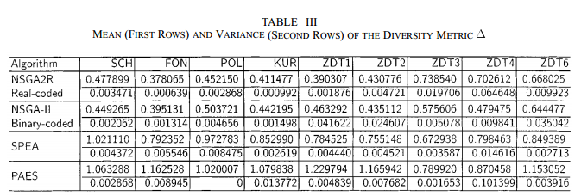

Slide 18
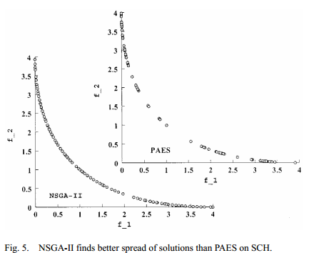

Slide 19
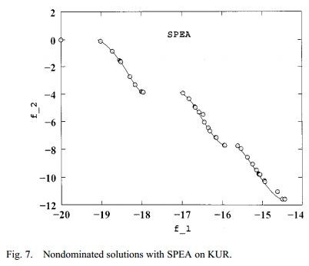
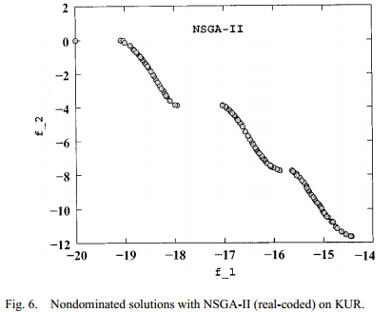

Slide 20
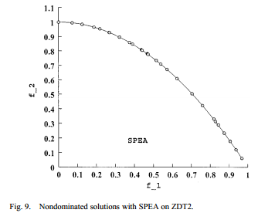
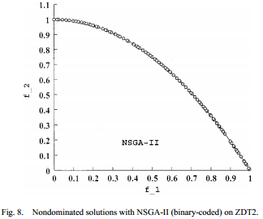

Slide 21
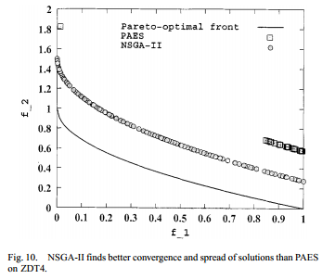
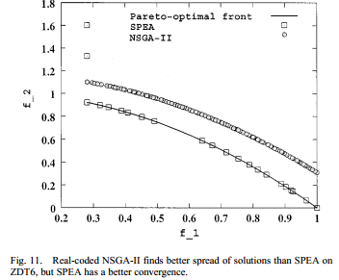

Slide 22
Constraint Handling
Solution i is feasible and solution j is not.
Solutions i and j are both infeasible, but solution has a smaller overall constraint violation.
Solutions i and j are feasible and solution dominates solution.

Slide 23
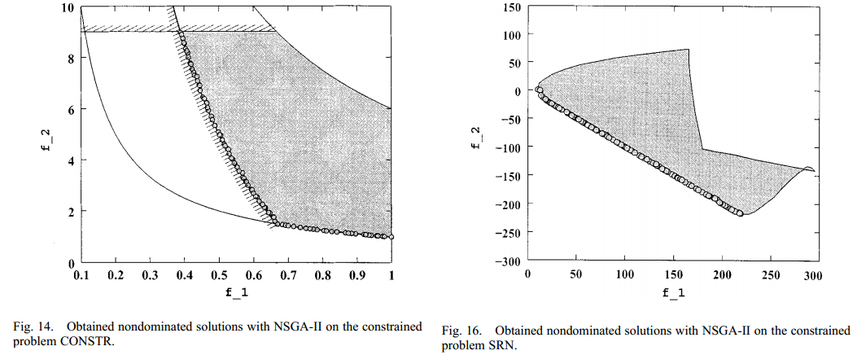

Slide 24
THE END

