Slide 1
All semi-local longest common subsequences in subquadratic time
Alexander Tiskin
Department of Computer Science, The University of Warwick
Lecture Notes in Computer Science, 2006, Volume 3967/2006, 352-363
Presenter: Yi-Pu Guo
2012-08-28

Slide 2
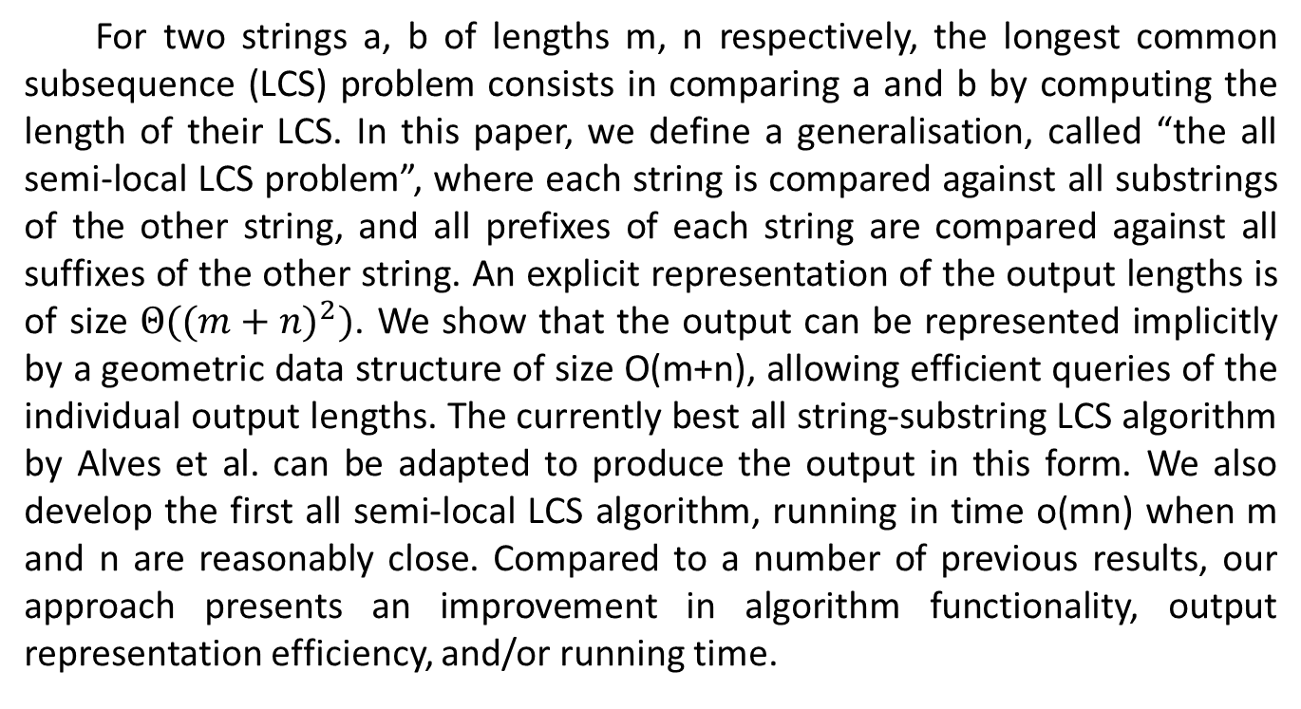
Abstract
For two strings a, b of lengths m, n respectively, the longest common subsequence (LCS) problem consists in comparing a and b by computing the length of their LCS. In this paper, we define a generalisation, called “the all semi-local LCS problem”, where each string is compared against all substrings of the other string, and all prefixes of each string are compared against all suffixes of the other string. An explicit representation of the output lengths is of size $Θ({(m+n)}^{2})$. We show that the output can be represented implicitly by a geometric data structure of size O(m+n), allowing efficient queries of the individual output lengths. The currently best all string-substring LCS algorithm by Alves et al. can be adapted to produce the output in this form. We also develop the first all semi-local LCS algorithm, running in time o(mn) when m and n are reasonably close. Compared to a number of previous results, our approach presents an improvement in algorithm functionality, output representation efficiency, and/or running time.

Slide 3
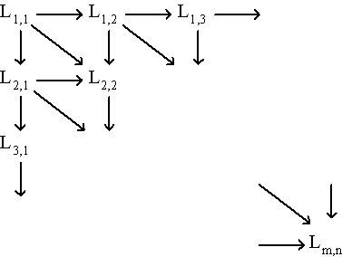
LCS (Longest Common Subsequence)
a = bacad
b = accbadcb
LCS = acad
能以 DP 方式求解：
(圖片摘自演算法課程之投影片)

Slide 4
Problem statement (1/2)
The all semi-local LCS problem: computing the LCS lengths on substrings of a and b as follows:
the all string-substring LCS problem: a against every substring of b
the all prefix-suffix LCS problem: every prefix of a against every suffix of b
the all substring-string LCS problem and
the all suffix-prefix LCS problem: (the roles of a and b exchanged.)
a
a
b
b

Slide 5
Problem statement (2/2)
The global comparison: full string against full string
The local comparison: all substrings against all substrings
Our problem lies in between, hence the term “semi-local”.
Many algorithms output
a single optimal score, or
a number of local scores close to the global optimal.
We require to output all the local optimal scores.

Slide 6





dag (directed acyclic graph)
weight = 1, iff α_{i} = β_{j}.
$$G$$
$$υ_{0,j}$$
LCS: max weight(v1 → v2)
●
●
$$υ_{i,0}$$
●
$$υ_{i′,n}$$
●
$$υ_{m,j′}$$
Notes:
abcabdcadcbad adbacdab

Slide 7
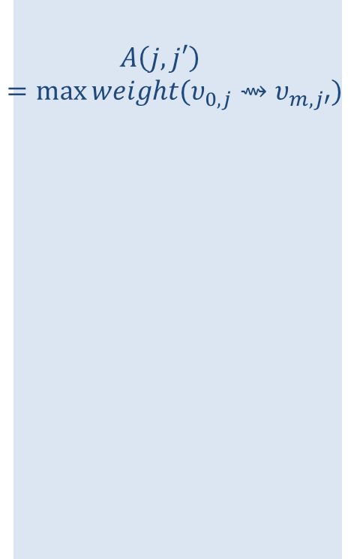
A(j,j’), A*(i,i’)
$$υ_{0,j}$$
●
$$A\left(j,j′\right)=\max{weight(υ_{0,j}⇝υ_{m,j′})}$$
●
$$υ_{i,0}$$
●
$$υ_{i′,n}$$
●
$$υ_{m,j′}$$
Notes:
abcabdcadcbad adbacdab

Slide 8


$G^{+}$: extension of G
$$G^{+}$$
無限延伸
Notes:
abcabdcadcbad adbacdab

Slide 9
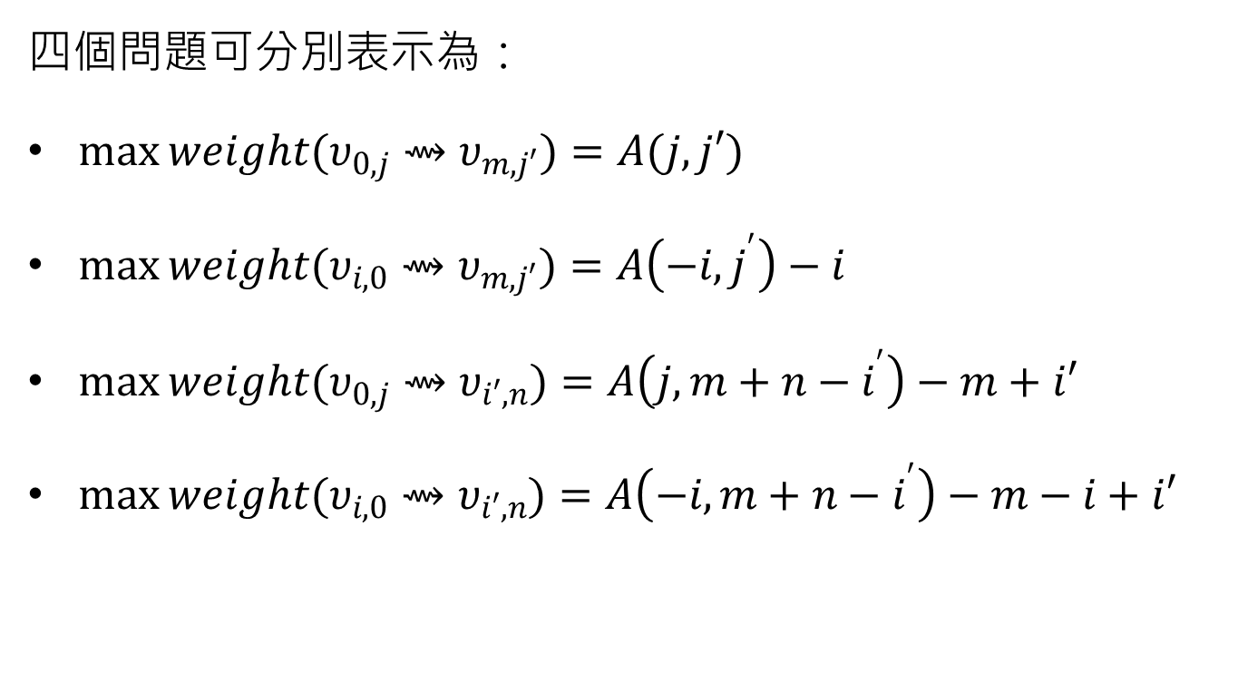
四個問題可分別表示為：
$\max{weight(υ_{0,j}⇝υ_{m,j′})}=A(j,j′)$
$\max{weight(υ_{i,0}⇝υ_{m,j′})}=A\left(−i,j^{′}\right)−i$
$\max{weight(υ_{0,j}⇝υ_{i′,n})}=A\left(j,m+n−i^{′}\right)−m+i′$
$\max{weight(υ_{i,0}⇝υ_{i′,n})}=A\left(−i,m+n−i^{′}\right)−m−i+i′$

Slide 10
$G^{+}$: extension of G
$$G^{+}$$
●
●
●
●
Notes:
abcabdcadcbad adbacdab

Slide 11

Theorem 1
$A(i,j)⊴A(i−1,j)$
$A(i,j)⊴A(i,j+1)$
if $A(i,j+1)⊲A(i−1,j+1)$, then $A\left(i,j\right)⊲A\left(i−1,j\right);$
if $A(i−1,j)⊲A(i−1,j+1)$, then $A\left(i,j\right)⊲A\left(i,j+1\right)$
1.
2.

Slide 12
3. if
then
4. if
then

Slide 13

Corollary 1
$if A\left(i,j\right)⊲A\left(i−1,j\right), then A\left(i,j^{′}\right)⊲A\left(i−1,j\right)for all j^{′}≤j$;
$if A\left(i,j\right)=A\left(i−1,j\right), then A\left(i,j^{′}\right)=A\left(i−1,j\right)for all j^{′}≥j$;
$if A\left(i,j\right)⊲A\left(i,j+1\right), then A\left(i,j^{′}\right)⊲A\left(i−1,j\right)for all j^{′}≤j$;
$if A\left(i,j\right)=A\left(i,j+1\right), then A\left(i,j^{′}\right)=A\left(i−1,j\right)for all j^{′}≥j.$

Slide 14
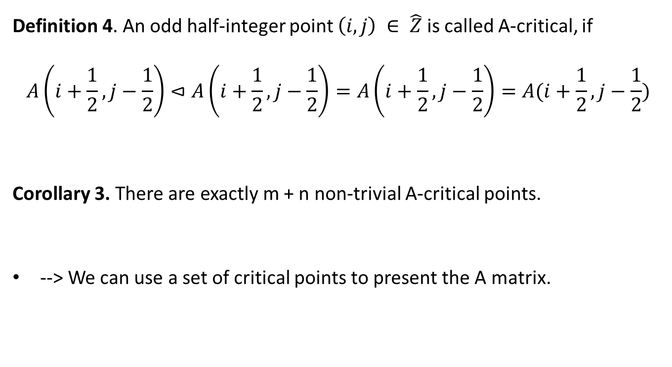
Definition 4. An odd half-integer point $\left(i,j\right) ∈ \hat{Z}$ is called A-critical, if
$$A\left(i+\frac{1}{2},j−\frac{1}{2}\right)⊲A\left(i+\frac{1}{2},j−\frac{1}{2}\right)=A\left(i+\frac{1}{2},j−\frac{1}{2}\right)=A(i+\frac{1}{2},j−\frac{1}{2})$$
Corollary 3. There are exactly m + n non-trivial A-critical points.
--> We can use a set of critical points to present the A matrix.

Slide 15
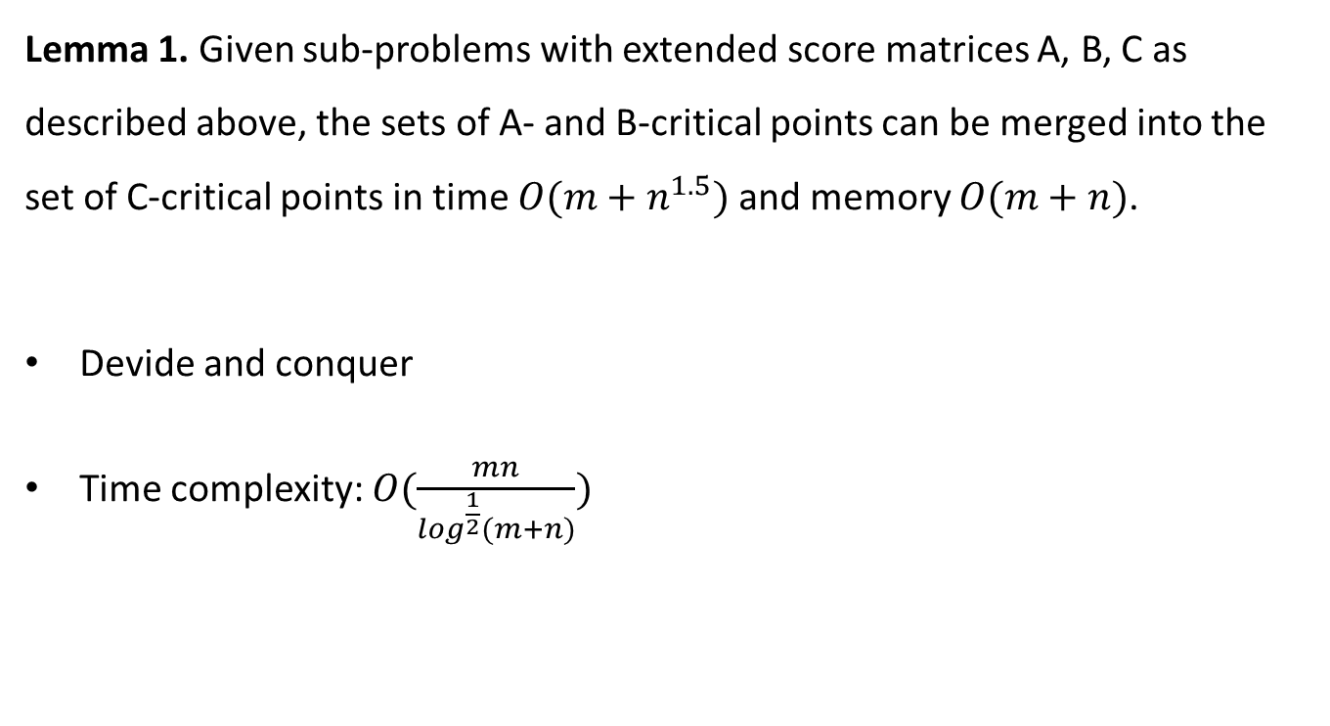
All semi-local LCS
Lemma 1. Given sub-problems with extended score matrices A, B, C as described above, the sets of A- and B-critical points can be merged into the set of C-critical points in time $O(m+n^{1.5})$ and memory $O(m+n)$.
Devide and conquer
Time complexity: $O(\frac{mn}{\log^{\frac{1}{2}}(m+n)})$

