Slide 1
An Efficient Non-dominated Sorting Method for Evolutionary Algorithms
H. Fang, Q. Wang, Y.-C. Tu, and M. F. Horstemeyer
Evolutionary Computation, vol. 16, pp. 355-384, 2008.
Prenster : Cheng-Han Lee
Date: 2012/8/28

Slide 2
Abstract
We present a new non-dominated sorting algorithm to generate the non-dominated fronts in multi-objective optimization with evolutionary algorithms, particularly the NSGA-II. The non-dominated sorting algorithm used by NSGA-II has a time complexity of O(MN²) in generating non-dominated fronts in one generation (iteration) for a population size N and M objective functions. Since generating non-dominated fronts takes the majority of total computational time (excluding the cost of fitness evaluations) of NSGA-II, making this algorithm faster will significantly improve the overall efficiency of NSGA-II and other genetic algorithms using non-dominated sorting.

Slide 3
The new non-dominated sorting algorithm proposed in this study reduces the number of redundant comparisons existing in the algorithm of NSGA-II by recording the dominance information among solutions from their first comparisons. By utilizing a new data structure called the dominance tree and the divide-and-conquer mechanism, the new algorithm is faster than NSGA-II for different numbers of objective functions. Although the number of solution comparisons by the proposed algorithm is close to that of NSGA-II when the number of objectives becomes large, the total computational time shows that the proposed algorithm still has better efficiency because of the adoption of the dominance tree structure and the divide-and-conquer mechanism.

Slide 4
Dominance Tree
non-dominate
dominate

Slide 5
Example
Solution | f1 | f2 | f3
1 | 182.08 | 100.13 | 192.21
2 | 187.53 | 246.16 | 203.20
3 | 197.15 | 201.57 | 318.86
4 | 47.48 | 74.96 | 22.69
5 | 37.05 | 304.83 | 381.19
6 | 126.88 | 54.58 | 144.17
7 | 101.77 | 49.18 | 111.91
8 | 37.47 | 18.63 | 446.57
Front 1 ： 4, 5, 7,8 Front 3 ：1
Front 2 ： 6 Front 4 ：2,3

Slide 6
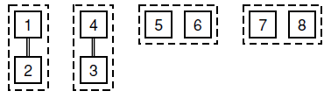
Round 1

Slide 7
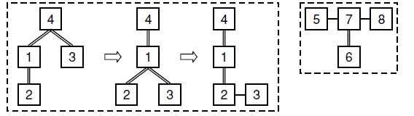
Round 2
5&6, 5&7, 6&7

Slide 8
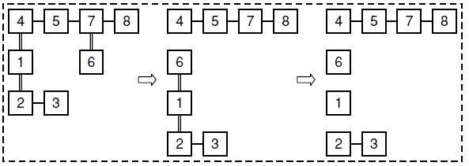
Round 3

Slide 9
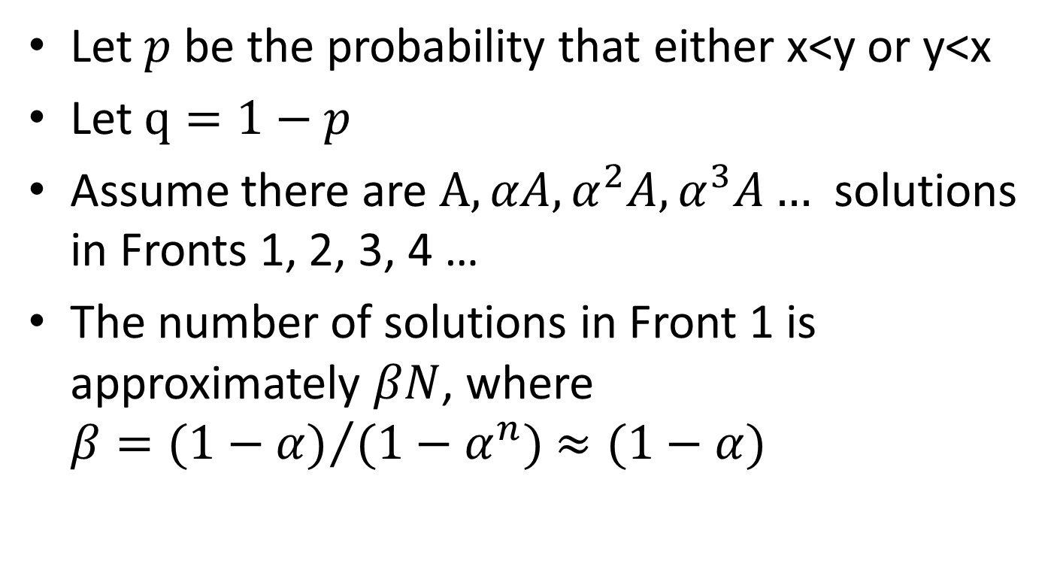
Time Complexity Analysis
Let $p$be the probability that either x<y or y<x
Let $q=1−p$
Assume there are $A, αA,α^{2}A,α^{3}A…$solutions in Fronts 1, 2, 3, 4 …
The number of solutions in Front 1 is approximately $βN$, where $β={(1−α)}/{(1−α^{n})}≈(1−α)$

Slide 10
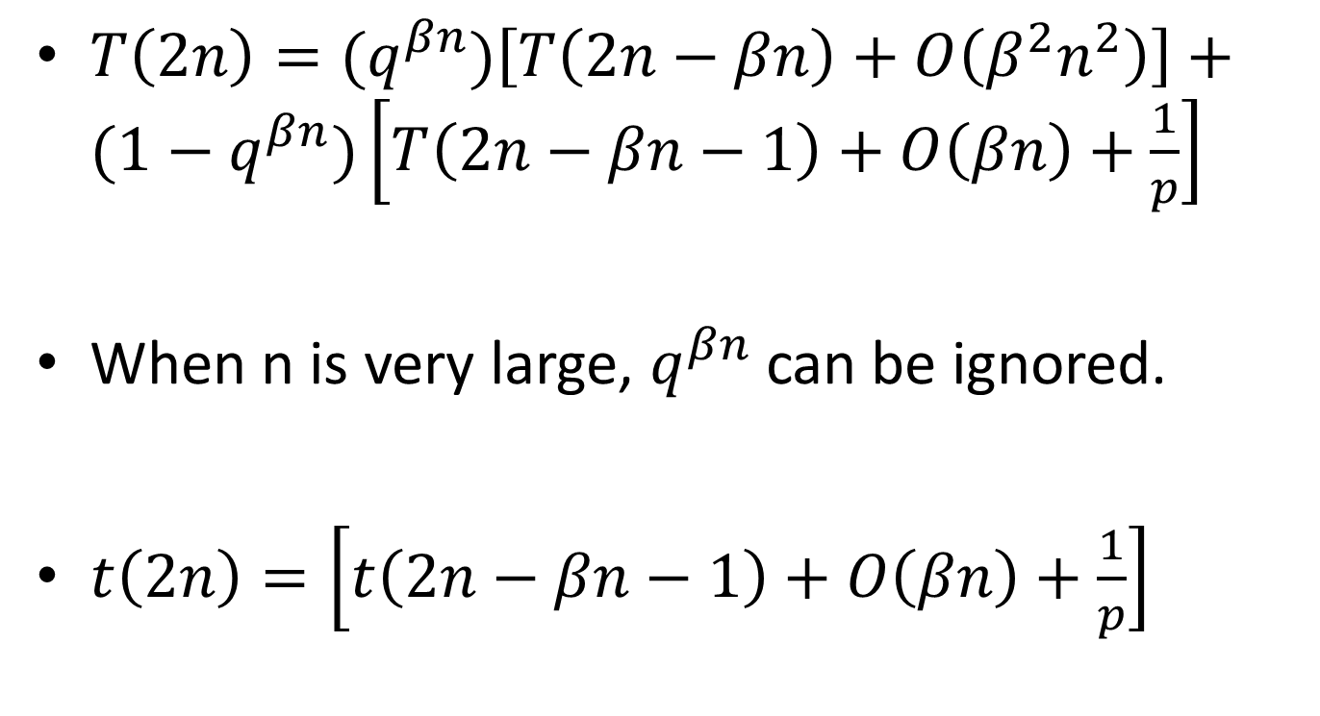
$T\left(2n\right)=(q^{βn})\left[T\left(2n−βn\right)+O\left(β^{2}n^{2}\right)\right]+(1−q^{βn})\left[T\left(2n−βn−1\right)+O\left(βn\right)+\frac{1}{p}\right]$
When n is very large, $q^{βn}$ can be ignored.
$t\left(2n\right)=\left[t\left(2n−βn−1\right)+O\left(βn\right)+\frac{1}{p}\right]$

Slide 11
t(n) = O(n) + O(log n) *1/p
T(N) = 2T(N/2) + t(N)
Using Master’s Theorem
T(N) = O(1/p * N log N)
M dimension
T(N) = O(1/p * M N log N)

Slide 12
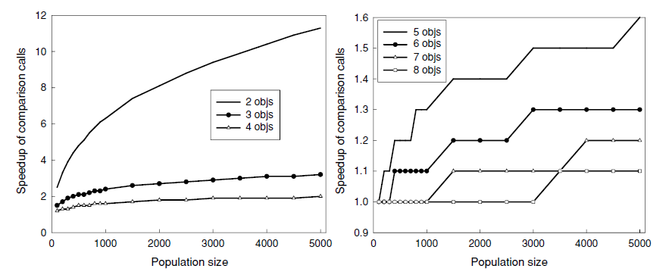
Compare with Deb's Algorithm

Slide 13
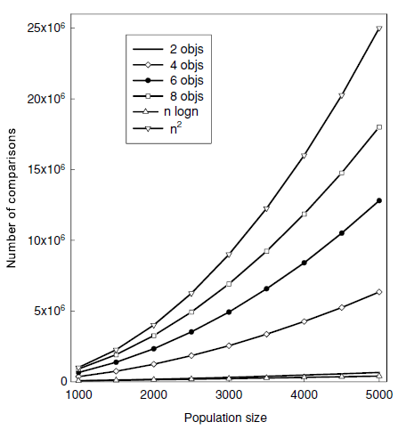

Slide 14
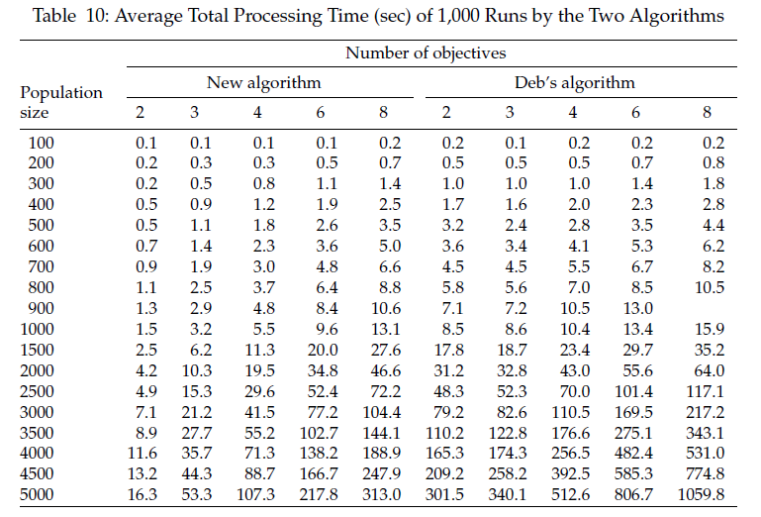

Slide 15
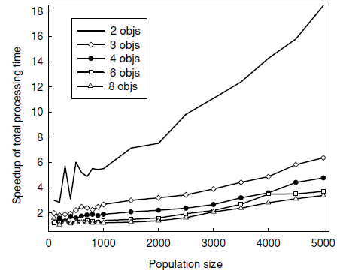

Slide 16
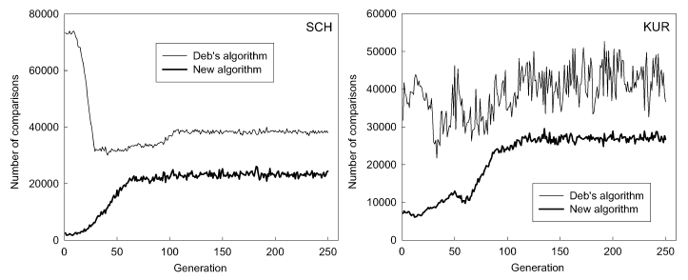

Slide 17
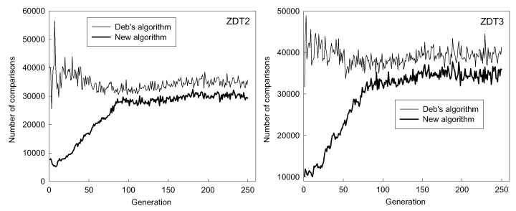

Slide 18
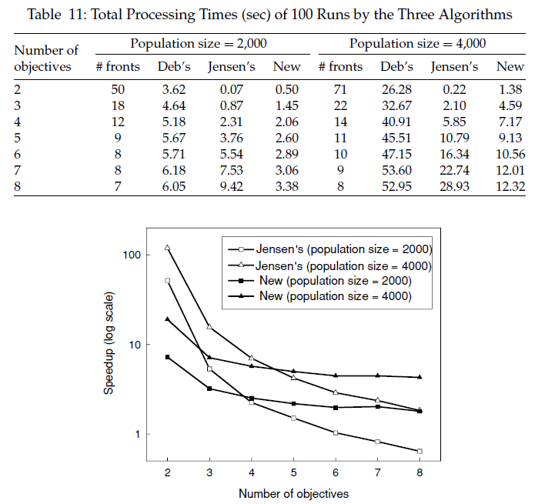

Slide 19
THE END

