Slide 1
An improved algorithm for the longest common subsequence problem
Sayyed RasoulMousavi , FarzanehTabataba
Computers & Operations Research
Vol.39 pp512-520 ,2012

Slide 2
A b s t r a c t (1/4)
The Longest Common Subsequence problem seeks a longest subsequence of every member of a given set of strings. It has applications, among others, in data compression, FPGA circuit minimization, and bioinformatics.
The problem is NP-hard for more than two input strings, and the existing exact solutions are impractical for large input sizes.

Slide 3
A b s t r a c t (2/4)
Therefore, several approximation and (meta) heuristic algorithms have been proposed which aim at finding good, but not necessarily optimal, solutions to the problem.

Slide 4
A b s t r a c t (3/4)
In this paper, we propose a new algorithm based on the constructive beam search method. We have devised a novel heuristic, inspired by the probability theory, intended for domains where the input strings are assumed to be independent. Special data structures and dynamic programming methods are developed to reduce the time complexity of the algorithm.

Slide 5
A b s t r a c t (4/4)
The proposed algorithm is compared with the state-of-the-art over several standard benchmarks including random and real biological sequences. Extensive experimental results show that the proposed algorithm outperforms the state-of-the-art by giving higher quality solutions with less computation time for most of the experimental cases.

Slide 6
Optimal Solution for LCS
For two input strings s1 、s2 ，LCS can be solved in O(|s1|*|s2|)
However, the problem is NP-hard for an arbitrary number of strings

Slide 7
Optimal Solution (Arbitrary Strings)
One approach is to use dynamic programming ,which can solve the problem in O(l^n) ,some of them can be improved to O(l^(n-1))
Other algorithms (not DP)for LCS ,whose complexity was still O(l^n).

Slide 8
Approximation Algorithm
approximation ratio of |∑|
Long Run (LR)
Expansion
Enhanced Long Run (ELR)
O(|∑|nl)
Best Next for Maximal Available Symbols (BNMAS)

Slide 9
Heuristic Algorithms
not guarantee an approximation ratio
Best-Next heuristic
O(|∑|nl)
G&V dynamic programming heuristic (G&V)
time horizon specialized branching heuristic (THSB)
ant colony optimization (ACO)
Beam Search algorithm (BS)
Improved Beam Search algorithm (IBS)

Slide 10
BS Algorithm
They compared BS with Expansion, Best-Next, G&V, THSB and ACO algorithms over three benchmarks.
results showed that BS algorithm is better than the above algorithm on average(quality and computation time)

Slide 11
Basic Notations and Definitions
string s ; denote the kth character of s
,
We say that is a subsequence of , and write ,if there is an injective function g from to such that:
For all
For all
We call function g a map of to .

Slide 12
Basic notations and Definitions
define the cost of a map g of s1 to s2 as the integer , where k=| |.
The null string is considered to be a subsequence of any string.
string x and S be a non empty set of strings . We write if for all .
A candidate solution x is called feasible
if

Slide 13
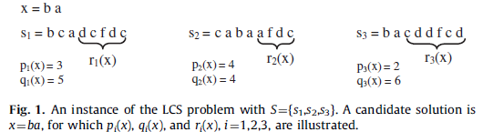
Basic Notations and Definitions
:the cost of the optimal(minial) map of x to .
:| |-
:the string obtained by deleting the first
characters from
R(x) :the set of

Slide 14
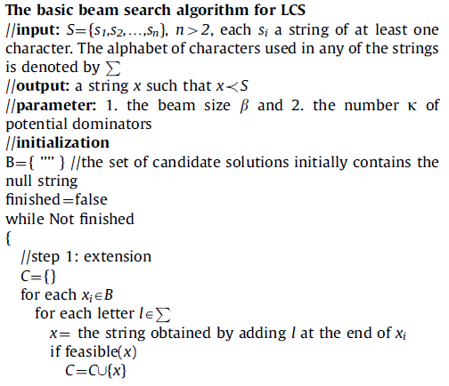
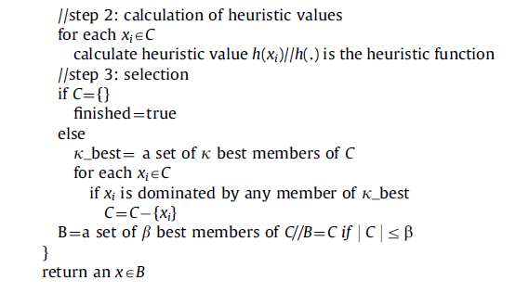
Algorithm

Slide 15
Rough Steps
While loop
Step 1, builds longer (feasible) candidate solutions //at most β of candidate solutions
Step 2, for each candidate solutions evaluate its heuristic value // by heuristic(.)
Step 3,we can got k-best candidate solutions (by step2) ,then remove the candidate solution which is dominated by the k-best .

Slide 16
Dominated
A candidate solution is dominated by another candidate solution if
S = abcab , j = aa , k = ac
p(j)= 4 > p(k)=3 // j is dominated by k

Slide 17
Probabilistic Heuristic
Let x be a candidate solution, mean the probability for , where s is a random string of length k
Authors thought that for a fair comparison, k has to be the same for all candidate solutions which are to be compared
They also said, how to find the best value for k still remains as an open question.

Slide 18

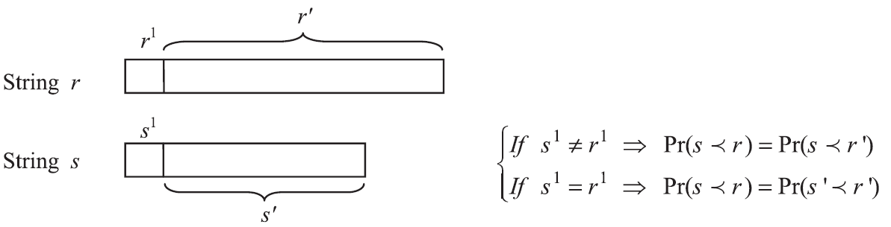
Probabilistic Heuristic
We make the assumption that the strings in S are ‘independent’.
=

Slide 19
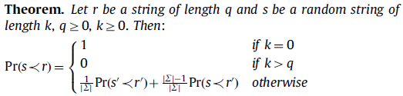
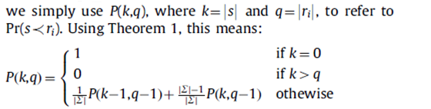

Slide 20
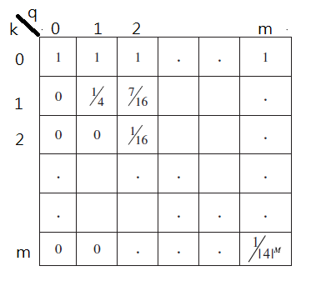
Heuristic Table
|∑|=4

Slide 21
Determine k
k set to 1 if the above formula gives 0.

Slide 22
Time Complexity
Before the while loop
O(nm|∑|) //will let feasible(.) in O(n).
O(m^2) //Heuristic table
In while loop (L) //L is output string length
O(β|∑|n) //Step(1)
O(β|∑|n) //step(2)
O(kβ|∑|n) +O(βlg(β |∑|)) //step(3)
Totally O(m^2+nm|∑|+L(βlg(β|∑|)+kβ|∑|n))

Slide 23
Experimental results
we report the results of comparing our proposed algorithm with the BS
we do not compare our algorithm with those ones, because such algorithms have already been evaluated and compared with BS .And BS is known as to be the current state-of-the-art.
used four datasets namely ES, ACO-random, ACO-rat , and ACO-virus

Slide 24
Experimental Results
We used the parameters β=200 and k=7 in our algorithm.
used four datasets namely ES, ACO-random, ACO-rat , ACO-virus , and BB benchmark

Slide 25
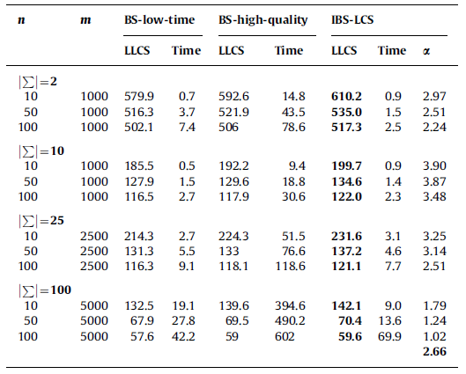
ES
n:input strings count
m:the length of the input strings
LLCS: the average length of the returned LCS
α: defined as(L2 -L1)/L1, where L2 and L1 are the average lengths of the solutions returned by IBS-LCS and BS-high-quality , respectively

Slide 26
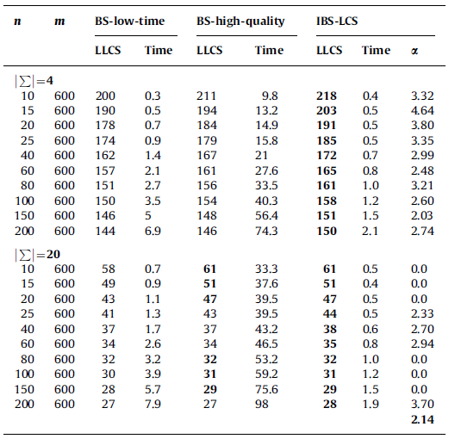
ACO-random

Slide 27
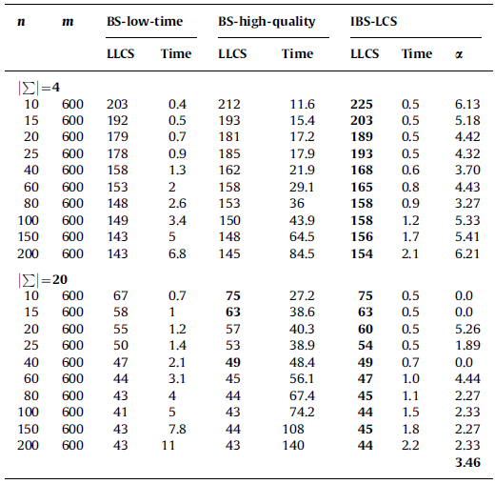
ACO-virus

Slide 28
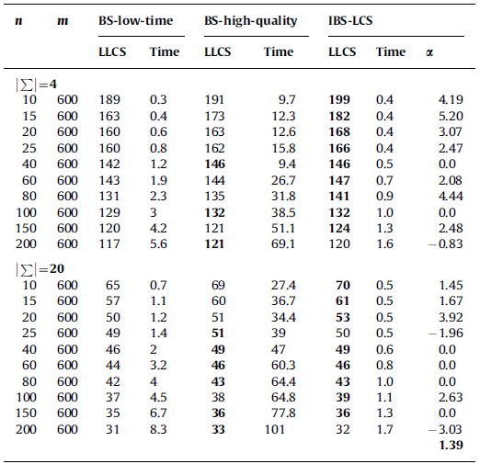
ACO-rat

Slide 29
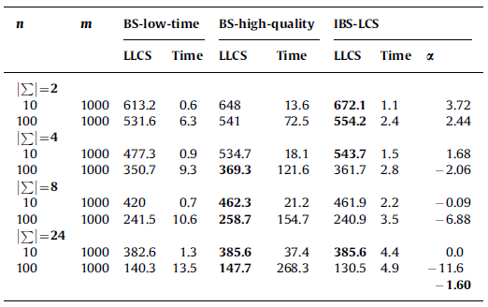
BB

Slide 30
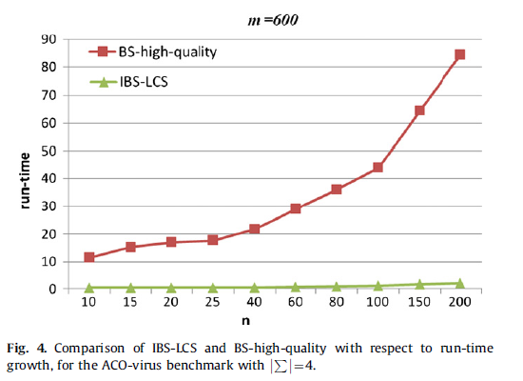
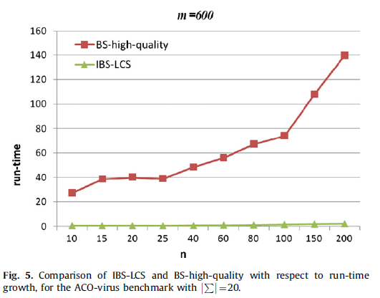
run-time growth

Slide 31
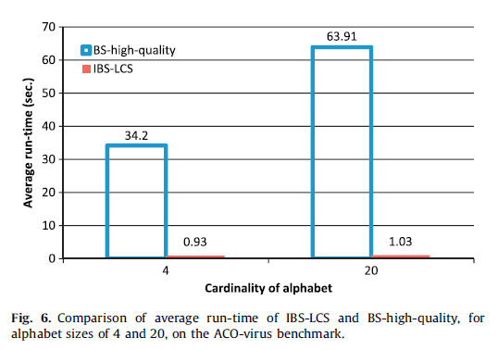
Average Run-time

Slide 32
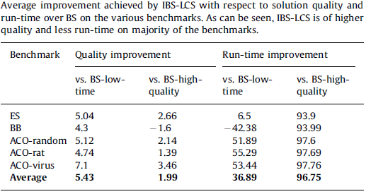
Quality

Slide 33
Conclusion
Experimental shows that IBS is not only faster but also more accurate than the BS on average.

