Slide 1
Optimal Filtering for Time Series Classification
Frank Höppner
Proceeding of 16th International Conference, Wroclaw, Poland, October 14-16, 2015
map
Presenter : Shu-Kai, Hung
Date : 2017/1/17

Slide 2
Abstract
The application of a (smoothing) filter is common practice in applications where time series are involved. The literature on time series similarity measures, however, seems to completely ignore the possibility of applying a filter first. In this paper, we investigate to what extent the benefit obtained by more complex distance measures may be achieved by simply applying a filter to the original series (while sticking to Euclidean distance). We propose two ways of deriving an optimized filter from classified time series to adopt the similarity measure to a given application. The empirical evaluation shows not only that in many cases a substantial fraction of the performance improvement can also be achieved by filtering, but also that for certain types of time series this simple approach outperforms more complex measures.

Slide 3
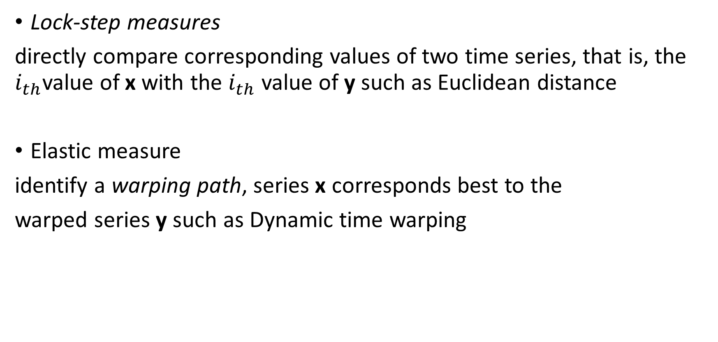
Similarity
Lock-step measures
directly compare corresponding values of two time series, that is, the $i_{th}$value of x with the $i_{th}$ value of y such as Euclidean distance
Elastic measure
identify a warping path, series x corresponds best to the
warped series y such as Dynamic time warping

Slide 4
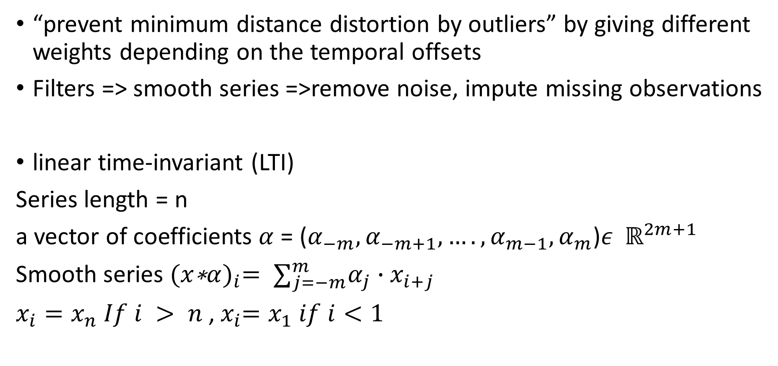
Filtering
“prevent minimum distance distortion by outliers” by giving different weights depending on the temporal offsets
Filters => smooth series =>remove noise, impute missing observations
linear time-invariant (LTI)
Series length = n
a vector of coefficients $α$ = ($α_{−m},α_{−m+1},….,α_{m−1},α_{m}$)$ε$ $ℝ^{2m+1}$
Smooth series ${(x\text{∗}α)}_{i}= ∑_{j=−m}^{m}α_{j}∙x_{i+j}$
$x_{i}=x_{n} If i > n$,${ x}_{i}=x_{1} if i<1$

Slide 5
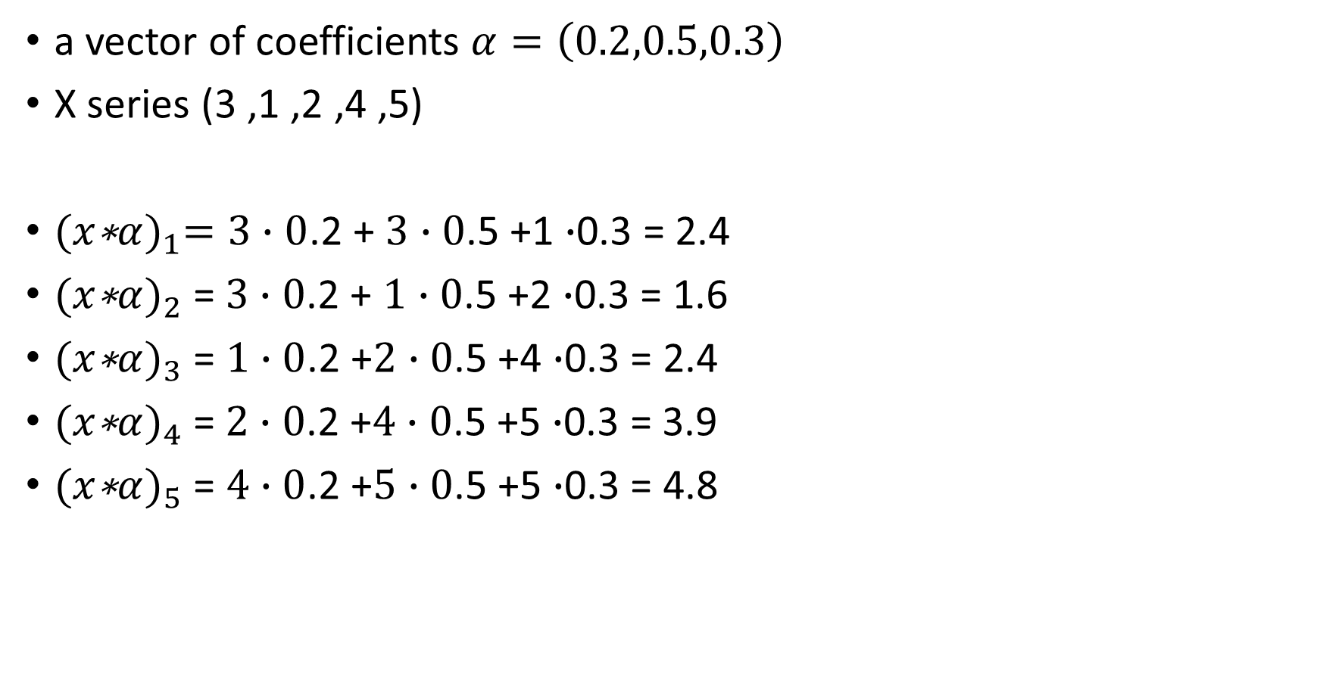
a vector of coefficients $α=\left(0.2,0.5,0.3\right)$
X series (3 ,1 ,2 ,4 ,5)
${(x\text{∗}α)}_{1}=3∙0$.2 + $3∙0$.5 +1 $∙$0.3 = 2.4
${(x\text{∗}α)}_{2}$= $3∙0$.2 + $1∙0$.5 +2 $∙$0.3 = 1.6
${(x\text{∗}α)}_{3}$ = $1∙0$.2 +$2∙0$.5 +4 $∙$0.3 = 2.4
${(x\text{∗}α)}_{4}$= $2∙0$.2 +$4∙0$.5 +5 $∙$0.3 = 3.9
${(x\text{∗}α)}_{5}$ = $4∙0$.2 +$5∙0$.5 +5 $∙$0.3 = 4.8

Slide 6
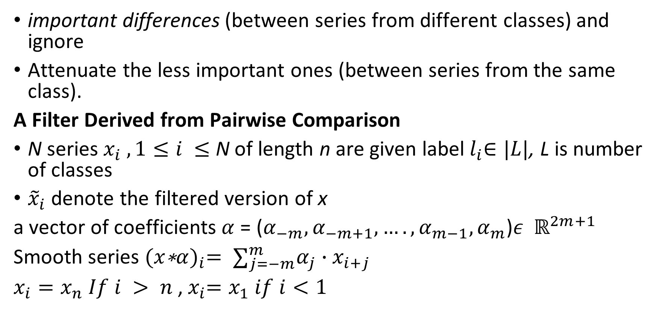
Optimized Filter for Time Series Similarity
important differences (between series from different classes) and ignore
Attenuate the less important ones (between series from the same class).
A Filter Derived from Pairwise Comparison
N series $x_{i} , 1≤i ≤$ N of length n are given label${ l}_{i}∈|L|$, L is number of classes
${\tilde{x}}_{i}$ denote the filtered version of x
a vector of coefficients $α$ = ($α_{−m},α_{−m+1},….,α_{m−1},α_{m}$)$ε$ $ℝ^{2m+1}$
Smooth series ${(x\text{∗}α)}_{i}= ∑_{j=−m}^{m}α_{j}∙x_{i+j}$
$x_{i}=x_{n} If i > n$,${ x}_{i}=x_{1} if i<1$

Slide 7
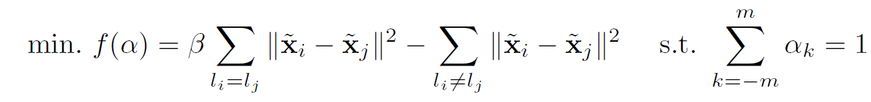
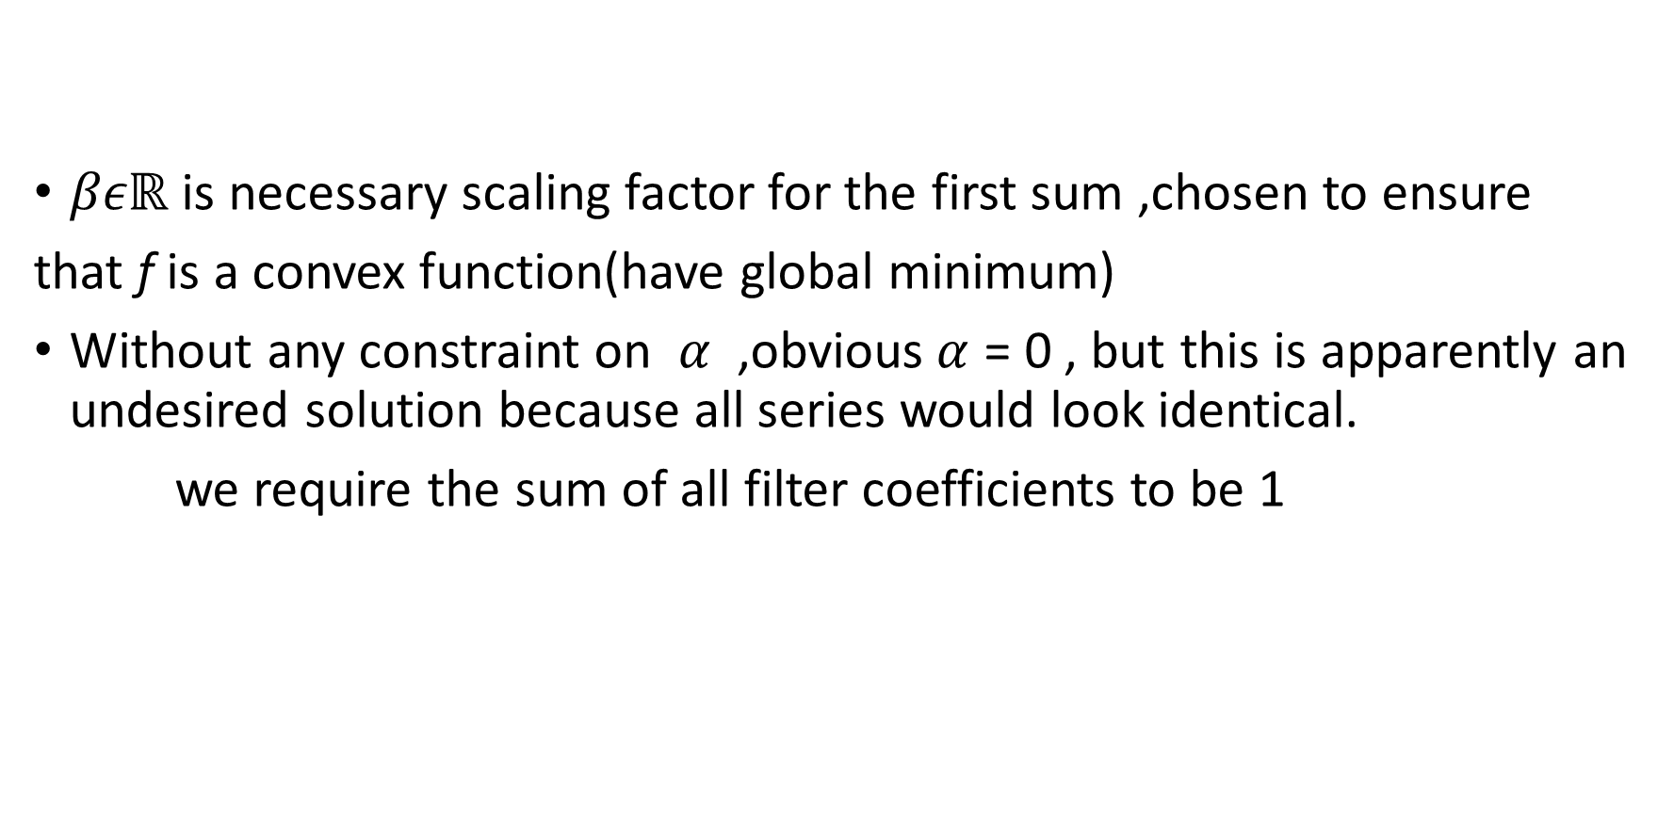
$βεℝ$ is necessary scaling factor for the first sum ,chosen to ensure
that f is a convex function(have global minimum)
Without any constraint on $α$ ,obvious$α$ = 0 , but this is apparently an undesired solution because all series would look identical.
we require the sum of all filter coefficients to be 1

Slide 8
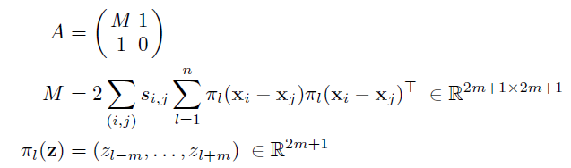

Proposition 1. Euclidean distance -obtained from sum constraint(ED-FS)
linear equation system A$α^{′}$ = b
Optimal filter$α$ = ($α_{−m},α_{−m+1},….,α_{m−1},α_{m}$)$ε$ $ℝ^{2m+1}$
$α^{′}$ = ($α_{−m},α_{−m+1},….,α_{m−1},α_{m}$,$λ$)
A$ε$ $ℝ^{2m+2×2m+2}$
b = (0, . . . , 0, 1)
$s_{i,j}= β for{ l}_{i}=l_{j}$, $s_{i,j}=−1 for{ l}_{i}≠{ l}_{j}$

Slide 9
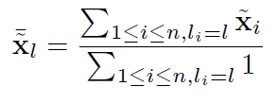
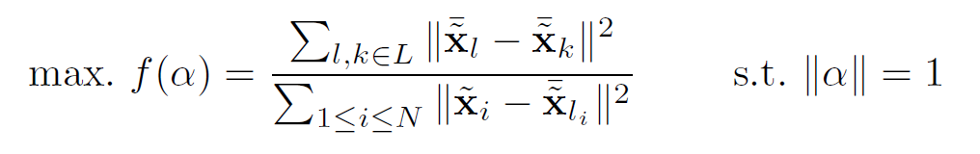
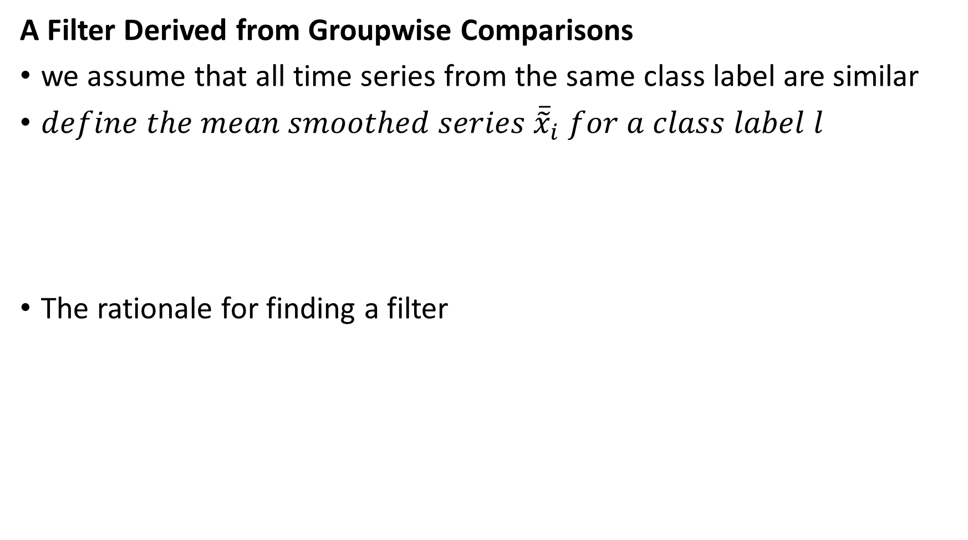
A Filter Derived from Groupwise Comparisons
we assume that all time series from the same class label are similar
$define the mean smoothed series$ ${\overline{\tilde{x}}}_{i}$ $for a class label l$
The rationale for finding a filter

Slide 10
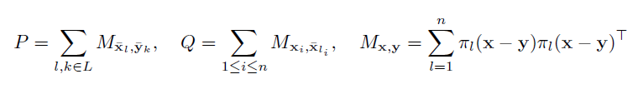

Proposition 2. filter constraint “norm=1” (ED-FN)
Optimal filter$α$ = ($α_{−m},α_{−m+1},….,α_{m−1},α_{m}$)$ε$ $ℝ^{2m+1}$ maximizing is the eigenvector with the largest eigenvalue of th matrix $Q^{−1}P{εℝ}^{2m+1×2m+1}$

Slide 11
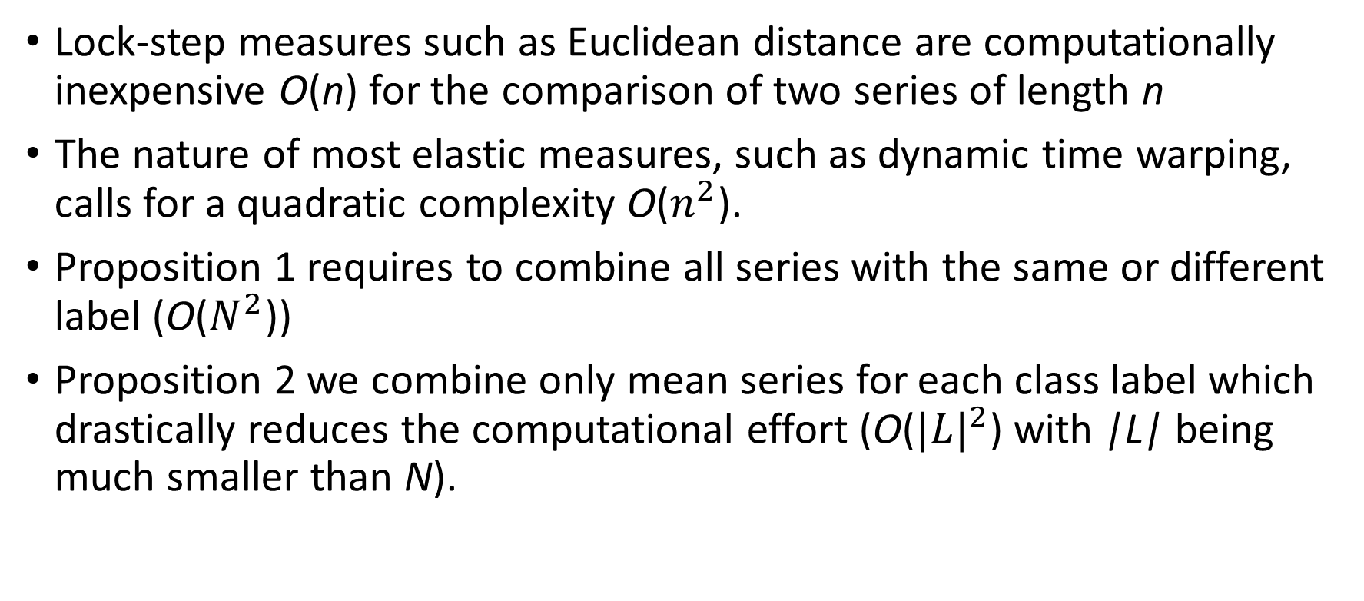
Computational Complexity
Lock-step measures such as Euclidean distance are computationally inexpensive O(n) for the comparison of two series of length n
The nature of most elastic measures, such as dynamic time warping, calls for a quadratic complexity O($n^{2}$).
Proposition 1 requires to combine all series with the same or different label (O($N^{2}$))
Proposition 2 we combine only mean series for each class label which drastically reduces the computational effort (O(${|L|}^{2}$) with |L| being much smaller than N).

Slide 12
Experimental Evaluation
Filter Width : chosen 2m to be 10% of the time series length but not larger than m = 7.

Slide 13
