Slide 1
An efficient dynamic programming algorithm for the generalized LCS problem with multiple substring exclusive constraints
Yingjie Wu, Lei Wang, Daxin Zhu, Xiaodong Wang
Journal of Discrete Algorithms Volume 26, May 2014, Pages 98–105
Presenter: Bi-Shiang Lin
Date:2017/1/17

Slide 2
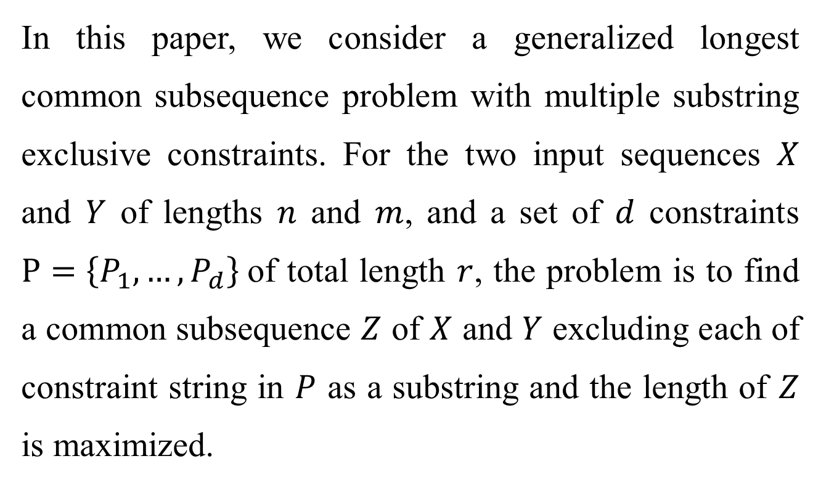
Abstract(1/2)
In this paper, we consider a generalized longest common subsequence problem with multiple substring exclusive constraints. For the two input sequences $X$ and $Y$ of lengths $n$ and $m$, and a set of $d$ constraints $P=\left\{P_{1},…,P_{d}\right\}$of total length $r$, the problem is to find a common subsequence $Z$ of $X$ and $Y$ excluding each of constraint string in $P$ as a substring and the length of $Z$ is maximized.

Slide 3
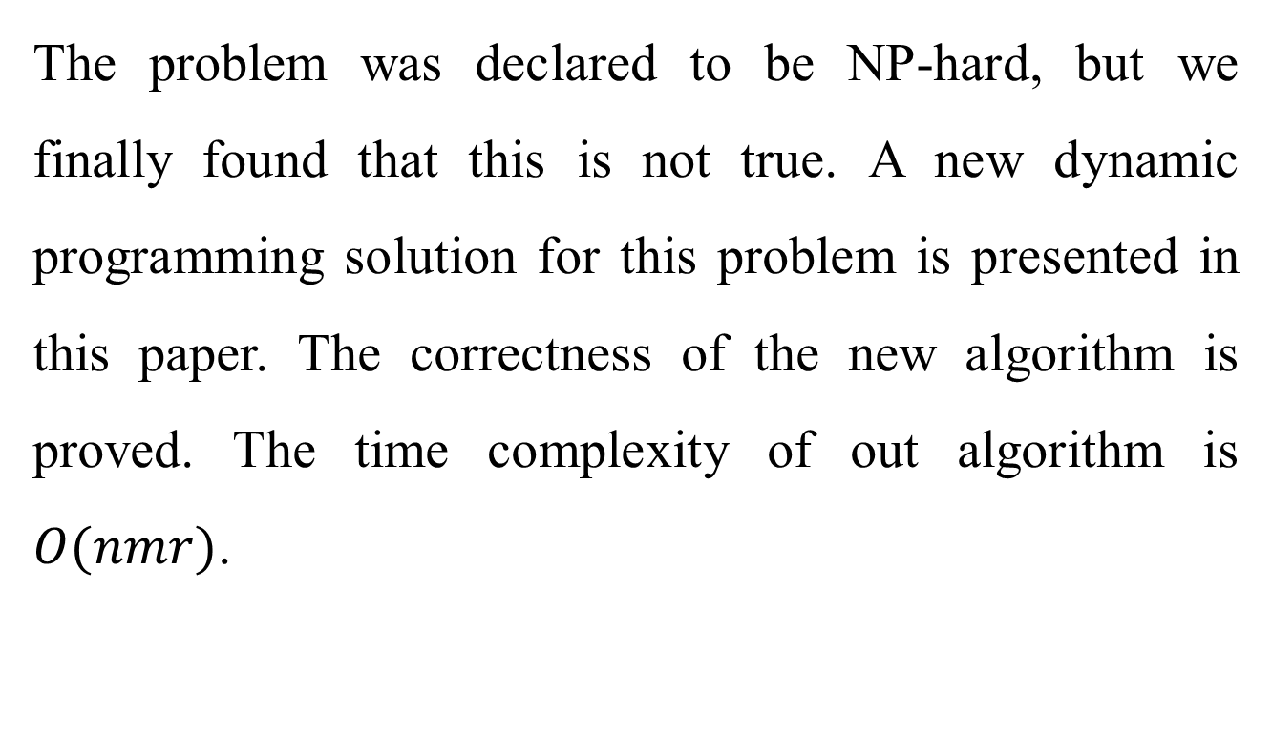
Abstract(2/2)
The problem was declared to be NP-hard, but we finally found that this is not true. A new dynamic programming solution for this problem is presented in this paper. The correctness of the new algorithm is proved. The time complexity of out algorithm is $O(nmr)$.

Slide 4
The GC-LCS problems
different constrain rules
substring / subsequence
include / exclude
(X,Y,P)=(abab,baab,bb)
SEQ-IC-LCS=(aab,bab)
(X,Y,P)=(abba,baba,bb)
STR-EC-LCS=(aba,bba)

Slide 5
M-STR-EC-LCS
multiple strings
substring
exclude
(X,Y)=(babab,aabba)
P={aab,aba,ba}
M-STR-EC-LCS=(bba,aba,abb,aab)

Slide 6
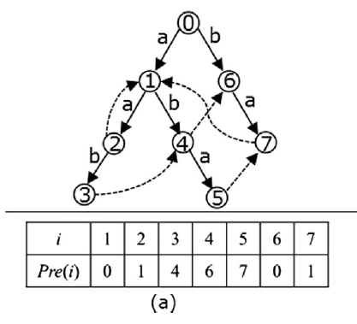
Keyword tree(1/3)
(X,Y)=(babab,aabba)
P={aab,aba,ba}
Pre(3)=4
Suffix(aab)=ab
1. no duplicate
2. no substring

Slide 7
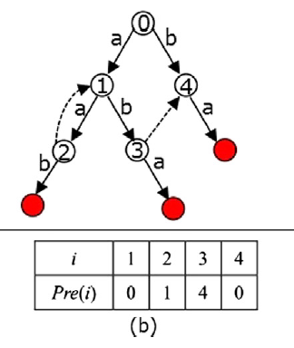
Keyword tree(2/3)
(X,Y)=(babab,aabba)
P={aab,aba,ba}

Slide 8
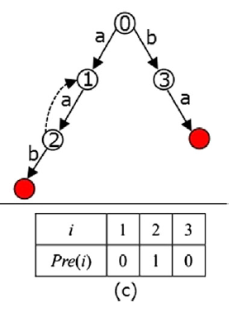
Keyword tree(3/3)
(X,Y)=(babab,aabba)
P={aab,aba,ba}

Slide 9
Algorithm
(X,Y)=(babab,aabba)
P={aab,aba,ba}
CS(bab,aabb)={a,b,bb,ab}
f(3,4,1)=(bab,aabb,1)=1
z(3,4,1)={a}
f(3,4,3)=(bab,aabb,3)=2
z(3,4,3)={b,ab,bb}

Slide 10
Algorithm
(X,Y)=(babab,aabba)
P={aab,aba,ba}
If not match
f(4,4,1)=max{f(3,4,1),f(4,3,1)}

Slide 11
Algorithm
(X,Y)=(babab,aabba)
P={aab,aba,ba}
If match
f(3,4,3)= max{f(2,3,3),1+f(2,3,q)} for some legal q
here, q = 0(b),1(ab),2(aab),3(bb)
when q = 0 and 2, easy to compute
when q = 1, use Pre(1) to compute

Slide 12
Algorithm
(X,Y)=(babab,aabba)
P={aab,aba,ba}
f(3,4,*)=f(bab,aabb,*)
 |  | 3 |  |  |  | 4
 |  | b |  |  |  | b
1 | b | 0 | 0 | 0 | 1 {b} | 0 | 0 | 0 | 1 {b}
2 | a | 0 | 1 {a} | 0 | 1 {b} | 0 | 1 {a} | 0 | 1 {b}
3 | b | 0 | 1 {a} | 0 | 2 {ab} | 0 | 1 {a} | 0 | 2 {ab,bb}

Slide 13
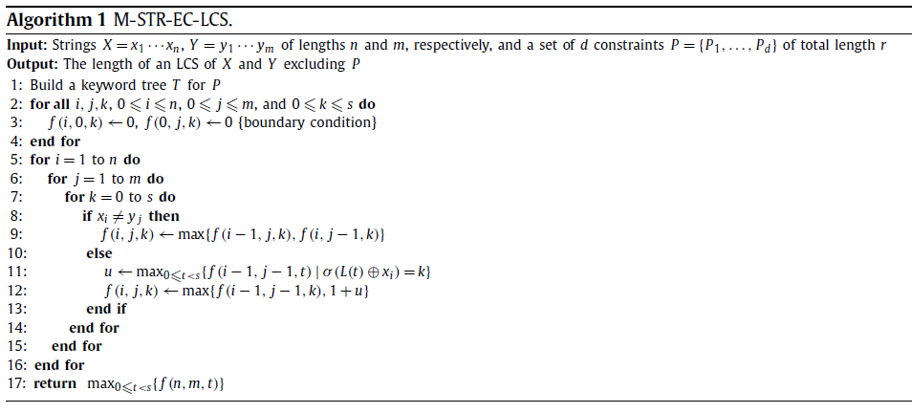
Algorithm

Slide 14
Algorithm
(X,Y)=(babab,aabba)
P={aab,aba,ba}
 | a | b
0 | 1 | 3
1 | 2 | 3
2 | 2 | x
3 | x | 3

Slide 15
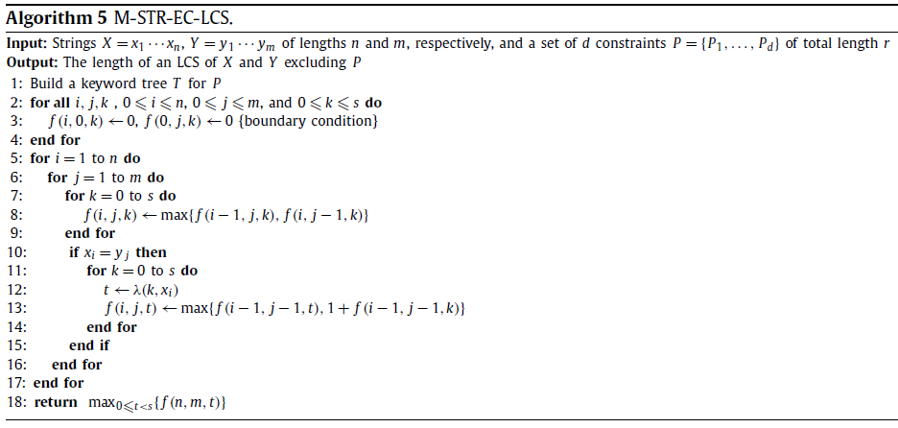
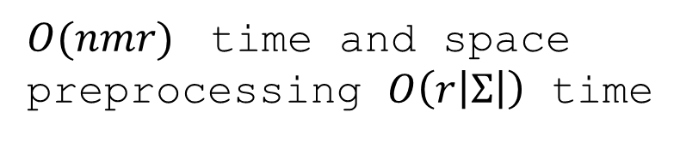
Algorithm(Final)
$O(nmr)$ time and space
preprocessing $O\left(r\left|Σ\right|\right)$ time

