Slide 1
Robust Real-Time Face Detection
PAUL VIOLA , MICHAEL J. JONES
International Journal of Computer Vision 57(2), 137–154, 2004
Presenter：Jia-Hong Liu
Date：2017/ 1/ 17

Slide 2
Abstract
This paper describes a face detection framework that is capable of processing images extremely rapidly while achieving high detection rates. There are three key contributions. The first is the introduction of a new image representation called the “Integral Image” which allows the features used by our detector to be computed very quickly. The second is a simple and efficient classifier which is built using the AdaBoost learning algorithm (Freund and Schapire, 1995) to select a small number of critical visual features from a very large set of potential features. The third contribution is a method for combining classifiers in a “cascade” which allows background regions of the image to be quickly discarded while spending more computation on promising face-like regions. A set of experiments in the domain of face detection is presented. The system yields face detection performance comparable to the best previous systems (Sung and Poggio, 1998; Rowley et al., 1998; Schneiderman and Kanade, 2000; Roth et al., 2000). Implemented on a conventional desktop, face detection proceeds at 15 frames per second.

Slide 3
Outline
Integral Image
AdaBoost learning algorithm
Cascade Classifier

Slide 4
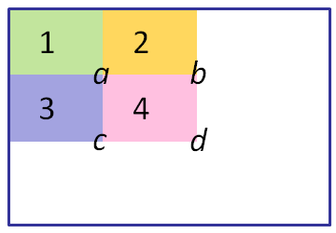
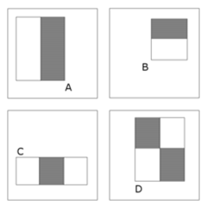
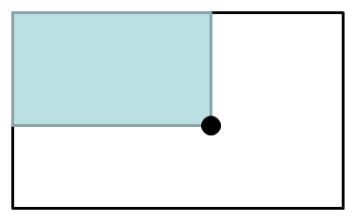
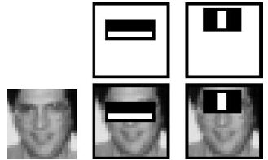
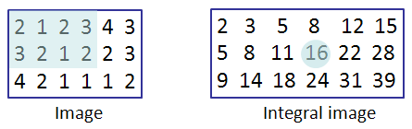
Integral Image

Slide 5
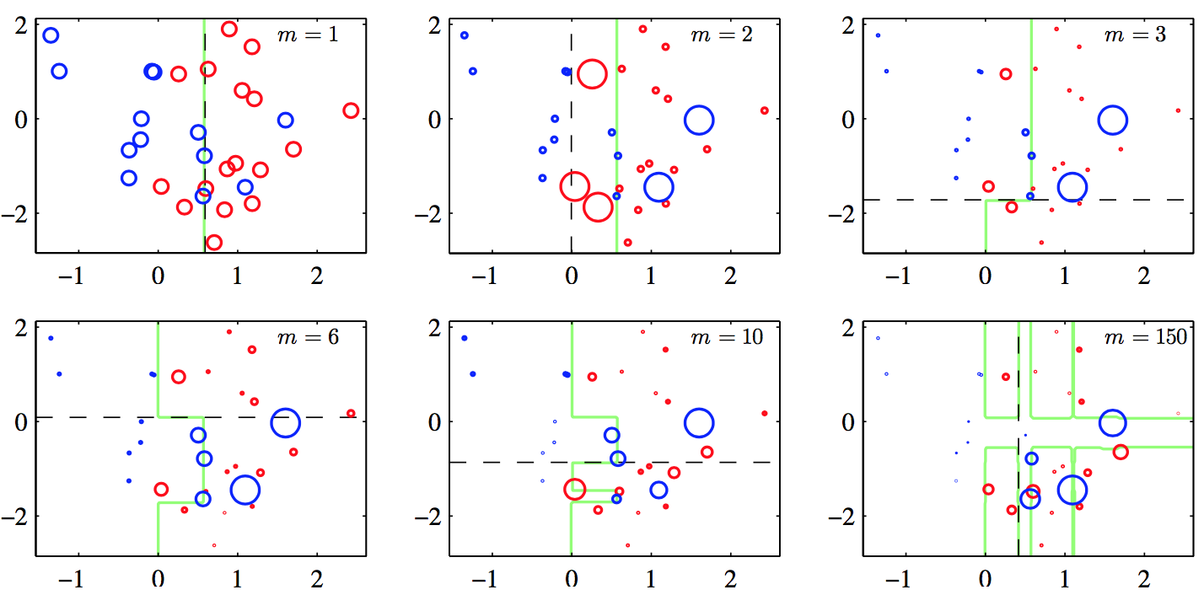
AdaBoost learning algorithm

Slide 6
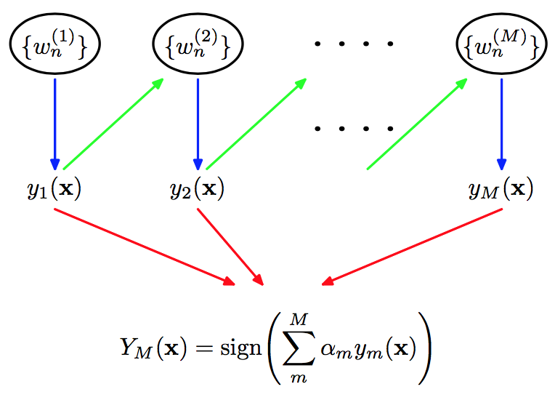
AdaBoost learning algorithm

Slide 7
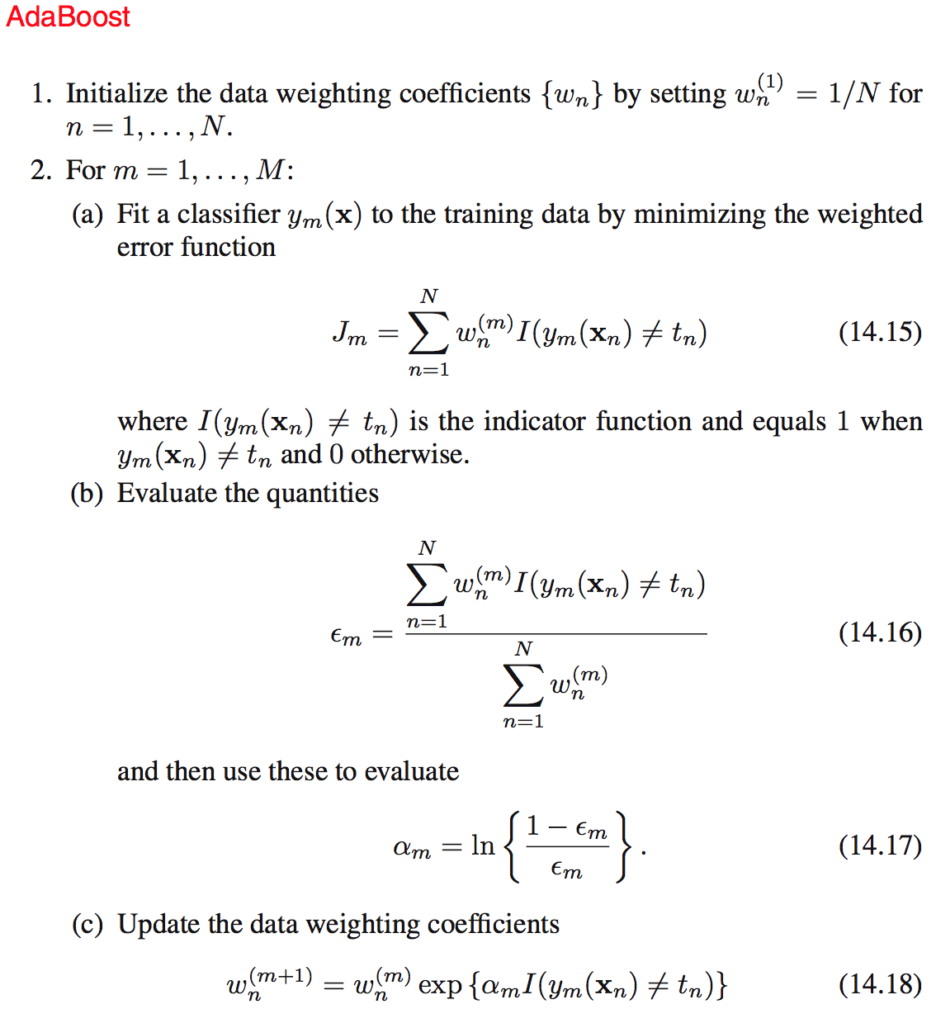
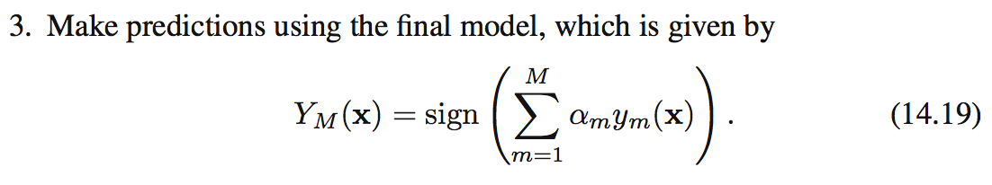

Slide 8
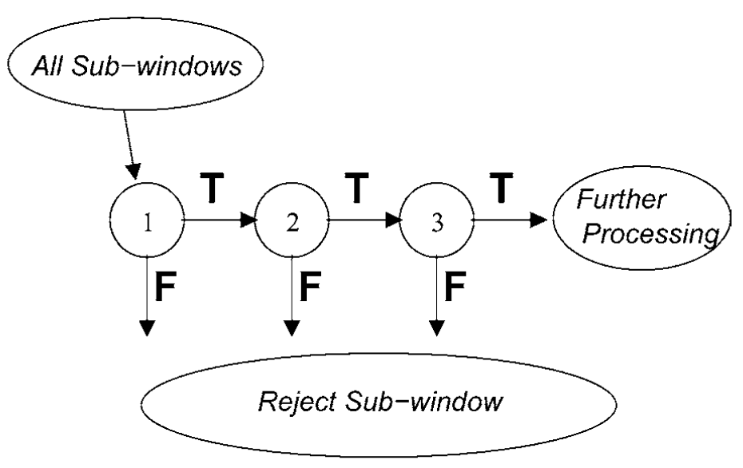
Cascade Classifier

Slide 9
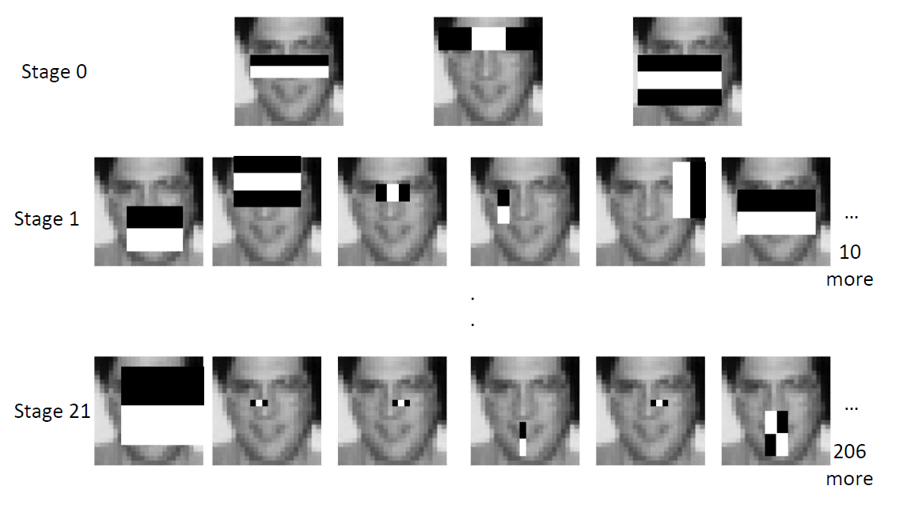
Example

Slide 10
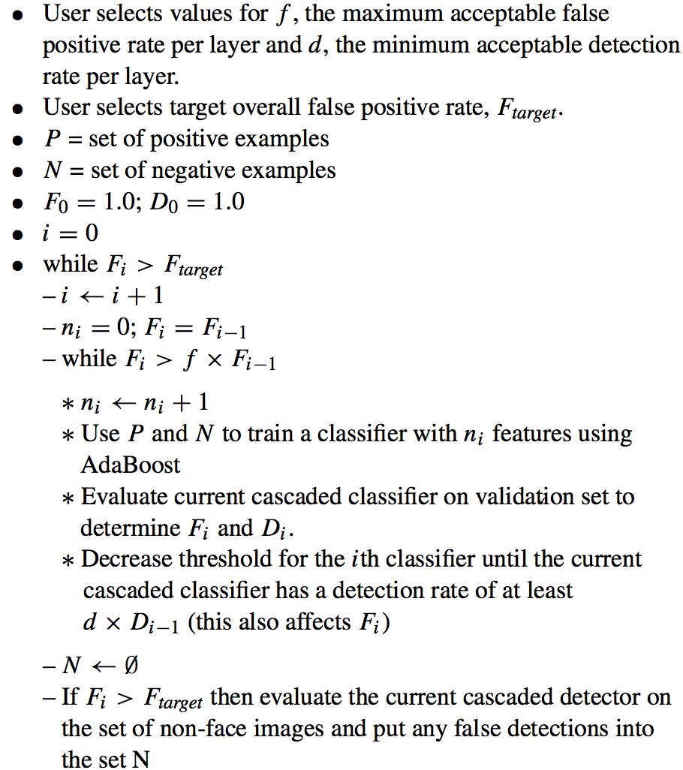
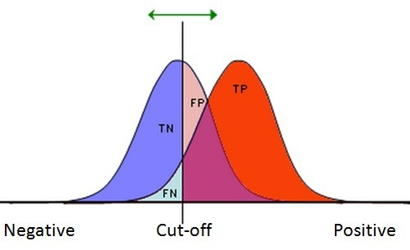
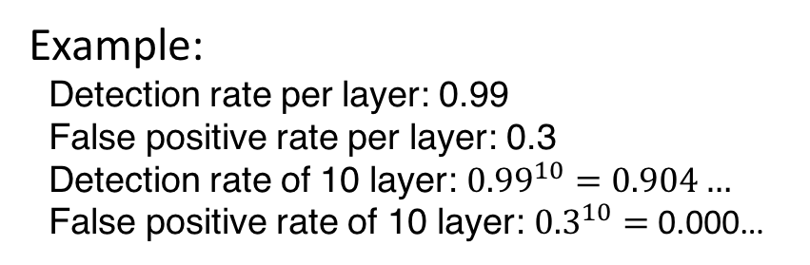
 |  | Predicted
 |  | Positive | Negative
True | Positive | TP | FN
 | Negative | FP | TN
Detection rate = TP/(TP+FN)
False positive rate = FP/(FP+TN)
Example:
Detection rate per layer: 0.99
False positive rate per layer: 0.3
Detection rate of 10 layer: ${0.99}^{10}=0.904…$
False positive rate of 10 layer: ${0.3}^{10}=$ 0.000…

Slide 11
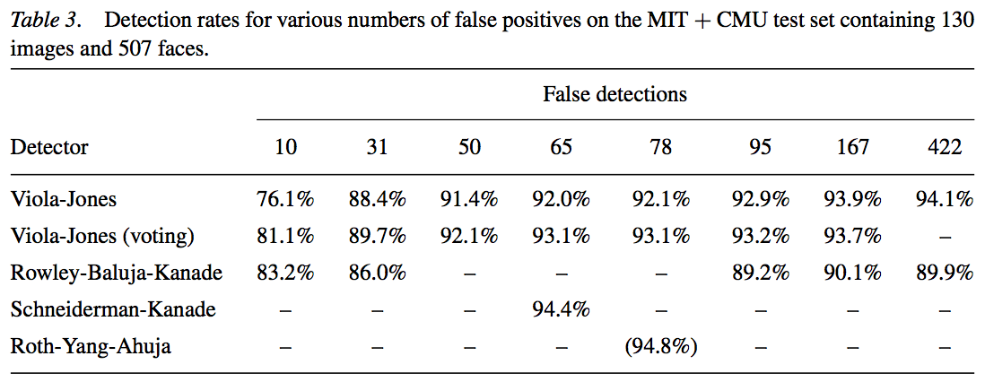
Result

