Slide 1
A Subquadratic Sequence Alignment Algorithm for Unrestricted Scoring Matrices
Maxime Crochemore, Gad M. Landau, and Michal Ziv-Ukelson
Society for Industrial and Applied Mathematics, Vol. 32, No. 6,
pp. 1654–1673 (2003)
Presenter: Shou-Fu Lo
Date:2017/09/27

Slide 2
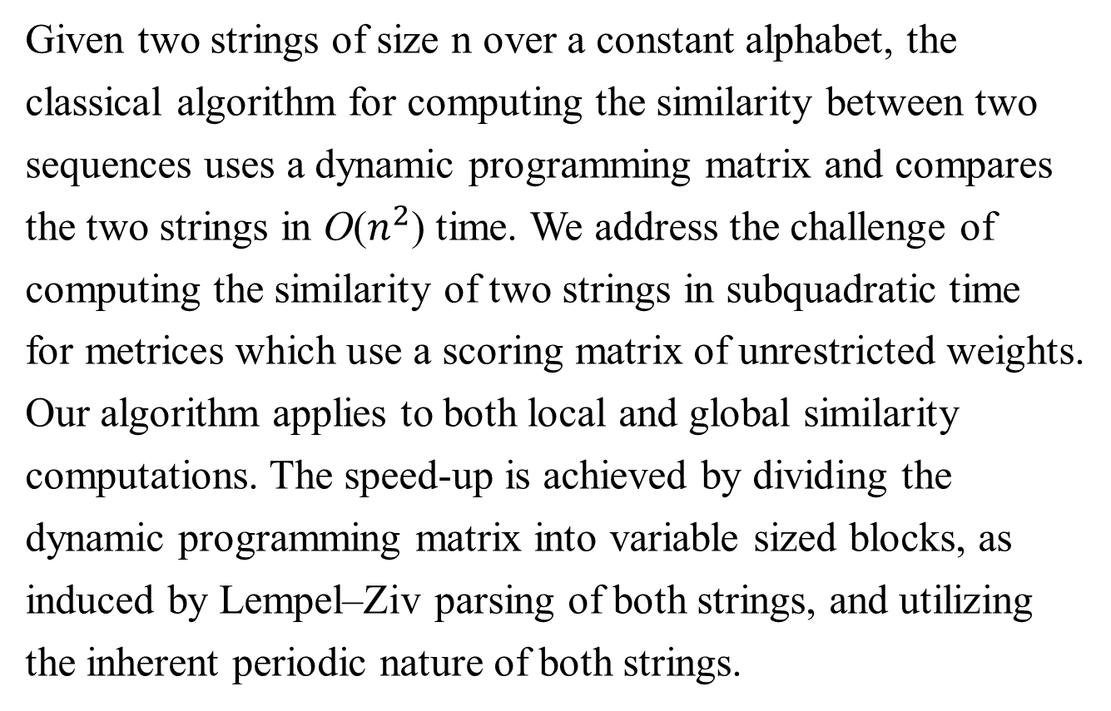
Abstract(1/2)
Given two strings of size n over a constant alphabet, the
classical algorithm for computing the similarity between two
sequences uses a dynamic programming matrix and compares
the two strings in O($n^{2}$) time. We address the challenge of
computing the similarity of two strings in subquadratic time
for metrices which use a scoring matrix of unrestricted weights.
Our algorithm applies to both local and global similarity
computations. The speed-up is achieved by dividing the
dynamic programming matrix into variable sized blocks, as
induced by Lempel–Ziv parsing of both strings, and utilizing
the inherent periodic nature of both strings.

Slide 3
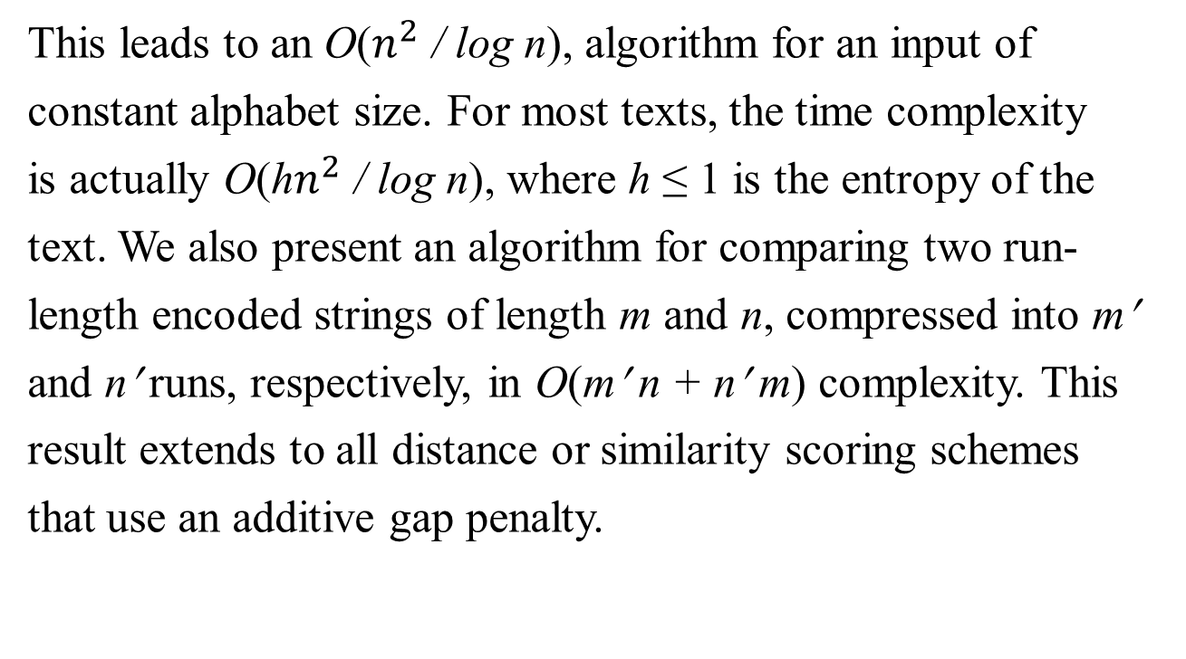
Abstract(2/2)
This leads to an O($n^{2}$ / log n), algorithm for an input of
constant alphabet size. For most texts, the time complexity
is actually O(h$n^{2}$ / log n), where h ≤ 1 is the entropy of the
text. We also present an algorithm for comparing two run-
length encoded strings of length m and n, compressed into m′
and n′ runs, respectively, in O(m′ n + n′ m) complexity. This
result extends to all distance or similarity scoring schemes
that use an additive gap penalty.

Slide 4
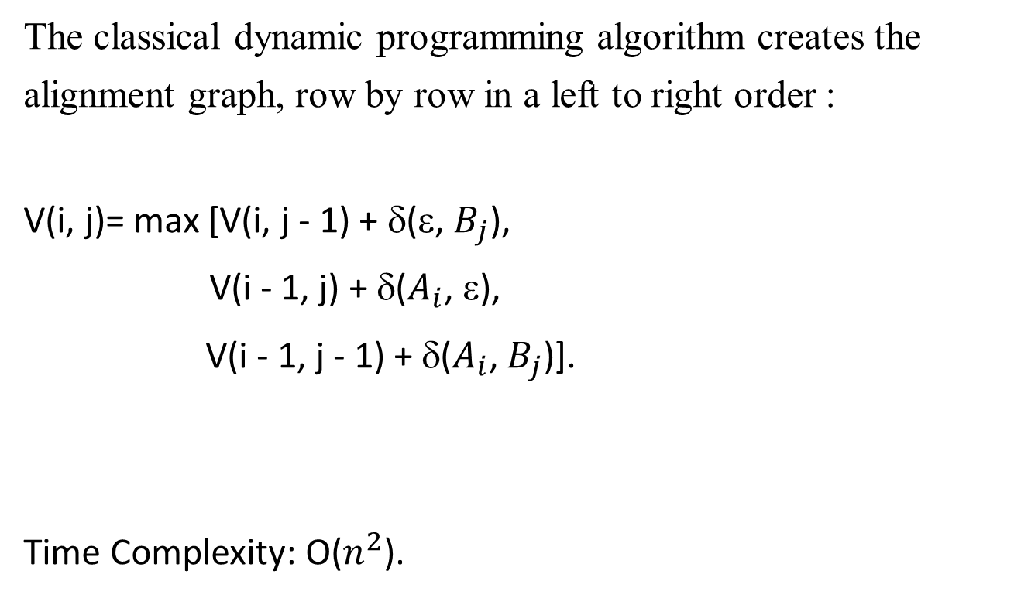
Global alignment via dynamic programming
The classical dynamic programming algorithm creates the
alignment graph, row by row in a left to right order :
V(i, j)= max [V(i, j - 1) + δ(ε, $B_{j}$),
V(i - 1, j) + δ($A_{i}$, ε),
V(i - 1, j - 1) + δ($A_{i}$,${ B}_{j}$)].
Time Complexity: O($n^{2}$).

Slide 5
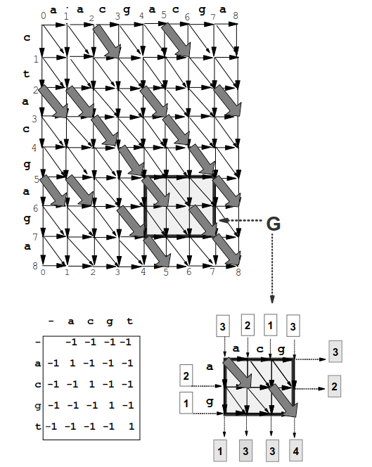
Alignment graph
A=ctacgaga B=aacgacga
The scoring scheme matrix δ is
shown in the lower left corner of
the ﬁgure.
Also speciﬁed are the values I for
the entries of the input border for G
(in white-shaded rectangles), and
the values O of the output border of
G (in grey-shaded rectangles), as
set during a local alignment
computation.

Slide 6
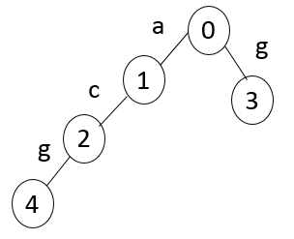
A block partition of the alignment graph based on LZ78 factorization
Example:
S=“aacgacga” is divided into four phrases:
a, ac, g, acg.
The trie for S:

Slide 7
A block partition of the alignment graph based on LZ78 factorization
Theorem (Lempel and Ziv): given a sequence S of size n over a constant alphabet. The maximal number of distinct phrases in S is O(n/log n).
A tighter upper bound will be O(hn/log n) where h is the entropy factor – a real number, 0 < h ≤1, which measures the amount of disorder in a sequence. Entropy is small when there is a lot of order (i.e, the sequence is repetitive) and large when there is a lot of disorder.
在資訊理論中，熵是接收的每條消息中包含的資訊的平均
量，又被稱為資訊熵、信源熵、平均資訊本體量。

Slide 8
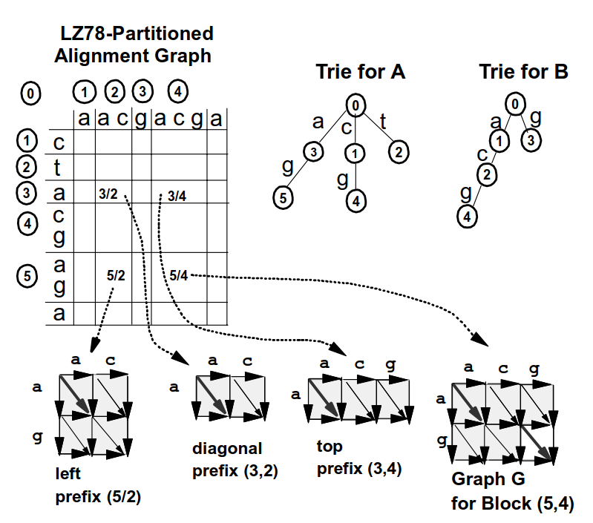
LZ78 – partitioned alignment graph

Slide 9
The only new cell in G, which doesn’t appear in any of it’s prefix blocks is the cell for comparing a and b. This cell consists of one new vertex and three new edges.
a
c
g
a
g

Slide 10
Computing the optimal global similarity value
• input border I – the left and top borders of G.
• output border O – the bottom and right borders of G.
Let lr denote the number of rows in G, lr = |xa|. Let lc denote the number of columns in G, lc = |yb|. Let t = lr + lc . Clearly, |I | = |O| = t.
2
a
c
g
3
4
5
a
5
1
4
g
I
0
3
0
1
G
2
O

Slide 11
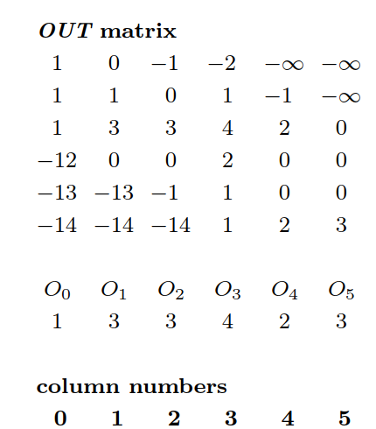
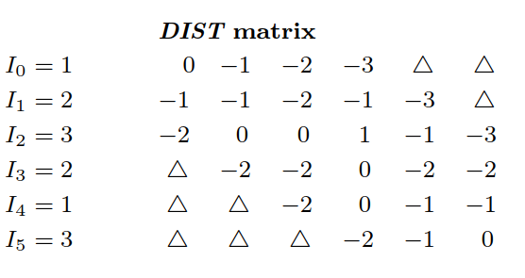
I/O propagation Across G
2
a
c
g
3
4
5
a
5
1
4
g
I
0
3
0
1
G
2
O

Slide 12
DIST and OUT properties
Definition: a matrix M[0…m,0…n] is Monge if either condition 1 or 2 below holds for all a,b=0…m; c,d=0…n:
1. Convex condition: M[a,c] + M[b,d] ≤ M[b,c] + M[a,d] for all a<b and c<d.
2. Concave condition: M[a,c] + M[b,d] ≥ M[b,c] + M[a,d] for all a<b and c<d.
Previous researches observed that DIST matrices are Monge arrays.
Since DIST is Monge, so is OUT, which is a DIST with constants added to its rows.
An important property of Monge arrays is that of being totally monotone.

Slide 13
DIST and OUT properties
Definition: a matrix M[0…m,0…n] is totally monotone if either condition 1 or 2 below holds for all a,b=0…m; c,d=0…n:
1. Convex condition: M[a,c] ≥ M[b,c]⇒ M[a,d] ≤ M[b,d] for all a<b and c<d.
2. Concave condition: M[a,c] ≤ M[b,c] ⇒ M[a,d] ≤ M[b,d] for all a<b and c<d.
Note that the Monge property implies total monotonicity, but the converse is not true. Therefore, Both DIST and OUT are totally monotone by the concave condition.

Slide 14
Computing O
An algorithm called SMAWK can compute in O(n) time all row and column maximum of an n x n totally monotone matrix, by querying only O(n) elements of the array. Hence we can use SMAWK on OUT to compute output row O. clearly, if both the full DIST and I are available, then computing an element of OUT is O(1) work. Thus, there is no need to compute and store the full matrix OUT but only the entries of OUT which are needed by SMAWK.

Slide 15
Computing O
In order to efficiently utilize Monge and Monotonicity properties, we need to address the following problem:
1. How to efficiently compute DIST and represent it in a format which allows direct access to its entries.

Slide 16
Incremental update of the new DIST information for G
As shown, in block G, there is only one “new” cell, in its lowest – rightmost corner. When processing G, we compute the scores of t (t= |I|) new optimal paths, leading from input border i to the new vertex (lr,lc). This values correspond to column lc of the DIST matrix for G and can be computed as follows:
a
c
g
a
c
g
a
c
g
a
a
a
g
g
g
G
G
G

Slide 17
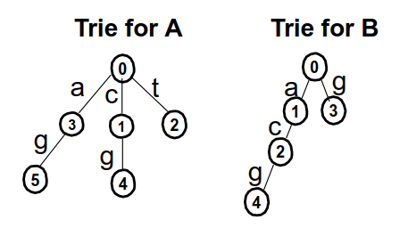
Querying a prefix block and obtaining its DIST column in constant time
Each block will be identified by a pair of numbers, composed of the serial numbers for its corresponding phrases in the LZ tries for A and B.
For example:
Comparison of “ag” and “acg” – (5,4).
The left prefix of G can be identified in constant time as follows:
The first number identical to the serial number of Xa, and the second corresponding to the serial number of Y, which is the direct ancestor of Yb in the trie for B.
Example: left prefix of G (5,4) will be: (5,2).
Similarly, Top prefix (3,4) can be identified in constant time.
a
c
g
a
g
G

Slide 18
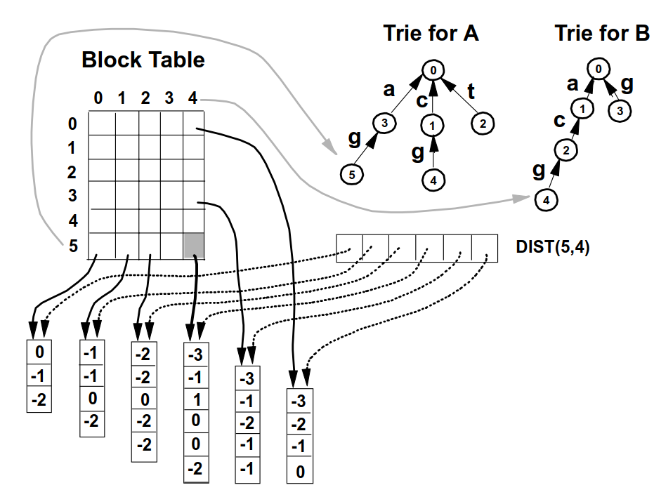
Maintaining direct access scheme
a
c
g
a
g
G
-3
-3 | -1 | -4
-1 | 1 | -2
-3 | 0 | -3
-3 | 0 | -2
 |  | -2
New DIST column for (5,4)

Slide 19
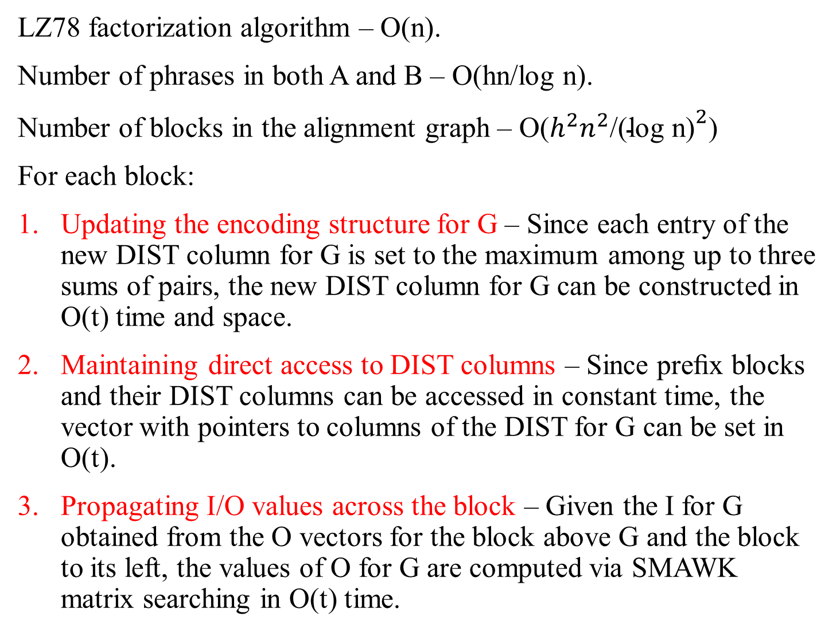
Time complexity
LZ78 factorization algorithm – O(n).
Number of phrases in both A and B – O(hn/log n).
Number of blocks in the alignment graph – O($h^{2}n^{2}$/${\text{(}\text{log} \text{n}\text{)}}^{2}$)
For each block:
Updating the encoding structure for G – Since each entry of the new DIST column for G is set to the maximum among up to three sums of pairs, the new DIST column for G can be constructed in O(t) time and space.
Maintaining direct access to DIST columns – Since preﬁx blocks and their DIST columns can be accessed in constant time, the vector with pointers to columns of the DIST for G can be set in O(t).
Propagating I/O values across the block – Given the I for G obtained from the O vectors for the block above G and the block to its left, the values of O for G are computed via SMAWK matrix searching in O(t) time.

Slide 20

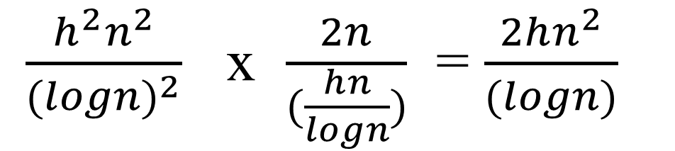
Time complexity
Total complexity – since the work for every block is linear with its I/O borders, the total complexity is linear with the total size of the borders of the blocks. In the alignment graph there are O(hn/log n) rows of size |B|, and O(hn/log n) columns of size |A|.
Therefore, the total complexity is O(h$n^{2}$/(log n)).
0
1
2
3
4
a | acg | g | ac | a
 |  |  |  |  | c
 |  |  |  |  | t
 |  |  |  |  | a
 |  |  |  |  | c g
 |  |  |  |  | a g
 |  |  |  |  | a
1
2
$\frac{h^{2}n^{2}}{{(logn)}^{2}}$ x $\frac{2n}{(\frac{hn}{logn})}$ = $\frac{2hn^{2}}{(logn)}$
3
4
5

Slide 21
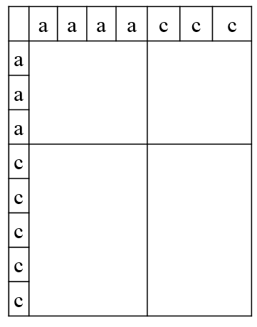
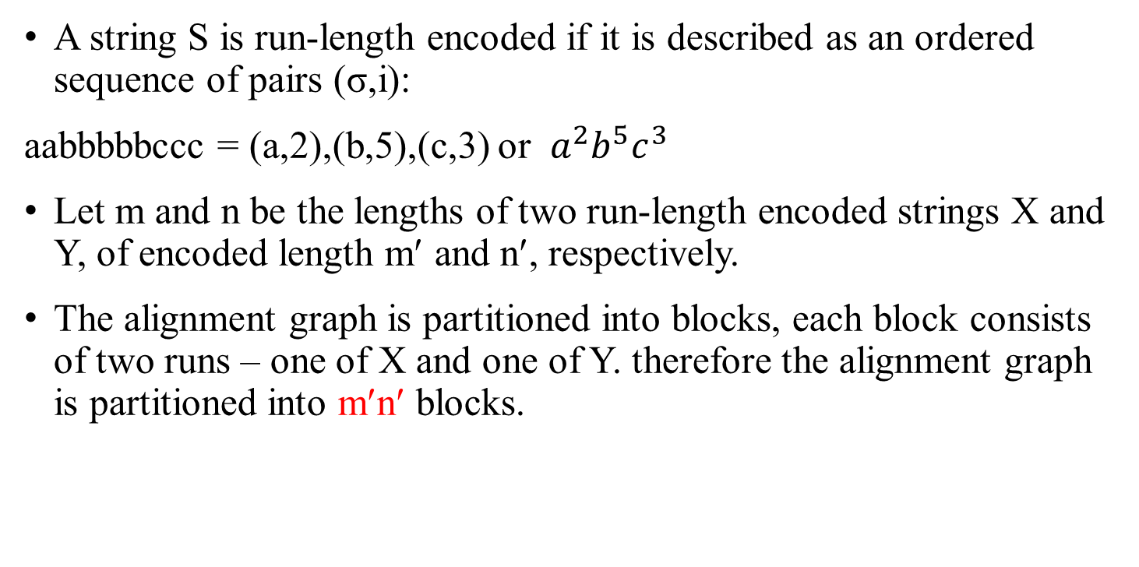
Comparing run length encoded strings
A string S is run-length encoded if it is described as an ordered sequence of pairs (σ,i):
aabbbbbccc = (a,2),(b,5),(c,3) or $a^{2}b^{5}c^{3}$
Let m and n be the lengths of two run-length encoded strings X and Y, of encoded length m′ and n′, respectively.
The alignment graph is partitioned into blocks, each block consists of two runs – one of X and one of Y. therefore the alignment graph is partitioned into m′n′ blocks.

Slide 22

Comparing run length encoded strings
The algorithm also propagates accumulated scores from the left-upper borders to the bottom-right borders of each block.
Consider the block R for comparing $^{i}$ of X and ${\text{}}^{j}$ of Y. An edge in R could be assigned one of three values: D(diagonal), H (horizontal) and V (vertical) according to scoring scheme.
Let ∆h and ∆w denote the diﬀerence in row index values and column index values, respectively, between entry i on the input border of R and entry j on the output border of R.
We show how to compute DIST [i, j] (which is the cost of the best scoring path from entry i in the input border of the block to entry j in the output border of the block) in constant time, given ∆h and ∆w for the input and output entries, and the values D, H , and V .

Slide 23
Computing DIST[i,j]
H + V ≤ D. Clearly, an optimal path from i to j can use all possible diagonal edges and only then the minimal number of remaining H and V edges necessary to reach j.
Therefore, DIST [i, j] obtains one of three values:
1. If ∆w = ∆h , then DIST [i, j] = D × ∆h .
2. If ∆w > ∆h , then DIST [i, j] = D × ∆h + H × (∆w − ∆h ).
3. If ∆w < ∆h , then DIST [i, j] = D × ∆w + V × (∆h − ∆w ).
• H + V > D. In this case, an optimal path never uses any diagonal edge.
DIST[i,j] = H × ∆w + V × ∆h
Therefore DIST[i,j] can be easily computed in constant time given a scoring scheme.

Slide 24
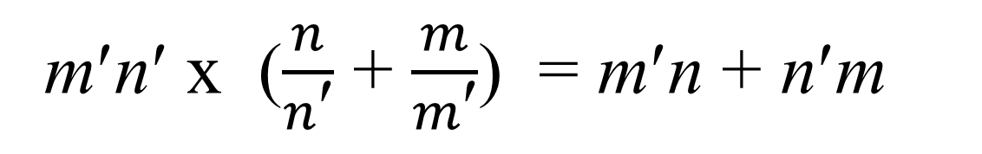
Time complexity
The O vector for each block is computed using SMAWK.
Vector I for block R can be obtained from the O vectors for the blocks above R and the block in its left.
Any value OUT[i,j]= I[i] + DIST[i,j], needed by SMAWK, can be computed in constant time.
Since The work for each block is linear with its I/O borders, the total time complexity is linear with the total size of the borders of the blocks – O(m′n + n′m).
m′n′ x ($\frac{n}{n\text{′}}$ + $\frac{m}{m\text{′}}$) = m′n + n′m

