Slide 1
Computing Longest Previous Factor in Linear Time and Applications
Maxime Crochemore, Lucian Ilie
Information Processing Letters 106.2 (2008): 75-80.
Presenter : Shie-Yan Lee
2017/10/03

Slide 2
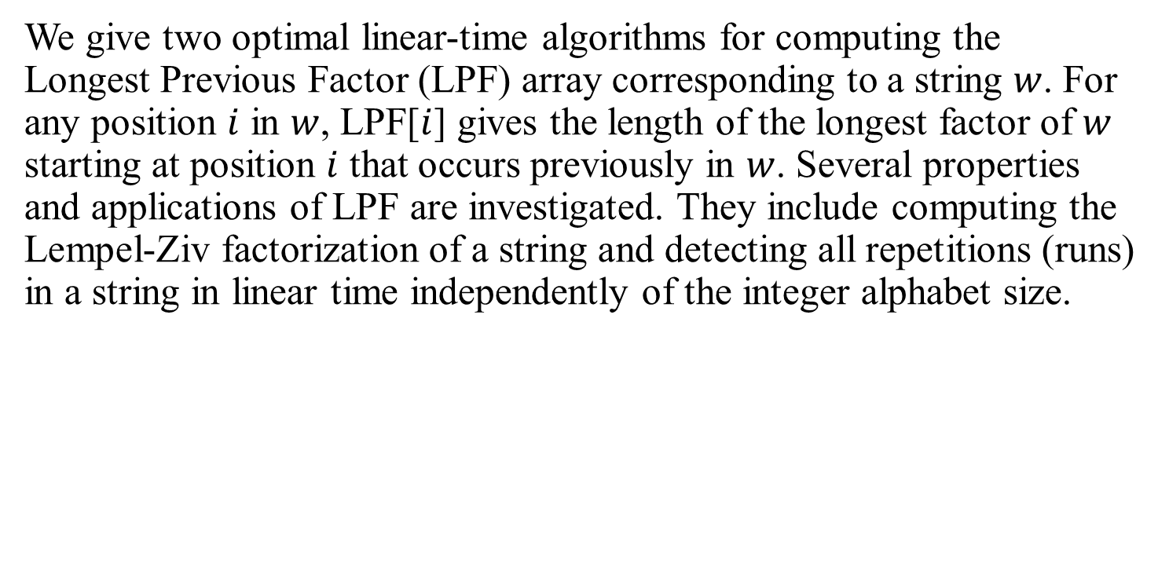
Abstract
We give two optimal linear-time algorithms for computing the Longest Previous Factor (LPF) array corresponding to a string $w$. For any position $i$ in $w$, LPF[$i$] gives the length of the longest factor of $w$ starting at position $i$ that occurs previously in $w$. Several properties and applications of LPF are investigated. They include computing the Lempel-Ziv factorization of a string and detecting all repetitions (runs) in a string in linear time independently of the integer alphabet size.

Slide 3


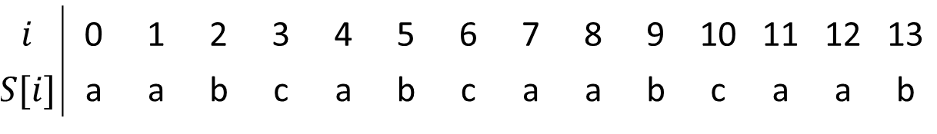



Longest Previous Factor (LPF)
$LPF[i] =max⁡( \{l│w[i…i+l−1]$is a factor of $w[0…i+l−2] \} ∪ \left\{0\right\} )$
$$i$$
$$w$$
$$l$$
$$l$$
$S$ : aabcabcaabcaab
$$i$$ | 0 | 1 | 2 | 3 | 4 | 5 | 6 | 7 | 8 | 9 | 10 | 11 | 12 | 13
$$S[i]$$ | a | a | b | c | a | b | c | a | a | b | c | a | a | b
$$LPF\left[7\right]=5$$

Slide 4


Longest Previous Factor (LPF)
$LPF[i] =max⁡( \{l│w[i…i+l−1]$is a factor of $w[0…i+l−2] \} ∪ \left\{0\right\} )$
$$i$$
$$w$$
$$l$$
$$l$$
$S$ : aabcabcaabcaab
$$i$$ | 0 | 1 | 2 | 3 | 4 | 5 | 6 | 7 | 8 | 9 | 10 | 11 | 12 | 13
$$S[i]$$ | a | a | b | c | a | b | c | a | a | b | c | a | a | b
$$LPF\left[8\right]=6$$

Slide 5
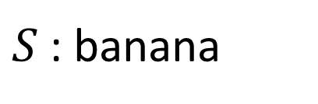
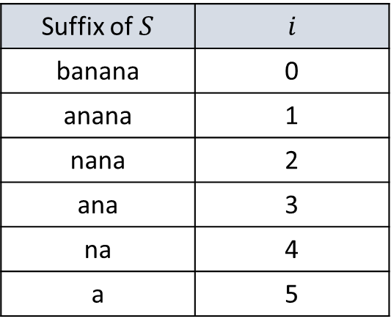
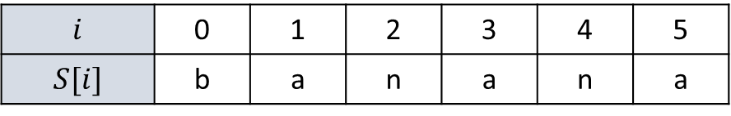
Suffix Array
$S$ : banana
$$i$$ | 0 | 1 | 2 | 3 | 4 | 5
$$S[i]$$ | b | a | n | a | n | a
Suffix of $S$ | $$i$$
banana | 0
anana | 1
nana | 2
ana | 3
na | 4
a | 5

Slide 6
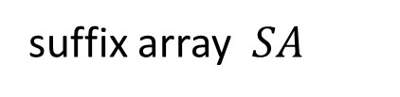
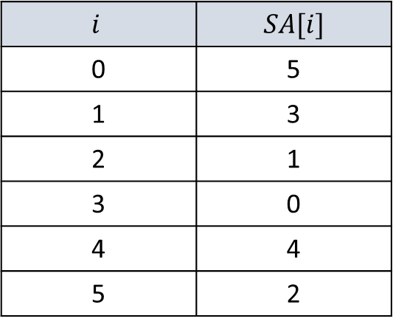
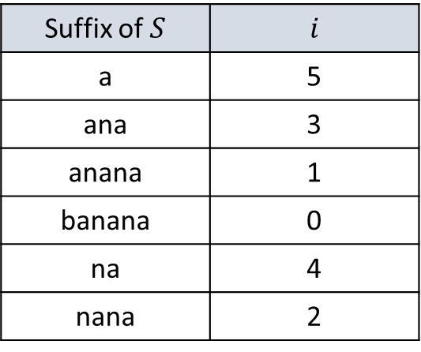
Suffix Array
$S$ : banana
$$i$$ | 0 | 1 | 2 | 3 | 4 | 5
$$S[i]$$ | b | a | n | a | n | a
suffix array $SA$
Suffix of $S$ | $$i$$
a | 5
ana | 3
anana | 1
banana | 0
na | 4
nana | 2
$$i$$ | $$SA[i]$$
0 | 5
1 | 3
2 | 1
3 | 0
4 | 4
5 | 2

Slide 7
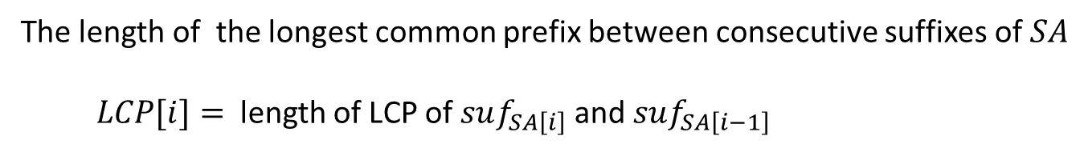
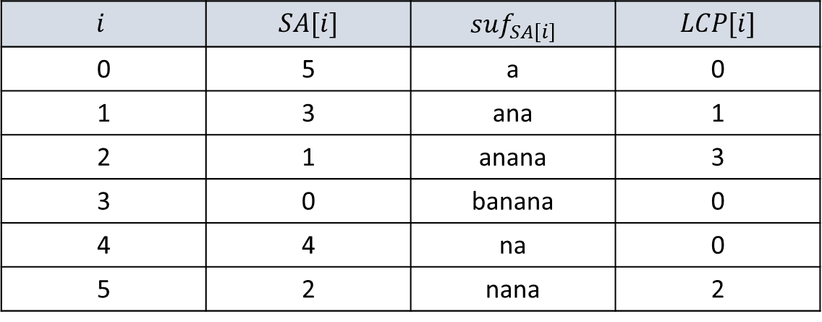
Longest Common Prefix (LCP)
The length of the longest common prefix between consecutive suffixes of $SA$
$LCP[i]=$ length of LCP of $suf_{SA\left[i\right]}$ and $suf_{SA\left[i−1\right]}$
S : banana
$$i$$ | $$SA[i]$$ | $$suf_{SA\left[i\right]}$$ | $$LCP[i]$$
0 | 5 | a | 0
1 | 3 | ana | 1
2 | 1 | anana | 3
3 | 0 | banana | 0
4 | 4 | na | 0
5 | 2 | nana | 2

Slide 8

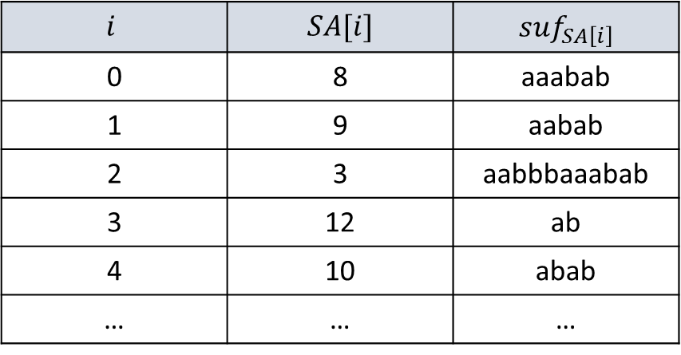














A direct algorithm for computing LPF from the suffix array
$$0$$
$$1$$
$$2$$
$$3$$
$$4$$
$$5$$
$$6$$
$$7$$
$$8$$
$$9$$
$$10$$
$$11$$
$$12$$
$$13$$
$$w$$
a b b a a b b b a a a b a b
$$i$$ | $$SA[i]$$ | $$suf_{SA\left[i\right]}$$
0 | 8 | aaabab
1 | 9 | aabab
2 | 3 | aabbbaaabab
3 | 12 | ab
4 | 10 | abab
… | … | …

Slide 9

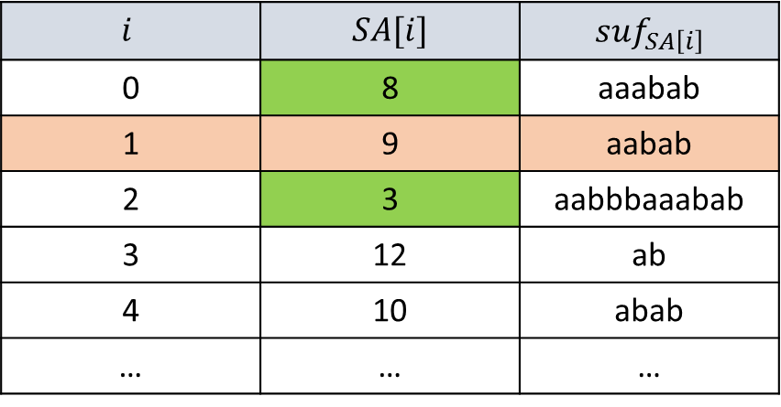















$$0$$
$$1$$
$$2$$
$$3$$
$$4$$
$$5$$
$$6$$
$$7$$
$$8$$
$$9$$
a b b a a b b b a a a b a b
$$w$$
a a b a b
$$i$$ | $$SA[i]$$ | $$suf_{SA\left[i\right]}$$
0 | 8 | aaabab
1 | 9 | aabab
2 | 3 | aabbbaaabab
3 | 12 | ab
4 | 10 | abab
… | … | …
$$suf_{8}$$
a a a b a b
$${pre}_{<}\left[9\right]=8$$
$$suf_{9}$$
a a b a b
$$suf_{3}$$
a a b b b a a a b a b
$${pre}_{>}\left[9\right]=3$$

Slide 10

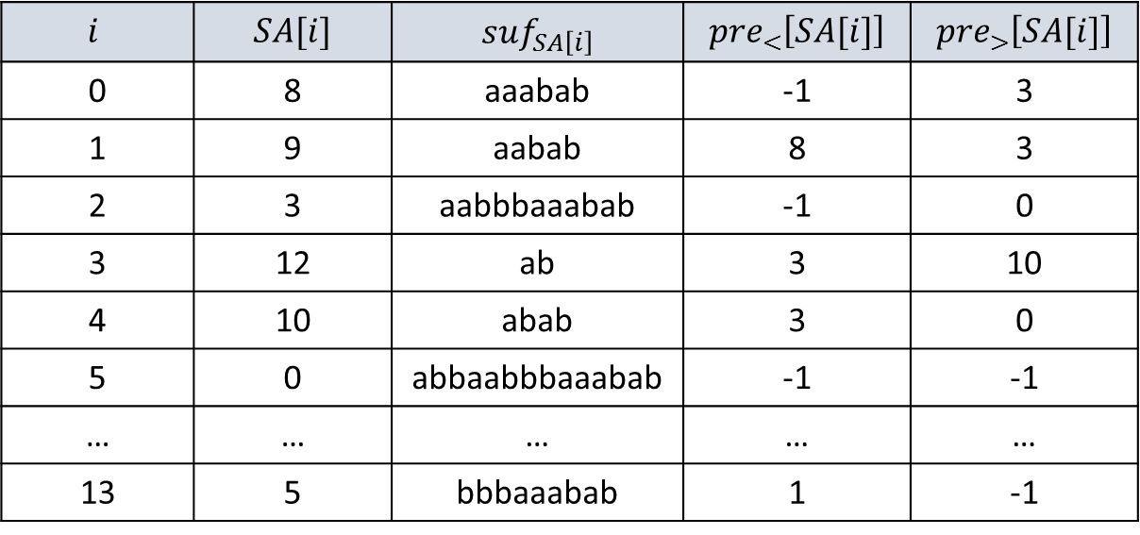



$$0$$
$$1$$
$$2$$
$$3$$
$$4$$
$$5$$
$$6$$
$$7$$
$$8$$
$$9$$
$$10$$
$$11$$
$$12$$
$$13$$
$$w$$
a b b a a b b b a a a b a b
$$i$$ | $$SA[i]$$ | $$suf_{SA\left[i\right]}$$ | $${pre}_{<}\left[SA[i]\right]$$ | $${pre}_{>}\left[SA[i]\right]$$
0 | 8 | aaabab | -1 | 3
1 | 9 | aabab | 8 | 3
2 | 3 | aabbbaaabab | -1 | 0
3 | 12 | ab | 3 | 10
4 | 10 | abab | 3 | 0
5 | 0 | abbaabbbaaabab | -1 | -1
… | … | … | … | …
13 | 5 | bbbaaabab | 1 | -1

Slide 11
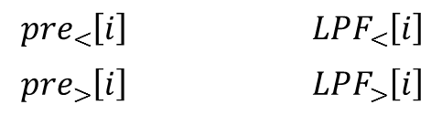
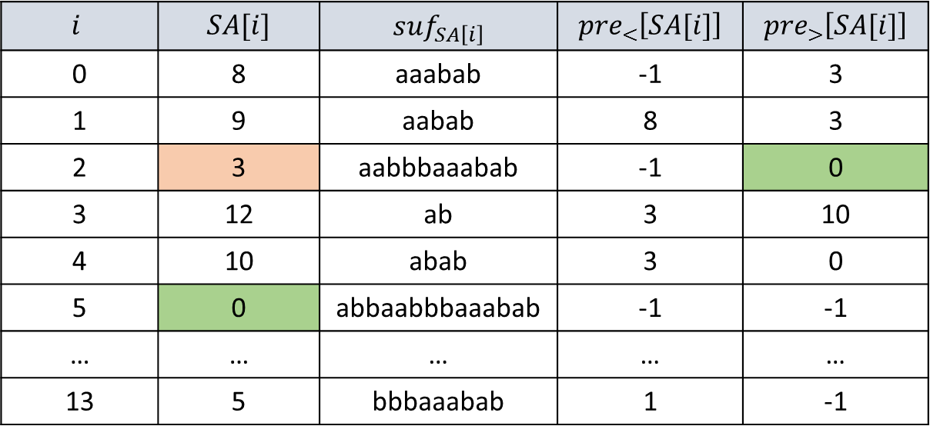

$$0$$
$$1$$
$$2$$
$$3$$
$$4$$
$$5$$
$$6$$
$$7$$
$$8$$
$$9$$
$$10$$
$$11$$
$$12$$
$$13$$
$$w$$
a b b a a b b b a a a b a b
$$i$$ | $$SA[i]$$ | $$suf_{SA\left[i\right]}$$ | $${pre}_{<}\left[SA[i]\right]$$ | $${pre}_{>}\left[SA[i]\right]$$
0 | 8 | aaabab | -1 | 3
1 | 9 | aabab | 8 | 3
2 | 3 | aabbbaaabab | -1 | 0
3 | 12 | ab | 3 | 10
4 | 10 | abab | 3 | 0
5 | 0 | abbaabbbaaabab | -1 | -1
… | … | … | … | …
13 | 5 | bbbaaabab | 1 | -1
$${pre}_{<}\left[i\right]$$ |  | $${LPF}_{<}\left[i\right]$$
$${pre}_{>}\left[i\right]$$ |  | $${LPF}_{>}\left[i\right]$$
$LPF\left[i\right]=max⁡\{{LPF}_{<}\left[i\right]$, ${LPF}_{>}\left[i\right]\}$

Slide 12
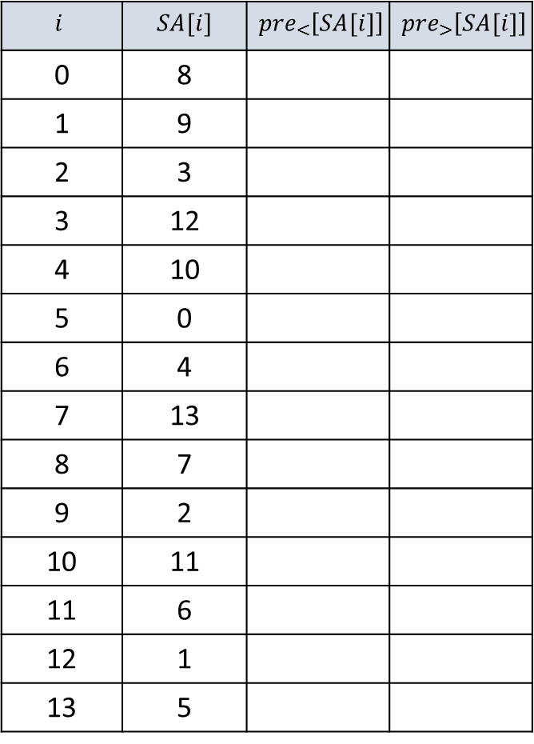

Computing the ${pre}_{<}$ and ${pre}_{>}$arrays
-1
8
9
3
12
10
0
4
13
7
2
11
6
1
5
-1
$$i$$ | $$SA[i]$$ | $${pre}_{<}\left[SA[i]\right]$$ | $${pre}_{>}\left[SA[i]\right]$$
0 | 8
1 | 9
2 | 3
3 | 12
4 | 10
5 | 0
6 | 4
7 | 13
8 | 7
9 | 2
10 | 11
11 | 6
12 | 1
13 | 5
Doubly linked list
(array)
i= 13 to 0

Slide 13

Computing the ${pre}_{<}$ and ${pre}_{>}$arrays
-1
8
9
3
12
10
0
4
13
7
2
11
6
1
5
-1
$$i$$ | $$SA[i]$$ | $${pre}_{<}\left[SA[i]\right]$$ | $${pre}_{>}\left[SA[i]\right]$$
0 | 8
1 | 9
2 | 3
3 | 12
4 | 10
5 | 0
6 | 4
7 | 13 | 4 | 7
8 | 7
9 | 2
10 | 11
11 | 6
12 | 1
13 | 5
Doubly linked list
(array)
i= 13 to 0

Slide 14
Computing the ${pre}_{<}$ and ${pre}_{>}$arrays
-1
8
9
3
12
10
0
4
7
2
11
6
1
5
-1
$$i$$ | $$SA[i]$$ | $${pre}_{<}\left[SA[i]\right]$$ | $${pre}_{>}\left[SA[i]\right]$$
0 | 8
1 | 9
2 | 3
3 | 12
4 | 10
5 | 0
6 | 4
7 | 13 | 4 | 7
8 | 7
9 | 2
10 | 11
11 | 6
12 | 1
13 | 5
Doubly linked list
(array)
i= 13 to 0

Slide 15

Computing the ${pre}_{<}$ and ${pre}_{>}$arrays
-1
8
9
3
12
10
0
4
7
2
11
6
1
5
-1
$$i$$ | $$SA[i]$$ | $${pre}_{<}\left[SA[i]\right]$$ | $${pre}_{>}\left[SA[i]\right]$$
0 | 8
1 | 9
2 | 3
3 | 12 | 3 | 10
4 | 10
5 | 0
6 | 4
7 | 13 | 4 | 7
8 | 7
9 | 2
10 | 11
11 | 6
12 | 1
13 | 5
Doubly linked list
(array)
i= 13 to 0

Slide 16

Computing the ${pre}_{<}$ and ${pre}_{>}$arrays
-1
8
9
3
10
0
4
7
2
11
6
1
5
-1
$$i$$ | $$SA[i]$$ | $${pre}_{<}\left[SA[i]\right]$$ | $${pre}_{>}\left[SA[i]\right]$$
0 | 8
1 | 9 | 8 | 3
2 | 3
3 | 12 | 3 | 10
4 | 10
5 | 0
6 | 4
7 | 13 | 4 | 7
8 | 7
9 | 2
10 | 11
11 | 6
12 | 1
13 | 5
Doubly linked list
(array)
i= 13 to 0

Slide 17
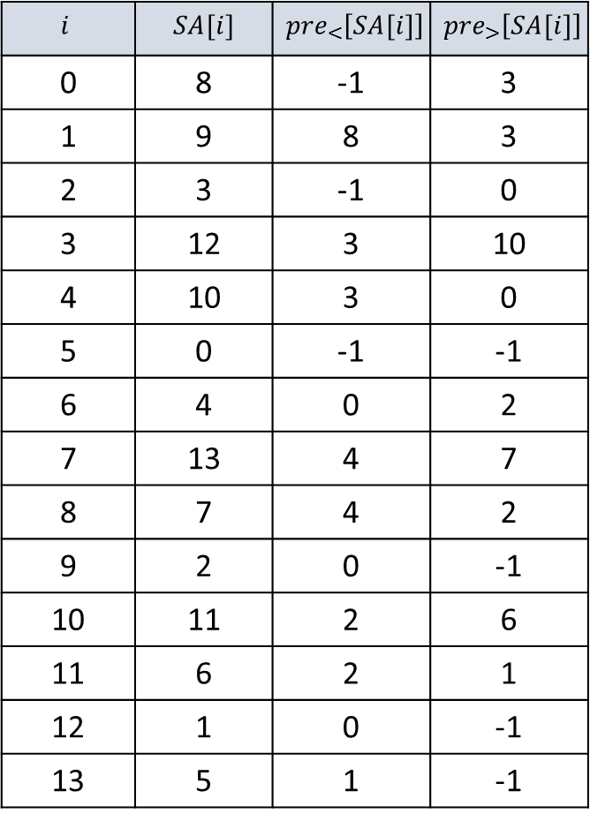
Computing the ${pre}_{<}$ and ${pre}_{>}$arrays
-1
0
-1
$$i$$ | $$SA[i]$$ | $${pre}_{<}\left[SA[i]\right]$$ | $${pre}_{>}\left[SA[i]\right]$$
0 | 8 | -1 | 3
1 | 9 | 8 | 3
2 | 3 | -1 | 0
3 | 12 | 3 | 10
4 | 10 | 3 | 0
5 | 0 | -1 | -1
6 | 4 | 0 | 2
7 | 13 | 4 | 7
8 | 7 | 4 | 2
9 | 2 | 0 | -1
10 | 11 | 2 | 6
11 | 6 | 2 | 1
12 | 1 | 0 | -1
13 | 5 | 1 | -1
Doubly linked list
(array)
i= 13 to 0

Slide 18

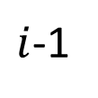







$$j=LPF_{<}\left[i−1\right]−1$$
$${pre}_{<}\left[i\right]$$
$${pre}_{<}\left[i−1\right]$$
$i$-1
$$i$$
$$w$$
$$j$$
$$j$$
$$j$$

Slide 19










$${pre}_{<}\left[21\right]$$
$${pre}_{<}\left[20\right]$$
$$3$$
$$10$$
$$11$$
$2$0
$2$1
$$w$$
b
c
b
c
b
a
b
c
b
c
b
a
a
b
c
b
c
b
b
$$5$$
$$5$$
$$5$$

Slide 20
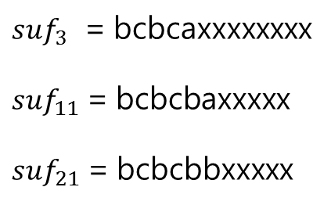

$${pre}_{<}\left[21\right]$$
$${pre}_{<}\left[20\right]$$
$$3$$
$$10$$
$$11$$
$2$0
$2$1
$$w$$
b
c
b
c
a
a
b
c
b
c
b
a
a
b
c
b
c
b
b
$$5$$
$$5$$
$$5$$
字典排序
$suf_{3 }$ = bcbcaxxxxxxxx
$suf_{11}$ = bcbcbaxxxxx
$suf_{21}$ = bcbcbbxxxxx
${pre}_{<}\left[21\right]$ should be$11 !$

Slide 21
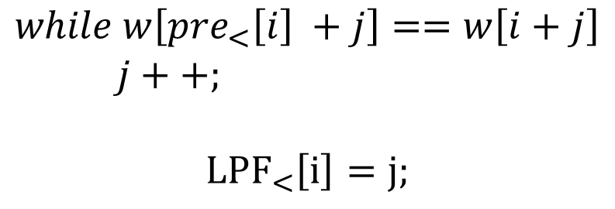
$${pre}_{<}\left[i\right]$$
$${pre}_{<}\left[i−1\right]$$
$i$-1
$$i$$
$$w$$
$$j$$
$$j$$
$$j$$
$$while w\left[{pre}_{<}\left[i\right] +j\right]==w\left[i+j\right]$$
$j++;$
$${LPF}_{<}\left[i\right]=j;$$

Slide 22
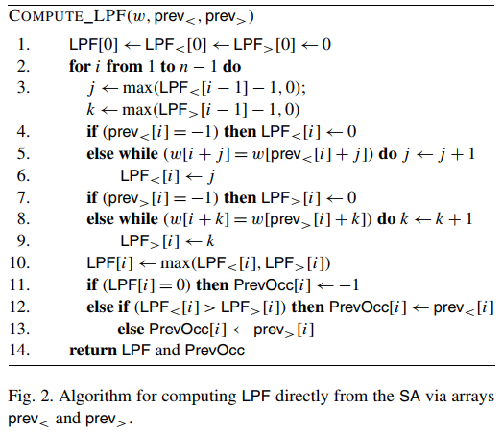
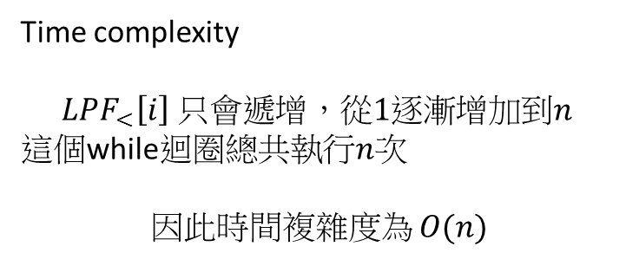
Time complexity
$$LPF_{<}\left[i\right] 只會遞增，從1逐漸增加到n$$
這個while迴圈總共執行$n$次
因此時間複雜度為 $O(n)$

Slide 23









An algorithm using LCP
$$j$$
$$i$$
$$w$$
$$l$$
$$i$$
$$l$$
$$suf_{i}$$
$$j$$
$$suf_{j}$$
$l$ = the length of the longest common prefix between these suffixes.

Slide 24
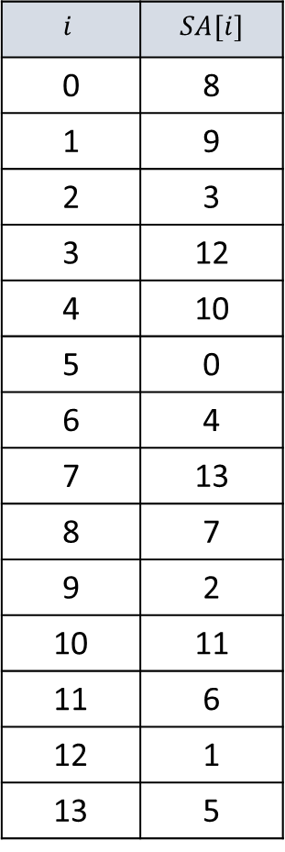
An algorithm using LCP
13
12
$$i$$ | $$SA[i]$$
0 | 8
1 | 9
2 | 3
3 | 12
4 | 10
5 | 0
6 | 4
7 | 13
8 | 7
9 | 2
10 | 11
11 | 6
12 | 1
13 | 5
2
11
10
1
9
0
1
2
1
8
7
2
3
6
2
5
4
3
4
3
2
3
2
1
0

Slide 25
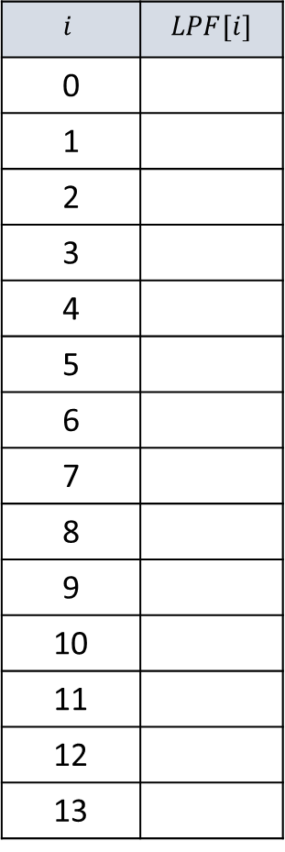
An algorithm using LCP
13
12
$$i$$ | $$LPF[i]$$
0
1
2
3
4
5
6
7
8
9
10
11
12
13
2
11
10
1
9
0
1
2
1
8
7
2
3
6
2
5
4
3
4
3
2
3
2
1
0

Slide 26
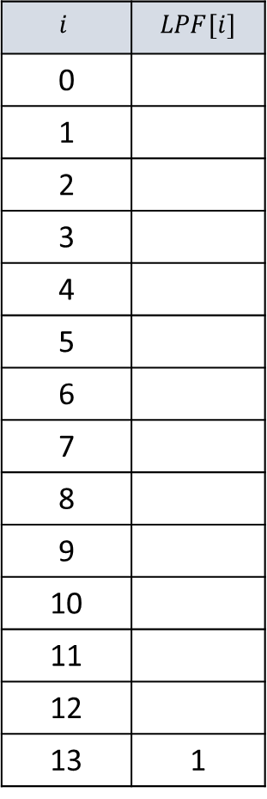
An algorithm using LCP
13
12
$$i$$ | $$LPF[i]$$
0
1
2
3
4
5
6
7
8
9
10
11
12
13 | 1
2
11
10
1
9
0
1
2
1
8
7
2
3
6
2
5
4
3
4
3
2
3
2
1
0

Slide 27
An algorithm using LCP
12
$$i$$ | $$LPF[i]$$
0
1
2
3
4
5
6
7
8
9
10
11
12
13 | 1
2
11
10
9
1
2
1
8
7
2
3
6
2
0
5
4
3
4
3
2
3
2
1
0

Slide 28
An algorithm using LCP
12
$$i$$ | $$LPF[i]$$
0
1
2
3
4
5
6
7
8
9
10
11
12
13 | 1
2
11
10
9
1
2
1
8
7
2
3
6
2
0
5
4
3
4
3
2
3
2
1
0

Slide 29

An algorithm using LCP
12
$$i$$ | $$LPF[i]$$
0
1
2
3
4
5
6
7
8
9
10
11
12 | 2
13 | 1
2
11
10
9
1
2
1
8
7
2
3
6
2
0
5
4
3
4
3
2
3
2
1
0

Slide 30
An algorithm using LCP
$$i$$ | $$LPF[i]$$
0
1
2
3
4
5
6
7
8
9
10
11
12 | 2
13 | 1
11
10
9
1
2
8
7
2
3
1
2
0
6
5
4
3
4
3
2
3
2
1
0

Slide 31
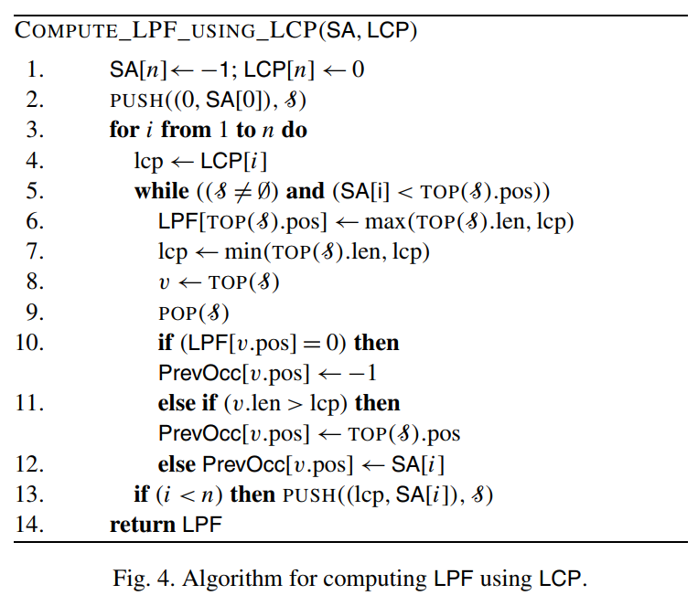
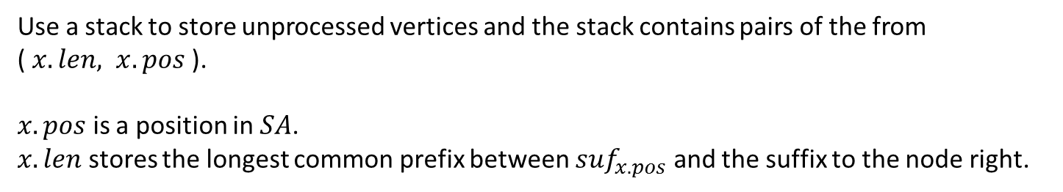

An algorithm using LCP
Use a stack to store unprocessed vertices and the stack contains pairs of the from
( $x.len, x.pos$).
$x.pos$ is a position in $SA$.
$x.len$ stores the longest common prefix between $suf_{x.pos}$ and the suffix to the node right.
$LPF$ is a permutation of $LCP$.

Slide 32
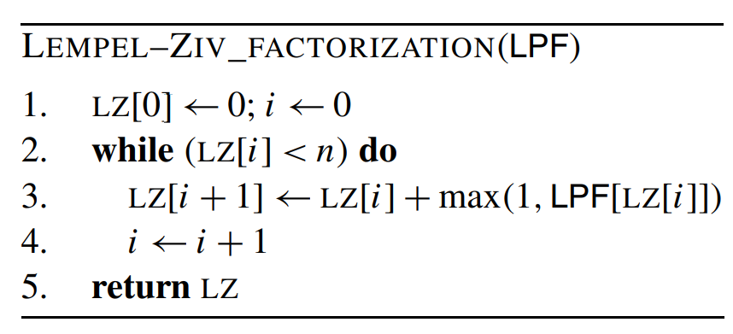
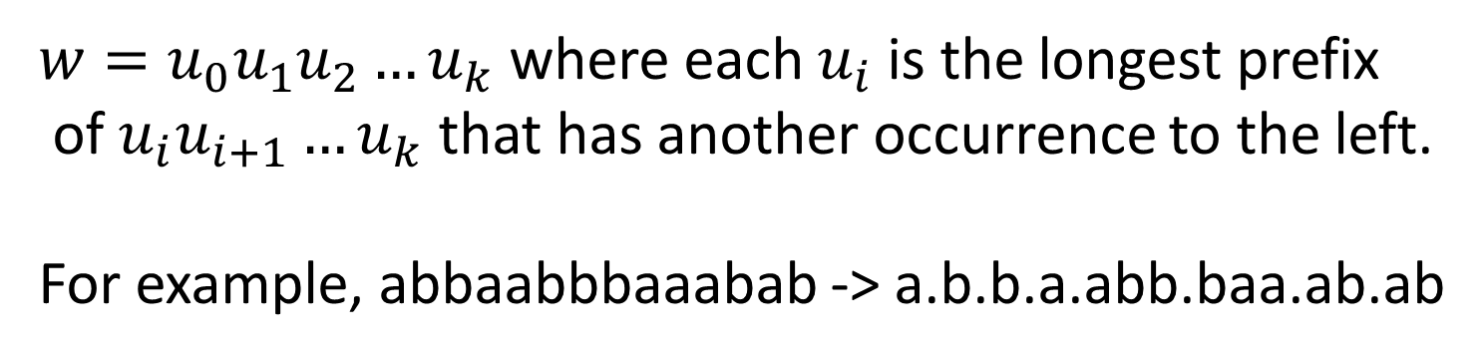

Applications
Lempel-Ziv factorization
$w=u_{0}u_{1}u_{2}…u_{k}$ where each $u_{i}$ is the longest prefix
of $u_{i}u_{i+1}…u_{k}$ that has another occurrence to the left.
For example, abbaabbbaaabab -> a.b.b.a.abb.baa.ab.ab
$$LZ=[0,1,2,3,4,7,10,12]$$

Slide 33
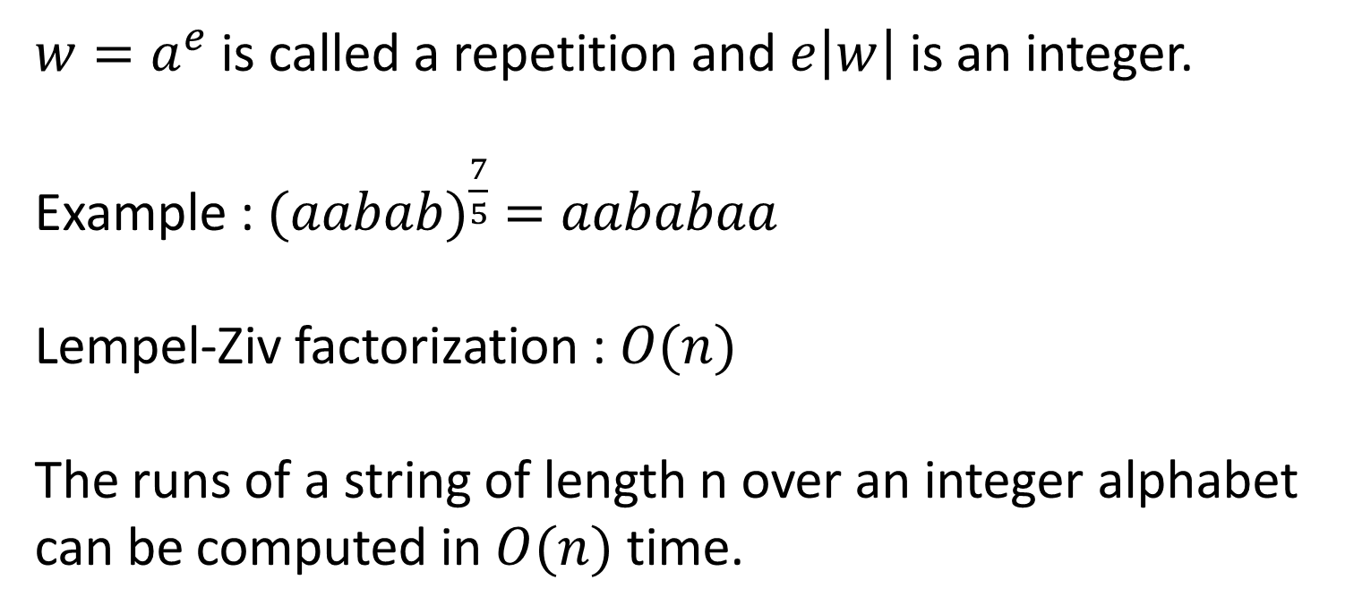
Applications
Computing runs in linear time
$w=a^{e}$is called a repetition and $e\left|w\right|$ is an integer.
Example : ${(aabab)}^{\frac{7}{5}} =aababaa$
Lempel-Ziv factorization : $O(n)$
The runs of a string of length n over an integer alphabet
can be computed in $O(n)$ time.

