Slide 1
Time series classification with ensembles of elastic distance measures
Jason Lines, Anthony Bagnall
Data Mining and Knowledge Discovery, Volume 29, Issue 3,
pp. 565 – 592, May 2015
Presenter : Bo-Xian Chen
Date : 2017/10/31

Slide 2
Abstract
Several alternative distance measures for comparing time series have recently been proposed and evaluated on time series classification (TSC) problems. These include variants of dynamic time warping (DTW), such as weighted and derivative DTW, and edit distance-based measures, including longest common subsequence, edit distance with real penalty, time warp with edit, and move–split–merge. These measures have the common characteristic that they operate in the time domain and compensate for potential localised misalignment through some elastic adjustment. Our aim is to experimentally test two hypotheses related to these distance measures. Firstly, we test whether there is any significant difference in accuracy for TSC problems between nearest neighbour classifiers using these distance measures. Secondly, we test whether combining these elastic distance measures through simple ensemble schemes gives significantly better accuracy.
Notes:
Neighbour
【英】= neighbor

Slide 3
Abstract
We test these hypotheses by carrying out one of the largest experimental studies ever conducted into time series classification. Our first key finding is that there is no significant difference between the elastic distance measures in terms of classification accuracy on our data sets. Our second finding, and the major contribution of this work, is to define an ensemble classifier that significantly outperforms the individual classifiers. We also demonstrate that the ensemble is more accurate than approaches not based in the time domain. Nearly all TSC papers in the data mining literature cite DTW(with warping window set through cross validation) as the benchmark for comparison. We believe that our ensemble is the first ever classifier to significantly outperform DTW and as such raises the bar for future work in this area.

Slide 4


Dynamic Time Warping(DTW)
$$D_{i, j}=d_{i, j}+\min\left\{\begin{aligned}&D_{i, j−1} \\ &D_{i−1, j} i=2, …, M j=2, …, N \\ &D_{i−1, j−1}\end{aligned}\right.$$
Warping Path
$$φ_{xy}=\left\{\begin{aligned}\left[1;K\right]→\left[1;M\right]×[1;N] \\ k→φ_{xy}\left(k\right)=(φ_{xy}^{x}\left(k\right),φ_{xy}^{y}\left(k\right))\end{aligned}\right.$$
$$\max\left(M, N\right)≤K≤M+N−1$$
Distance
$$DTW\left(Q, C\right)=min\left\{\begin{aligned}\sqrt{\sum_{k=1}^{K}{φ_{k}}}\end{aligned}\right.$$

Slide 5
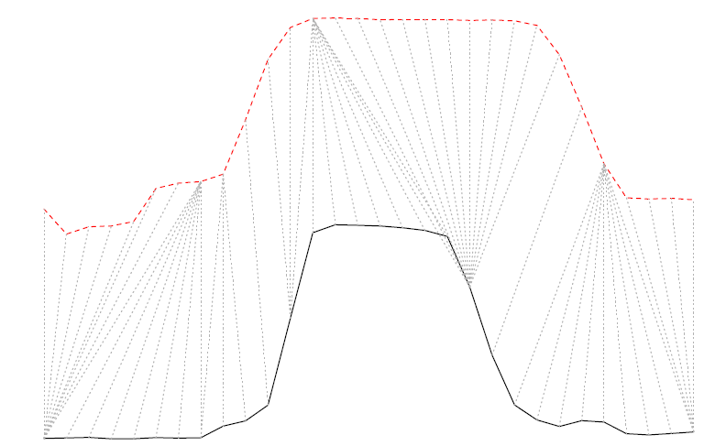
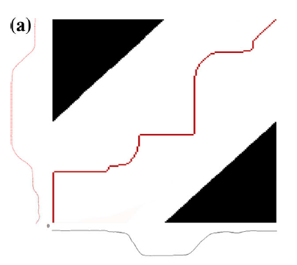
Dynamic Time Warping(DTW)

Slide 6


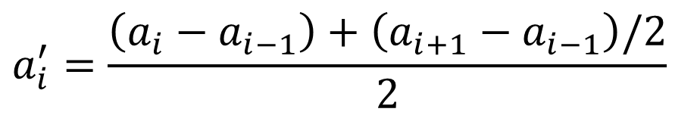





Derivative Dynamic Time Warping(DDTW)
Series
$$a=\{a_{1}, a_{2}, …, a_{m}\}$$
$$a′=\{{a′}_{1}, {a′}_{2}, …, {a′}_{m−1}\}$$
$${a′}_{i} is average of the slope between a_{i−1}, a_{i} and a_{i} and a_{i+1}$$
$$a_{i}^{′}=\frac{\left(a_{i}−a_{i−1}\right)+\left(a_{i+1}−a_{i−1}\right)/2}{2}$$
$$a_{i−1}$$
$$a_{i}$$
$$Derivative DTW→mitigate noise$$
$$1$$
$$a_{i+1}$$
$$2$$

Slide 7
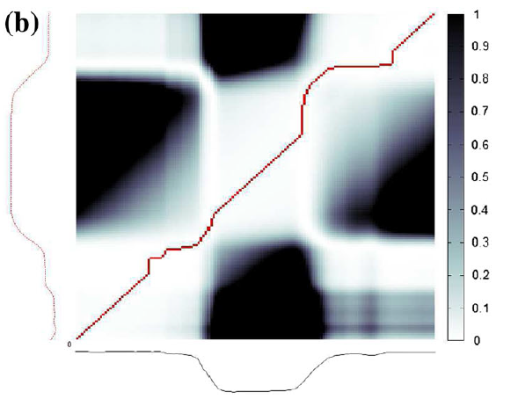
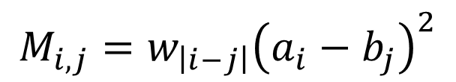
Weighted Dynamic Time Warping(WDTW)
Adds a Multiplicative Weight Penalty
Weight Penalty
$$M_{i, j}=w_{\left|i−j\right|}{\left(a_{i}−b_{j}\right)}^{2}$$

Slide 8
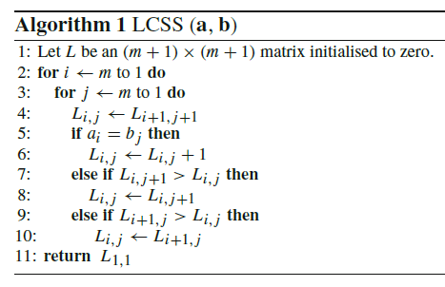
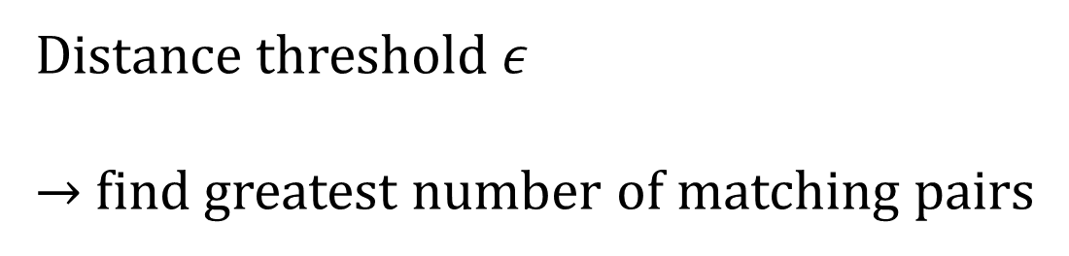
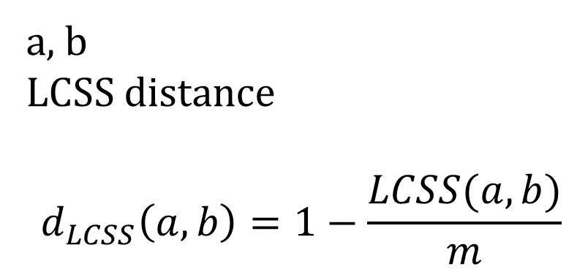
Longest Common Subsequence(LCSS)
Distance threshold $ε$
→ find greatest number of matching pairs
a, b
LCSS distance
$$d_{LCSS}\left(a, b\right)=1−\frac{LCSS(a, b)}{m}$$

Slide 9
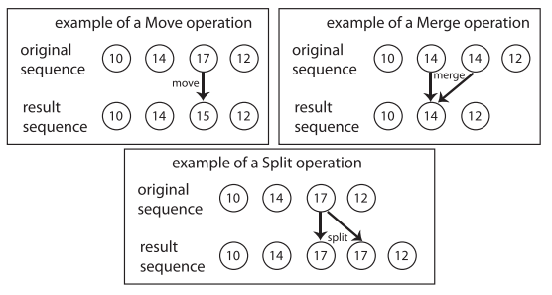



Move-Split-Merge(MSM) Distance
Edit distance
Insert
Delete
Substitute
$$Cost\left(Move_{i, v}\right)=|v|$$
$$Cost\left(Merge_{i}\right)=c$$
MSM
Move
Merge
Split
$$Cost\left(Split_{i}\right)=c$$

Slide 10
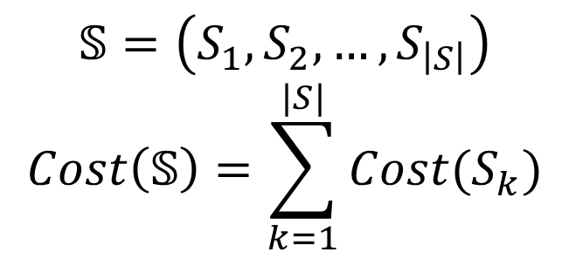



Move-Split-Merge(MSM) Distance
$$Cost\left(Move_{i, v}\right)=|v|$$
$$Cost\left(Merge_{i}\right)=c$$
Sequence of operations
$$𝕊=\left(S_{1}, S_{2}, …, S_{\left|S\right|}\right)$$
$$Cost\left(𝕊\right)=\sum_{k=1}^{|S|}{Cost(S_{k})}$$
$$Cost\left(Split_{i}\right)=c$$

Slide 11
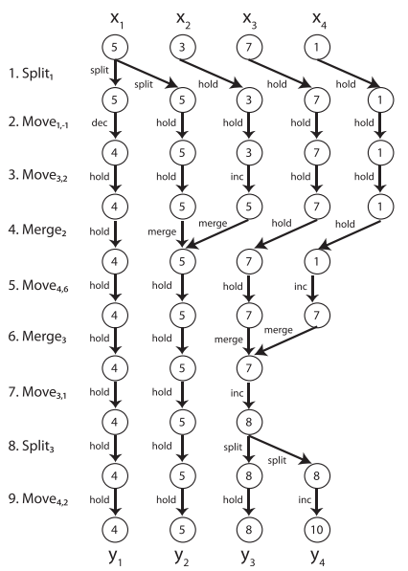
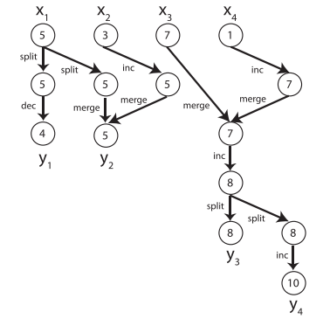
Move-Split-Merge(MSM) Distance

Slide 12
Data Sets
75 data sets
46 UCR repository
24 are used in other published work
5 new data

Slide 13
Ensemble Schemes and Distance Measures
Equal
Best
Proportional
Significant
Euclidean distance(ED)
DTW and DDTW
DTWCV and DDTWCV
WDTW and WDDTW
LCSS
ERP
TWE
MSM

Slide 14
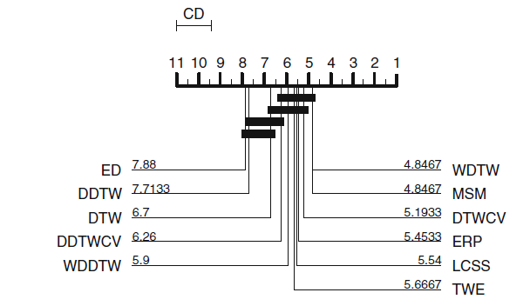
Critical Difference

Slide 15
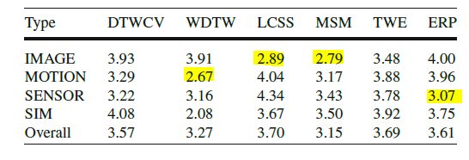
Average Ranks

Slide 16
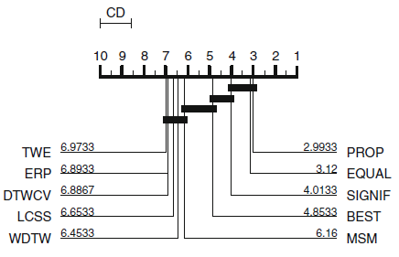
Individual v.s. Ensemble
Six highest ranked individual classifiers & four ensemble techniques

Slide 17
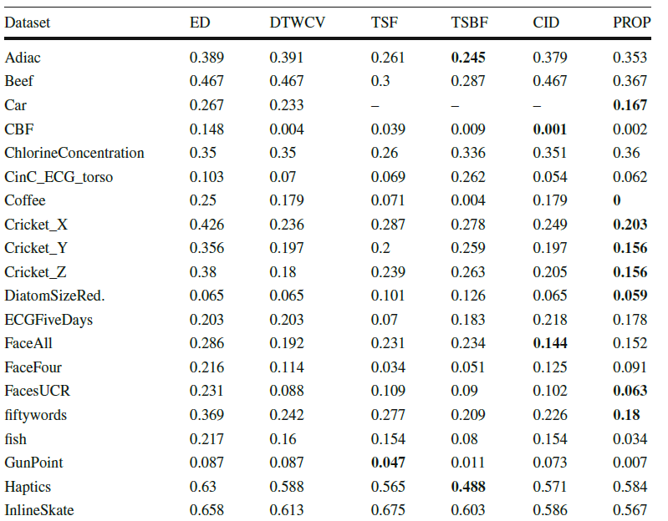
Experimental Results

Slide 19

Critical Difference
K classifiers over n data sets → Rank
$$Q=\frac{12n}{k(k+1)}\left[\sum_{j=1}^{k}{{\overline{γ}}_{j}^{2}}−\frac{k{\left(k+1\right)}^{2}}{4}\right]$$

