Slide 1
On the Marriage of Lp-norms and Edit Distance
Lei Chen
Raymond Ng
Proceedings of the 30th VLDB Conference, Toronto, Canada, 2004
Presenter: Hsiu-Chieh Hung
Date: 2017/10/31

Slide 2
Abstract(1/2)
Existing studies on time series are based on two categories of distance functions. The first category consists of the Lp-norms. They are metric distance functions but cannot support local time shifting. The second category consists of distance functions which are capable of handling local time shifting but are non-metric. The first contribution of this paper is the proposal of a new distance function, which we call ERP (“Edit distance with Real Penalty”). Representing a marriage of L1- norm and the edit distance, ERP can support local time shifting, and is a metric.

Slide 3
Abstract(2/2)
The second contribution of the paper is the development of pruning strategies for large time series databases. Given that ERP is a metric, one way to prune is to apply the triangle inequality. Another way to prune is to develop a lower bound on the ERP distance. We propose such a lower bound, which has the nice computational property that it can be efficiently indexed with a standard B+-tree. Moreover, we show that these two ways of pruning can be used simultaneously for ERP distances. Specifically, the false positives obtained from the B+-tree can be further minimized by applying the triangle inequality. Based on extensive experimentation with existing benchmarks and techniques, we show that this combination delivers superb pruning power and search time performance, and dominates all existing strategies.

Slide 4
Query sequence
database
找出k個跟query sequence最近的time series

Slide 5
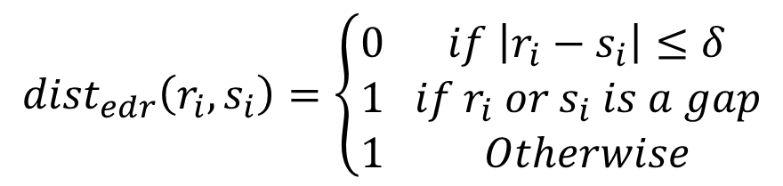
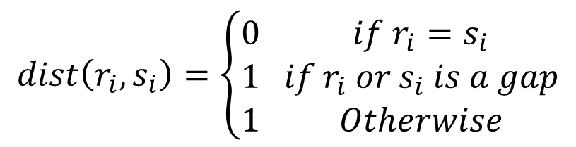
Edit Distance
$$dist\left(r_{i}, s_{i}\right)=\left\{\begin{aligned}&0 &if r_{i}=s_{i} \\ &1 &if r_{i} or s_{i} is a gap \\ &1 &Otherwise\end{aligned}\right.$$
$${dist}_{edr}\left(r_{i}, s_{i}\right)=\left\{\begin{aligned}&0 &if \left|r_{i}−s_{i}\right|≤δ \\ &1 &if r_{i} or s_{i} is a gap \\ &1 &Otherwise\end{aligned}\right.$$

Slide 6
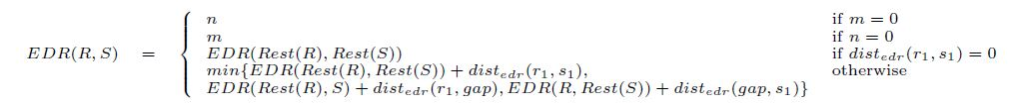
Edit Distance

Slide 7
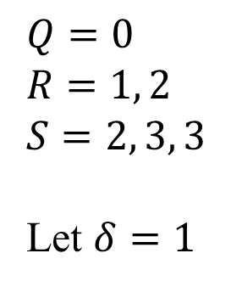
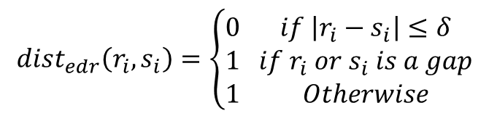
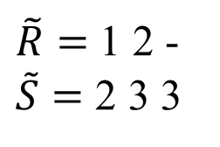
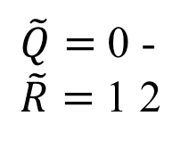
Edit Distance
$${dist}_{edr}\left(r_{i}, s_{i}\right)=\left\{\begin{aligned}&0 &if \left|r_{i}−s_{i}\right|≤δ \\ &1 &if r_{i} or s_{i} is a gap \\ &1 &Otherwise\end{aligned}\right.$$
$$Q=0$$
$$R=1, 2$$
$$S=2, 3, 3$$
Let $δ=1$
$\tilde{Q}=$ 0 -
$\tilde{R}=$ 1 2
$\tilde{R}=$ 1 2 -
$\tilde{S}=$ 2 3 3
EDR(Q, R) = 0 + 1 = 1
EDR(R, S) = 0 + 0 + 1 = 1
EDR(Q, S) = 3 > EDR(Q, R) + EDR(R, S)
Triangle inequality

Slide 8
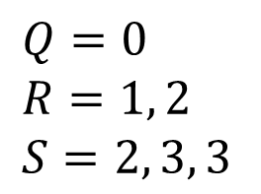
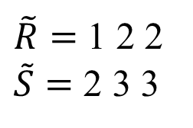
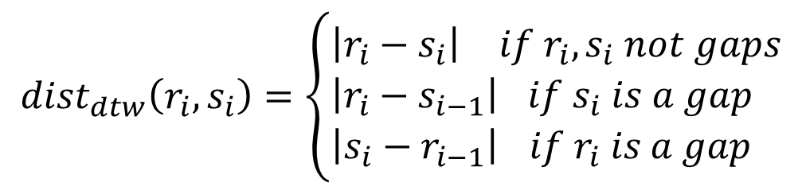
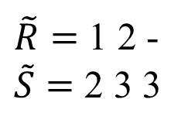
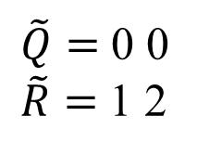
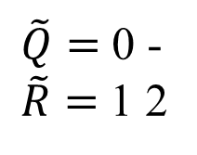
DTW
$${dist}_{dtw}\left(r_{i}, s_{i}\right)=\left\{\begin{aligned}&\left|r_{i}−s_{i}\right| &if r_{i}, s_{i} not gaps \\ &\left|r_{i}−s_{i−1}\right|&if s_{i} is a gap \\ &\left|{s_{i}−r}_{i−1}\right|&if r_{i} is a gap\end{aligned}\right.$$
$$Q=0$$
$$R=1, 2$$
$$S=2, 3, 3$$
$\tilde{Q}=$ 0 -
$\tilde{R}=$ 1 2
$\tilde{Q}=$ 0 0
$\tilde{R}=$ 1 2
$\tilde{R}=$ 1 2 -
$\tilde{S}=$ 2 3 3
$\tilde{R}=$ 1 2 2
$\tilde{S}=$ 2 3 3
DTW(Q, R) = 1 + 2 = 3
DTW(R, S) = 1 + 1 + 1 = 3
DTW(Q, S) = 8 > DTW(Q, R) + DTW(R, S)
Triangle inequality

Slide 9
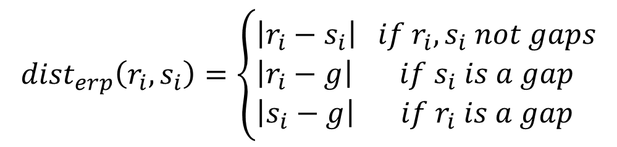

ERP
$${dist}_{erp}\left(r_{i}, s_{i}\right)=\left\{\begin{aligned}&\left|r_{i}−s_{i}\right| &if r_{i}, s_{i} not gaps \\ &\left|r_{i}−g\right|&if s_{i} is a gap \\ &\left|s_{i}−g\right|&if r_{i} is a gap\end{aligned}\right.$$
$$g=0$$
Satisfy triangle inequality

Slide 10
Pruning method
Triangle inequality
Lower bound

Slide 11
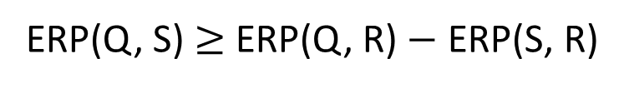
Pruning method — Triangle inequality
Pmatrix：儲存資料庫pairwise比較的資訊
procArray：已經跟query sequence比較過的資訊
result：儲存目前為止最近的k個time series的資訊
ERP(Q, S) $≥$ ERP(Q, R) $−$ ERP(S, R)

Slide 12
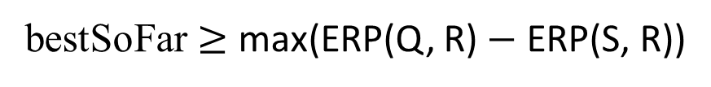
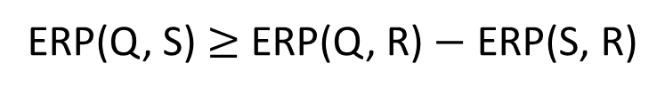
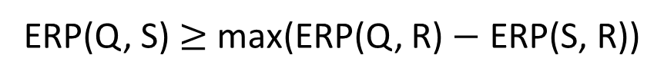
Pruning method — Triangle inequality
Pmatrix：儲存資料庫pairwise比較的資訊
procArray：已經跟query sequence比較過的資訊
result：儲存目前為止最近的k個time series的資訊
scan
ERP(Q, S) $≥$ ERP(Q, R) $−$ ERP(S, R)
ERP(Q, S) $≥$ max(ERP(Q, R) $−$ ERP(S, R))
bestSoFar $≥$ max(ERP(Q, R) $−$ ERP(S, R))
Find the best
計算ERP(Q, S)

Slide 13
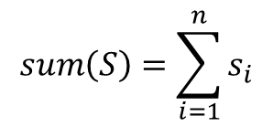

Pruning method — Lower bound
$${DLB}_{erp}\left(Q, S\right)=\left|sum\left(Q\right)−sum(S)\right|$$
$$sum\left(S\right)=\sum_{i=1}^{n}{s_{i}}$$

Slide 14

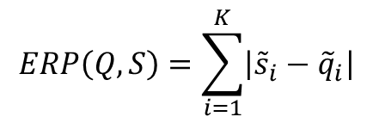

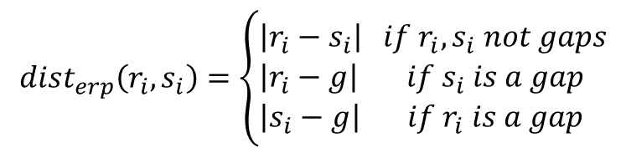

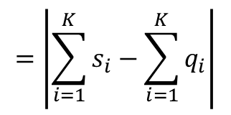
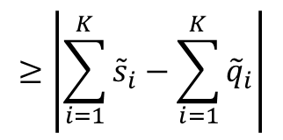
Pruning method — Lower bound
$${dist}_{erp}\left(r_{i}, s_{i}\right)=\left\{\begin{aligned}&\left|r_{i}−s_{i}\right| &if r_{i}, s_{i} not gaps \\ &\left|r_{i}−g\right|&if s_{i} is a gap \\ &\left|s_{i}−g\right|&if r_{i} is a gap\end{aligned}\right.$$
$${DLB}_{erp}\left(Q, S\right)=\left|sum\left(Q\right)−sum(S)\right|$$
$$ERP\left(Q,S\right)=\sum_{i=1}^{K}{\left|{\tilde{s}}_{i}−{\tilde{q}}_{i}\right|}$$
$$≥\left|\sum_{i=1}^{K}{{\tilde{s}}_{i}−\sum_{i=1}^{K}{{\tilde{q}}_{i}}}\right|$$
$$=\left|\sum_{i=1}^{K}{s_{i}−\sum_{i=1}^{K}{q_{i}}}\right|$$
Because $g=0$
$${=DLB}_{erp}\left(Q, S\right)$$

Slide 15
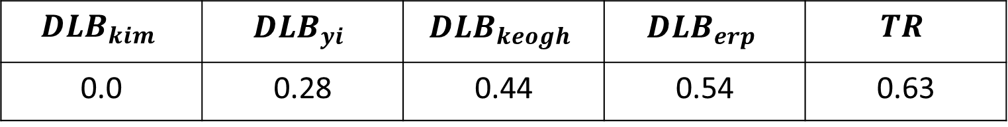
Experiment
24 datasets
Each dataset contains 200 time series with length 256
k = 20
$${DLB}_{kim}$$ | $$DLB_{yi}$$ | $$DLB_{keogh}$$ | $$DLB_{erp}$$ | $$TR$$
0.0 | 0.28 | 0.44 | 0.54 | 0.63

Slide 16
Experiment
M-tree | TR | B+tree | B+TR(static) |  |  | B+TR(dynamic)
 |  |  | 20 | 50 | 100 | 20 | 50 | 100
0.59 | 0.63 | 0.72 | 0.76 | 0.80 | 0.82 | 0.74 | 0.76 | 0.77

Slide 17
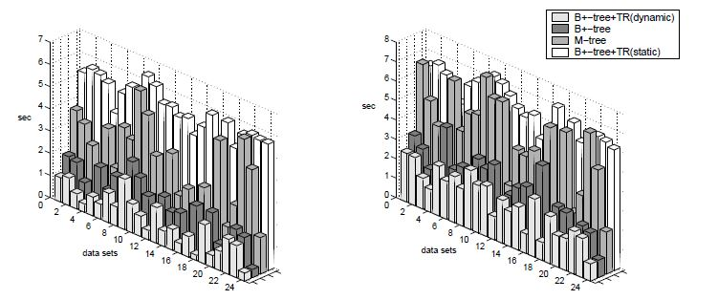
Experiment
k = 5
k = 20

