Slide 1
Faster algorithms for computing longest common increasing subsequences
Martin Kutz, Gerth Stølting Brodal, Kanela Kaligosi, Irit Katriel
Journal of Discrete Algorithms 9 (2011), pp. 314–325
Presenter: Shou-Fu Lo
Date: 2017/11/21

Slide 2
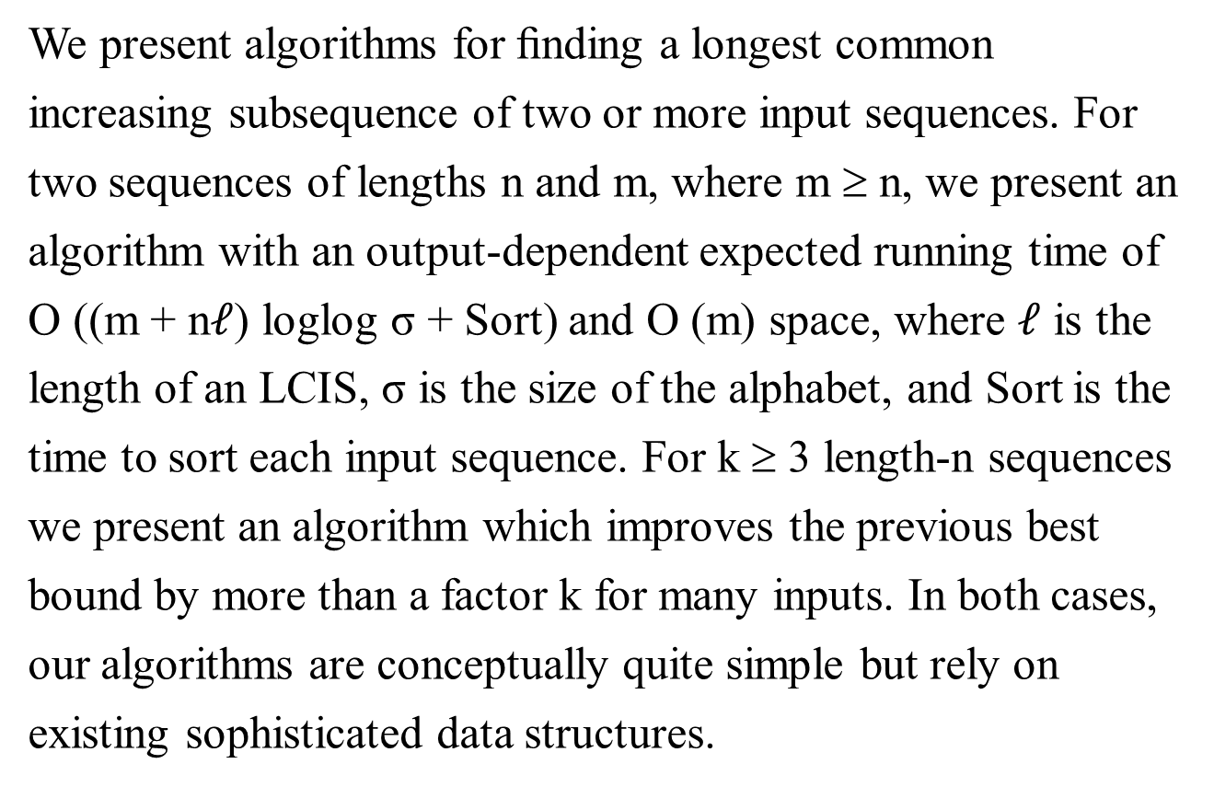
Abstract(1/2)
We present algorithms for ﬁnding a longest common
increasing subsequence of two or more input sequences. For
two sequences of lengths n and m, where m ≥ n, we present an
algorithm with an output-dependent expected running time of
O ((m + n$ℓ$) loglog σ + Sort) and O (m) space, where $ℓ$ is the
length of an LCIS, σ is the size of the alphabet, and Sort is the
time to sort each input sequence. For k ≥ 3 length-n sequences
we present an algorithm which improves the previous best
bound by more than a factor k for many inputs. In both cases,
our algorithms are conceptually quite simple but rely on
existing sophisticated data structures.

Slide 3
Abstract(2/2)
Finally, we introduce the problem of longest common weakly-
increasing (or non-decreasing) subsequences (LCWIS), for
which we present an O (min{m + nlogn, mloglogm})-time
algorithm for the 3-letter alphabet case. For the extensively
studied longest common subsequence problem, comparable
speedups have not been achieved for small alphabets.

Slide 4
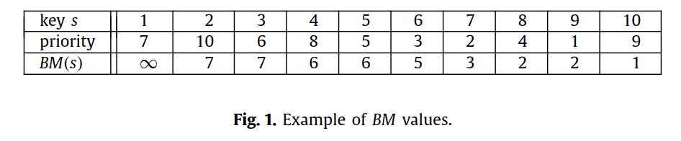
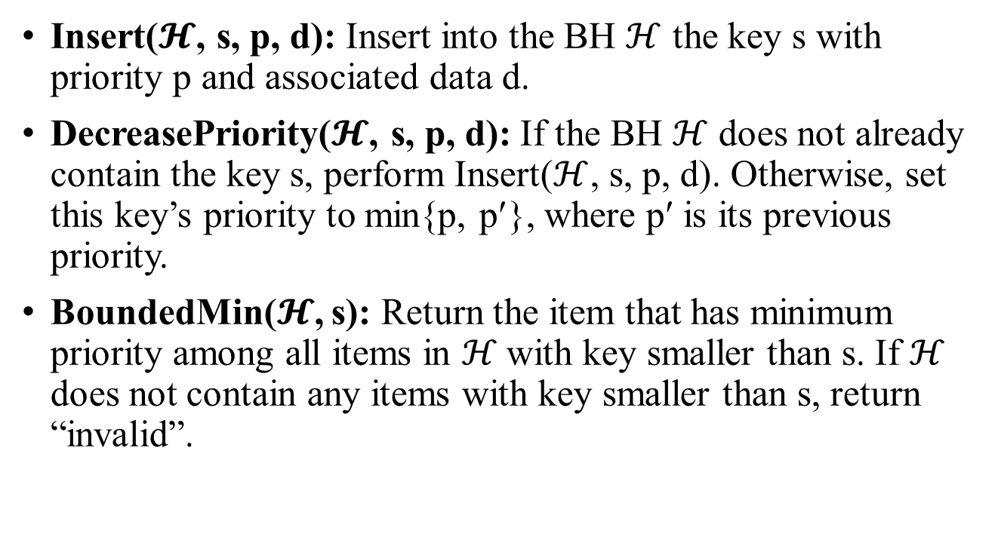
Bounded heaps
Insert($𝓗$, s, p, d): Insert into the BH $ℋ$ the key s with priority p and associated data d.
DecreasePriority($𝓗$, s, p, d): If the BH $ℋ$ does not already contain the key s, perform Insert($ℋ$, s, p, d). Otherwise, set this key’s priority to min{p, p′}, where p′ is its previous priority.
BoundedMin($𝓗$, s): Return the item that has minimum priority among all items in ℋ with key smaller than s. If ℋ does not contain any items with key smaller than s, return “invalid”.

Slide 5
Bounded heaps
Using van Emde Boas tree (vEB tree).
Lemma 1.There exists an implementation of bounded heaps
that requires O (n) space and supports each of the above
operations in O (loglogn) amortized time, where keys are
drawn from the set {1, . . . , n}.

Slide 6
LCIS
 | a₁ | a₂ | a₃ | a₄ | a₅
A | 5 | 2 | 3 | 4 | 6
 | b₁ | b₂ | b₃ | b₄ | b₅ | b₆ | b₇
B | 2 | 4 | 5 | 7 | 6 | 1 | 3
 | a₁ | a₂ | a₃ | a₄ | a₅
A | 5 | 2 | 3 | 4 | 6
 | b₁ | b₂ | b₃ | b₄ | b₅
B | 2 | 4 | 5 | 6 | 3
L_{i}[j] = k
i = LCIS長度
j = a_{j} 在B的位置
k = a_{j} 出現在B最小的index
L₁[1] = 3
L₁[2] = 1
L₁[3] = 5
L₁[4] = 2
L₁[5] = 4

Slide 7

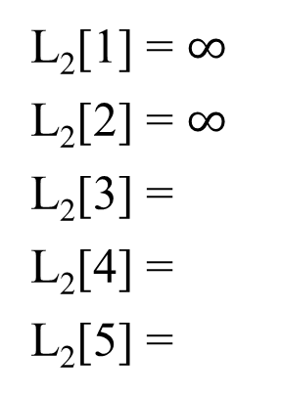


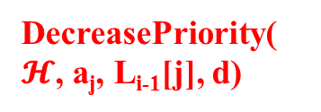





LCIS
 | a₁ | a₂ | a₃ | a₄ | a₅
A | 5 | 2 | 3 | 4 | 6
 | b₁ | b₂ | b₃ | b₄ | b₅
B | 2 | 4 | 5 | 6 | 3
BoundedMin($𝓗$, a_{j})
$$ℋ$$
a_{j} | 2 | 3 | 4 | 5 | 6
L_{i-1}[j]
L₁[1] = 3
L₁[2] = 1
L₁[3] = 5
L₁[4] = 2
L₁[5] = 4
DecreasePriority($𝓗$, a_{j}, L_{i-1}[j], d)
3
a_{j} | 2 | 3 | 4 | 5 | 6
L_{i-1}[j] | 1 |  |  | 3
L₂[1] = $∞$
L₂[2] = $∞$
L₂[3] =
L₂[4] =
L₂[5] =
a_{j} | 2 | 3 | 4 | 5 | 6
L_{i-1}[j] | 1 | 5 |  | 3
$$∞$$
$$5$$
$$∞$$
a_{j} | 2 | 3 | 4 | 5 | 6
L_{i-1}[j] | 1 | 5 | 2 | 3
$$2$$
$$∞$$
$$4$$
a_{j} | 2 | 3 | 4 | 5 | 6
L_{i-1}[j] | 1 | 5 | 2 | 3 | 4

Slide 8
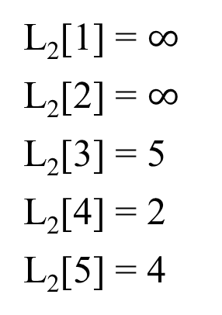
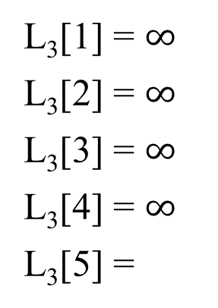
LCIS
 | a₁ | a₂ | a₃ | a₄ | a₅
A | 5 | 2 | 3 | 4 | 6
 | b₁ | b₂ | b₃ | b₄ | b₅
B | 2 | 4 | 5 | 6 | 3
$$ℋ$$
a_{j} | 2 | 3 | 4 | 5 | 6
L_{i-1}[j]
L₂[1] = $∞$
L₂[2] = $∞$
L₂[3] = 5
L₂[4] = 2
L₂[5] = 4
a_{j} | 2 | 3 | 4 | 5 | 6
L_{i-1}[j]
L₃[1] = $∞$
L₃[2] = $∞$
L₃[3] = $∞$
L₃[4] = $∞$
L₃[5] =
a_{j} | 2 | 3 | 4 | 5 | 6
L_{i-1}[j] |  | 5
a_{j} | 2 | 3 | 4 | 5 | 6
L_{i-1}[j] |  | 5 | 2
$$∞$$
$$4$$
a_{j} | 2 | 3 | 4 | 5 | 6
L_{i-1}[j] |  | 5 | 2 |  | 4

Slide 9
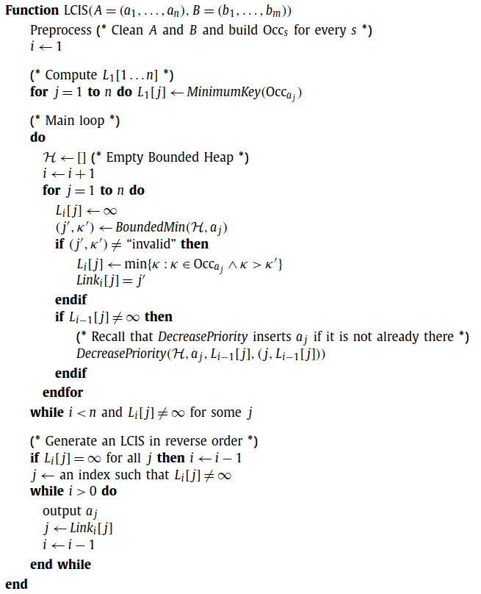
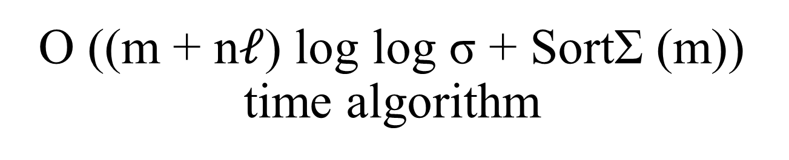
O ((m + n$ℓ$) log log σ + SortΣ (m)) time algorithm

Slide 10
Longest common non-decreasing or weakly-increasing subsequences (LCWIS)
Σ = {α, β, γ } in their standard order: α < β < γ .
A = α β α α α β β B = β β α α α α β
We show how to solve LCWIS for the 2-letter alphabet in linear time and for the 3-letter alphabet in O (min{m +nlog n, m log log m}) time

Slide 11
LCWIS for the 2-letter case
Σ = {α, β, γ } in their standard order: α < β < γ .
A = α β α α α β β B = β α α α α β
Preprocessing:
Arrays Num_{A,α} , Num_{B,α} , Num_{A,β} , . . . , Num_{B,γ} that count the number of αs, βs and γs.
e.g. Num_{A,α} [4] = 3, Num_{B, β} [3] = 1;
We also create arrays Pos_{A,α} through Pos_{B,γ} , which provide us with the position of the ith occurrence of α, β, or γ in A or B.
e.g. Pos_{A,α} [4] = 5, Pos_{B,β} [2] = 6;

Slide 12
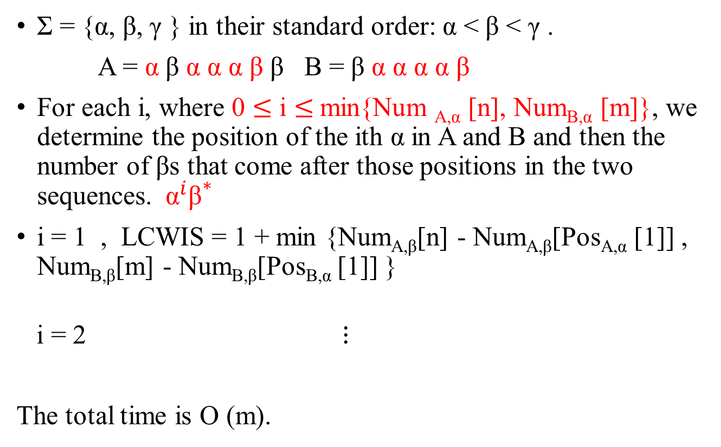
LCWIS for the 2-letter case
Σ = {α, β, γ } in their standard order: α < β < γ .
A = α β α α α β β B = β α α α α β
For each i, where 0 $≤$ i $≤$min{Num _{A,α} [n], Num_{B,α} [m]}, we determine the position of the ith α in A and B and then the number of βs that come after those positions in the two sequences. ${ \text{α}}^{i}{\text{β}}^{∗}$
i = 1 , LCWIS = 1 + min {Num_{A,β}[n] - Num_{A,β}[Pos_{A,α} [1]] , Num_{B,β}[m] - Num_{B,β}[Pos_{B,α} [1]] }
i = 2 $⋮$
The total time is O (m).

Slide 13

LCWIS for the 3-letter case in O (m + nlogn) time
The naïve extension of the above approach to three letters would have to deal with a quadratic number of tentative exponent pairs (i, j) for subsequences of type${ \text{α}}^{i}{\text{β}}^{j}{\text{γ}}^{∗}$

Slide 14
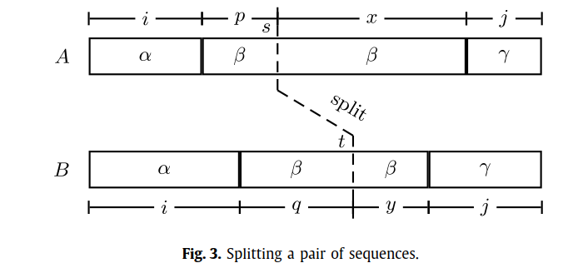
LCWIS for the 3-letter case in O (m + nlogn) time
We determine the ith pair of αs from the left and then count the number of βs in A and B up to the split (s, t).
There are p = Num_{A,β} [s] −Num_{A,β} [Pos_{A,α} [i]] such βs in A and q = Num_{B,β} [t] − Num_{B,β} [Pos_{B,α} [i]] in B.
left-aligned α-part
right-aligned γ -part

Slide 15
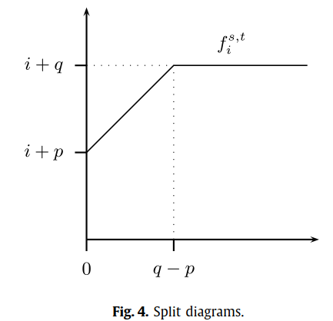

LCWIS for the 3-letter case in O (m + nlogn) time
Assume p $≤$ q for the moment. For the three values i, p, q, we deﬁne a piecewise-linear function $f_{i}^{s,t}$ consisting of a slope-1 segment from (0, i + p) to (q − p, i + q) and a horizontal extension from that point to inﬁnity.

Slide 16

LCWIS for the 3-letter case in O (m + nlogn) time
For example, with no extra βs from the right, we only get min(p, q) = p many pairs of βs, which together with the i αs yield a sequence of length $f_{i}^{s,t}$(0) = i + p.
If we have q − p free βs on the right, we could get a sequence of length f (q − p) = i + q.

Slide 17

LCWIS for the 3-letter case in O (m + nlogn) time
Assuming x $≥$ y, The value $f_{i}^{s,t}$(x - y) tells us exactly how long a subsequence we can build to the left of the split if we throw in a surplus of (x - y) βs into A.
We can now use our function $f_{i}^{s,t}$ to obtain the length of an LCWIS of type ${ \text{α}}^{i}{\text{β}}^{∗}{\text{γ}}^{j}$. That would cost quadratic time and space.

Slide 18
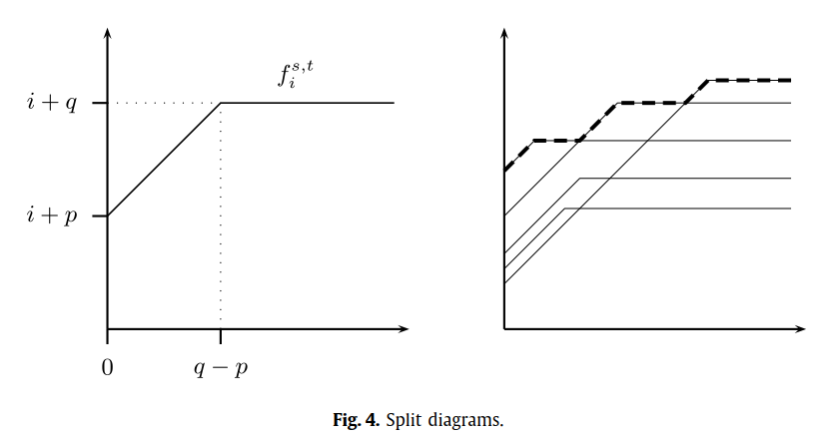

LCWIS for the 3-letter case in O (m + nlogn) time
The trick is now to draw the functions $f_{i}^{s,t}$for all values of i into one diagram. Their pointwise maximum $f_{i}^{s,t}$, the upper envelope of their plots.

Slide 19
LCWIS for the 3-letter case in O (m + nlogn) time
In particular, any such subsequence with exactly i many αs has all its αs to the left of the cut (Pos _{A,α} [i], Pos_{B,α} [i]) and all its γs to the right of that cut.

Slide 20
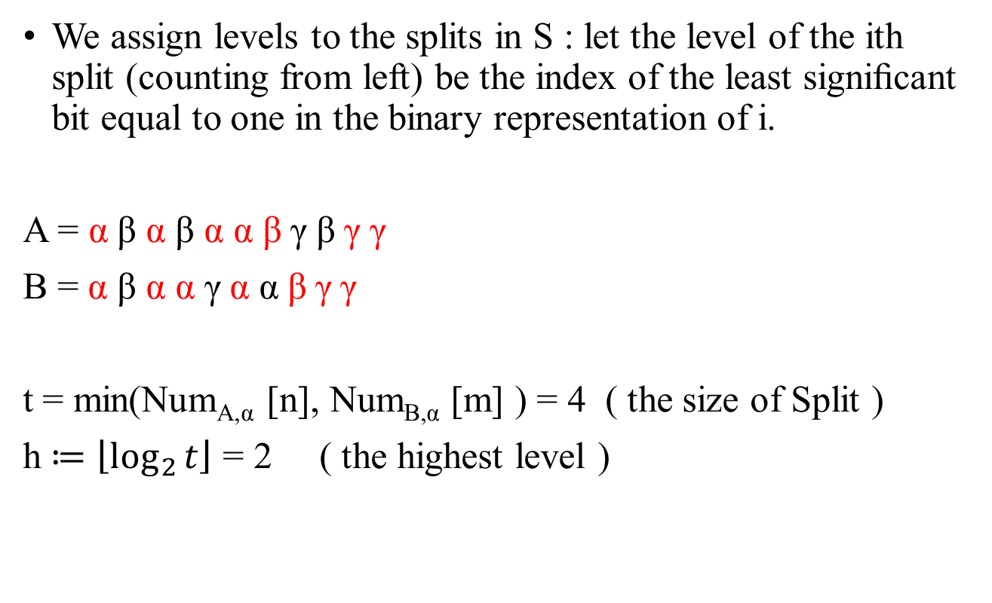
LCWIS for the 3-letter case in O (m + nlogn) time
We assign levels to the splits in S : let the level of the ith split (counting from left) be the index of the least signiﬁcant bit equal to one in the binary representation of i.
A = α β α β α α β $\text{γ}$ β $\text{γ}$ $\text{γ}$
B = α β α α $\text{γ}$α α β $\text{γ}$ $\text{γ}$
t = min(Num_{A,α} [n], Num_{B,α} [m] ) = 4 ( the size of Split )
h $≔\left\lfloor \log_{2}{t}\right\rfloor$ = 2 ( the highest level )

Slide 21
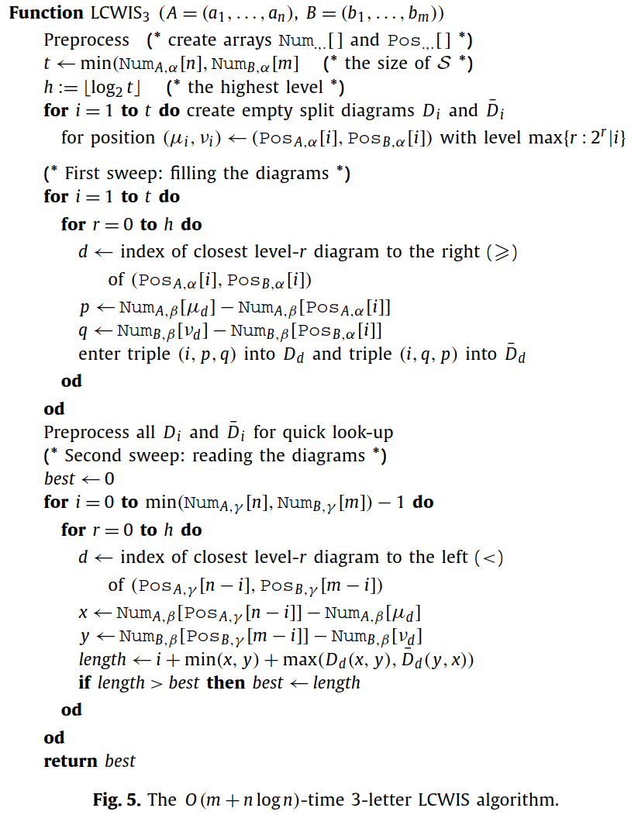
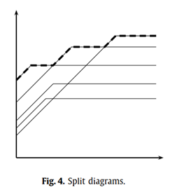

LCWIS for the 3-letter case in O (m + nlogn) time
p
A = α β α β α α β $\text{γ}$ β $\text{γ}$ $\text{γ}$
B = α β α α $\text{γ}$α α β $\text{γ}$ $\text{γ}$
level-r = $2^{0}、2^{1}$、$2^{2}$
q
d

Slide 22

LCWIS for the 3-letter case in O (m + nlogn) time
x
A = α β α β α α β $\text{γ}$ β $\text{γ}$ $\text{γ}$
B = α β α α $\text{γ}$α α β $\text{γ}$ $\text{γ}$
length =
max($D$_{d} (x, y), $\overline{D}$_{d} ( y, x))
+ min(x, y)
+ i
y
d

Slide 23
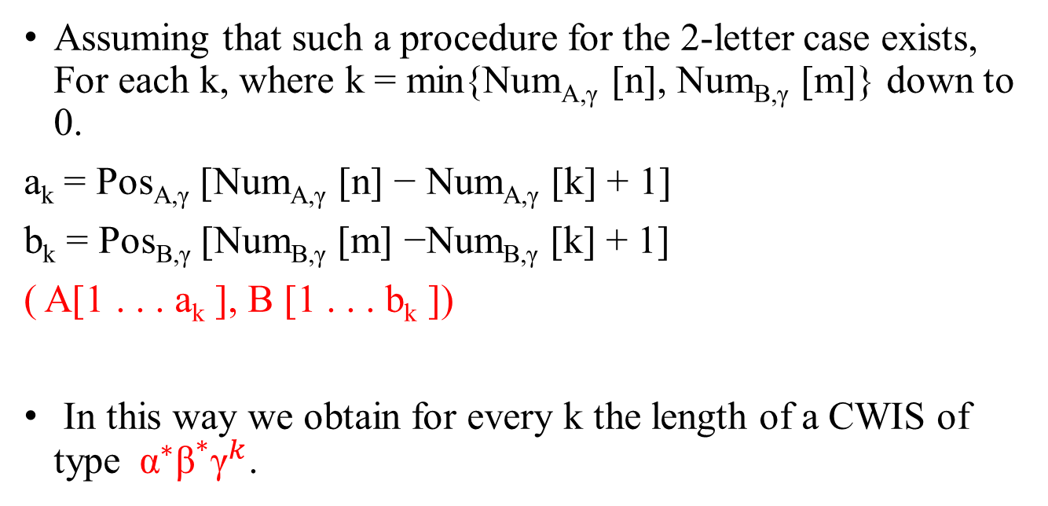
LCWIS for the 3-letter case in O (m log log m) time
Assuming that such a procedure for the 2-letter case exists, For each k, where k = min{Num_{A,γ} [n], Num_{B,γ} [m]} down to 0.
a_{k} = Pos_{A,γ} [Num_{A,γ} [n] − Num_{A,γ} [k] + 1]
b_{k} = Pos_{B,γ} [Num_{B,γ} [m] −Num_{B,γ} [k] + 1]
( A[1 . . . a_{k} ], B [1 . . . b_{k} ])
In this way we obtain for every k the length of a CWIS of type ${ \text{α}}^{∗}{\text{β}}^{∗}{\text{γ}}^{k}$.

Slide 24
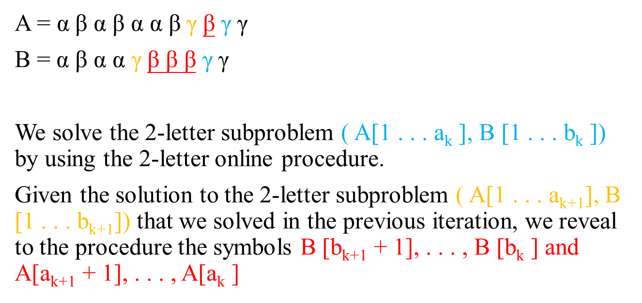
LCWIS for the 3-letter case in O (m log log m) time
A = α β α β α α β $\text{γ}$ β $\text{γ}$ $\text{γ}$
B = α β α α $\text{γ}$β β β $\text{γ}$ $\text{γ}$
We solve the 2-letter subproblem ( A[1 . . . a_{k} ], B [1 . . . b_{k} ]) by using the 2-letter online procedure.
Given the solution to the 2-letter subproblem ( A[1 . . . a_{k+1}], B [1 . . . b_{k+1}]) that we solved in the previous iteration, we reveal to the procedure the symbols B [b_{k+1} + 1], . . . , B [b_{k} ] and A[a_{k+1} + 1], . . . , A[a_{k} ]

Slide 25
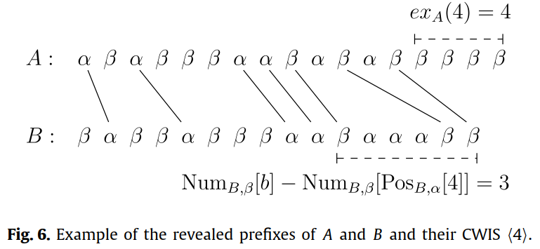
LCWIS for the 3-letter case in O (m log log m) time
Solving the 2-letter case:
ex_{A} = (Num_{A,β} [a] − Num_{A,β} [Pos_{A,α} [i]]) − (Num_{B,β}[b] − Num_{B,β} [Pos_{B,α} [i]])

Slide 26
LCWIS for the 3-letter case in O (m log log m) time
Keep four priority queues L_{A} , EX_{A} , L_{B} , EX_{B} as described and a variable that holds the current solution, i.e., the currently best CWIS.
Maximum priority queue L_{A} keeping CWISs with ex_{A} (i) > 0
Minimum priority queue EX_{A} that holds the CWISs of L_{A} sorted by their excess of βs in A .

Slide 27
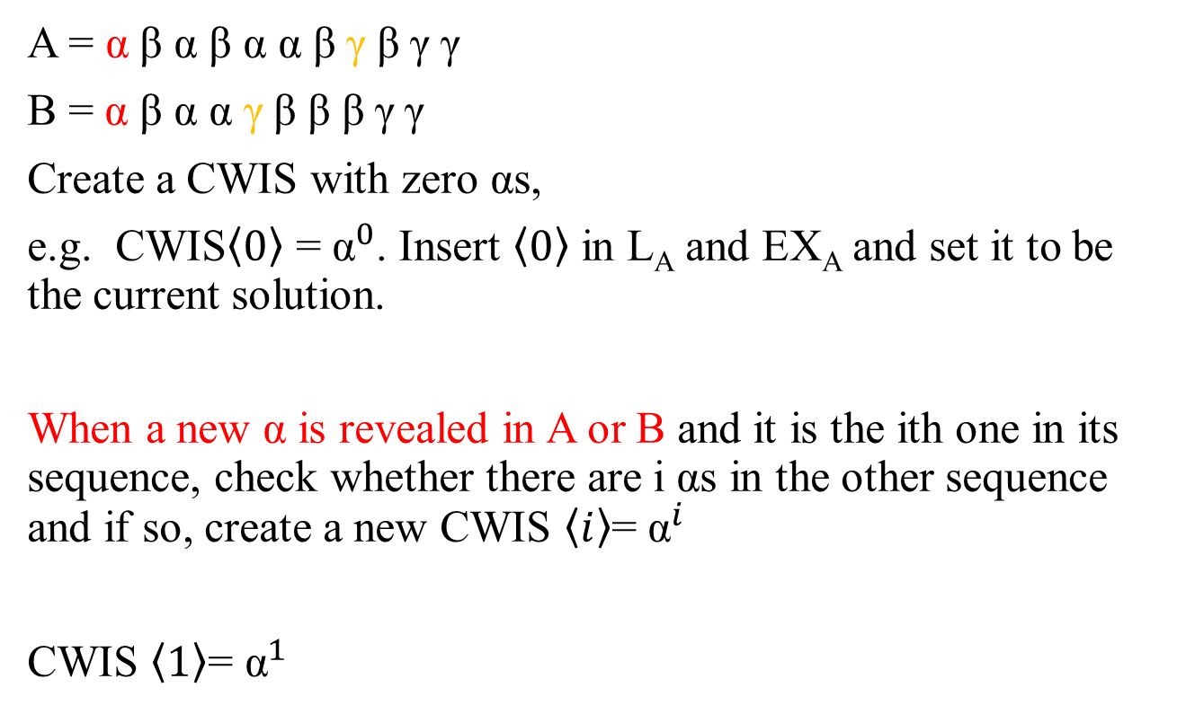
LCWIS for the 3-letter case in O (m log log m) time
A = α β α β α α β $\text{γ}$ β $\text{γ}$ $\text{γ}$
B = α β α α $\text{γ}$β β β $\text{γ}$ $\text{γ}$
Create a CWIS with zero αs,
e.g. CWIS$\left\langle 0\right\rangle$ = ${\text{α}}^{0}$. Insert $\left\langle 0\right\rangle$ in L_{A} and EX_{A} and set it to be the current solution.
When a new α is revealed in A or B and it is the ith one in its sequence, check whether there are i αs in the other sequence and if so, create a new CWIS $\left\langle i\right\rangle$= ${\text{α}}^{i}$
CWIS $\left\langle 1\right\rangle$= ${\text{α}}^{1}$

Slide 28
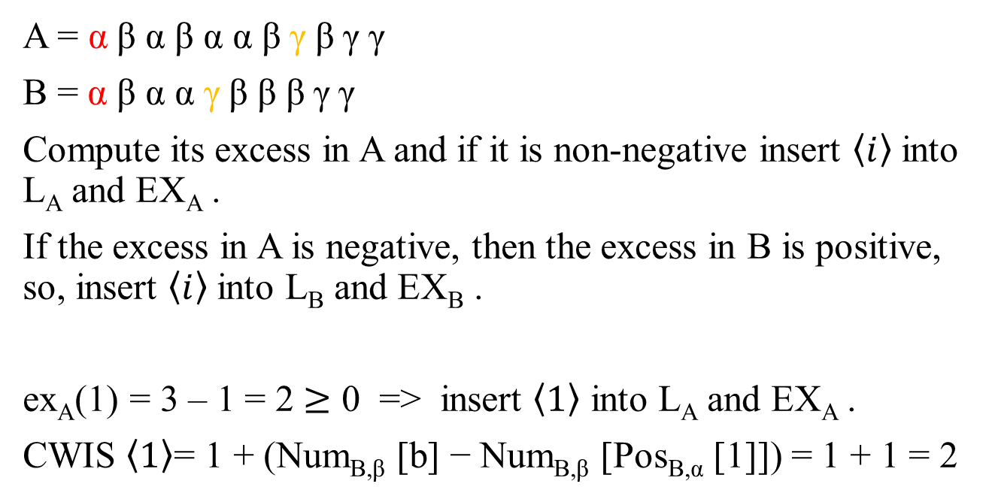
LCWIS for the 3-letter case in O (m log log m) time
A = α β α β α α β $\text{γ}$ β $\text{γ}$ $\text{γ}$
B = α β α α $\text{γ}$β β β $\text{γ}$ $\text{γ}$
Compute its excess in A and if it is non-negative insert $\left\langle i\right\rangle$ into L_{A} and EX_{A} .
If the excess in A is negative, then the excess in B is positive, so, insert $\left\langle i\right\rangle$ into L_{B} and EX_{B} .
ex_{A}(1) = 3 – 1 = 2 $≥$ 0 => insert $\left\langle 1\right\rangle$ into L_{A} and EX_{A} .
CWIS $\left\langle 1\right\rangle$= 1 + (Num_{B,β} [b] − Num_{B,β} [Pos_{B,α} [1]]) = 1 + 1 = 2

Slide 29
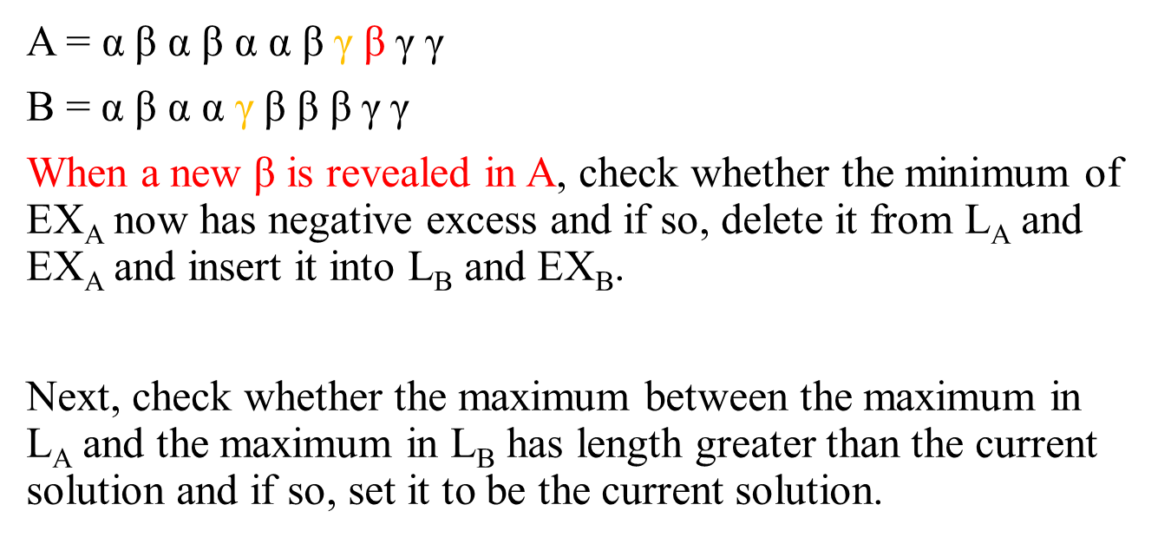
LCWIS for the 3-letter case in O (m log log m) time
A = α β α β α α β $\text{γ}$ β $\text{γ}$ $\text{γ}$
B = α β α α $\text{γ}$β β β $\text{γ}$ $\text{γ}$
When a new β is revealed in A, check whether the minimum of EX_{A} now has negative excess and if so, delete it from L_{A} and EX_{A} and insert it into L_{B} and EX_{B}.
Next, check whether the maximum between the maximum in L_{A} and the maximum in L_{B} has length greater than the current solution and if so, set it to be the current solution.

Slide 30
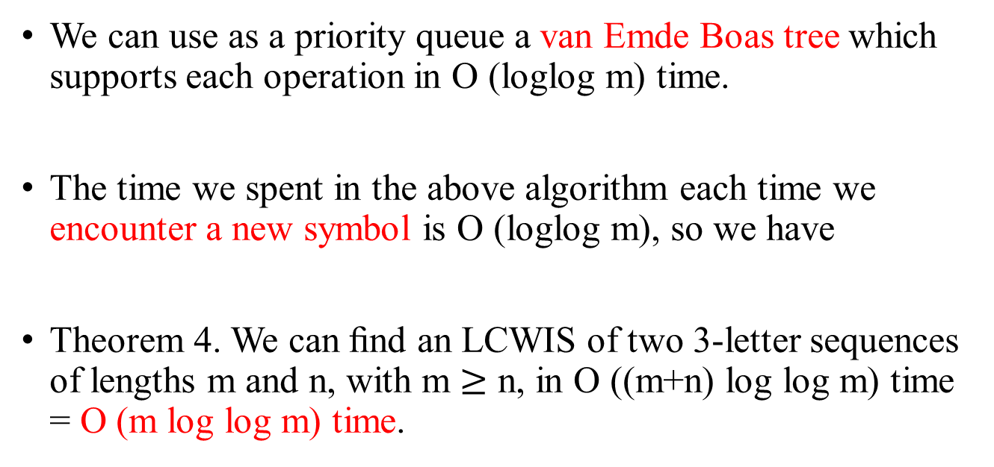
LCWIS for the 3-letter case in O (m log log m) time
We can use as a priority queue a van Emde Boas tree which supports each operation in O (loglog m) time.
The time we spent in the above algorithm each time we encounter a new symbol is O (loglog m), so we have
Theorem 4. We can ﬁnd an LCWIS of two 3-letter sequences of lengths m and n, with m $≥$ n, in O ((m+n) log log m) time = O (m log log m) time.

