Slide 1
An Efficient Parallel Algorithm for Longest Common Subsequence Problem on GPUs
Jiaoyun Yang(陽嬌云), Yun Xu(許云), Yi Shang(商伊)
Proceedings of the World Congress on Engineering 2010 Vol I WCE 2010, June 30 - July 2, 2010, London, U.K
Presenter: Cheng-Han Wu
Date:2017/11/21

Slide 2
Abstract(1/2)
Sequence alignment is an important problem in computational biology and finding the longest common subsequence (LCS) of multiple biological sequences is an essential and effective technique in sequence alignment. A major computational approach for solving the LCS problem is dynamic programming. Several dynamic programming methods have been proposed to have reduced time and space complexity. As databases of biological sequences become larger, parallel algorithms become increasingly important to tackle large size problems. In the mean-time, general-purpose computing on graphics processing units (GPGPU) has emerged as a promising technology for cost-effective high performance computing.

Slide 3
Abstract(2/2)
In this paper, we develop an efficient parallel algorithm on GPUs for the LCS problem. We propose a new technique that changes the data dependency in the score table used by dynamic programming algorithms to enable higher degrees of parallelism. The algorithm takes advantage of the large number of processing units and the unique memory-accessing properties of GPUs to achieve high performance. The algorithm was implemented on Nvidia 9800GT GPUs and tested on randomly generated sequences of different lengths. The experiment results show that the new algorithm is about 6 times faster on GPUs than on typical CPUs and is 3 times faster than an existing efficient parallel algorithm, the diagonal parallel algorithm.

Slide 4

longest common subsequence
 |  | T | G | C | A | T | A
 | 0 | 0 | 0 | 0 | 0 | 0 | 0
A | 0 | 0 | 0 | 0 | 1 | 1 | 1
T | 0 | 1 | 1 | 1 | 1 | 2 | 2
T | 0 | 1 | 1 | 1 | 1 | 2 | 2
G | 0 | 1 | 2 | 2 | 2 | 2 | 2
C | 0 | 1 | 2 | 3 | 3 | 3 | 3
C | 0 | 1 | 2 | 3 | 3 | 3 | 3
A | 0 | 1 | 2 | 3 | 4 | 4 | 4
$$S\left[i,j\right]=\left\{\begin{aligned}0 \\ s\left[i−1,j−1\right]+1 \\ \max\left(S\left[i−1,j\right],S\left[i,j−1\right]\right)\end{aligned} \begin{matrix}i or j is 0 \\ a_{i}=b_{j} \\ o.w\end{matrix}\right.$$
Notes:
DP,O(mn),the cells on the same diagonal in the score table doesn’t depend on each other, so that they can be computed in parallel

Slide 5
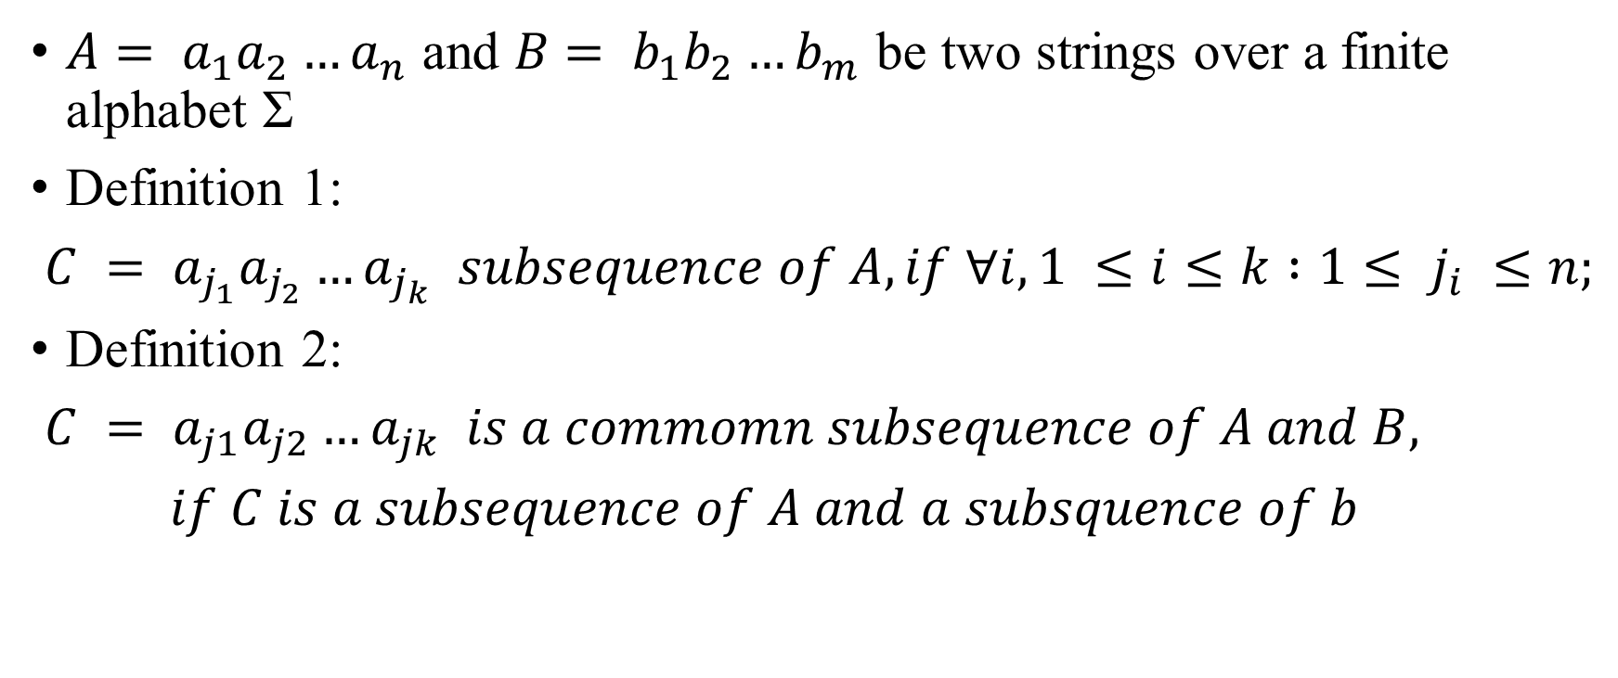
New Parallel LCS algorithm
$A$ $= a_{1}a_{2}…a_{n}$ and $B$ $= b_{1}b_{2}…b_{m}$ be two strings over a finite alphabet Σ
Definition 1:
$C = a_{j_{1}}a_{j_{2}}…a_{j_{k} } subsequence of A,if ∀i, 1 ≤i≤k :1≤ j_{i} ≤n;$
Definition 2:
$C = a_{j1}a_{j2}…a_{jk } is a commomn subsequence of A and B,$
$if C is a subsequence of A and a subsquence of b$
Notes:
rearranging the entries in the score matrix for greater parallelism

Slide 6
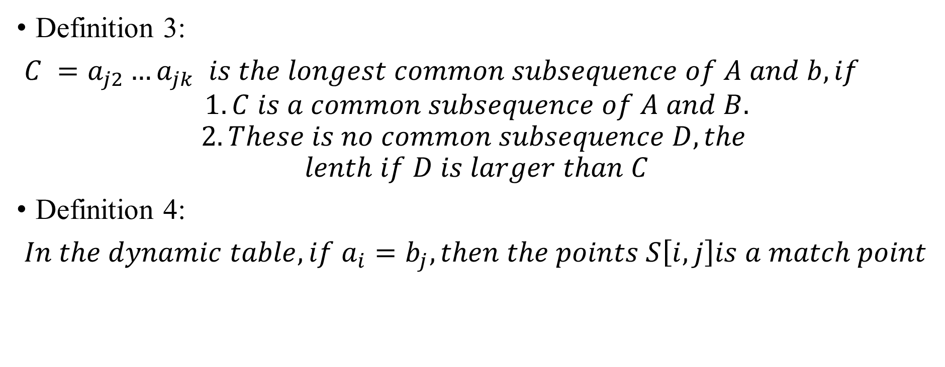
Definition 3:
$C =a_{j2}…a_{jk } is the longest common subsequence of A and b,if$
$$1.C is a common subsequence of A and B.$$
$$2.These is no common subsequence D,the$$
$$lenth if D is larger than C$$
Definition 4:
$In the dynamic table, if a_{i}=b_{j}, then the points S\left[i,j\right]is a match point$

Slide 7
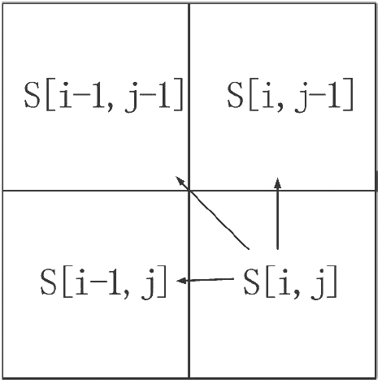
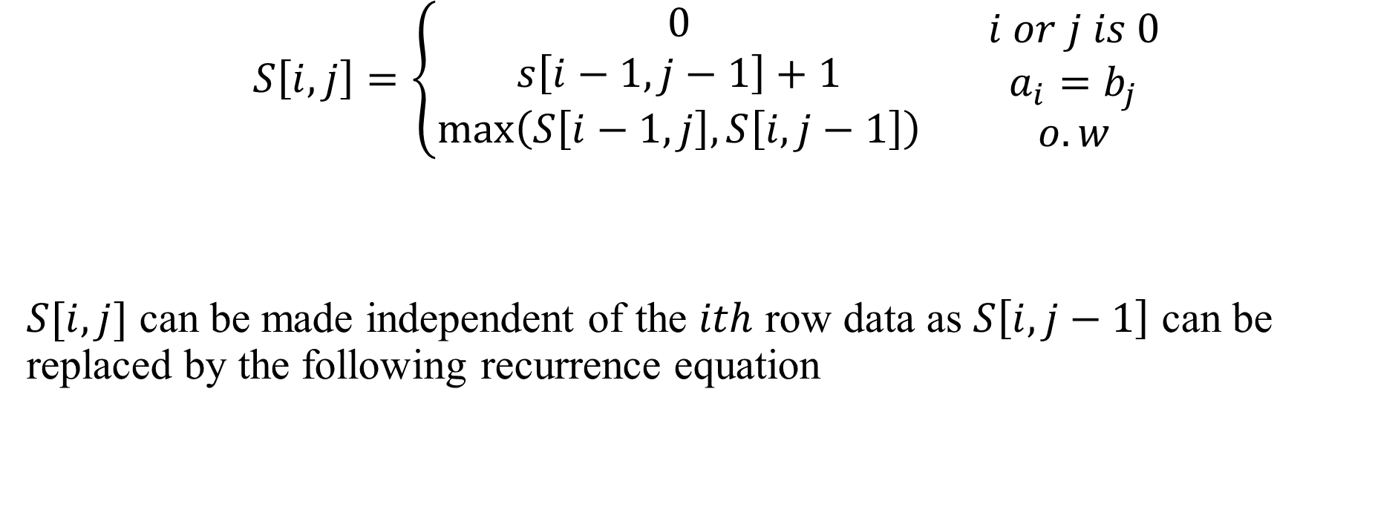
Data Dependency
$$S\left[i,j\right]=\left\{\begin{aligned}0 \\ s\left[i−1,j−1\right]+1 \\ \max\left(S\left[i−1,j\right],S\left[i,j−1\right]\right)\end{aligned} \begin{matrix}i or j is 0 \\ a_{i}=b_{j} \\ o.w\end{matrix}\right.$$
$S[i,j]$ can be made independent of the $ith$ row data as $S\left[i,j−1\right]$ can be replaced by the following recurrence equation
Notes:
In order to compute the same row data or column data in parallel

Slide 8
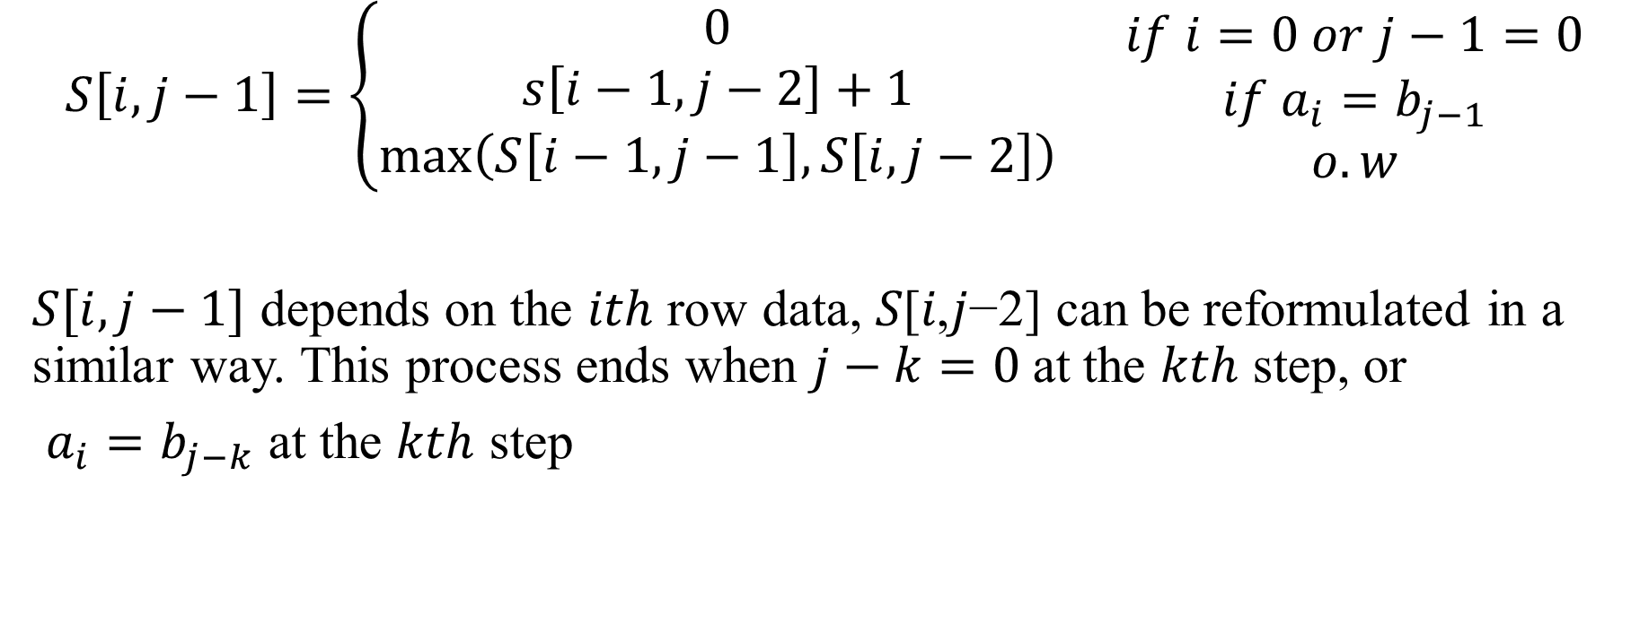
$$S\left[i,j−1\right]=\left\{\begin{aligned}0 \\ s\left[i−1,j−2\right]+1 \\ \max\left(S\left[i−1,j−1\right],S\left[i,j−2\right]\right)\end{aligned} \begin{matrix}if i=0 or j−1=0 \\ if a_{i}=b_{j−1} \\ o.w\end{matrix}\right.$$
$S[i,j−1]$ depends on the $ith$ row data, 𝑆[𝑖,𝑗−2] can be reformulated in a similar way. This process ends when $j−k=0$at the $kth$ step, or
$a_{i}=b_{j−k}$ at the $kth$ step

Slide 9
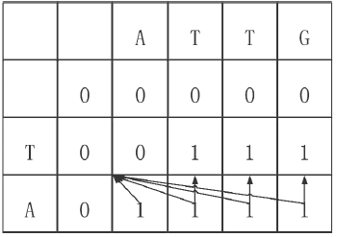
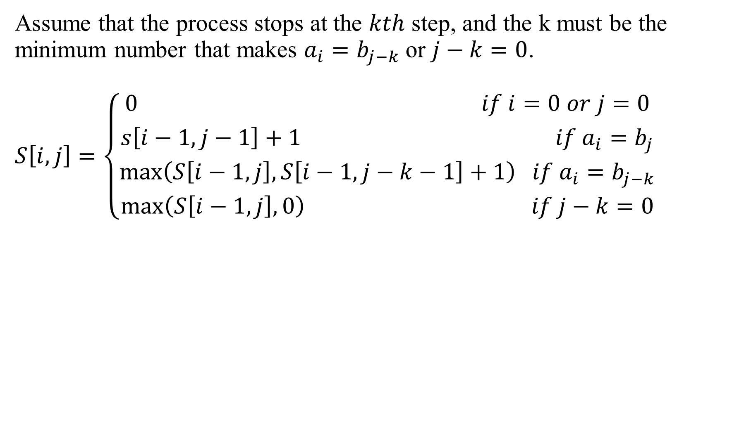
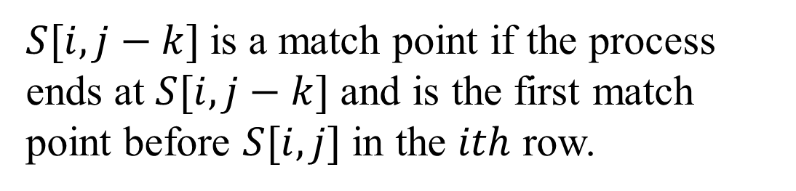
Assume that the process stops at the $kth$ step, and the k must be the minimum number that makes $a_{i}=b_{j−k}$or $j−k=0$.
$$S\left[i,j\right]=\left\{\begin{aligned}{0 if i=0 or j=0 \atop s\left[i−1,j−1\right]+1 if a_{i}=b_{j}} \\ {\max\left(S\left[i−1,j\right],S\left[i−1,j−k−1\right]+1\right) if a_{i}=b_{j−k} \atop \max\left(S\left[i−1,j\right],0\right) if j−k=0}\end{aligned} \right.$$
$S[i, j−k]$is a match point if the process ends at $S[i, j−k]$ and is the first match point before $S[i, j]$in the $ith$ row.
Notes:
In order to compute the same row data or column data in parallel
S[i,j] can be made independent of the ith row data as S[i,j-1]

Slide 10

Preprocessing
Table P size: $l∗(m+1)$, $l$ is the size of the finite alphabet Σ
Let $C[1…l]$ be the finite alphabet and $P[i, j]$represent the maximum
number before j that makes $b_{\text{p}\text{[}\text{i}\text{,}\text{j}\text{]}}= C[i]$.
Notes:
In order to compute the same row data or column data in parallel
S[i,j] can be made independent of the ith row data as S[i,j-1]

Slide 11

$$P\left[i,j\right]=\left\{\begin{aligned}0 \\ j−1 \\ P[i,j−1]\end{aligned} \begin{matrix}if j=0 \\ if b_{j−1}=C[i] \\ o.w\end{matrix}\right.$$
 |  | A | T | T | G | C | C | A
 | 0 | 1 | 2 | 3 | 4 | 5 | 6 | 7
A | 0 | 0 | 1 | 1 | 1 | 1 | 1 | 1
T | 0 | 0 | 0 | 2 | 3 | 3 | 3 | 3
C | 0 | 0 | 0 | 0 | 0 | 0 | 5 | 6
G | 0 | 0 | 0 | 0 | 0 | 4 | 4 | 4
Notes:
In order to compute the same row data or column data in parallel
S[i,j] can be made independent of the ith row data as S[i,j-1]

Slide 12
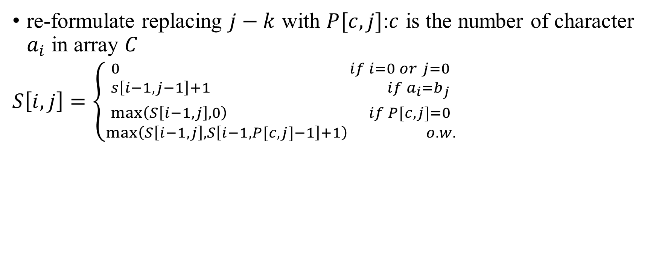
re-formulate replacing $j−k$ with $P[c, j]$:$c$ is the number of character $a_{i}$ in array $C$
$S\left[i,j\right]=\left\{\begin{aligned}{0 if i=0 or j=0 \atop s\left[i−1,j−1\right]+1 if a_{i}=b_{j}} \\ {\max\left(S\left[i−1,j\right],0\right) if P[c,j]=0 \atop \max\left(S\left[i−1,j\right],S\left[i−1,P[c,j]−1\right]+1\right) o.w.}\end{aligned} \right.$

Slide 13
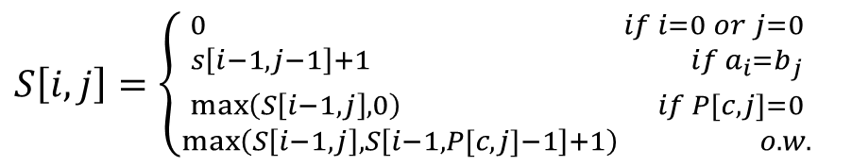
 |  | T | G | C | A | T | A
 | 0 | 0 | 0 | 0 | 0 | 0 | 0
A | 0 | 0 | 0 | 0 | 1 | 1 | 1
T | 0 | 1 | 1 | 1 | 1 | 2 | 2
T | 0 | 1 | 1 | 1 | 1 | 2 | 2
G | 0 | 1 | 2 | 2 | 2 | 2 | 2
C | 0 | 1 | 2 | 3 | 3 | 3 | 3
C | 0 | 1 | 2 | 3 | 3 | 3 | 3
A | 0 | 1 | 2 | 3 | 4 | 4 | 4
$S\left[i,j\right]=\left\{\begin{aligned}{0 if i=0 or j=0 \atop s\left[i−1,j−1\right]+1 if a_{i}=b_{j}} \\ {\max\left(S\left[i−1,j\right],0\right) if P[c,j]=0 \atop \max\left(S\left[i−1,j\right],S\left[i−1,P[c,j]−1\right]+1\right) o.w.}\end{aligned} \right.$
 |  | A | T | T | G | C | C | A
 | 0 | 1 | 2 | 3 | 4 | 5 | 6 | 7
A | 0 | 0 | 1 | 1 | 1 | 1 | 1 | 1
T | 0 | 0 | 0 | 2 | 3 | 3 | 3 | 3
C | 0 | 0 | 0 | 0 | 0 | 0 | 5 | 6
G | 0 | 0 | 0 | 0 | 0 | 4 | 4 | 4

Slide 14
Time Complexity
Step 1.Calculate table P takes O(m) time
Step 2.Calculate table S takes O(n) time
Overall the algorithm’s time complex is O(max(m, n))

Slide 15
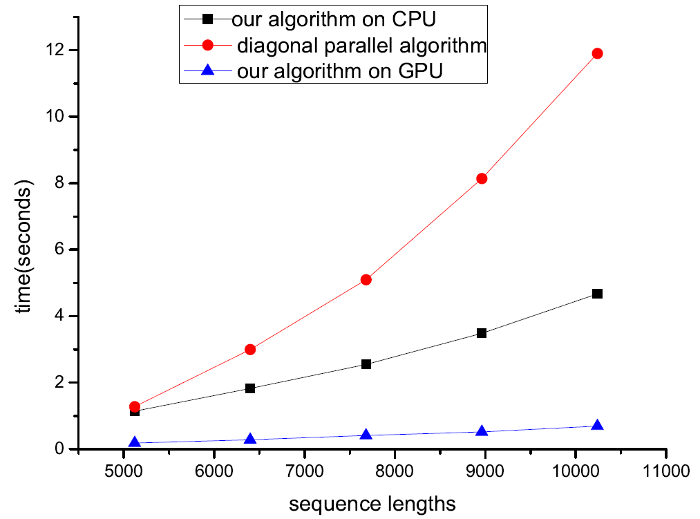
Experimental Results
Notes:
CUDA

