Slide 1
Iterative Dictionary Construction for Compression of Large DNA Data Sets
Shanika Kuruppu
Bryan Beresford-Smith
Thomas Conway
Justin Zobel
IEEE/ACM Transactions on Computational Biology and Bioinformatics, VOL. 9, NO. 1, JANUARY/FEBRUARY 2012
Presenter: Hsiu-Chieh Hung
Date: 2017/12/13

Slide 2
Abstract(1/2)
Genomic repositories increasingly include individual as well as reference sequences, which tend to share long identical and near-identical strings of nucleotides. However, the sequential processing used by most compression algorithms, and the volumes of data involved, mean that these long-range repetitions are not detected. An order-insensitive, disk-based dictionary construction method can detect this repeated content and use it to compress collections of sequences. We explore a dictionary construction method that improves repeat identification in large DNA data sets. Our adaptation, COMRAD, of an existing disk-based method identifies exact repeated content in collections of sequences with similarities within and across the set of input sequences.

Slide 3
Abstract(2/2)
COMRAD compresses the data over multiple passes, which is an expensive process, but allows COMRAD to compress large data sets within reasonable time and space. COMRAD allows for random access to individual sequences and subsequences without decompressing the whole data set. COMRAD has no competitor in terms of the size of data sets that it can compress (extending to many hundreds of gigabytes) and, even for smaller data sets, the results are competitive compared to alternatives; as an example, 39 S. cerevisiae genomes compressed to 0.25 bits per base.

Slide 4
RAY
Step 1
Input：aabcbcaabcabc
aa:1

Slide 5
RAY
Step 1
Input：aabcbcaabcabc
aa:1
ab:1

Slide 6
RAY
Step 1
Input：aabcbcaabcabc
aa:1
ab:1
bc:1

Slide 7
RAY
Step 1
Input：aabcbcaabcabc
aa:1
ab:1
bc:1
cb:1

Slide 8
RAY
Step 1
Input：aabcbcaabcabc
aa:1
ab:1
bc:2
cb:1

Slide 9
RAY
Step 1
Input：aabcbcaabcabc
aa:2
ab:3
bc:4
cb:1
ca:2

Slide 10
RAY
Step 2
Input：aabcbcaabcabc
threshold f = 2
aa:2
ab:3
bc:4
cb:1
ca:2
aabcbcaabcabc (no candidate)

Slide 11
RAY
Step 2
Input：aabcbcaabcabc
threshold f = 2
aa:2
ab:3
bc:4
cb:1
ca:2
aabcbcaabcabc (no candidate)

Slide 12
RAY
Step 2
Input：aabcbcaabcabc
threshold f = 2
aa:2
ab:3
bc:4
cb:1
ca:2
aabcbcaabcabc (candidate bc:1)
Candidate
bc:1
Count: bc > cb && bc > 2

Slide 13
RAY
Step 2
Input：aabcbcaabcabc
threshold f = 2
aa:2
ab:3
bc:4
cb:1
ca:2
aabcbcaabcabc (candidate bc:2)
Candidate
bc:2
Count: bc > ca && bc > 2

Slide 14
RAY
Step 2
Input：aabcbcaabcabc
threshold f = 2
aa:2
ab:3
bc:4
cb:1
ca:2
aabcbcaabcabc (no candidate)
Candidate
bc:2

Slide 15
RAY
Step 2
Input：aabcbcaabcabc
threshold f = 2
aa:2
ab:3
bc:4
cb:1
ca:2
aabcbcaabcabc
Candidate
bc:4

Slide 16
RAY
Step 3
Input：aabcbcaabcabc
threshold f = 2
aa:2
ab:3
bc:4
cb:1
ca:2
Dictionary
aabcbcaabcabc
Candidate
bc → A
bc:4
aaAAaaAaA

Slide 17
RAY
Step 4：repeat step1 ~ step3
Input：aaAAaaAaA
threshold f = 2
aa:2
aA:3
AA:1
Aa:2
Dictionary
Candidate
bc → A
aA:3
aA → B
aBAaBB

Slide 18
RAY
Step 4：repeat step1 ~ step3
Input：aBAaBB
threshold f = 2
aB:2
BA:1
Aa:1
BB:1
Dictionary
Candidate
bc → A
aB:2
aA → B
CACB
aB → C

Slide 19
RAY
Step 4：repeat step1 ~ step3
Input：CACB
threshold f = 2
CA:1
AC:1
CB:1
Dictionary
Candidate
bc → A
aA → B
aB → C

Slide 20
COMRAD
First iteration
Step 1：Count all substrings of length L and it’s reverse complement
Step 2：Create frequency dictionary
Step 3：Substitution

Slide 21
Reverse Complement
ATGC
Reverse：
CGTA
Reverse complement：
GCAT
5’-ATGC-3’
3’-TACG-5’

Slide 22
COMRAD
First iteration
Step 1：Count all substrings of length L and it’s reverse complement
Step 2：Create frequency dictionary
Step 3：Substitution

Slide 23
COMRAD
Second and Subsequent iterations
Step 1：Count all patterns of length h and it’s reverse complement
Step 2：Create frequency dictionary
Step 3：Substitution

Slide 24


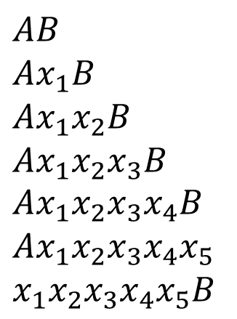
$$5≤h<L$$
Patterns
$$AB$$
$$Ax_{1}B$$
$$Ax_{1}x_{2}B$$
$$Ax_{1}x_{2}x_{3}B$$
$$Ax_{1}x_{2}x_{3}x_{4}B$$
$$Ax_{1}x_{2}x_{3}x_{4}x_{5}$$
$$x_{1}x_{2}x_{3}x_{4}x_{5}B$$
$$h=6$$

Slide 25
COMRAD
Second and Subsequent iterations
Step 1：Count all patterns of length h and it’s reverse complement
Step 2：Create frequency dictionary
Step 3：Substitution

Slide 26
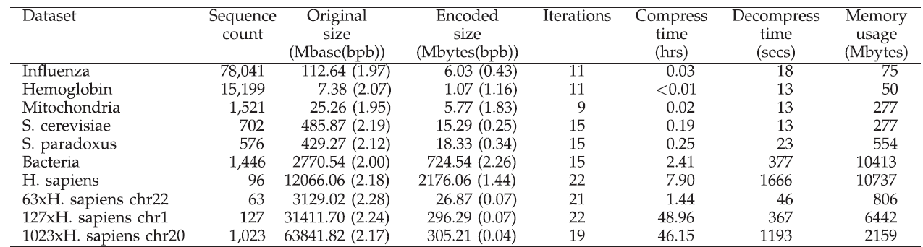
Experiment

Slide 27
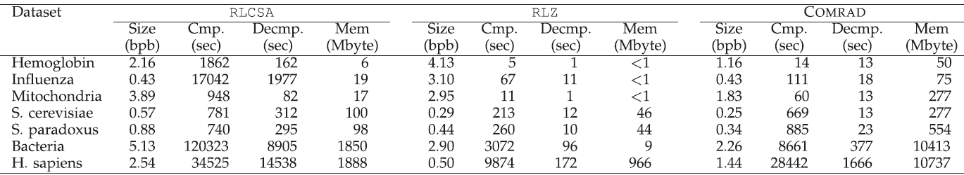
Experiment

Slide 28
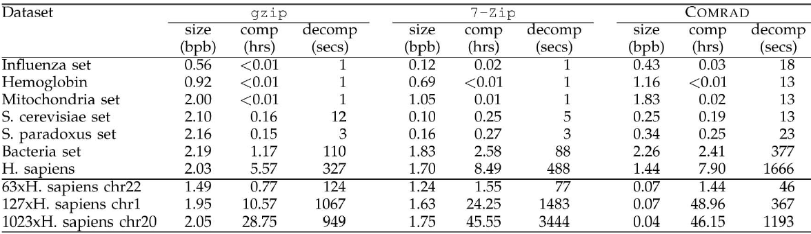
Experiment

