Slide 1
Fundamental analysis and technical analysis integrated system for stock filtration
Cluster Computing, March 2017, Volume 20, Issue 1, pp 883–894
Narissara Eiamkanitchat, Theerasak Moontuy, Sakgasit Ramingwong1

Slide 2
Abstract(1/2)
Fundamentals and technical investigation is a technique which enhances decision making for stock investors. The fundamental analysis includes looking at any information, other than the trading patterns of the stock itself, which can affect the cost and the perceived value of a stock. Technical analysis is an exchanging apparatus utilized to assess securities and endeavor to forecast their future development by breaking down insights accumulated from exchanging action, such as price movement and volume. This system utilizes data mining techniques to analyze various stock information and the factors to create a logical decision model. This helps new and inexperienced investors to make less errors as well as make the stock market more approachable to the general community. This research focuses on a high performance stock selection using the fundamental analysis of individual stocks, which is reflected in the financial statements.

Slide 3
Abstract(2/2)
Ten criteria calculated from stock financial statement reports are proposed for the analysis. The 10 years of historical fundamental information on organizations recorded in Thailand stock exchange were clustered into three groups and used the fundamental criteria to classify the interesting return stocks selection. The multilayer perceptron neural network is used in the training process to verify the clustering results. For the technical analysis, experimental results reveal that the exponential moving average technique is the most favorable and thus being selected to apply in our system. To affirm the productivity of the suggested stocks, an experiment using information from the system’s decision model based on the Stock Exchange of Thailand data in the year 2015 is conducted. After the activities from 5000 simulated portfolios, the average returns of the ports are positive. In fact, the ports gain almost three times higher than the average market yield. This indicates the efficiency of the system’s stock filtering and decision making capabilities.

Slide 4
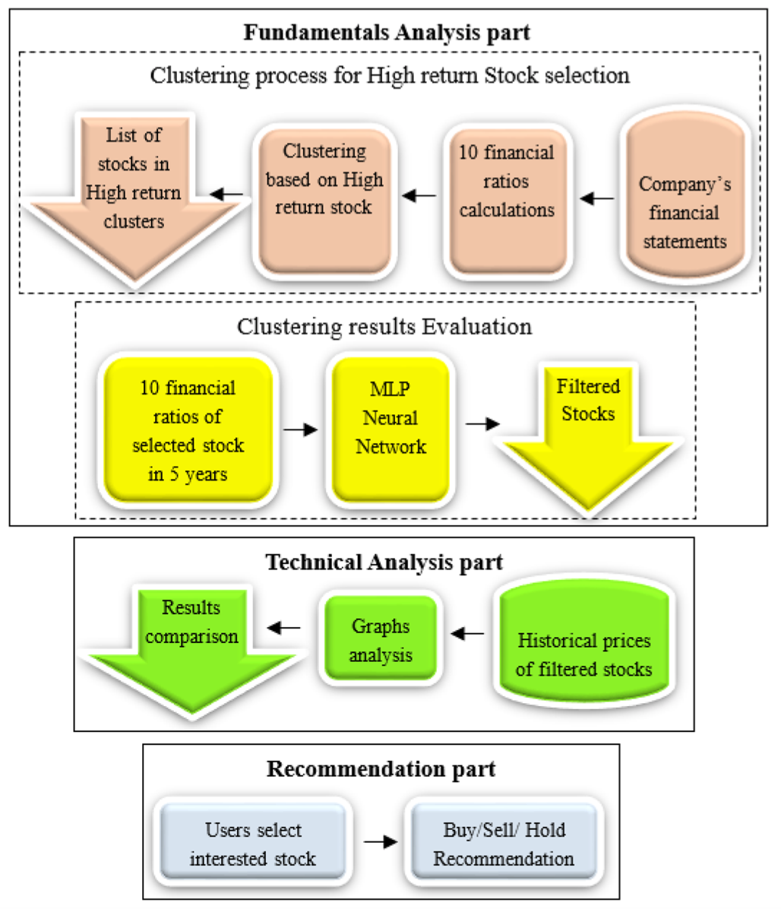

Slide 5
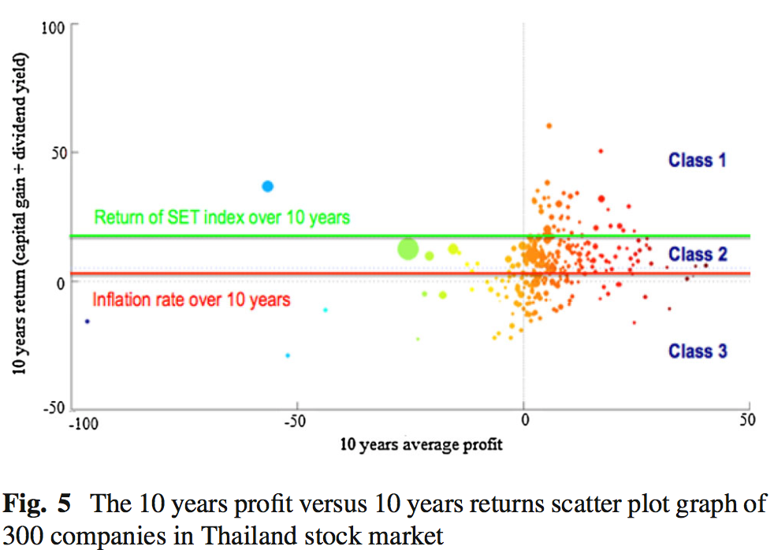
Fundamental analysis
Notes:
2004 to 2013
capital gain資本利得
Dividend yield 股利率

Slide 6
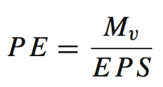
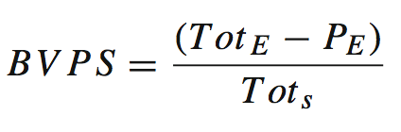
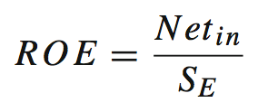

10 financial ratio values (1/3)
Price to earnings ratio
M_{v} is the market value per share
E P S is the earnings per share
Tot _{E} is the total shareholder equity
P_{E} is the preferred equity
Tot _{s} is the total outstanding shares
Book value per share
Net_{in} is the net income for the full fiscal year, before paying dividends to the common stock holder but after dividends to the preferred stock
S_{E} is the equity of shareholders, not include preferred shares
Return on equity
Dividend payout ratio
$$DPR=\frac{DPS}{EPS}$$
DPS is the annual dividends per common share
EPS is the earnings per share
Notes:
M_{v} is the market value per share
E P S is the earnings per share
Tot _{E} is the total shareholder equity
P_{E} is the preferred equity
Tot _{s} is the total outstanding shares
Book value per share 每股帳面價值
Shareholders Equity 股東權益
preferred equity 優先股股權
total outstanding shares已發行股份總數，在外股票；流通股票
Net_{in} is the net income for the full fiscal year, before paying dividends to the common stock holder but after dividends to the preferred stock
S_{E} is the equity of shareholders, not include preferred shares
DPS is the annual dividends per common share
EPS is the earnings per share

Slide 7
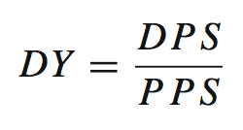
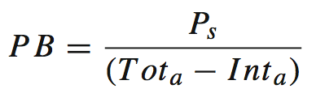
10 financial ratio values (2/3)
DPS is the annual dividends per common share
PPS is the price per share
Dividend yield
P is the stock price Tot_{a} is the total asset
Int_{a} intangible assets and liabilities
Price to book ratio
Total current asset
C is the cash
C_{eq} is the cash equivalents
Acc_{rec} is the accounts receivable
Inv is the inventory
S_{markis} the marketable securities
Ex_{pre} is the prepaid expenses
Liq_{conv} is the other liquid assets that can be readily converted to cash
Notes:
DPS is the annual dividends per common share
PPS is the price per share
Dividend yield 現金殖利率
annual dividends per common share 每股股息
price per share 每股價錢
P is the stock price Tot_{a} is the total asset
Int_{a} intangible assets and liabilities.
Price to book ratio 股價淨值比
intangible assets 無形資產
Liabilities 負債
C is the cash
C_{eq} is the cash equivalents
Acc_{rec} is the accounts receivable
Inv is the inventory
S_{markis} the marketable securities
Ex_{pre} is the prepaid expenses
Liq_{conv} is the other liquid assets that can be readily converted to cash
Total current asset 流動資產
Cash 現金
cash equivalents 現金等價物
accounts receivable 應收帳款
Inventory 存貨
marketable securities 有價證券
prepaid expenses 預付費用

Slide 8
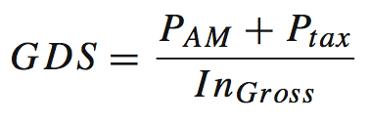
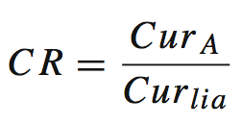
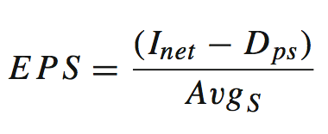
10 financial ratio values (3/3)
P_{AM} is the annual mortgage payments
P_{tax} is the property taxes
In_{Gross} is the gross family income
Gross debt service ratio
Cur_{A} is the current assets
Cur_{lia} is the current liabilities
Current ratio
I_{net} is the net income
D_{ps} is the dividends on preferred stock
Avg_{S} is the average outstanding shares
Earnings per share
Notes:
P_{AM} is the annual mortgage payments
P_{tax} is the property taxes
In_{Gross} is the gross family income
Gross debt service ratio 償債保障比率
annual mortgage payments 年抵押貸款
property taxes 財產稅
gross family income 毛利
Cur_{A} is the current assets
Cur_{lia} is the current liabilities
current ratio流動比率
current assets 流動資產
current liabilities 流動負債
I_{net} is the net income
D_{ps} is the dividends on preferred stock
Avg_{S} is the average outstanding shares
Earnings per share 每股盈餘
net income 稅後淨利
dividends 分紅
Preferred Stock 優先股
average outstanding shares 流通在外平均股數

Slide 9
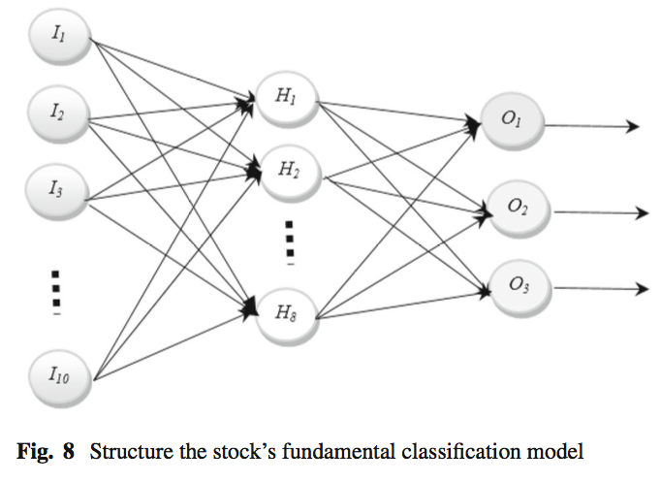
The 3-layer neural network

Slide 10
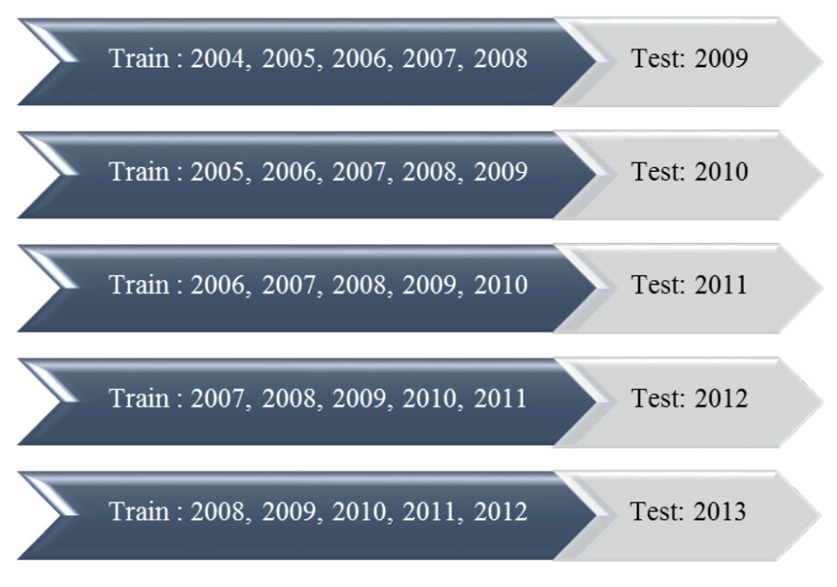
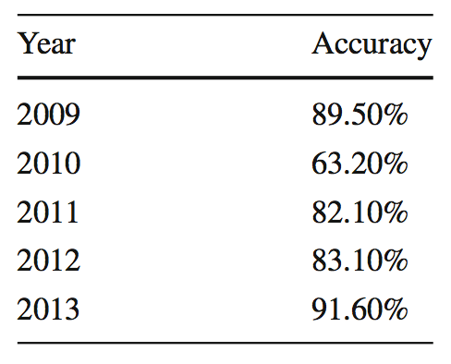
Experimental method and results(1/2)

Slide 11
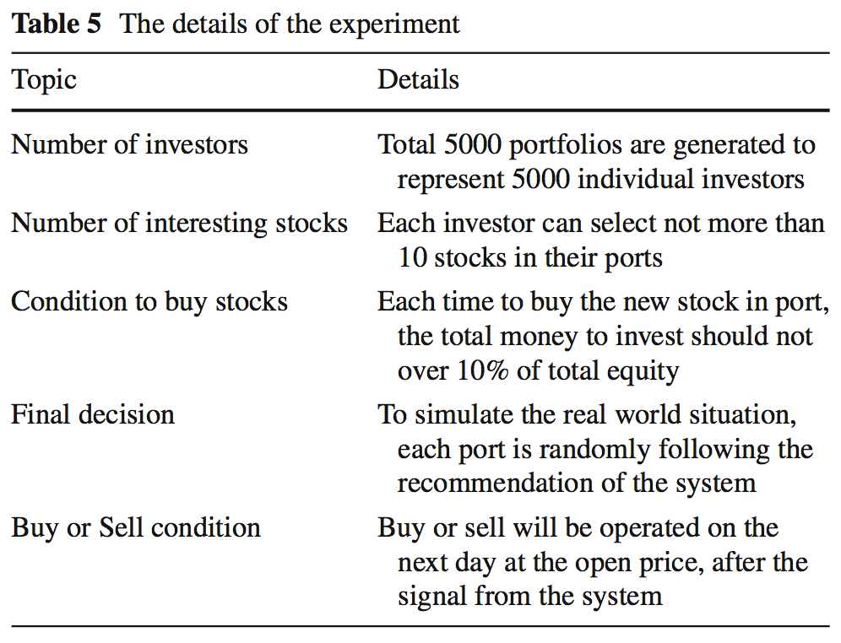
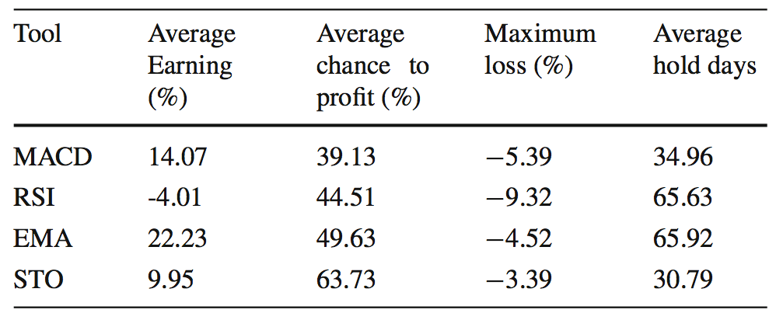
Experimental method and results(2/2)

