Slide 1
The longest almost-increasing subsequence
Amr Elmasry
Information Processing Letters, Vol. 110, pp. 655-658, 2010.
Presenter: Hong-Yu Chen
Date: Nov. 9, 2010

Slide 2
Abstract
Given a sequence of n elements, we introduce the notion of an almost-increasing subsequence as the longest subsequence that can be converted to an increasing subsequence by possibly adding a value, that is at most a fixed constant, to each of the elements. We show how to optimally construct such subsequence in O(n logk) time, where k is the length of the output subsequence.

Slide 3
Robinson-Schensted-Knuth Algorithm for LIS
Input
3
5
2
7
4
8
1
6
1
3
3
2
2
2
2
1
1
L
2
5
5
5
4
4
4
4
3
7
7
7
7
6
4
8
8
8
LIS: 3578
time complexity: O(nlogn)
  n numbers are inserted and each insertion takes O(logn) time for binary search.

Slide 4




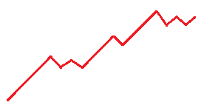

The longest almost-increasing subsequence
Given a sequence and a constant , our goal is to construct a longest subsequence such that
Notes:
先講動機
1.
2. There are applications where the data items have a small amount of noise.

Slide 5
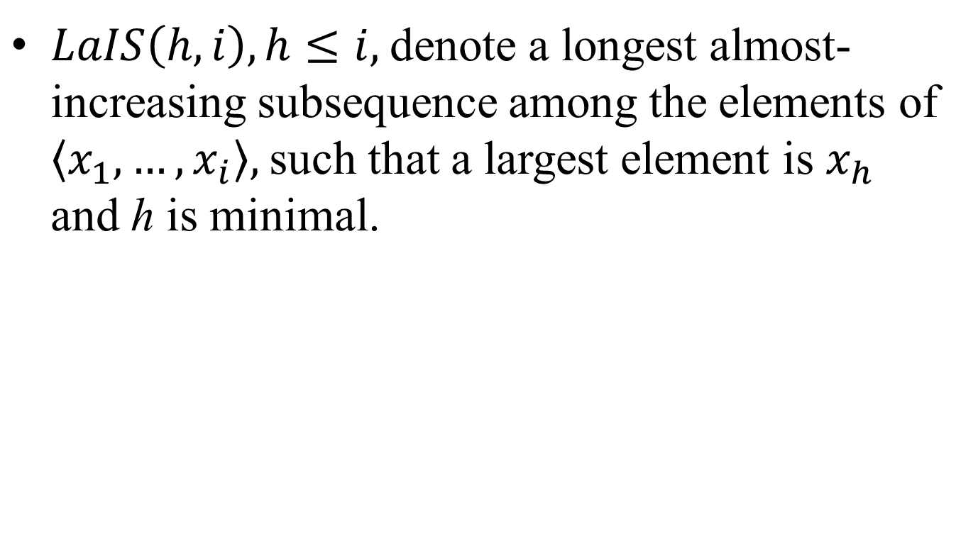
Recursive formulation

Slide 6
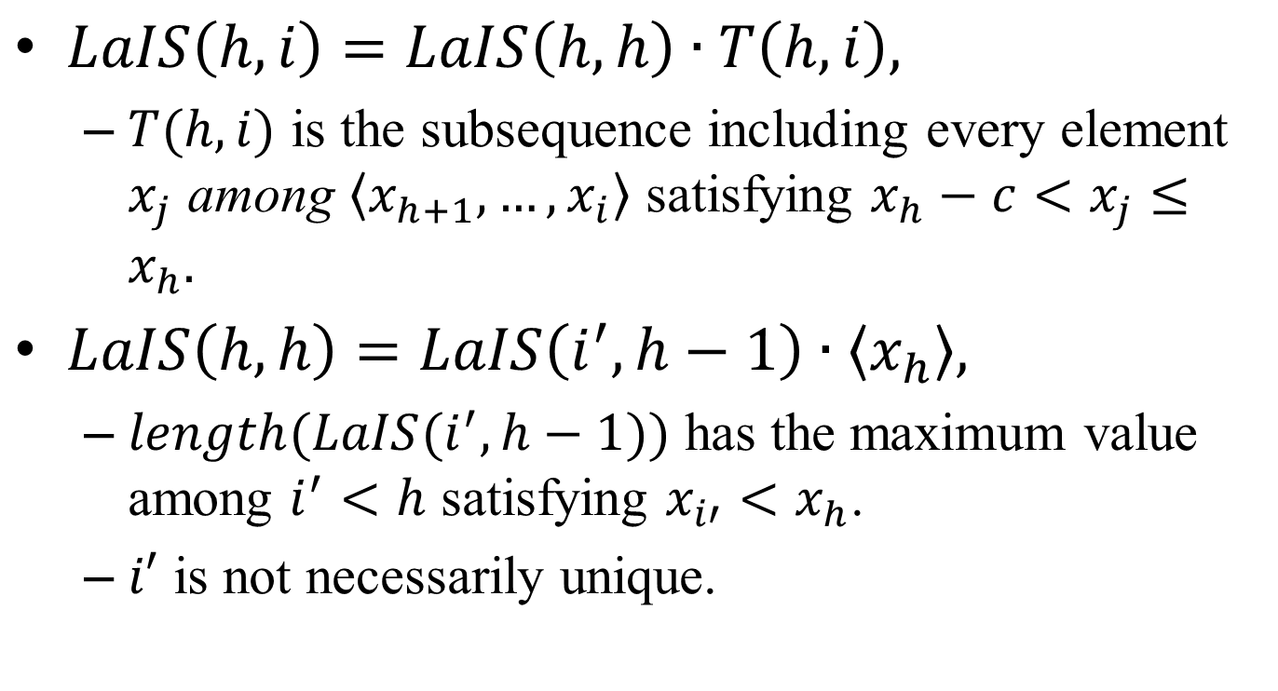
Recursive formulation

Slide 7
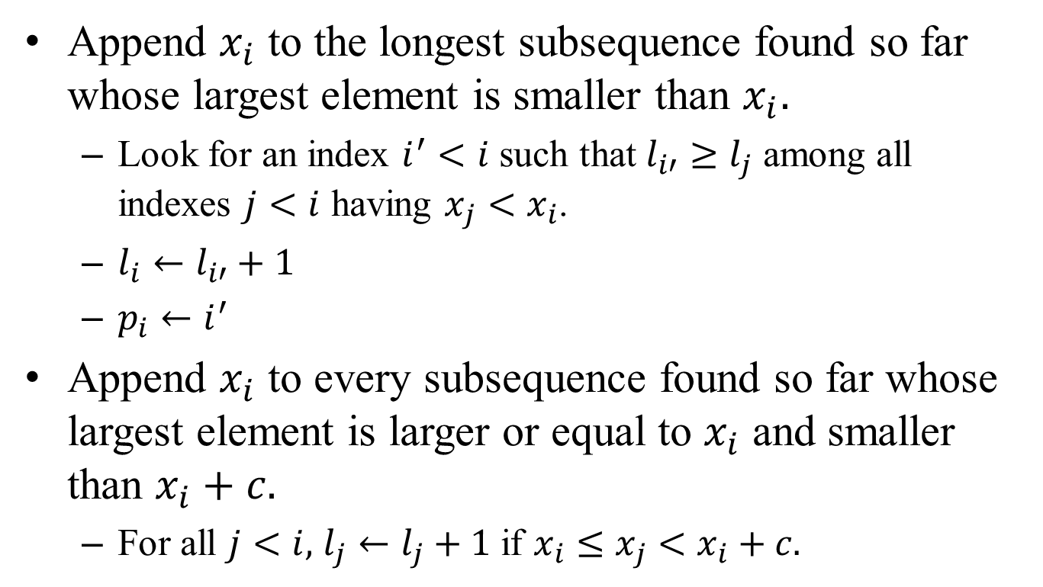
The basic algorithm
Notes:
1. Find a longest almost-increasing subsequence whose largest element is 𝑥_𝑖.

Slide 8
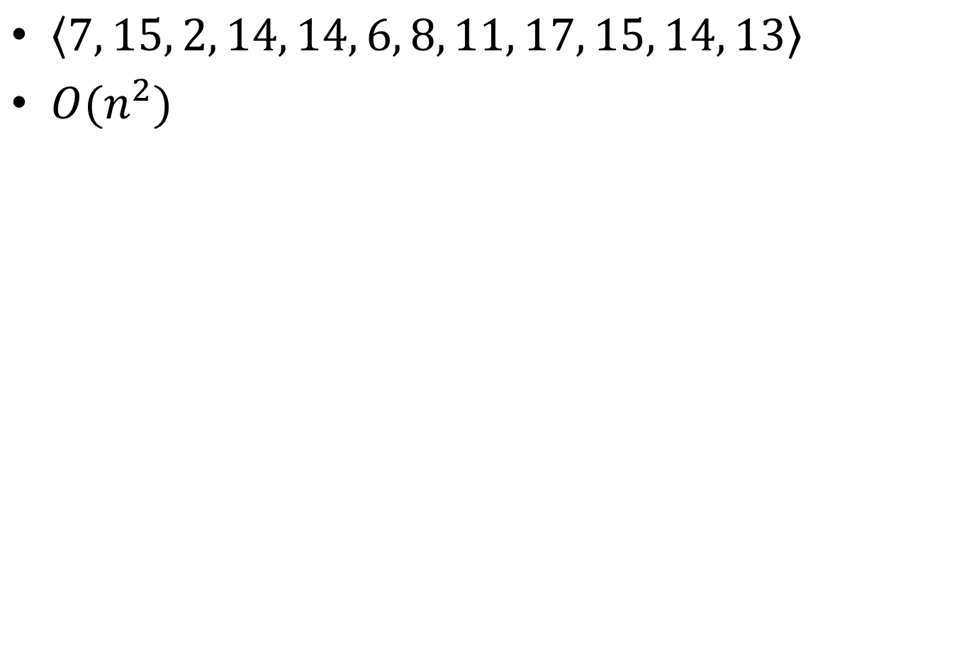
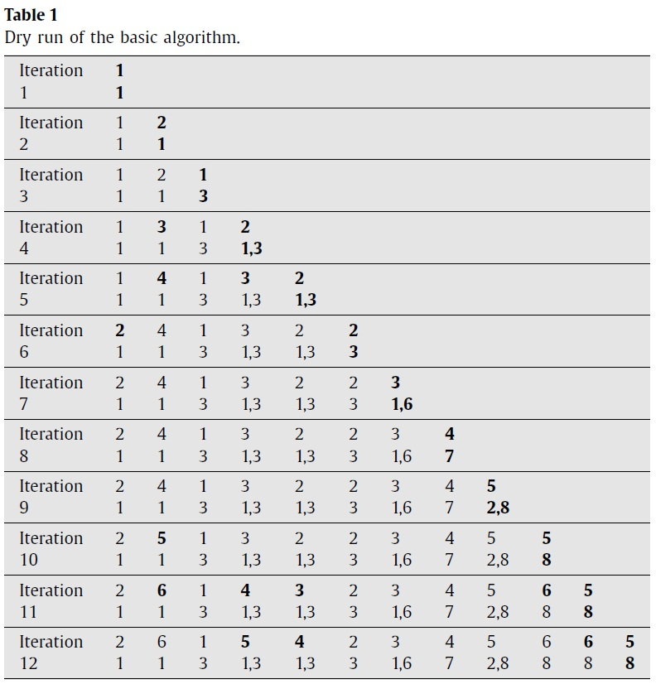
Notes:
因為要 maintains 所有 elements 的 𝑙_𝑖, 所以需要 𝑂(𝑛^2).

Slide 9
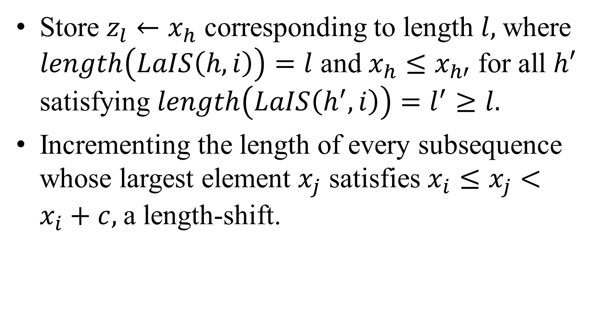
The improved algorithm

Slide 10
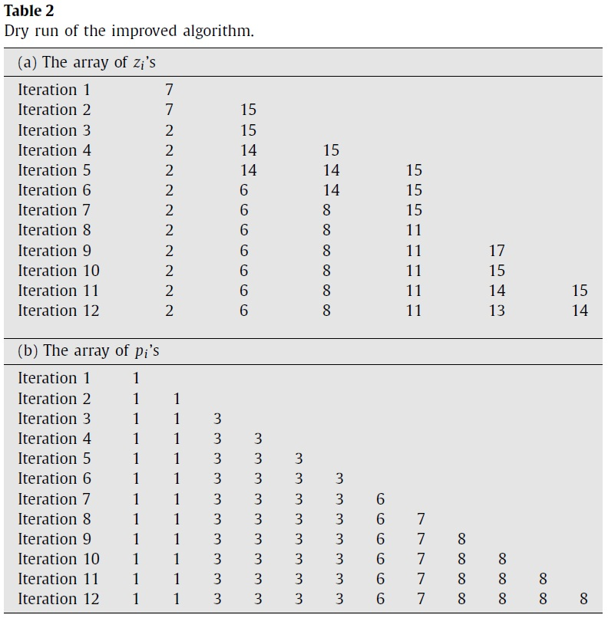

Slide 11
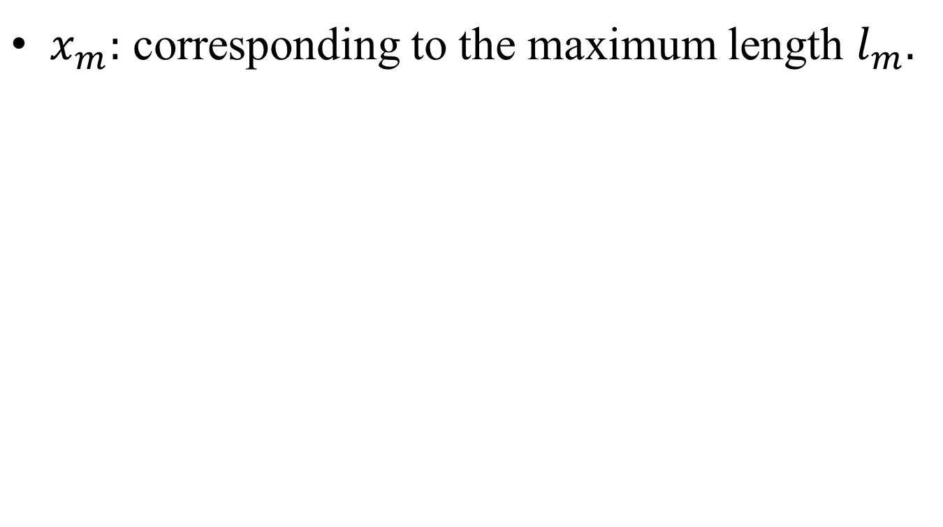
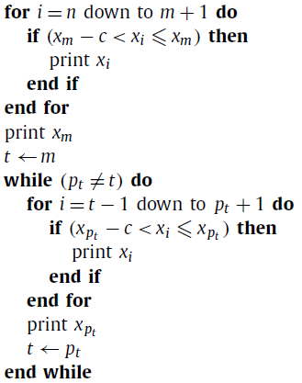
Produce the LaIS in reverse order

Slide 12
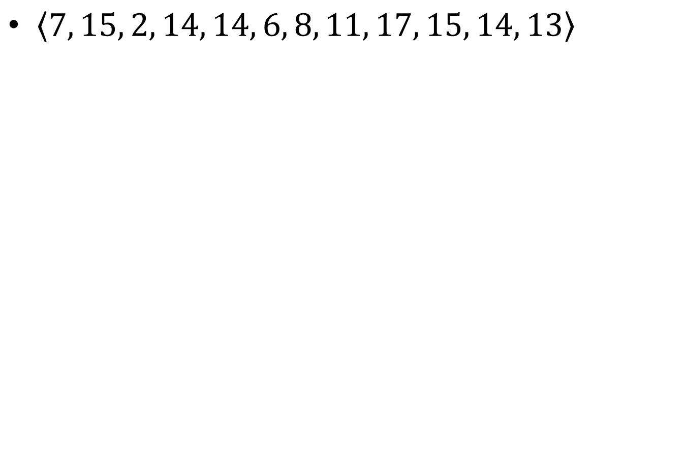























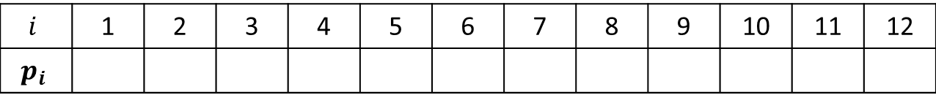
Notes:
Build a balanced search structure over the nodes of the linked list.

