Slide 1
Backbone Building from Quadrilaterals: A Fast and Accurate Algorithm for Protein Backbone
Reconstruction from Alpha Carbon Coordinates
DOMINIK GRONT, SEBASTIAN KMIECIK, ANDRZEJ KOLINSKI
J. Comput. Chem. 28 (2007), pp. 1593–1597
Presenter: Kai-Yu Chen
Date: Nov. 9, 2010

Slide 2
Abstract
In this contribution, we present an algorithm for protein backbone reconstruction that comprises very high computational efficiency with high accuracy. Reconstruction of the main chain atomic coordinates from the α carbon trace is a common task in protein modeling, including de novo structure prediction, comparative modeling, and processing experimental data. The method employed in this work follows the main idea of some earlier approaches to the problem. The details and careful design of the present approach are new and lead to the algorithm that outperforms all commonly used earlier applications. BBQ (Backbone Building from Quadrilaterals) program has been extensively tested both on native structures as well as on near-native decoy models and compared with the different available existing methods. Obtained results provide a comprehensive benchmark of existing tools and evaluate their applicability to a large scale modeling using a reduced representation of protein conformational space.

Slide 3
Introduction
We assume that the problem of reconstruction of an all-atom chain from a CA trace can be separated into two subsequent steps: (i) reconstruction of the all-atom backbone, and (ii) reconstruction of the side-chain geometry for a given backbone.
In this contribution, we deal only with the first task, postponing the second step to the further work, which is now in progress.

Slide 4
Introduction
Many of the approaches that have been proposed so far utilize protein fragment libraries derived from known structures to locate possible fragments that do not violate a specified CA trace. The most favorable fragments to construct the entire backbone are selected using energy-based, homology-based, or geometric criteria.

Slide 5
Introduction
In contrast to the homology-based methods, approaches with no reference to structural databases perform de novo construction of the backbone and try to minimize its energy.
The Ab initio strategy considers the inter-actions between all atoms of amino acids and solutions, such as van der Waals force, electrostatic force(靜電力), hydrogen bonds and hydrophobic force(疏水性). Then, the most stable conformation of molecular is determined by energy minimization.

Slide 6
Materials and Methods
To derive a statistics for positions of backbone atoms, we took a nonredundant protein database precomputed by the PISCES server. The dataset contains 1259 protein chains with mutual pairwise sequence similarity not higher than 90%. All these proteins were deposited to the database PDB prior to April 2006.
We took all the protein structures deposited to PDB between April 1, 2006 and July 22, 2006 and discarded the redundant entries. Finally, the testing set contained 81 protein chains with mutual sequence similarity below 50%.

Slide 7
Materials and Methods
Each continuous fragment of four CAs is called a quadrilateral(四邊形).
We define two coordination systems:
R-coordinate : It is used to define a tetrapeptide(四肽), i.e., protein fragment of four amino acids.
L-coordinate : It defines a local Cartesian coordinate system centered on a given CA atom.

Slide 8
Materials and Methods
In 3D space, four points have six internal degrees of freedom. Assuming that the distance between neighboring atoms (denoted as R₁₂) is constant we have only three free variables left. The R₁₂ distance is equal to 3.78 Å.
Three other distances were chosen as local coordinates: R₁₃ distance (between first and third CA atoms in a quadrilateral), R₂₄, and R₁₄ (defined similarly to R₁₃).

Slide 9
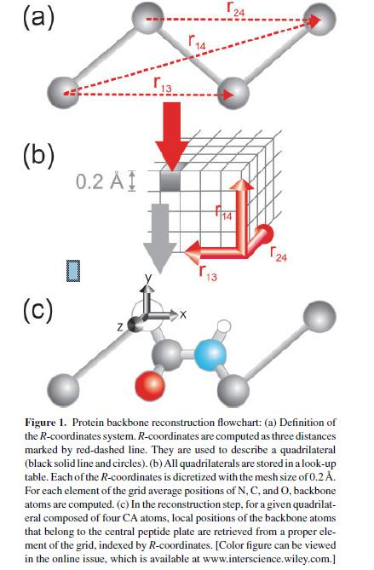

Slide 10
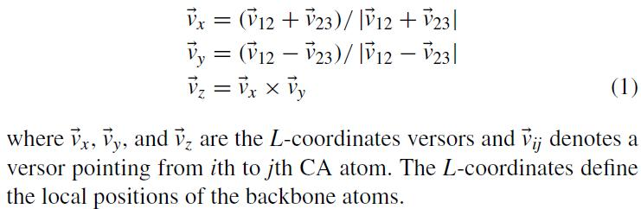
Materials and Methods
For each quadrilateral, we also define a L-coordinates system as simple linear combinations:
In some preliminary tests, we had withdrawn those quadrilaterals for which R-factor was higher than the given threshold value.
We decided to keep only these quadrilaterals with R-factor below 50 as a reasonable compromise between the statistics and the amount of noise introduced by the low-quality data.
It is possible to create over 263,000 different quadrilaterals from our training data set.

Slide 11
Materials and Methods
For each of these quadrilaterals, we computed LCS coordinates of atoms that form central peptide plate (between the second and third CA atoms).
We also computed R-coordinates. The R-coordinates were divided by 0.2 and rounded down to the nearest integer. This defined indices pointing to certain bins in a three dimensional array.
We allow R₂₄ and R₁₃ distances vary from 4.0 Å to 7.6 Å, distance R₁₄ in the range of 4.0–11 Å (or −11.0 A to −4.0 A for the left-handed conformations)
The resulting three dimensional look-up table can hold 22,680 different quadrilaterals. In practice, the set of 263,000 quadrilaterals creates only 5148 discrete states. For every one of these states, we computed average positions for the N, C, and O atoms.

Slide 12
Materials and Methods
To reconstruct backbone atoms CA trace R-coordinates are calculated for subsequent quadrilaterals and a proper set of local coordinates for N, C, and O atoms are retrieved from the look-up table.

Slide 13
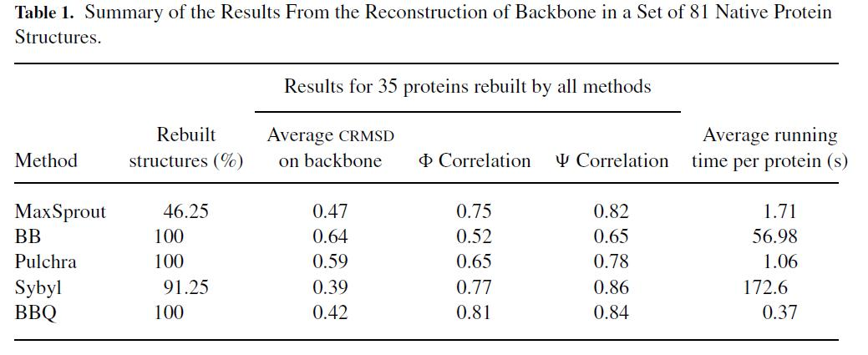
Results

