Slide 1
Towards the prediction of essential genes by integration of,network topology, cellular localization and biological process information
Marcio L Acencio and Ney Lemke
BMC Bioinformatics, September 2009
Presenter:Zih-Jie Yang
Date: November 9th,2010
115/11/08

Slide 2
Abstract(1/4)
Background: The identification of essential genes is important for the understanding of the minimal requirements for cellular life and for practical purposes, such as drug design. However, the experimental techniques for essential genes discovery are labor-intensive and time-consuming. Considering these experimental constraints, a computational approach capable of accurately predicting essential genes would be of great value. We therefore present here a machine learning based computational approach relying on network topological features, cellular localization and biological process information for prediction of essential genes.
115/11/08

Slide 3
Abstract(2/4)
Results: We constructed a decision tree-based meta-classifier and trained it on datasets with individual and grouped attributes-network topological features, cellular compartments and biological processes-to generate various predictors of essential genes. We showed that the predictors with better performances are those generated by datasets with integrated attributes. Using the predictor with all attributes, i.e., network topological features, cellular compartments and biological processes, we obtained the best predictor of essential genes that was then used to classify yeast genes with unknown essentiality status.
115/11/08

Slide 4
Abstract(3/4)
Finally, we generated decision trees by training the J48 algorithm on datasets with all network topological features, cellular localization and biological process information to discover cellular rules for essentiality. We found that the number of protein physical interactions, the nuclear localization of proteins and the number of regulating transcription factors are the most important factors determining gene essentiality.
115/11/08

Slide 5
Abstract(4/4)
Conclusion: We were able to demonstrate that network topological features, cellular localization and biological process information are reliable predictors of essential genes. Moreover, by constructing decision trees based on these data, we could discover cellular rules governing essentiality.
115/11/08

Slide 6
必要性蛋白質（essential protein）
必要性蛋白質（essential protein）為當此蛋白質在蛋白質複合體中遭到基因剔除式突變(null mutation)去除後，會危及很多重要的生化反應路徑(biologically important pathways)，進而造成蛋白質複合體的功能喪失，致使生物體無法生存(inviable)。因此瞭解必要性蛋白質的特性，並預測某些蛋白質是否為必要性蛋白質是很重要的課題。
115/11/08

Slide 7
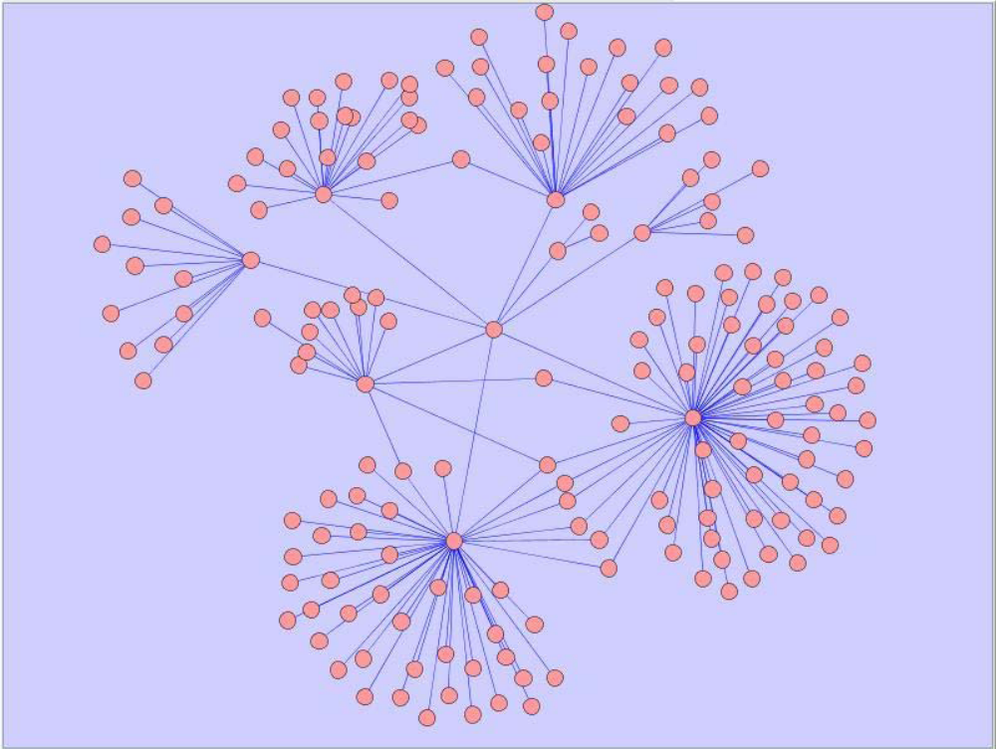
蛋 白 質 交 互 作 用 (Protein-protein interaction)
每一個點為一個蛋白質，每一個邊所連結的兩的點則代表這兩個蛋白質之間有交互作用。
115/11/08

Slide 8
Method
Network topological features
Cellular localization and biological process annotation of yeast genes
115/11/08

Slide 9
Network topological features
1. Degree
2. Clustering coecient
3. Betweenness centrality
4. Closeness centrality
5. Identicalness
115/11/08

Slide 10
Degree
ppi: Degree centrality related to protein physical interaction
metin: Indegree related to metabolic Interaction
metout: Outdegree related to metabolic interaction
regin: Indegree related to transcriptional regulation interaction
regout: Outdegree related to transcriptional regulation interaction
115/11/08

Slide 11
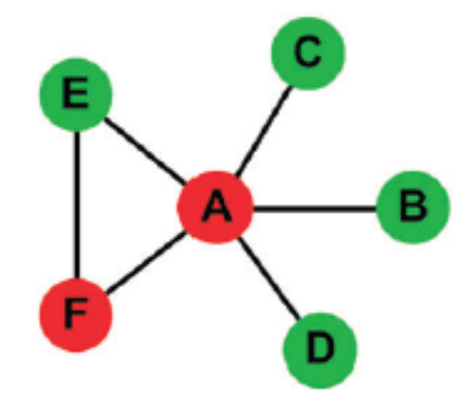
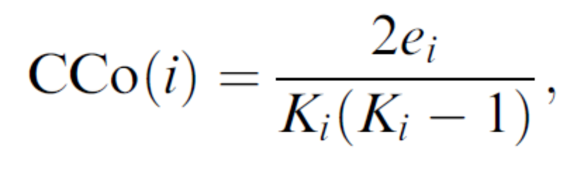
Clustering coefficient (CCo)
群聚係數
Node i的群聚係數定義為其鄰居彼此間也是鄰居的程度
CCo(i)=e_{i}/C(K_{i},2)
e_{i}為鄰居之間的邊數(NID(i))
K_{i}為node i的degree
e_{A} =1
K_{A}=5
CCo(A)=2*1/(5*4)
Larger clustering coefficient mean that many of their interacting partners interact with each other.
115/11/08

Slide 12
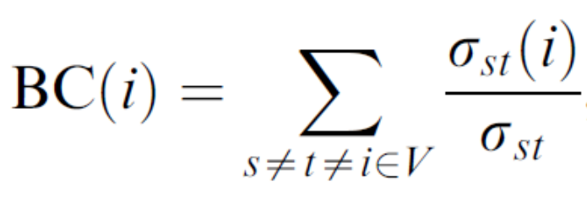
Betweenness centrality (BC)
The betweenness centrality (BC) of a node i measures the ratio of the shortest paths going through a node i.
where δ_{st} is the number of shortest paths from node s to node t, and δ_{st}(i) is the number of shortest paths from s to t that pass through node i.
larger betweeness centrality represent the bottlenecks on the interaction network or pathways they participate in
115/11/08

Slide 13
Betweenness centrality
inbet(g): Betweenness centrality related to all interactions
inbetppi(g): Betweenness centrality related to protein physical interactions
inbetmet(g): Betweenness centrality related to metabolic interactions
inbetreg(g): Betweenness centrality related to transcriptional regulation interactions
115/11/08

Slide 14
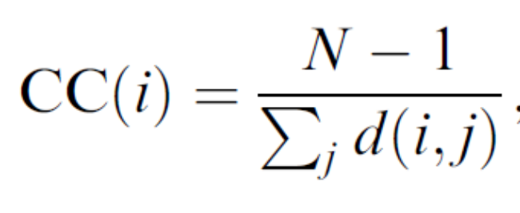
Closeness centrality (CC)(cent)
Closeness centrality (CC) of a node i is the reciprocal of the sum of average shortest distances from all other nodes in the network to node i.
where N is the total number of nodes in the network, and d(i,j) is the length of the shortest path from node i to node j.
CC(A)=(6-1)/(1+1+1+1+1)=1
115/11/08

Slide 15
Identicalness(ident)
Number of genes with identical network topological characteristics
115/11/08

Slide 16
Cellular localization and biological process
cellular component(cytoplasm細胞質, endoplasmic reticulum內質網, mitochondrion線粒體, nucleus核or other localization)
biological processes (cell cycle細胞週期, metabolic process新陳代謝過程, signal transduction訊息傳遞, transcription轉錄, transport or other process)
115/11/08

Slide 17
Dataset
General Repository for Interaction Datasets (BioGRID)
1,024 essential gene entries, 4,097 nonessential gene
115/11/08

Slide 18

Classifier design
We used WEKA (Waikato Environment for Knowledge Analysis) software package, a collection of machine learning algorithms for data mining tasks , for designing, training and evaluating the classifiers applied to prediction of essential genes.
Wiki: Weka (Waikato Environment for Knowledge Analysis) is a popular suite of machine learning software written in Java, developed at the University of Waikato, New Zealand.
115/11/08

Slide 19
Balanced dataset
(1) first, we split the dataset of classified genes into two subsets: "essential genes set“, containing 1,024 essential gene entries, and "nonessential genes set", containing 4,097 non-essential gene entries;
(2) second, we selected all entries from the essential genes set (1,024 entries) and randomly selected 1,024 entries from the non-essential genes set;
(3) we then created the balanced dataset containing the 2,048 selected entries with random distribution of the essential gene and non-essential gene entries. This procedure was repeated 10 times in order to generate 10 different balanced datasets containing different sets of non-essential gene entries.
115/11/08

Slide 20

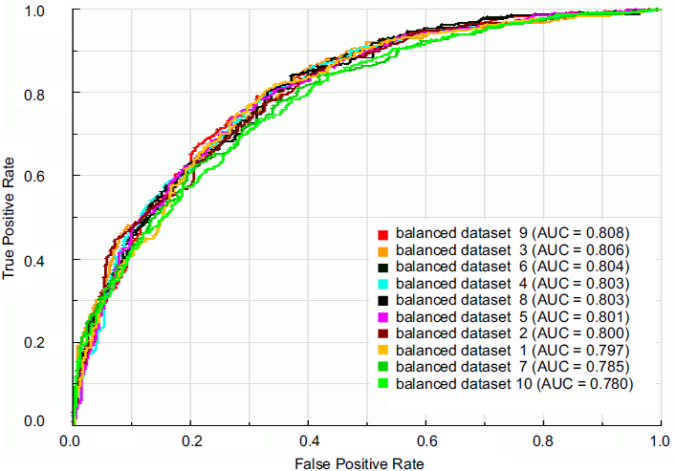
Comparison of the classification performance among balanced datasets
115/11/08

Slide 21
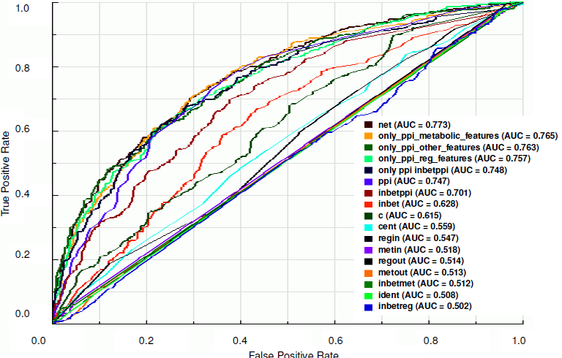
Prediction of essential genes by network topological features
115/11/08

Slide 22
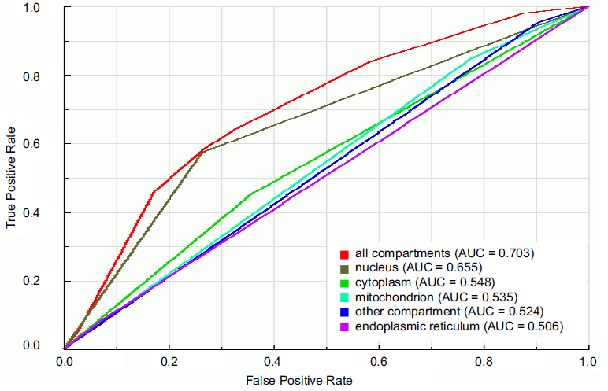
Prediction of essential genes by cellular localization and biological process data
115/11/08

Slide 23
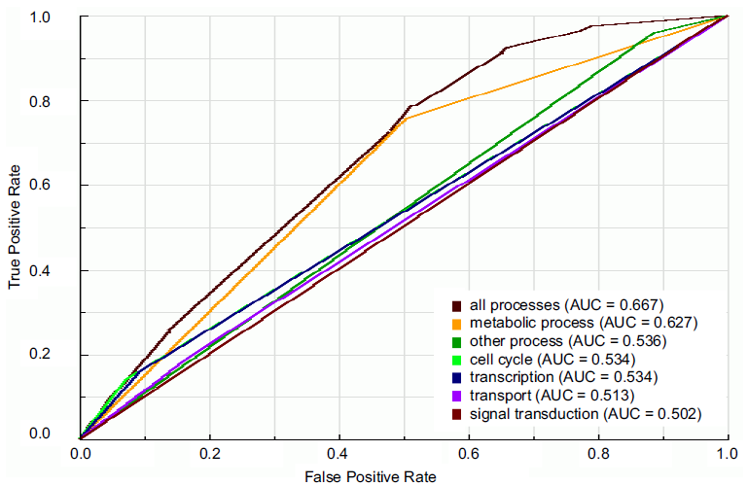
Prediction of essential genes by cellular localization and biological process data
115/11/08

Slide 24
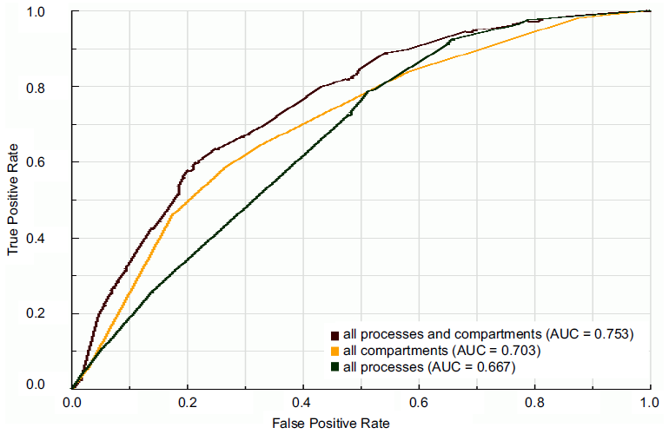
Prediction of essential genes by cellular localization and biological process data
115/11/08

Slide 25
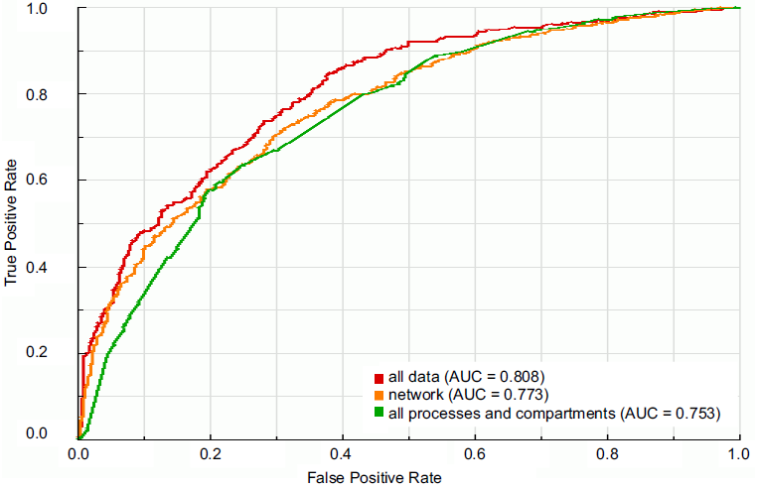
Prediction of essential genes by integrating network topological features, cellular localization and biological process information
115/11/08

Slide 26
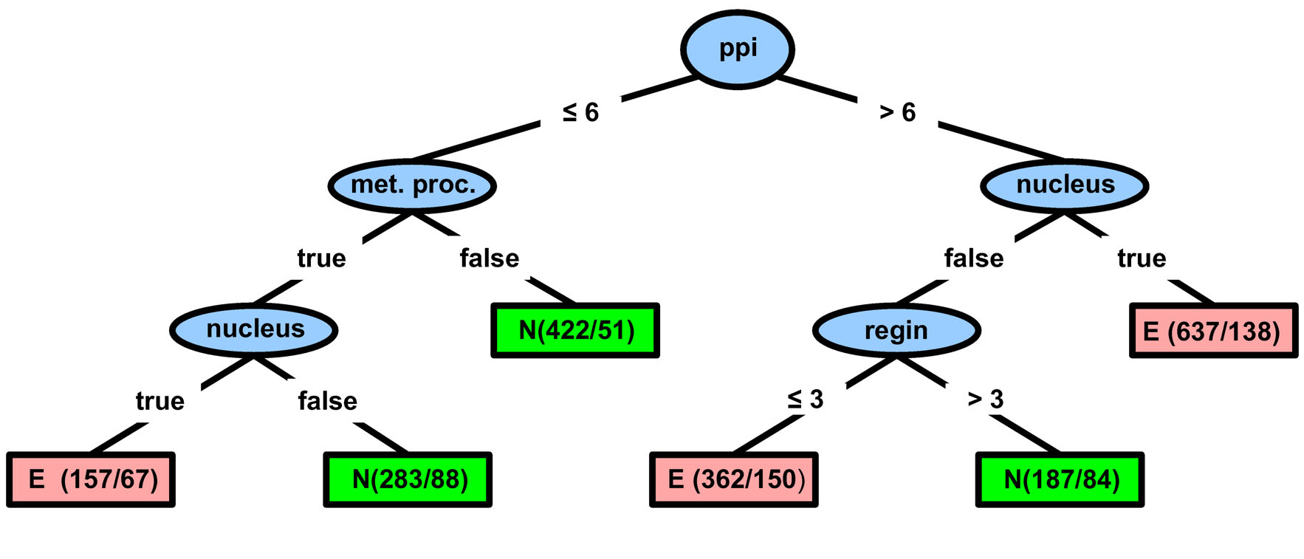
Cellular rules for gene essentiality
115/11/08

