Slide 1
‘Protein Peeling’: an approach for splitting a 3D protein structure into compact fragments
Jean-Christophe Gelly, Alexandre G. de Brevern, and Serge Hazout
BIOINFORMATICS, Vol. 22, pp. 129–133, 2006
Presenter: Dong-Jian Lin
Date: Dec. 08, 2010

Slide 2
Abstract
Motivation: The object of this study is to propose a new
method to identify small compact units that compose
protein three-dimensional structures. These fragments,
called ‘protein units (PU)’, are a new level of description to
well understand and analyze the organization of protein
structures. The method only works from the contact
probability matrix, i.e. the inter Ca-distances translated into
probabilities. It uses the principle of conventional
hierarchical clustering, leading to a series of nested
partitions of the 3D structure. Every step aims at dividing

Slide 3
Abstract(cont.)
optimally a unit into 2 or 3 subunits according to a criterion
called ‘partition index’ assessing the structural
independence of the subunits newly defined. Moreover, an
entropy-derived squared correlation R is used for
assessing globally the protein structure dissection. The
method is compared to other splitting algorithms and shows
relevant performance.

Slide 4
Protein Unit(PU)
An intermediate level of organization, between
secondary structures elements and domains.
A PU is a compact subregion of the 3D
structure corresponding to one sequence fragment.
Each PU must have a high number of intra-PU
contacts, and, a low number of inter-PU contacts.

Slide 5
Protein Peeling
At a given iteration, the protein sequence is cut
into M PUs. For each PU, the optimal cutting into 2
or 3 sub-PUs is searched. A criterion, named
partition index (PI) derived from the Matthews
correlation coefficient (MCC), assesses the quality
of every split by quantifying the subunits
independence in terms of contacts. The resulting
cutting maximizes the PI criterion.

Slide 6
Protein Peeling
(2) A squared entropy-derived correlation R is
used for assessing globally the quality of the
protein partition into PUs. As this correlation
increases after each new split, the process is
reiterated while the R-value is less than an
user-fixed threshold R₀.

Slide 7
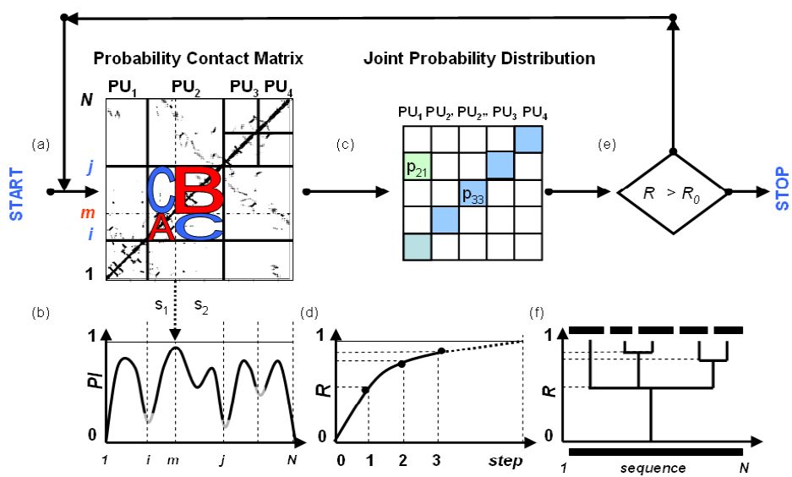
Protein Peeling

Slide 8
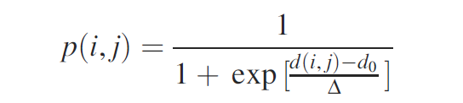
Contact Probability Matrix P
with the parameters d₀ and Δ fixed to 8 and 1.5, Å ,
respectively in our study. For a distance d(i, j) close to 0,
the contact probability p(i, j) is almost 1. For a large
distance, p(i, j) = 0.

Slide 9
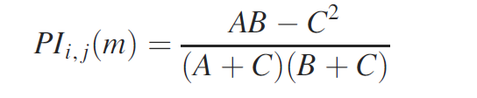
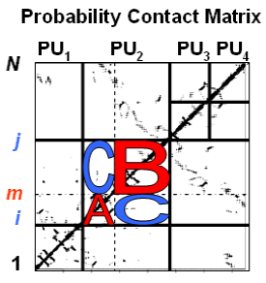
Partition Index(PI)
The complete absence of contacts between these two
subunits (i.e. C = 0) leads to a maximal value of the
partition index. A large presence of contacts between
subunits (C > 0) induces a low PI value.

Slide 10
Assessing the global 3D structure protein splitting into PUs
squared entropy-derived correlation, R
The contact probability matrix P is translated into a joint probability matrix p_{XY} of dimension M · M (M is the number of PUs).

Slide 11
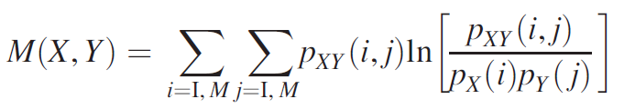

This squared correlation measures the independence level
between two discrete variables. It varies between 0 and
R_{max} Thus, in the absence of contacts between PUs, the
matrix is diagonal (R close to 1).

Slide 12
Results
Results of the peeling process performed
on globular actin (pdb code 1atnA)(球型肌動
蛋白)

Slide 13
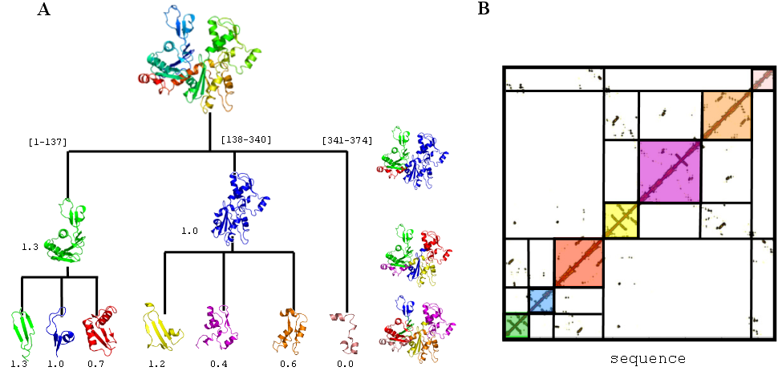
Results
de

Slide 14
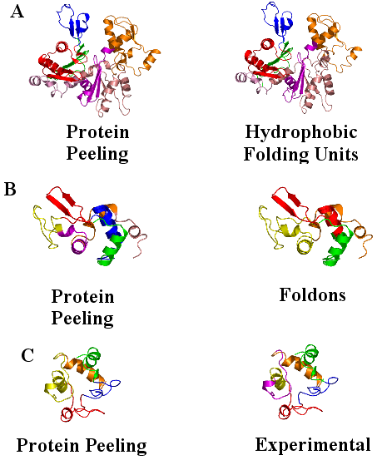

Slide 15
Thanks for your listening!

