Slide 1
The Reconstruction of a Protein Backbone from C^{α} Coordinates
Kaiwan Gan, Peter Alexander, James M. Coxon, A. John McKinnon, Gillian H. Worth
Biopolymers, Vol. 41, 381–389(1997)
Presenter: Kai-Yu Chen
Date: Dec. 14, 2010

Slide 2
Abstract
A Monte Carlo Protein Building method to construct the backbone and C^{β} atomic coordinates from known C^{α} coordinates is reported. The method selects values of dihedral angles from ranges established from a statistical analysis of the relationship between dihedral angles of the backbone and C^{α} coordinates for a protein data base. The averaged coordinates from ten backbone models of a protein were used to define a mean structure that was refined by energy minimization using the AMBER force field (GB/SA) . By the latter method the average atomic deviation and rmsd of the backbone and C^{β} atoms for 24 proteins is between 0.14 and 0.32 Å (average 0.22 Å ) and 0.22 and 0.61 Å (average 0.43 Å ) , respectively. A comparison with other methods is made.

Slide 3
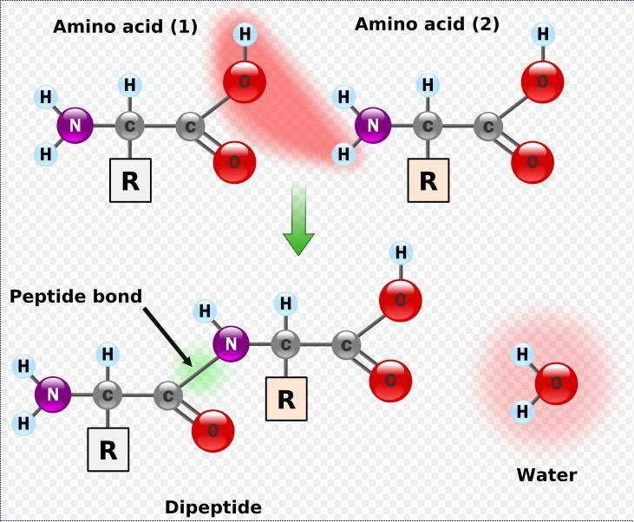
Introduction
Monte Carlo Protein Building (MCPB)
  Addressing the positioning of the atoms of the first peptide.
  A Monte Carlo method for selecting values of bond lengths and angles and dihedral angles from predetermined ranges to reconstruct atomic coordinates of the backbone and β-carbons.
Peptide (肽鍵)

Slide 4

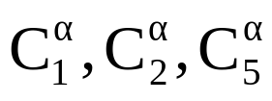

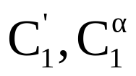







Method
Generation of the First peptide
  The carbonyl carbon of the first amino acid lies close to a plane defined by .
  The angle is ca. 21.5 ̊.
  The bond length is 1.540 Å.
After is defined, the atomic coordinate N₂ and O₁ are calculated from and .
  A bond length and angle are randomly selected from within the ranges
  Å and .
  The dihedral angle is set to zero as for a planar peptide bond.

Slide 5







Method
For generating O₁ coordinates
  The bond length is randomly selected within the ranges Å and an angle for selected within the ranges .
  The dihedral angle is chosen at 180 ̊.
The distance N₂ and is computed. If the distance is in the range of Å ,then the coordinates are accepted. If outside this range the coordinates of both these atoms are regenerated until the distance is within the defined range.

Slide 6




Method
Generation of the Backbone Atoms of the Second and Subsequent Amino Acids
  The dihedral angle will define and with appropriate bond lengths and bond angles.
  The dihedral angle will define N₃ and O₂ .
A data base for dihedral angles was established from a statistical analysis of the relationship between dihedral angles of the backbone and C^{α} coordinates.

Slide 7



Method
In i-th amino acid: the distance v₆ (between
to ) and the torsion angle v₁₃
( ).
We divided the values of v₆ and v₁₃ into four ranges :
  v₆ :(1) 4.0–6.0 A°, (2) 6.0–8.0 A°, (3) 8.0–9.5 A°, (4) 9.5–13.0 A
  v₁₃(1) 180 ̊ to 90 ̊, (2) 90 ̊to 0,̊ (3) 0 ̊to -90,̊ (4)
  -90 ̊to -180 ̊

Slide 8
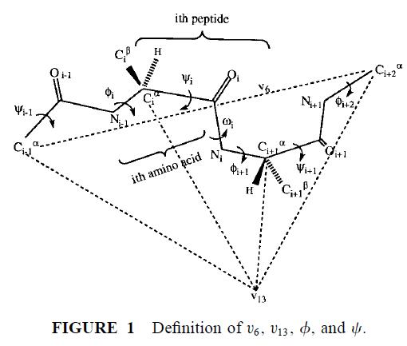
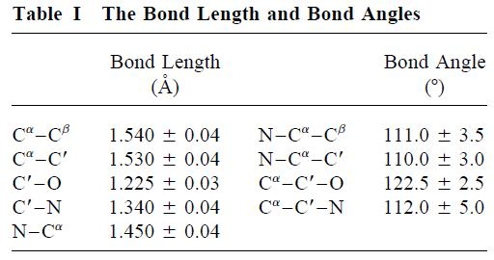
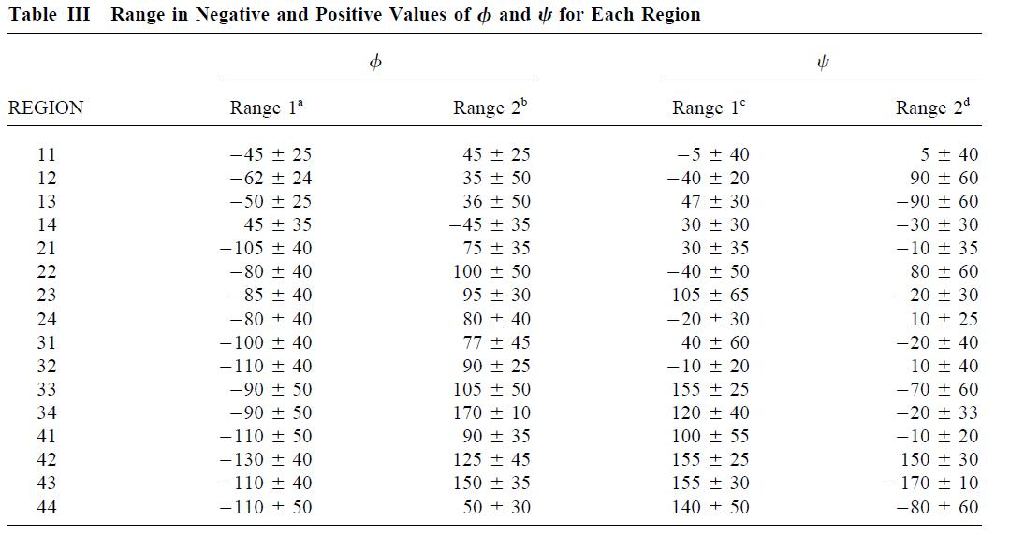

Slide 9
Method
Energy Minimization of the Backbone Model
  Using the OPLS/AMBER force field and GB/SA water model.

Slide 10
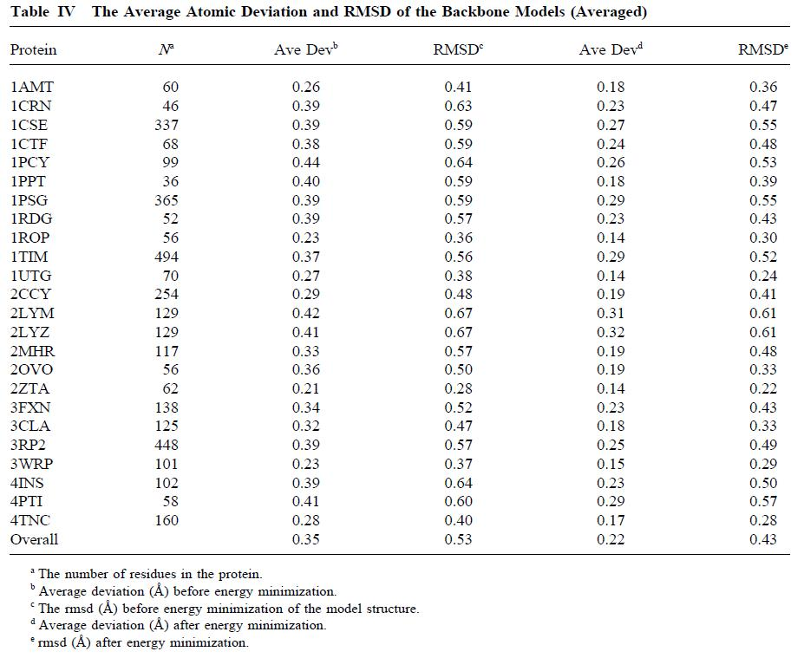
Results

Slide 11
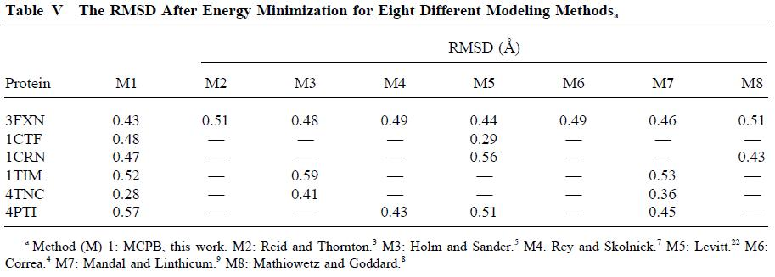
Results

