Slide 1
A new taxonomy-based protein fold recognition approach based on autocross-covariance transformation
Qiwen Dong, Shuigeng Zhou, and Jihong Guan
BIOINFORMATICS ORIGINAL PAPER Vol. 25 no. 20 2009, pages 2655–2662
Speaker: Chong-Jie Wang
Date: October 18, 2010

Slide 2
Abstract(1/2)
Motivation: Fold recognition is an important step in protein structure and function prediction. Traditional sequence comparison methods fail to identify reliable homologies with low sequence identity, while the taxonomic methods are effective alternatives, but their prediction accuracies are around 70%, which are still relatively low for practical usage.
Results: In this study, a simple and powerful method is presented for taxonomic fold recognition, which combines support vector machine (SVM) with autocross-covariance (ACC) transformation. The evolutionary information represented in the form of position-specific score matrices is converted into a series of fixed-length vectors by ACC transformation and these vectors are then input to a SVM classifier for fold recognition.

Slide 3
Abstract(2/2)
The sequence-order effect can be effectively captured by this scheme. Experiments are performed on the widely used D-B dataset and the corresponding extended dataset, respectively. The proposed method, called ACCFold, gets an overall accuracy of 70.1% on the D-B dataset, which is higher than major existing taxonomic methods by 2–14%. Furthermore, the method achieves an overall accuracy of 87.6% on the extended dataset, which surpasses major existing taxonomic methods by 9–17%. Additionally, our method obtains an overall accuracy of 80.9% for 86-folds and 77.2% for 199-folds. These results demonstrate that the ACCFold method provides the state-of-the-art performance for taxonomic fold recognition.

Slide 4
dataset
D-B dataset:
311 proteins for training and 383 proteins for test.
Any two proteins in the training set share <40% identity and each fold has at least seven members.
Each protein in the test set has not more than 35% identity to any protein in the training set.
The proteins in this dataset belong to 27 different SCOP folds.

Slide 5
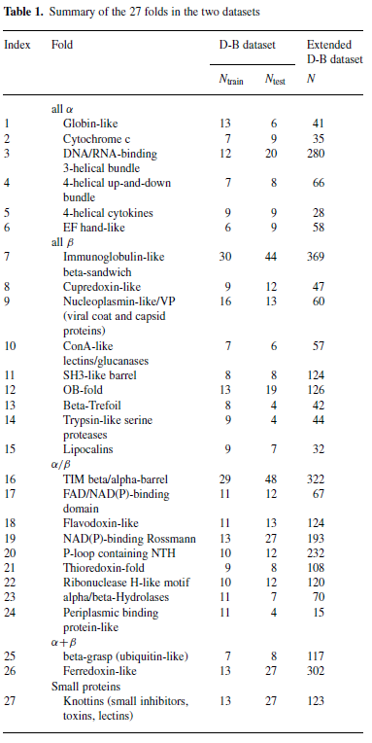

Slide 6
dataset
F86: contains 86 folds and 5671 sequences, in which each fold has at least 25 members.
F199: contains 199 folds and 7437 sequences, in which each fold has at least 10 members.

Slide 7
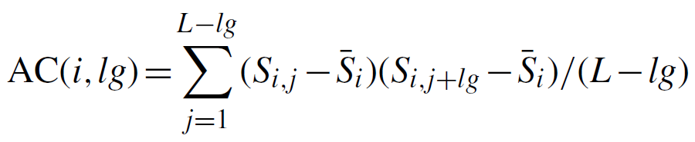
ACC transformation
Use PSSM
AC: the correlation of the same property between two residues separated by a distance of lg along the sequence.

Slide 8
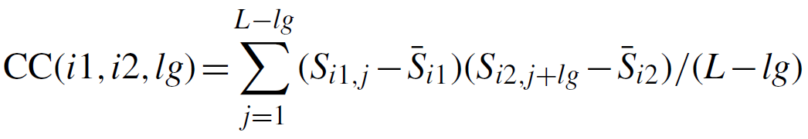
ACC transformation
CC: the correlation of two different properties between two residues separated by lg along the sequence.

Slide 9
A R N D C Q E G H I L K M F P S T W Y V
G 0 -3 -1 -2 -3 -2 -3 6 -3 -4 -4 -2 -3 -4 -3 -1 -2 -3 -4 -4
V 2 -3 -3 -3 -1 -2 -2 -2 -3 3 0 -2 0 1 -2 -1 -1 -3 -1 3
S 2 -2 -2 -2 -2 -1 -1 -1 -2 -3 -3 -1 -2 -4 7 1 -1 -4 -3 -2
C -1 -4 -4 -4 10 -4 -5 -3 -4 -2 -2 -4 -2 -3 -4 -2 -2 -3 -3 -2
L 0 3 -2 -3 -2 -1 -1 -3 -2 0 3 1 1 -1 -3 -2 -1 -3 -2 -1
C -1 -4 -4 -4 10 -4 -5 -3 -4 -2 -2 -4 -2 -3 -4 -2 -2 -3 -3 -2
D 0 -2 1 6 -3 -1 1 -2 -2 -2 -3 0 -3 -4 -2 -1 -1 -5 -3 -1
S 0 -1 2 2 -2 0 0 -1 -1 -3 -3 -1 -2 -3 -1 5 1 -4 -2 -2
D -2 -2 1 7 -4 -1 1 -2 -2 -4 -4 -1 -4 -4 -2 1 -1 -5 -4 -4
G 0 -3 -1 -2 -3 -2 -3 6 -3 -5 -4 -2 -3 -4 -3 -1 -2 -3 -4 -4
P -1 -3 -3 -2 -4 -2 -2 -3 -3 -4 -4 -2 -3 -5 8 -1 -2 -5 -4 -3
S 0 0 3 3 -2 0 0 -1 2 -3 -3 0 -2 -3 -2 3 2 -4 -2 -2
V 0 -2 -2 -3 -1 -2 -2 -3 -3 2 0 -2 0 -1 0 0 2 -3 -2 3
A R N D C Q E G H I L K M F P S T W Y V
…
…
…

Slide 10
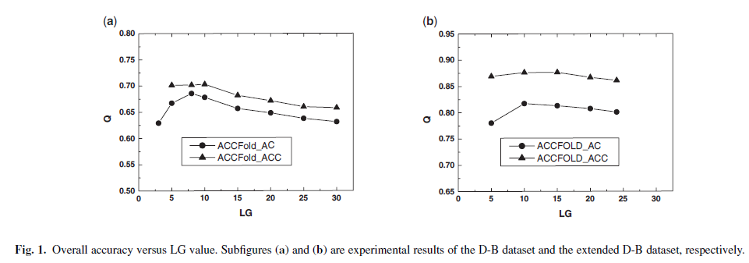
Results

Slide 11
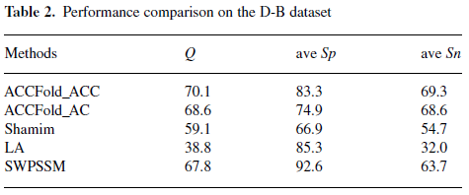

Slide 12
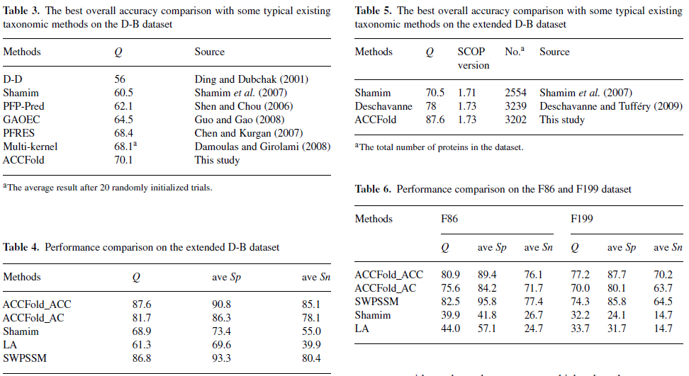

Slide 13
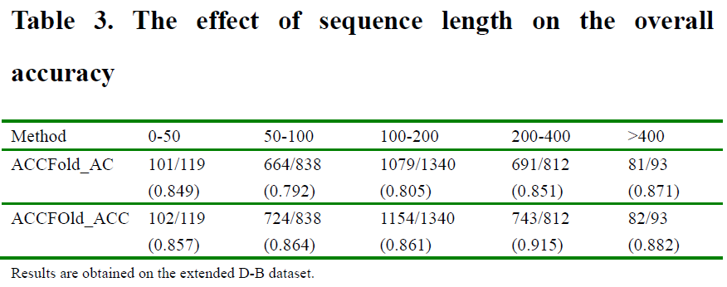

Slide 14
Thank you!

