Slide 1
Profile-based direct kernels for remote homology detection and fold recognition
Huzefa Rangwala and George Karypis
BIOINFORMATICS,
Vol. 21, No. 23, 2005, pages 4239–4247

Slide 2
Abstract
Motivation: Protein remote homology (同族關係) detection is a central problem in computational biology. Supervised learning algorithms based on support vector machines are currently one of the most effective methods for remote homology detection. The performance of these methods depends on how the protein sequences are modeled and on the method used to compute the kernel function between them.

Slide 3
Abstract
Results: We introduce two classes of kernel functions that are constructed by combining sequence profiles with new and existing approaches for determining the similarity between pairs of protein sequences. These kernels are constructed directly from these explicit protein similarity measures and employ effective profile-to-profile scoring schemes for measuring the similarity between pairs of proteins.

Slide 4
Abstract
Experiments with remote homology detection and fold recognition problems show that these kernels are capable of producing results that are substantially better than those produced by all of the existing state-of-the-art SVM-based methods. In addition, the experiments show that these kernels, even when used in the absence of profiles, produce results that are better than those produced by existing non-profile-based schemes.

Slide 5
Remote Homology Detection
Detecting homologs (同族關係) at low levels of sequence similarity

Slide 6
Sequence Profiles
PSSM
Protein
sequence
PSI-BLAST
program
Sequence
profiles
PSFM
PSSM: position-specific scoring matrix
PSFM: position-specific frequency matrix

Slide 7
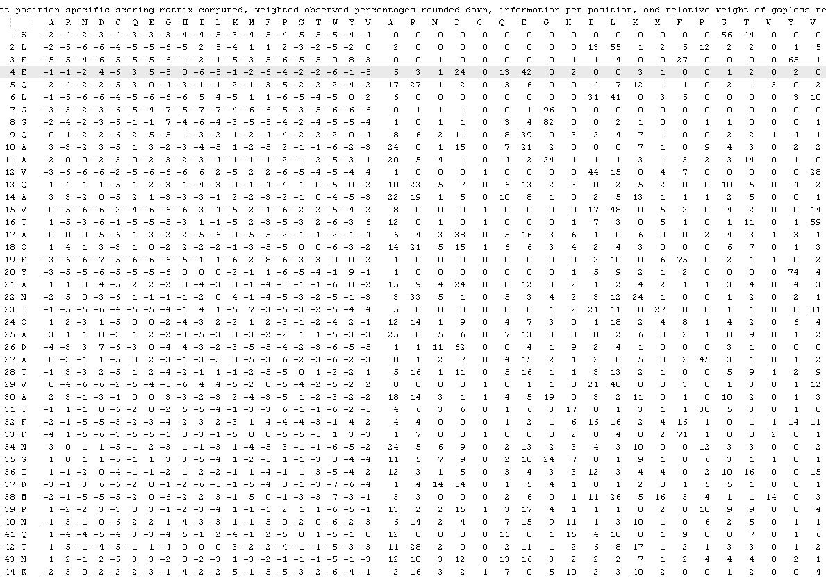
Sequence Profiles
PSSM
PSFM

Slide 8
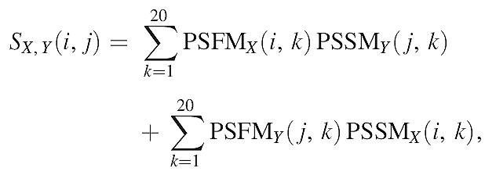
Profile-based Sequence Similarity
The similarity score between the i-th position of protein’s X profile, and the j-th position of protein’s Y profile is given by

Slide 9
Profile-based Sequence Similarity
+
×
×
PSSMx
i
PSFMy
L1
L1×20
j
L2
1~20
L2×20
1~20

Slide 10
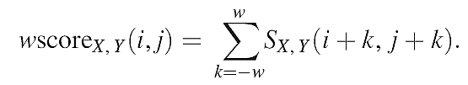

All fixed-width wmers (AF-PSSM)
+
×
×
PSSMx
PSFMy
(i-w)~ (i+w)
L1
L1×20
L2
(j-w)~ (j+w)
1~20
L2×20
wmer_{x}(i)
1~20
wmer_{y}(i)

Slide 11
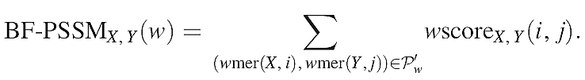
Best fixed-width wmer (BF-PSSM)
The BF-PSSM kernel selects a subset P'w of Pw [wscore(i,j)>0] such that (1) each position of X and each position of Y is present in at most one wmer pair and (2) the sum of the wscores of the selected pairs is maximized.

Slide 12
Best fixed-width wmer (BF-PSSM)
The BF-PSSM kernel selects a subset P'w of Pw [wscore(i,j)>0] such that (1) each position of X and each position of Y is present in at most one wmer pair and (2) the sum of the wscores of the selected pairs is maximized.
(j₁-w)~ (j₁+w)
wmer_{y}(j₁)
PSFMx
(i-w)~ (i+w)
L1
PSFMy
L1×20
L2
(j₂-w)~ (j₂+w)
1~20
L2×20
wmer_{x}(i)
1~20
i對j本應有(L2-2w)個分數需考慮，現在只選一個最大的
wmer_{y}(j₂)

Slide 13
Best variable-width wmer (BV-PSSM)
Being derived from the BF-PSSM kernel but operates with variable width wmers. In particular, given a user-supplied width w, it considers the set of all possible wmer-pairs whose length ranges from one to w
(j₁-w')~ (j₁+w')
wmer_{y}(j₁)
PSFMx
(i-w)~ (i+w)
L1
PSFMy
L1×20
L2
(j₂-w')~ (j₂+w')
1~20
L2×20
wmer_{x}(i)
w'可從1~w
1~20
i對j本應有(L2-2w')個分數需考慮，現在只選一個最大的，且w'可變
wmer_{y}(j₂)

Slide 14
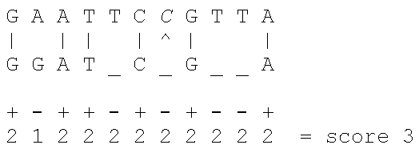
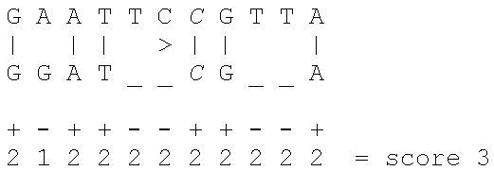
Affine Gap Penalties
Gap = Gapopen + Len * Gapextend
Assuming +2 for a match, -2 for a gapopen, and -1 for a mismatch or gapextend

Slide 15
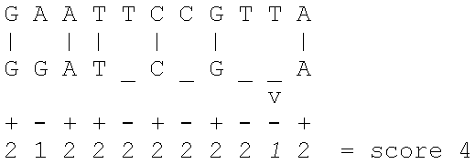
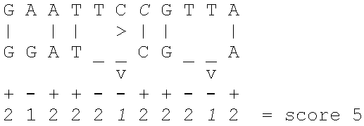
Affine Gap Penalties
Gap = Gapopen + Len * Gapextend
Assuming +2 for a match, -2 for a gapopen, and -1 for a mismatch or gapextend

Slide 16
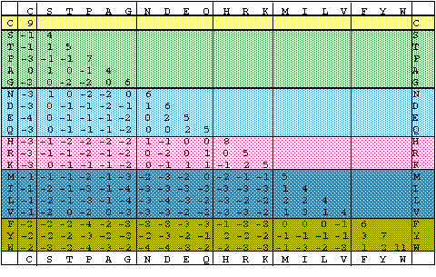
BLOSUM Matrix
BLOSUM62就是以序列區塊兩兩最低相似程度62%作為分群標準的建成的矩陣

Slide 17
Smith–Waterman PSSM (SW-PSSM)
Given two sequences X and Y of lengths n and m, respectively, the SW-PSSM kernel computes their similarity as the score of the optimal local alignment in which the similarity between two sequence positions is determined using the profile-to-profile scoring scheme of Equation (2), and a position-independent affine gap model. The actual alignment is computed using the O(nm) dynamic programming algorithm developed by Gotoh (1982).

Slide 18
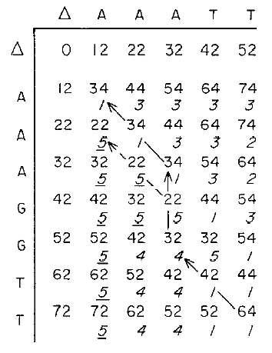
Smith–Waterman PSSM (SW-PSSM)
PSSMx
j₁
i₁
PSFMy
i₂
L1
j₂
i₃
L1×20
L2
1~20
j₃
L2×20
1~20

Slide 19
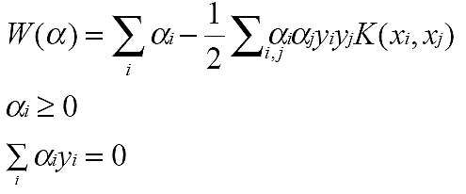
Sequence Similarity & SVM Kernel
SVM訓練(最佳化)過程：

Slide 20
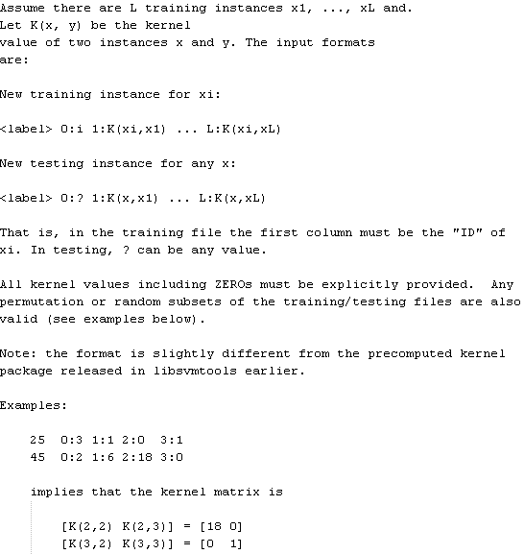
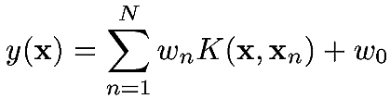
Sequence Similarity & SVM Kernel
LibSVM訓練(最佳化)過程：
LibSVM可允許使用者輸入資料間的相似度，最後輸出α_{i}

Slide 21

SVM預測
SVM prediction
  其中w_{n}為SVM訓練後所得參數，假設K(x,y)=exp(-(x-y)²)，N=2, w0=0, w1=-1, w2=+1。
x1=-1
0
x2=1

Slide 22
SVM預測
SVM prediction
  假設要預測x=0.5應該是屬那一類，則
  K(-1,0.5)=exp(-(-1-0.5)^2)=0.105
  K(1,0.5)=exp(-(1-0.5)^2)=0.779
  y(0.5)=-1*0.105+1*0.779=0.674>0
  故應該屬於+1這一類
x1=-1
0
x2=1

Slide 23
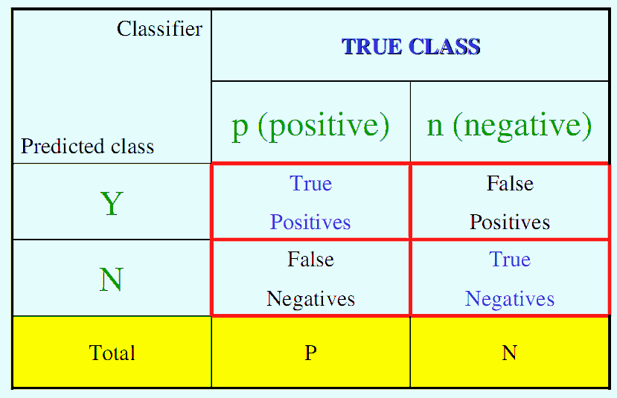
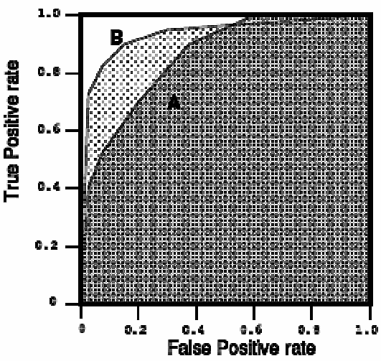
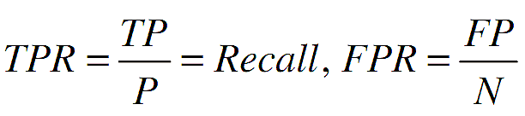
Receiver Operating Characteristic (ROC)
AUC
http://www.anaesthetist.com/mnm/stats/roc/Findex.htm

Slide 24
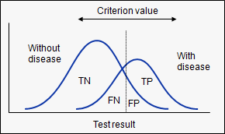
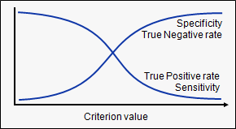
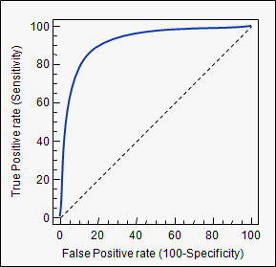
Receiver Operating Characteristic (ROC)
In a Receiver Operating Characteristic (ROC) curve the true positive rate (Sensitivity) is plotted in function of the false positive rate (100-Specificity) for different cut-off points. Each point on the ROC curve represents a sensitivity/specificity pair corresponding to a particular decision threshold.
http://www.medcalc.org/manual/roc-curves.php

Slide 25
ROC50
The ROC50 is the area under the ROC curve plotted until 50 true negatives (or false positives) (看兩曲線是否重疊) are found. ROC50 can be normalized to 0~1, with 1 corresponding to most sensitive and selective search. (?)
50 negatives
ROC50
http://www.medcalc.org/manual/roc-curves.php

Slide 26
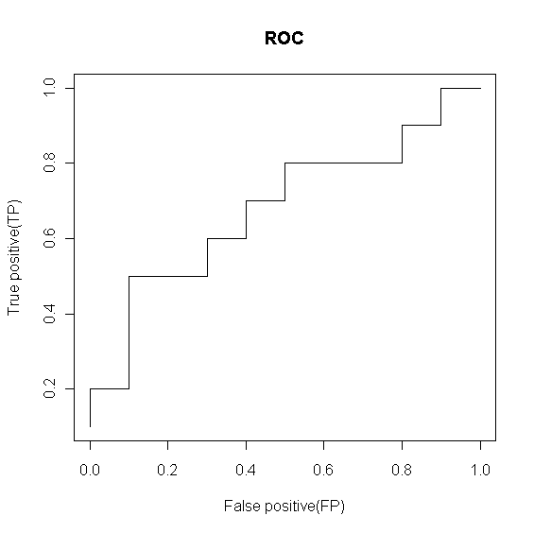
Receiver Operating Characteristic (ROC)
Use thresholds to create ROC curve
Score Class
------------------
0.9 P
0.8 P
0.7 N
0.6 P
0.55 P
0.54 P
0.53 N
0.52 N
0.51 P
0.505 N
0.4 P
0.39 N
0.38 P
0.37 N
0.36 N
0.35 N
0.34 P
0.33 N
0.30 P
0.1 N
threshold=0.900000
N P
N 10 9
P 0* 1*
TP FP
0.1 0.0
------------------
threshold=0.800000
N P
N 10 8
P 0* 2*
TP FP
0.2 0.0
------------------
threshold=0.300000
N P
N 1 0
P 9* 10*
TP FP
1.0 0.9
http://www.anaesthetist.com/mnm/stats/roc/Findex.htm
Notes:
tb <- read.table('roct.txt',header=T)
tn <- table(tb[,2]); x<- NULL
for(thr in tb[,1]){
print(sprintf('threshold=%f',thr),quote=F)
print(ttb <- table(ifelse(tb[,1]>=thr,"P","N"),tb[,2]))
dttb <- c(ttb['P','P'],ttb['P','N'])
x <- rbind(x, dttb/tn); dttbxy <- dttb/tn; names(dttbxy) <- c('TP','FP')
print(dttbxy)
}
plot(x[,2],x[,1],xlab='False positive(FP)',ylab='True positive(TP)',type='l',main='ROC')

Slide 27
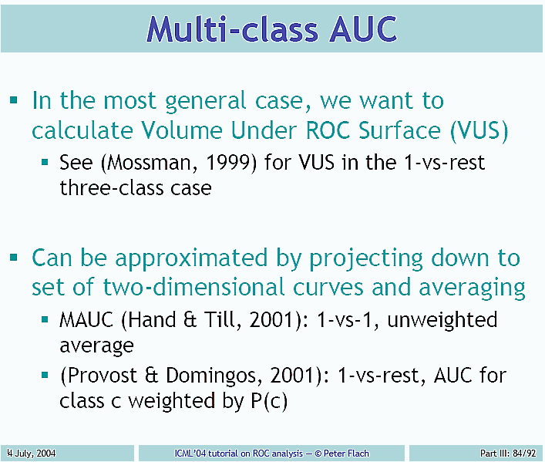
Multi-Class AUC

Slide 28
Multi-Class AUC
Recently two approaches emerged that are useful for multiclass cost-sensitive optimisation, capable of using input costs and priors to optimise operating weights.
The first is a hill-climbing approach as presented in that can easily be adapted to the cost-sensitive case.
The second is an evolutionary approach, attempting to find a global solution to the minimisation problem.
Thomas C.W. Landgrebe, Robert P.W. Duin, "Approximating the multiclass ROC by pairwise analysis"

Slide 29
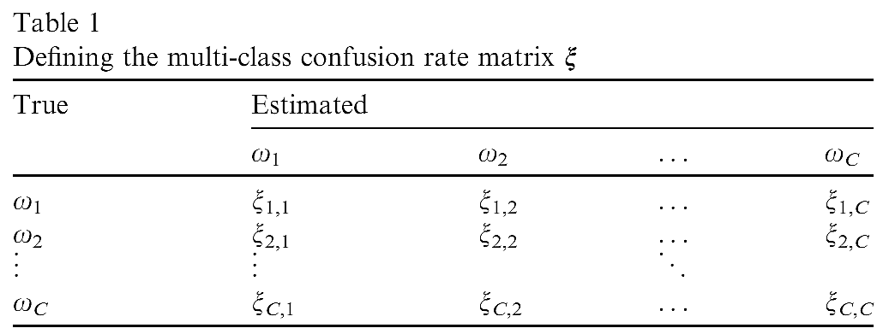
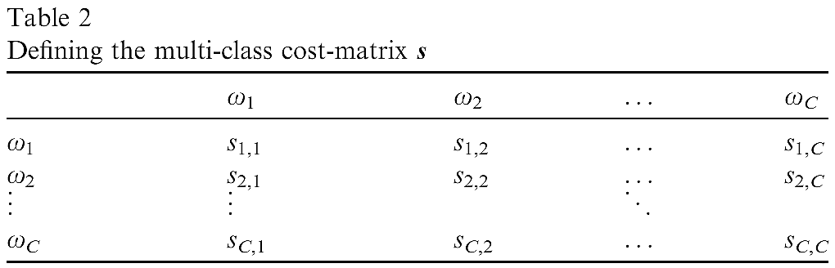
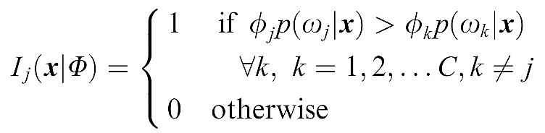
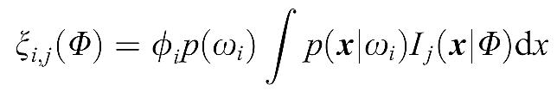
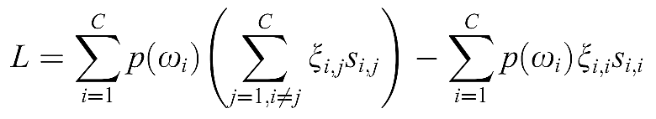
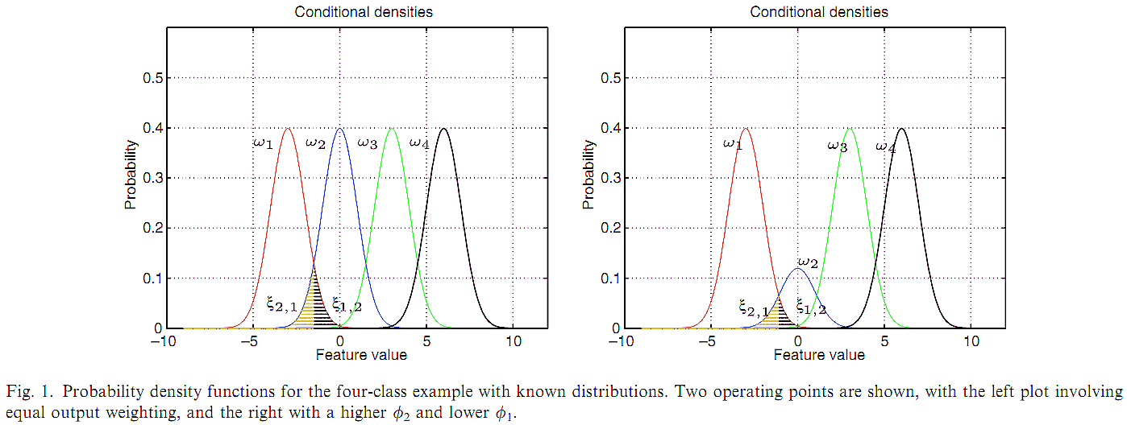


Thomas C.W. Landgrebe, Robert P.W. Duin, "Approximating the multiclass ROC by pairwise analysis"

Slide 30
Since the classiﬁer has (C-1) degrees of freedom, the ROC is constructed by generating a (C-1) dimensional grid of all possible operating weights U, with resolution r. steps across the output range. In the multiclass case (C > 2), computing the ROC involves the generation of a C-1 dimensional grid with r steps, resulting in r^(C-1) operating points.
Thomas C.W. Landgrebe, Robert P.W. Duin, "Approximating the multiclass ROC by pairwise analysis"

Slide 31
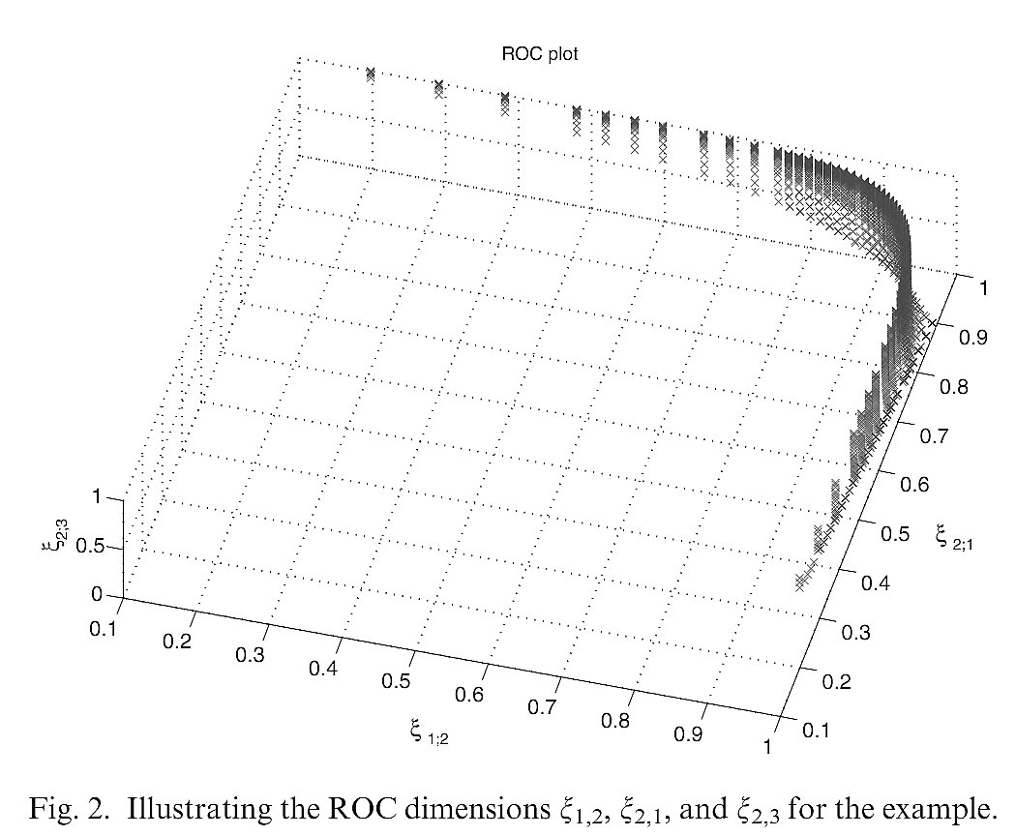
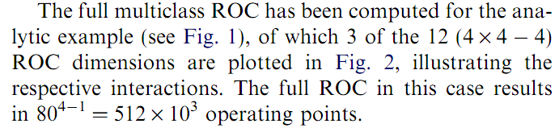
Thomas C.W. Landgrebe, Robert P.W. Duin, "Approximating the multiclass ROC by pairwise analysis"

Slide 32
SCOP: Structural Classification of Proteins
The different major levels in the hierarchy
  Family: Clear evolutionarily relationship
    Proteins clustered together into families are clearly evolutionarily related. Generally, this means that pairwise residue identities between the proteins are 30% and greater. However, in some cases similar functions and structures provide definitive evidence of common descent in the absense of high sequence identity; for example, many globins form a family though some members have sequence identities of only 15%.
  Superfamily: Probable common evolutionary origin
    Proteins that have low sequence identities, but whose structural and functional features suggest that a common evolutionary origin is probable are placed together in superfamilies.
    For example, actin, the ATPase domain of the heat shock protein, and hexakinase together form a superfamily.
  Fold: Major structural similarity
    Proteins are defined as having a common fold if they have same major secondary structures in same arrangement and with the same topological connections. Different proteins with the same fold often have peripheral elements of secondary structure and turn regions that differ in size and conformation. In some cases, these differing peripheral regions may comprise half the structure. Proteins placed together in the same fold category may not have a common evolutionary origin: the structural similarities could arise just from the physics and chemistry of proteins favoring certain packing arrangements and chain topologies.
http://swissmodel.expasy.org/course/text/chapter4b.htm

Slide 33
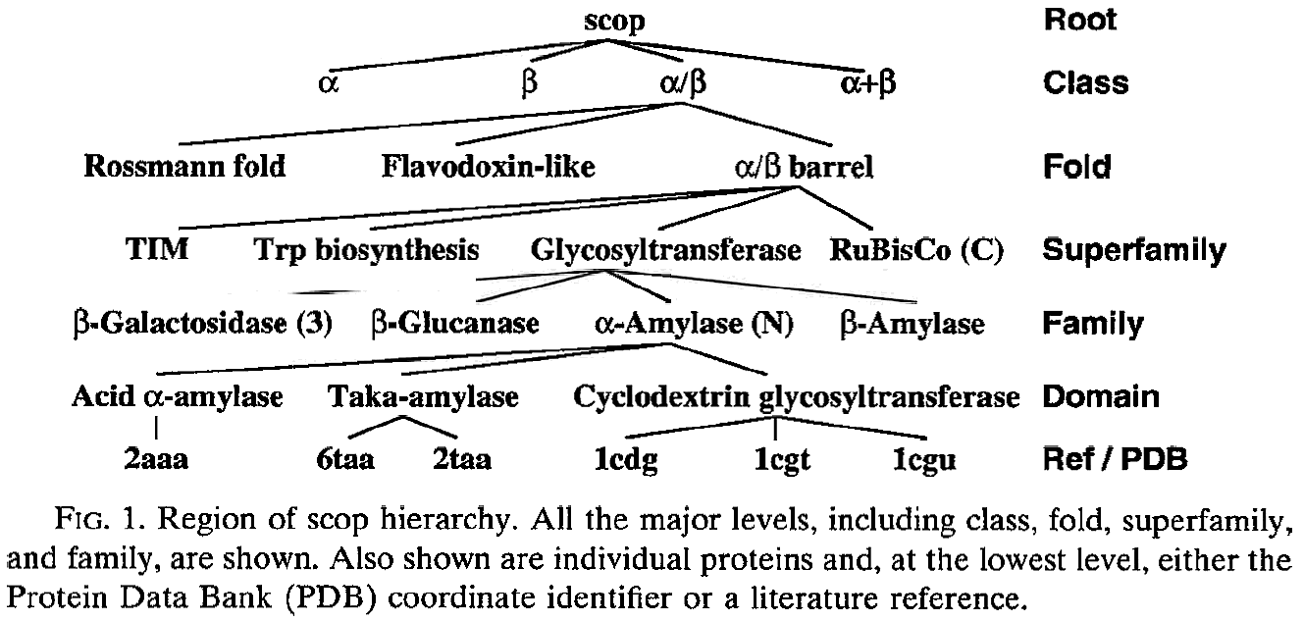
SCOP: Structural Classification of Proteins
"Understanding Protein Structure: Using Scop for Fold Interpretation" By STEVEN E. BRENNER, CYRUS CHOTHIA, TIM J. P. HUBBARD, and ALEXEY G. MURZIN

Slide 34
Dataset
Astral SCOPE 1.53
  Total 4352 sequences
  It does not contain any sequence pairs with an E-value threshold < 10^(-25)
  54 superfamilies
  23 folds
    Each covers several superfamilies

Slide 35
Performance Measure
ROC (receiver operating characteristic)
ROC50
  The area under the ROC curve up to the first 50 false positives
mRFP
  The number of false positives scoring as high or better than the median-scoring true positives.

Slide 36
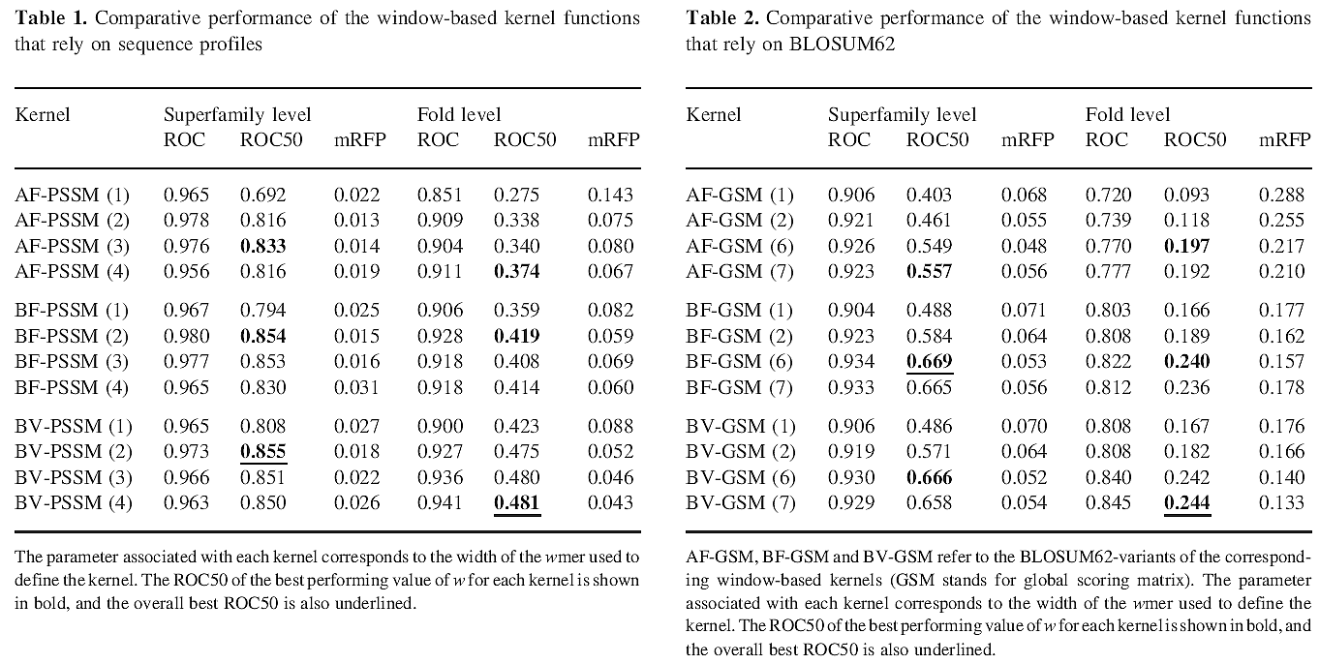
Results
同樣是用window，但採profile之結果比採BLOSUM62佳

Slide 37
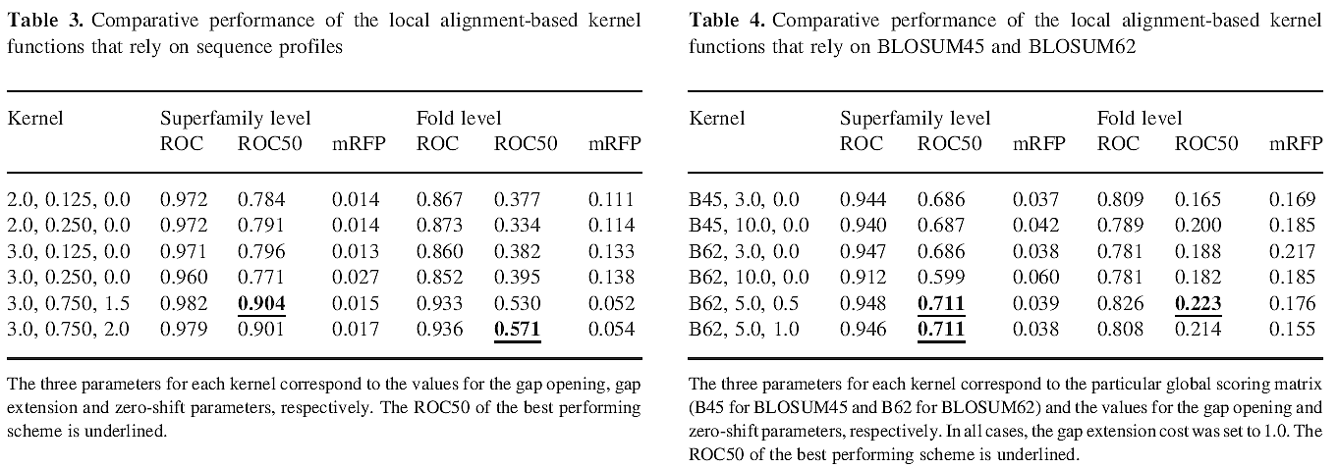
Results
採profile時，須調整gapopen, gapextend等alignment參數
同樣是用window，但採profile之結果比採BLOSUM62佳
採BLOSUM62之結果比採BLOSUM45佳

Slide 38
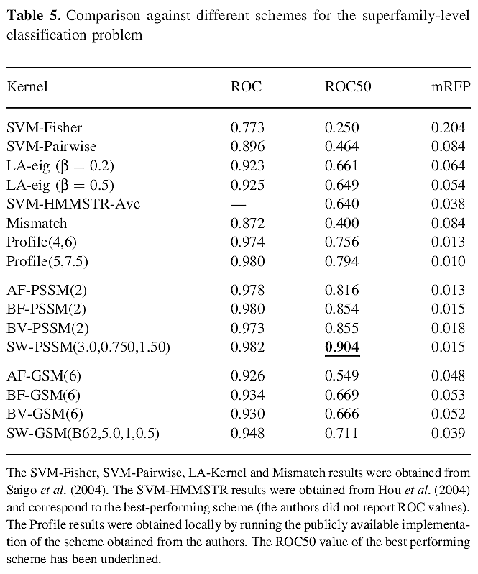

Slide 39
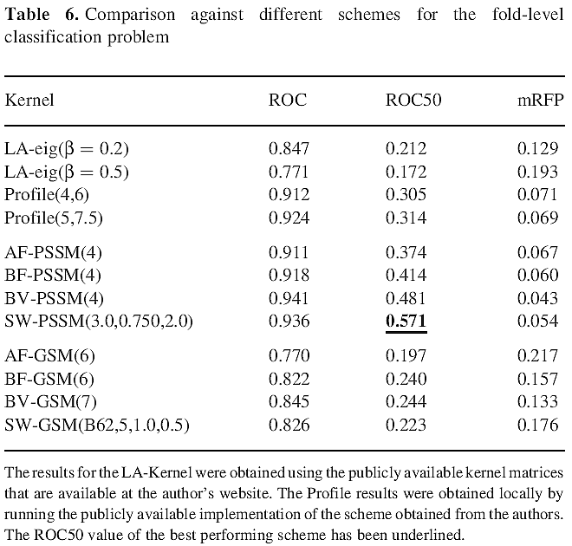

Slide 40
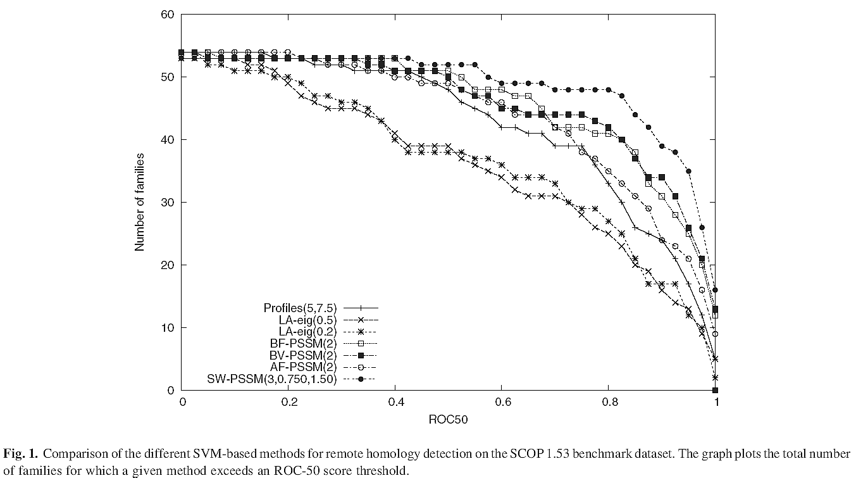

Slide 41
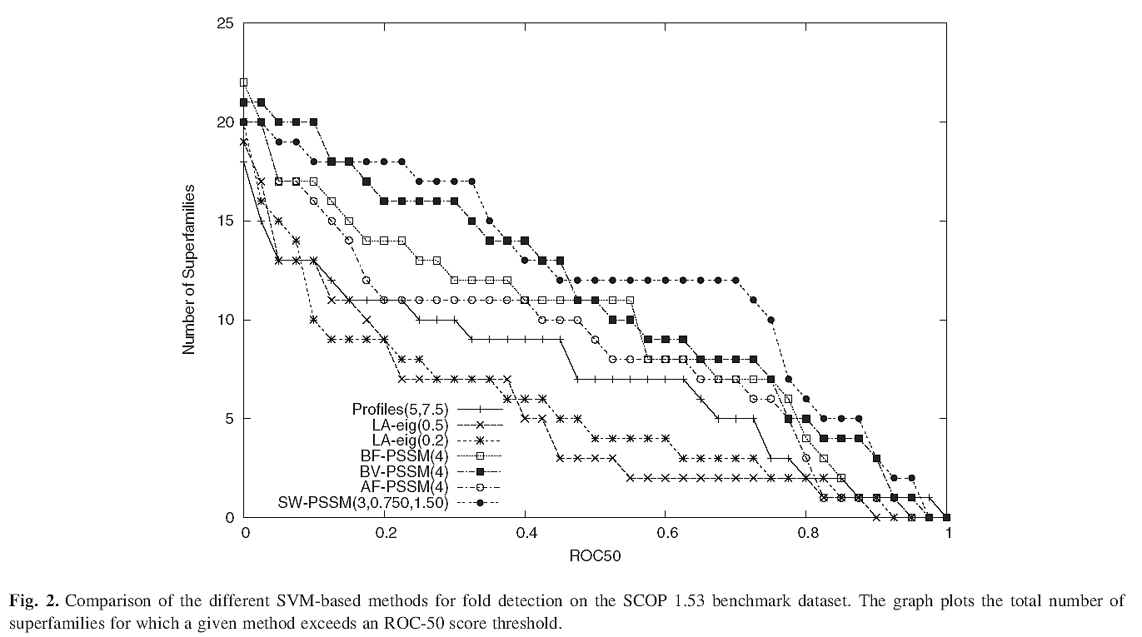

Slide 42
