Slide 1
Essential Proteins Discovery from Weighted
Protein Interaction Networks
Min Li, Jianxin Wang, Huan Wang, and Yi Pan
BIOINFORMATICS RESEARCH AND APPLICATIONS
Lecture Notes in Computer Science , 2010, pages 89-100
Presenter:Zih-Jie Yang
Date: December 28th,2010
115/11/07

Slide 2
Abstract(1/2)
Identifying essential proteins is important for understanding the minimal requirements for cellular survival and development. Fast growth in the amount of available protein-protein interactions has produced unprecedented opportunities for detecting protein essentiality on network level. A series of centrality measures have been proposed to discover essential proteins based on network topology. However, most of them treat all interactions equally and are sensitive to false positives.
115/11/07

Slide 3
Abstract(2/2)
In this paper, six standard centrality measures are redefined to be used in weighted network. A new method for weighting protein-protein interactions is proposed based on the combination of logistic regression-based model and function similarity. The experimental results on yeast network show that the weighting method can improve the performance of centrality measures considerably. More essential proteins are discovered by the weighted centrality measures than by the original centrality measures used in unweighted network. Even about 20% improvements are obtained from closeness centrality and subgraph centrality.
115/11/07

Slide 4
必要性蛋白質（essential protein）
必要性蛋白質（essential protein）為當此蛋白質在蛋白質複合體中遭到基因剔除式突變(null mutation)去除後，會危及很多重要的生化反應路徑(biologically important pathways)，進而造成蛋白質複合體的功能喪失，致使生物體無法生存(inviable)。因此瞭解必要性蛋白質的特性，並預測某些蛋白質是否為必要性蛋白質是很重要的課題。
115/11/07

Slide 5
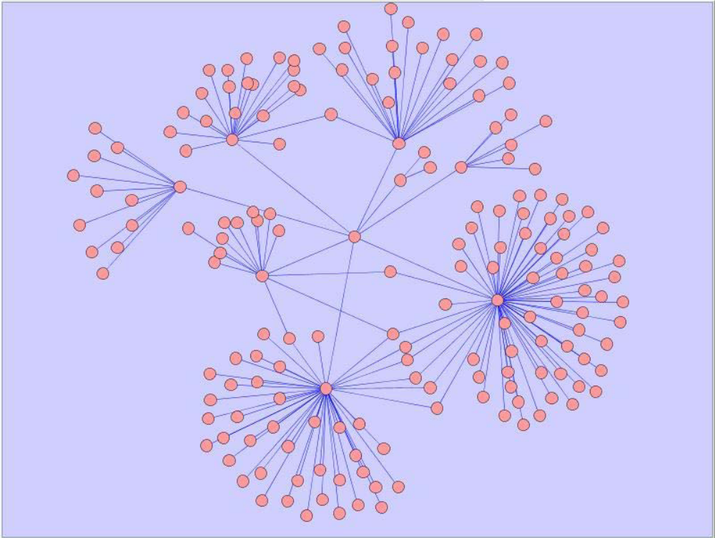
蛋 白 質 交 互 作 用 (Protein-protein interaction)
每一個點為一個蛋白質，每一個邊所連結的兩的點則代表這兩個蛋白質之間有交互作用。
115/11/07

Slide 6
Centrality Measures
1.Degree centrality (DC)
2.Betweenness centrality (BC)
3.Closeness centrality (CC)
4.Subgraph centrality(SC)
5.Eigenvector centrality(EC)
6.Information centrality(IC)
115/11/07

Slide 7

Degree centrality (DC)
The weighted degree centrality DC^{W}(i) of a node i is the sum of weights of the edges connecting node i and its neighbors.
where N_{i} is the set of neighbors of node i.
115/11/07

Slide 8

Betweenness centrality (BC)
The weighted betweenness centrality BC^{W}(i) of a node i is equal to the average fraction of shortest paths that pass through the node i.
where δ_{st} denotes the total number of shortest paths between s and t, and δ_{st}(i) denotes the number of shortest paths from s to t that pass through the node i.
115/11/07

Slide 9

Closeness centrality (CC)
The weighted closeness centrality CC^{W}(i) of a node i in a weighted graph G can be defined as:
where c_{p}(i, j) is the cost of a shortest path p from node i to node j . c_{p} (i,j) = 1/w(i,j).
CC^{W}(i) is a global metric which describes how the given node i connects to other nodes.
115/11/07

Slide 10

Subgraph centrality (SC)
The weighted subgraph centrality SC^{W}(i) of a node i in a weighted graph G can be defined as:
where μ_{l}(i) denotes the number of closed walks of length l which starts and ends at node i.
115/11/07

Slide 11
Eigenvector centrality(EC)
The weighted eigenvector centrality EC^{W}(i) of a node i in a weighted graph G is defined as the ith component of the principal eigenvector of A, where A is an edge weight matrix. Let λ be an eigenvalue and e be the eigenvector. Then for an equation λe = Ae, we can obtain EC^{W}(i) = e₁(i), where e₁ corresponds to the largest eigenvalue of A.
115/11/07

Slide 12

Information centrality(IC)
The weighted information centrality IC^{W}(i) of a node i in a weighted graph G is defined as:
where n is the number of nodes in graph G and I_{ij} = (r_{ii} + r_{jj} − r_{ij} )⁻¹. Let D be a diagonal matrix of the weighted degree of each node and J be a matrix with all its elements equal to one. Then, we get R = (r_{ij}) = [D − A + J]⁻¹. For computational purposes, Iii is defined as infinite. Thus, 1/I_{ii} = 0.
115/11/07

Slide 13
Construct Weighted Protein Interaction Network
1. Observing its experimental evidences
2. Evaluating its function similarity.
115/11/07

Slide 14
Observing its experimental evidences
For each interaction, its reliability score is determined by its experimental evidences and the number of observations in each experimental type.
The experiments are classed into four categories:
  1.coimmunoprecipitation screens
  2.yeast two-hybrid assays
  3.large scale experiments
  4.small scale experiments
The reliability score of an interaction between node i and node j is marked as L_{O}(i, j) for it is computed based on logistic regression.
115/11/07

Slide 15

Evaluating its function similarity
We calculate the function similarity of two connected proteins based on GO (Gene Ontology) semantic similarity.
The similarity of two GO terms c₁ and c₂ is defined as:
where p(c) denotes the probability of encountering term c in the target species and C_{T} (c1, c2) denotes the sets of common ancestors of term c1 and term c2.
115/11/07

Slide 16
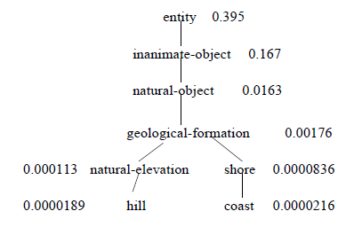

between the concepts of Hill and Coast is:
which is equal to 0.59.
115/11/07

Slide 17
Evaluating its function similarity
Let F_{i} and F_{j} denote the sets of function annotations for protein i and protein j, respectively. Then, the function similarity S_{F} (i, j) of protein i and protein j can be defined as:
115/11/07

Slide 18

Evaluating its function similarity
To satisfy that the confidence score of each interaction should be between 0 and 1, the following normalization operation is performed.
where Max_S_{F} and Min_S_{F} denote the maximum value and minimum value of all the interactions’ function similarity scores, respectively.
115/11/07

Slide 19

Evaluating its function similarity
By considering both the reliability measurement and the function similarity, we define the confidence score C_{score}(i, j) of an interaction connecting protein i and protein j as formula:
115/11/07

Slide 20
Datasets
The protein-protein interactions of Saccharomyces cerevisiae are downloaded from DIP database.
There are 4746 proteins and 15166 interactions in total without selfinteractions and repeated interactions.
115/11/07

Slide 21
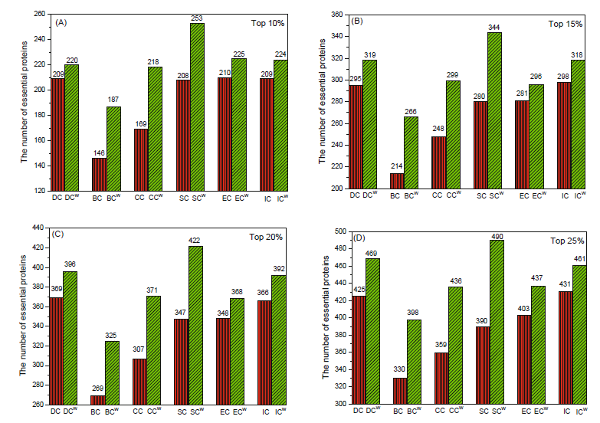

Results
115/11/07

Slide 22
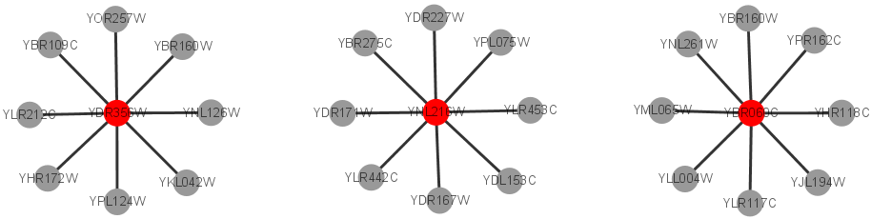
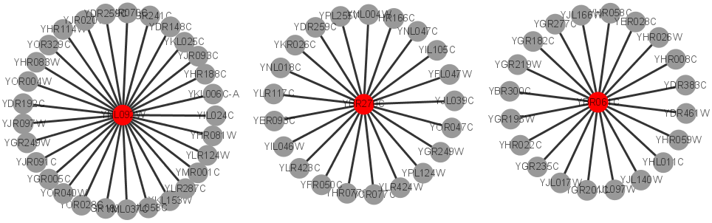
Results
We give three examples of essential proteins: YDR356W, YNL216W, and YBR060C with 8 interactions. Their weighted degrees are all larger than 4.5. By contrast, the three examples which have more than 20 interactions are validated to be not essential. Their weighted degrees are smaller than 4.0.
115/11/07

Slide 23
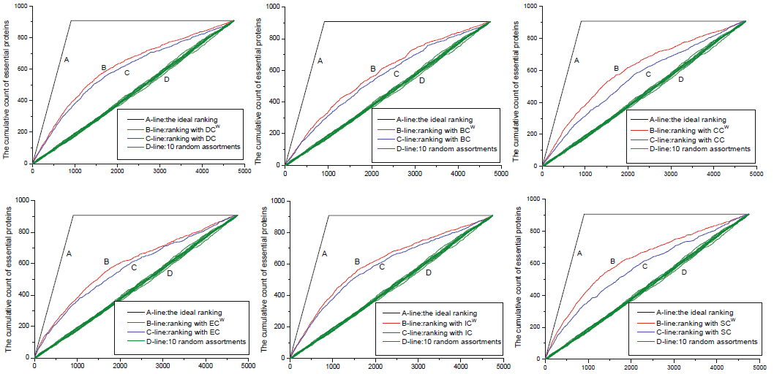
Results
115/11/07

Slide 24
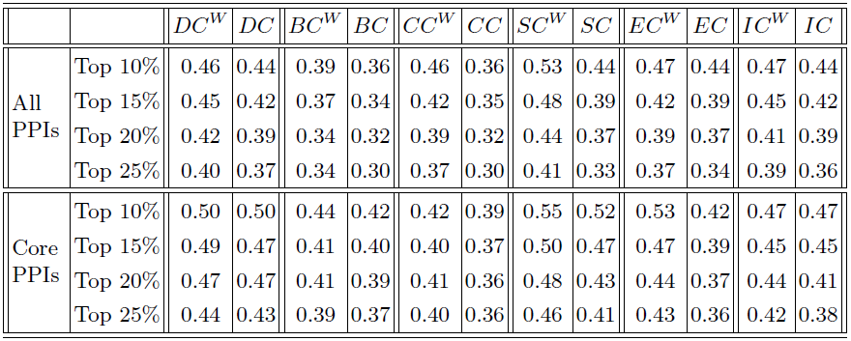
Results
115/11/07

