Slide 1
On the longest common subsequence of Thue-Morse words
Joakim Blikstad
Information Processing Letters, Volume 164, December 2020
Presenter : Yu-Ju Liao
Date : Jun. 04, 2022

Slide 2
Abstract
The length a(n) of the longest common subsequence of the nth Thue-Morse word and its bitwise complement is studied. An open problem suggested by Jean Berstel in 2006 is to find a formula for a(n). In this paper we prove new lower bounds on a(n) by explicitly constructing a common subsequence between the Thue-Morse words and their bitwise complement. We obtain the lower bound a(n) = 2n(1 − o(1)), saying that when n grows
large, the fraction of omitted symbols in the longest common subsequence of the nth Thue-Morse word and its bitwise complement goes to 0. We further generalize to any prefix of the Thue-Morse sequence, where we prove similar lower bounds.

Slide 3
Thue-Morse sequence
The Thue-Morse sequence starts as follows
t = 011010011 0010110 ...
0000 | 0
0001 | 1
0010 | 1
0011 | 0
0100 | 1
0101 | 0

Slide 4

Thue-Morse words
Let μ denote the morphism on {0, 1} defined by
μ(0) = 01 and μ(1) = 10.
If n ≥ 0 then
μ^{n}(1) = μ^{n}(0) where z denotes taking the bitwise complement of z (i.e., swapping 0s and 1s).
μ^{m+n}(0) = μ^{m}(μ^{n}(0)).
|μ^{n}(0) | = 2^{n}
μ^{n+1}(0) = μ^{n}(0)μ^{n}(1) and μ^{n+1}(1) = μ^{n}(1)μ^{n}(0).
Thue-Morse words
t = 011010011 0010110 ...

Slide 5
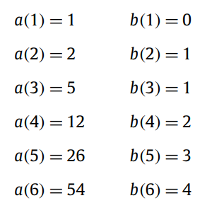
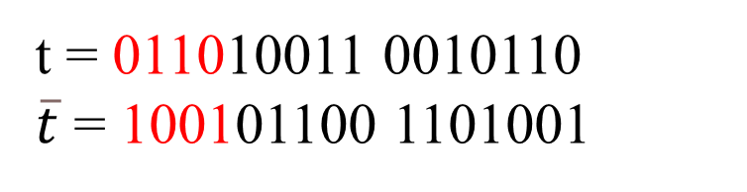
a(n),b(n)
t = 011010011 0010110
$\overline{t}$ = 100101100 1101001

Slide 6
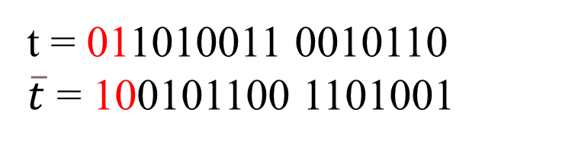
a(n),b(n)
t = 011010011 0010110
$\overline{t}$ = 100101100 1101001

Slide 7
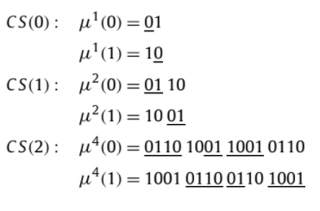
CS(k)

Slide 8
CS(k)

Slide 9
CS(k)

Slide 10


f(k)
f (k)

Slide 11


f(k)
For every integer k ≥ 0,
k = 3,
μ⁴(0) = 0110 1001 1001 0110
μ⁴(1) = 1001 0110 0110 1001

Slide 12

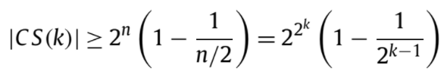
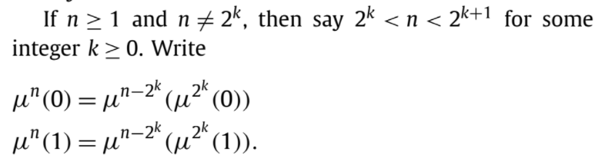


a(n) = 2^{n}(1 − O(n⁻¹))
|CS(k)| =
Extension to all n,

Slide 13
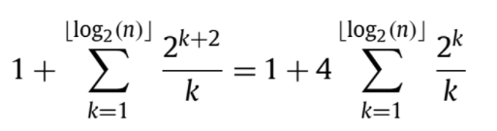

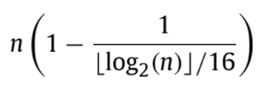
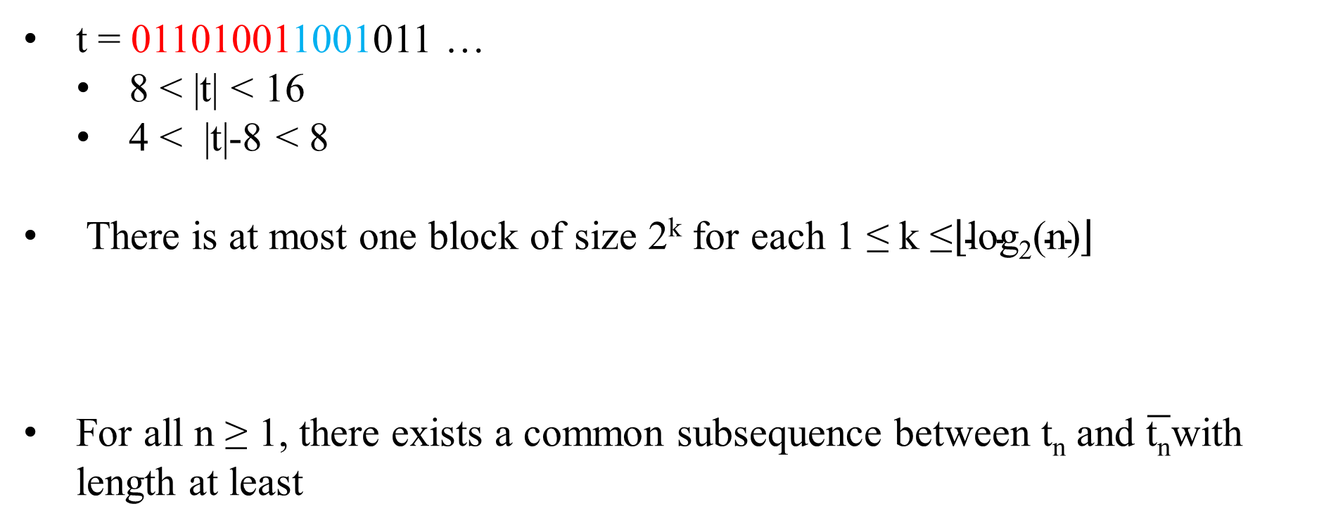
b(n) =n(1 − O( 1/logn ))
t = 011010011001011 …
8 < |t| < 16
4 < |t|-8 < 8
There is at most one block of size 2^{k} for each 1 ≤ k ≤$\left\lfloor \text{log}\text{2}\text{(}\text{n}\text{)}\right\rfloor$
For all n ≥ 1, there exists a common subsequence between t_{n} and $\overline{\text{t}\text{n}}$with length at least

Slide 14
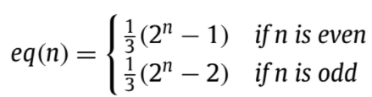
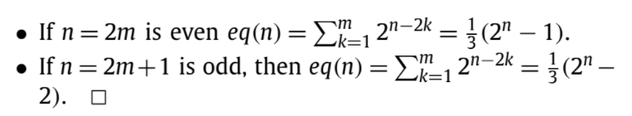
Strengthening the analysis
Let eq(n) = |{i : 0 ≤ i < 2n − 1 and t_{i} = t_{i}+1}|
1 | 1
10 | 1
11 | 0
100 | 1
101 | 0
110 | 0
111 | 1
1000 | 1
. . . . .0 1 1 1 1
2k

Slide 15
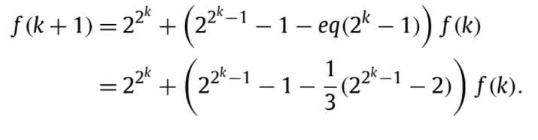
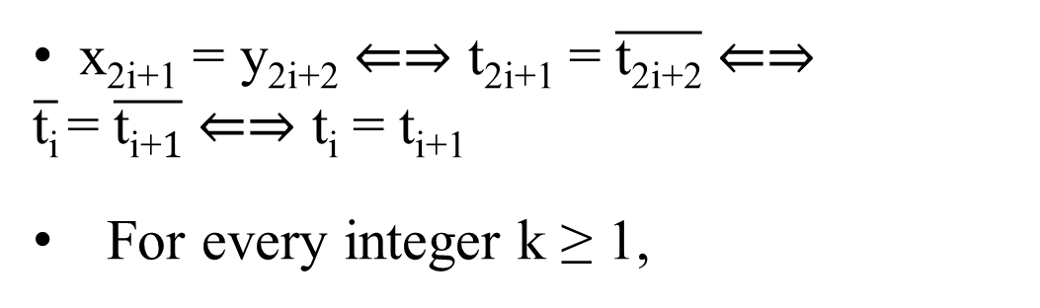
Strengthening the analysis
Let eq(n) = |{i : 0 ≤ i < 2n − 1 and t_{i} = t_{i}+1}|
0 | 0
1 | 1
10 | 1
11 | 0
100 | 1
101 | 0
110 | 0
111 | 1
1000 | 1
x_{2i+1} = y_{2i+2} ⇐⇒ t_{2i+1} = $\overline{\text{t}\text{2}\text{i}\text{+2}}$ ⇐⇒
$\overline{\text{t}\text{i}}$= $\overline{\text{t}\text{i}\text{+}1}$ ⇐⇒ t_{i} = t_{i+1}
For every integer k ≥ 1,

Slide 16
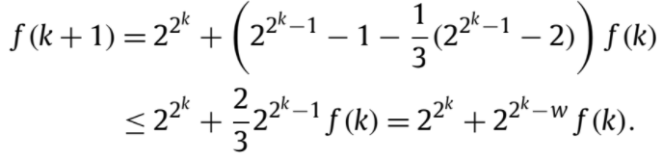

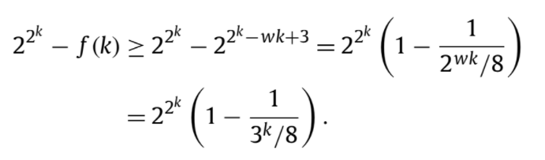
Strengthening the analysis
For every integer k ≥ 1,
,w = log(3)
CS(k)

Slide 17

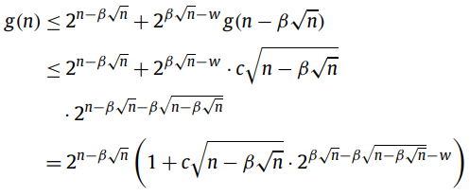
A better construction
g(n) = 2^{n} − a(n)
g(n) = O( √n · 2^{n−β √n})
g(n) = 2^{n} − a(n)
=
α ≈ β √n,

Slide 18
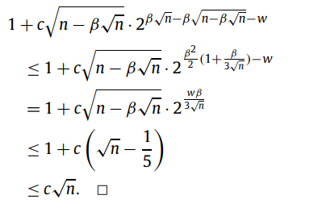

A better construction
g(n) $≤$
g(n) = O( √n · 2^{n−β √n})

Slide 19
A better construction
g(n) $≤$
g(n) = O( √n · 2^{n−β √n})

