Slide 1
A hybrid heuristic–genetic algorithm for task scheduling in heterogeneous processor networks
Mohammad I.Daoud, NawwafKharma Journal of Parallel and Distributed Computing
Volume 71, Issue 11, November 2011, Pages 1518-1531
Date: Jan. 11, 2022
Presenter: Jue-Jun, Wu

Slide 2
Abstract
Efficient task scheduling on heterogeneous distributed computing systems (HeDCSs) requires the consideration of the heterogeneity of processors and the inter-processor communication. This paper presents a two-phase algorithm, called H2GS, for task scheduling on HeDCSs. The first phase implements a heuristic list-based algorithm, called LDCP, to generate a high quality schedule. In the second phase, the LDCP-generated schedule is injected into the initial population of a customized genetic algorithm, called GAS, which proceeds to evolve shorter schedules. GAS employs a simple genome composed of a two-dimensional chromosome. A mapping procedure is developed which maps every possible genome to a valid schedule. Moreover, GAS uses customized operators that are designed for the scheduling problem to enable an efficient stochastic search. The performance of each phase of H2GS is compared to two leading scheduling algorithms, and H2GS outperforms both algorithms. The improvement in performance obtained by H2GS increases as the inter-task communication cost increases.

Slide 3
Hybrid Heuristic–Genetic Scheduling (H2GS) algorithm
In the first phase, runs a heuristic scheduling algorithm, called the Longest Dynamic Critical Path (LDCP) algorithm,to quickly generate a high quality task schedule.
In the second phase, a new Genetic Algorithm, called Genetic Algorithm for Scheduling (GAS), searches that approximate area to improve the schedule generated by the LDCP algorithm.

Slide 4
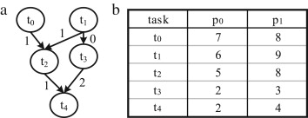
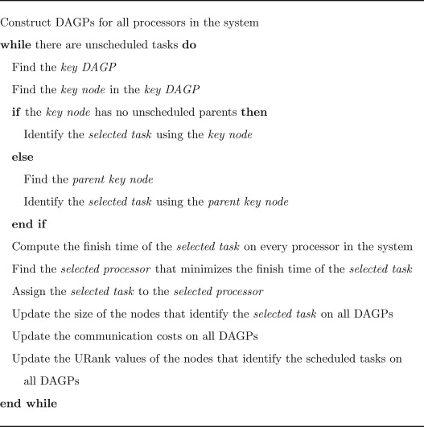

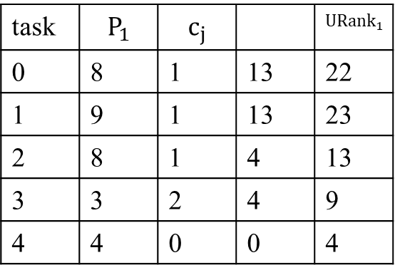
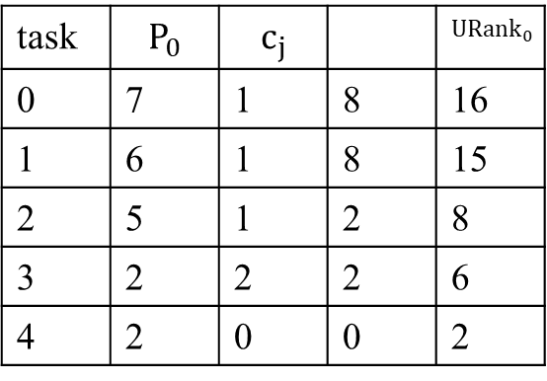
The Longest Dynamic Critical Path (LDCP) algorithm
task | $$P_{0}$$ | $$c_{j}$$ |  | $${URank}_{0}$$
0 | 7 | 1 | 8 | 16
1 | 6 | 1 | 8 | 15
2 | 5 | 1 | 2 | 8
3 | 2 | 2 | 2 | 6
4 | 2 | 0 | 0 | 2
task | $$P_{1}$$ | $$c_{j}$$ |  | $${URank}_{1}$$
0 | 8 | 1 | 13 | 22
1 | 9 | 1 | 13 | 23
2 | 8 | 1 | 4 | 13
3 | 3 | 2 | 4 | 9
4 | 4 | 0 | 0 | 4

Slide 5
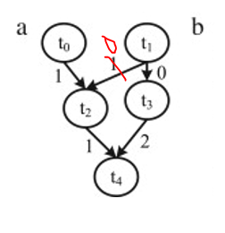
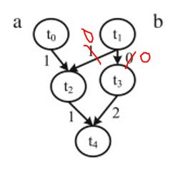
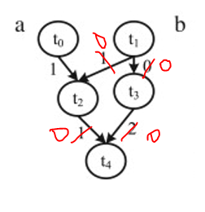












0
0
0
$$t_{1}$$
$$t_{0}$$
$$t_{1}$$
$$t_{0}$$
$$t_{1}$$
$$t_{0}$$
6
8
9
6
8
9
6
8
9
$$t_{3}$$
$$t_{3}$$
$$t_{2}$$
$$t_{2}$$
$$t_{2}$$
14
14
14
16
$$t_{4}$$
Notes:
每個task選最早完成的P

Slide 6
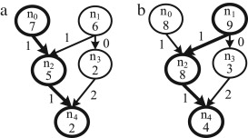

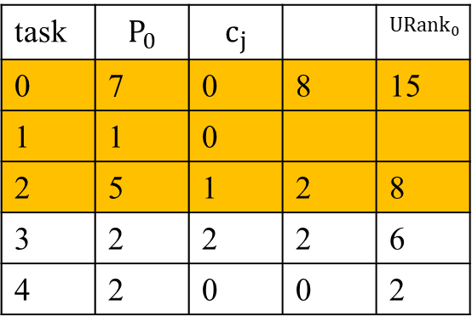

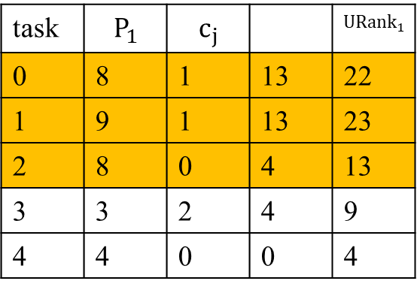

0
$$t_{1}$$
$$t_{0}$$
6
8
9
$$t_{2}$$
14
task | $$P_{0}$$ | $$c_{j}$$ |  | $${URank}_{0}$$
0 | 7 | 0 | 8 | 15
1 | 1 | 0
2 | 5 | 1 | 2 | 8
3 | 2 | 2 | 2 | 6
4 | 2 | 0 | 0 | 2
task | $$P_{1}$$ | $$c_{j}$$ |  | $${URank}_{1}$$
0 | 8 | 1 | 13 | 22
1 | 9 | 1 | 13 | 23
2 | 8 | 0 | 4 | 13
3 | 3 | 2 | 4 | 9
4 | 4 | 0 | 0 | 4
Notes:
每個task選最早完成的P

Slide 7
設定編碼 (Encoding) 方式。
編碼確定時，同時也會確定染色體的長 度
設定族群數(Population size)
設定選擇、交配及突變方式 (Crossover, Mutation and Selection )
設定交配率 (Crossover rate) 及突變率 (Mutation rate)

Slide 8
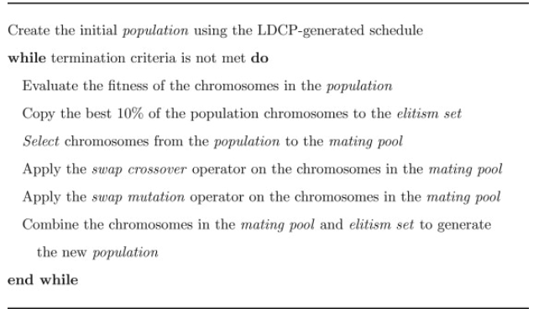
Genetic algorithm for scheduling (GAS)

Slide 9
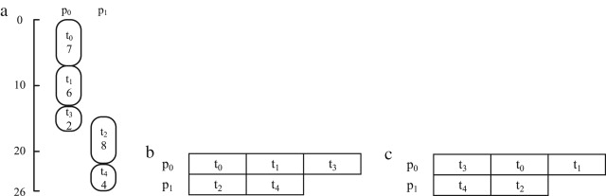
Schedule encoding and Chromosome decoding
all the tasks in the application DAG must be scheduled, any task in the application DAG must be executed only once, and the precedence constraints between tasks must be preserved.
(i) the assignment of each task in the application DAG to one of the processors in the computing system, and (ii) the execution ordering of tasks assigned to the same processor.

Slide 10

Fitness evaluation and selection
$\frac{1}{l}$ , where l is the length of its decoded schedule.
Copies of the fittest 10% of the chromosomes in the population are copied without change to the elitism set.

Slide 11
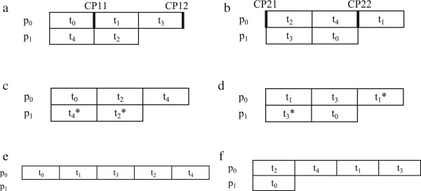
Swap crossover
Notes:
若與原先的任務優先順序不同則不交換

Slide 12
A. Schedule encoding
B. Chromosome decoding
C. Initialization
D. Fitness evaluation
E. Selection and elitism
F. Swap crossover
G. Swap mutation
H. Termination criterion

Slide 13
population
Good population size is about 20-30, however, sometimes sizes 50-100 are reported as the best.
(視問題的可能解答範圍而定， 測試幅度可加減5)
Very big population size usually does not improve performance of GA.
Some research also shows, that the best population size depends on the size of encoded string (chromosomes). If you have chromosomes with 32 bits, the population should be higher than for chromosomes with 16 bits. 毎一個染色體編碼的長度越長，精確度愈高，但是所需的編碼、解碼 成本也會相對增加

Slide 14
將 LDCP 生成的時間表插入 GAS 的初始種群中，使 GAS 能夠利用 LDCP 發現的高質量構建塊，以及確保多樣化種群的基於處理器和隨機生成的染色體，從而實現有效的搜索空間的探索。為了降低 GAS 算法的複雜性，種群中的染色體數量或種群大小在整個 GAS 運行期間是固定的。最小種群由使用 LDCP 算法生成的染色體和基於處理器的染色體組成。

Slide 15
crossover
交配率越高，則新物種進入族群的速度愈快，整個搜尋最佳解的速度 也就愈快；但若太高，則優良物種被取走的速度可能會比新物種的進 化來得快，而使得交配的原意喪失。
In some research, the rate is defined as the ratio of the number of offspring produced in each generation to the population size.
Crossover rate should be high generally, about 80%-95%.
However, some results show that for some problems crossover rate about 60% is the best
Offspring/population

Slide 16
Mutation rate
Mutation rate should be low.
Best rate seems to be about 0.5% ~ 1%,
However: If it is too low, 有可能陷入局部最佳解而無法跳出。
If it is too high, 則與隨機搜尋無異，且所産生的子代將失去與父 代的相似性。同時，演算法也失去了對過去搜尋結果學習的能力 (The ability to learn from the history of the search)。

Slide 17
Termination criterion
執行設定的世代數 例如：設定k ≥ 1,000時停止，k 代表第 k 個世代
前後世代最佳值之差異低於設定的極小值 成熟率大於設定值 例如：S為成熟率。設定S ≥ 80%時停止
成熟：當族群中絕大部分的染色體都具有相同基因時，交配也無法産 生一個不同的子代，此時即為收斂(亦稱為成熟)。
早熟：當成熟的現象發生在尋優的初期，將使尋優結果陷於局部最佳 解，而無法尋得最佳解的困境，稱為早熟或提早收歛。

Slide 18
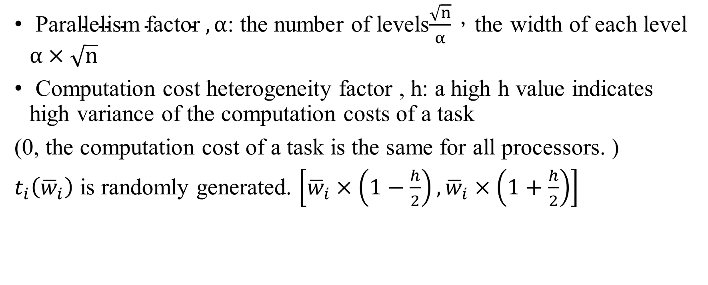
Experiments
$\text{Parallelism} \text{factor} , α$: the number of levels$\frac{\sqrt{n}}{α}$，the width of each level $α×\sqrt{n}$
Computation cost heterogeneity factor , h: a high h value indicates high variance of the computation costs of a task
(0, the computation cost of a task is the same for all processors. )
$t_{i}\left({\overline{w}}_{i}\right)$ is randomly generated. $\left[{\overline{w}}_{i}×\left(1−\frac{h}{2}\right),{\overline{w}}_{i}×\left(1+\frac{h}{2}\right)\right]$
Notes:
alpha較低的值會導致 DAG 的並行度較低 [5]。
易購的變異性高低

Slide 19

Created random DAGs set
2000 application DAGs
Numbers of processors: 2,4,6,8
Nodes sizes: 20,40,60,80,100
CCR values: 0.1, 0.5, 1, 2, 5
$α$ values: 0.5, 1, 2, 5
h values: 0.1, 0.2, 0.4, 0.6, 0.8

Slide 20

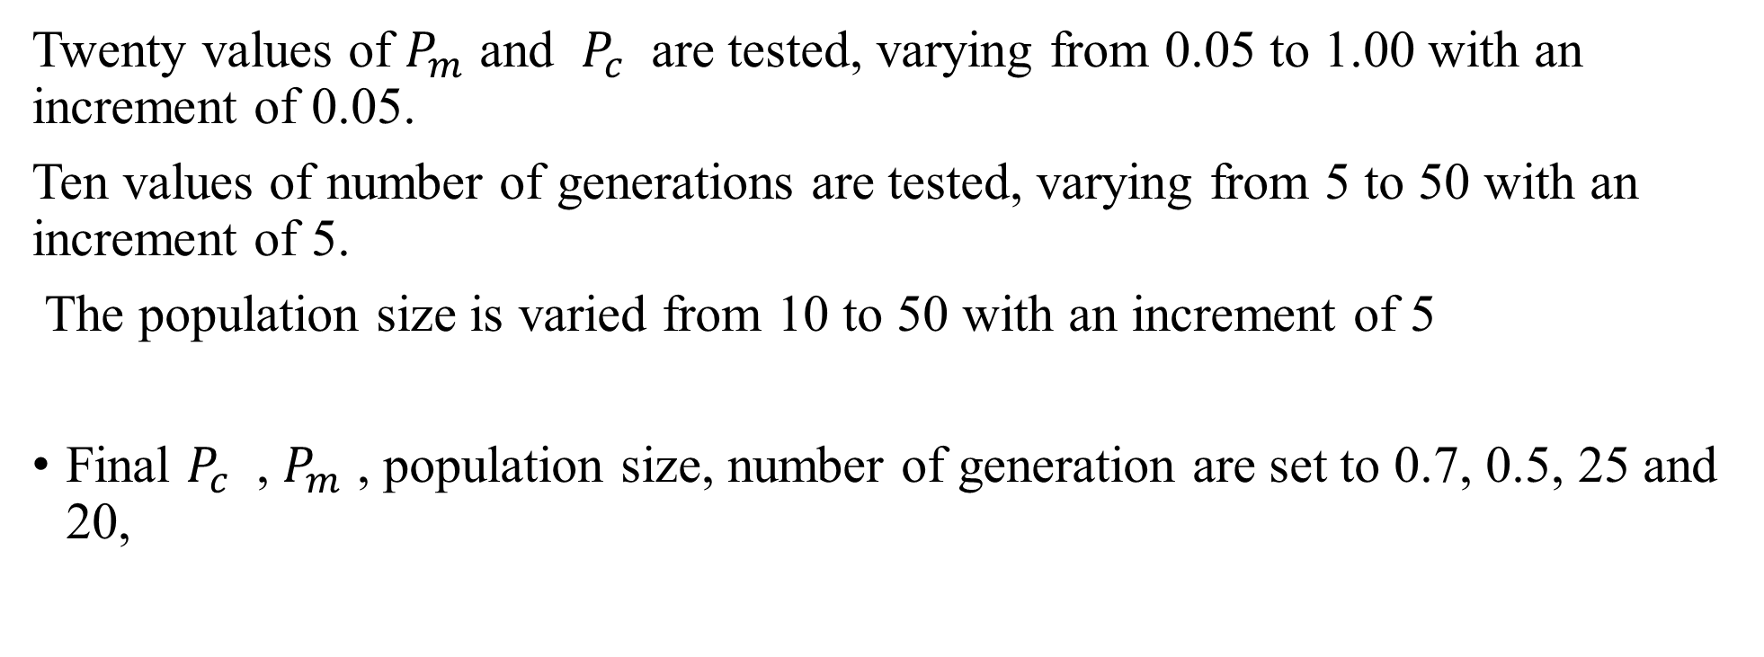
Twenty values of $P_{m}$ and $P_{c}$ are tested, varying from 0.05 to 1.00 with an increment of 0.05.
Ten values of number of generations are tested, varying from 5 to 50 with an increment of 5.
The population size is varied from 10 to 50 with an increment of 5
Final $P_{c}$ , $P_{m}$ , population size, number of generation are set to 0.7, 0.5, 25 and 20,

Slide 21
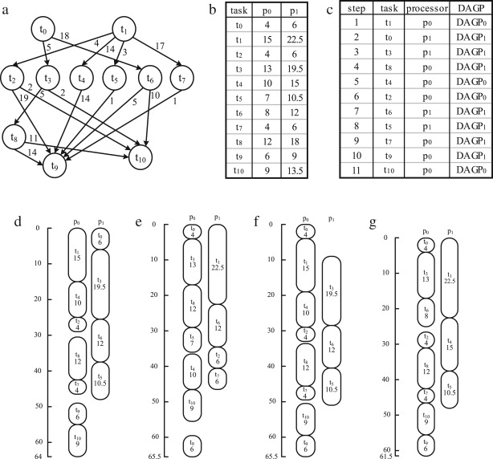
(d) LDCP, (e) DLS, (f) HEFT, and (g) H2GS algorithms.

Slide 22
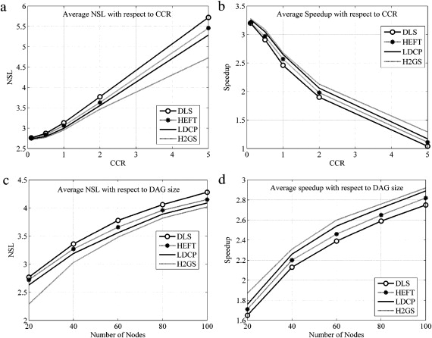

Slide 23
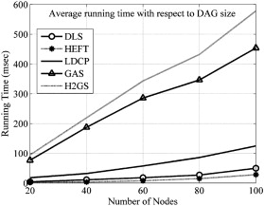

Slide 24
Longest Dynamic Critical Path algorithm generates a near-optimal task schedule
Designed Genetic Algorithm for Scheduling
A new mapping procedure is developed to map every possible chromosome in the search space into a valid task schedule.
A set of customized genetic operators are introduced to further optimize the schedule received from the LDCP algorithm.

Slide 25
Thanks for listening

