Slide 1
Towards Human-Level Performance in Solving Double Dummy Bridge Problem
Szymon Kowalik and Jacek Mańdziuk
28th International Conference, ICONIP 2021, Sanur, Bali, Indonesia, December 8–12, 2021, Proceedings, Part I
Presenter: Jing-Ping Jan
Date: Jan. 11, 2022

Slide 2
Abstract
Double Dummy Bridge Problem (DDBP) is a hard classification problem that consists in estimating the number of tricks to be taken by N-S pair during a bridge game. In this paper we propose a new approach to DDBP which utilizes convolutional neural networks (CNNs) and a dedicated matrix representation of the problem, suitable for the CNN application. Following previous studies on the application of neural networks to DDBP, we take a knowledge-free approach, i.e. the CNN models are trained with no use of any expert knowledge or explicitly indicated bridge rules. As a result, two models are derived: a baseline CNN model and its ensemble refinement. The results are compared with two former neural network approaches, showing significant superiority of the CNN-based solution.

Slide 3
Abstract
Depending on the type DDBP deal, i.e. trump or notrump, our approach either outperforms or is slightly inferior to the outcomes of human bridge grandmasters solving DDBP. This state-of-the-art performance is complemented in the paper with an analysis of the internal structure (weight patterns) of the trained CNNs, which partly explains the underlying classification process.

Slide 4
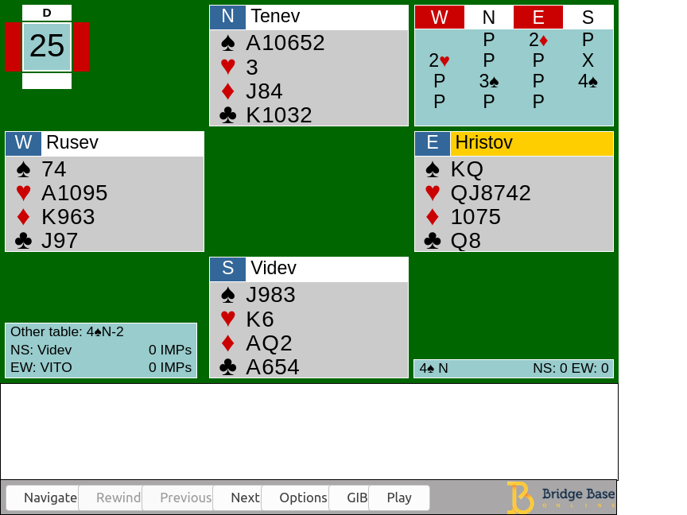
Introduction
Bidding stage Find the most profitable contract for the playing stage
Playing stage 13 rounds of a card-strength competition

Slide 5
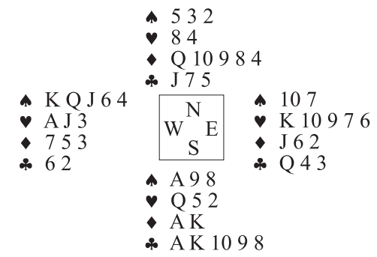
Double Dummy Bridge Problem(DDBP)

Slide 6
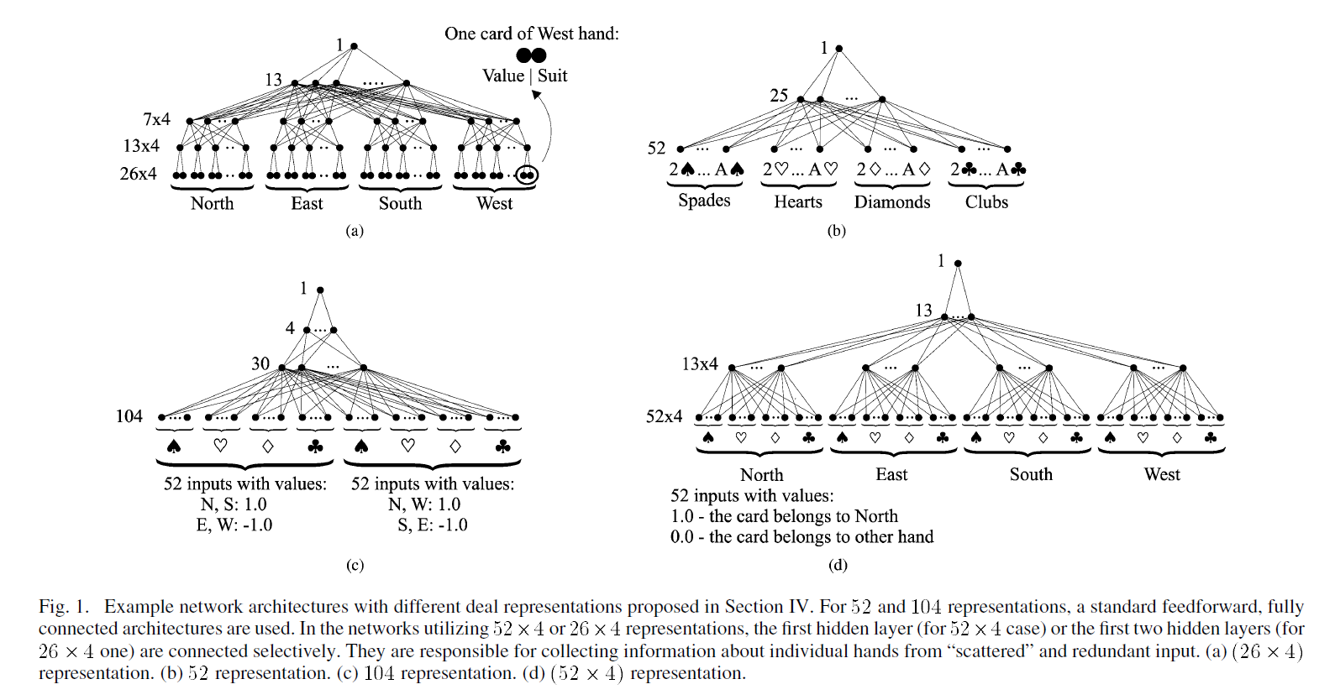
Previous

Slide 7
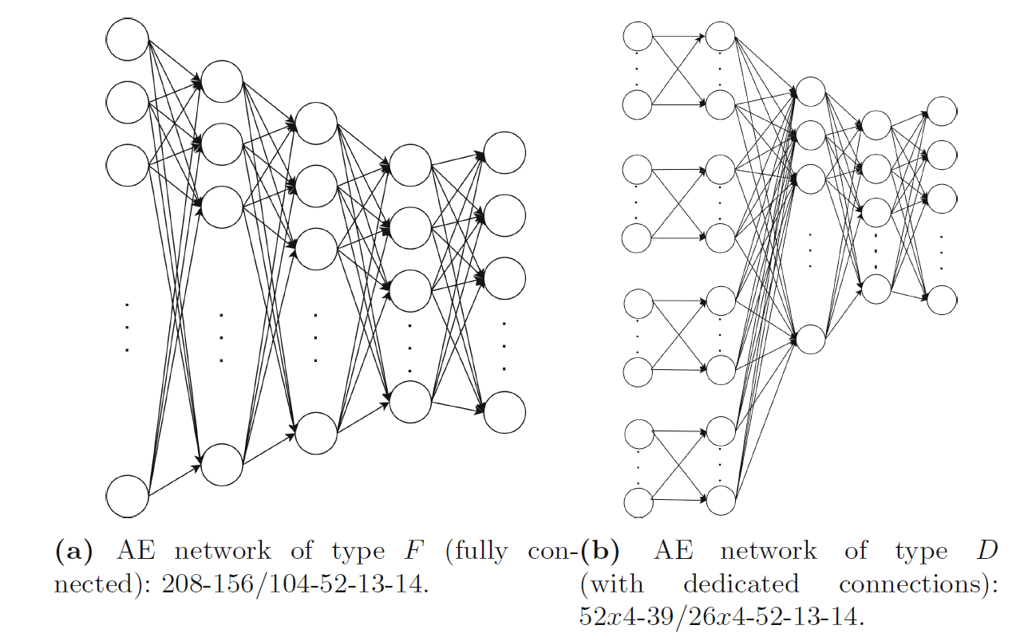
Previous

Slide 8
Previous
(52x4)-(26x4)-26-13-1
(52x4)-(13x4)-13-1
Model | NT Contracts | TR Contracts
Multiplayer Perceptron(MLP) | 97.34|84.31|37.80 | 99.88|96.48|53.11
Autoencoder(AE-MLP) | 96.63|86.18|41.73 | 99.72|95.33|51.28
Human grandmasters | 94.74|88.30|73.68 | 88.34|81.63|53.06
TypeD, (52x4)-(26x4)-52-13-14

Slide 9
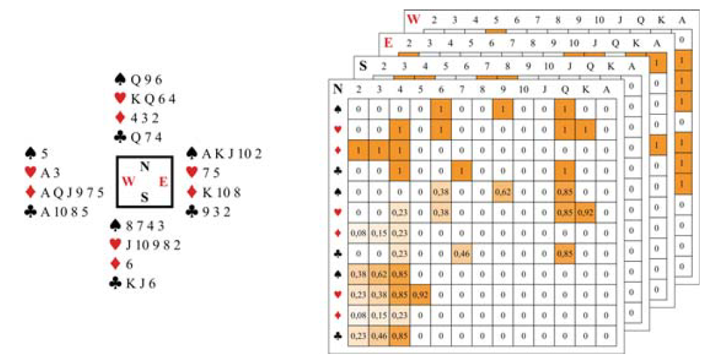
Current representation of a deal

Slide 10
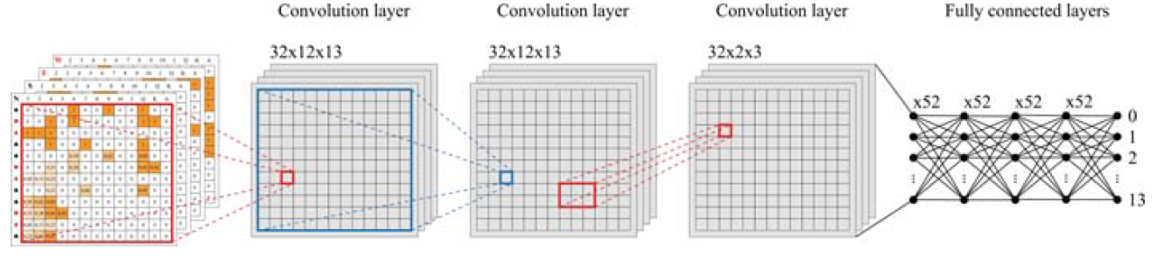
Baseline CNN-Based DDBP Solver

Slide 11
Baseline CNN-Based DDBP Solver
Hyperparameter | Value
 | NT Contracts | TR Contracts
Convolutional layers
Number of layers | 4 | 3
Filter sizes in successive layers | (12x13), (12x13), (2x3), (2x3) | (12x13), (12x13), (2x3)
Number of filters | 32
Activation function | SELU
Fully connected layers
Number of layers | 4 and output layer
Number of neurons in successive layers | 52, 52, 26, 26, 14 | 52, 52, 52, 52, 14
Activation function | ELU | Softplus

Slide 12
Experimental
10

Slide 13
Experimental
 | NT Contracts | TR Contracts
Mean | 98.03|93.17|57.24 | 99.89|97.84|58.42
Standard deviation | 00.18|00.44|00.89 | 00.02|00.21|00.90
State-of-the-art | 96.63|86.18|41.73 | 99.88|96.48|53.11

Slide 14
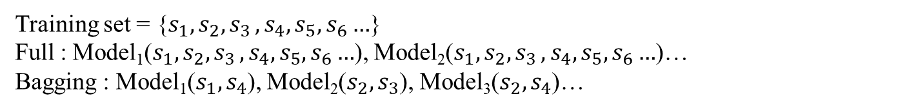
Experimental
Training set | Voting | NT Contracts | TR Contracts
Full | Hard | 98.55|95.16|63.46 | 99.93|98.79|63.62
Full | Soft | 98.61|95.39|64.13 | 99.94|98.83|63.83
Bagging | Hard | 98.08|93.68|58.40 | 99.91|98.27|60.37
Bagging | Soft | 98.15|94.03|59.08 | 99.91|98.38|60.87
Mean |  | 98.03|93.17|57.24 | 99.89|97.84|58.42
State-of-the-art |  | 96.63|86.18|41.73 | 99.88|96.48|53.11
Human grandmasters |  | 94.74|88.30|73.68 | 88.34|81.63|53.06
Training set = {$s_{1},s_{2}{,s}_{3},s_{4},s_{5},s_{6}…$}
Full : Model₁($s_{1},s_{2}{,s}_{3},s_{4},s_{5},s_{6}…$), Model₂($s_{1},s_{2}{,s}_{3},s_{4},s_{5},s_{6}…$)…
Bagging : Model₁($s_{1},s_{4}$), Model₂($s_{2},s_{3}$), Model₃($s_{2},s_{4}$)…

Slide 15
Experimental
Training set | Voting | NT Contracts | TR Contracts
Full | Hard | 98.55|95.16|63.46 | 99.93|98.79|63.62
Full | Soft | 98.61|95.39|64.13 | 99.94|98.83|63.83
Bagging | Hard | 98.08|93.68|58.40 | 99.91|98.27|60.37
Bagging | Soft | 98.15|94.03|59.08 | 99.91|98.38|60.87
Mean |  | 98.03|93.17|57.24 | 99.89|97.84|58.42
State-of-the-art |  | 96.63|86.18|41.73 | 99.88|96.48|53.11
Human grandmasters |  | 94.74|88.30|73.68 | 88.34|81.63|53.06
Hard voting: Where each individual model votes for the class and the ensemble result is determined by a majority vote
Soft voting: Involving the summation of probabilities assigned to each class by individual classifiers – the highest sum becomes the ensemble outcome.

