Slide 1
A Variable Iterated Greedy Algorithm for the Traveling Salesman Problem with Time Windows
Korhan Karabulut, M. Fatih Tasgetiren
Information Sciences, 2014
Vol. 279, pp. 383-395
Presenter: Tsung-Lin Lu
Date: Jan. 11, 2022

Slide 2
Abstract (1/2)
This paper presents a variable iterated greedy algorithm for solving the traveling salesman problem with time windows (TSPTW) to identify a tour minimizing the total travel cost or the makespan, separately. The TSPTW has several practical applications in both production scheduling and logistic operations. The proposed algorithm basically relies on a greedy algorithm generating an increasing number of neighboring solutions through the use of the idea of neighborhood change in variable neighborhood search (VNS) algorithms. In other words, neighboring solutions are generated by destructing a solution component and reconstructing the solution again with variable destruction sizes. In addition, the proposed algorithm is hybridized with a VNS algorithm employing backward and forward 1_Opt local searches to further enhance the solution quality.

Slide 3
Abstract (2/2)
The performance of the proposed algorithm was tested on several benchmark suites from the literature. Experimental results confirm that the proposed algorithm is either competitive to or even better than the best performing algorithms from the literature. Ultimately, new best-known solutions are obtained for 38 out of 125 problem instances of the recently proposed benchmark suite, whereas 15 out of 31 problem instances are also further improved for the makespan criterion.

Slide 4
Outline
TSP with Time Windows (TSPTW)
VIG_VNS Algorithm
Variable Iterated Greedy Algorithm (VIG)
Variable Neighborhood Search (VNS)
Superiority of Feasible Solutions (SF)
Adaptive Penalty Approach
Results

Slide 5
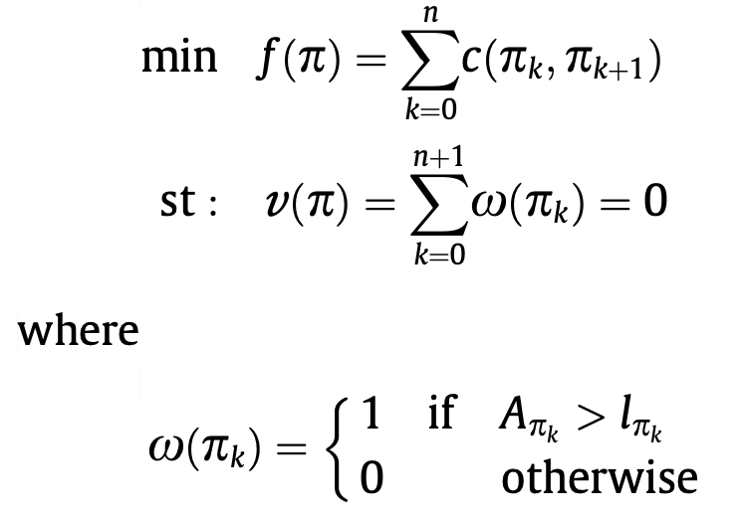
TSP with Time Windows (TSPTW)
Time
C₁, place a
C₄, place d
C₅, place e
C₇, place g
C₂, place b
C₃, place c
C₆, place f
e₂
l₂
A tour visiting each node once, starting and ending at the depot.
Cost c(i, j) = travel time (i→j) + a service time at customer i.
A time window [e_{i}, l_{i}] : Customer i can't be serviced before e_{i} or visited later than l_{i}.
A_{𝛑k} : arrival time at customer 𝛑_{k}.

Slide 6
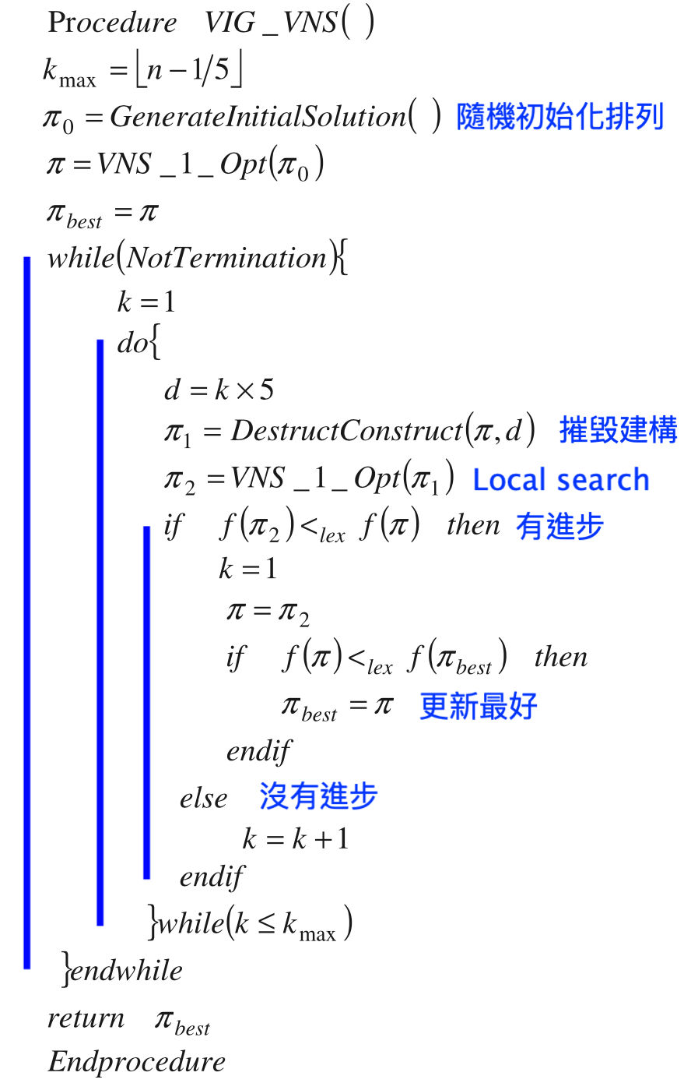
VIG_VNS Algorithm
Variable (V) : variable destruction sizes (d)
Iterated (I) : while
Greedy (G) : DestructConstruct()
Variable Neighborhood Search (VNS) : VNS_1_Opt()
Superiority of Feasible Solutions (SF) : <_{lex}

Slide 7
Variable Iterated Greedy Algorithm (VIG)
In an IG algorithm, there are two central procedures consisting of the destruction and the construction phases.
DestructConstruct(𝛑, 3) :
Step1: Destruction.
Step2 : Construction.
0 | 5 | 1 | 3 | 4 | 6 | 9 | 2 | 8 | 7 | 0
→
0 | 5 | 3 | 4 | 9 | 2 | 8 | 0
+
1 | 6 | 7
0 | 1 | 5 | 3 | 4 | 9 | 2 | 8 | 0
0 | 5 | 1 | 3 | 4 | 9 | 2 | 8 | 0
0 | 5 | 3 | 1 | 4 | 9 | 2 | 8 | 0
0 | 5 | 3 | 4 | 1 | 9 | 2 | 8 | 0
0 | 5 | 3 | 4 | 9 | 1 | 2 | 8 | 0
0 | 5 | 3 | 4 | 9 | 2 | 1 | 8 | 0
Choose the best partial solution and keep it for the next iteration until the size of 𝛑 is n.
0 | 5 | 3 | 4 | 9 | 2 | 8 | 1 | 0

Slide 8
Variable Neighborhood Search (VNS)
The destruction and construction procedure of iterated greedy algorithms.
1_Opt local search : A single node is removed.
VNS_1_Opt(𝛑) :
Step1: Destruction.
Step2 : Construction.
0 | 4 | 2 | 1 | 5 | 3 | 0
→
0 | 4 | 2 | 1 | 5 | 0
+
3
0 | 4 | 2 | 1 | 3 | 5 | 0
0 | 4 | 2 | 3 | 1 | 5 | 0
Choose the best partial solution and keep it for the next iteration until the size of iteration is n – 1.
0 | 4 | 3 | 2 | 1 | 5 | 0
0 | 3 | 4 | 2 | 1 | 5 | 0

Slide 9
Superiority of Feasible Solutions (SF)
Constrained optimization based on lexicographic ordering, where constraint violation and objective function value are distinguished.
𝛑 _{a} is deemed to be superior to 𝛑 _{b}
𝛑 _{a} is feasible, and 𝛑 _{b} is not.
𝛑 _{a} and 𝛑 _{b} are both feasible, and 𝛑 _{a} has a smaller objective function value than 𝛑 _{b}.
𝛑 _{a} and 𝛑 _{b} are both infeasible, but 𝛑 _{a} has a smaller overall constraint violation v(𝛑 _{a}).

Slide 10
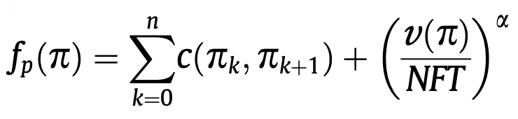
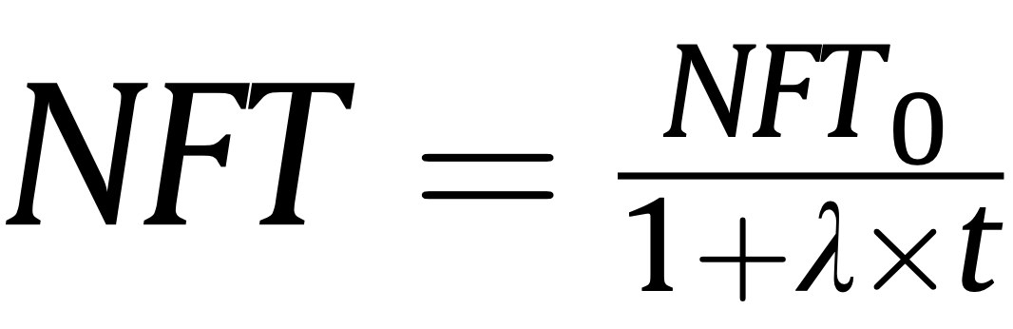
Adaptive Penalty Approach
A ‘‘near feasibility threshold’’ (NFT) corresponds to a ‘‘promising region’’ beyond the feasible region.
Cost
Penalty
NFT₀ is an upper bound for NFT
𝛼 is a user-defined positive parameter
t is the iteration counter

Slide 11
Results (1/4)
Intel Core i5 processor at 2.53 GHz.
Five available sets of benchmark instances :
n represents the number of customers.
w is the time window width.
Best is the best known or optimal value.

Slide 12
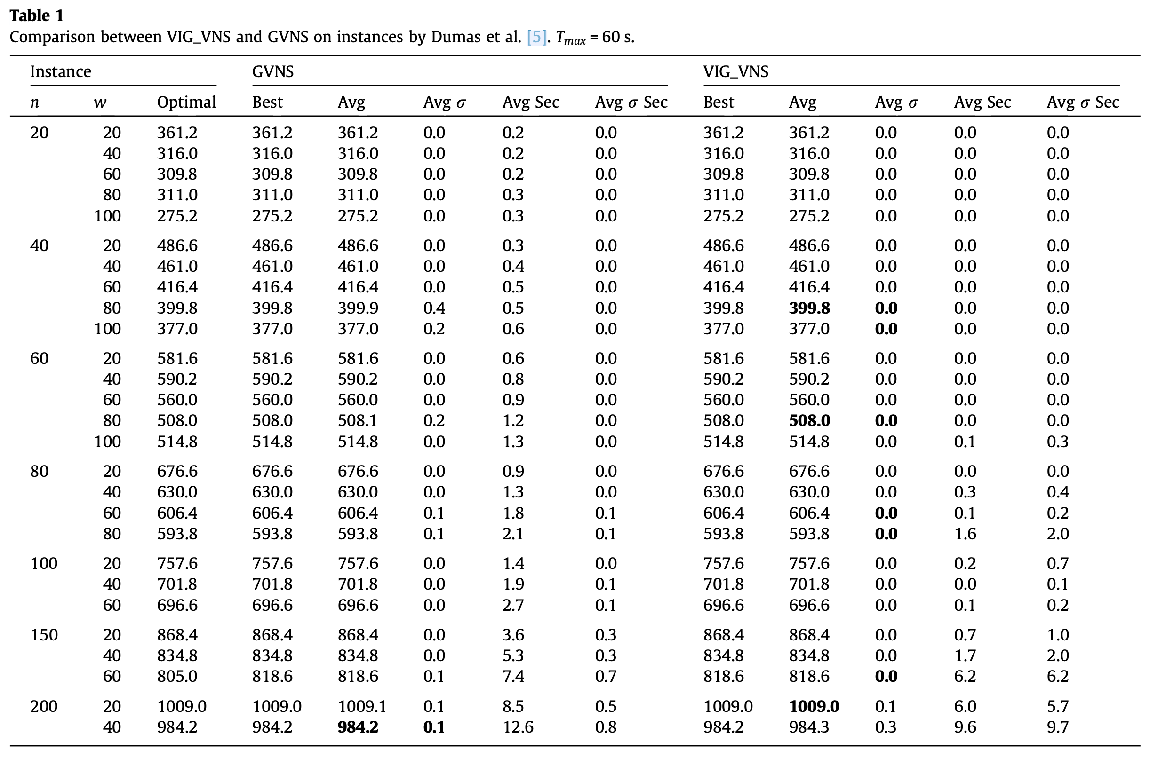

Slide 13
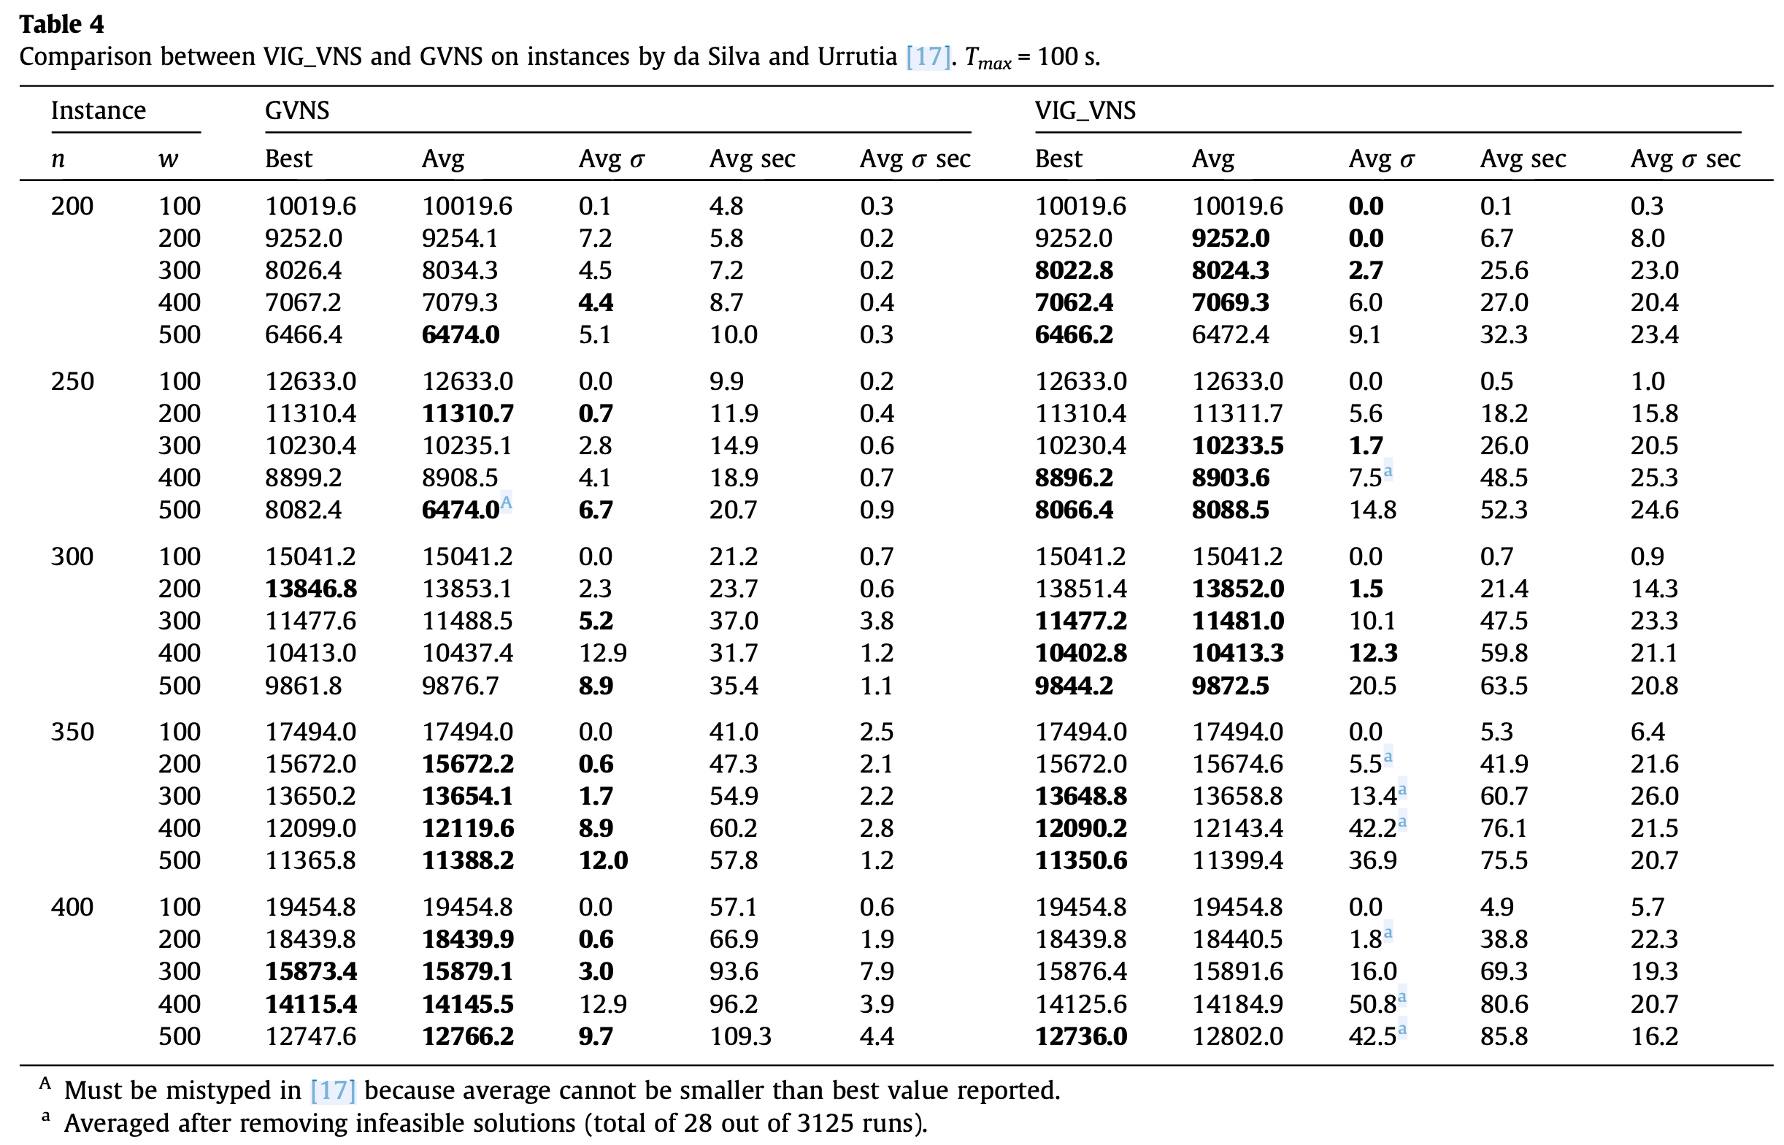

Slide 14
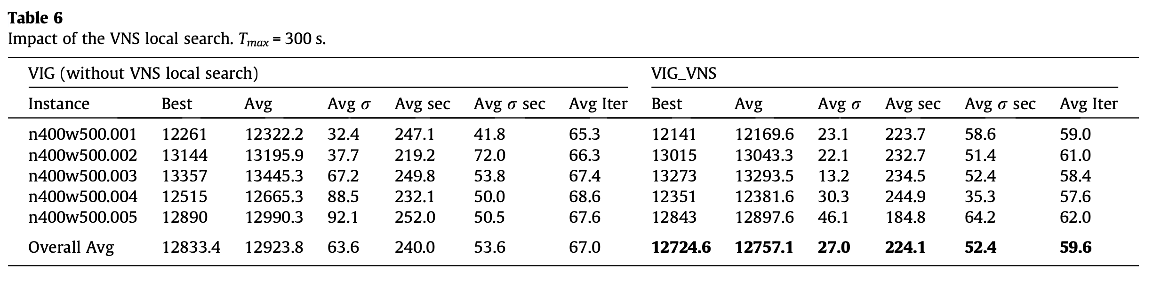
Results (4/4)
In the five sets, avg values of GVNS and VIG_VNS are not statistically difference.
VIG without a VNS local search was statistically equivalent to the VIG_VNS algorithm.

Slide 15
Thank you for listening

Slide 16
Abstract
s

