Slide 1
Computing a longest common almost-increasing subsequence of two sequences
Toan Thang Ta, Yi-Kung Shieh, Chin Lung Lu
Theoretical Computer Science 854 (2021) 44–51
Presenter: Cheng-Han Ho
Date: Apr. 19, 2022

Slide 2
Abstract
Given a positive constant c, a sequence S = (s₁, s₂, . . . , s_{k}) of k numbers is said to be
almost increasing if and only if s_{i} > max_{1≤j<i} s_{j} − c for all 1 < i ≤ k. A longest common
almost-increasing subsequence (LCaIS) between two input sequences is a longest common
subsequence that is also an almost increasing sequence. We found out that the existing
algorithm proposed by Moosa et al. [1] to ﬁnd an LCaIS of two sequences without repeated
elements gives an incorrect result for some instances. In this work, we present a dynamic
programming algorithm that can correctly compute an LCaIS between any two sequences
with repeated elements in O (nml) time and O (nm) space, where n and m are the lengths
of two input sequences and l is the length of the output LCaIS.

Slide 3

LCaIS (Longest Common almost-Increasing Subsequence)
A = 3, 2, 1, 3, 2
B = 1, 3, 3, 2
c = 2
LCIS(X) = 1, 3 or 1, 2
LCaIS(X) = 1, 3, 2

Slide 4
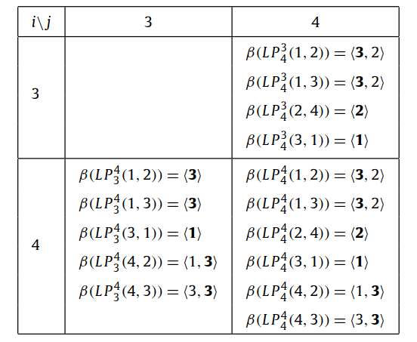
algorithm (1/4)
A = 3, 2, 1, 3, 2
B = 1, 3, 3, 2
c = 2
when A₄ ≠ B₄
加入 L(i-1, j), L(i, j-1)

Slide 5
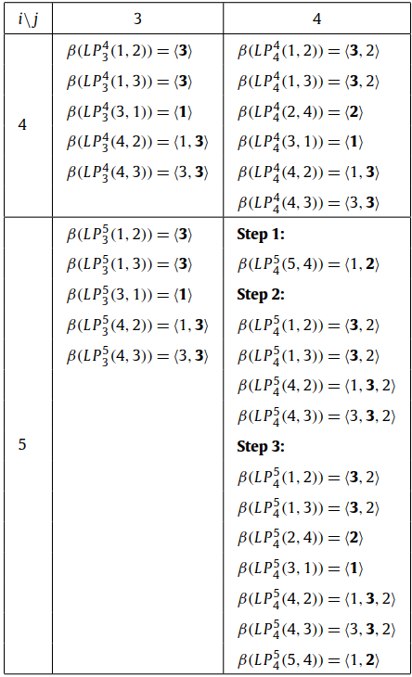
algorithm (2/4)
✓
when A₅ = B₄ = 2
Step.1
把 2 加到左上中一個長度最長，
且最大值比 2 小的答案
Step.2
把 2 加到左上中那些最大值比 2 大一點點的答案
Step.3
加入 L(i-1, j), L(i, j-1)

Slide 6
algorithm (3/4)
✓
✓
✓
✓
when A₅ = B₄ = 2
Step.1
把 2 加到左上中一個長度最長，
且最大值比 2 小的答案
Step.2
把 2 加到左上中那些最大值比 2 大一點點的答案
Step.3
加入 L(i-1, j), L(i, j-1)

Slide 7
algorithm (4/4)
when A₅ = B₄ = 2
Step.1
把 2 加到左上中一個長度最長，
且最大值比 2 小的答案
Step.2
把 2 加到左上中那些最大值比 2 大一點點的答案
Step.3
加入 L(i-1, j), L(i, j-1)

Slide 8
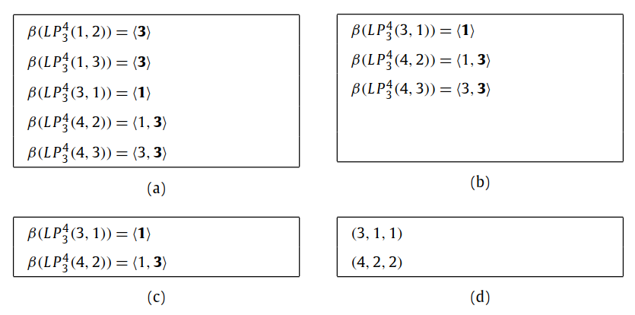
simpliﬁed L(i, j)
A = 3, 2, 1, 3, 2
B = 1, 3, 3, 2
c = 2
每種長度的答案只記一個
刪掉 domiated
刪掉 redundant
最後轉換成 3-tuple value

Slide 9
simpliﬁed L(i, j)
A = 3, 2, 1, 3, 2
B = 1, 3, 3, 2
c = 2
每種長度的答案只記一個
刪掉 domiated
刪掉 redundant
最後轉換成 3-tuple value

Slide 10
simpliﬁed L(i, j)
A = 3, 2, 1, 3, 2
B = 1, 3, 3, 2
c = 2
每種長度的答案只記一個
刪掉 domiated
刪掉 redundant
最後轉換成 3-tuple value

Slide 11
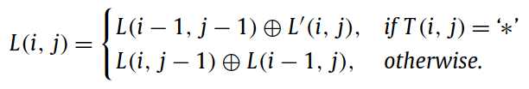
recursive formula

Slide 12
complexity
每個格子最多只會有 𝓁 個答案
O(nm𝓁)

