Slide 1
Recognition of d-Dimensional Monge Arrays
Rüdiger Rudolf
Discrete Applied Mathematics, 1994
Volume 52, pp. 71-82
Presenter: Tsung-Lin Lu
Date: April 19, 2022

Slide 2
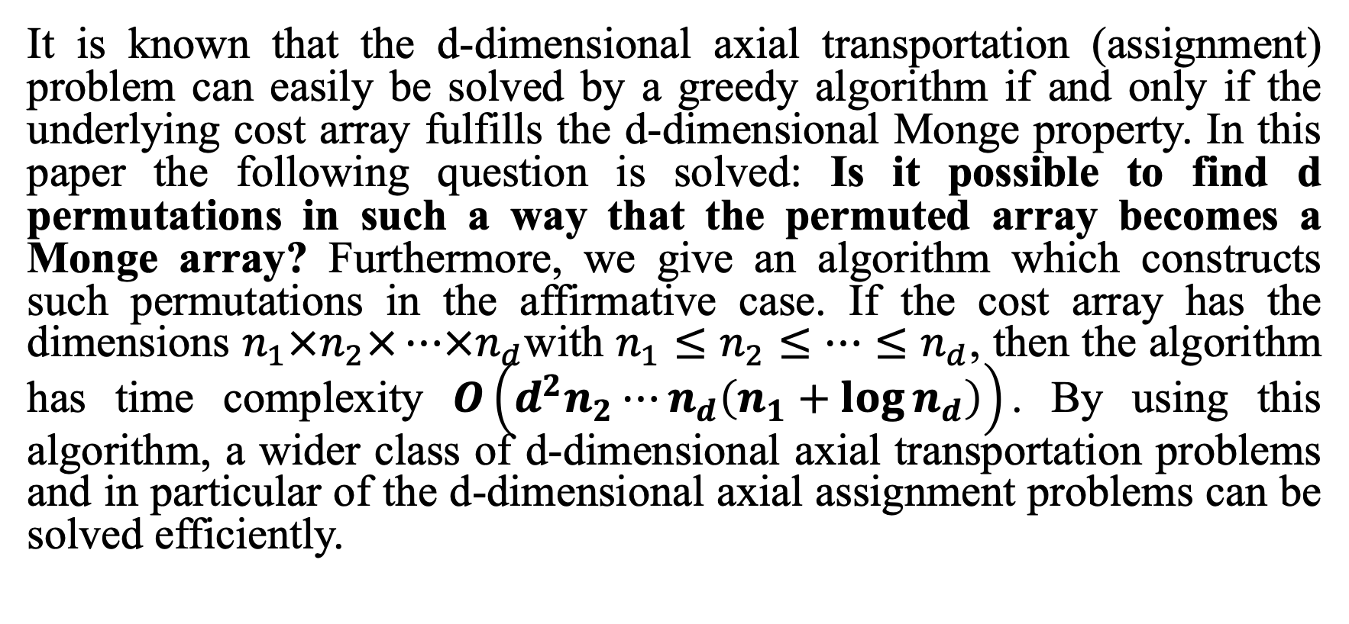
Abstract
It is known that the d-dimensional axial transportation (assignment) problem can easily be solved by a greedy algorithm if and only if the underlying cost array fulfills the d-dimensional Monge property. In this paper the following question is solved: Is it possible to find d permutations in such a way that the permuted array becomes a Monge array? Furthermore, we give an algorithm which constructs such permutations in the affirmative case. If the cost array has the dimensions $n_{1}×n_{2}×⋯×n_{d}$with $n_{1}≤n_{2}≤⋯≤n_{d}$, then the algorithm has time complexity $O\left(d^{2}n_{2}⋯n_{d}\left(n_{1}+\log{n_{d}}\right)\right)$. By using this algorithm, a wider class of d-dimensional axial transportation problems and in particular of the d-dimensional axial assignment problems can be solved efficiently.

Slide 3
Outline
Monge Matrix
Assignment Problem
Algorithm for 2-D by Deineko and Filonenko
Algorithm for 3-D
Time Complexity

Slide 4
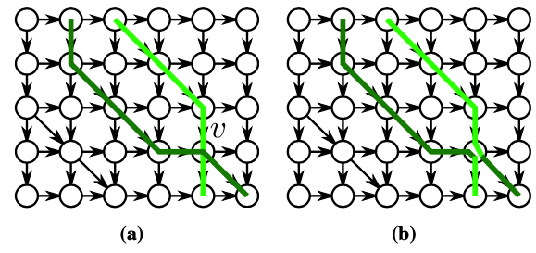
Monge Matrix (1/2)
Monge observed that if unit quantities are to be transported from locations X and Y to Z and W in such a way as to minimize the total distance traveled, then the route from X and the route from Y must not intersect.
X
Y
X
Y
W
Z
W
Z

Slide 5
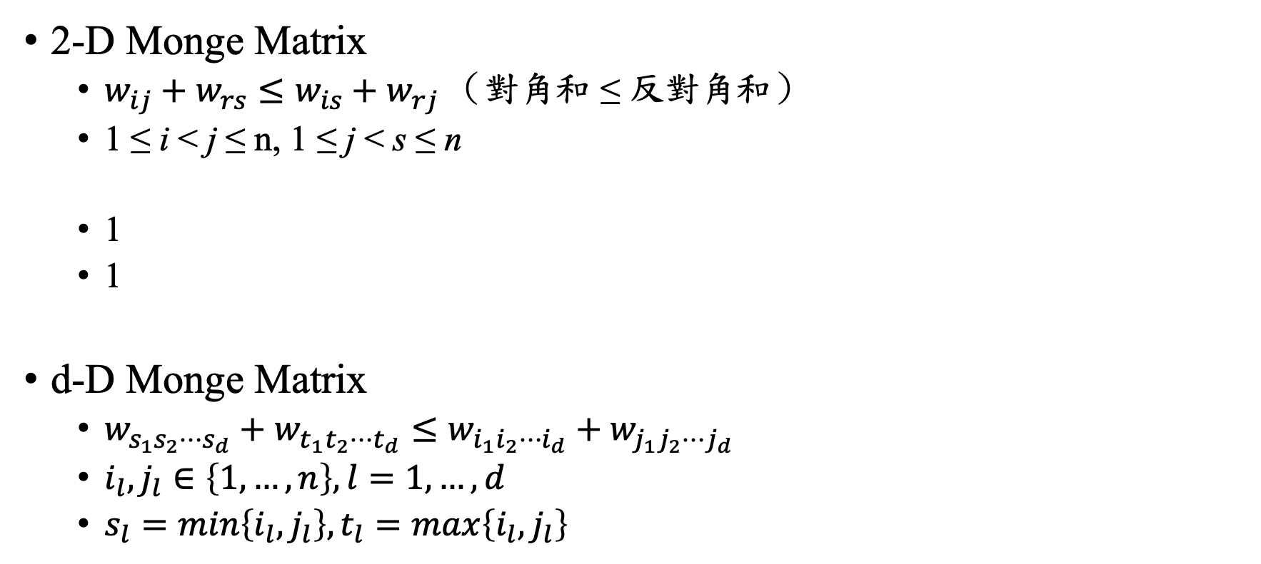
Monge Matrix (2/2)
2-D Monge Matrix
$w_{ij}+w_{rs}≤w_{is}+w_{rj}$ （對角和 ≤ 反對角和）
1 ≤ i < j ≤ n, 1 ≤ j < s ≤ n
1
1
d-D Monge Matrix
$w_{s_{1}s_{2}⋯s_{d}}+w_{t_{1}t_{2}⋯t_{d}}≤w_{i_{1}i_{2}⋯i_{d}}+w_{j_{1}j_{2}⋯j_{d}}$
$i_{l},j_{l}∈\left\{1,…,n\right\},l=1,…,d$
$s_{l}=min\left\{i_{l},j_{l}\right\},t_{l}=max\left\{i_{l},j_{l}\right\}$
2D Monge Matrix
1 2 3 4
1 9 12 12 15
2 12 14 14 16
3 15 16 16 17
4 15 16 16 17

Slide 6
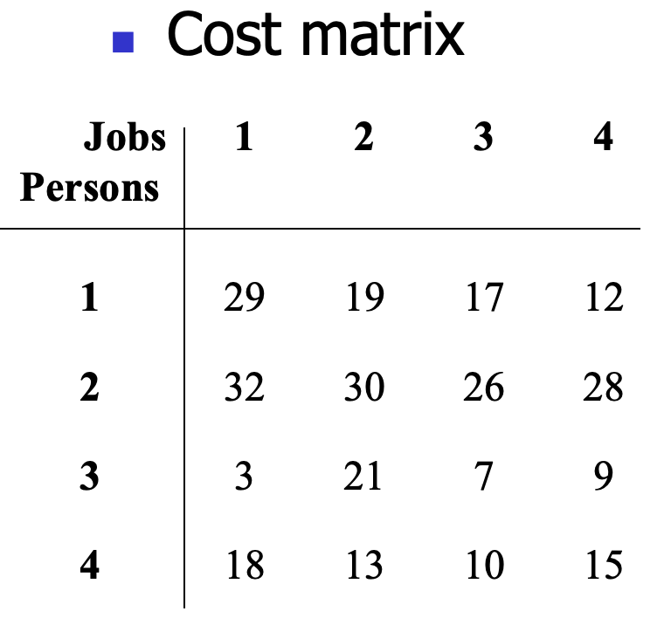
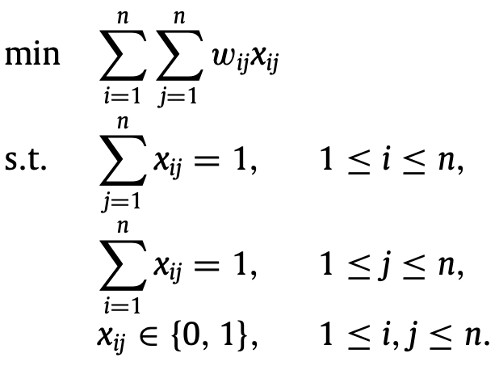
Assignment Problem
(weight matrix )
The assignment problem and the transportation problem can be solved faster (by a greedy algorithm) if the weight matrix is a Monge matrix.

Slide 7
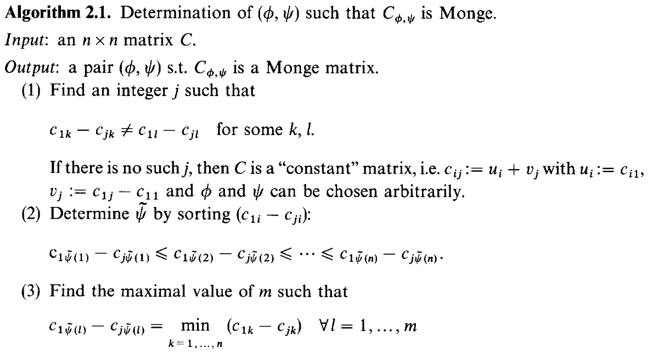
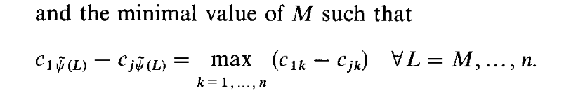
Algorithm for 2-D by Deineko and Filonenko (1/3)

Slide 8
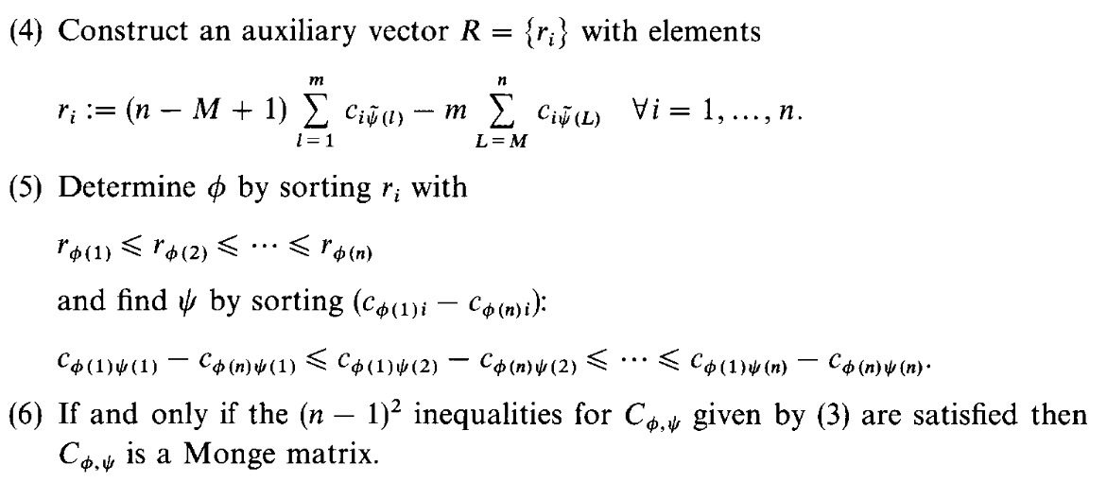
Algorithm for 2-D by Deineko and Filonenko (2/3)

Slide 9

Algorithm for 2-D by Deineko and Filonenko (3/3)
找j：第1列和第j列不等價
找𝟁~：排序（第1列-第j列），其順序為𝟁~
找m和M：在第2步的排序中，m為最小值的最大名次，M為最大值的最小名次
建構R
找𝟇：排序R，其順序為𝟇
找𝟁：排序(第𝟇₁列-第𝟇_{n}列)，其順序為𝟁
檢查C_{𝟇, 𝟁}是否為monge?
It is not Monge.
1 2 3 4
1 12 15 12 9
2 16 17 16 15
3 14 16 14 12
4 16 17 16 15
It is Monge.
4 1 3 2
1 9 12 12 15
3 12 14 14 16
2 15 16 16 17
4 15 16 16 17
第1列-第2列 | -4 | -2 | -4 | -6
𝟁~ | 4 | 1 | 3 | 2
 | m=1 |  |  | M=4
R(第4行-第2行) | -6 | -2 | -4 | -2
𝟇 | 1 | 3 | 2 | 4
第1列-第4列 | -4 | -2 | -4 | -6
𝟁 | 4 | 1 | 3 | 2
𝟇 (phi), 𝟁 (psi)

Slide 10
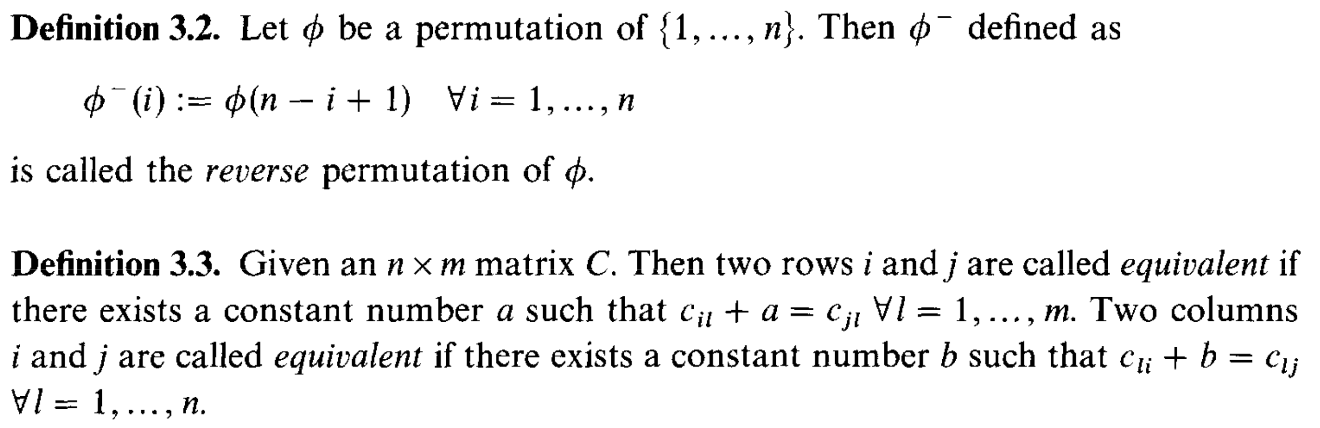
Algorithm for 3-D (1/7)
倒序
兩列/行差固定，則稱為等價

Slide 11
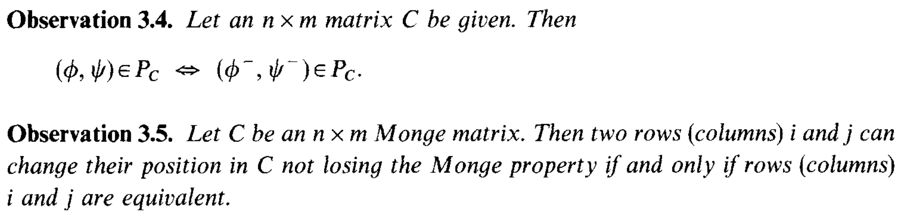
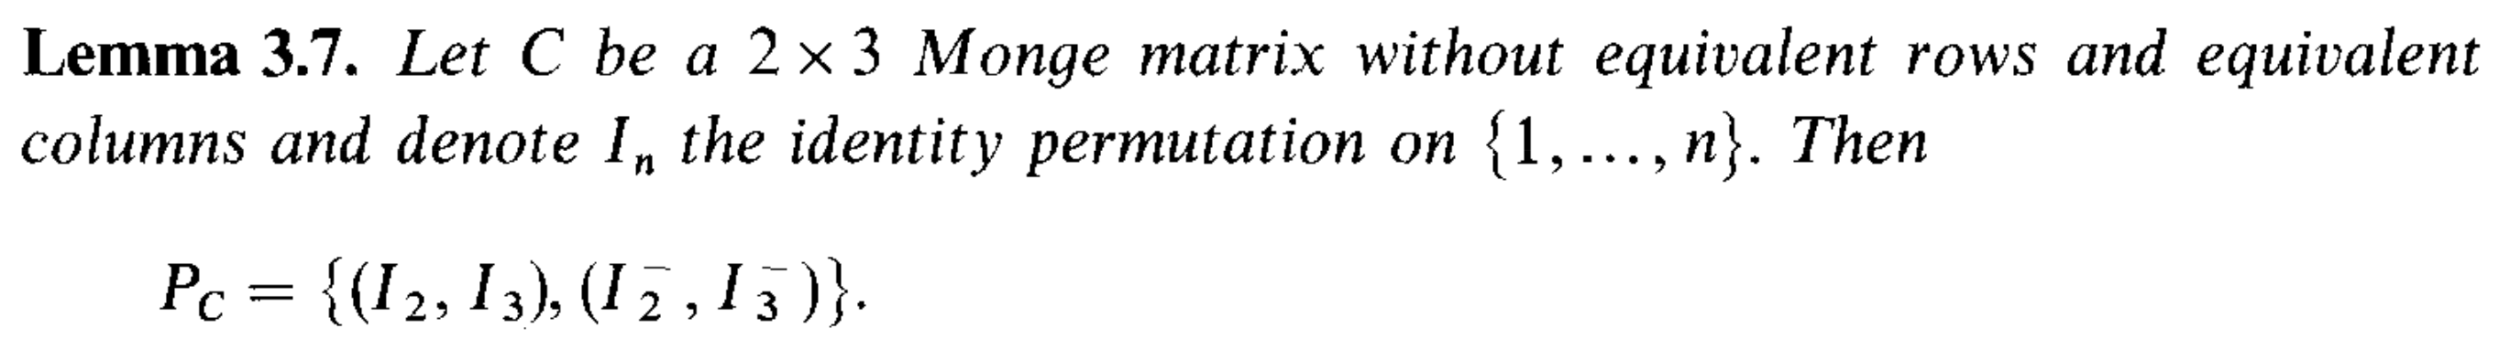
Algorithm for 3-D (2/7)
1 2 3 4
1 9 12 12 15
2 10 13 13 16
3 15 16 16 17
4 15 16 16 17
4 3 2 1
4 17 16 16 15
3 17 16 16 15
2 16 13 13 10
1 15 12 12 9
1 2 3 4
2 10 13 13 16
1 9 12 12 15
3 15 16 16 17
4 15 16 16 17
倒序會保有Monge
等價列/行互換會保有Monge
連續的等價列/行

Slide 12
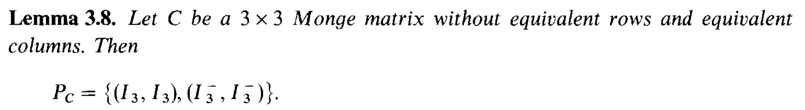
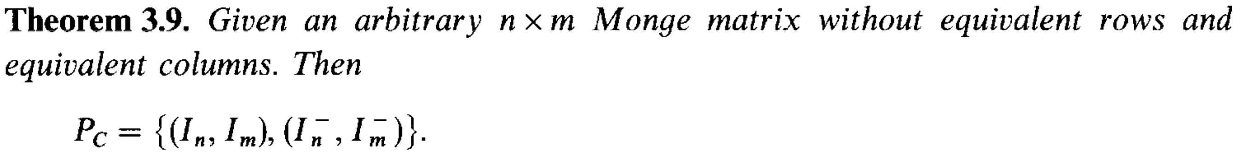
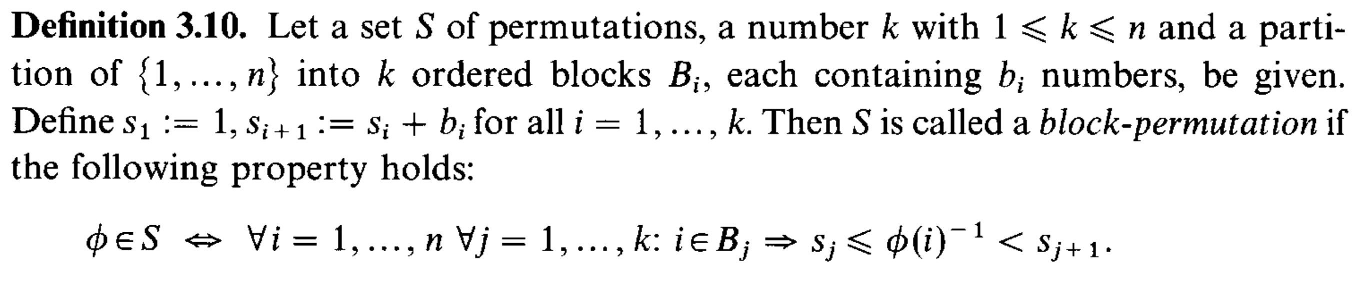
Algorithm for 3-D (3/7)
對於沒有等價行/列的 n x m 矩陣，矩陣的『倒序』是不破壞 Monge 結構的情況下，對其進行重排的唯一方法。
連續的等價列/行視為一個區塊

Slide 13
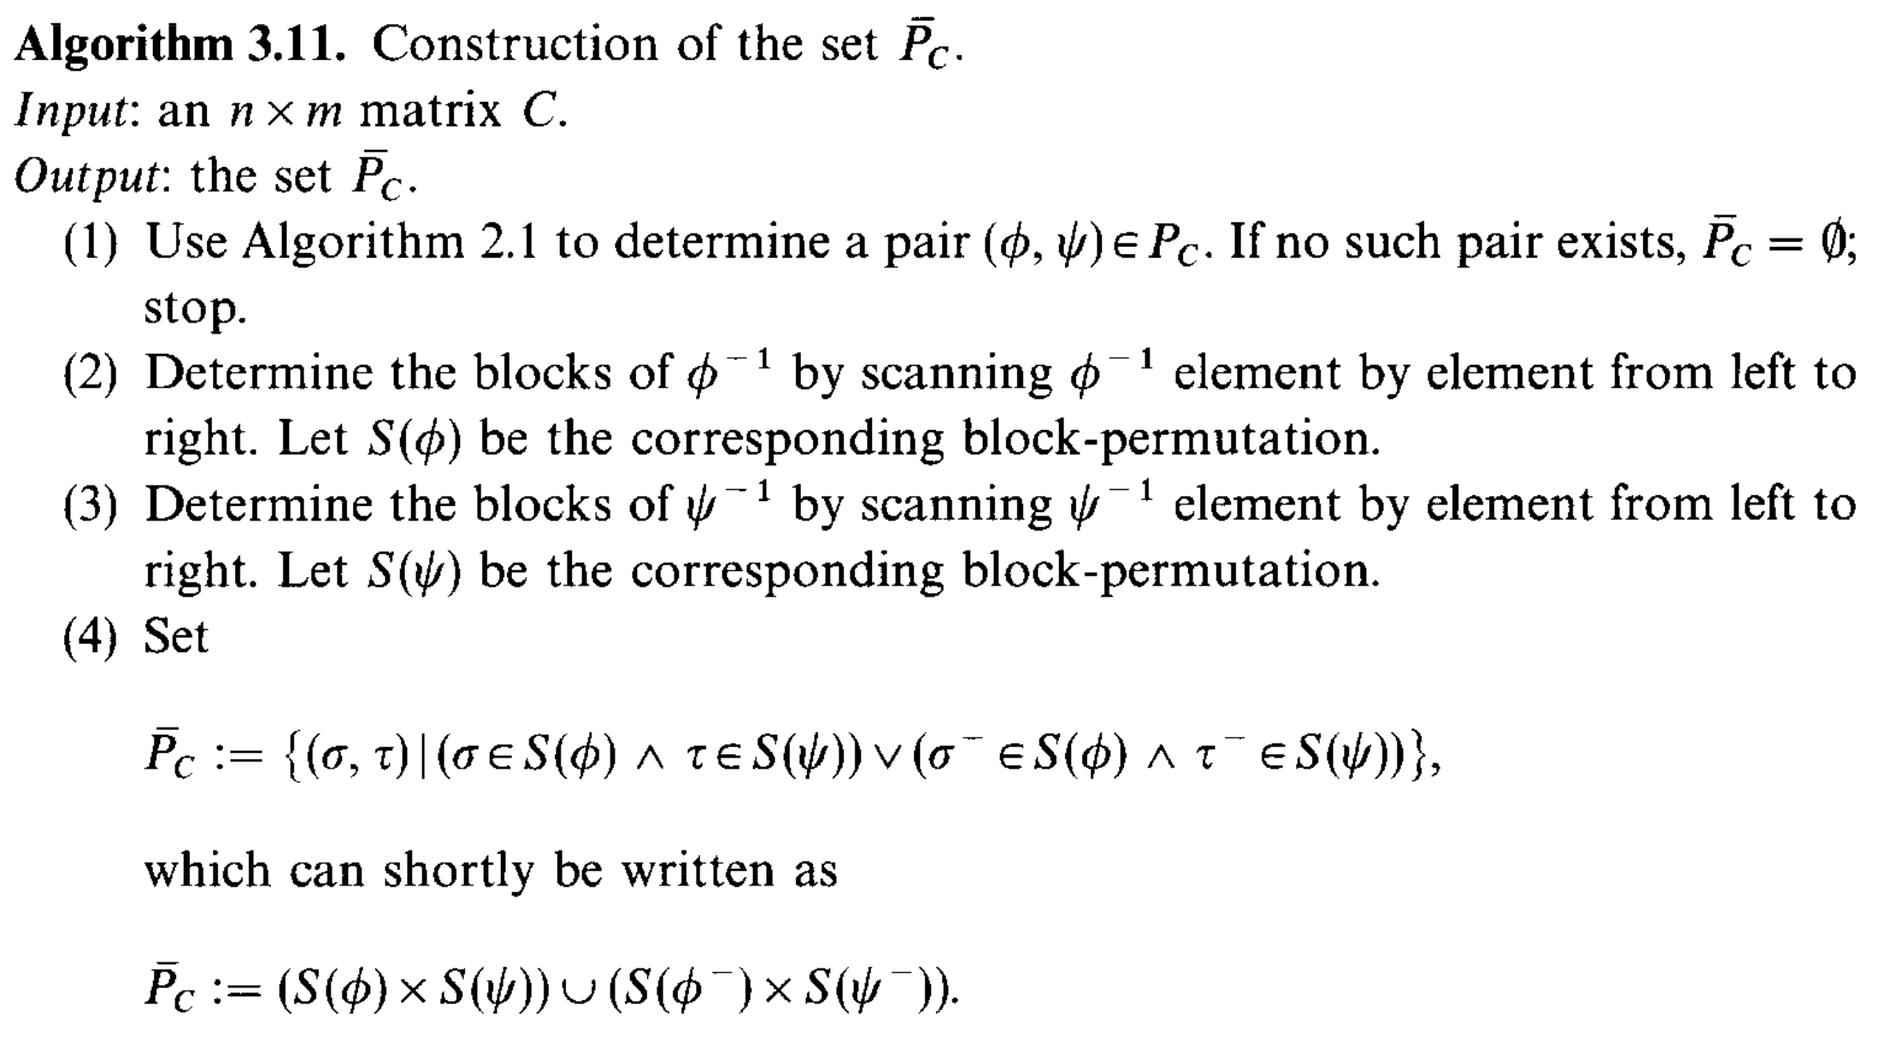
Algorithm for 3-D (4/7)

Slide 14
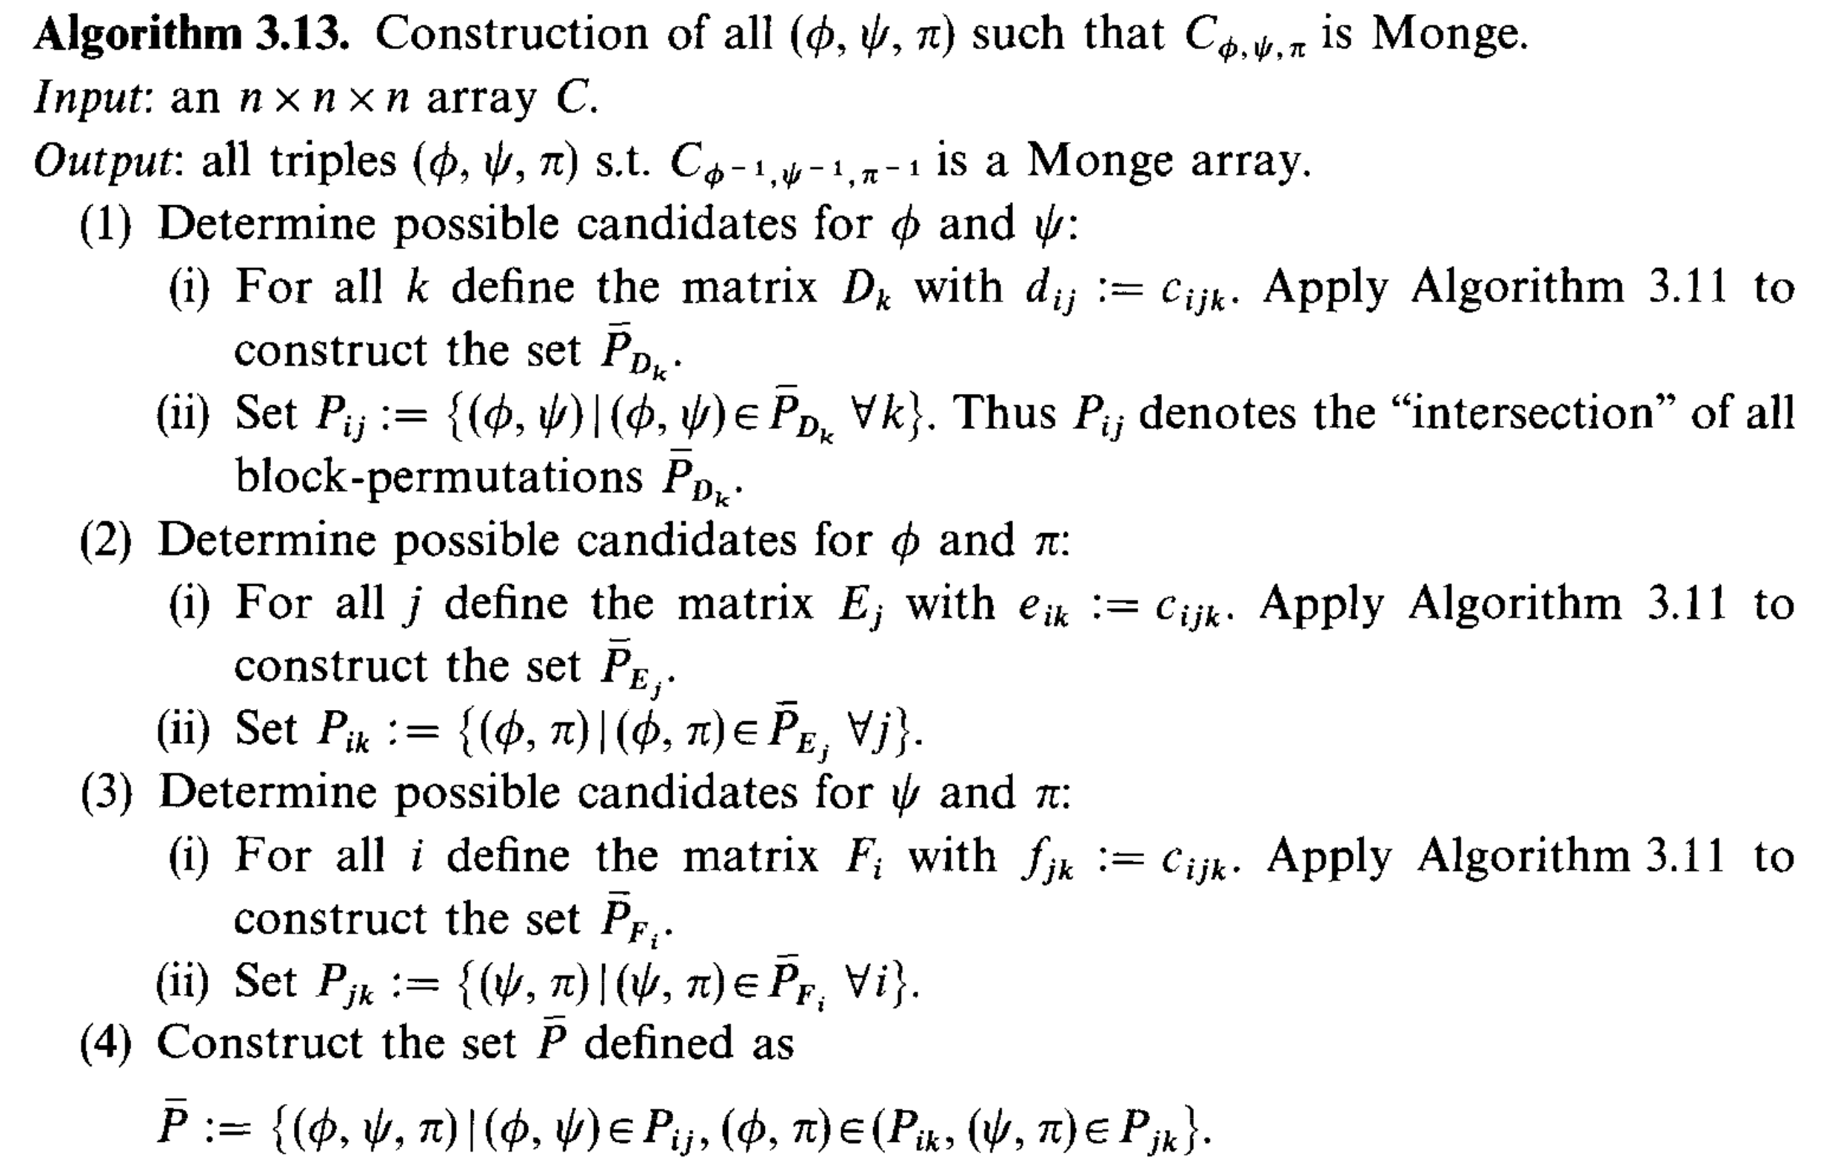
Algorithm for 3-D (5/7)

Slide 15
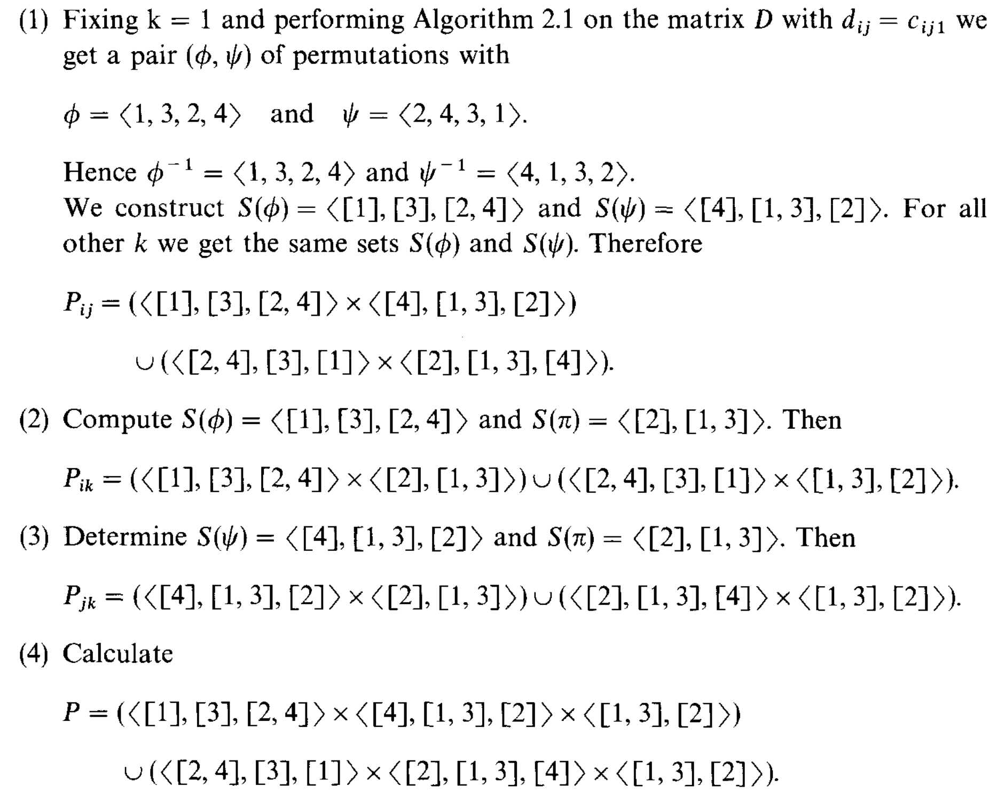
Example for 3D (6/7)
It is not Monge.
12 15 12 9
16 17 16 15
14 16 14 12
16 17 16 15
6 12 6 0
14 16 14 12
10 14 10 6
14 16 14 12
12 15 12 9
16 17 16 15
14 16 14 12
16 17 16 15
第1列-第2列 | -8 | -4 | -8 | -12
𝟁~ | 4 | 1 | 3 | 2
 | m=1 |  |  | M=4
R(第4行-第2行) | -12 | -4 | -8 | -4
𝟇 | 1 | 3 | 2 | 4
第1列-第4列 | -8 | -4 | -8 | -12
𝟁 | 4 | 1 | 3 | 2
It is Monge.
𝟇 (phi), 𝟁 (psi)
9 12 12 15
12 14 14 16
15 16 16 17
15 16 16 17
9 12 12 15
12 14 14 16
15 16 16 17
15 16 16 17
0 6 6 12
6 10 10 14
12 14 14 16
12 14 14 16

Slide 16
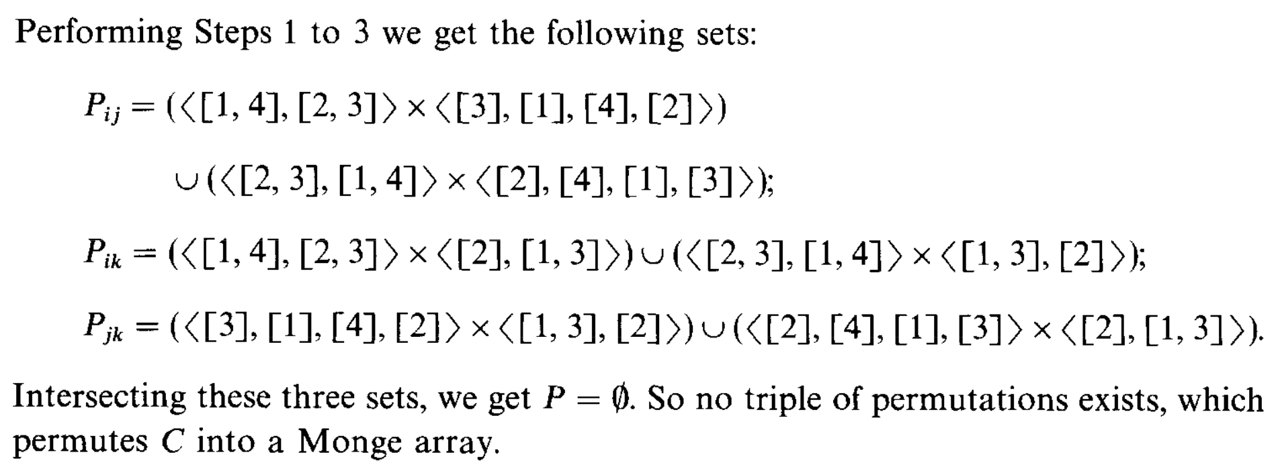
Example for 3D (7/7)
3 1 4 2
6 2 8 4
6 2 8 4
3 1 4 2
9 3 12 6
18 6 24 12
18 6 24 12
9 3 12 6
3 1 4 2
6 2 8 4
6 2 8 4
3 1 4 2
綠色框框不一樣，所以P=∅，故C無法重排成Monge。

Slide 17

Time Complexity
Algorithm for 2-D
$O\left(nm+n\log{n}\right)$
Algorithm for 3-D
$O(n^{3})$
Algorithm for d-D
$O(d^{2}n^{d})$
$O\left(d^{2}n_{2}⋯n_{d}\left(n_{1}+\log{n_{d}}\right)\right)$

Slide 18
Thank you for listening

Slide 19
Abstract

