Slide 1
A Budget Constrained Scheduling Algorithm for Workflow Applications
Hamid Arabnejad and Jorge G. Barbosa
Journal of Grid Computing, volume 12, pages 665–679 (2014)
Date: Apr. 19, 2022
Presenter: Jue-Jun Wu

Slide 2
Abstract
Service-oriented computing has enabled a new method of service provisioning based on utility computing models, in which users consume services based on their Quality of Service (QoS) requirements. In such pay-per-use models, users are charged for services based on their usage and on the fulfilment of QoS constraints; execution time and cost are two common QoS requirements. Therefore, to produce effective scheduling maps, service pricing must be considered while optimising execution performance. In this paper, we propose a Heterogeneous Budget Constrained Scheduling (HBCS) algorithm that guarantees an execution cost within the user’s specified budget and that minimises the execution time of the user’s application. The results presented show that our algorithm achieves lower makespans, with a guaranteed cost per application and with a lower time complexity than other budget-constrained state-of-the-art algorithms. The improvements are particularly high for more heterogeneous systems, in which a reduction of 30 % in execution time was achieved while maintaining the same budget level.

Slide 3
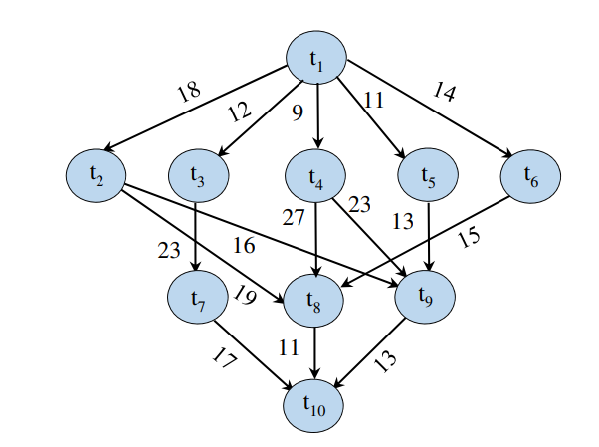

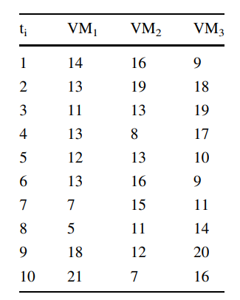
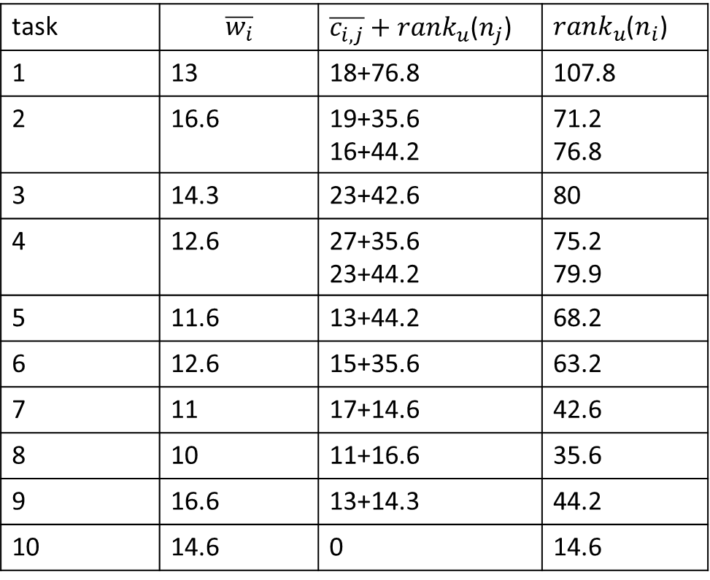
HEFT
task | $$\overline{w_{i}}$$ | $\overline{c_{i,j}}+{rank}_{u}$($n_{j}$) | ${rank}_{u}$($n_{i}$)
1 | 13 | 18+76.8 | 107.8
2 | 16.6 | 19+35.6 16+44.2 | 71.2 76.8
3 | 14.3 | 23+42.6 | 80
4 | 12.6 | 27+35.6 23+44.2 | 75.2 79.9
5 | 11.6 | 13+44.2 | 68.2
6 | 12.6 | 15+35.6 | 63.2
7 | 11 | 17+14.6 | 42.6
8 | 10 | 11+16.6 | 35.6
9 | 16.6 | 13+14.3 | 44.2
10 | 14.6 | 0 | 14.6

Slide 4
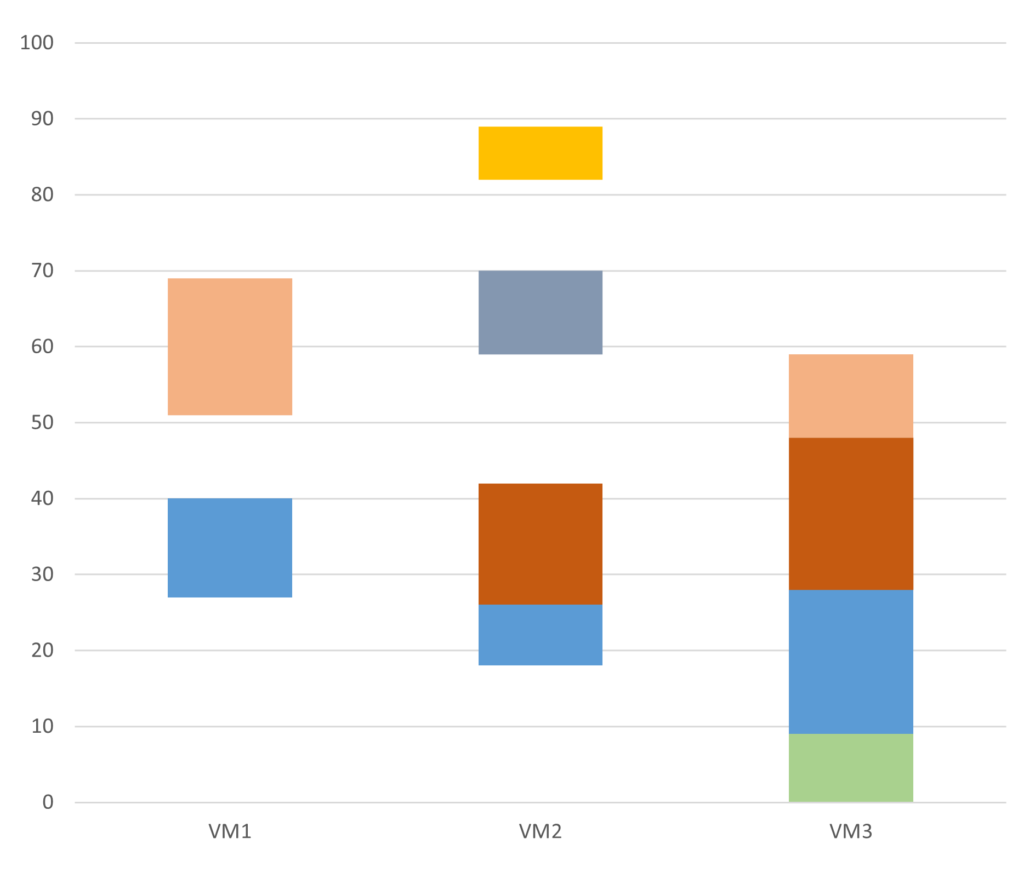
Base price VM1:$7 VM2:$5 VM3:$3
Budget Cost = 31*7 + 42*5 + 49*3 = 574
Budget constraied: 500
t10
t8
t9
t7
t2
t6
t5
t4
t3
t1

Slide 5
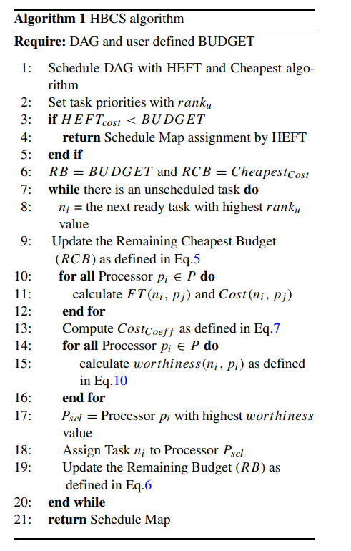
Heterogeneous Budget Constrained Scheduling (HBCS)
Task Selection
Processor Selection

Slide 6



Base price VM1:$7 VM2:$5 VM3:$3
Remaining Budget(RB) : 398+0.2(935-398)= $505
Remaining Cheapest Budget(RCB): 505-27= $478
Notes:
935~398

Slide 7
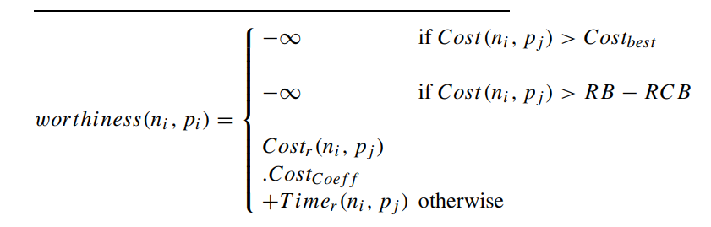


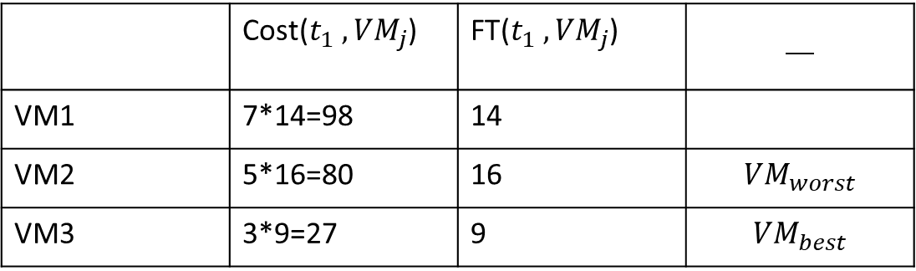
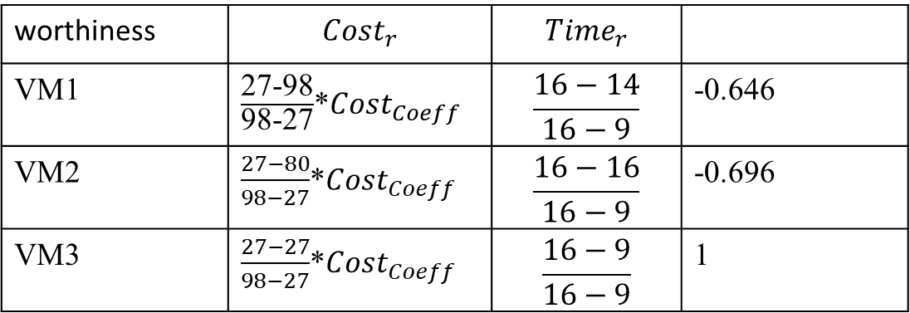
$${Cost}_{Coeff}=478/505$$
 | Cost($t_{1} ,{VM}_{j}$) | FT($t_{1} ,{VM}_{j}$)
VM1 | 7*14=98 | 14
VM2 | 5*16=80 | 16 | $${VM}_{worst}$$
VM3 | 3*9=27 | 9 | $${VM}_{best}$$
worthiness | $${Cost}_{r}$$ | $${Time}_{r}$$
VM1 | $\frac{\text{27-98}}{\text{98-27}}$*${Cost}_{Coeff}$ | $$\frac{16−14}{16−9}$$ | -0.646
VM2 | $\frac{27−80}{98−27}$*${Cost}_{Coeff}$ | $$\frac{16−16}{16−9}$$ | -0.696
VM3 | $\frac{27−27}{98−27}$*${Cost}_{Coeff}$ | $$\frac{16−9}{16−9}$$ | 1

Slide 8
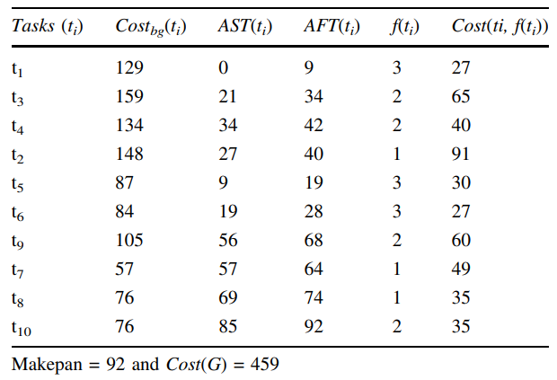
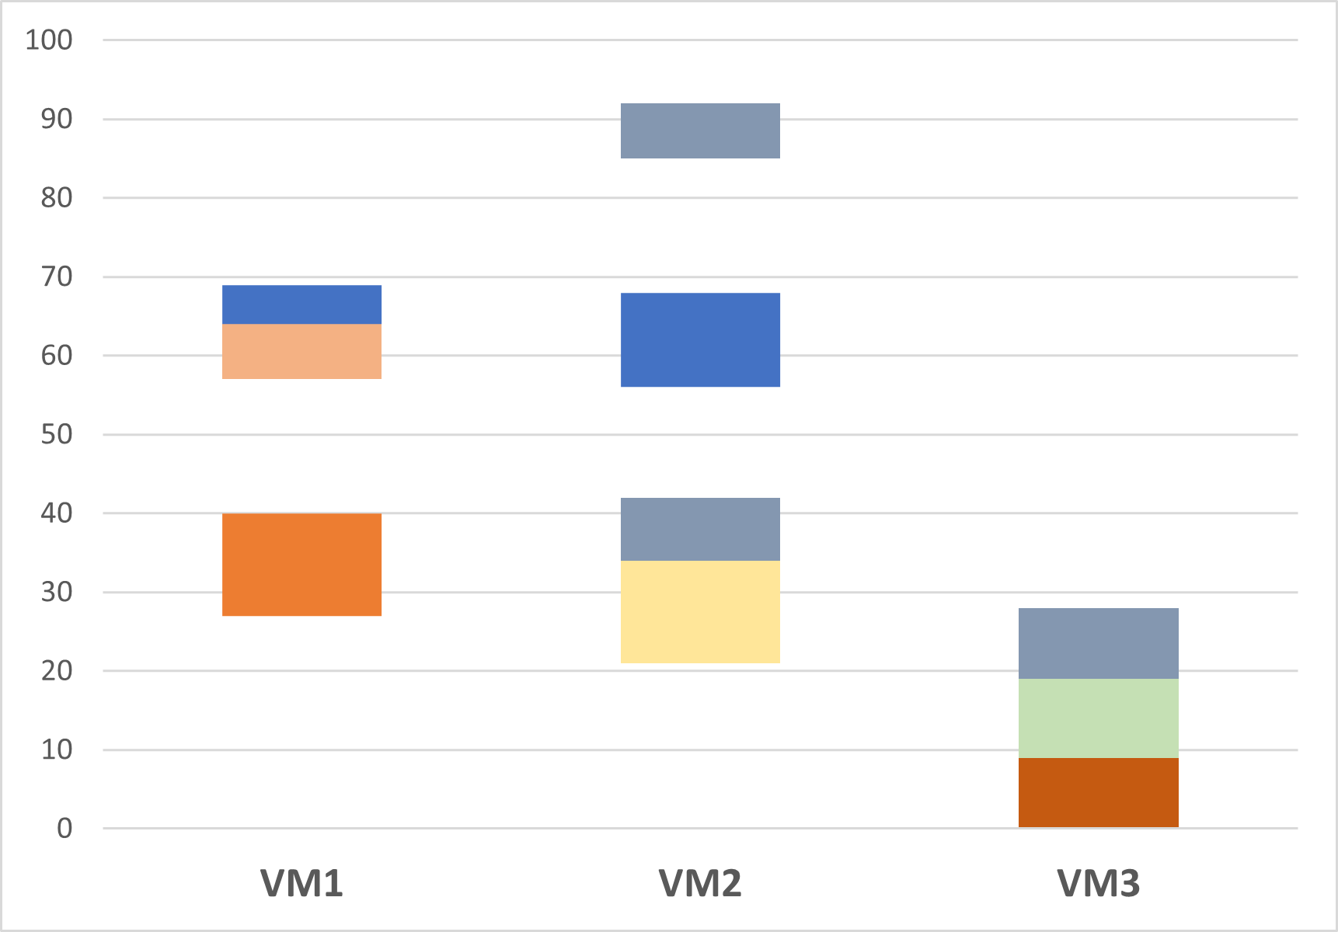
t10
t8
t7
t9
t4
t2
t3
t6
t5
t1

Slide 9
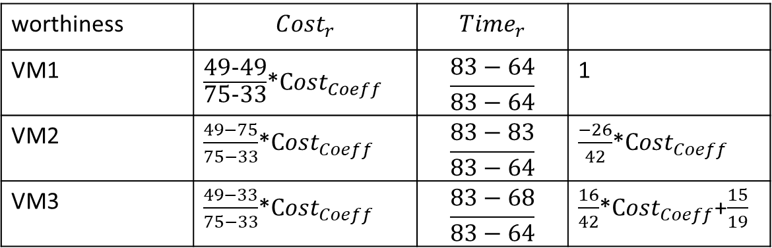
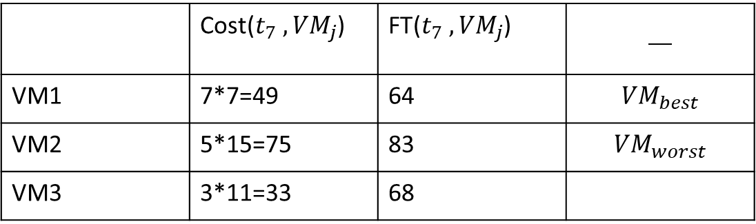
 | Cost($t_{7} ,{VM}_{j}$) | FT($t_{7} ,{VM}_{j}$)
VM1 | 7*7=49 | 64 | $${VM}_{best}$$
VM2 | 5*15=75 | 83 | $${VM}_{worst}$$
VM3 | 3*11=33 | 68
worthiness | $${Cost}_{r}$$ | $${Time}_{r}$$
VM1 | $\frac{\text{49-49}}{\text{75-33}}$*${Cost}_{Coeff}$ | $$\frac{83−64}{83−64}$$ | 1
VM2 | $\frac{49−75}{75−33}$*${Cost}_{Coeff}$ | $$\frac{83−83}{83−64}$$ | $\frac{−26}{42}$*${Cost}_{Coeff}$
VM3 | $\frac{49−33}{75−33}$*${Cost}_{Coeff}$ | $$\frac{83−68}{83−64}$$ | $\frac{16}{42}$*${Cost}_{Coeff}$+$\frac{15}{19}$

Slide 10
t10
t8
t7
t9
t4
t2
t3
t6
t5
t1

Slide 11
HEFT HBCS
t10
t10
t8
t8
t9
t7
t9
t7
t2
t4
t6
t5
t2
t4
t3
t6
t3
t5
t1
t1
Makesapn = 89 and Cost(G) = 574
Makespan = 92 and Cost(G) = 459

Slide 12
Each DAG was created by choosing the value for each parameter randomly from the parameter data set. The total number of DAGs generated in our simulation was 1000.
the number of tasks n = [10...60],
jump = [1, 2, 3],
regularity = [0.2, 0.4, 0.8],
fat = [0.2, 0.4, 0.8],
density = [0.2, 0.4, 0.8].
Notes:
A jump indicates that an edge can go from level l to level l+jump
The regularity 每層level 數量的均衡性.

Slide 13

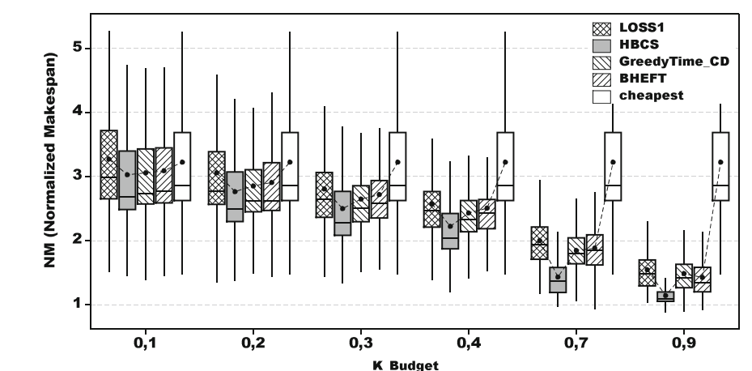
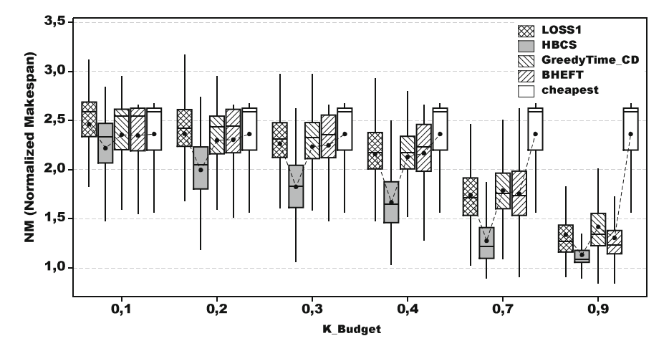
Normalized Makespan for Random workflows with CPUused=8
Normalized Makespan for Random workflows with CPUused=32

Slide 14

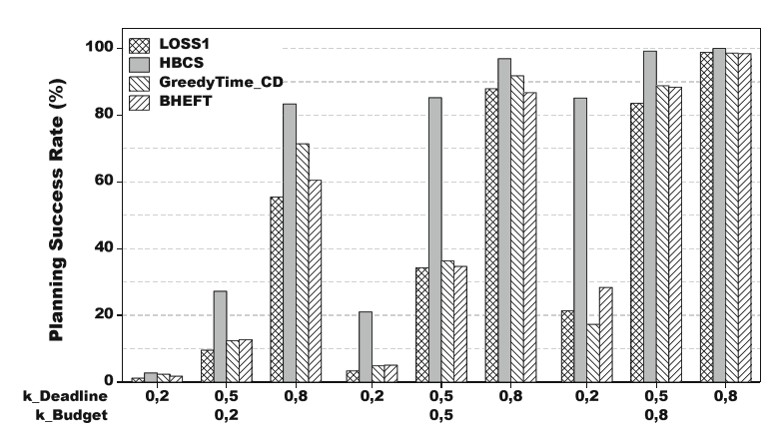
Using the budget deadline constrained methodology.
Notes:
有效ˊ時間表的百分比

Slide 15
The end.

Slide 16


