Slide 1
Machine Learning from Theory to Algorithms: An Overview
Jafar Alzubi, Anand Nayyar, Akshi Kumar
Journal of physics: conference series, 2018 (Vol. 1142, No. 1, p. 012012)
Presenter: Yun-An Chen
Date: July 26, 2022

Slide 2
Abstract(1/2)
The current SMAC (Social, Mobile, Analytic, Cloud) technology trend paves the way to a future in which intelligent machines, networked processes and big data are brought together. This virtual world has generated vast amount of data which is accelerating the adoption of machine learning solutions& practices. Machine Learning enables computers to imitate and adapt human-like behaviour. Using machine learning, each interaction, each action performed, becomes something the system can learn and use as experience for the next time.

Slide 3
Abstract(2/2)
This work is an overview of this data analytics method which enables computers to learn and do what comes naturally to humans, i.e. learn from experience. It includes the preliminaries of machine learning, the definition, nomenclature and applications’ describing it’s what, how and why. The technology roadmap of machine learning is discussed to understand and verify its potential as a market & industry practice. The primary intent of this work is to give insight into why machine learning is the future.

Slide 4
Machine Learning
Supervised Learning
(1) Regression
(2) Decision Tree
(3) Naïve Bayes
Unsupervised Learning
(1) K-Means Clustering
Reinforcement Learning
Ensemble Learning
Artificial neural networks (ANNs)

Slide 5
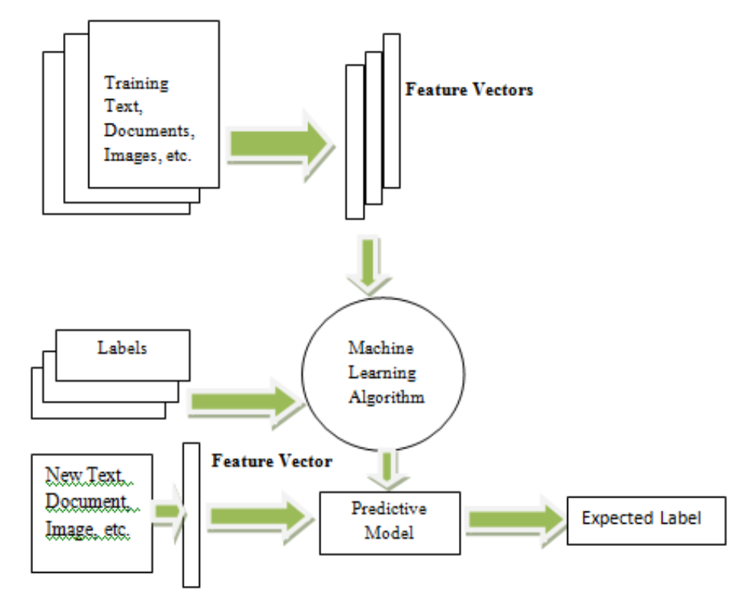
Supervised learning
Regression
Classification

Slide 6
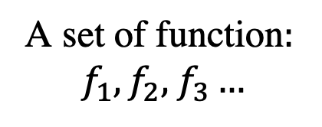

Regression
$$y=wx+b$$
Loss function L
input: function
Output: how bad the function is
Gradient Descent
Goodness of
Function f
Training
Data
Model
A set of function$:$
$f_{1},f_{2},$ $f_{3}…$
input
output(scalar)
Pick the best function

Slide 7
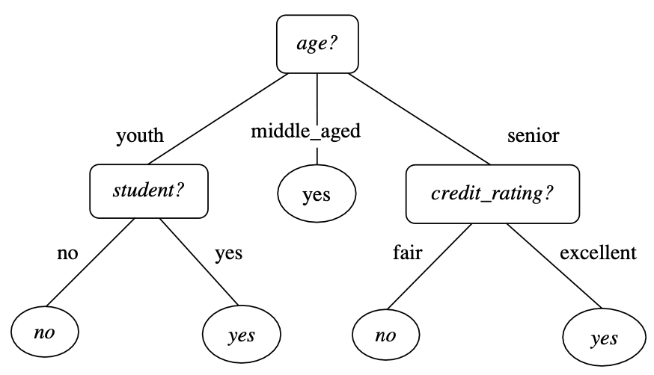
Decision Tree
Classification and regression tree(CART)
Iterative Dichotomiser 3(ID3)
Automatic Interaction Detection (CHAID)
Chi-Squared C4.5
Conditions for splitting:
Information gain
Gini Index
Entropy

Slide 8
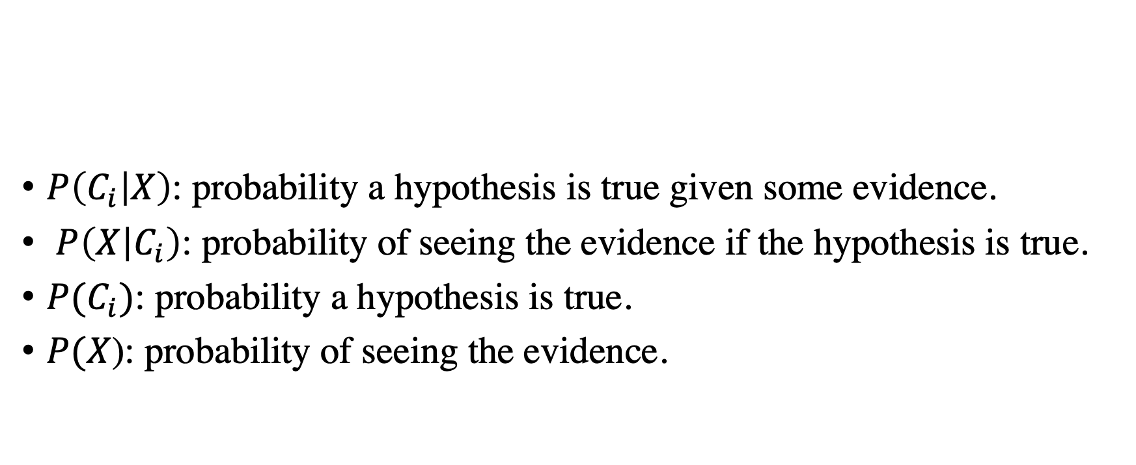
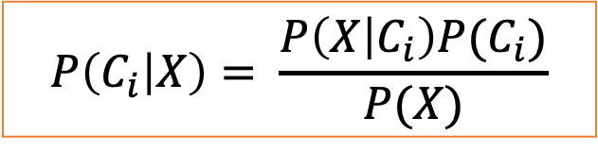
Naïve Bayes
$P\left(C_{i} | X\right)$: probability a hypothesis is true given some evidence.
$P\left(X | C_{i}\right)$: probability of seeing the evidence if the hypothesis is true.
$P(C_{i})$: probability a hypothesis is true.
$P(X$): probability of seeing the evidence.
$$P\left(C_{i} | X\right)= \frac{P\left(X | C_{i}\right)P(C_{i})}{P(X)}$$

Slide 9
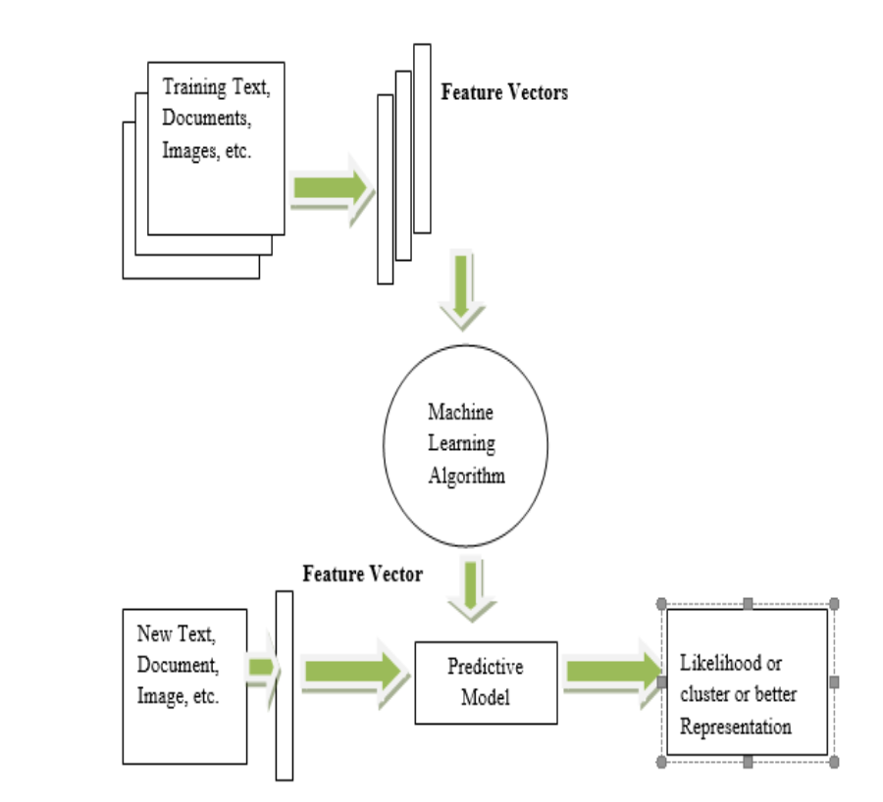
Unsupervised learning

Slide 10
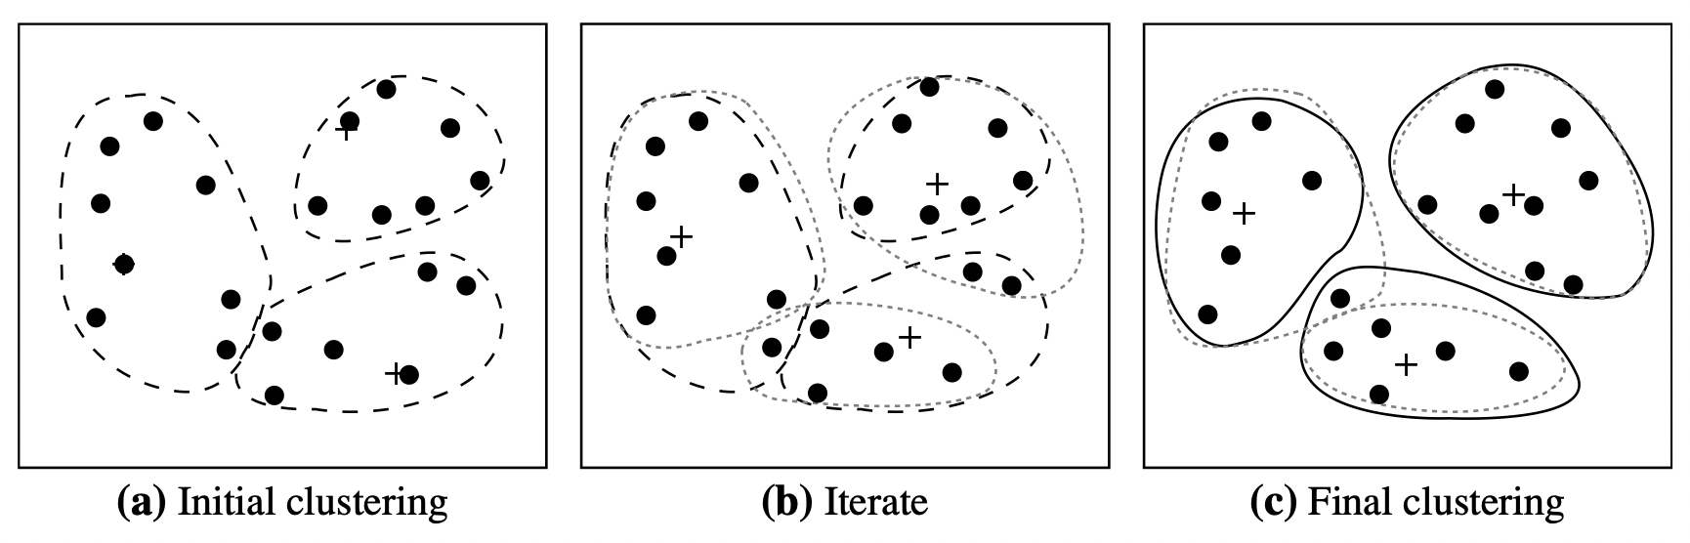
K-Means Clustering
(1) arbitrarily choose k objects from D as the initial cluster centers.
(2) repeat
(re)assign each object to the cluster to which the object is the most similar, based on the mean value of the objects in the clusters;
update the cluster means;
until no change;

Slide 11
Reinforcement learning
Function output
Action
Reward
Actor
(policy network)
Environment
Observation
Function input

Slide 12
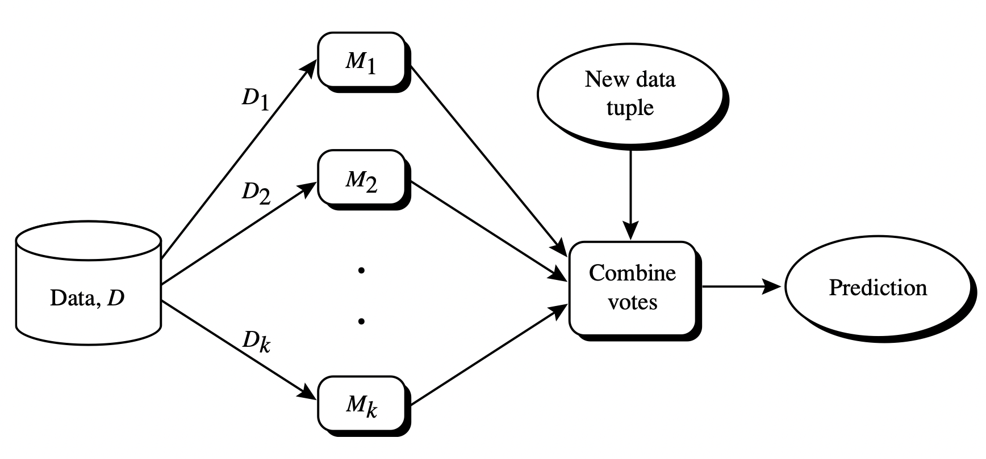

Ensemble learning
create k training data set
Classifier $M_{i}$

Slide 13
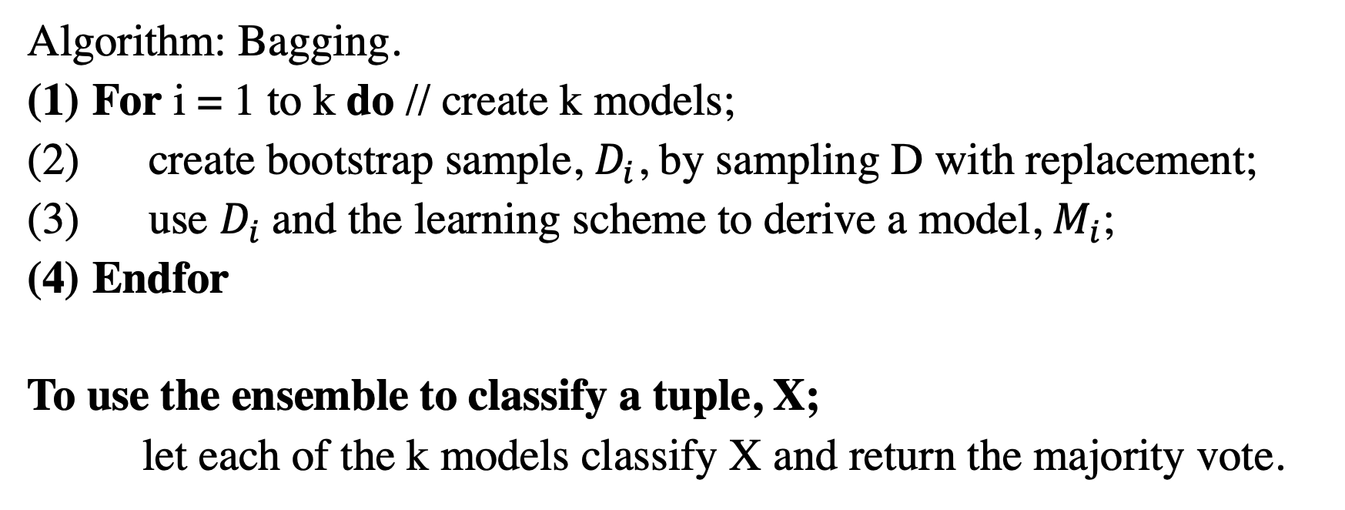
Random Forest
Input:
D, a set of d training tuples;
k, the number of models in the ensemble;
A classification learning scheme.
Algorithm: Bagging.
For i = 1 to k do // create k models;
create bootstrap sample, $D_{i}$, by sampling D with replacement;
use $D_{i}$and the learning scheme to derive a model, $M_{i}$;
Endfor
To use the ensemble to classify a tuple, X;
let each of the k models classify X and return the majority vote.

Slide 14

Artificial Neural Network
Supervised Neural Network
Unsupervised Neural Network
Reinforcement Neural Network
X1
P1
X1
w1
Y1
P2
X2
X2
w2
$$X1×w1+X2×w2=y$$
perceptron
input
hidden
output

Slide 15
Applications of ML
Robotics and Artificial Intelligence
Web and Social Media: Google uses the Naïve Bayes algorithm for document categorization.
Speech Recognition
Filtering Emails
Autonomous Vehicles
Medical Field

