Slide 1
Genetic algorithm approach for precedence-constrained sequencing problems
YoungSu Yun and Chiung Moon
Journal of Intelligent Manufacturing, Vol. 22, pp. 379– 388, 2011
Presenter: Chih-Hsuan Chien​
Date: Aug 2, 2022

Slide 2
Abstract
In this paper we propose a genetic algorithm (GA) approach based on a topological sort (TS)-based representation procedure for effectively solving precedence constrained sequencing problems (PCSPs). The TS-based representation procedure used in the proposed GA approach can generate feasible sequences in PCSPs. By applying the proposed GA approach, the sequence determination problems with precedence constraints can be easily solved. Experimental results show that the proposed GA approach is a good alternative in locating optimal sequence for various types of PCSPs.

Slide 3
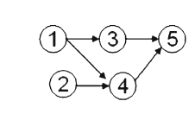
Precedence-constrained sequencing problem (PCSP)
(1,3,2,4,5 )
Notes:
要用一串序列去表示各個節點之間的先後順序關係，各個節點之間有一些先後的限制，那這些先後限制可以用topologic去表示

Slide 4
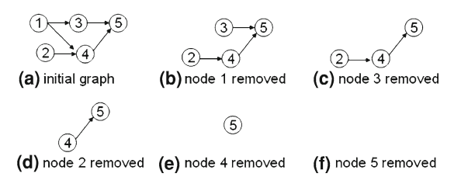
Priority-based
 | 1 | 2 | 3 | 4 | 5
priority | 4 | 1 | 5 | 2 | 3
(1,3,2,4,5 )

Slide 5
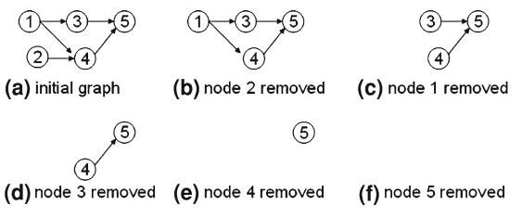
TS-based
(2,1,3,4,5 )

Slide 6
Crossover
(a, b, c, d)= (2, 1, 3, 1)
a: 1- population size
b and c: 1-node size
d:0- 2

Slide 7


Crossover
(a, b, c, d)= (2, 1, 3, 1)
Before crossover:
After crossover:

Slide 8



Mutation
Before mutation:
After mutation:
Notes:
21435

Slide 9
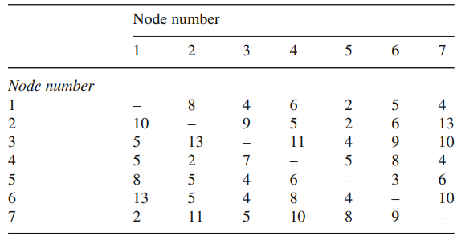
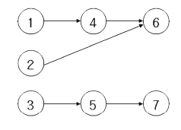
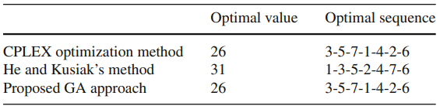
Experiments

Slide 10
