Slide 1
The Longest Commonly Positioned Increasing Subsequences Problem
Xiaozhou He¹ (賀小舟), Yinfeng Xu¹ (徐寅峰)
Journal of Combinatorial Optimization, 2018
Volume 35, pp. 331-340
Presenter: Tsung-Lin Lu
Date: Aug. 2, 2022
1. Business School, Sichuan University, Chengdu, China

Slide 2
Abstract (1/2)
Based on the well-known longest increasing subsequence problem and longest common increasing subsequence (LCIS) problem, we propose the longest commonly positioned increasing subsequences (LCPIS) problem.
Let 𝐴 = ⟨𝑎₁, 𝑎₂, …, 𝑎_{𝑛}⟩ and 𝐵 = ⟨𝑏₁, 𝑏₂, …, 𝑏_{𝑛}⟩ be two input sequences. Let 𝐴𝑠𝑢𝑏 = ⟨𝑎_{𝑖1}, 𝑎_{𝑖2}, …, 𝑎_{𝑖𝑙}⟩ be a subsequence of A and 𝐵𝑠𝑢𝑏 = ⟨𝑏_{𝑗1}, 𝑏_{𝑗2}, …, 𝑏_{𝑗𝑙}⟩ be a subsequence of B such that 𝑎_{𝑖𝑘} ≤ 𝑎_{𝑖𝑘+1}, 𝑏_{𝑗𝑘} ≤ 𝑏_{𝑗𝑘+1} (1≤𝑘<𝑙) and 𝑎_{𝑖𝑘} and 𝑏_{𝑗𝑘} (1≤𝑘≤𝑙) are commonly positioned (have the same index 𝑖𝑘 = 𝑗𝑘) in A and B respectively but these two elements do not need to be equal.

Slide 3
Abstract (2/2)
The LCPIS problem aims at finding a pair of subsequences Asub and
𝐵𝑠𝑢𝑏 as long as possible. When all the elements of the two input sequences are positive integers, this paper presents an algorithm with 𝑂(𝑛log𝑛loglog𝑀) time to compute the LCPIS, where 𝑀 = 𝑚𝑖𝑛{𝑚𝑎𝑥_{1≤𝑖≤𝑛}𝑎_{𝑖}, 𝑚𝑎𝑥_{1≤𝑗≤𝑛}𝑏_{𝑗}}. And we also show a dual relationship between the LCPIS problem and the LCIS problem.

Slide 4
Outline
Longest Commonly Positioned Increasing Subsequences (LCPIS)
Algorithm
Complexity
LCPIS v.s. LCIS

Slide 5
Longest Commonly Positioned Increasing Subsequences (LCPIS)
A = ⟨1, 3, 6, 4, 5, 2, 5, 9, 7, 8⟩
B = ⟨2, 4, 3, 5, 3, 7, 2, 1, 6, 8⟩
LCS (longest common subsequence): ⟨4, 5, 2, 8⟩
A = ⟨1, 3, 6, 4, 5, 2, 5, 9, 7, 8⟩
B = ⟨2, 4, 3, 5, 3, 7, 2, 1, 6, 8⟩
LCIS (longest common increasing subsequence): ⟨3, 5, 7, 8⟩
A = ⟨1, 3, 6, 4, 5, 2, 5, 9, 7, 8⟩
B = ⟨2, 4, 3, 5, 3, 7, 2, 1, 6, 8⟩
LCPIS:
𝐴𝑠𝑢𝑏 ⟨1, 3, 4, 7, 8⟩
𝐵𝑠𝑢𝑏 ⟨2, 4, 5, 6, 8⟩

Slide 6
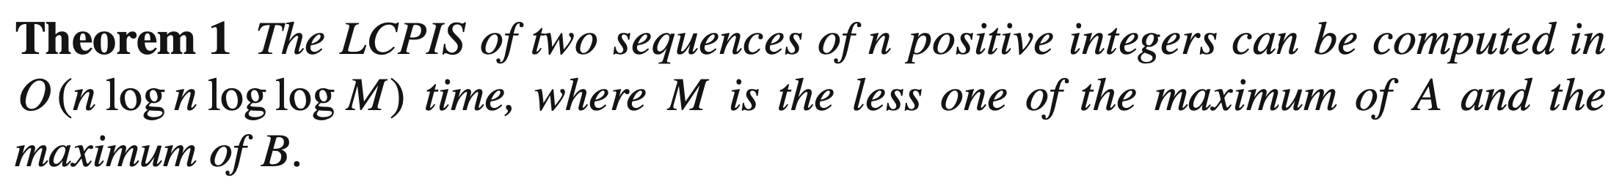
Algorithm (1/4)
T₁
(1, 2), (5, 2), (9, 1)
A = ⟨1, 3, 6, 4, 5, 2, 5, 9, 7, 8⟩
B = ⟨2, 4, 3, 5, 3, 7, 2, 1, 6, 8⟩
LCPIS:
𝐴𝑠𝑢𝑏 ⟨1, 3, 4, 7, 8⟩
𝐵𝑠𝑢𝑏 ⟨2, 4, 5, 6, 8⟩
Algorithm for LCPIS: vEB tree + dominance
T₂
(2, 7), (3, 4), (5, 3), (6, 3)
T₃
(4, 5)
T₄
(7, 6)
query, insert and delete by vEB tree
T₅
(8, 8)
binary search
n pair of couple

Slide 7
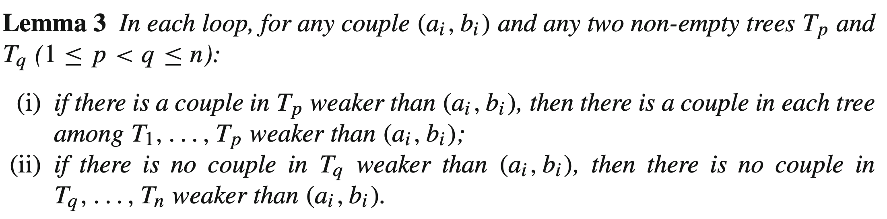
Algorithm (2/4)
在集合中，Couple不會重複
在集合中，第一數字由小到到排序時，第二數字會由大到小排序
在p層中的couple，前面每一層，一定存在一個比此couple小的；而後面每一層則反之。

Slide 8
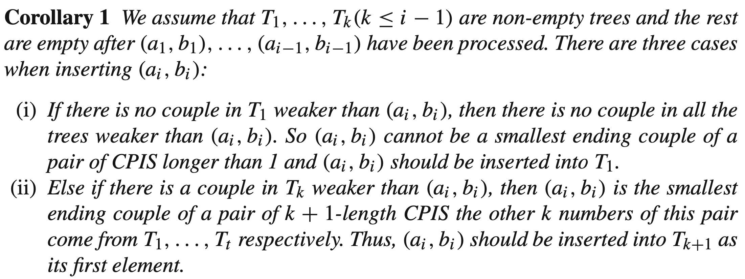
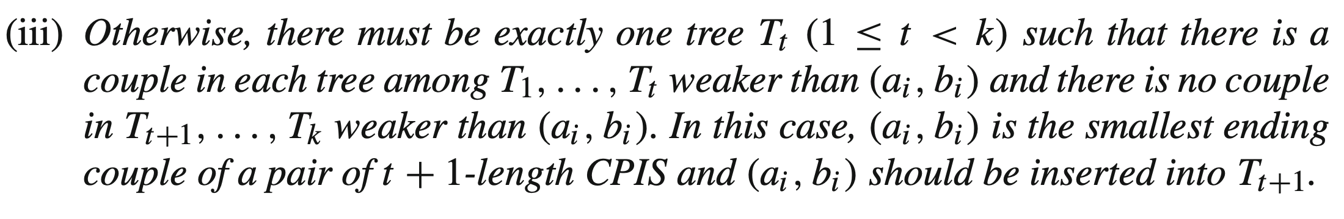
Algorithm (3/4)
插入新couple時有三種狀況：
插入第一層
插入中間層
新增最高層

Slide 9
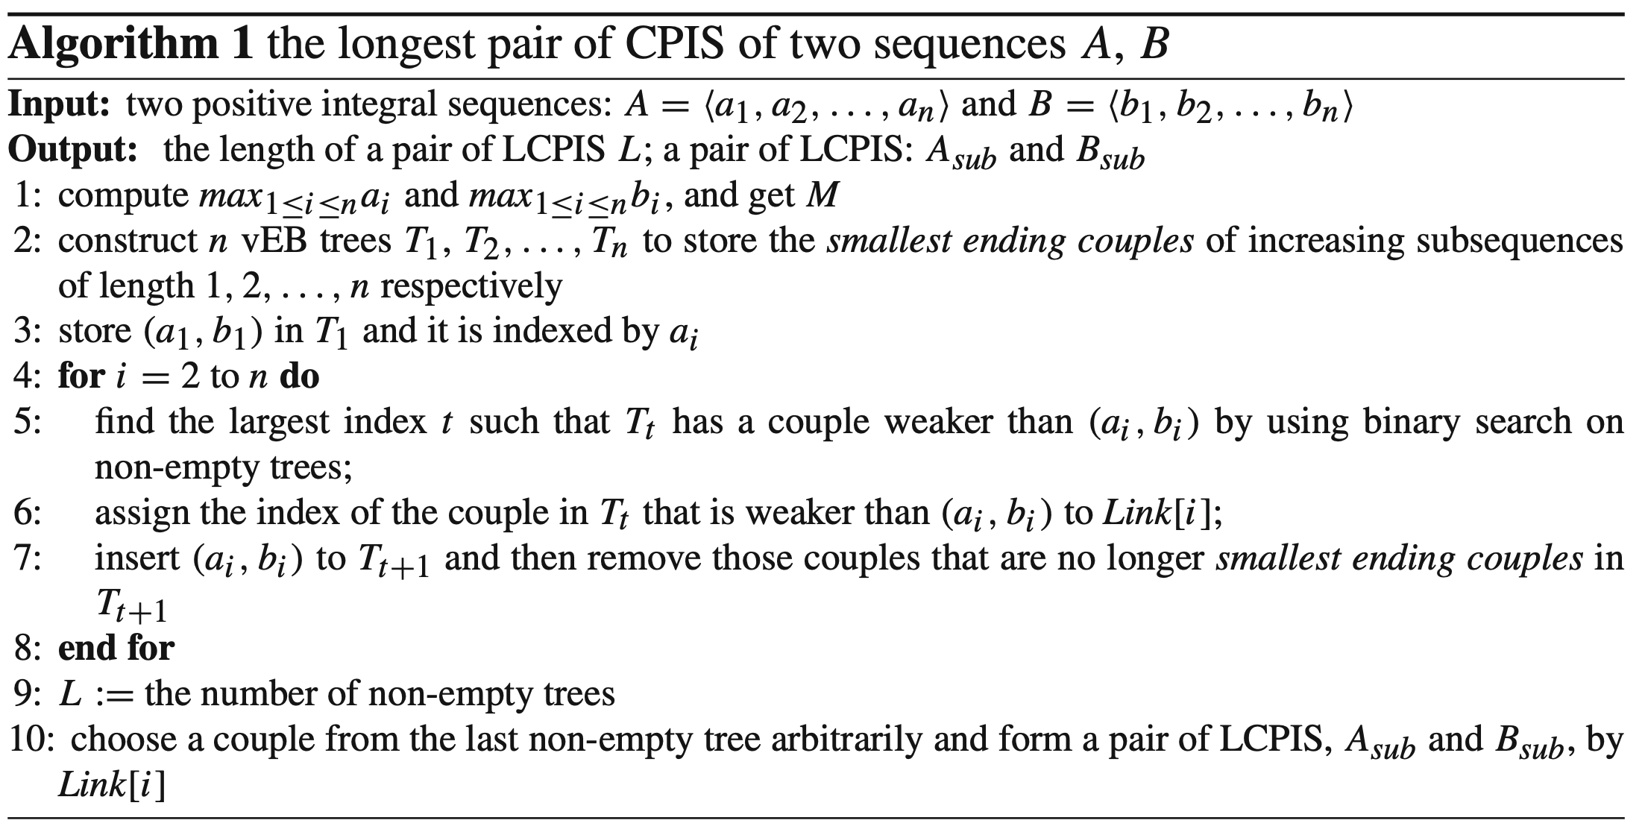
Algorithm (4/4)

Slide 10
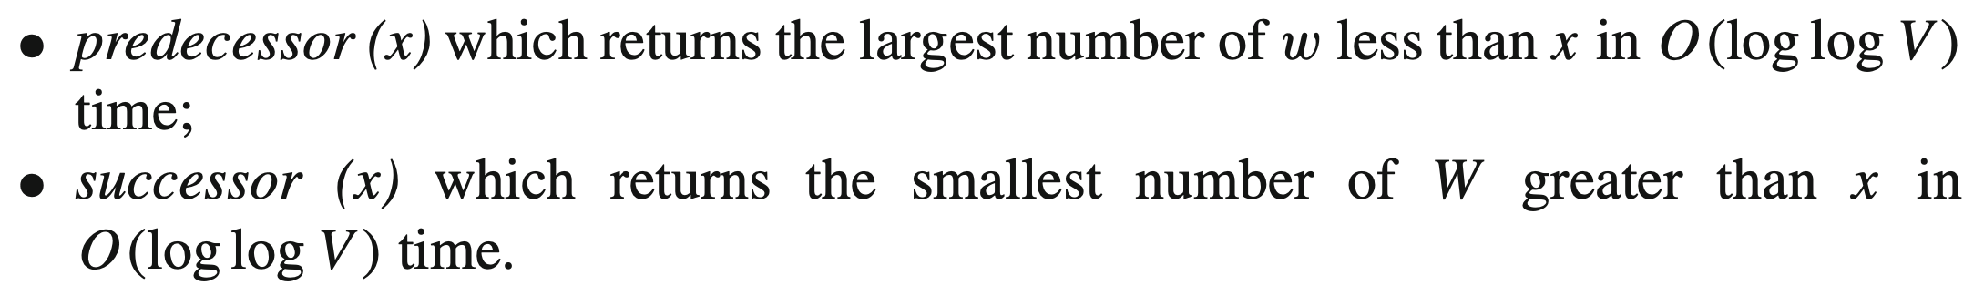
Complexity
vEB tree:

Slide 11
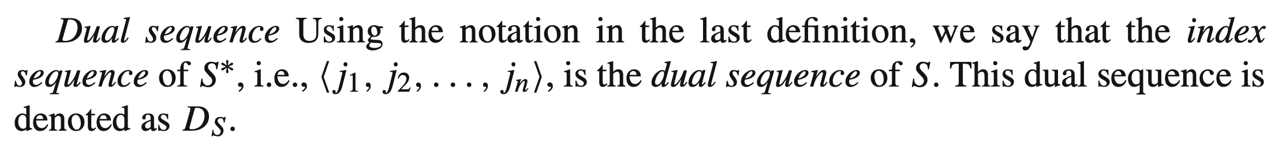
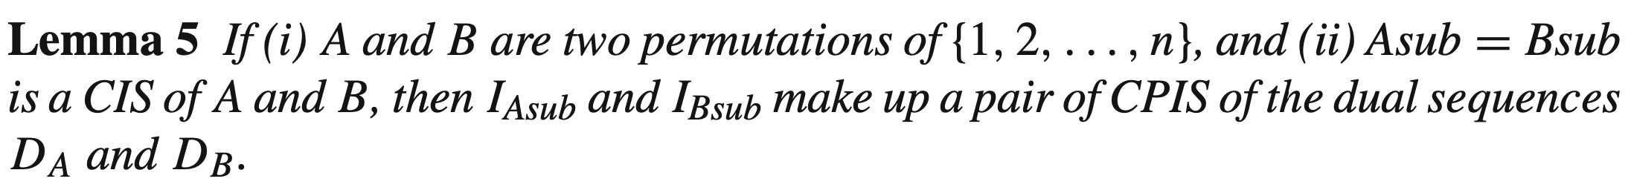
LCPIS v.s. LCIS

Slide 12
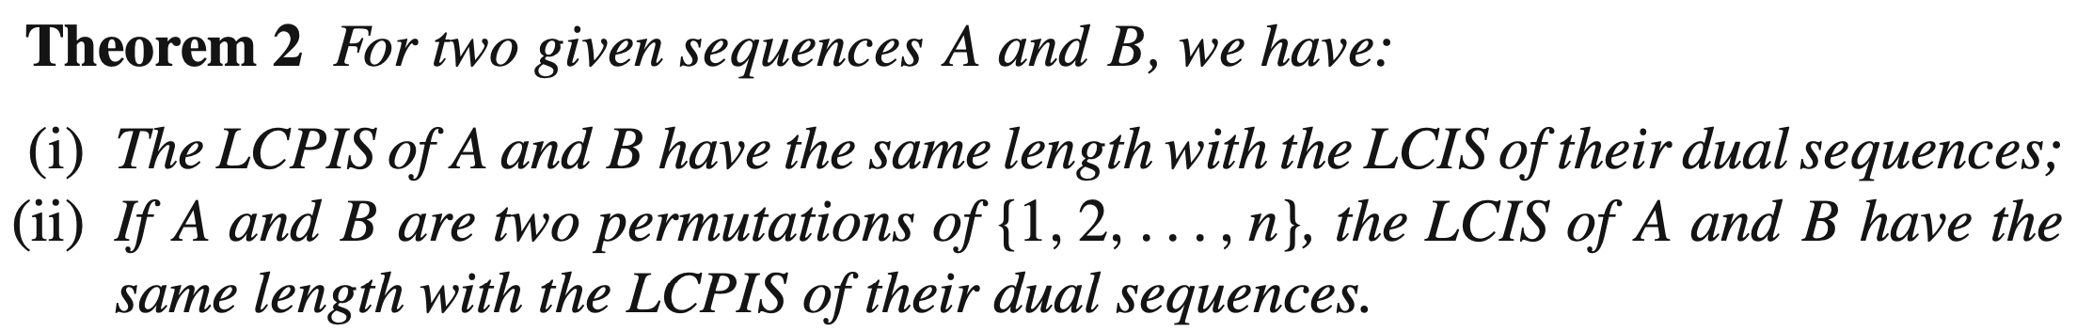
LCPIS v.s. LCIS

Slide 13
Thank you for listening

Slide 14
Abstract
s

