Slide 1
Order-Preserving Pattern Matching with Partition
Youngho Kim, Joong Chae Na, and Jeong Seop Sim
Available at SSRN: https://ssrn.com/abstract=4814059 or http://dx.doi.org/10.2139/ssrn.4814059
Presenter: Wen-Yu Chang
Date: Sept. 10, 2024
Notes:
學者可以發表他們的早期研究，在理論和發現方面進行合作，並且他們的想法可在同儕審查出版之前獲得肯定
https://www.elsevier.com/zh-tw/products/ssrn-preprint-services

Slide 2
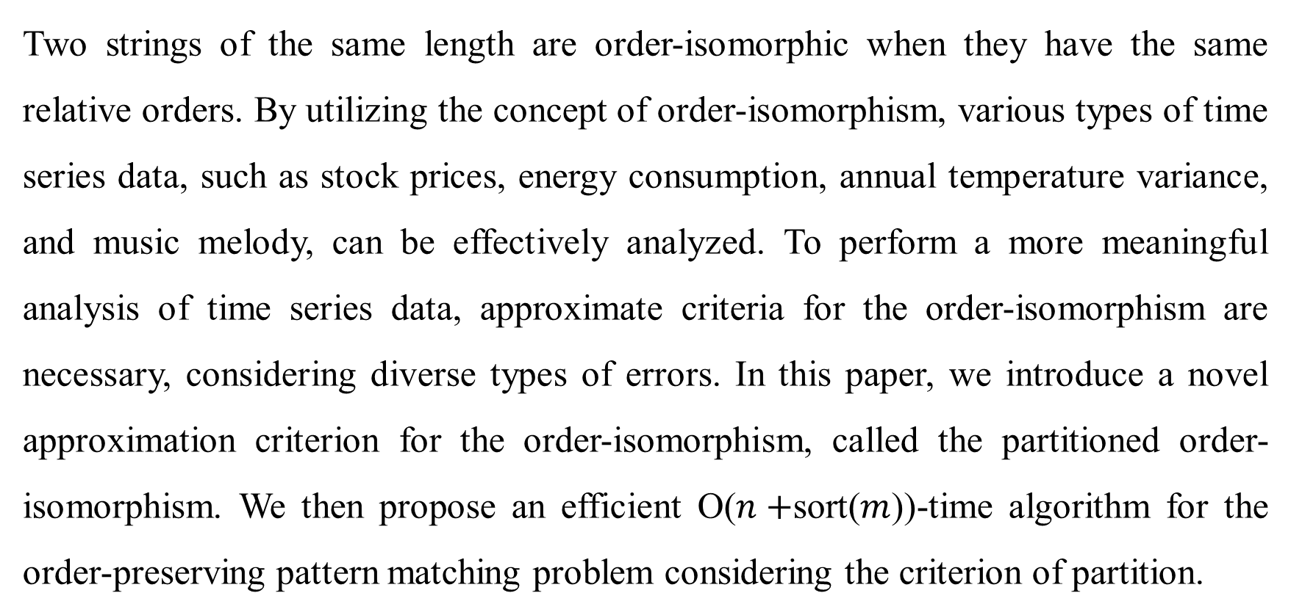
Abstract
Two strings of the same length are order-isomorphic when they have the same relative orders. By utilizing the concept of order-isomorphism, various types of time series data, such as stock prices, energy consumption, annual temperature variance, and music melody, can be effectively analyzed. To perform a more meaningful analysis of time series data, approximate criteria for the order-isomorphism are necessary, considering diverse types of errors. In this paper, we introduce a novel approximation criterion for the order-isomorphism, called the partitioned order-isomorphism. We then propose an efficient O($n+$sort($m$))-time algorithm for the order-preserving pattern matching problem considering the criterion of partition.

Slide 3
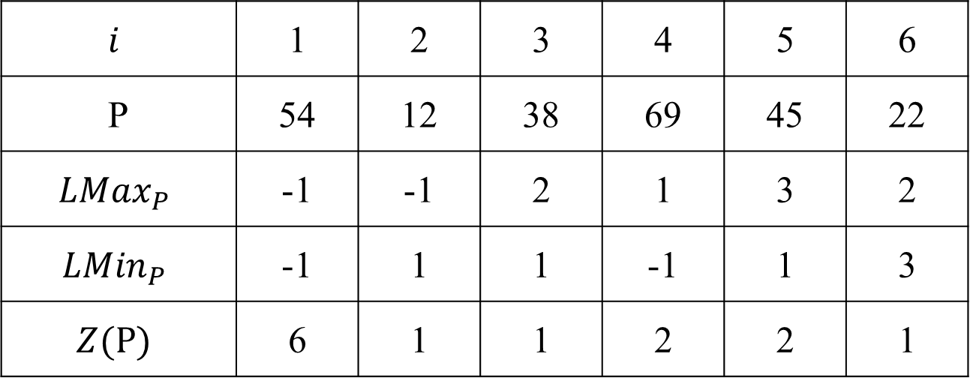
Location table
$$i$$ | 1 | 2 | 3 | 4 | 5 | 6
P | 54 | 12 | 38 | 69 | 45 | 22
$${LMax}_{P}$$ | -1 | -1 | 2 | 1 | 3 | 2
$${LMin}_{P}$$ | -1 | 1 | 1 | -1 | 1 | 3
$$Z(P)$$ | 6 | 1 | 1 | 2 | 2 | 1

Slide 4
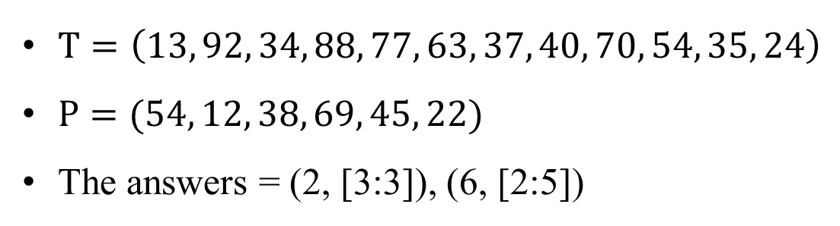




OPPM with partition
$T=\left(13, 92, 34, 88, 77, 63, 37, 40, 70, 54, 35, 24\right)$
$P=(54, 12, 38, 69, 45, 22)$
The answers = (2, [3:3]), (6, [2:5])
$$T[2..7]$$
92 | 34 | 88 | 77 | 63 | 37
$$T[6..11]$$
63 | 37 | 40 | 70 | 54 | 35
$$P$$
54 | 12 | 38 | 69 | 45 | 22
$$P$$
54 | 12 | 38 | 69 | 45 | 22
3 | 1 | 2 | 3 | 2 | 1
2 | 1 | 2 | 4 | 3 | 1

Slide 5
OPPM with partition
$T=\left(13, 92, 34, 88, 77, 63, 37, 40, 70, 54, 35, 24\right)$
$P=(54, 12, 38, 69, 45, 22)$
The answers = (2, [3:3]), (6, [2:5])
$$T[2..7]$$
92 | 34 | 88 | 77 | 63 | 37
$$T[6..11]$$
63 | 37 | 40 | 70 | 54 | 35
$$P$$
54 | 12 | 38 | 69 | 45 | 22
$$P$$
54 | 12 | 38 | 69 | 45 | 22
3 | 1 | 2 | 3 | 2 | 1
3 | 1 | 2 | 3 | 2 | 1

Slide 6
OPPM with partition
$T=\left(13, 92, 34, 88, 77, 63, 37, 40, 70, 54, 35, 24\right)$
$P=(54, 12, 38, 69, 45, 22)$
The answers = (2, [3:3]), (6, [2:5])
$$T[2..7]$$
92 | 34 | 88 | 77 | 63 | 37
$$T[6..11]$$
63 | 37 | 40 | 70 | 54 | 35
$$P$$
54 | 12 | 38 | 69 | 45 | 22
$$P$$
54 | 12 | 38 | 69 | 45 | 22
3 | 1 | 2 | 3 | 2 | 1
3 | 1 | 2 | 4 | 2 | 1

Slide 7
OPPM with partition
$T=\left(13, 92, 34, 88, 77, 63, 37, 40, 70, 54, 35, 24\right)$
$P=(54, 12, 38, 69, 45, 22)$
The answers = (2, [3:3]), (6, [2:5])
$$T[2..7]$$
92 | 34 | 88 | 77 | 63 | 37
$$T[6..11]$$
63 | 37 | 40 | 70 | 54 | 35
$$P$$
54 | 12 | 38 | 69 | 45 | 22
$$P$$
54 | 12 | 38 | 69 | 45 | 22
3 | 1 | 2 | 3 | 2 | 1
4 | 1 | 2 | 5 | 3 | 1

Slide 8
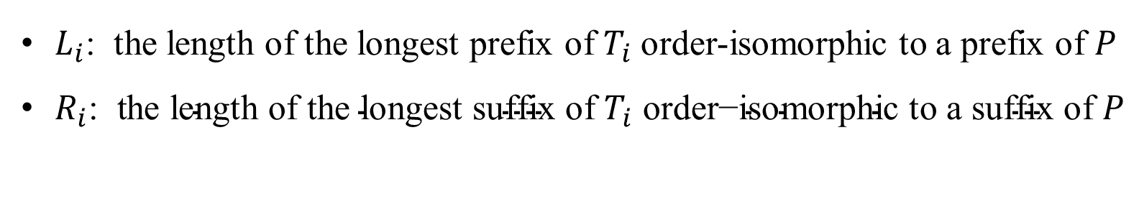
Prefix and suffix
$L_{i}$: the length of the longest prefix of $T_{i}$ order-isomorphic to a prefix of $P$
$R_{i}\text{: }\text{the} \text{length} \text{of} \text{the} \text{longest} \text{suf}\text{fix} \text{of} T_{i} \text{order}\text{−}\text{isomorphic} \text{to} \text{a} \text{suf}\text{fix} \text{of} P$

Slide 9
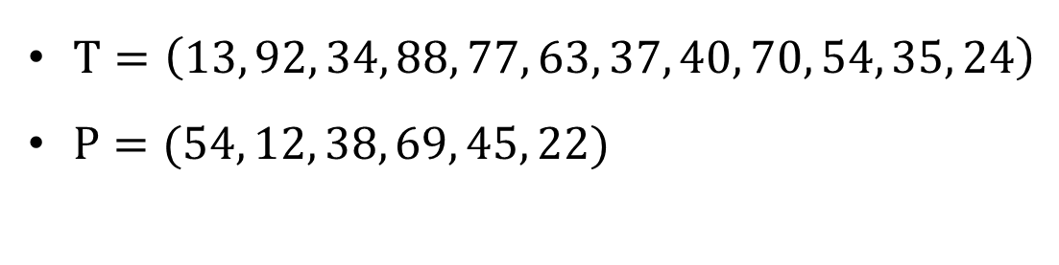
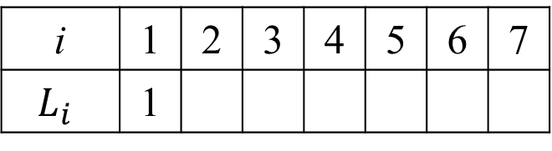


The algorithm
i | 1 | 2 | 3 | 4 | 5 | 6 | 7
$$L_{i}$$ | 1
$T=\left(13, 92, 34, 88, 77, 63, 37, 40, 70, 54, 35, 24\right)$
$P=(54, 12, 38, 69, 45, 22)$
$$T$$
13 | 92 | 34 | 88 | 77 | 63 | 37 | 40 | 70 | 54 | 35 | 24
$$P$$
54 | 12 | 38 | 69 | 45 | 22

Slide 10
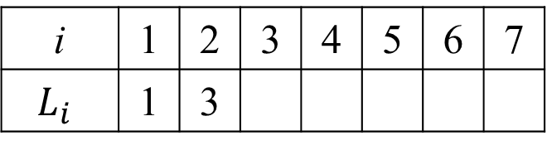
The algorithm
i | 1 | 2 | 3 | 4 | 5 | 6 | 7
$$L_{i}$$ | 1 | 3
$T=\left(13, 92, 34, 88, 77, 63, 37, 40, 70, 54, 35, 24\right)$
$P=(54, 12, 38, 69, 45, 22)$
$$T$$
13 | 92 | 34 | 88 | 77 | 63 | 37 | 40 | 70 | 54 | 35 | 24
$$P$$
54 | 12 | 38 | 69 | 45 | 22

Slide 11
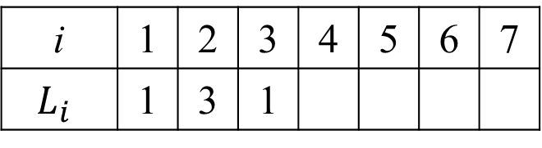
The algorithm
i | 1 | 2 | 3 | 4 | 5 | 6 | 7
$$L_{i}$$ | 1 | 3 | 1
$T=\left(13, 92, 34, 88, 77, 63, 37, 40, 70, 54, 35, 24\right)$
$P=(54, 12, 38, 69, 45, 22)$
$$T$$
13 | 92 | 34 | 88 | 77 | 63 | 37 | 40 | 70 | 54 | 35 | 24
$$P$$
54 | 12 | 38 | 69 | 45 | 22

Slide 12
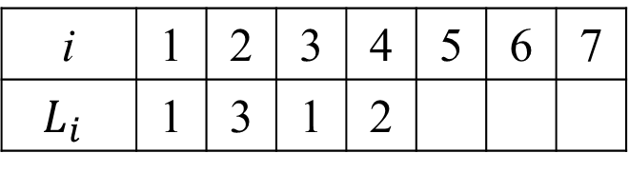
The algorithm
i | 1 | 2 | 3 | 4 | 5 | 6 | 7
$$L_{i}$$ | 1 | 3 | 1 | 2
$T=\left(13, 92, 34, 88, 77, 63, 37, 40, 70, 54, 35, 24\right)$
$P=(54, 12, 38, 69, 45, 22)$
$$T$$
13 | 92 | 34 | 88 | 77 | 63 | 37 | 40 | 70 | 54 | 35 | 24
$$P$$
54 | 12 | 38 | 69 | 45 | 22

Slide 13
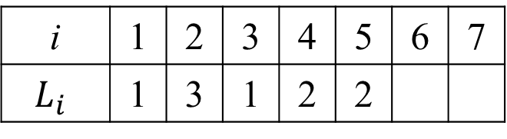
OPPM with partition
i | 1 | 2 | 3 | 4 | 5 | 6 | 7
$$L_{i}$$ | 1 | 3 | 1 | 2 | 2
$T=\left(13, 92, 34, 88, 77, 63, 37, 40, 70, 54, 35, 24\right)$
$P=(54, 12, 38, 69, 45, 22)$
$$T$$
13 | 92 | 34 | 88 | 77 | 63 | 37 | 40 | 70 | 54 | 35 | 24
$$P$$
54 | 12 | 38 | 69 | 45 | 22

Slide 14
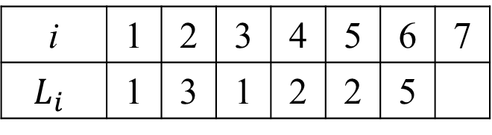
The algorithm
i | 1 | 2 | 3 | 4 | 5 | 6 | 7
$$L_{i}$$ | 1 | 3 | 1 | 2 | 2 | 5
$T=\left(13, 92, 34, 88, 77, 63, 37, 40, 70, 54, 35, 24\right)$
$P=(54, 12, 38, 69, 45, 22)$
$$T$$
13 | 92 | 34 | 88 | 77 | 63 | 37 | 40 | 70 | 54 | 35 | 24
$$P$$
54 | 12 | 38 | 69 | 45 | 22

Slide 15
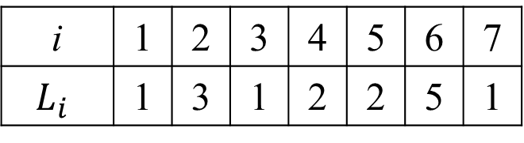
The algorithm
i | 1 | 2 | 3 | 4 | 5 | 6 | 7
$$L_{i}$$ | 1 | 3 | 1 | 2 | 2 | 5 | 1
$T=\left(13, 92, 34, 88, 77, 63, 37, 40, 70, 54, 35, 24\right)$
$P=(54, 12, 38, 69, 45, 22)$
$$T$$
13 | 92 | 34 | 88 | 77 | 63 | 37 | 40 | 70 | 54 | 35 | 24
$$P$$
54 | 12 | 38 | 69 | 45 | 22

Slide 16
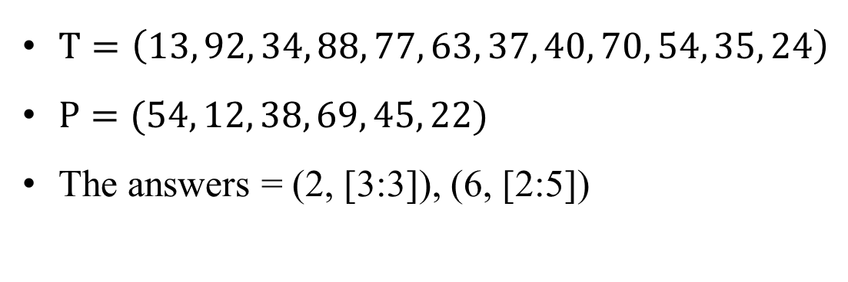
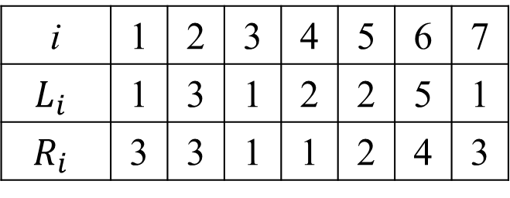
The result
$T=\left(13, 92, 34, 88, 77, 63, 37, 40, 70, 54, 35, 24\right)$
$P=(54, 12, 38, 69, 45, 22)$
The answers = (2, [3:3]), (6, [2:5])
i | 1 | 2 | 3 | 4 | 5 | 6 | 7
$$L_{i}$$ | 1 | 3 | 1 | 2 | 2 | 5 | 1
$$R_{i}$$ | 3 | 3 | 1 | 1 | 2 | 4 | 3
Computing $R_{i}$ using the reversed strings of P and T

Slide 17
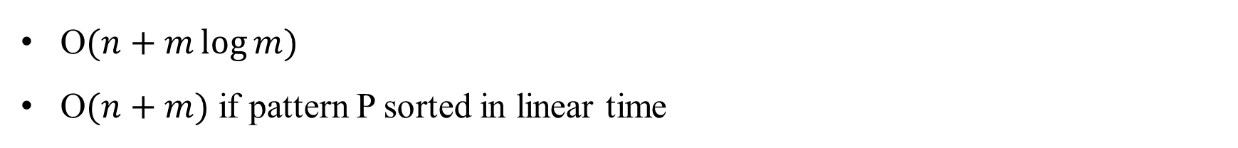
Time Complexity
O$(n+m\log{m})$
O$(n+m)$ if pattern P sorted in linear time

