Slide 1
The equivalence of theorem proving and the interconnection problem
James F. Lynch
ACM Sigda Newsletter(1975), 5(3), 31-36
Presenter: Hsin-Chang Yu
Date: Sept. 10, 2024

Slide 2
Abstract
A simple method of converting statements in mathematical logic to equivalent interconnection problems is demonstrated. This shows that if there exists a practical method for solving interconnection problems, then there exists a practical proof procedure for statements in mathematical logic.

Slide 3
Abstract
(In the terminology of Cook [1] and Karp [4], the interconnection problem is NP-complete.) Since such a procedure has been sought for without success for almost 100 years, we should not expect the interconnection problem to be any easier. This holds equally true for finding a method which will route a given percentage of wires.

Slide 4

Flow Free
Release in 2012
Big Duck Games LLC

Slide 5
Flow Free

Slide 6

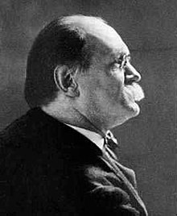
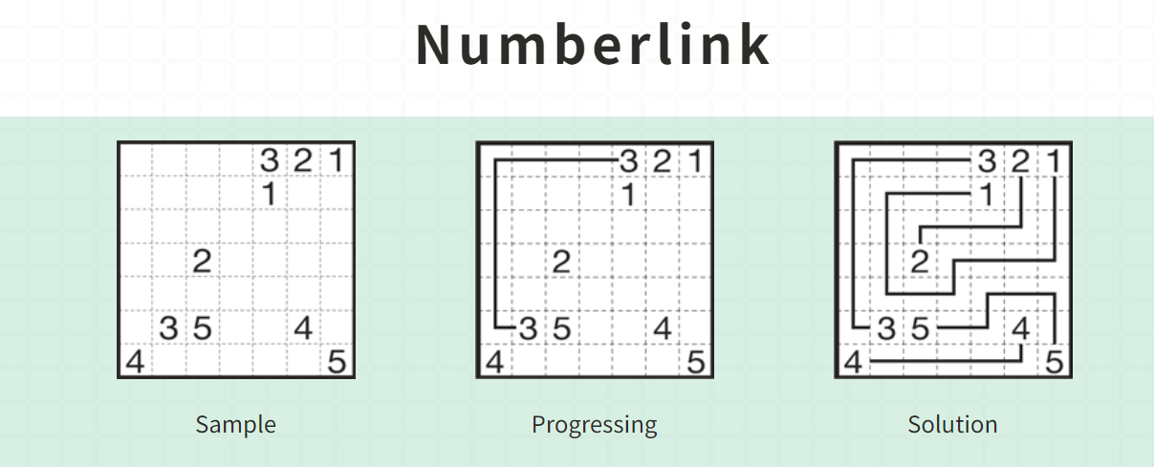
Flow Free
Sam Loyd
1841 - 1911

Slide 7
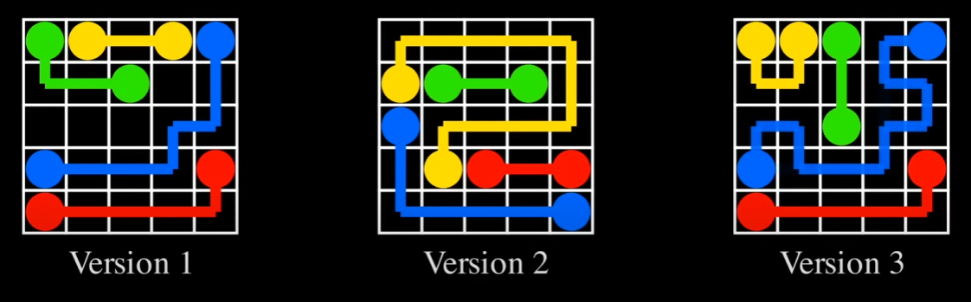
Flow Free

Slide 8
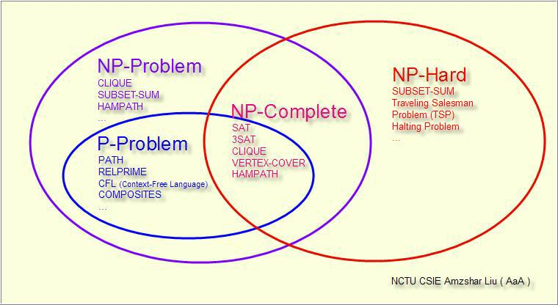
NP (complexity)

Slide 9
NP (complexity)
A decision problem 𝐶 is NP-complete if:
𝐶 is in NP
Every problem in NP is reducible to 𝐶 in polynomial time

Slide 10
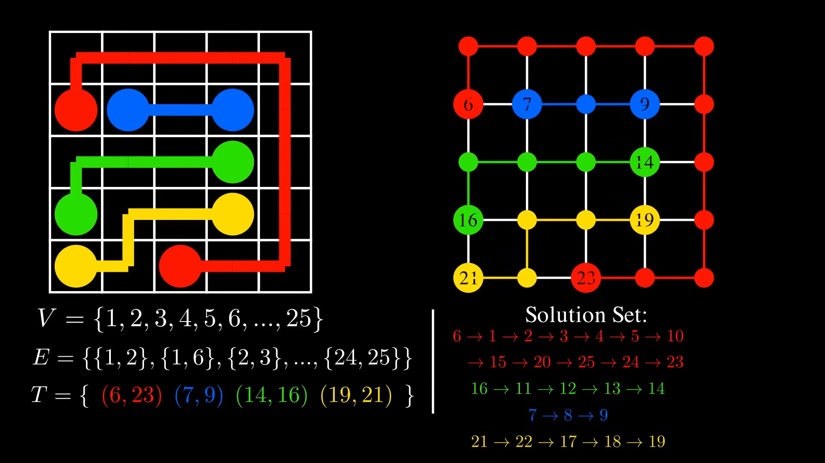
Step 1

Slide 11
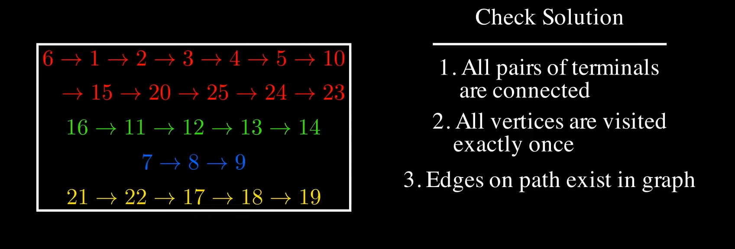
Step 1

Slide 12
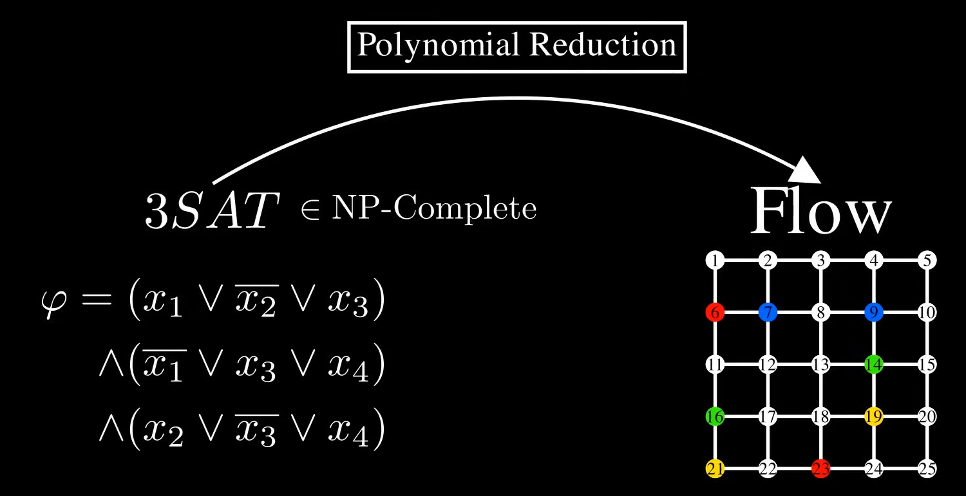
Step 2

Slide 13
Step 2

Slide 14
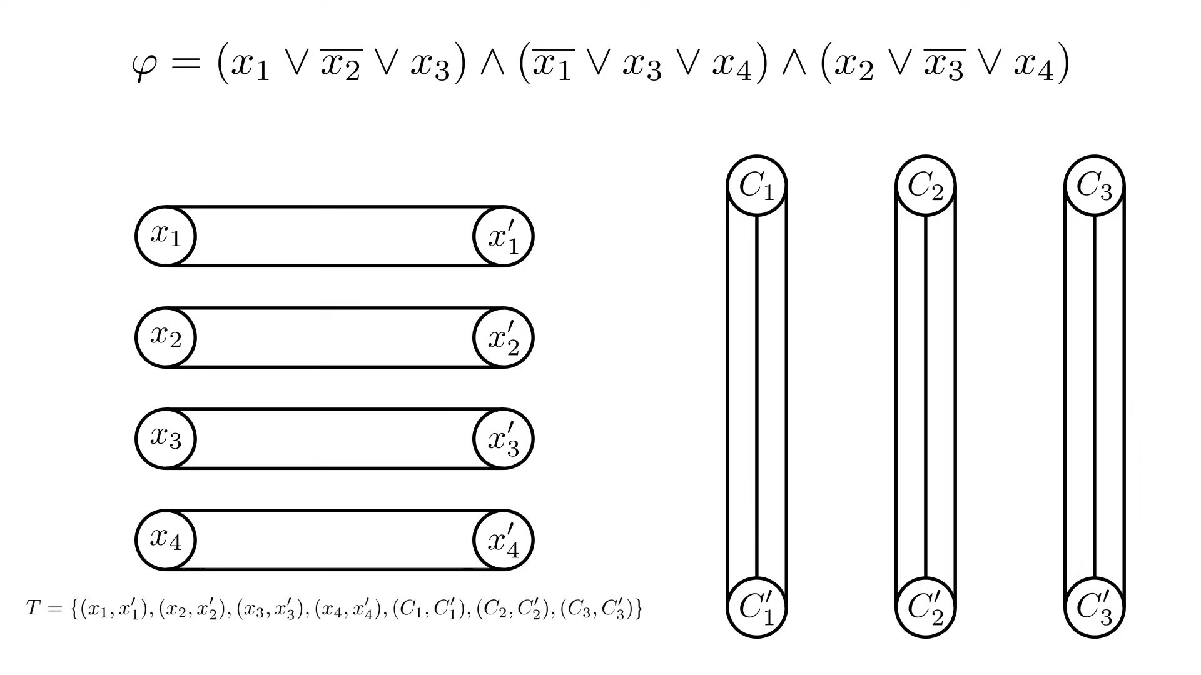
Step 2

Slide 15
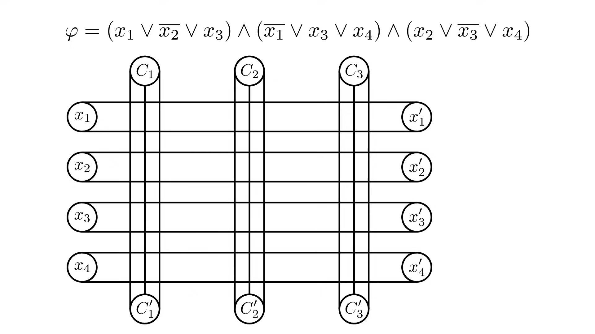
Step 2

Slide 16
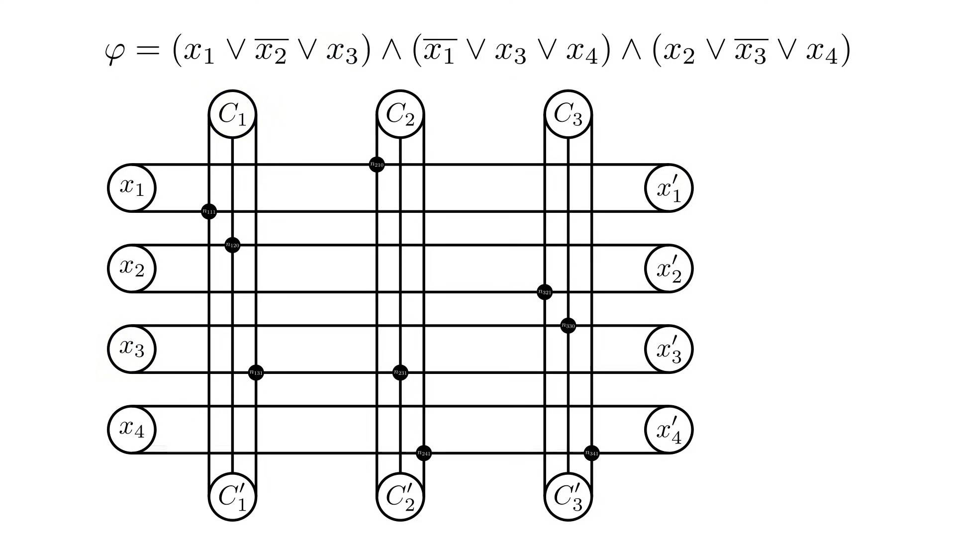
Step 2

Slide 17
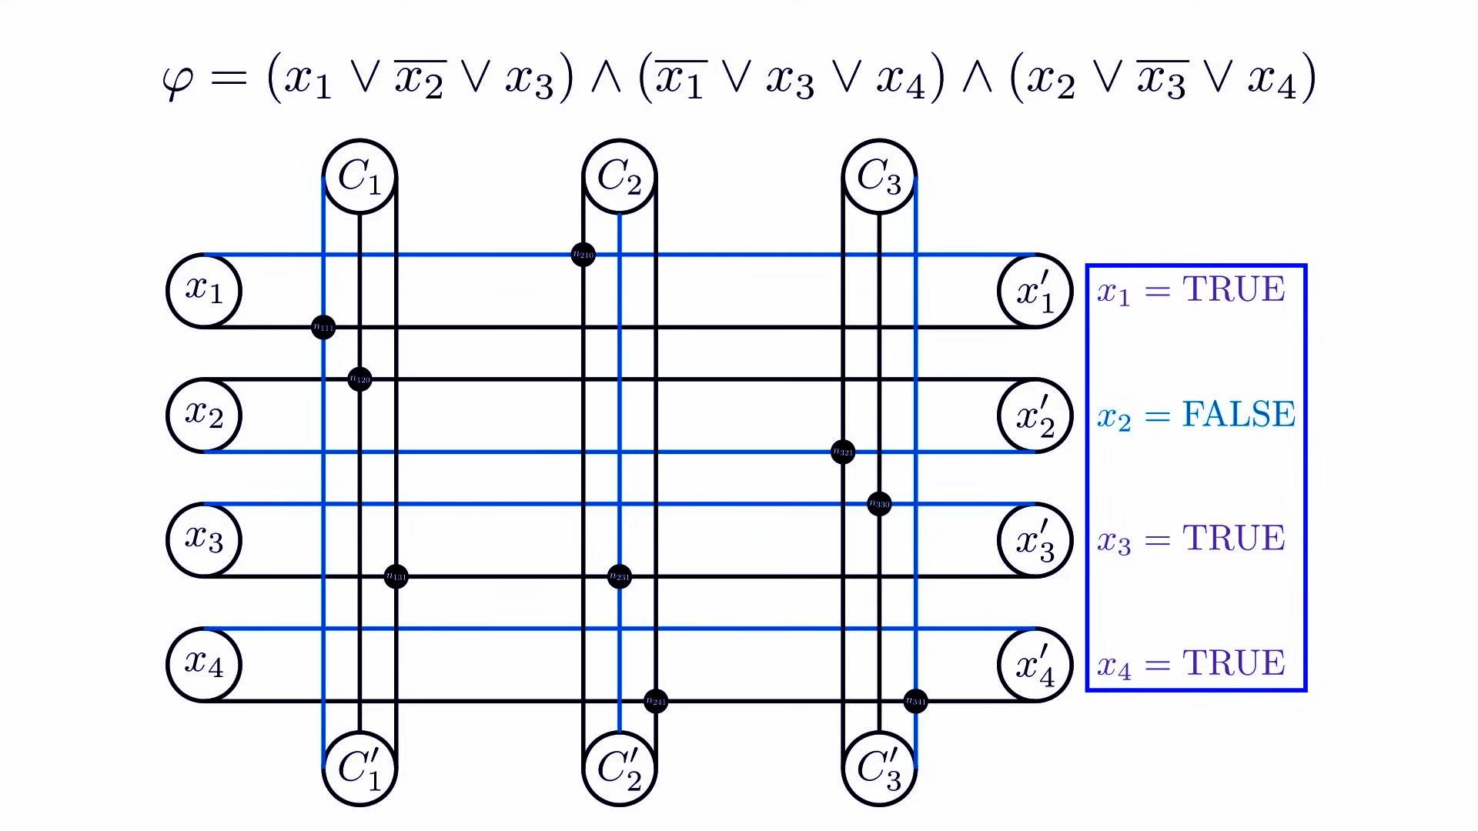
Step 2

Slide 18
Step 2

Slide 19
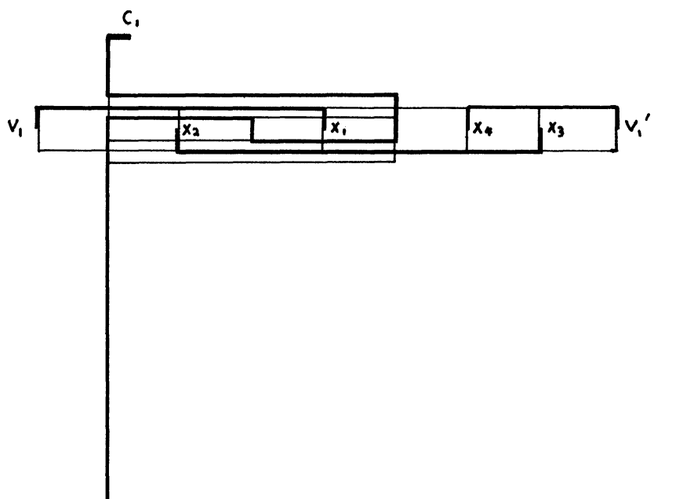

Slide 20
Thanks
Notes:
Given a string S of length n, an integer p ∈ [1..n] is a period of S if S[i] = S[i + p] for all i ∈ [1..n − p].
S[|S| − p + 1] = c

