Slide 1
The longest almost-increasing subsequence
Amr Elmasry
Information Processing Letters 110 (2010)655-658
Presenter: Tse-Ying Huang
Date: Nov. 5, 2024
Notes:
2014 年第十屆數字技術國際會議
斯洛伐克 日利納

Slide 2
Abstract
Given a sequence of n elements, we introduce the notion of an almost-increasing subsequence as the longest subsequence that can be converted to an increasing subsequence by possibly adding a value, that is at most a fixed constant, to each of the elements. We show how to optimally construct such subsequence in O(n logk) time, where k is the length of the output subsequence

Slide 3

LaIS(Longest almost-Increasing Subsequence)
Sequence x = 7,15,2,14,14,6,8,11,17,15,14,13
C = 2
LaIS(x) = 7,6,8,11,15,14
$∀_{i}y_{i}>\max_{j=1}^{i−1}y_{j}−c$

Slide 4
The basic algorithm
x = 7,15,2,14,14,6,8,11,17,15,14,13
C=2
i=1
i=2
i=3
7
7
7,15
7
7,15
2

Slide 5
The basic algorithm
x = 7,15,2,14,14,6,8,11,17,15,14,13
C=2
Step1: Find which one is <14
Step2:Find which maximum number is <=14+c and >=14
i=3
i=4
7
7,15
2
7
7,15,14
2
2,14

Slide 6
The basic algorithm
x = 7,15, 2,14,14,6,8,11,17,15,14,13
C=2
Step1: Find which one is <14
Step2:Find which maximum number is <14+c and >=14
i=4
i=5
7
7,15,14
2
2,14
7
7,15,14,14
2
2,14,14
2,14

Slide 7
The basic algorithm
X= 7,15, 2,14,14,6,8,11,17,15,14,13
C=2
Step1: Find which one is <6
Step2:Find which maximum number is <6+c and >=6
i=5
i=6
7
7,15,14,14
2
2,14,14
2,14
7,6
7,15,14,14
2
2,14,14
2,14
2,6

Slide 8
The basic algorithm
X= 7,15, 2,14,14,6,8,11,17,15,14,13
C=2
Step1: Find which one is <8 and the length is larger
Step2:Find which maximum number is <8+c and >=8
i=6
i=7
7,6
7,15,14,14
2
2,14,14
2,14
2,6
7,6
7,15,14,14
2
2,14,14
2,14
2,6
2,6,8

Slide 9
The basic algorithm
X= 7,15, 2,14,14,6,8,11,17,15,14,13
C=2
Step1: Find which one is <11 and the length is larger
Step2:Find which maximum number is <11+c and >=11
i=7
i=8
7,6
7,15,14,14
2
2,14,14
2,14
2,6
2,6,8
7,6
7,15,14,14
2
2,14,14
2,14
2,6
2,6,8
2,6,8,11

Slide 10
The basic algorithm
X= 7,15, 2,14,14,6,8,11,17,15,14,13
C=2
Step1: Find which one is <17 and the length is larger
Step2:Find which maximum number is <17+c and >=17
i=8
i=9
7,6
7,15,14,14
2
2,14,14
2,14
2,6
2,6,8
2,6,8,11
7,6
7,15,14,14
2
2,14,14
2,14
2,6
2,6,8
2,6,8,11
2,6,8,11,17

Slide 11
The basic algorithm
X= 7,15, 2,14,14,6,8,11,17,15,14,13
C=2
Step1: Find which one is <15 and the length is larger
Step2:Find which maximum number is <15+c and >=15
i=9
i=10
7,6
7,15,14,14
2
2,14,14
2,14
2,6
2,6,8
2,6,8,11
2,6,8,11,17
7,6
7,15,14,14,15
2
2,14,14
2,14
2,6
2,6,8
2,6,8,11
2,6,8,11,17
2,6,8,11,15

Slide 12
The basic algorithm
X= 7,15, 2,14,14,6,8,11,17,15,14,13
C=2
Step1: Find which one is <14 and the length is larger
Step2:Find which maximum number is <14+c and >=14
i=10
i=11
7,6
7,15,14,14,15
2
2,14,14
2,14
2,6
2,6,8
2,6,8,11
2,6,8,11,17
2,6,8,11,15
7,6
7,15,14,14,15,14
2
2,14,14,14
2,14,14
2,6
2,6,8
2,6,8,11
2,6,8,11,17
2,6,8,11,15,14
2,6,8,11,14

Slide 13
The basic algorithm
X= 7,15, 2,14,14,6,8,11,17,15,14,13
C=2
Step1: Find which one is <14 and the length is larger
Step2:Find which maximum number is <14+c and >=14
i=11
i=12
7,6
7,15,14,14,15,14
2
2,14,14,14
2,14,14
2,6
2,6,8
2,6,8,11
2,6,8,11,17
2,6,8,11,15,14
2,6,8,11,14
7,6
7,15,14,14,15,14
2
2,14,14,14,13
2,14,14,13
2,6
2,6,8
2,6,8,11
2,6,8,11,17
2,6,8,11,15,14
2,6,8,11,14,13
2,6,8,11,13

Slide 14
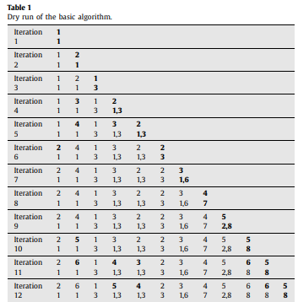
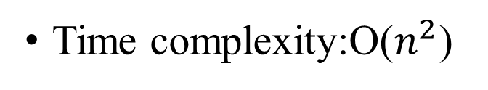
The basic algorithm
x = 7,15,2,14,14,6,8,11,17,15,14,13
C=2
Time complexity:O($n^{2}$)

Slide 15
The improved algorithm(1/4)
x = 7,15,2,14,14,6,8,11,17,15,14,13
C=2
i=1 7
i=2 7,15
i=3 2,15
Length=1 2
Length=2 2,15

Slide 16
The improved algorithm(2/4)
x = 7,15,2,14,14,6,8,11,17,15,14,13
C=2
i=3 2,15
i=4 2,14,15
Add 14 to first element>14
Delete the first element which >=14+c
Length=1 2
Length=2 2,14
Length=3 7,15,14

Slide 17
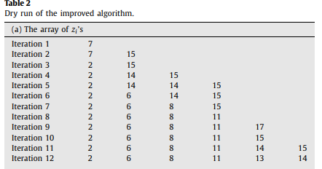
The improved algorithm(3/4)
x = 7,15,2,14,14,6,8,11,17,15,14,13
C=2
Add 14 to first element>14
Delete the first element which >=14+c

Slide 18
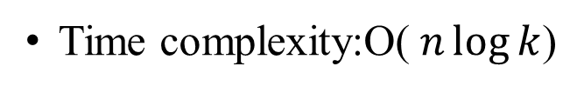
The improved algorithm(4/4)
1.n is the length of input
2. k is the length of LaIS
x = 7,15,2,14,14,6,8,11,17,15,14,13
Time complexity:O($n\log{k}$)
i | X[i] | z（The last element of the current longest subsequence.） | P[i]
1 | 7 | [7] | 1
2 | 15 | [7,15] | 1
3 | 2 | [2,15] | 3
4 | 14 | [2,14] | 3
5 | 14 | [2,14,14,15] | 3
6 | 6 | [2,6,14,15] | 3
7 | 8 | [2,6,8,15] | 6
8 | 11 | [2,6,8,11] | 7
9 | 17 | [2,6,8,11,17] | 8
10 | 15 | [2,6,8,11,15] | 8
11 | 14 | [2,6,8,11,14,15] | 8
12 | 13 | [2,6,8,11,13,14] | 8

