Slide 1
Text documents clustering using data mining techniques
Ahmed Adeeb Jalal, Basheer Husham Ali.
International Journal of Electrical and Computer Engineering (IJECE) Vol. 11, No. 1, February 2021, pp. 664~670
Presenter: Wan-Ni Ou
Date: Nov. 4, 2024
Notes:
Computer Engineering Department, College of Engineering, Al-Iraqia University, Iraq

Slide 2
Abstract(1/2)
Increasing progress in numerous research fields and information technologies, led to an increase in the publication of research papers. Therefore, researchers take a lot of time to find interesting research papers that are close to their field of specialization. Consequently, in this paper we have proposed documents classification approach that can cluster the text documents of research papers into the meaningful categories in which contain a similar scientific field.

Slide 3
Abstract(2/2)
Our presented approach based on essential focus and scopes of the target categories, where each of these categories includes many topics. Accordingly, we extract word tokens from these topics that relate to a specific category, separately. The frequency of word tokens in documents impacts on weight of document that calculated by using a numerical statistic of term frequency-inverse document frequency (TF-IDF)
The proposed approach uses title, abstract, and keywords of the paper, in addition to the categories topics to perform the classification process. Subsequently, documents are classified and clustered into the primary categories based on the highest measure of cosine similarity between category weight and documents weights.

Slide 4
Data set
Contains 518 papers since 2012 to 2019 include different topic scopes.
Goal: classify these papers into five clusters.
Cluster 1: Computer Science, Computer Engineering, and Informatics.
Cluster 2: Electronics.
Cluster 3: Electrical and Power Engineering.
Cluster 4: Telecommunication and Information Technology.
Cluster 5: Instrumentation and Control Engineering

Slide 5
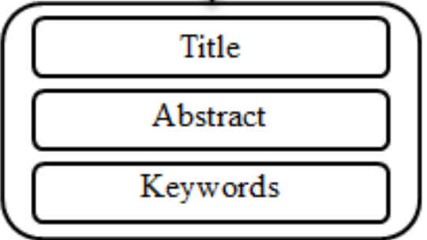
Preprocessing
Tokenization
Split a sentence into tokens (words).
He is running. => {He, is, running }
Filtering
Remove stop words, such as "the," "is," and "in.”
Lemmatization
Each word is reduced to its base form, such as converting "running" to "run.“
Stemming
Word endings are removed to extract the stem of each word, such as converting "connects" to "connect."

Slide 6



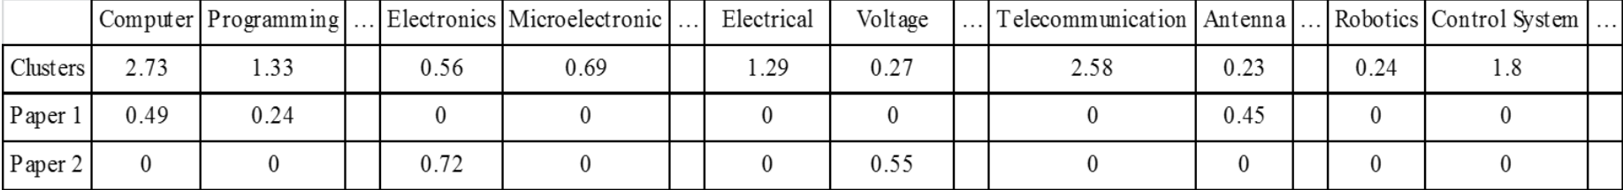
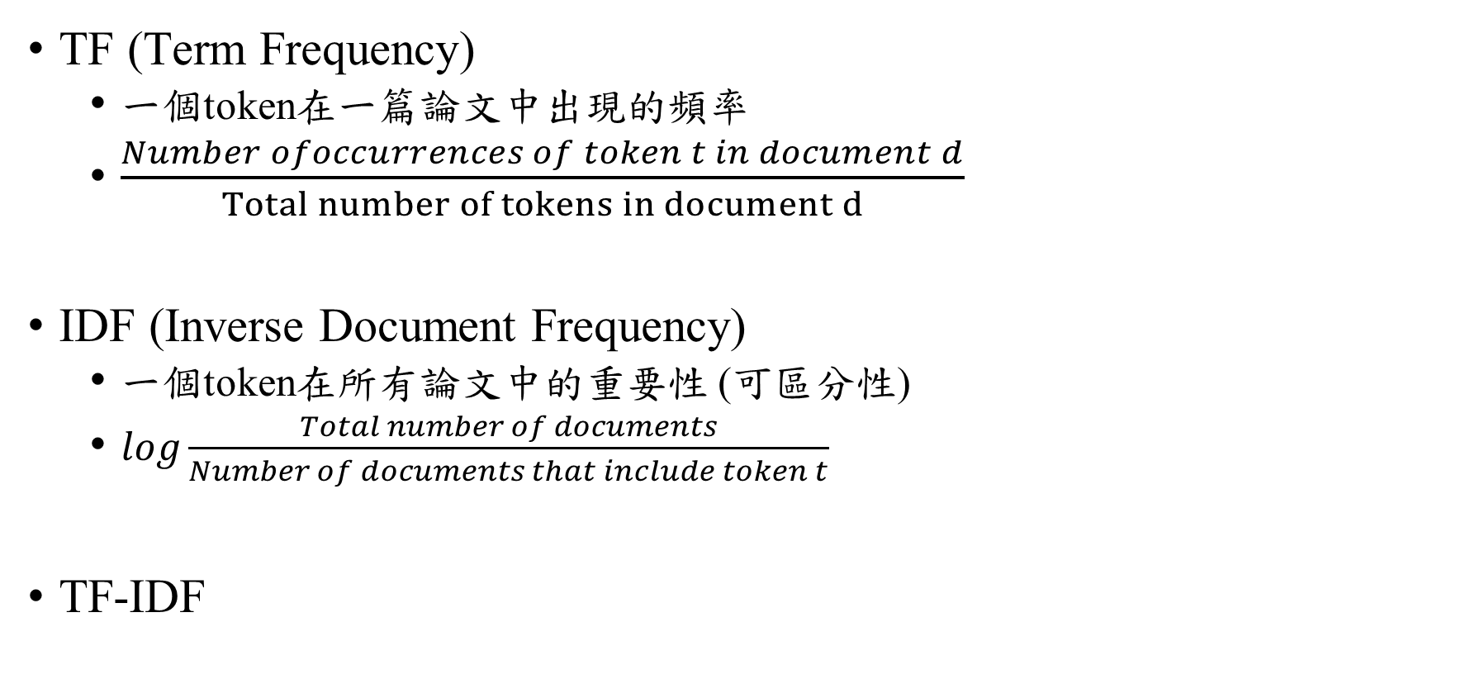
TF-IDF
TF (Term Frequency)
一個token在一篇論文中出現的頻率
$\frac{Number ofoccurrences of token t in document d}{Total number of tokens in document d}$
IDF (Inverse Document Frequency)
一個token在所有論文中的重要性 (可區分性)
$log\frac{Total number of documents}{Number of documents that include token t}$
TF-IDF

Slide 7
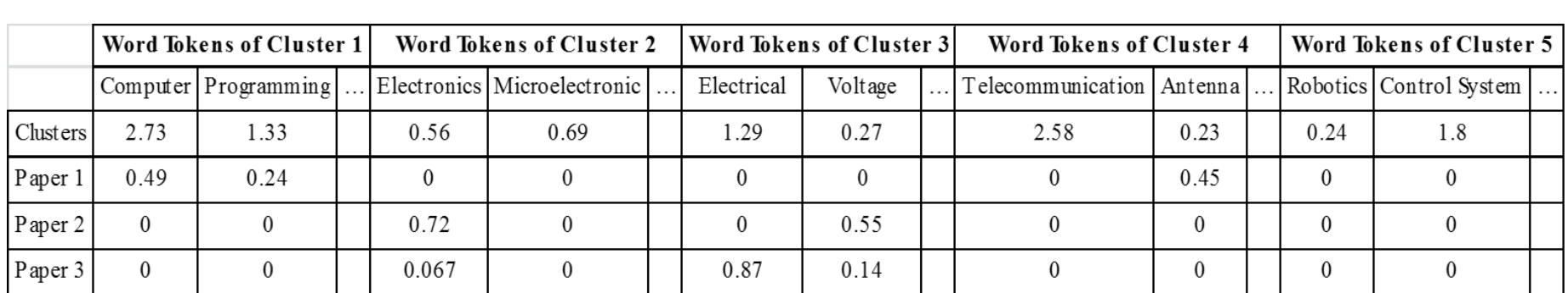

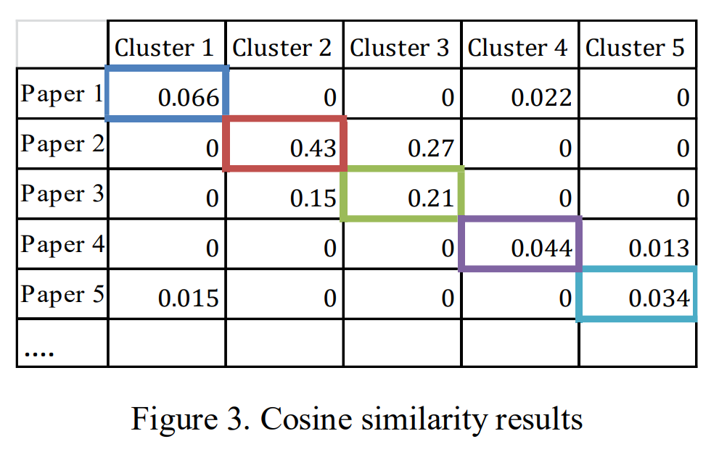
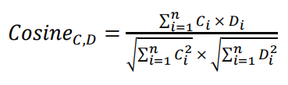
Cosine Similarity
T

Slide 8
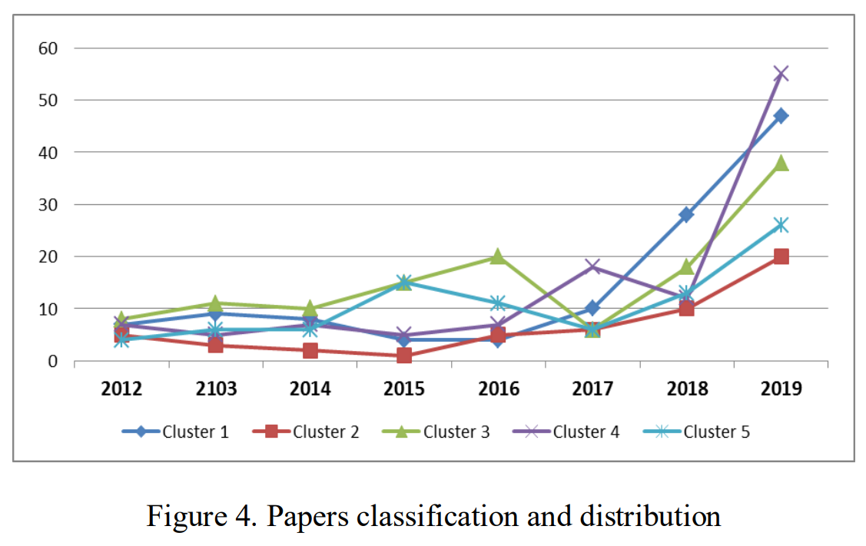
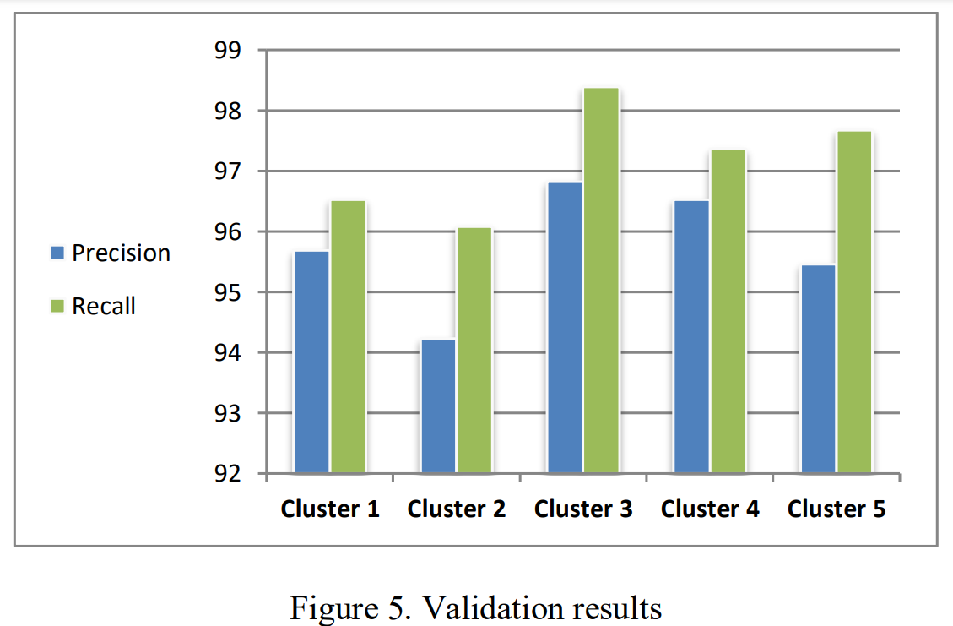
Result
L

Slide 9
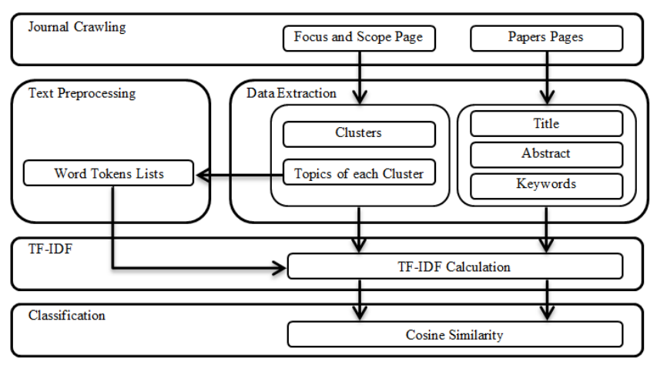
Flow diagram

Slide 10
Thanks

