Slide 1
Technical analysis strategy optimization using a machine learning approach in stock market indices
Ayala, J., García-Torres, M., Noguera, J. L. V., Gómez-Vela, F., & Divina, F. (2021). Knowledge-Based Systems, 225, 107119.
Presenter : Jing-Xiang Yang
Date : Nov 5, 2024

Slide 2
ABSTRACT(1)
Within the area of stock market prediction, forecasting price values or movements is one of the most challenging issue. Because of this, the use of machine learning techniques in combination with technical analysis indicators is receiving more and more attention. In order to tackle this problem, in this paper we propose a hybrid approach to generate trading signals. To do so, our proposal consists of applying a technical indicator combined with a machine learning approach in order to produce a trading decision. The novelty of this approach lies in the simplicity and effectiveness of the hybrid rules as well as its possible extension to other technical indicators.

Slide 3
ABSTRACT(2)
In order to select the most suitable machine learning technique, we tested the performances of Linear Model (LM), Artificial Neural Network (ANN), Random Forests (RF) and Support Vector Regression (SVR). As technical strategies for trading, the Triple Exponential Moving Average (TEMA) and Moving Average Convergence/Divergence (MACD) were considered. We tested the resulting technique on daily trading data from three major indices: Ibex35 (IBEX), DAX and Dow Jones Industrial (DJI). Results achieved show that the addition of machine learning techniques to technical analysis strategies improves the trading signals and the competitiveness of the proposed trading rules.

Slide 4
Method
Contribution
Combines machine learning + technical analysis indicators to generate Profitable trades.
LinearModel (LM)
Artificial Neural Networks (ANN)
Random Forests (RF)
Support Vector Regression (SVR)
TEMA
MACD

Slide 5
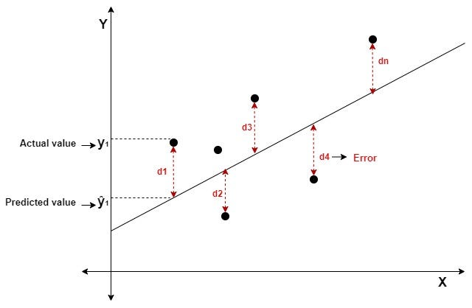

LM/SVR
LM
SVR
Defines an error tolerance range
Notes:
誤差超過容許範圍才會計算損失
允許預測和實際上存在些落差 => 防止 overfit

Slide 6
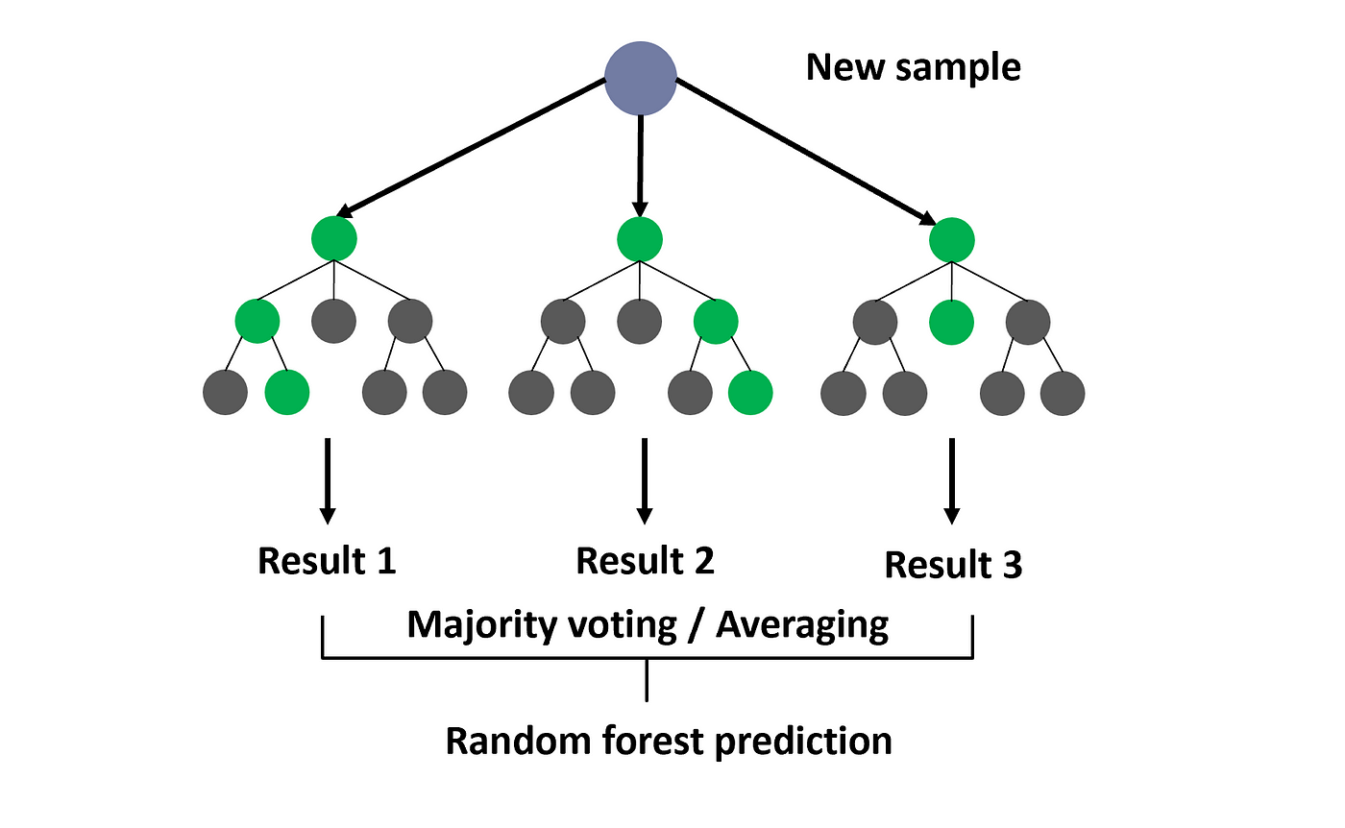
RF
Decision Tree
A < 9
 | A | B | C | actual | predict
Case 1 | 10 | 10 | 3 | 20 | C
Case 2 | 8 | 7 | 9 | 22 | A
… | … | … | … | … | …
Case N | 9 | 9 | 9 | 20 | D
B < 10
C < 7
Predic A
Predic B
Predic C
Predic D
Notes:
Predict 的依據 : 葉節點上的 instance 都有對應的 actual value，將這些 actual value 的值相加取平均作為 predict 值
Loss 值就是 actual – predict, 訓練過程就是決定一個 node 來做劃分可以讓以這個 node 劃分結果的 loss 為最小

Slide 7
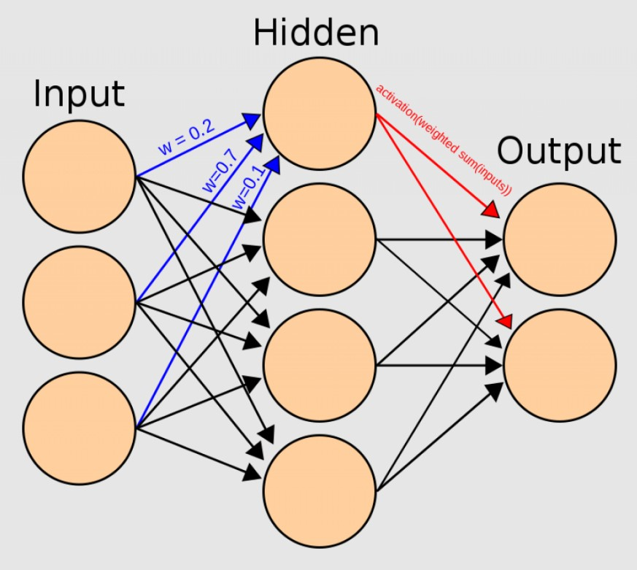
ANN

Slide 8


TEMA
The short-term upward trend is strong.
Giving three periods of time
m (fast)
n (medium)
p (slow)

Slide 9
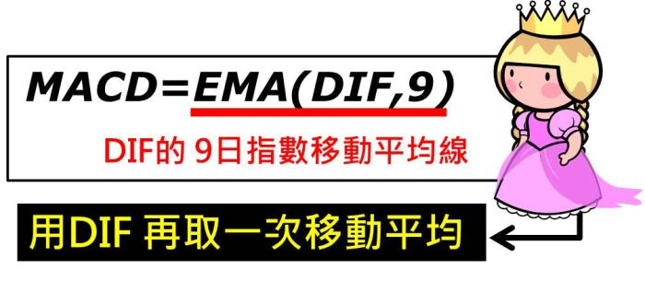
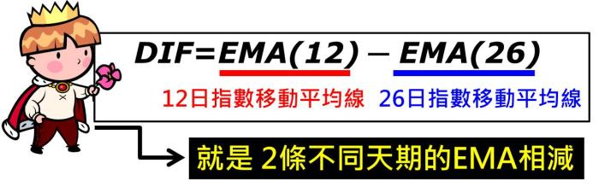
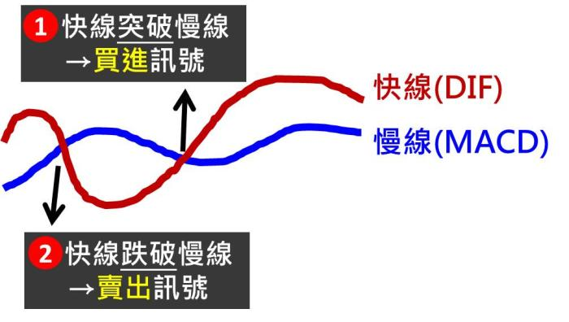
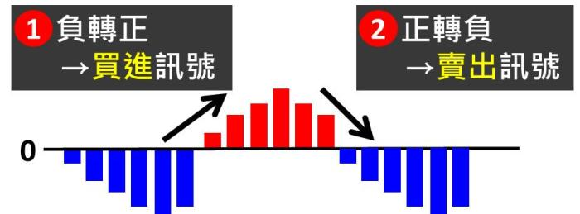
MACD
DIF
MACD
Notes:
DIF : 差離值

Slide 10
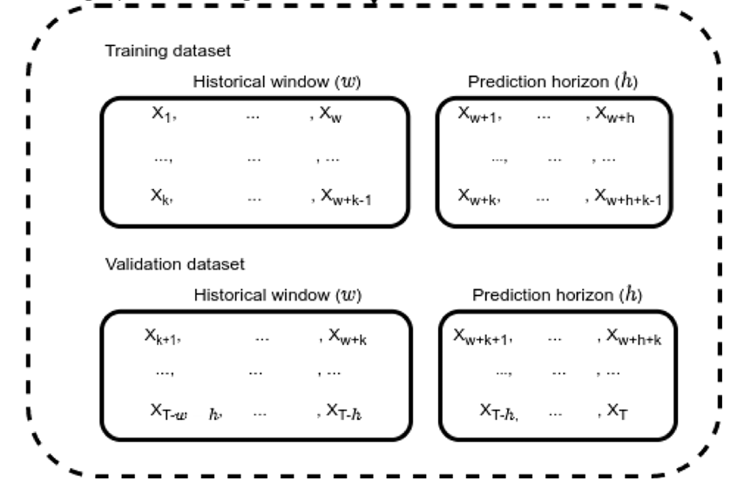
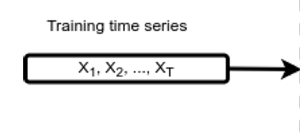
Method
LM
ANN
RF
SVR

Slide 11
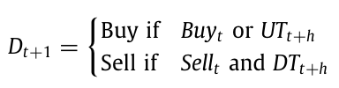
Propose Signal
Technical analysis
Model predict
Notes:
機器學習預測 t+h 的股價
技術指標分析第 t+1 的買賣訊號
如果在 t + 1 天預測未來股價為上漲趨勢或技術分析給出的信號為買入訊號 則進行買入 反之賣出

Slide 12
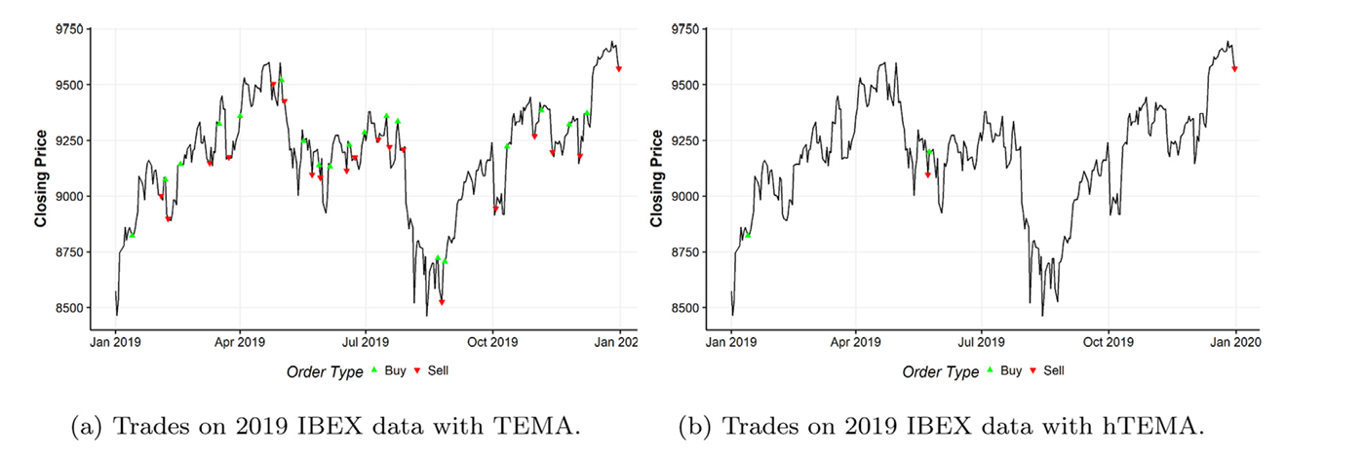
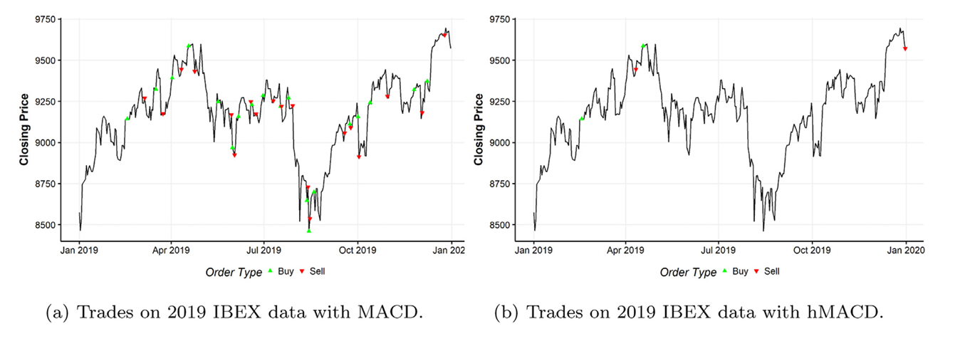

Slide 13

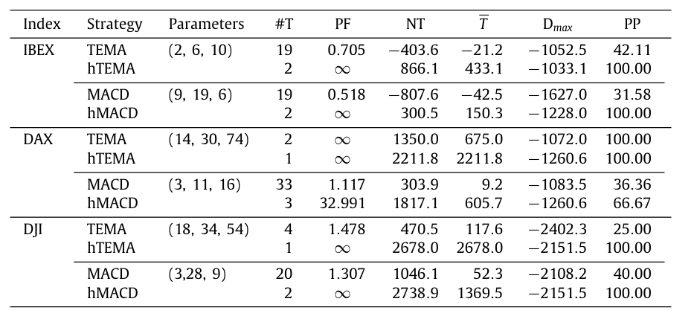








Experiments

Slide 14
Thanks

