Slide 1
Lossless Compression of High-volume Numerical Data from Simulations
Vadim Engelson, Peter Fritzson and Dag Fritzson
Linköping University Electronic Press, 2000.
Presenter: Yen-Yu Chen
Date: Nov.19, 2024

Slide 2
Abstract
Applications in scientific computing operate with high-volume numerical data and the occupied space should be reduced. Traditional compression algorithms cannot provide sufficient compression ratio for such kinds of data. We propose a lossless algorithm of delta-compression (a variant of predictive coding) that packs the higher-order differences between adjacent data elements. The algorithm takes into account varying domain (typically, time) steps. The algorithm is simple, it has high performance and delivers a high compression ratio for smoothly changing data. Both lossless and lossy variants of the algorithm can be used. The algorithm has been successfully applied to the output from a simulation application that uses a solver of ordinary differential equations.

Slide 3
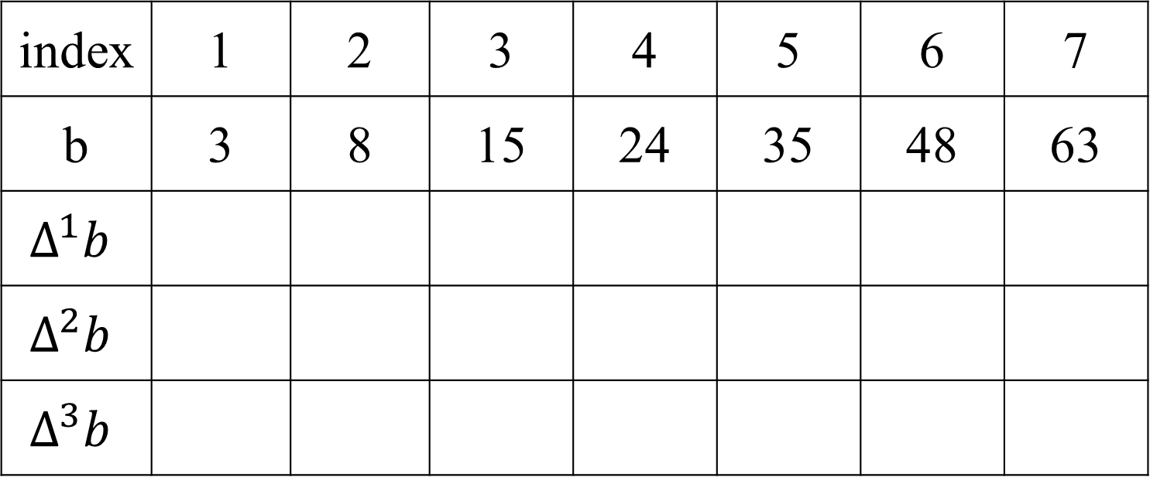
m Order Difference
index | 1 | 2 | 3 | 4 | 5 | 6 | 7
b | 3 | 8 | 15 | 24 | 35 | 48 | 63
$$Δ^{1}b$$
$$Δ^{2}b$$
$$Δ^{3}b$$
Notes:
手畫

Slide 4
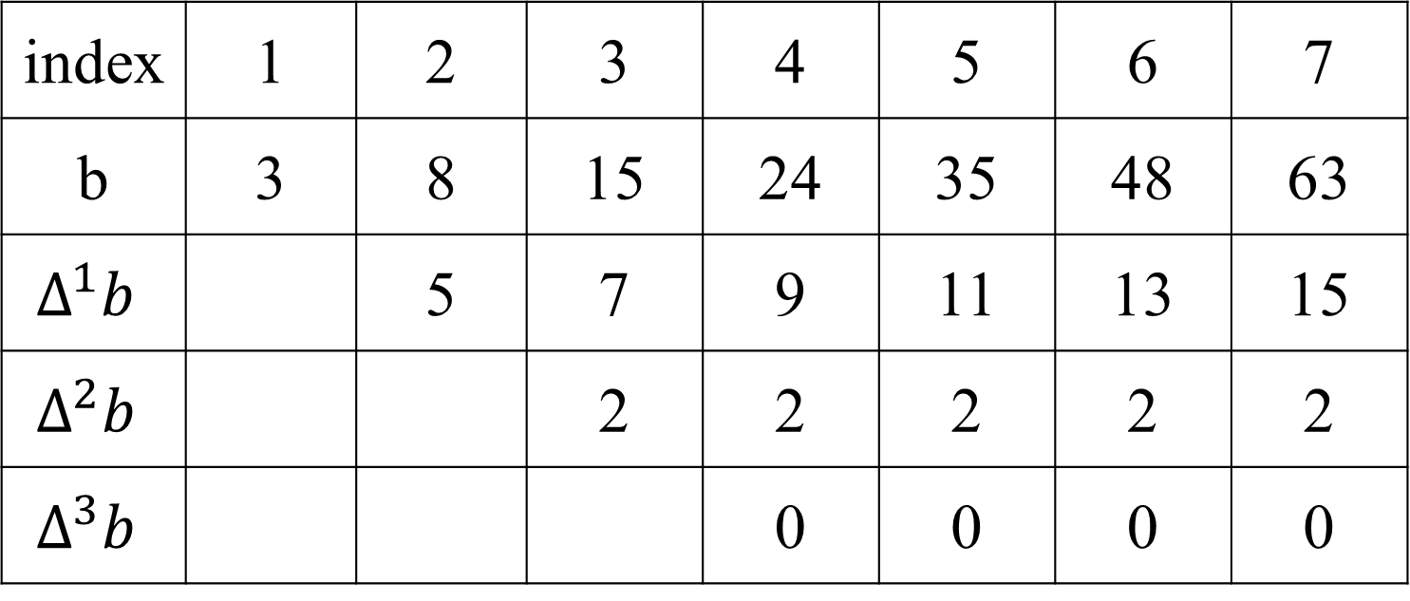
m Order Difference
index | 1 | 2 | 3 | 4 | 5 | 6 | 7
b | 3 | 8 | 15 | 24 | 35 | 48 | 63
$$Δ^{1}b$$ |  | 5 | 7 | 9 | 11 | 13 | 15
$$Δ^{2}b$$ |  |  | 2 | 2 | 2 | 2 | 2
$$Δ^{3}b$$ |  |  |  | 0 | 0 | 0 | 0

Slide 5
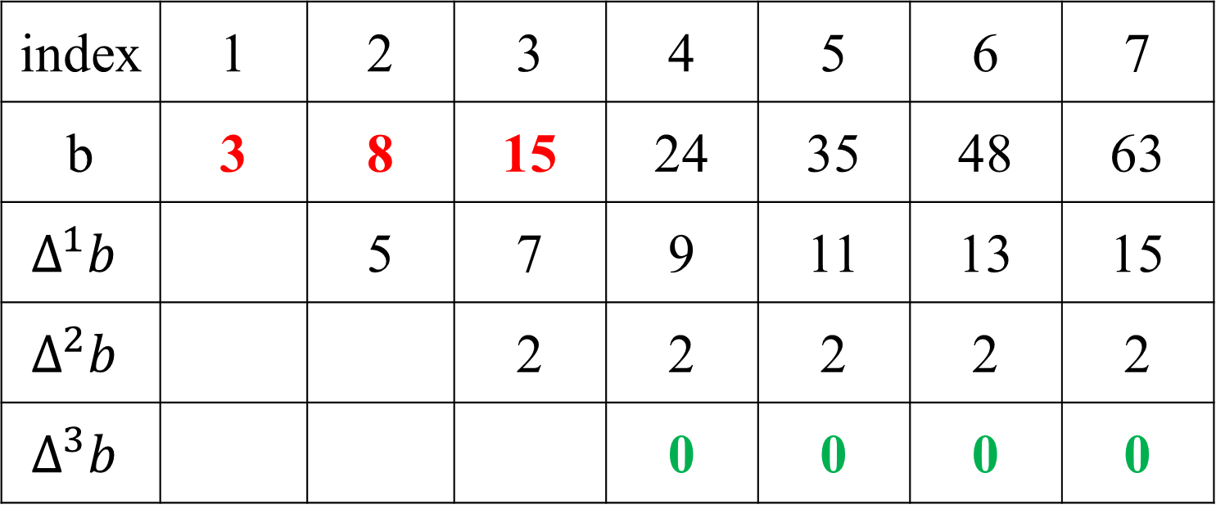
Compress with m Order Difference(1/2)
m=3
m
n-m
index | 1 | 2 | 3 | 4 | 5 | 6 | 7
b | 3 | 8 | 15 | 24 | 35 | 48 | 63
$$Δ^{1}b$$ |  | 5 | 7 | 9 | 11 | 13 | 15
$$Δ^{2}b$$ |  |  | 2 | 2 | 2 | 2 | 2
$$Δ^{3}b$$ |  |  |  | 0 | 0 | 0 | 0

Slide 6
Compress with m Order Difference(2/2)
m=3
m
n-m
index | 1 | 2 | 3 | 4 | 5 | 6 | 7
c | 3 | 8 | 15 | 0 | 0 | 0 | 0
1 bits
1 bits
1 | 0 | 0 | 0 | 0
6 bits
1 bits
1 bits

Slide 7
Decompress (1/3)
m=3
m
n-m
index | 1 | 2 | 3 | 4 | 5 | 6 | 7
c | 3 | 8 | 15 | 0 | 0 | 0 | 0
1 | 0 | 0 | 0 | 0

Slide 8
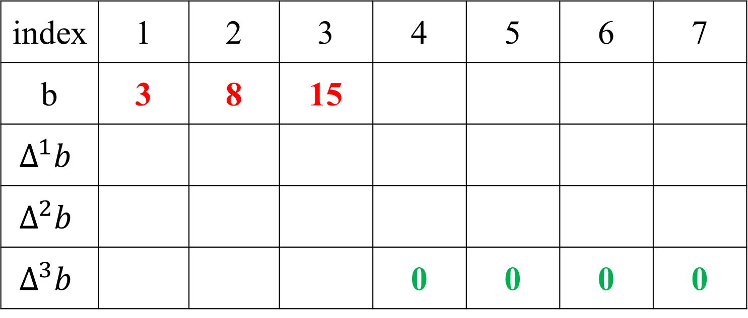
Decompress (2/3)
m=3
m
n-m
index | 1 | 2 | 3 | 4 | 5 | 6 | 7
b | 3 | 8 | 15
$$Δ^{1}b$$
$$Δ^{2}b$$
$$Δ^{3}b$$ |  |  |  | 0 | 0 | 0 | 0

Slide 9
Decompress (3/3)
m=3
m
n-m
index | 1 | 2 | 3 | 4 | 5 | 6 | 7
b | 3 | 8 | 15 | 24 | 35 | 48 | 63
$$Δ^{1}b$$ |  | 5 | 7 | 9 | 11 | 13 | 15
$$Δ^{2}b$$ |  |  | 2 | 2 | 2 | 2 | 2
$$Δ^{3}b$$ |  |  |  | 0 | 0 | 0 | 0

Slide 10
High Level Relationship
index | 1 | 2 | 3 | 4 | 5 | 6 | 7
b | 3 | 8 | 15 | 24 | 35 | 48 | 63
$$Δ^{1}b$$ |  | 5 | 7 | 9 | 11 | 13 | 15
$$Δ^{2}b$$ |  |  | 2 | 2 | 2 | 2 | 2
$$Δ^{3}b$$ |  |  |  | 0 | 0 | 0 | 0

Slide 11
High Level Relationship
Notes:
自己畫

Slide 12
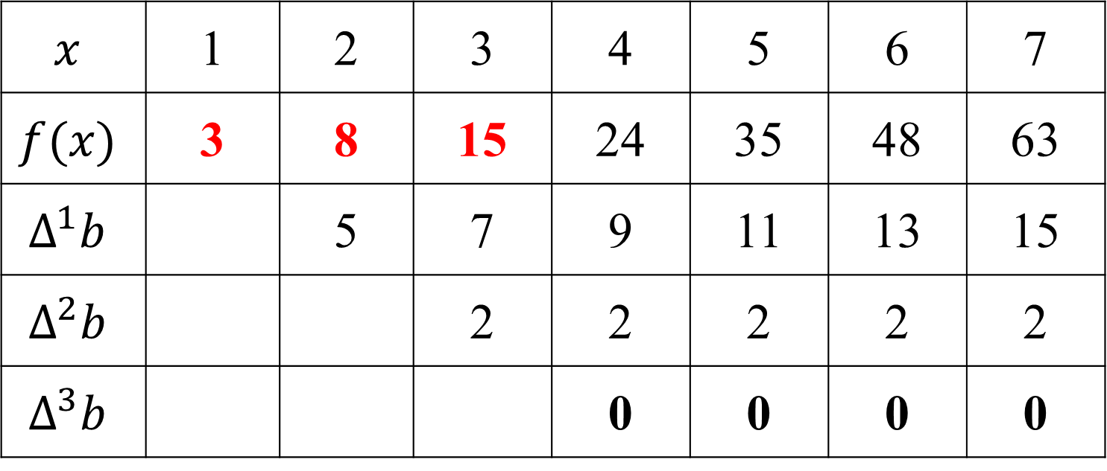
Lagrange Extrapolation
m=3
m
$$x$$ | 1 | 2 | 3 | 4 | 5 | 6 | 7
$$f(x)$$ | 3 | 8 | 15 | 24 | 35 | 48 | 63
$$Δ^{1}b$$ |  | 5 | 7 | 9 | 11 | 13 | 15
$$Δ^{2}b$$ |  |  | 2 | 2 | 2 | 2 | 2
$$Δ^{3}b$$ |  |  |  | 0 | 0 | 0 | 0

Slide 13
High Level Relationship
Notes:
自己畫

Slide 14
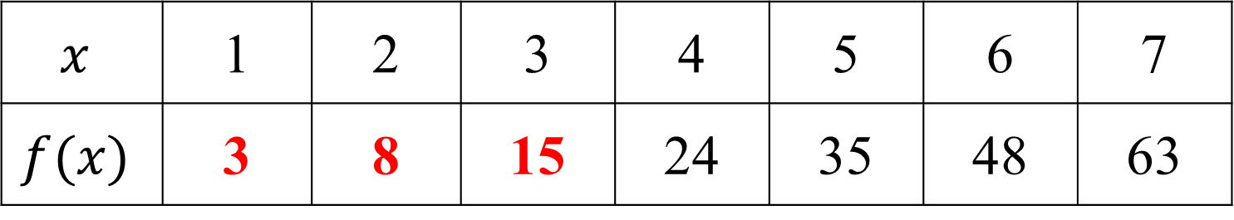



Lagrange Extrapolation Cauculate
m=3
$$x_{m−2}$$
$$x_{m−1}$$
$$x_{m}$$
$$x$$ | 1 | 2 | 3 | 4 | 5 | 6 | 7
$$f(x)$$ | 3 | 8 | 15 | 24 | 35 | 48 | 63
m
$$φ\left(x\right)=L_{1}\left(x\right){f(x}_{1})+…+L_{m}(x){f(x}_{m})$$
$$L_{i}\left(x\right)=\frac{\left(x−x_{1}\right)\left(x−x_{2}\right)…\left(x−x_{i−1}\right)\left(x−x_{i+1}\right)…(x−x_{m})}{\left(x_{i}−x_{1}\right)\left(x_{i}−x_{2}\right)…\left(x_{i}−x_{i−1}\right)\left(x_{i}−x_{i+1}\right)…(x_{i}−x_{m})}$$

Slide 15
Lagrange Extrapolation Cauculate
m=3
$$x_{m−2}$$
$$x_{m−1}$$
$$x_{m}$$
$$x$$ | 1 | 2 | 3 | 4 | 5 | 6 | 7
$$f(x)$$ | 3 | 8 | 15 | 24 | 35 | 48 | 63
m
$$φ\left(x\right)=L_{1}\left(x\right){f(x}_{1})+…+L_{m}(x){f(x}_{m})$$
$$L_{i}\left(x\right)=\frac{\left(x−x_{1}\right)\left(x−x_{2}\right)…\left(x−x_{i−1}\right)\left(x−x_{i+1}\right)…(x−x_{m})}{\left(x_{i}−x_{1}\right)\left(x_{i}−x_{2}\right)…\left(x_{i}−x_{i−1}\right)\left(x_{i}−x_{i+1}\right)…(x_{i}−x_{m})}$$

Slide 16
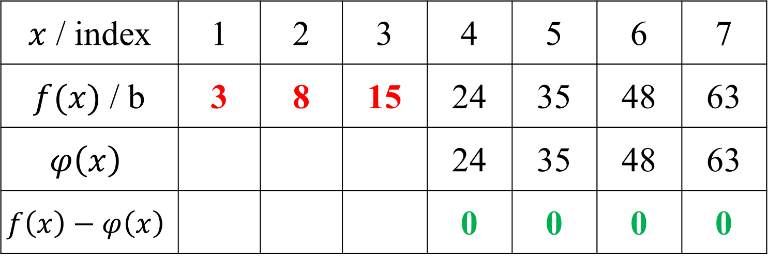
Lagrange Extrapolation Compress
m=3
$x$ / index | 1 | 2 | 3 | 4 | 5 | 6 | 7
$f(x)$ / b | 3 | 8 | 15 | 24 | 35 | 48 | 63
$$φ\left(x\right)$$ |  |  |  | 24 | 35 | 48 | 63
$$f\left(x\right)−φ\left(x\right)$$ |  |  |  | 0 | 0 | 0 | 0

Slide 17
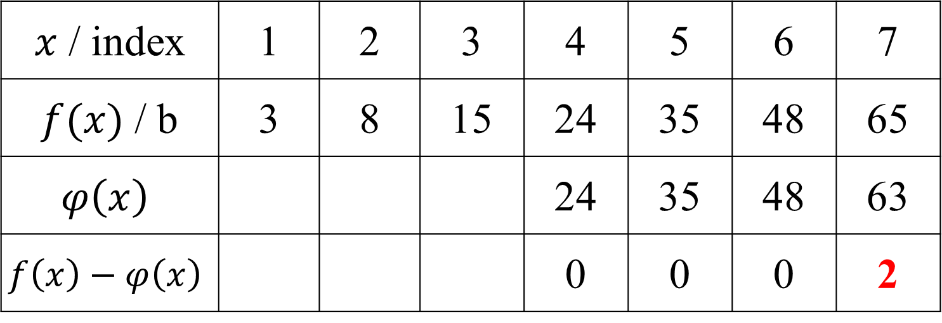
Lossless Compression
m=3
$x$ / index | 1 | 2 | 3 | 4 | 5 | 6 | 7
$f(x)$ / b | 3 | 8 | 15 | 24 | 35 | 48 | 65
$$φ\left(x\right)$$ |  |  |  | 24 | 35 | 48 | 63
$$f\left(x\right)−φ\left(x\right)$$ |  |  |  | 0 | 0 | 0 | 2

Slide 18
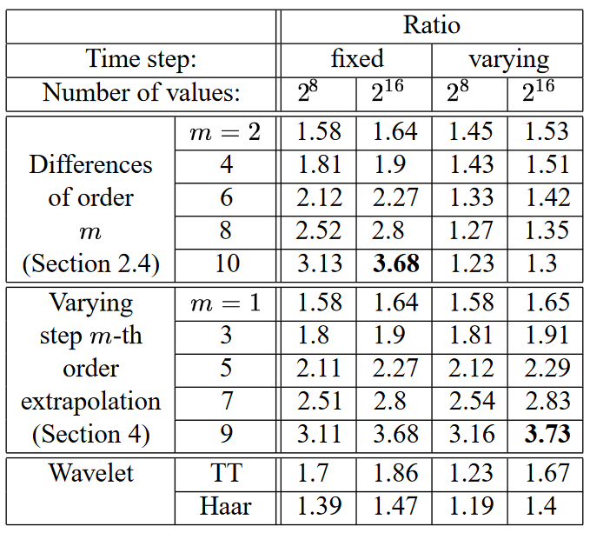
High Level Relationship
Notes:
自己畫

